Slide 1
感恩遇见，相互成就，本课件资料仅供您个人参考、教学使用，严禁自行在网络传播，违者依知识产权法追究法律责任。
更多教学资源请关注
公众号：溯恩英语
知识产权声明

Slide 2
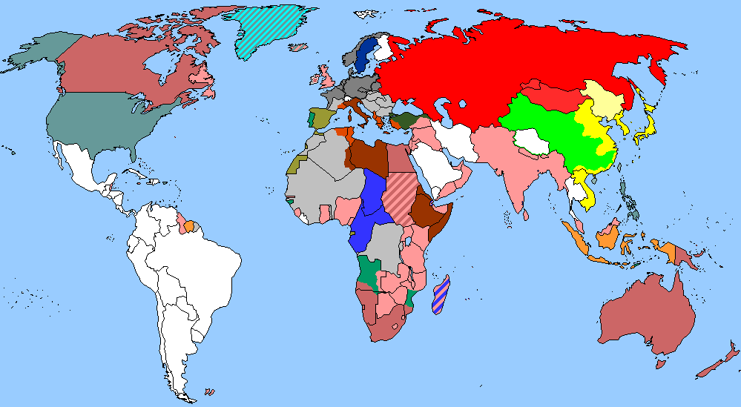
The World
September 16th-30th, 2024

Slide 3
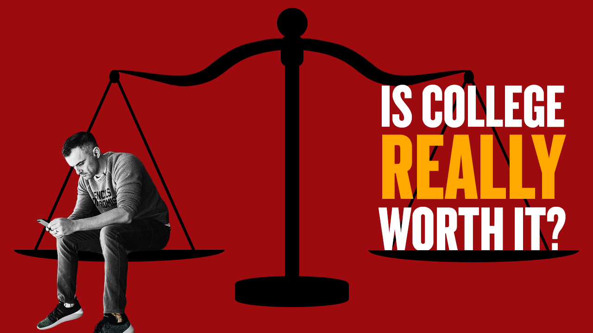
1. Is college worth it? 大学值得上吗？

Slide 4
Text Completion
Newsweek (September 20, 2024 P10&11)
Many Americans have little faith in the value of a college degree, seeing universities as places where political agendas _________ (push) and where students are not taught the skills they need to succeed in life, but put on a path to a lifetime of oppressive debt.
According to a recent Gallup survey, ___ growing proportion of Americans are losing confidence in higher education. The survey, ________ (release) in July, found that only about a third (36 percent) of Americans said they have a great deal or quite a lot of confidence in higher education, ______ 32 percent said they had little or no confidence. The numbers are significantly down from a decade ago, when 57 percent reported _______ (have) a great deal or quite a lot of confidence in higher education and only 10 percent said they had little or none.
For those who said they had very little or no confidence, 41 percent talked about colleges being “too liberal” or trying to “indoctrinate” or “brainwash” students. Some 37 percent were critical of colleges not teaching relevant skills or graduates not being able to find ___________ (employ), while 28 percent cited concerns about cost, such as the hefty price tag for tuition or the mounting debt that follows those who can’t afford to pursue a degree _______ taking out student loans.
Some parents would also prefer their children _____ (get) some life experience—by getting a job, pursuing _________ (vocation) training, starting a business or doing community service—instead of going straight into higher education. About 46 percent of parents said in a 2021 Gallup survey that they would prefer that their children not enroll in a four-year college degree ___________ (immediate) after high school.
are pushed
a
released
while
having
employment
without
to get
vocational
immediately

Slide 5
Reading Comprehension
Which of the following statements is correct according to the text?
A. In ten years a lot more people have lost faith in the usefulness of college.
B. More than half of people recently surveyed have faith in higher education.
C. Most people lose confidence in higher education because of the college tuition.
D. Some parents want their children to go directly into workplace after high school.

Slide 6
Vocabulary
1. agenda: a list of items to be discussed at a meeting
（会议的）议程表，议事日程
Many of the coalition members could have their own political agendas.
许多联盟成员可能会有他们自己的政治议题。
2. hefty: (of a person or an object) big and heavy
（人或物体）大而重的
If he is found guilty he faces a hefty fine.
如果被判有罪，他就要面临巨额罚款。
Translation
对政府来说，现在教育是当务之急。
For the government, education is now at the top of the agenda.
Translation
他们毫不费力地卖掉了它，得到了一笔可观的利润。
They sold it easily and made a hefty profit.

Slide 7
Translation
Many Americans have little faith in the value of a college degree, seeing universities as places where political agendas are pushed and where students are not taught the skills they need to succeed in life, but put on a path to a lifetime of oppressive debt.
许多美国人对大学学位的价值几乎没有信心，他们认为大学是推动政治议程的地方，在这里，学生们没有学到在生活中取得成功所需的技能，而是走上了一条终生背负沉重债务的道路。
Some 37 percent were critical of colleges not teaching relevant skills or graduates not being able to find employment, while 28 percent cited concerns about cost, such as the hefty price tag for tuition or the mounting debt that follows those who can’t afford to pursue a degree without taking out student loans.
约37%的人批评大学没有教授相关技能，或者毕业生找不到工作，而28%的人表示担心成本，比如高昂的学费，或者那些没有学生贷款就负担不起攻读学位的人背负的债务越来越多。

Slide 8
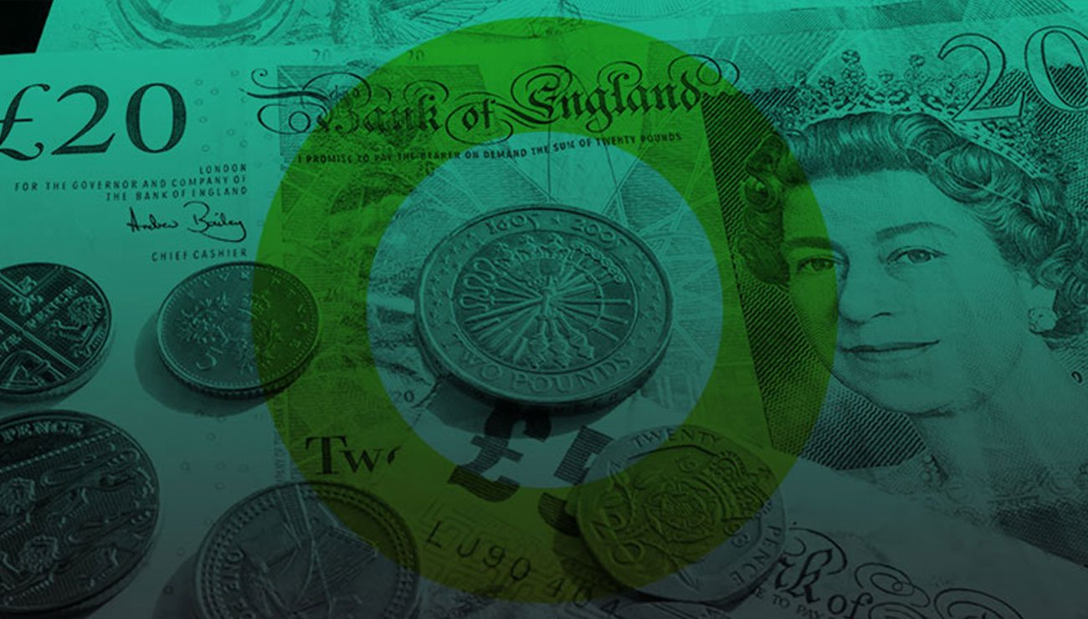
2. Price Increases Are Easing, Report Shows
英国物价上涨正在缓解

Slide 9
Text Completion
The New York Times (September 28, 2024 B1)
Inflation cooled in August, the latest sign of progress in the Federal Reserve’s years long fight to bring rapid price increases back ______ control.
The Personal Consumption Expenditures index climbed by 2.2 percent from a year _______ (early), data ________ (release) Friday showed. That is down from 2.5 percent in July and slightly softer than economist forecasts. It was the slowest annual inflation reading since early 2021. After stripping out volatile food and fuel prices for a better sense of the underlying inflation trend, a “core” price index was a bit more stubborn on ___ annual basis. The core measure came in at 2.7 percent, up from 2.6 percent _________ (previous) and in line with what economists ____________ (expect). But comparing prices from month to month, core inflation slowed to a modest 0.1 percent in August
Altogether, the report offers further ______ (prove) that price increases are swiftly fading. Already, that has allowed the Fed ________ (begin) to lower interest rates from a more than two-decade high of 5.3 percent. After _______ (raise) borrowing costs sharply and then holding them at a high level to slow the economy and weigh down inflation, ________ (office) voted last week to cut rates by a larger-than-usual half percentage point. Policymakers also signaled that more rate cuts are coming, as long as inflation continues to fade.
under
earlier
released
an
previously
had expected
proof
to begin
raising
officials

Slide 10
Vocabulary
1. inflation: a general rise in the prices of services and goods in a particular country, resulting in a fall in the value of money 通货膨胀
Wage increases must be in line with inflation. 工资的增长必须与通货膨胀率
2. volatile: changing easily from one mood to another 易变的；无定性的
There have been riots before and the situation is volatile. 先前一直就有暴乱，局势变化无常。
Translation
通货膨胀是一种持续的威胁。
Inflation is a constant threat.
Translation
战争时期食品和燃料的价格极易波动。
Food and fuel prices are very volatile in a war situation.

Slide 11
Translation
After stripping out volatile food and fuel prices for a better sense of the underlying inflation trend, a “core” price index was a bit more stubborn on an annual basis. The core measure came in at 2.7 percent, up from 2.6 percent previously and in line with what economists had expected.
在剔除波动性较大的食品和燃料价格以更好地了解潜在通胀趋势后，“核心”价格指数在年度基础上更加顽固。核心指数为2.7%，高于之前的2.6%，符合经济学家的预期。
After raising borrowing costs sharply and then holding them at a high level to slow the economy and weigh down inflation, officials voted last week to cut rates by a larger-than-usual half percentage point.
在大幅提高借贷成本并将其维持在较高水平以减缓经济增长并抑制通胀之后，官员们上周投票决定将利率下调0.5个百分点，幅度高于往常。

Slide 12
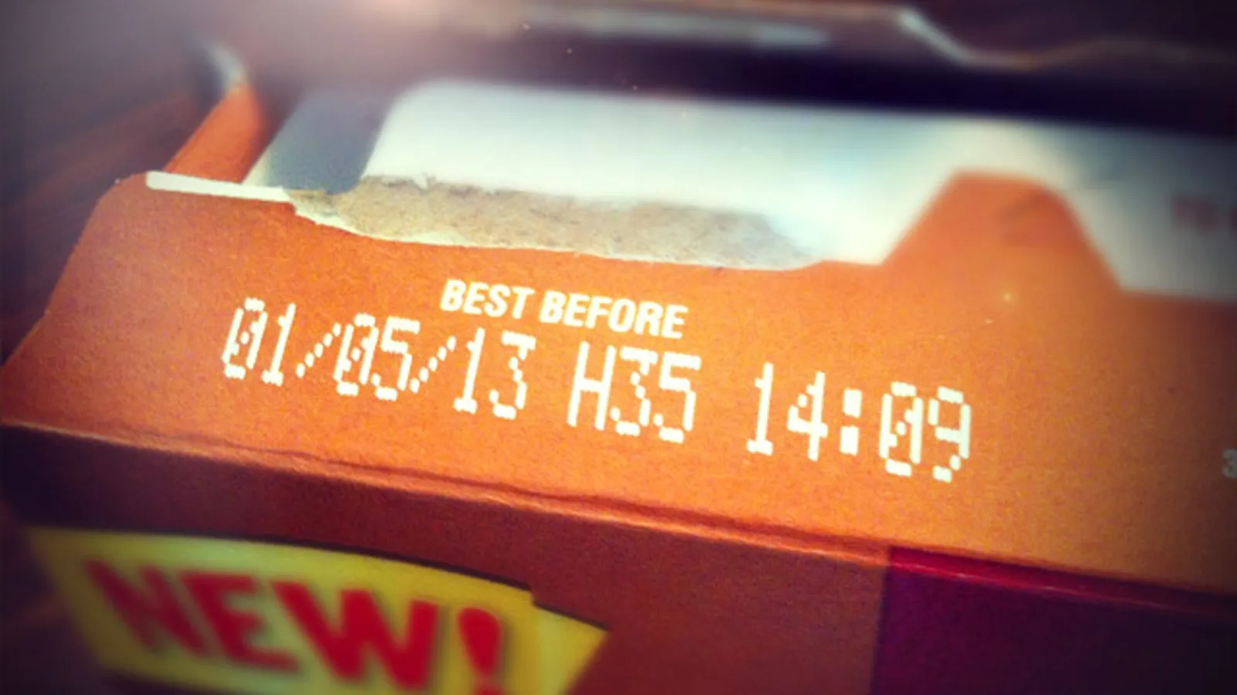
3. EATING OLD FOOD
过期食物能不能吃？
Readers Digest USA (September, 2024 P95)

Slide 13
Text Completion
Readers Digest USA (September, 2024 P95)
confusing
The stamped expiration date—and its __________ (confuse) cousins “use by” and “best before”—should be but one tool in your hmm-should-I-eat-this? toolbox.
“With the exception of infant formula, food labels aren’t standardized or _________ (regulate),” says nutritionist Marie Spiker, an ________ (assist) professor at the University of Washington. “Few are related to biology or food safety—just peak ________ (fresh). “And so, she says, it’s ______ (total) fine and safe to eat foods __________ are not at their exact peak.
Handling, packaging, refrigeration and storage all affect any food’s farm-to-plate timeline, so your best tools are your eyes and nose.
“Most of the time, this is intuitive,” says Spiker. “If it looks good ____ smells good, it’s probably good.” Not sure? Consider this: “Spores spread through soft, porous surfaces. So in general, hard foods are more difficult to permeate and therefore _____ (safe) to eat,” she says. Don’t trust your sense of smell or sight? Check out the FDA’s website, ______ food safety guidelines are available.
So you probably should toss the whole package if you spot mold on bread, soft cheeses like Brie and feta, or soft produce such as strawberries. But it’s not too gross to slice off the funky stuff and save the rest of ________ (potato), cured meat like salami, or hard cheeses like my beloved cheddar.
regulated
assistant
freshness
totally
which / that
and
safer
where
potatoes

Slide 14
Vocabulary
1. intuitive: obtained by using your feelings rather than by considering the facts凭直觉得到的；直觉的
He had an intuitive sense of what the reader wanted. 他能直觉地感到读者需要什么。
2. permeate: to spread to every part of an object or a place渗透；弥漫；扩散
The smell of leather permeated the room. 屋子里弥漫着皮革的气味。
Translation
他似乎对我的感受有一种直觉。
He seemed to have an intuitive awareness of how I felt.
Translation
水很容易渗透棉布衣服。
Water will easily permeate a cotton dress.

Slide 15
Translation
“With the exception of infant formula, food labels aren’t standardized or regulated,” says nutritionist Marie Spiker, an assistant professor at the University of Washington. “Few are related to biology or food safety—just peak freshness. ”
华盛顿大学助理教授、营养学家玛丽·斯派克说：“除了婴儿配方奶粉，食品标签没有标准化或监管。” “很少有与生物学或食品安全有关的——只有最高的新鲜度。”
Handling, packaging, refrigeration and storage all affect any food’s farm-to-plate timeline, so your best tools are your eyes and nose.
处理、包装、冷藏和储存都会影响食物从农场到餐桌的时间，所以你最好的工具是你的眼睛和鼻子。

Slide 16
4. More than 3,000 chemicals from food packaging have entered our bodies 食品包装中发现3000多种潜在有害化学物质

Slide 17
Text Completion
The Washington Post (September 19, 2024 A9)
Researchers from Switzerland and other countries discovered that of the ________ (rough) 14,000 known chemicals in food packaging, 3,601 — or about 25 percent — ________________ (find) in the human body, whether in samples of blood, hair or breast milk.
Those chemicals include metals, volatile ________ (organ) compounds, per- and polyfluoroalkyl substances or PFAS, phthalates and many others known to disrupt the endocrine system and cause cancer or other diseases. The study, __________ (publish) in the Journal of Exposure Science and Environmental Epidemiology, didn’t directly examine the link _____ these illnesses. But the researchers say their inventory of chemicals can help future research into health risk.
“There are known hazardous chemicals that _____ (be) known to be linked with adverse human health outcomes,” said Jane Muncke, the chief scientific officer of the Food Packaging Forum ______ one of the paper’s authors.“And these chemicals leach out of packaging.”
Scientists have known for many years chemicals can spill out of food packaging into the food itself. How many chemicals — and in what _________ (quantity) — depends on the type of packaging and the type of food. Scientists say that there is ____ need for better testing of food packaging and further regulations on _______ is considered safe to put food in.
roughly
have been found
organic
published
to
are
and
quantities
a
what

Slide 18
Vocabulary 1
1. disrupt : to make it difficult for sth to continue in the normal way
扰乱；使中断；打乱
Demonstrators succeeded in disrupting the meeting.
示威者成功地扰乱了会议。
2. inventory: a written list of all the objects, furniture, etc. in a particular building
（建筑物里的物品、家具等的）清单；财产清单
Before starting, he made an inventory of everything that was to stay.
出发前，他把要留下的所有东西列了一份详细清单。
Translation
中风可导致大脑供氧中断。
A stroke can disrupt the supply of oxygen to the brain.
Translation
如果是这样，那么您就模拟了一个清单。
If so, you’re modeling inventory.

Slide 19
Vocabulary 2
3. adverse : negative and unpleasant; not likely to produce a good result
不利的；有害的；反面的
They have attracted strong adverse criticism.
他们已招致强烈非难。
4. leach: to remove chemicals, minerals, etc. from soil
（建筑物里的物品、家具等的）清单；财产清单
Nitrates leach from the soil into rivers.
硝酸盐由土壤渗入江河。
Translation
众所周知，这种药具有不良副作用。
This drug is known to have adverse side effects.
Translation
养分很快就被滤掉了。
The nutrient is quickly leached away.

Slide 20
Translation
Researchers from Switzerland and other countries discovered that of the roughly 14,000 known chemicals in food packaging, 3,601 — or about 25 percent — have been found in the human body, whether in samples of blood, hair or breast milk.
来自瑞士和其他国家的研究人员发现，在食品包装中已知的大约1.4万种化学物质中，有3601种(约占25%)存在于人体中，包括血液、头发或母乳样本。
Those chemicals include metals, volatile organic compounds, per- and polyfluoroalkyl substances or PFAS, phthalates and many others known to disrupt the endocrine system and cause cancer or other diseases.
这些化学物质包括金属、挥发性有机化合物、全氟烷基和多氟烷基物质或PFAS、邻苯二甲酸盐以及许多其他已知会破坏内分泌系统并导致癌症或其他疾病的物质。

Slide 21
5. BBC News 09/19/2024

Slide 22
Dictation
The White House says President Biden has told Donald Trump he was _______ that Mr. Trump is safe after what’s being investigated as a second assassination _______. Mr. Trump said the President could not have been nicer and had asked for suggestions. Donald Trump added that he needed more people on his security detail.
The President of Ecuador, Daniel Noboa, says he will seek to amend the constitution to allow the ____________ of foreign military bases in the country. President Noboa said asking the US military to leave the country in 2009 had helped turn Ecuador into a ______ for drug traffickers.
The mayor of the Polish town of Nysa has told 40,000 residents to head for higher ground as the Kłodzka River threatens to burst its banks. Soldiers and volunteers are racing to build sandbag ________.
Hundreds of Brazilian firefighters are battling a blaze spreading through a nature reserve near the capital, Brasilia. The country’s worst _______ in seven decades is fuelling fires in the Amazon rainforest.
Spending freezes have been introduced by the aerospace giant Boeing. The company also says it may have to ______ staff temporarily as it deals with the impact of a strike involving some 30,000 workers.
Rescue teams in Sierra Leone are searching for more survivors in the ______ of a seven-story building that’s collapsed in the capital, Freetown, killing at least eight people.
Researchers are warning that infections ________ to antibiotics could kill nearly 40 million people worldwide between now and mid-century.
The boss of Amazon, Andy Jassy, has told hundreds of thousands of its global e-commerce workforce they will be required to work ________ in the office from the start of next year.
relieved
attempt
establishment
cradle
defenses
drought
lay off
rubble
resistant
full-time

Slide 23
Vocabulary
1. amend: to change a law, document, statement, etc. slightly in order to correct a mistake or to improve it 修正，修订（法律文件、声明等）
The president agreed to amend the constitution.
总统同意修订宪法。
2. workforce: all the people in a country or an area who are available for work
（国家或行业等的）劳动力，劳动大军，劳动人口
It is a country where half the workforce is unemployed.
这是一个一半劳动力失业的国家。
Translation
他要求看修订版本。
He asked to see the amended version.
Translation
本地四分之一的劳动力都失业了。
A quarter of the local workforce is/are unemployed.

Slide 24
Translation
The White House says President Biden has told Donald Trump he was relieved that Mr. Trump is safe after what’s being investigated as a second assassination attempt. Mr. Trump said the President could not have been nicer and had asked for suggestions. Donald Trump added that he needed more people on his security detail.
白宫称，拜登总统告诉唐纳德·特朗普，他安全无事，总统深感宽慰，此前正在调查对后者的第二次暗杀企图。特朗普表示，总统非常友好，并征求了一些建议。唐纳德·特朗普补充说，他需要更多的人来保护他的安全。
Spending freezes have been introduced by the aerospace giant Boeing. The company also says it may have to lay off staff temporarily as it deals with the impact of a strike involving some 30,000 workers.
航空巨头波音公司已经冻结了开支。该公司还表示，它可能不得不暂时裁员，因为它要处理涉及约3万名工人的罢工的影响。

