Slide 1


感恩遇见，相互成就，本课件资料仅供您个人参考、教学使用，严禁自行在网络传播，违者依知识产权法追究法律责任。
更多教学资源请关注
公众号：溯恩英语
知识产权声明

Slide 2
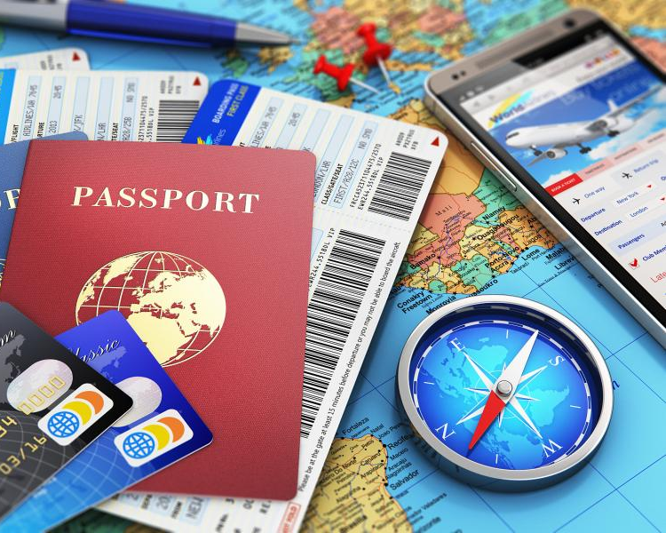
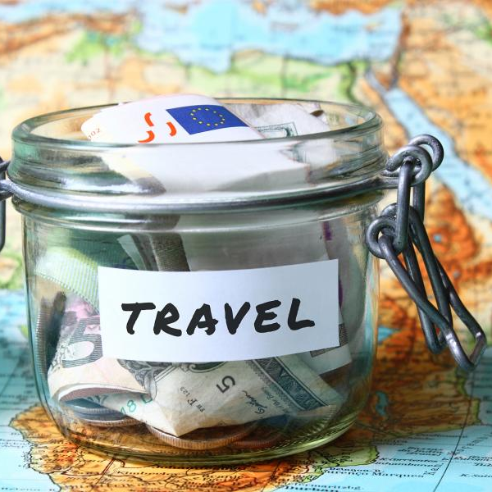
Travelling Around
Listening and Speaking
---Get ready to travel
DEE

Slide 3
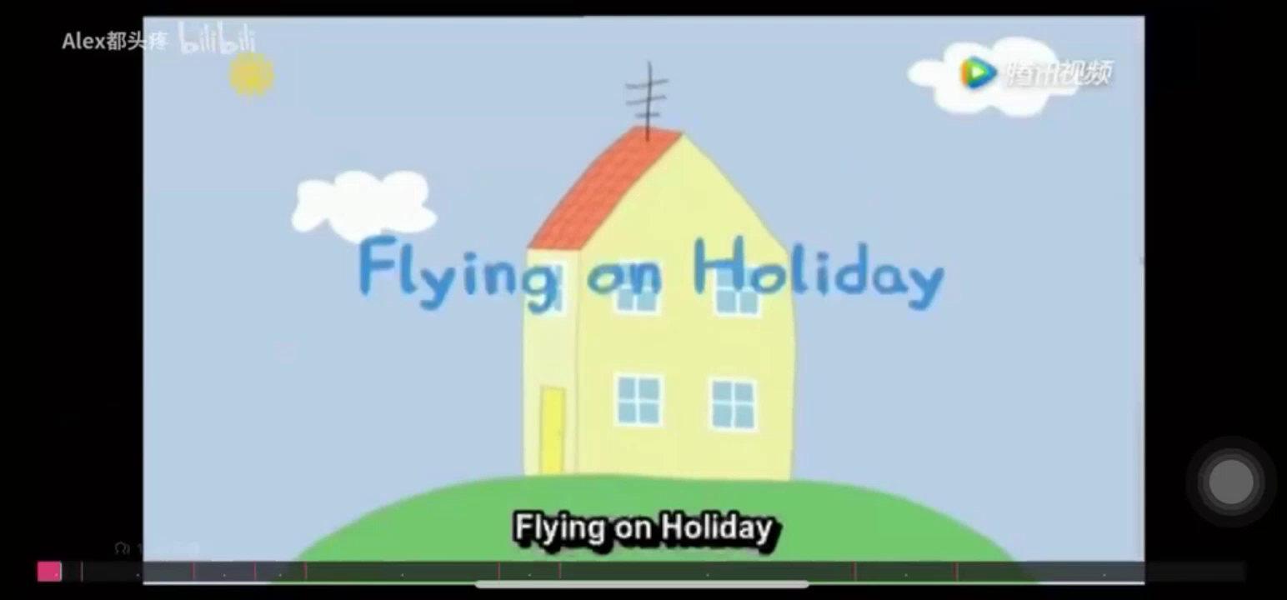
Warming up

Slide 4

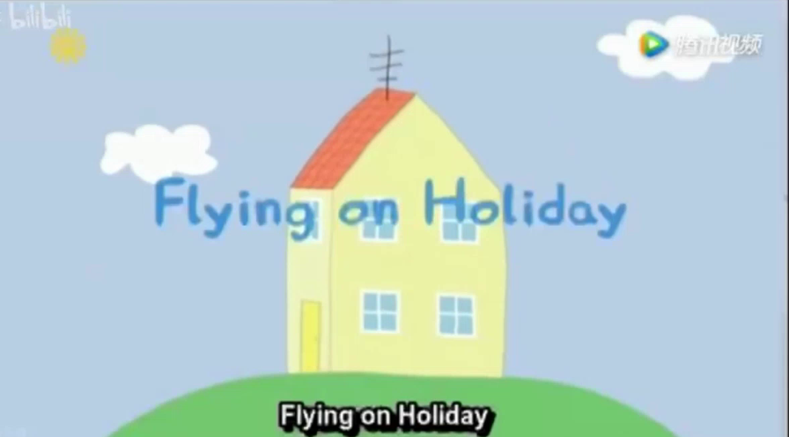
Warming up
Enjoy a short video Flying on Holiday and answer the following questions:
1.Where are Peppa and her family going for a holiday?
2.What is Mummy Pig doing before travelling?
3.How are they going to get there?
4.How are they planning to get around after they arrive?
5.What happens to them when renting a car?
6.What happens to Daddy Pig when driving on the road?

Slide 5

Listening for the content
two destinations
Focus on key words
Listen for key words and phrases. Focus on getting the main idea, not on single words or grammar.
1.Circle the two places Meilin is going to for holiday.
A.Germany. B. England. C. Iceland. D. France.
2.How is she going to get there?
A.By sea. B. By air. C. By train.
3.How is she planning to get around after she arrives?
A.By car. B. By train. C. On foot.
the transport
the transport
the time

Slide 6
Listening for the content
Listen to the second part of the conversation and answer the questions.
1.Where is Paul’s family going over the holiday?
2.Why are they going there?
3.What is Paul planning to see there?
the destination
the reason
the detailed information

Slide 7
Listening for the content
Listen to the second part of the conversation and answer the questions.
1.Where is Paul’s family going over the holiday?
2.Why are they going there?
3.What is Paul planning to see there?
the destination
Meilin: So what about you, Paul? Do you have any travel plans?
Paul: Yes, actually! My parents are taking me to ____________ in China to visit ___________!
YN Province
Lijiang
the reason
father’s friend
He invited us
Paul:Yes. One of my ______________ lives there. ________________ to visit.
Meilin:Oh, that's nice!
the detailed information
Meilin: What're you planning to see there?
Paul: Well, I know I'm definitely going to see the ____________ and ___________________.
Old Town of lj
Yulong Snow Mountain

Slide 8
Listening for the language
Listen to the whole conversation again and fill in the table below.
am\is\are+doing...
(Present Continuous Tense)
To show future plans
Travel Plan
Meilin | She _______________ around Europe for two weeks with his aunt and uncle. She __________ to visit France and Germany. |  | She already has her passport. She ___________ for her visa. They ___________ air tickets online. They______________a car and driving.
Paul | His parents _________ him to visit Lijiang. | He_________ a guidebook. | He ___________ a few light sweaters and a coat.
Choose a destination
Collect information
Make arrangements
is travelling
is applying
are booking
is planning
are renting
are taking
is buying
is taking

Slide 9
Talking for the structure
An example | Structure of a travel plan
A: Hi, Julie! Do you have any plans for the holiday?
B: Hi, Wang Lei!Yes, I'm planning to travel to Jiuzhaigou.Actually,I've just finished the travel arrangements!
A:Oh,good idea! Jiuzhaigou is an extremely beautiful place.
B:Yes, I'm looking forward to seeing the colourful lakes, amazing waterfalls ..
A:How are you getting ready for your trip?
B:I'm...
Greetings and ask for the travel plan.
Choose a destination.
Show your agreement.
List reasons and collect information.
Ask the arrangements in detail.
Share your travel plan and arrangements.

Slide 10
Share your travel plan
Greetings and ask for the travel plan.
Contents | Criteria
Plan | Make your travel plan detailed and logical.
Language | Make your conversation fluent. Use correct words and grammar patterns.
Structure | Make your travel plan complete.
Acting | Use proper body language and act confidently.
Choose a destination.
Show your agreement.
List reasons and collect information.
Ask the arrangements in detail.
Share your travel plan and arrangements.

Slide 11
Critical Thinking
Travel, in the younger sort, is a part of education;
in the elder, a part of experience.---Francis Bacon
Is it worth the time and energy to get ready to travel? Share your opinion and list your reasons.
Advantages
Disadventages
enjoy beatutiful scenery
time-consuming travel arrangements
taste delicious food
expect language barriers
experience diverse cultures
face different culture shock
...
...

Slide 12
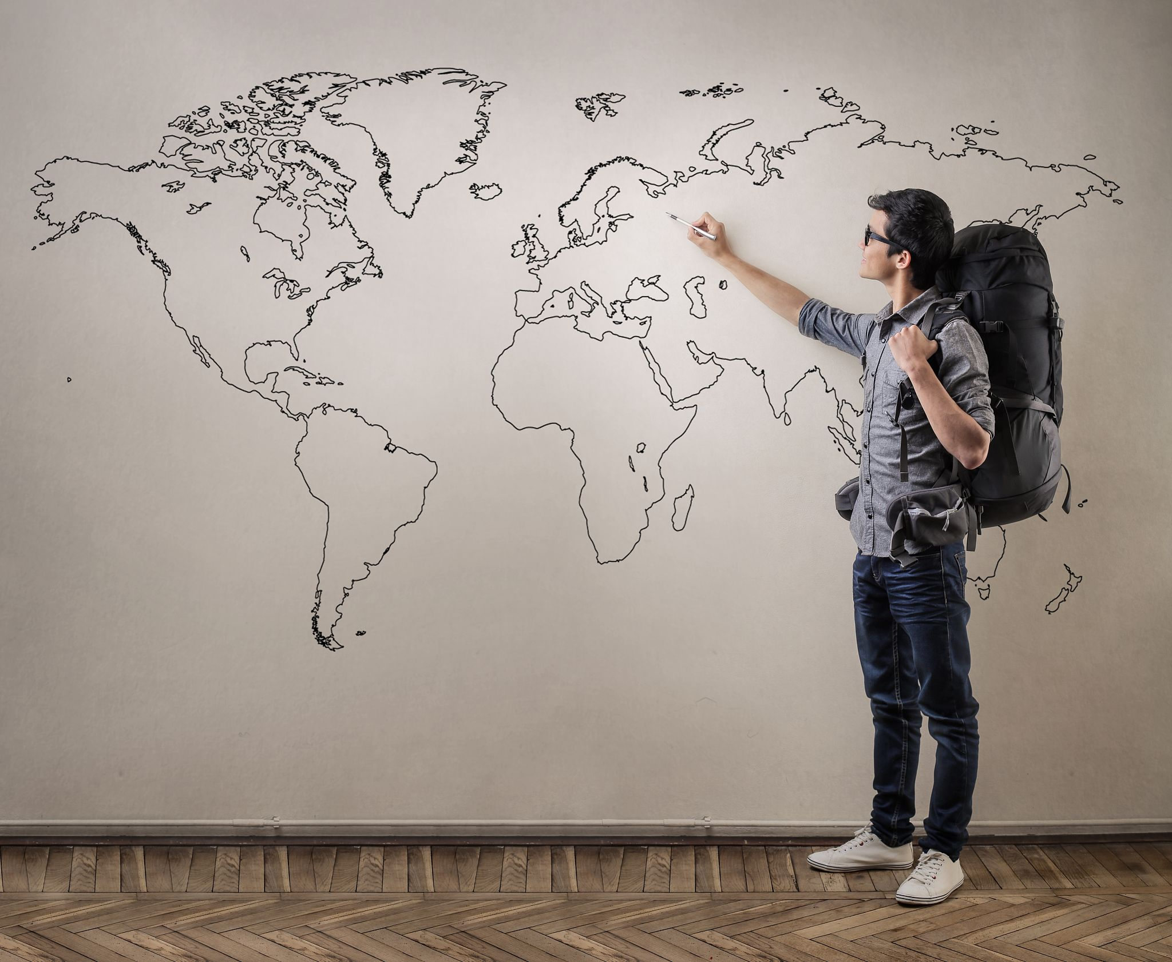
Travel, in the younger sort, is a part of education;
in the elder, a part of experience.---Francis Bacon
To prepare
To experience
To havest

Slide 13
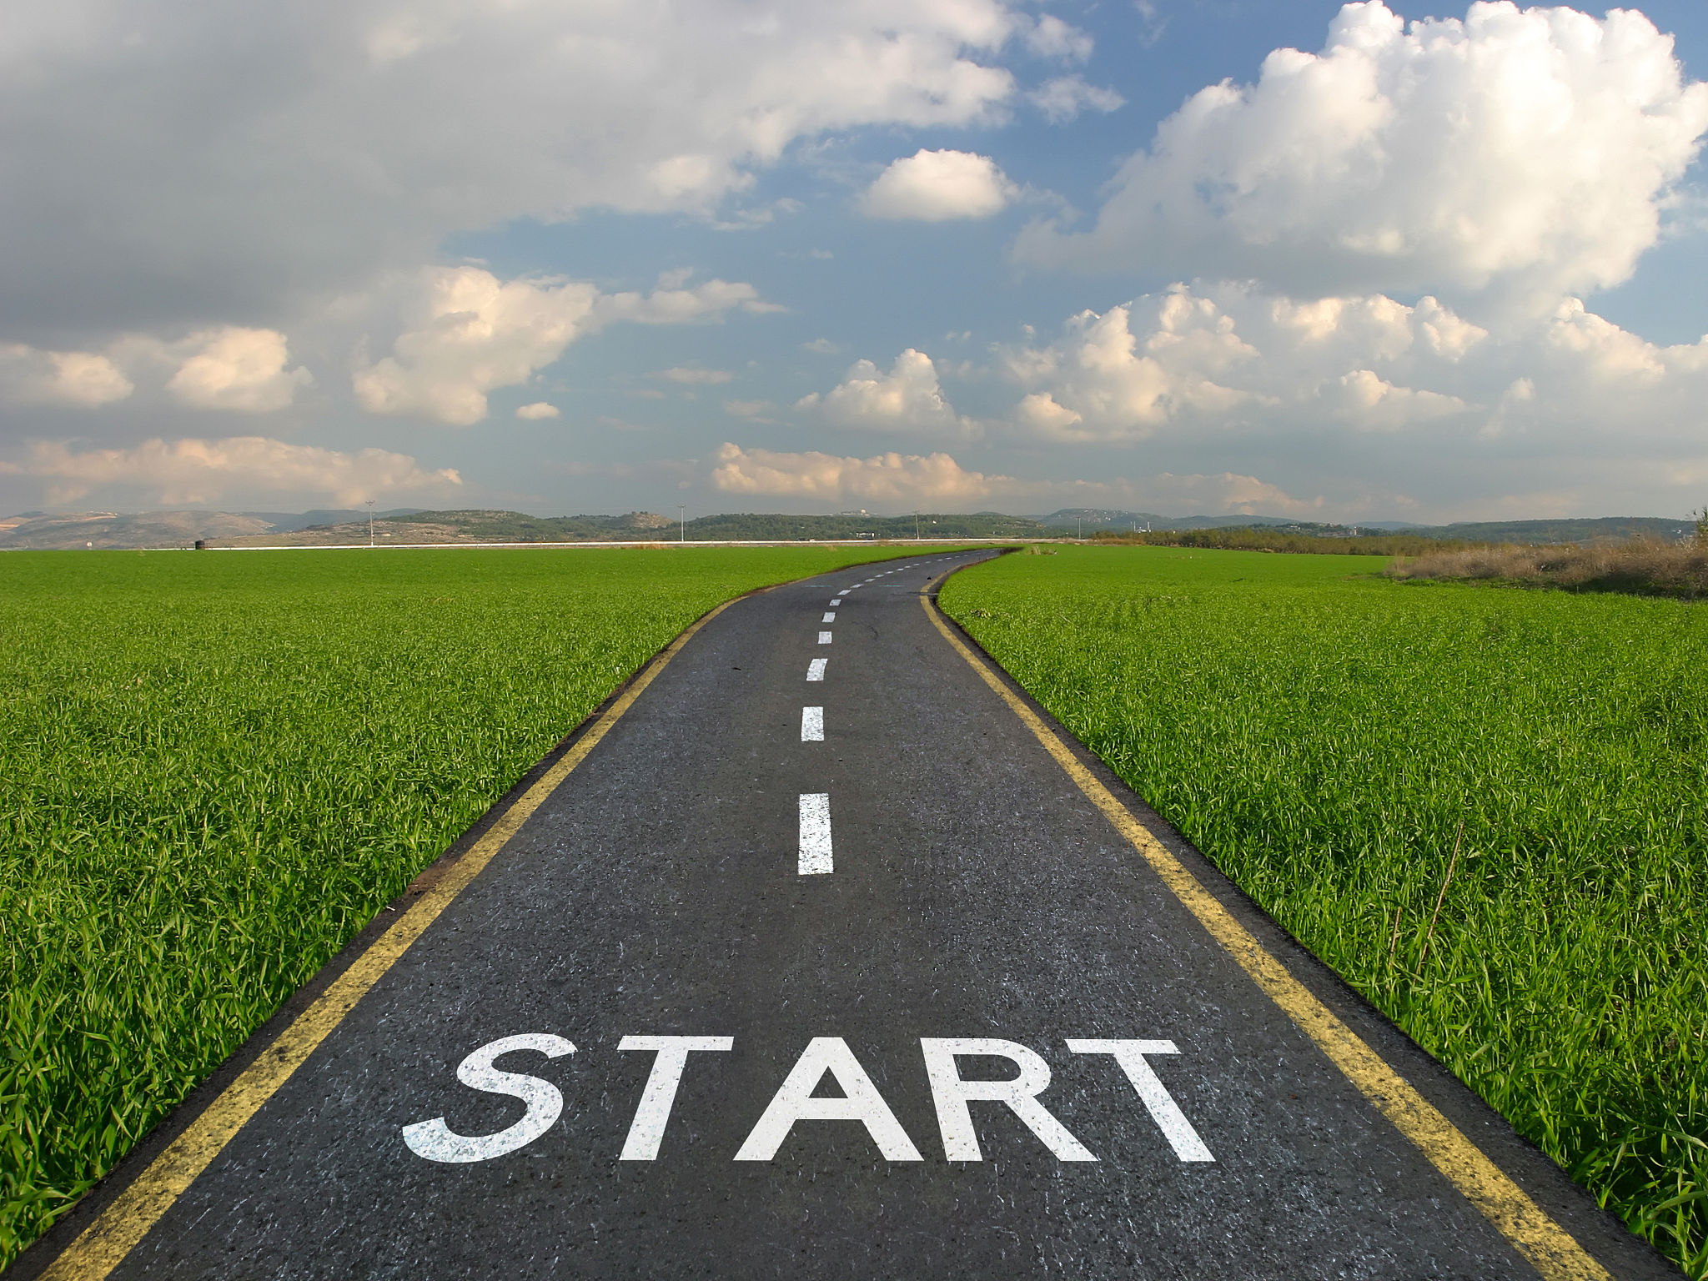
Homework
Make a travel plan for your winter vocation or polish your travel plan in this class, make it complete and logical and use the correct expressions and grammer patterns. If you want to share it with me, email me at Deefucaidi@sina.com.

