Slide 1
扫码关注
回复：hello sun
获取课件制作、录课等实用工具包
知识产权声明
感恩遇见，相互成就，本课件资料仅供您个人参考、教学使用，严禁自行在网络传播，违者依知识产权法追究法律责任。
更多教学资源请关注
订阅号：溯恩英语

Slide 2
B4U1
Women of achievement
New Words and Expressions

Slide 3
重点单词
1. ________ n. 人类
2. ________ n. 运动；战役 vi. 作战；参加运动
3. ________ vt. & vi. 举动；（举止或行为）表现
4. ________ n. 荫；阴凉处 vt. 遮住光线
5. ________ vt. 观察；观测；遵守
6. ________ vt. & n. 尊敬；尊重；敬意
7. ________ vt. & vi. 讨论；辩论；争论
8. ________ n. 人群；观众 vt. 挤满；使拥挤
9. ________ n. & vt. 支持；拥护
10.________ vi. 谈到；查阅；参考
11. ________ vt. 计划；打算
12.________ vt. 递送；生（小孩儿）；发表（演说等）
human being
campaign
behave
shade
observe
respect
argue
crowd
support
refer
intend
deliver

Slide 4
重点单词
13. ________ n. 成就；功绩
14. ________ n. 项目；工程；规划
15. ________ n. 专家；专业工作者
16. ________ n. 连接；关系
17. ________ n. 组织；机构；团体
18. ________ adj. 值得的；值得做的
19. ________ n. 联系；关系；结合；纽带
20. ________ adj. 直言的；坦诚
21. ________ n. 款待；娱乐；娱乐表演
22.________ vt. 鼓舞；激发；启示
23. ________ adj. 谦虚的；谦让的；适度的
24.________ adj. 考虑周到的
achievement
project
specialist
connection
organization
worthwhile
bond
outspoken
entertainment
inspire
modest
considerate

Slide 5
派生单词
1.____________ n. 成就；功绩 _________ v. 完成；达到
2.___________ n. 连接；关系 ________ v. 连接；接通；沟通
3. ___________ n. 组织；机构；团体 _________ v. 组建；安排；管理
4.________ vt. 观察；观测；遵守 ___________ n. 观察；观测
5.________ vt. & n. 尊敬；尊重 ________ adj. 尊敬的；表示敬意的
6. _____ vt. & vi. 讨论；辩论；争论 _________ n. 争论；争辩；争吵
7._____________ n. 款待；娱乐 ________ v. 娱乐；款待
8._______ vt. 鼓舞；激发；启示 __________ n. 灵感；鼓舞
9.________ n. & vt. 支持；拥护 ________ n. 支持者；拥护者
10. ___________ adj. 考虑周到的 ___________ n. 考虑；体谅
achievement
achieve
connection
connect
organization
organize
observe
observation
respect
respectful
argue
argument
entertainment
entertain
inspire
inspiration
support
supporter
considerate
consideration

Slide 6
重点短语
move off
1.________________ 离开；起程；出发
2.________________ 过着……的生活
3.________________ （想法、问题等）涌上心头4.________________ 蔑视；瞧不起
5.________________ 查阅；参考；谈到
6.________________ （偶然）遇见；碰见
7._______________ 继续；坚持
lead a … life
crowd in
look down upon/on
by chance
come across
carry on

Slide 7
词义释义
entertainment
____________ films/movies, music, etc. used to entertain people
____________ having or involving expert knowledge of a particular area of work, study or medicine
____________ a sudden serious and dangerous event or situation which needs immediate action to deal with it
____________ an organization that has a particular purpose, especially one that is connected with education or a particular profession
____________ practical or financial help that is provided, often by the government, for people or animals that need it
____________ the group of people who have gathered to watch or listen to something
____________ a planned piece of work that is designed to find information about something, to produce something new, or to improve something
specialist
emergency
institute
welfare
audience
project

Slide 8
话题词汇
outspoken, considerate, kindness, modest, determination, inspire
Qualities
Behaviours
campaign, observe, respect, argue, refer to, deliver, support, carry on

Slide 9
美句赏析
achievement
Without failure there is no _____________. ---John C. Maxwell
___________with other people affect not only the quality of our lives but also our survival. ---Dean Ornish
Creative thinking _______ ideas. Ideas _______ change. ---Barbara Januszkiewicz
The only true source of politeness is ____________. ---William Gilmore Simms
Success is full of promise till one gets it, and then it seems like a ____ from which the bird has flown. ---Henry Ward Beecher
Connections
inspires
inspire
consideration
nest

Slide 10
遣词造句
Group 1: achievement; specialist; connection
Group 2: behave; worthwhile; observe
Group 3: outspoken; lead a ... life; inspire
Group 4: come across; refer to; intend
Group 5: by chance; shade; nest
After studying the connections between humans and animals for many years, the specialist made a great achievement in this field.
It is worthwhile to observe the rules and behave yourself.
As an outspoken supporter of enviornment protection, she leads a busy life and has inspired a lot of people.
If you intend to learn English well, you'd better refer to a dictionary when you come across new words.
We sat down in the shade of the tree and a nest fell down by chance.

Slide 11
核心词汇
1. behave
v.
写出例句中behave相关表达的意思
He behaved in a very responsible way.
He behaved as if/though nothing had happened.
I want you to behave yourselves while I'm away.
It is a badly-behaved class.
表现得很有责任心
显得像是
表现得体
不守规矩的
派生词
behaviour n. 行为

Slide 12
Quiz
用behave相关表达补充完整句子
behave yourself
1. You will get some candies if you _______________.
2. When he was asked to admit the mistake, he _______________________________.
behaved as if nothing had happened
3. He is a _____________ boy, as he never fails to greet teachers.
well-behaved

Slide 13
核心词汇
2. observe
v.
将例句中observe相关意思与右边中文意思匹配。
The police observed a man enter the bank.
I felt he was observing everything I did.
He will observe Thanksgiving with family members.
The crowd observed a minute's silence in memory of those who had died.
遵守（规则、法律等）
庆祝
看到；注意到
观察；监视

Slide 14
Quiz
改写句子
1. The rules should be obeyed by all members.
The rules should be observed by all members.
2. How do you celebrate New Year?
How do you observe New Year?
3. Have you noticed any changes lately?
Have you observed any changes lately?

Slide 15
核心词汇
3. deliver
v.
根据例句写出deliver的相关短语及意思
1. The Canadians plan to deliver more food to Southern Somalia (索拉里).
deliver sth to sb 把某物递送给某人
2. The president will deliver a speech about schools.
deliver a speech 发表演讲
3. They rushed her to hospital where doctors delivered her baby.
deliver one's baby 接生小孩
4. She always delivers on her promise.
deliver on one's promise 信守诺言

Slide 16
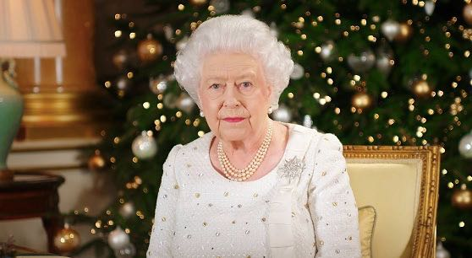
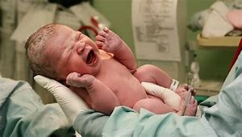
Quiz
根据图片写句子
Queen Elizabeth is delivering a speech to share her annual Chirstmas message.
The doctor delivered the baby.

Slide 17
核心词汇
4. crowd
n. & v.
利用例句找出crowd的词性和用法
A small crowd had gathered outside the church.
We all crowded into her office to sing “Happy Birthday”.
He prefers to be one of the crowd.
Memories crowded in on her.
n. 人群
v. 拥挤
n. 凡夫俗子
v. 涌上（脑海）

Slide 18
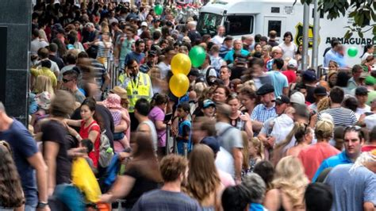
Quiz
根据图片用crowd的不同词性写表达
1. Crowds of people poured into the street.
2. Thousands of people crowded the street.

Slide 19
核心词汇
5. refer
v.
写出refer to在例句中的含义。
Her mother never referred to him again.
This paragraph refers to the events of last year.
You may refer to your notes if you want.
My doctor referred me to a specialist.
提起
描述；涉及
查阅
将...送交给（以求帮助等）

Slide 20
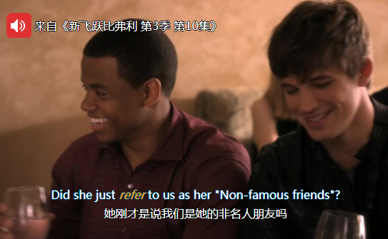
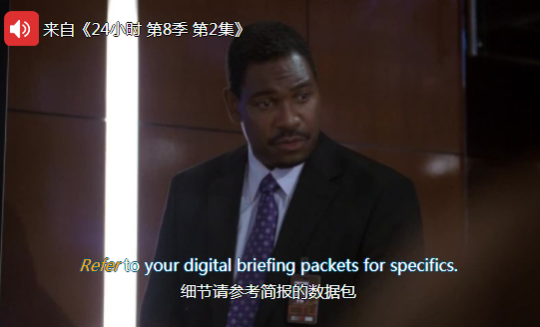
Quiz
台词翻译

Slide 21
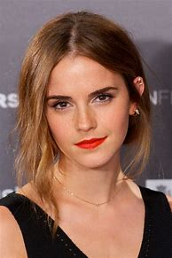
即学即用
Emma Watson is a British actress born in 1990, who is best known as Hermione in Harry Potter movies. Besides being an actor, Emma is also an activist ________ for the rights of women. On Sep. 20, 2014, she _______ a speech about gender inequality and began the HeForShe ___________. She ________ that women should not be _________________ and should be ________. Her ideas are greatly _________. For Emma, she will _________ her efforts for women’s rights.
arguing
delivered
campaign
observed
looked down upon
respected
supported
carry on

Slide 22
扫码关注
回复：hello sun
获取课件制作、录课等实用工具包
知识产权声明
感恩遇见，相互成就，本课件资料仅供您个人参考、教学使用，严禁自行在网络传播，违者依知识产权法追究法律责任。
更多教学资源请关注
订阅号：溯恩英语

