Slide 1
感恩遇见，相互成就，本课件资料仅供您个人参考、教学使用，严禁自行在网络传播，违者依知识产权法追究法律责任。
更多教学资源请关注
公众号：溯恩高中英语
知识产权声明

Slide 2
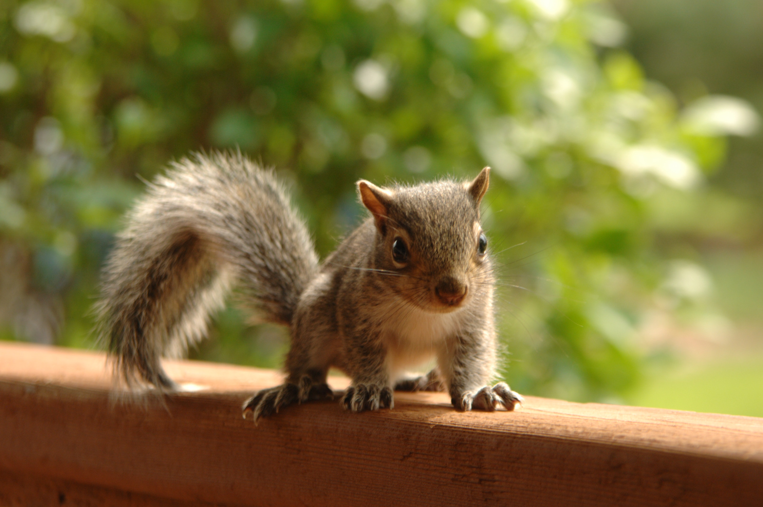
202302黑吉皖滇四省联考读后续写讲评
An orphaned baby squirrel
陈星可
浙江省天台中学

Slide 3
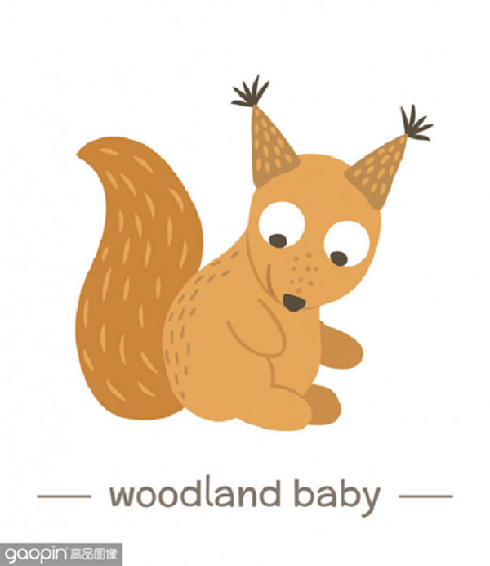
I.文本呈现
My husband and I enjoy seeing life through the eyes of our children. It’s amazing to watch as they discover their world.
While we were outdoors last summer enjoying the sunshine, our oldest daughter, Kaytlin, called me to the doorway. Beneath the steps was a baby red squirrel.
We watched it from a distance, not wanting to disturb it or scare off its mother. But after a long wait – and looking all around our house for signs of a nest or a mother – we realized the tiny squirrel was lost.
Shaking terribly, he was weak, thin, and hungry. We tried to find an expert to help, but the Inland Fisheries and Wildlife website showed that there were no wildlife experts in our area. After some quick research, we concluded that the best way to give the squirrel a fighting chance was to care for him ourselves. So a trip to the local store for milk and supplies was in order.
More research taught us how much to feed him, how to estimate his age, how and when to wean (断奶) him, and that we should let him go as soon as he could survive on his own.
Our daughters and I took turns in feeding ”Squirt”. Kaytlin took on the most responsibility. She taught him to eat from a bottle, and she woke in the night for his feeds.
To our relief, Squirt soon became healthy and strong. Within a few weeks he became more active. He would chatter (吱吱叫) for his next meal, playfully go around the girls, and lie down on them for sleep. It wasn’t long before he was weaned onto solid food and reintroduced to the wild.
His first few visits to the great outdoors were funny. Just like a child, he would play in the grass some and then run back to Kaytlin for safety. Soon she had him climbing trees and finding nest material.
注意：
1．续写词数应为150左右； 2．请按如下格式在答题卡的相应位置作答。
One day in the trees, Squirt met up with a family of gray squirrels.____________________________
One night, Squirt didn’t come back to our house and it rained hard._______________________________

Slide 4
IA.文本解读--语言积累
1.在台阶下
2.把...吓跑
3.一段漫长而沉默的等待
4.鸟窝或者妈妈的迹象
5.微小但是值得一搏的机会
6.轮流做某事
7.承担责任
8.嬉闹地在孩子身边转
9.重新接触野外世界
10.靠自己存活
1.beneath the steps
2.scare ... off/away
3.a long and silent wait
4.signs of a nest or a mother
5.a fighting chance
6.take turns in doing, take turns to do
7.take on /shoulder responsibility
8.playfully go around the kids
9.be reintroduced to the wild
10.survive on one’s own

Slide 5
IB.文本解读--情节理解
Last summer while we were e__________ the sunshine, our daughter Kaytlin found a baby red squirrel beneath the steps, which was obviously lost, weak, thin and h__________. Aftr many v_________ efforts and some quick research. we started to care for the baby squirrel by ________ (we), which we named Squirt. Fortunately, Squirt grew healthy, strong and active. More than that, he started to ______________ (reintroduce) to the outside world and develop some __________(survive) skills, which meant that it would not be long __________ we should let him go to the wild, __________ he belonged.
One day ______ the trees, Squirt met up with a family of gray squirrels...
enjoying
hungry
vain
ourselves
be reintroduced
survival
before
where
in

Slide 6
IC.文本解读
1.My husband and I enjoy seeing life through the eyes of our children. It’s amazing to watch as they discover their world.
2.While we were outdoors last summer enjoying the sunshine, our oldest daughter, Kaytlin, called me to the doorway. Beneath the steps was a baby red squirrel.
3. We watched it from a distance, not wanting to disturb it or scare off its mother. But after a long wait – and looking all around our house for signs of a nest or a mother – we realized the tiny squirrel was lost.
4.Shaking terribly, he was weak, thin, and hungry. We tried to find an expert to help, but the Inland Fisheries and Wildlife website showed that there were no wildlife experts in our area. After some quick research, we concluded that the best way to give the squirrel a fighting chance was to care for him ourselves. So a trip to the local store for milk and supplies was in order.
首段是整篇文章的眼，也是续写部分的提示。后文需
要呼应，交代我们通过通过孩子的眼睛发现了什么样的世界。大人可能认为Kaytlin不舍得松鼠离开我们的家；而Kaytlin可能为松鼠找到家而开心并实现个人的成长。
Watch一词告诉我们：我和丈夫是站在旁观者的视角来
见证这件事的，续写部分也要遵循这一原则。
第三段红色词都表明我们都很爱护动物、尊重动物。这些伏笔告诉读者最后松鼠一定会回到他应该有的生活，enjoy the freedom to live in the wild with his peers.
第四段红色词描述松鼠所处的状态和我们想要帮助他的困难；划线词部分我们所付出的努力。最后一句话起到承接下一段的作用。

Slide 7
IC.文本解读
5.More research taught us how much to feed him, how to estimate his age, how and when to wean (断奶) him, and that we should let him go as soon as he could survive on his own.
6. Our daughters and I took turns in feeding
”Squirt”. Kaytlin took on the most responsibility. She taught him to eat from a bottle, and she woke in the night for his feeds.
7. To our relief, Squirt soon became healthy and strong. Within a few weeks he became more active. He would chatter (吱吱叫) for his next meal, playfully go around the girls, and lie down on them for sleep. It wasn’t long before he was weaned onto solid food and reintroduced to the wild.
8. His first few visits to the great outdoors were funny. Just like a child, he would play in the grass some and then run back to Kaytlin for safety. Soon she had him climbing trees and finding nest material.
第5-6段讲述我们如何照看小松鼠。这过程让Kaytlin学会了承担责任，学会了如何照顾别人，是她人生当中一个重要的部分。这样在续写部分她让松鼠回归大自然也就水到渠成了。
第7-8段划线词表现了松鼠在我们照料下健康成长。从接受milk到solid food，从室内到室外，从go around girls到climb trees, find nest materials，为后续的回归自然做好了铺垫。
Tip:
第7-8段有许多描写松鼠动作的词汇表达，要在续写部分加以调整性的运用，是描写生动形象。

Slide 8
II.写作思路
1.One day in the trees, Squirt met up with a family of gray squirrels.
思路1：①因为同类，被接纳，马上打成一片，和谐相处； ②我们不舍+高兴---③每天晚上还是回来，不过越来越迟(连接下段首句)
思路2：①因为毛色不同，谨慎试探，被接纳，和谐相处；②我们高兴--- ③每天晚上还是回来，不过越来越迟，和我们疏远，我们有点失落(连接下段首句)
2.One night, Squirt didn’t come back to our house and it rained hard.
思路1:担心被雨淋湿想不到躲藏处；当晚/ 第二天寻找，与新朋友相处挺好的，放心告别；永远离开/偶尔回来
思路2:担心被雨淋湿想不到躲藏处；当晚/ 第二天寻找，/被雨淋湿+饥寒，抱回家；一如往常每天回来；
思路3：在担心中度过一晚；第二天院子里见到松鼠和他的伙伴，与我们告别；感悟（给以关心，也要给以自由；或者呼应首段）

Slide 9
II.写作思路-情节构建（Q-A）
1.One day in the trees, Squirt met up with a family of gray squirrels.
Q1:How did Squirt get along with the gray squirrels? (动作+心理活动)
Q2:How did we react to Squirt’s new condition? (不舍+高兴，心理活动）
Q3: Did he come back to our house every night?(下段首句)
2.One night, Squirt didn’t come back to our house and it rained hard.
Q1:How did we feel about Squirt’s absence in such terrible weather?（情感+心理活动）
Q2:What did we do with the situation? （动作）
Q3: How would the story end? What was my reflection?（结尾+感悟）
(回应文本首段 seeing life through the eyes of our children. It’s amazing to watch as they discover their world. 解读一个有爱和关心的世界)

Slide 10
II.写作思路-表达
1.One day in the trees, Squirt met up with a family of gray squirrels.
Q1:How did Squirt get along with the gray squirrels? (动作+心理活动)
Curious to see creatures of his kind with just a different color, Squirt felt a sense of natural closeness rising in his body. He took one step forward tentatively, but quickly jumped back. However, the next moment, we found that Squirt was playing with these gray squirrels merrily among the branches, and chasing after each other
At first, he was hesitant to approach them, but after a few tentative and cautious trials, he finaaly took his first step to the group.
Surprised and excited, Squirt put his nose to them, approaching slowly and cautiously.
Squealing in delight, never had Squirt acted so delightedly in his life.
He bounced up and down aming the trees as if announcingproudly that he had found his own family.
First hesitant, he soon grew curious and approached them with caution, his tiny red tail wagging back and forth.

Slide 11
II.写作思路-表达
1.One day in the trees, Squirt met up with a family of gray squirrels.
Q2:How did we react to Squirt’s new condition? (不舍+高兴，心理活动）
We were relieved that he would finally return to his natural world, where he belonged. Meanwhile, we were sad because we had already made him a member of our family, without whom our life would be much less vigorous.
Squirt seemed to have found a new family, and we couldn't help but feel a little bittersweet.
The girls and I watched in amazement as he chased them up and down the tree trunks and branches. We knew that this was a great sign and that he was ready to be on his own.
Seeing this, we smiled in relief and watched them from a distance, with a hope that Squirt could survive on his own and back to the wild.
At the sight of this, Kaytlin said, half joking and half serious, that Squirt would soon become wild, to which we all responded with a sad smile.
As we observed Squirt's interactions with the other squirrels, a mix of pride and sorrow washed over us, knowing that it was time for him to fully integrate back into the wild.

Slide 12
II.写作思路-表达
1.One day in the trees, Squirt met up with a family of gray squirrels.
Q3: Did he come back to our house every night?(下段首句)
Day after day Squirt would hang out with his peers and day by day he seemed less attached to us.
For several days he played all day in the trees surrounding our house but came down at bedtime.
Squirt seemed to have found a new family, and we couldn't help but feel a little bittersweet watching him go.
We knew that this was a great sign and that he was ready to be on his own.
They knew that it would be hard to say goodbye to Squirt, but they also knew that it was the right thing to do.
Squirt often went outdoors, looking for new friends, but still came back home at night.
He still came back every night, but much later. And every morning, he set off early.
Not until then did we realize that it was time for him to go back in the wild, where he belonged.

Slide 13
II.写作思路-表达
2.One night, Squirt didn’t come back to our house and it rained hard.
Q1:How did we feel about Squirt’s absence in such terrible weather?
Worried, we searched every corner of the yard, praying that he could be sheltering from the rain somewhere, but in vain.
Throughout the night, we were dominated by anxiety, praying that he had found shelter.
We worried about his safety, wondering if he had found a warm and dry place to shelter from the big rain.
Desperately, our whole family put on our raincoats, took out our headlights and searched every corner of our garden.
We called his name, but there was no response. We searched the trees and the bushes, but he was nowhere to be seen.
We worried about him all night, hoping he had found a dry spot to shelter from the rain.

Slide 14
II.写作思路-表达
2.One night, Squirt didn’t come back to our house and it rained hard.
Q2:What did we do with the situation?
Suddenly out of a tree hole came this red creature, who was sleepily looking at us and then jumped into Kaytlin’s arms.
Our girls wanted to seek Squirt. We prevented them because it was too dangerous. But when the sun rose the next day, there was Squirt, begging for food.
The next morning, we went out to search for him, calling his name and looking everywhere. Finally, we found him in a nearby tree, making himself a ball, shivering in the rain.
But the next day he appeared on the branch of a tree near our house. He seemed to be saying goodbye to us before he disappeared into the forest.
Suddenly there came an excited cry, "Here he is!" We raced towards a big tree. There was a hole beneath a big branch, at the entrance of which Squirt was standing and chattered at us.
I was awoken by the cheerful chattering outside. As I peered through the window, I was greeted with Squirt and his squirrel buddies bouncing around in our garden.

Slide 15
II.写作思路-表达
2.One night, Squirt didn’t come back to our house and it rained hard.
Q3: How would the story end? What was my reflection?（结尾）
The red baby squirrel left, turned back, left again and once more turned back before finally disappearing among the trees.
Over the next few days, Squirt started coming back to visit us less frequently, until finally he stopped coming altogether.
They knew that it would be hard to say goodbye to Squirt, but they also knew that it was the right thing to do.
They were sad to see Squirt go, but they were also happy that he was finally back where he belonged.
Watching Squirt enjoying his feast, we realized that it was time to say goodbye to him, however unwilling we were.
They knew that it would be hard to say goodbye to Squirt, but they also knew that it was the right thing to do.

Slide 16
II.写作思路-表达
2.One night, Squirt didn’t come back to our house and it rained hard.
Q3: How would the story end? What was my reflection?（感悟）
Though a little sad, I exchanged an understanding smile with my husband, really glad that the bitter-sweet experience helped our kids find their world of love with Squirt for company.(回扣原文首句）
Every time we took a walk in the forest, I always felt there was a red figure nearly, as if the red Squirt was accompanying us all the time, never really departing.
We can shower all the creatures with love and care, but we also should allow them the freedom to return to the wild.
Without him, we would not have learnt about how to care for a squirrel and our daughters would not have learned so much about responsibility and empathy.
It was a tearful moment, but we knew it was the right thing to do. Squirt had taught us so much about caring for others and letting go.
We will always remember the time we spent with Squirt and the lessons we learned about the importance of taking care of our wildlife.

Slide 17
III.参考范文1
One day in the trees, Squirt met up with a family of gray squirrels. Unfortunately, they were not pleased with his presence and scolded him, swatting him away. Squirt quickly learned to be more socially aware and, for the next few days, he spent his time playing in the trees around our house. At night, he would come down to rest. Squirt's visits to the trees became a regular occurrence, and he soon became familiar with the family of squirrels. He learned to respect their boundaries and, in return, they accepted him as part of their community. Squirt was now a part of the family, and he enjoyed his time in the trees with them.
One night, Squirt didn't come back to our house and it rained hard. Our girls fretted. But when the sun rose, there was Squirt, begging for a bite to eat. And that remained the pattern for a few weeks.Squirt became well known in our neighborhood, and visitors knew to be on the lookout when they stopped by. But mostly he played in the trees, chattering away to anyone who happened to cross his path and occasionally swiping snacks from our toddler boys.The experience was entertaining and heartwarming for our family. In the wild and somewhat silly moments of raising an orphaned baby squirrel, our children learned to value and appreciate life.

Slide 18
III.参考范文2
One day in the trees, Squirt met up with a family of gray squirrels. At first Squirt was hesitant,but he soon realized that they were friendly and he started to play with them.The girls and I watched in amazement as he chased them up and down the tree trunks and branches. Kaytlin was thrilled to see Squirt making friends and becoming more confident. We knew that this was a great sign and that he was ready to be on his own.
One night, Squirt didn't come back to our house and it rained hard. We were worried about him and thought that he might have gotten lost again, but the next morning he appeared at the door soaking wet and shivering. Kaytlin took him in and dried him off,and we all breathed a sigh of relief.Over the next few days, Squirt started coming back to visit us less and less, until finally he stopped coming altogether. Although we missed him. we knew that this was a good thing and that he was finally able to live his life in the wild,where he belonged.We will always remember the time we spent with Squirt and the lessons we learned about the importance of taking care of our wildlife.

Slide 19
III.下水作文
One day in the trees, Squirt met up with a family of gray squirrels. Curious to see these creatures, Squirt felt a sense of natural closeness rising in his body. He took one step forward tentatively, but quickly jumped back. However, the next moment, we found that Squirt was playing with these gray squirrels merrily among the branches, and chasing after each other. Seeing their relationship bonded, we felt both relieved and a bit sad, especially Kaytlin. We were relieved that he would finally return to his natural world, where he belonged. Meanwhile, we were sad because we had already made him a member of our family. Day after day Squirt would hang out with his peers and day by day he seemed less attached to us.
One night, Squirt didn't come back to our house and it rained hard. Worried, we searched
every corner of the yard, praying that he could be sheltering from the rain somewhere, but in vain. Not wanting to give up the hope of finding him, we opened our umbrellas and with headlights headed for the place where they used to play together. Suddenly out of a tree hole came this red creature, who was sleepily looking at us and then jumped into Kaytlin’s arms. “He is gong to leave us forever,” Kaytlin sighed. Though a little sad, I exchanged an understanding smile with my husband, really glad that the bitter-sweet experience helped our kids find their world of love with Squirt for company.

Slide 20
III.原文本的故事
One day in the trees, he met up with a family of gray squirrels that was none too happy about his visit. They scolded and swatted at him, and he quickly learned some social skills. For several days he played all day in the trees surrounding our house but came down at bedtime.
And then one night, he didn't. The rain pounded hard, and our girls fretted. But when the sun rose, there was Squirt, begging for a bite to eat. And that remained the pattern for a few weeks.
Squirt became well known in our neighborhood, and visitors knew to be on the lookout when they stopped by. But mostly he played in the trees, chattering away to anyone who happened to cross his path and occasionally swiping snacks from our toddler boys.
The experience was entertaining and heartwarming for our family. In the wild and somewhat silly moments of raising an orphaned baby squirrel, our children learned to value and appreciate life.

Slide 21
补充素材：读后续写中的动物叫声
狮子 lion | roar | Kept in the cage, the lion roared angrily, attempting to get out.
老虎tiger | roar | The powerfultiger roared ferociously, warning the other animals to keep off.
狼 wolf | howl/roar/bark | Seeing this, the wolf still howled outside the door for some time and then left unwillingly.
大象 elephant | trumpet | The mighty elephant trumpeted loudly, showing its strength.
狗 dog | bark | Brady kept barking at them anxiously and continuously.
猫 cat | 喵meow | The meekcat meowed softly,obviously glad at his owner’s return .
熊bear | growl低吼声/roar | With an angry roar, the bear ran to the lake to wash his eyes.
公鸡 rooster乌鸦 crow | crow啼叫，打鸣 | The proud rooster crowed early, which quite annoyed me, who wanted to sleep a little longer.
鸭子 ducks | quack嘎嘎叫 | The cheerful duck quacked loudly,closely followed by her kids
松鼠 squirrel | chirp叽叽喳喳chatter吱吱叫 | Startled by the unexpected stranger, the gray squirrel chattered fiercely and trembled his furry tail.
鸟 bird | chirp叽叽喳喳chatter吱吱叫 | Perching on my palm, she chirped/squeaked merrily, eyes fixed on mine again
青蛙 frog | croak呱呱叫 | The lively frog croaked in the pond, making a splash.
蜜蜂 bee | buzz 嗡嗡叫hum哼唱 | Looking at the sea of flowers and smelling their fragrance, the busy bee buzzed/hummedenergetically.

Slide 22
人与自然（动物）话题巩固练1：-20230108浙江省省考
I was invited to a cookout on an old friend’s farm in western Washington. I parked my car outside the farm and walked past a milking house which had apparently not been used in many years. A noise at a window caught my attention, so I entered it. it was a hummingbird (蜂鸟), desperately trying to escape. She was covered in spider-webs (蛛网) and was barely able to move her wings. She ceased her struggle the instant I picked her up.
With the bird in my cupped hand, I looked around to see how she had gotten in. The broken window glass was the likely answer. I stuffed a piece of cloth into the hole and took her outside, closing the door securely behind me.
When I opened my hand, the bird did not fly away; she sat looking at me with her bright eyes. I removed the sticky spider-webs that covered her head and wings. Still, she made no attempt to fly. Perhaps she had been struggling against the window too long and was too tired? Or too thirsty?
As I carried her up the blackberry-lined path toward my car where I kept a water bottle, she began to move. I stopped, and she soon took wing but did not immediately fly away.
Hovering (悬停), she approached within six inches of my face. For a very long moment, this tiny creature looked into my eyes, turning her head from side to side. Then she flew quickly out of sight.
During the cookout, I told my host the hummingbird incident. They promised to fix the window. As I was departing, my friends walked me to my car. I was standing by the car when a hummingbird flew to the center of our group and began hovering. She turned from person to person until she came to me. She again looked directly into my eyes, then let out a squeaking call and was gone. For a moment, all were speechless. Then someone said, “ She must have come to say good-bye.”
注意：1. 续写词数应为150左右；2. 请按如下格式在答题纸的相应位置作答
A few weeks later, I went to the farm again.
I was just about to leave when the hummingbird appeared.

Slide 23
参考范文-20230108浙江省省考
A few weeks later, I went to the farm again. I parked my car, stepped onto the blackberry-lined path and wandered my way to the milky house. A sense of familiarity rose from my feet, and soon I found myself standing face to face with the milking house where I met the hummingbird. The newly-installed window was sparkling in the sunlight, reflecting the pure blue of the clear sky. I was delighted to find the window fixed while at a loss that the little hummingbird was nowhere to be found. Enjoying a cookout on my old friend's farm, I couldn't stop turning my head from side to side, expecting to meet my little friend again. However, my expectation remained till the very end.
I was just about to leave when the hummingbird appeared. A familiar squeaking call floated into my ears, breaking the silence. Hardly had the sound vanished in the wind when I turned to the position where it came I waved my hand to greet the hummingbird. Hovering, she looked into my eyes with her bright eyes. Without difficulty, she recognized me, which left me in exhilaration. Warmth filled up my body. Standing on the blackberry lined path where we separated last time, we looked into each other’s eyes, the wind was stroking my head and the sun was giving off warmth and brightness. I turned back as the little creature squeaked and gone with no hope of meeting her again. But I knew the experiences that I spent with her would never fade away as time went by.

Slide 24
人与自然（动物）话题巩固练2：-20230215浙江省十校联考April Fools' Day
Nat woke early and jumped out of bed. Today was the best day of the year for him. Nat loved to play tricks, and today was April Fools’ Day.
Some of Nat’s tricks were big hits. Last year, he short-sheeted his sister’s bed. She couldn’t understand what was going on and started to think that her legs must have grown much longer during the day. When she realized what had happened, she laughed her head off.
Some of Nat’s tricks were not so successful. Mom didn’t think finding a furry toy mouse in the fridge was humorous at all. After she calmed down a bit, she said, “That’s it! There’s a ban on Nat tricks for two weeks.”
Nat was also the class clown. He was always making jokes in class. He liked it when he made the other kids laugh. Since it was April Fools’ Day, he felt like he had to come up with something really good to provide his classmates with some really good entertainment.
For that, Nat thought long and hard before he came up with his brilliant idea. He bought two toy frogs which were made out of green plastic and looked very realistic. Nat knew just the trick he would play on his classmates.
Nat arrived at school early. To succeed in his plan, he needed to get into the classroom before anyone else. Nat’s class had a rainforest terrarium (饲养皿). It had plants, insects, and three frogs in it. Nat’s idea was to pretend that the frogs had escaped. He knew that Ms. Lopez, his teacher, wasn’t afraid of frogs but several of his classmates, including himself, were.
Nat slipped into the classroom. Good! There was nobody here. He put one of the toy frogs on the floor, near the terrarium and the other on his friend Stacey’s desk. Nat knew that Stacey really didn’t not like frogs. Also, she played a great trick on him last April Fools’ Day. To make his trick more convincing, Nat pushed the lid of the terrarium open. Then he rushed off to morning gathering.
注意：
1.续写词数应为150左右： 2.请按如下格式在答题卡的相应位置作答。
When the students got back to class, no one noticed the toy frogs at first.
Nat realized that he had opened the lid of the terrarium.

Slide 25
参考范文-20230215浙江省十校联考April Fools' Day
When the students got back to class, no one noticed the frogs at first. Then Stacey, who finally noticed the frog, screamed and pointed at her desk. The whole class exploded. A couple of other kids leapt out of their seats and shrieked while the rest were laughing and banging their desks. Nat was feeling very pleased with himself. His trick was definitely a success. But he knew he had to hide his glee. He pretended that he was working and reached out for a piece of paper. It was then that something cold and wet slithered滑动 past his fingers. It was a frog- a real one!
Nat realized that he had opened the terrarium. Suddenly, there came a loud croak呱呱地叫 from under his chair. Nat almost jumped out of his skin吓了一跳 with fright. Now he became the laughingstock of the class. What scared him even more was the only person who remained serious-Ms. Lopez. She calmly walked down the aisle, scooped up the frog and put it back into the terrarium. Then she came to Nat’s side, seemingly waiting for his confession. Nat felt his face burning and apologized to Ms Lopez. He also promised to be considerate from then on.

Slide 26
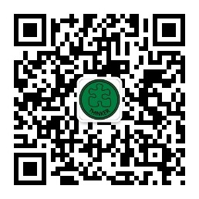
Thank you for your attention!

