Slide 1
感恩遇见，相互成就，本课件资料仅供您个人参考、教学使用，严禁自行在网络传播，违者依知识产权法追究法律责任。
更多教学资源请关注
公众号：溯恩高中英语
知识产权声明

Slide 2
高考英语阅读理解 专项突破1
· 主旨大意
· 推理判断
· 词义猜测
· 细节理解
· 语篇连贯

Slide 3
第二课
主旨大意
(新闻报道&科研报告)

Slide 4
一、新闻报道
浙江卷对“新闻报道”的考查：
1
2020.1 | B篇 | 威斯康辛州的密尔沃基市用奶酪盐水替代岩盐除冬季路上的冰。
2017.6 | C篇 | 意大利政府对移民提出新的语言技能要求，要求移民必须参加一项语言能力考试。
2016.10 | B篇 | 哥本哈根的皇冠假日酒店给在连接着发电机的自行车上锻炼来发电的客人提供免费餐，以此来推广酒店的环保理念。
《课程标准》在“语篇知识”中提出：掌握新闻报道的常见语篇结构、标题特征和语言特点。
你知道“新闻报道”类语篇有哪些组成部分吗？

Slide 5
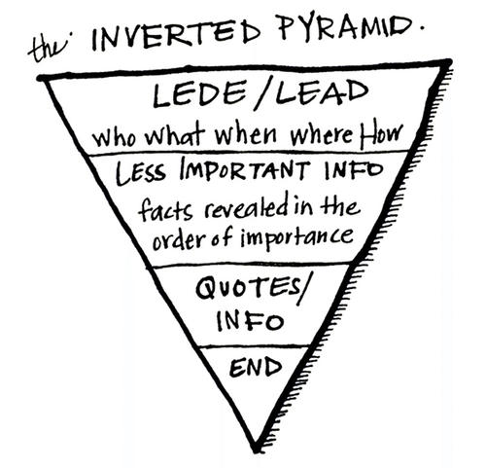
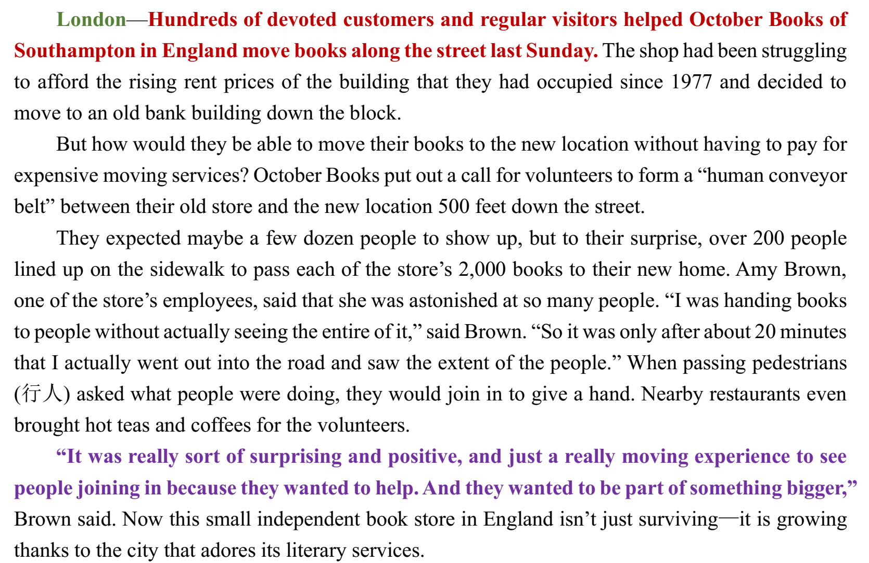
2.“新闻报道”类语篇的组成部分
标题
(headline)
报到地点 (place line)
导语(lead)
内容梗概
主体(body)
具体细节
评论 (quotes)
他人看法

Slide 6
3.“新闻报道”类语篇主旨大意题考查点
to inform
to persuade
to entertain
1. 写作目的
2. 文章标题
3. 文章大意
· What’s the main purpose of the passage?
· What can be a suitable title for the text?
· What’s the text mainly about?
新闻报道4个组成部分（标题除外）中哪部分和这两类题型最为相关？

Slide 7
4.“新闻报道”类语篇标题选择题
London—Hundreds of devoted customers and regular visitors helped October Books of Southampton in England move books along the street last Sunday. The shop had been struggling to afford the rising rent prices of the building that they had occupied since 1977 and decided to move to…
But how would they be able to move their books to the new location without having to pay for expensive…
They expected maybe a few dozen people to show up, but to their…
“It was really sort of surprising and positive, and just a really moving experience to see people joining in because they wanted to help…
London—Hundreds of devoted customers and regular visitors helped October Books of Southampton in England move books along the street last Sunday. The shop had been struggling to afford the rising rent prices of the building that they had occupied since 1977 and decided to move to…
But how would they be able to move their books to the new location without having to pay for expensive…
They expected maybe a few dozen people to show up, but to their…
“It was really sort of surprising and positive, and just a really moving experience to see people joining in because they wanted to help…
23. What can be a suitable title for the text?
A. Human Chain of People Help Move a Bookstore
B. Booklovers Gather for Moving Books in England
C. Bookstore Gets Crowdfunding for Future Survival
D. People Feeling Positive by Helping out a Bookstore
1. 找到“导语”
2. 定位“关键词”
3. 对应选项

Slide 8
▶Practice
Recently on the island of Siberut in Indonesia’s, some electricity-starved villages are developing their own energy by relying on a material that has been part of their lives for thousands of years: bamboo.
According to Jaya Wahono, CEO of Clean Power Indonesia (CPI), there are around 50,000 villages that don’t have reliable access to electricity…
Requiring little care every season, bamboo can actually become more productive while preventing soil erosion…
While nations around the world plan how to equip their infrastructure for the changing climate, Indonesia might have found their path into the …
Recently on the island of Siberut in Indonesia’s, some electricity-starved villages are developing their own energy by relying on a material that has been part of their lives for thousands of years: bamboo.
According to Jaya Wahono, CEO of Clean Power Indonesia (CPI), there are around 50,000 villages that don’t have reliable access to electricity…
Requiring little care every season, bamboo can actually become more productive while preventing soil erosion…
While nations around the world plan how to equip their infrastructure for the changing climate, Indonesia might have found their path into the …
1. What can be a suitable title for the text?
A. Bamboo: A Kind of New Energy for Indonesia.
B. Lack of Electricity Prevents Villages from Developing.
C. Why are Bamboos Important in Easing Climate Change?
D. Indonesia Looks to its Past to Solve Modern Energy Troubles.

Slide 9
▶其他题目
London—Hundreds of devoted customers and regular visitors helped October Books of Southampton in England move books along the street last Sunday. The shop had been struggling to afford the rising rent prices of the building that they had occupied since 1977 and decided to move to an old bank building down the block.
…
They expected maybe a few dozen people to show up, but to their surprise, over 200 people lined up on the sidewalk to pass each of the store’s 2,000 books to their new home…When passing pedestrians (行人) asked what people were doing, they would join in to give a hand. Nearby restaurants even brought hot teas and coffees for the volunteers.
1. Which of the following factor drove
October Books to a new location?
A. Cultural difference.
B. Government policy.
C. Financial difficulty.
D. Business condition.
2. How did people passing by react to the
“human conveyor belt”?
A. They contributed their little bit to help.
B. They stopped and took some pictures.
C. They bought hot teas for the volunteers.
D. They felt astonished and called the local
TV.

Slide 10
▶Practice
Terrafugia Inc, said Monday that its new flying car has completed its first flight, bringing the company closer to its goal of selling the flying car within the next year. The vehicle—named the Transition—has two seats…
Around 100 people have already put down a $10,000 deposit to get a Transition when they go on sale…
Inventors have been trying to make flying car since…
Mann said Terrafugia was helped by the Federal Aviation…
Terrafugia Inc, said Monday that its new flying car has completed its first flight, bringing the company closer to its goal of selling the flying car within the next year. The vehicle—named the Transition—has two seats…
Around 100 people have already put down a $10,000 deposit to get a Transition when they go on sale…
Inventors have been trying to make flying car since…
Mann said Terrafugia was helped by the Federal Aviation…
4. What is the best title for the text?
A. Flying Car at Auto Show. B. The Transition’s First Flight.
C. Pilots’ Dream Coming True. D. Flying Car Closer to Reality.
“新闻报道”类语篇的标题，直接对应“新闻导语”关键词。

Slide 11
▶Practice
Terrafugia Inc. said Monday that its new flying car has completed its first flight, bringing the company closer to its goal of selling the flying car within the next year. The vehicle—named the Transition—has two seats wheels and wings that fold up so it can be driven like a car. The Transition, which flew at 1,400 feet for eight minutes last month, can reach around 70 miles per hour on the road and 115 in the flies using a 23-gallon tank of gas and bums 5 gallons per hour in the air. On the ground, it gets 35 miles per gallon.
Terrafugia Inc. said Monday that its new flying car has completed its first flight, bringing the company closer to its goal of selling the flying car within the next year. The vehicle—named the Transition—has two seats wheels and wings that fold up so it can be driven like a car. The Transition, which flew at 1,400 feet for eight minutes last month, can reach around 70 miles per hour on the road and 115 in the flies using a 23-gallon tank of gas and bums 5 gallons per hour in the air. On the ground, it gets 35 miles per gallon.
1. What is the first paragraph mainly about?
A. The basic data of the Transition. B. The advantages of flying cars.
C. The potential market for flying cars. D. The designers of the Transition.
段落大意题要抓住每个选项的“核心词汇”，再与段落内容去对应

Slide 12
▶Practice
Around 100 people have already put down a $10,000 deposit to get a Transition when they go on sale, and those numbers will likely rise after Terrafugia introduces the Transition to the public later this week at the New York Auto Show. But don’t expect it to show up in too many driveways. It’s expected to cost $279,000. And it won’t help if you’re stuck in traffic. The car needs a runway.
Inventors have been trying to make flying cars since the 1930s, according to Robert Mann, an airline industry expert. But Mann thinks Terrafugia has come closer than anyone to making the flying car a reality. The government has already permitted the company to use special materials to make it easier for the vehicle to fly. The Transition is now going through crash tests to make sure it meets federal safety standards.
2. Why is the Transition unlikely to show up
in too many driveways?
A. It causes traffic jams.
B. It is difficult to operate.
C. It is very expensive.
D. It bums too much fuel.
3. What is the government’s attitude to the
development of the flying car?
A. Cautious B. Favorable.
C. Ambiguous. D. Disapproving.

Slide 13
5.“新闻报道”类语篇文章大意题
“新闻报道”类语篇的文章大意题与标题选择题有何类似之处？
文章大意≈文章标题
导语
Terrafugia Inc, said Monday that its new flying car has completed its first flight, bringing the company closer to its goal of selling the flying car within the next year.
Flying Car Closer to Reality
London—Hundreds of devoted customers and regular visitors helped October Books of Southampton in England move books along the street last Sunday.
Human Chain of People Help Move a Bookstore
Recently on the island of Siberut in Indonesia’s, some electricity-starved villages are developing their own energy by relying on a material that has been part of their lives for thousands of years: bamboo.
Indonesia Looks to its Past to Solve Modern Energy Troubles

Slide 14
二、科研报告
浙江卷对“科研报告”的考查：
1
2020.1 | C篇 | 研究发现父亲在孩子的成长中极大地影响孩子毅力的养成。
2017.6 | B篇 | 大多数美国孩子睡眠不足已经成了一种习惯，文章介绍了这种习惯的原因及采取的相应措施
2017. 11 | B篇 | 两位研究者多了一个关于人们穿白大褂对注意力的试验，从而来验证“着装认知”理论
《课程标准》在“语篇知识”中提出：掌握说明文语篇的主要写作目的以及其主要语篇结构特征。
《课程标准》在“语篇类型”中提出，了解科研和学术报告。
你知道“研究报告”类语篇有哪些组成部分吗？

Slide 15
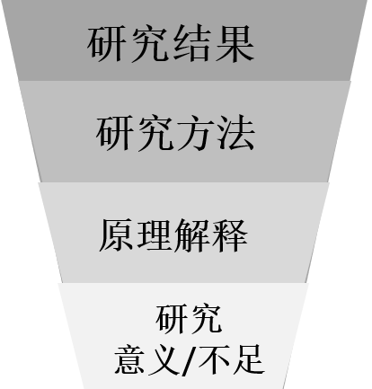
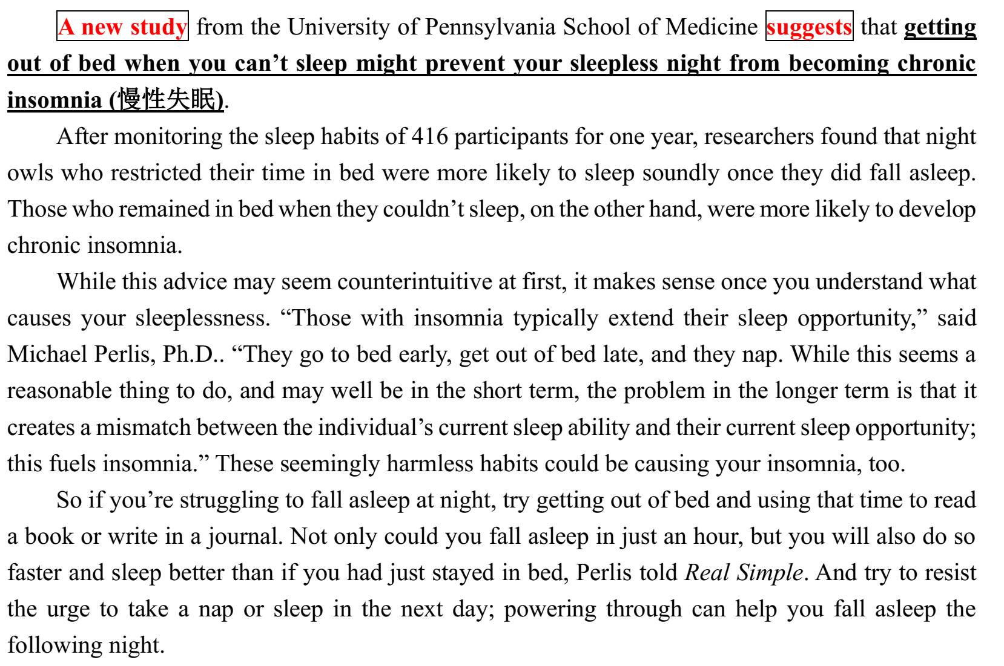
2.“科研报告”类语篇的结构
A new study/research suggests/ discovers/reveals/finds…
研究结论
（首段）
…by
·experiment
·observation
·survey
·case study
研究方法
原理解释:
（中间）
研究意义/不足:
（结尾）

Slide 16
3.“科研报告”类语篇主旨大意题考查点
to inform
to persuade
to entertain
1. 写作目的
2. 文章标题
3. 文章大意
· What’s the main purpose of the passage?
· What can be a suitable title for the text?
· What’s the text mainly about?
科研报告四部分中中哪部分和这两类题型最为相关？

Slide 17
4.“科研报告”类语篇标题选择题
A new study from the University of Pennsylvania School of Medicine suggests that getting out of bed when you can’t sleep might prevent your sleepless night from becoming chronic insomnia (慢性失眠).
After monitoring the sleep habits of 416 participants for one year, researchers found that night owls who restricted their time in bed were more likely to…
While this advice may seem counterintuitive at first, it makes sense once you understand what causes your sleeplessness…
So if you’re struggling to fall asleep at night, try getting out of bed and using that time…
24. What can be a suitable title for the text?
A. Sleepless? Get Out of Bed.
B. Advice on Sleeping Problems.
C. Avoiding Chronic Insomnia.
D. Taking a Nap During the Day.
1. 找到“研究结果”
2. 定位“关键词”
3. 对应选项

Slide 18
▶Practice
Study Confirms That Cats Respond to Their Names
Hey Kitty! Yes, you. A new study suggests household cats can respond to the sound of their own names.
No surprise to you or most cat owners, right? But Japanese scientists said Thursday that they’ve provided the first experimental evidence that cats can distinguish between words that we people say..
Can Language Learning Happen During Sleep?
A new study suggests some language learning can take place during sleep.
Researchers from Switzerland's University of Bern say they discovered people were able to learn new language words during deep levels of sleep. Results of the study recently appeared in the publication Current Biology.

Slide 19
▶其他题目
counter-: the opposite
e.g. counter-argument / countermeasure
After monitoring the sleep habits of 416 participants for one year, researchers found that night owls who restricted their time in bed were more likely to sleep soundly once they did fall asleep. Those who remained in bed when they couldn’t sleep, on the other hand, were more likely to develop chronic insomnia.
While this advice may seem counterintuitive at first, it makes sense once you understand what causes your sleeplessness…
So if you’re struggling to fall asleep at night, try getting out of bed and using that time to read a book or write in a journal. Not only could you fall asleep in just an hour, but you will also do so faster and sleep better than if you had just stayed in bed, Perlis told Real Simple…
21. Which of the following best explains
“counterintuitive” underlined in paragraph
3?
A. Contrary to common belief.
B. Unlike anything else.
C. Similar to first reaction.
D. Beyond wildest imagination.
22. What’s Perlis’ s advice for a sleepless night?
A. Get out of bed. B. Remain in bed.
C. Keep wide awake. D. Take a nap.

Slide 20
5.“科研报告”类语篇写作目的题
A new study from the University of Pennsylvania School of Medicine suggests that getting out of bed when you can’t sleep might prevent your sleepless night from becoming chronic insomnia (慢性失眠).
After monitoring the sleep habits of 416 participants for one year, researchers found that night owls who restricted their time in bed were more likely to…
While this advice may seem counterintuitive at first, it makes sense once you understand what causes your sleeplessness…
So if you’re struggling to fall asleep at night, try getting out of bed and using that time…
to inform
to persuade
to entertain
23. What’s the writer’s purpose in writing the text?
A. To promote a healthy lifestyle.
B. To introduce a new finding.
C. To encourage similar study.
D. To discuss the cause of sleeplessness.
1. 明确目的“to
introduce/inform”
2. 找到“研究结果”
3. 对应选项

Slide 21
5.“科研报告”类语篇文章大意题
“研究报告”类语篇的文章大意题与标题选择题有何类似之处？
文章大意≈文章标题
研究结果
Hey Kitty! Yes, you. A new study suggests household cats can respond to the sound of their own names.
Study Confirms That Cats Respond to Their Names
A new study from the University of Pennsylvania School of Medicine suggests that getting out of bed when you can’t sleep might prevent your sleepless night from becoming chronic insomnia
Sleepless? Get Out of Bed.
A new study suggests some language learning can take place during sleep.
Researchers from Switzerland's University of Bern say they discovered people were able to learn new language words during deep levels of sleep.
Can Language Learning Happen During Sleep?

Slide 22
▶ Practice
A warm drink of milk before bed has long been the best choice for those wanting a good night’s sleep. But now a study has found it really does help people nod off—if it is milked from a cow at night.
…
The study, by researchers from Seoul, South Korea, involved mice being fed with dried milk powder made from cows milked both during the day and at night.
Those given night milk, which contained 10 times the amount of melatonin, were less active and less anxious than those fed with the milk collected during daytime, according to the study published in The Journal of Medicinal Food.
A warm drink of milk before bed has long been the best choice for those wanting a good night’s sleep. But now a study has found it really does help people nod off—if it is milked from a cow at night.
…
The study, by researchers from Seoul, South Korea, involved mice being fed with dried milk powder made from cows milked both during the day and at night.
Those given night milk, which contained 10 times the amount of melatonin, were less active and less anxious than those fed with the milk collected during daytime, according to the study published in The Journal of Medicinal Food.
3. What can be a suitable title for the text?
A. Milk Drinking and Health
B. Fat, Sugar and Health
C. An Experiment on Mice
D. Night Milk and Sleep
1. According to the text, the mice fed with daytime milk ________.
A. started sleep more easily
B. were less active
C. were more anxious
D. woke up later

Slide 23
▶ Practice
A warm drink of milk before bed has long been the best choice for those wanting a good night’s sleep. But now a study has found it really does help people nod off—if it is milked from a cow at night.
…
Night milk quickened the start of sleep and caused the mice to sleep longer.
While the effect of cows milk harvested at different times has not been tested on humans up to now, taking melatonin drugs has been suggested to those who are struggling to fall asleep at night.
2. Which of the following is true of
melatonin according to the text?
A. It’s used in sleeping drugs.
B. It exists in milk in great amount.
C. It can make people more energetic.
D. It’s been tested on mice for ten years.
4. How does the author support the theme of
the text?
A. By giving examples.
B. By providing research results.
C. By explaining statistical data.
D. By stating arguments

Slide 24
三、小结
地点
导语
文章标题
文章大意
新闻报道
主体
主旨大意题
（新闻报道
&研究报告）
评论
研究结论
文章标题
文章大意
研究方法
to introduce
/inform
研究报告
原理解释
写作目的
研究意义/不足

