Slide 1

感恩遇见，相互成就，本课件资料仅供您个人参考、教学使用，严禁自行在网络传播，违者依知识产权法追究法律责任。
更多教学资源请关注
公众号：溯恩高中英语
知识产权声明

Slide 2


Unit5 Language Around The World
Kethrine

Slide 3
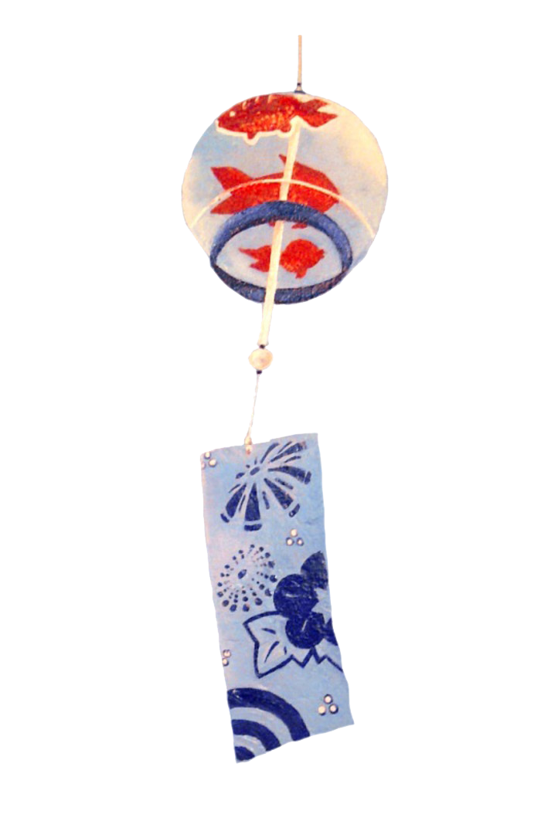


  After class, the students will be able to:
Learning
aims
  have a better understanding of the development of Chinese characters and its importance.
  introduce the development of Chinese characters in English.
  improve the ability of skimming, scanning,analyzing discourse and thinking logically.
  Enhance national confidence and pride.

Slide 4
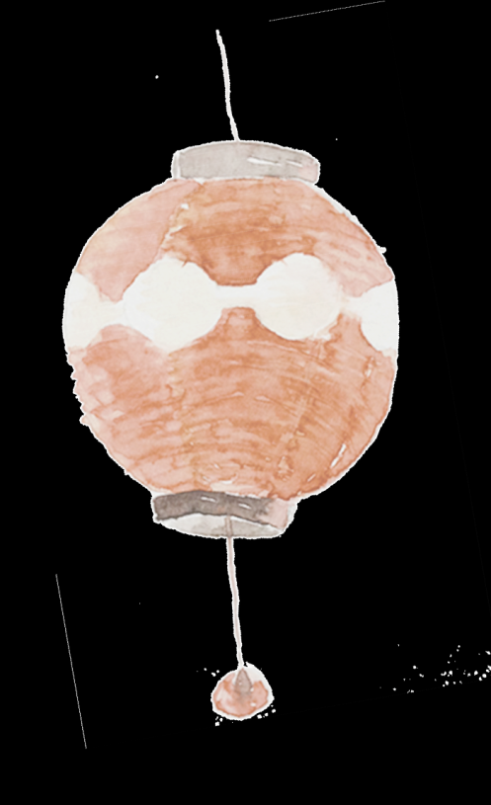
Lead in
Enjoy the following videos.
001licSElx07vOqrJAsU01041200dsOW0E010.mp4
厉害了，我的国，看中华城市繁荣发展 高清(480P).qlv

Slide 5

What makes China it is today despite many ups and downs in its history?
patriotism, Chinese traditional culture, Chinese characters, classical Chinese books...

Slide 6










Warm up
Quick-minded Drill

Slide 7
Prediction
Now, can you predict what we will learn today?

Slide 8
Prediction
Possible answers:
1. Traditional Chinese culture
2. The history of Chinese characters
3. The development of Chinese history…

Slide 9
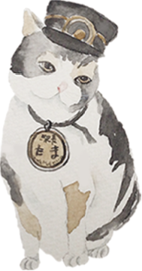
Skimming
Skim the text quickly to find out the main idea.
This text is mainly about the _______ and _______ of Chinese __________.
development
importance
characters
Tip 1：Where can we find the main
idea of the whole text?

Slide 10
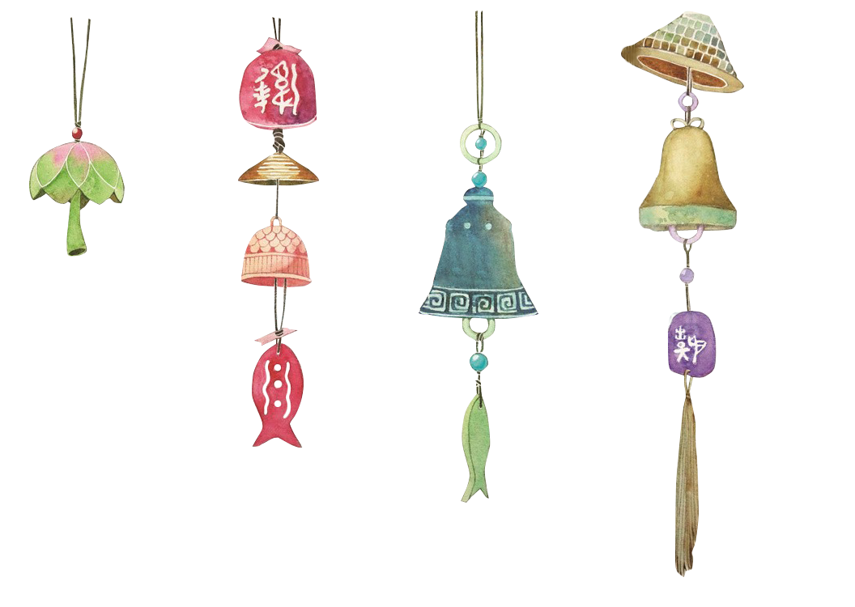
Scan the text to find the words and phrases that describe a time.
By the Shang Dynasty
( around 1600-1046 BC)
At the beginning
Over the
years
Qin Dynasty
(221-207 BC)
Today
( In modern times)

Slide 11
Thinking Drill
Why does the author write the text in chronological order?
It arranges information
according to time.
Make the order of events clear.
Make the passage logical.
Tip 2: When providing the historical background to a topic, it is necessary to describe events in chronological order, or in the time sequence that they occurred.

Slide 12
Tip 3: Can you list some words that represent the chronological order?
at first, to begin with, then, after that, later,
soon, from then on, as time goes by/with time going by, recently/lately, since then,
meanwhile/at the same time,finally/eventually...

Slide 13
Work in groups of four
Read the text carefully again and
make a detailed mind map about the
development of Chinese writing system.

Slide 14
Written Chinese was a picture-based language whose symbol was carved on animal bones and shells.
People can read the classic works written by ancient Chinese.
Chinese writing system has developed into an art form, known as Chinese calligraphy.
A larger number of international students appreciate Chinese culture and history through this amazing language.
The system developed into different forms because of geography, which led to varieties of dialects and characters.
At the beginning
Over the
years
Today
( In modern times)
By the Shang Dynasty
( around 1600-1046 BC)
Qin Dynasty
(221-207 BC)
Emperor Qinshihuang united the seven major states into one unified country where the Chinese writing system began to develop in one direction.
The symbols had become well-developed writing system.

Slide 15
Work in pairs
Think and discuss the following questions.
How did written Chinese unify Chinese people divided by geography and dialects? How did written Chinese connect Chinese people today with those of the past?

Slide 16
Summary
Can you summarize the importance of Chinese characters?
Chinese civilisation has continued all the way through into modern times.
The Chinese writing system is of great importance in uniting the Chinese and culture. Even today, no matter where Chinese people live or what dialect they speak, they can still communicate in writing.
Written Chinese has also become an important means by which China’s present is connected with its past.
People can read the classic works written by ancient Chinese.
Chinese writing system has developed into an art form, known as Chinese calligraphy.
A larger number of international students appreciate Chinese culture and history through this amazing language.

Slide 17
Summary Writing
Directions: Please read the passage again and write a summary of it in no more than 120 words.

Slide 18
Possible version
Chinese writing system plays a significant role in the development
of Chinese ancient civilization. Originally, written Chinese was carved on animal bones, which looked like pictures. As time went by, writing Chinese developed into various dialects and characters because of geography. It's emperor Qinshihuang that unified the country. From then on, Chinese writing system began to develop into one direction.
Nowadays, written Chinese can help people have a connection with its past. People can admire classic works written in ancient times. Chinese characters have developed into an art from named Chinese calligraphy. In addition, more and more foreigners learn Chinese to appreciate Chinese culture and history because China plays a significant part at the world stage.

Slide 19
Homework
Our school will receive exchange students from Britain. Please design a brochure in English to introduce the development and importance of Chinese characters to British friends. Attention should be paid to the combination of pictures and texts.

Slide 20
Thank you！

