Slide 1


感恩遇见，相互成就，本课件资料仅供您个人参考、教学使用，严禁自行在网络传播，违者依知识产权法追究法律责任。
更多教学资源请关注
公众号：溯恩英语
知识产权声明

Slide 2
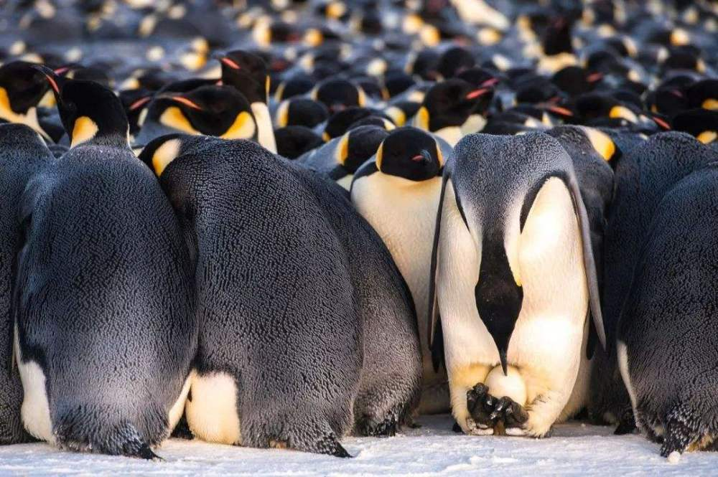
2024年3月广东省一模高三英语
企鹅暖宝宝
Problem-solution 续写手法
傅嘉

Slide 3
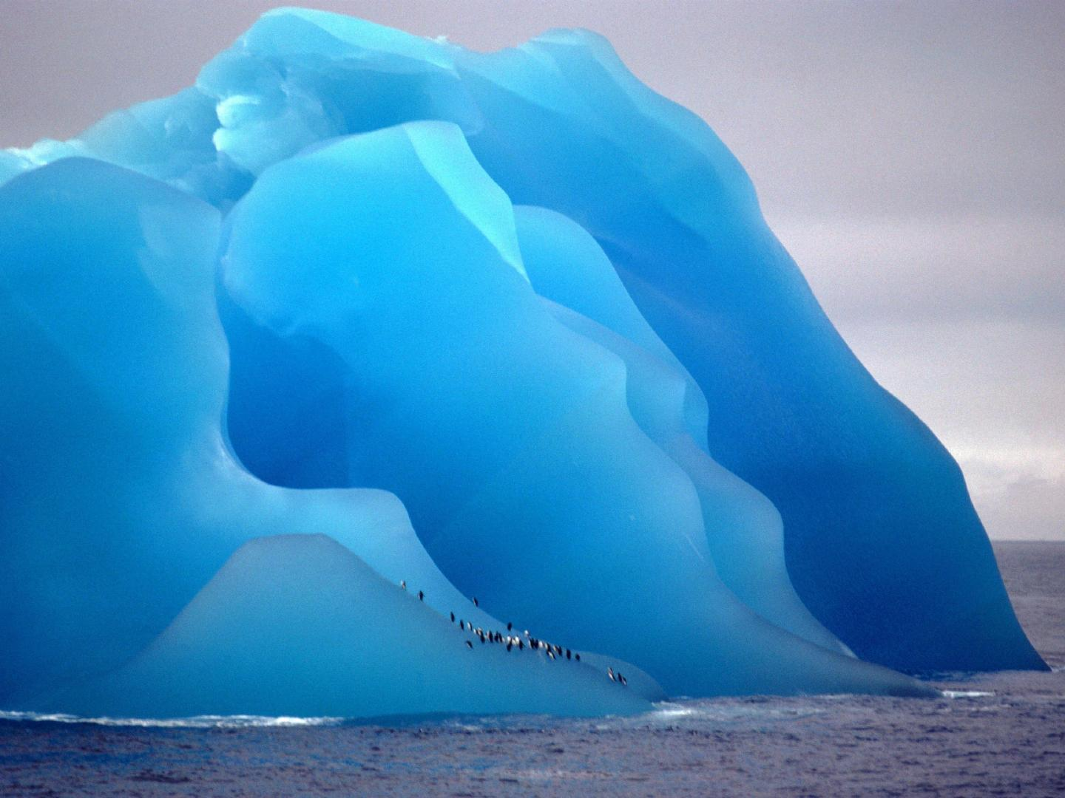

原文本
When Mary entered the south Pole Penguin Research Lab , she saw her friend Tom gently stroking（轻抚）a penguin in his arms. As children of the lab scientists , Mary and Tom often observed the emperor penguins that were studied to understand how they adapted to extreme temperatures —insights that could aid human survival.
"We're thirteen, Tom. It's time to grow up and stop playing with the lab penguins," said Mary as she started cleaning. "They're research animals, not pets. "
" But the birds listen to me！" insisted Tom, his breath forming a cloud in the freezing air. "You're just trying to be a penguin whisperer again." Mary replied, shaking her head with a gentle smile. The penguins seemed playful as they walked, dove, swam and chased their live fish for sport before eating.
Suddenly, an alarm rang out and red lights flashed, signaling a problem. The kids rushed over to look into it. "It's colder than before —there's ice forming on the water," noted Tom. Though always cold, Mary had never seen ice here before. She checked the habitat monitor and found that the temperature had gone down a lot. "The heater must be broken!"
Mary quickly sent a message to their parents' research team, who were conducting outdoor studies. With the adults away, the kids would have to deal with the freezing conditions until help arrived.
Time dragged as Mary and Tom anxiously waited. The increasing cold caused them to shake. “ I wonder what emperor penguins do in extreme cold, since they stay in the Pole all winter instead of going somewhere warmer," asked Mary. "They huddle(挤作 一 团) ," Tom answered. " They huddle together tightly so that the birds in the middle will be warm enough. " " What about the ones on the edge?" Mary asked. "They push their way towards the center, and then move back out to the edge, and struggle back again. Scientists in the early 21st century recorded it. " He replied as he stared at the large crowd of the penguins in the lab.

Slide 4
Read for information
When Mary entered the south Pole Penguin Research Lab , she saw her friend Tom gently stroking（轻抚）a penguin in his arms. As children of the lab scientists , Mary and Tom often observed the emperor penguins that were studied to understand how they adapted to extreme temperatures —insights that could aid human survival.
Q1: What was studied in the lab?

Slide 5
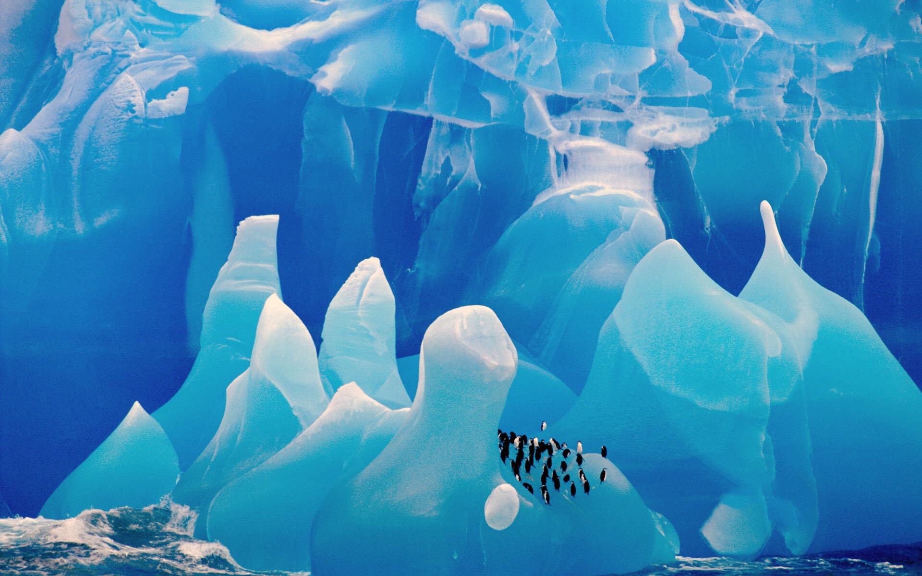
"We're thirteen, Tom. It's time to grow up and stop playing with the lab penguins," said Mary as she started cleaning. "They're research animals, not pets. "
" But the birds listen to me！" insisted Tom, his breath forming a cloud in the freezing air. "You're just trying to be a penguin whisperer again." Mary replied, shaking her head with a gentle smile. The penguins seemed playful as they walked, dove, swam and chased their live fish for sport before eating.
Q2: What were Tom and Mary doing in the lab?

Slide 6
Suddenly, an alarm rang out and red lights flashed, signaling a problem. The kids rushed over to look into it. "It's colder than before —there's ice forming on the water," noted Tom. Though always cold, Mary had never seen ice here before. She checked the habitat monitor and found that the temperature had gone down a lot. "The heater must be broken!"
Q3: What was wrong ?

Slide 7
Mary quickly sent a message to their parents' research team, who were conducting outdoor studies. With the adults away, the kids would have to deal with the freezing conditions until help arrived.
Q4: What did Mary do ?
Q5: What did their
Parents do?

Slide 8
Time dragged as Mary and Tom anxiously waited. The increasing cold caused them to shake. “ I wonder what emperor penguins do in extreme cold, since they stay in the Pole all winter instead of going somewhere warmer," asked Mary. "They huddle(挤作 一 团) ," Tom answered. " They huddle together tightly so that the birds in the middle will be warm enough. " " What about the ones on the edge?" Mary asked. "They push their way towards the center, and then move back out to the edge, and struggle back again. Scientists in the early 21st century recorded it. " He replied as he stared at the large crowd of the penguins in the lab.
Q6: How did they feel?
Q7: What did the penguins do in the extreme cold in the South Pole?

Slide 9
Read for clues
Echo 1
“
When Mary entered the south Pole Penguin Research Lab , she saw her friend Tom gently stroking（轻抚）a penguin in his arms. As children of the lab scientists , Mary and Tom often observed the emperor penguins that were studied to understand how they adapted to extreme temperatures —insights that could aid human survival.
Tom’s insight aided their survival in the
extreme cold.
// helped them to adapt to extreme temperatures in the lab.

Slide 10
"We're thirteen, Tom. It's time to grow up and stop playing with the lab penguins," said Mary as she started cleaning. "They're research animals, not pets. "
" But the birds listen to me！" insisted Tom, his breath forming a cloud in the freezing air. "You're just trying to be a penguin whisperer again." Mary replied, shaking her head with a gentle smile. The penguins seemed playful as they walked, dove, swam and chased their live fish for sport before eating.
Echo2
Tom quickly took action and pushed the crowd of penguins to circle around. What amazed Mary most was that the birds did listen to Tom as if knowing exactly what to do.

Slide 11
Echo3
Thanks to Mary’s message, their parents
got informed of their emergency and came back to the lab
as soon as possible.
Mary quickly sent a message to their parents' research team, who were conducting outdoor studies. With the adults away, the kids would have to deal with the freezing conditions until help arrived.

Slide 12
Time dragged as Mary and Tom anxiously waited. The increasing cold caused them to shake. “ I wonder what emperor penguins do in extreme cold, since they stay in the Pole all winter instead of going somewhere warmer," asked Mary. "They huddle(挤作 一 团) ," Tom answered. " They huddle together tightly so that the birds in the middle will be warm enough. " " What about the ones on the edge?" Mary asked. "They push their way towards the center, and then move back out to the edge, and struggle back again. Scientists in the early 21st century recorded it. " He replied as he stared at the large crowd of the penguins in the lab.
Echo4
Mary and Tom pushed
their way into the middle so as to keep warm. Time ticking by, they moved back out to the edge and strived to go into the center again and again.

Slide 13
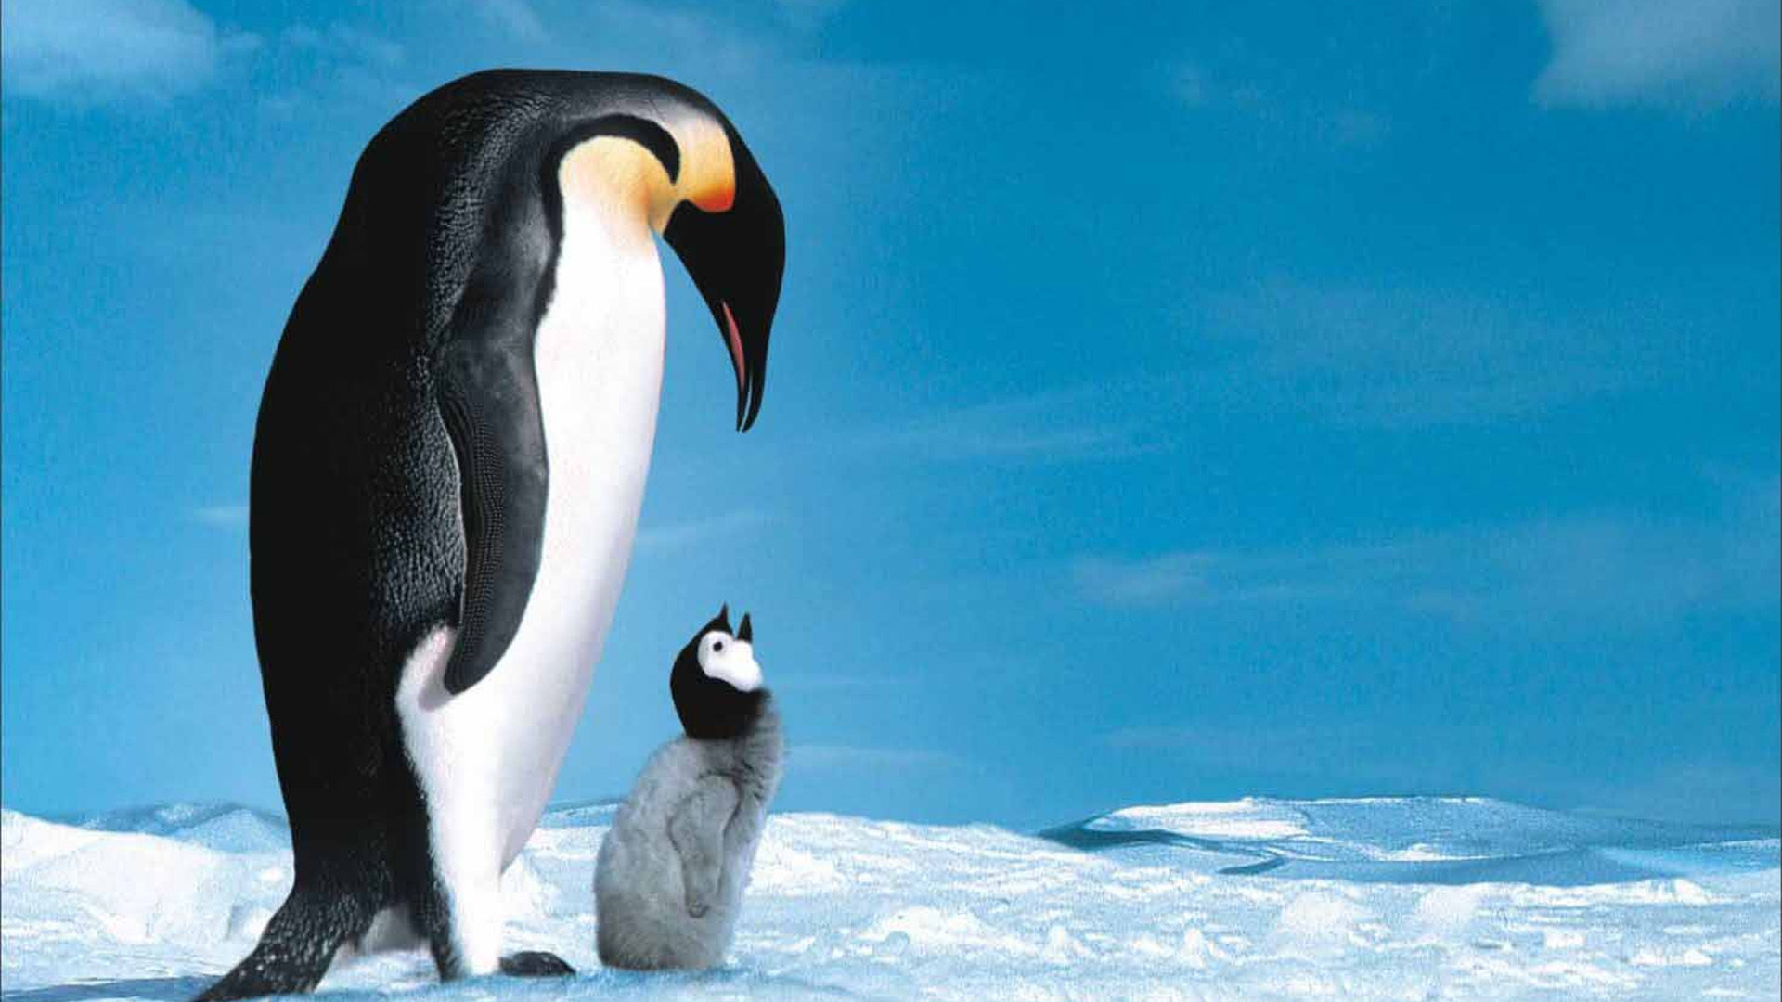
Analysis of the story --- charater and plot
Key role: Tom, Mary
Minor role：parents ,penguins
Place : the south Pole Penguin Research Lab
Cause: the heater in the lab has broken it’s getting colder
How: huddle with penguins to keep warm
Result: Mary and Tom saved themselves by huddling with
penguins to keep themselves warm

Slide 14
Design plots for each paragraph
在设计情节之前 ，考生要有一定的关于南极气温的了解。实验室是科学家研究企鹅的场所，加热器坏了，要进行维修，这个是本文中要解决的一个小问题。关键的首要问题是 两个孩子要和企鹅一起抱团取暖，顺利度过危机，解决实际问题。
南极常识：：南极点终年被冰雪覆盖，年平均气温为零下48度，夏季平均气温为零下25~30度，冬季平均气温为零下55~60度。2022年南极年均气温为-12.1℃，较常年偏高1.0%。

Slide 15
Design plots for each paragraph
Para1:"I have an idea to stay warm." Tom shouted excitedly.
第一段： 结合原文Tom 介绍企鹅是如何在野外抵御严寒的，可推知在加热器坏了的实验室里，两人会和企鹅聚集在一起共同抵御寒冷。把企鹅抵御严寒的方法，在遇到困境时，创造性地进行迁移运用。(本文与2024-1 浙江全国卷读后续写文本十分相似）

Slide 16
Design plots for each paragraph
Para2: Two and a half hours later, the parents returned with help.
思考： help 指什么？
父母赶回实验室，带来了援助。父母的情绪表现如何？接下来专业的人员修好坏了的 heater (解决小问题）；父母表扬孩子反应迅速，面对突发情况，临危不乱，迅速找到解决办法。
专业维修 the heater 的工作人员

Slide 17
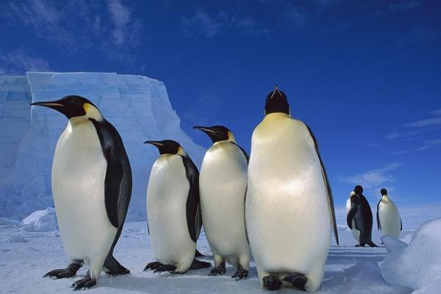
三处衔接1、2处理
" They huddle together tightly so that the birds in the middle will be warm enough. " " What about the ones on the edge?" Mary asked. "They push their way towards the center, and then move back out to the edge, and struggle back again. Scientists in the early 21st century recorded it. " He replied as he stared at the large crowd of the penguins in the lab.
Para1:"I have an idea to stay warm." Tom shouted excitedly.
Link1:
“ We can mimic what the emperor penguins do in the wild! We can huddle together with the lab penguin crowd to keep warm.”

Slide 18
三处衔接1、2处理
Para1:"I have an idea to stay warm." Tom shouted excitedly.
Para2: Two and a half hours later, the parents returned with help.
Link2:
Tom and Mary pushed their way into the middle of the circle ,then came back to the edge and strived to go back to the center to fight against the biting / extreme cold.

Slide 19
衔接处3处理
Para2: Two and a half hours later, the parents returned with help.
Link3:
A: Thanks to Mary’s message, their parents got informed of their emergency and sped back.
B: With anxiety written on their face, the parents searched for their children.

Slide 20
结尾句(句群）处理
Para2: Two and a half hours later, the parents returned with help.
Ending sentences: （回扣原文第一段结尾处的伏笔）
Through the unique experience Mary and Tom realized the meaning of their parents’ scientific work/ research--– Learning how penguins adapt to the extreme temperatures did aid their survival.

Slide 21
各段句间主语平行或交叉进行叙事
Para1:"I have an idea to stay warm." Tom shouted excitedly.
1+2：（ 两个简单句 +阐述an idea ）
“We can mimic what the emperor penguins do in the wild! Let’s huddle together with the penguin crowd here to keep warm!”
3. ( 二连动+ 迅速行动，形成企鹅圈）
Tom quickly took action and pushed the penguins to circle around.

Slide 22
（What 主从 was that 表从+ 拟人手法+企鹅鸟顺从的表现）
What amazed Mary most was that the birds did listen to Tom as if knowing exactly what to do.
（ 夸张手法+ 感叹一下Tom 和企鹅窃窃私语的关键作用）
Being a penguin whisperer played a critical role in such a life-or-death situation!
6. （非谓语+ Mary 点头赞许,钦佩Tom 反应灵光）
Mary, impressed by Tom’s quick thinking, nodded her head to show her approval for this brilliant idea.

Slide 23
7. （ 三连动+ 如何在实践中使用企鹅保暖的方式）
Tom and Mary pushed their way into the middle of the circle ,then came back to the edge and strived to go back to the center to fight against the biting / extreme cold, again and again.

Slide 24
各段句间主语平行或交叉进行叙事
Para2: Two and a half hours later, the parents returned with help.
（with 结构+ 焦急的父母找孩子们）
With anxiety written on their face, the parents searched for their children.
(非谓语动词+ 父母感到欣慰）
Seeing Mary and Tom nestling together with the lab penguins, their parents breathed a sigh of relief.

Slide 25
各段句间主语平行或交叉进行叙事
3. （非谓语+ 救援队的抢修行为）
The rescue team quickly assessed the situation, locating the dead heater and initiating repairs.
4. （简单句+ 实验室气温回升正常水平）
Soon the temperature returned to norm in the lab.

Slide 26
5. （非谓语+ Mary+Tom 心怀感恩）
Overwhelmed with an enormous sense of gratitude, Mary and Tom treated all the penguins to their favorite fish.
6. （简单句 +父母夸孩子们机智、临危不惧）
Their scientist parents thumbed up for their quick mind and bravery in the face of adversity.

Slide 27
7. （定语从句 +人生转折点）
Through the unique experience Mary and Tom realized the meaning of their parents’ scientific work/ research--– Learning how penguins adapt to the extreme temperatures did aid their survival.

Slide 28
习作欣赏
Para1:"I have an idea to stay warm." Tom shouted excitedly.
“We can mimic what the emperor penguins do in the wild! Let’s huddle together with the penguin crowd here to keep warm!” Tom quickly took action and pushed the penguins to circle around. What amazed Mary most was that the birds did listen to Tom as if knowing exactly what to do. Being a penguin whisperer played a critical role in such a life-or-death situation! Mary, impressed by Tom’s quick thinking, nodded her head to show her approval for this brilliant idea. Tom and Mary pushed their way into the middle of the circle ,then came back to the edge and strived to go back to the center to fight against the extreme cold, again and again.

Slide 29
Para2: Two and a half hours later, the parents returned with help.
With anxiety written on their face, the parents searched for their children. Seeing Mary and Tom nestling together with the lab penguins, their parents breathed a sigh of relief. The rescue team quickly assessed the situation, locating the dead heater and initiating repairs. Soon the temperature returned to norm in the lab. Overwhelmed with an enormous sense of gratitude, Mary and Tom treated all the penguins to their favorite fish. Their scientist parents thumbed up for their quick mind and bravery in the face of adversity. Through the unique experience Mary and Tom realized the meaning of their parents’ scientific work/ research--– Learning how penguins adapt to the extreme temperatures did aid their survival.

Slide 30
