Slide 1

感恩遇见，相互成就，本课件资料仅供您个人参考、教学使用，严禁自行在网络传播，违者依知识产权法追究法律责任。
更多教学资源请关注
公众号：溯恩高中英语
知识产权声明

Slide 2
How to Appreciate
a Play
M8U4 Reading
浙江省桐乡市高级中学
沈萃萃
Notes:
www.515ppt.com

Slide 3


Free talk
● Which foreign movie do you like best? Why?
● Which line (台词) in the movie impresses you most?
● Facing teasing and scorn (轻蔑), Forrest Gump, with an IQ of 75, is always kind, honest and brave, which finally helps him achieve incredible success and win respect from others. This movie inspires us to stay true to the original self and remain kind whatever the difficulties.
● Life is like a box of chocolates. You
never know what you’re gonna get.

Slide 4

Free talk
● What elements does a high quality play cover?
Settings of each Act
(time, place, surroundings)
Well-organized and appealing plots (beginning, development, climax, ending)
Pygmalion
Play
Characters with obvious personality
Attractive lines
Clear stage directions
A highlighted theme

Slide 5
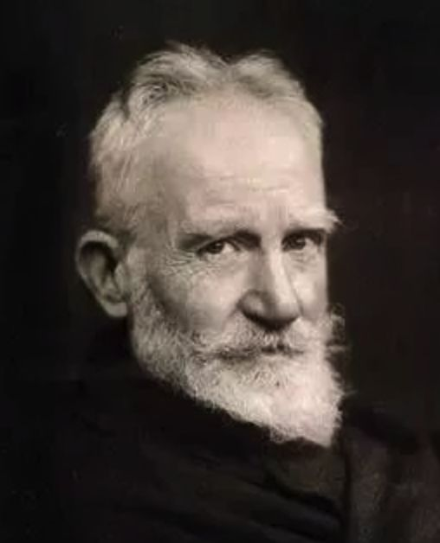
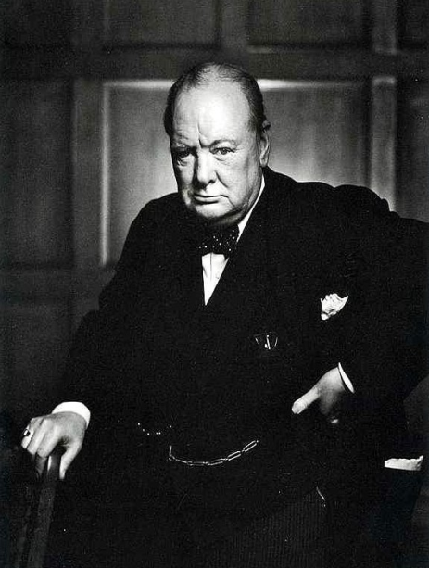
About the author
● An Irish dramatist, a literary critic, socialist spokesman, and humorous playwright.
● A defender of women’s rights, and advocate of equality of income.
● In 1925 he was awarded the Nobel Prize for Literature. He accepted the honor but refused the money.
“You’re so skinny. When people see you, they will know how poor your country is.”
“You’re a meat ball. When people see you, they will know the reason why our country is so poor.”
George Bernard Shaw
(1856-1950)

Slide 6

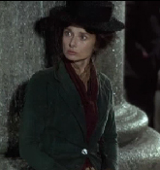
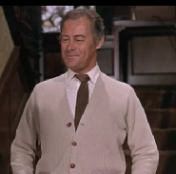
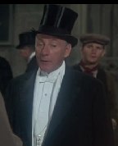
Characters
Social status & personality
lower class
Eliza Doolittle (E): a poor flower girl who is ambitious to improve herself.
a poor flower girl
middle class
ambitious
an expert in
Professor Higgins (H): an expert in phonetics, convinced that the quality of a person’s English decides his/ her position in society
phonetics
convinced
an official in
Colonel Pickering (CP): an official in the army and later a friend of Higgins who sets him a task
the army
a friend of Higgins
upper class
Tip 1 : Characters with different social status and personality help create conflict and make the plot more appealing.

Slide 7
Setting of Act one “ Fateful Meetings”
11:15 pm,
in 1941
London, England,
outside a theatre
rain pouring, cab whistles blowing
Time |  | Place |  | Surroundings
Characters | Appearance | Action
hiding from the rain, listening, watching reactions, making notes
Professor Higgins
wearing dark garments and a woolen scarf
Eliza Doolittle
sheltering from the rain
A gentleman
passing, hesitating for a moment
Tip 2 : The setting of an Act is intended to help the audience picture a particular place or type of surroundings where the Act takes place.

Slide 8
Plot
Lines 1 — 15
● Please find out all the broken sentences by Eliza.
● Can you correct them in terms of grammar and spelling?
❶ Come over’ere, cap’in, and buy me flowers off a poor girl.
Come over here captain, and buy some flowers from a poor girl.
❷ I can giv’ou change, cap’in.
I can give you change, captain.
❸ I ain’t done nothing wrong by speaking to that gentleman.
I haven’t done anything wrong by speaking to that gentleman.
❹ I ain’t no thief. I’m an honest girl I am!
I am not a thief. I’m an honest girl! I am!
poor pronunciation & low social status
● Guess: why does Eliza become Higgins’ target?

Slide 9
Plot
Lines 16 — 58
● Please find out all the stage directions and classify them
into three categories.
gives her a handkerchief
hands over the paper covered in writing
pushes it back at him
reads imitating Eliza
has been watching the girl and now speaks to Higgins
ignores her
carelessly throws a handful of money into her basket
leave together
looking at the collected money in amazement
imitates him
goes out
kindly
still worried
looking confused
rudely
proudly
emotion
action
Tip 3 : Stage directions are instructions in a play to indicate the movements, positions or tones of an actor/ actress, or the sound effects and lighting, which help us to understand the lines and the plot better.
in his own voice
in her own voice
sound effect

Slide 10
Plot
Lines 16 — 58
● What does Higgins think of the newly rich?
● What is Higgins’ plan to transform Eliza?
● What are Higgins’ attitudes towards Eliza and Pickering?
Can you find out the evidence from the play?
They become wealthy financially, but their pronunciation still remains poor, which to some degree reveals their original lower social status.
Higgins will educate Eliza to speak properly so that she can pass herself off in three months as a duchess at an ambassador’s garden party, and perhaps work as a lady’s maid or a shop assistant.

Slide 11
● What social phenomenon can be reflected?
The social status of each character influences the way they behave to each other. Generally speaking, people are more polite to those who they think are of a higher social class and less polite to those they consider are members of a lower class.
❶ you silly girl
❷ (rudely) Look at this girl,
with her terrible English:
the English that will
condemn her to the gutter
to the end of her days.
❸ (ignores her)
❹ (carelessly throws a
handful of money into her
basket
❶ But, sir…
❷ We must have a
celebration, my dear man.
impolite
respectful

Slide 12

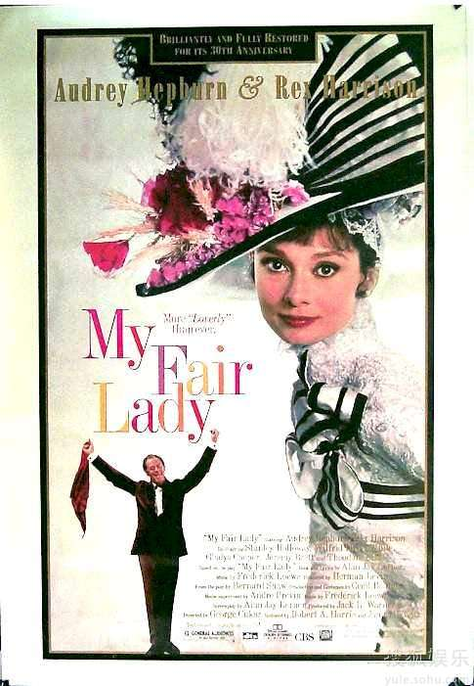
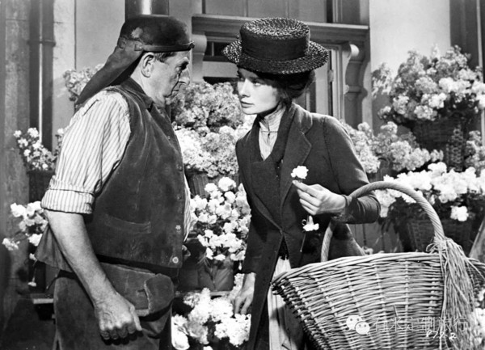
Tip 4 : The attraction of the plot lies in presenting vivid emotions and actions, creating conflict between characters, and reflecting a certain phenomenon that can strike a chord (引起共鸣) with the audience.

Slide 13

Tip 4 : The attraction of the plot lies in presenting vivid emotions and actions, creating conflict between characters, and reflecting a certain phenomenon that can strike a chord (引起共鸣) with the audience.

Slide 14
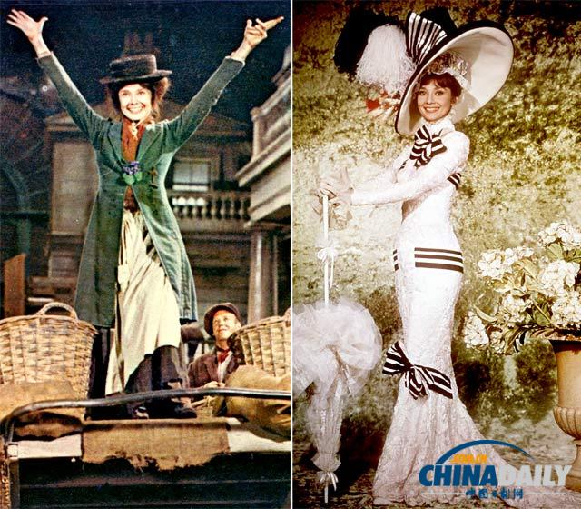
Design the following plot
● Have a discussion in groups of four.
If you were the playwright, how would you continue to
write the play? (What will happen next? What kind of
ending will you design?)
George Bernard Shaw’s version
Higgins is extremely strict with Eliza in educating her to speak properly. In the process, a great many conflicts and funny things come about. Through their persistent efforts, Eliza eventually performs perfectly in a reception dinner hosted by a Greek ambassador and successfully integrates herself into the upper class. Meanwhile, Higgins develops a deep affection for Eliza.

Slide 15
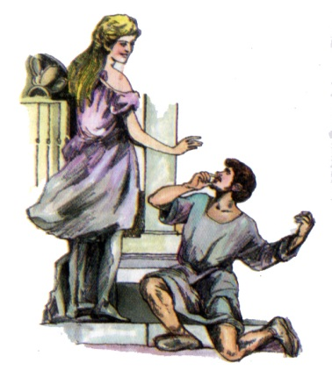
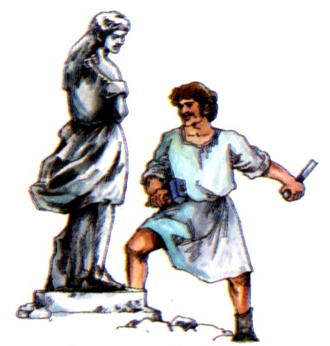
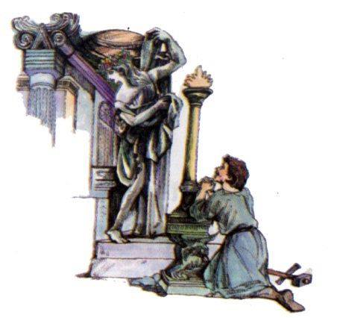
Theme
● Why did George Bernard Shaw title this play “Pygmalion”?
Pygmalion, a gifted artist, makes a stone statue of a beautiful woman.
He asks the Greek Goddess to bring her to life.
Finally, his wish is granted.

Slide 16
Theme
Pygmalion Effect
● Why did George Bernard Shaw title this play “Pygmalion”?
● On the basis of this classic Greek story, can you work out
the theme of the play “Pygmalion”?
The greater the expectation placed on people, the better they will perform.

Slide 17
Ending
As Shakespeare put it, “Life is a stage”.
Everyone is a playwright to create the play of his own.
Everyone is an actor/ actress to determine how to perform on the stage.
As for us now, the College Entrance Examination is also a stage.
So strive to write the best version of your play and perform with all your efforts.
Meantime, keep the Pygmalion Effect in mind.
Always believe you can achieve success and your belief will be granted.

Slide 18
THANKS
Notes:
www.515ppt.com

