Slide 1


感恩遇见，相互成就，本课件资料仅供您个人参考、教学使用，严禁自行在网络传播，违者依知识产权法追究法律责任。
更多教学资源请关注
公众号：溯恩英语
知识产权声明

Slide 2

2024届Z20名校联盟第三次联考
The flowers of May will bloom in your June.
Fay
2024.05
客 观 题 解 析

Slide 3
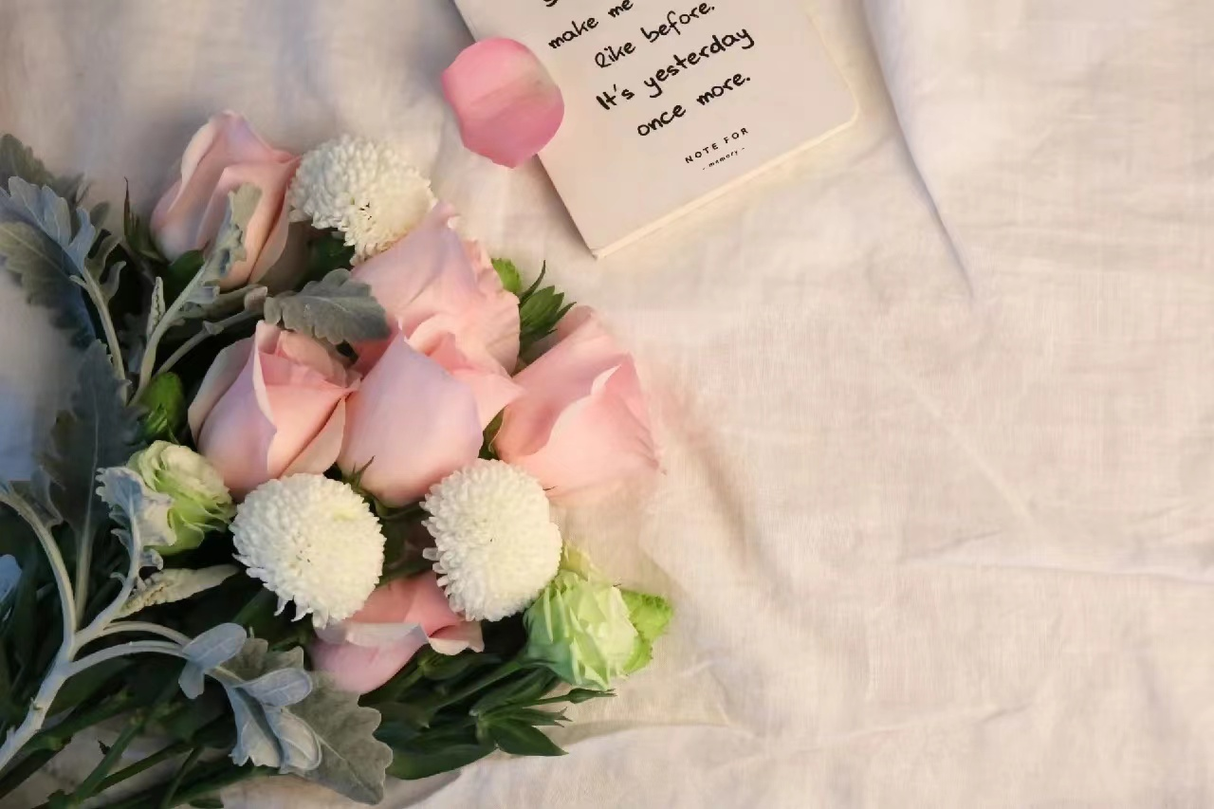
阅 读 理 解
Comprehension

Slide 4






语篇 | 体裁 | 主要内容
A | 应用文 | 音乐剧介绍宣传：《Bring It On》是一部受同名电影启发的作品，讲述了主角Campbell在被迫转到新学校后，如何与舞蹈团队合作，克服挑战，共同参加全国啦啦队锦标赛的故事。该剧汇集了百老汇顶尖创意人才，为观众提供了一个充满活力和多样性的娱乐体验。
B | 记叙文 | 讲述了马拉维少年威廉·卡姆卡瓦姆巴在辍学和饥荒的逆境中，通过自学和创新，利用风力发电技术为村庄带来电力，最终成为达特茅斯学院毕业生的励志故事。
C | 说明文 | 文章介绍了建筑师诺曼·福斯特在卡塔尔设计的卢塞尔塔，其设计融合了创新材料和环保技术，旨在成为该地区金融和公共空间的新地标。
D | 说明文 | 研究揭示了由于自花传粉增加，现代三色堇体型缩小、花蜜减少，这不仅影响了传粉昆虫，还可能减少植物的遗传多样性，加速传粉昆虫数量的下降，从而威胁生态系统的稳定性。
七选五 | 应用文 | 文章为计划独自旅行的人提供四个贴士：自主规划行程、与当地人交流、遇到不顺时候的建议、从小规模旅行开始，以增强信心和适应独立旅行。

Slide 5
Bring It On: The Musical
①Bitingly relevant and inspired by the hit film of the same name, Bring It On takes audiences on a high-flying journey that is filled with the complexities of friendship, forgiveness and self-definition.
②Uniting some of the freshest and funniest creative minds on Broadway, Bring It On features an original story by Tony Award winner Jeff Whitty, music and lyrics by Tony Award-wining composer Lin-Manuel Miranda, and music supervision by Tony and Grammy Award winner Alex Lacamoire. The production is directed and staged by Tony Award winner Andy Blankenbuehler. It was proposed as a candidate for the Tony Award for Best Musical.
③ Campbell, the main character, is a cheer-leading star at Truman High School and her senior year should prove the most joyful -- she's been named captain of the team! However, an unexpected redistricting has forced her to spend her final year of high school at the neighboring Jackson High School. Despite challenges Campbell befriends the school's dance crew. Together with their headstrong and hardworking leader, Danielle they form a powerful team for the ultimate competition the National Championships.
④ The show's name alone will fill the seats, and audience's word of mouth will pack the house. With a colorful variety of characters and an exciting fresh sound, Bring It On is sure to be everything that you hoped for.
21B
特征 | A short story (短篇故事) | An introduction to a theater (剧院介绍) | A film review (电影评论) | An advertisement of a play (剧本广告)
目的 | 娱乐和启发思考 | 提供关于剧院的信息 | 评估电影并提供意见 | 推广剧本并吸引观众
结构 | 通常包含情节、角色、设定和主题 | 信息可能包含历史、设施和即将上演的剧目 | 包括电影简介、分析和评价 | 突出剧的特点，如情节、演员、导演和特别推荐
内容 | 虚构或真实的叙述 | 关于剧院的历史、目标和运营细节等 | 对电影的艺术和娱乐价值的分析 | 关于剧的演出信息和卖点
22A
22. What can we learn about The Musical Bring It On?
23. What is the text?
A short story. B. An introduction to a theater
C. A film review. D. An advertisement of a play.

Slide 6
①18 years ago, a 14-year-old boy from Kasungu district in Malawi was forced to drop out of school for lack of fees. At the same time, a severe famine was destroying his village, claiming people's lives and leaving desperation in its wake.
②This was a situation to break the strongest of minds but William Kamkwamba did not give up. Young as he was, he knew that education was where his future lay. He found hope in the library and feasted on the knowledge that he harvested from its books. It was there that he came across a science textbook entitled Using Energy. He learned that he could generate electricity using wind. The youngster realized that, if mastered, this power could help his village in exceptional ways.
③Armed with determination and an iron will, the teenager set out to build a windmill out of random materials from a scrapyard (垃圾场). Though his outside world was collapsing to dust, the youngster did not hesitate about his purpose. He defended himself from all doubt and criticism. He worked tirelessly until his dream of bringing electricity to his village became reality. Soon, he was caught in the center of media attention that took him to new places that he would never have stepped on without his invention
④In his village, the dust has not settled yet and the winds of change continue to blow across the land. Windmills pump water to irrigate crops, sweeping away another period of hunger. William's former primary school boasts new and stronger buildings, thanks to the help of well-wishers and the villagers united efforts.
⑤What seemed like a hopeless situation has been turned into an inspirational story that motivates each and every one of us, persuading us that no misfortune is set in stone. William refused to be a school drop-out forever. He sought solutions for his problems and continued fighting even when the going got tough. He was able to rise above poverty to become a graduate from one of America's best universities, Dartmouth College.
24C
25A。 CD未提及
27.B
A. 知识滋养心灵，教育承诺财富。
B. 需要激发发明，困难造就英雄。
C. 批评促进成功，怀疑促进创造。
D. 逆境激发灵感，支持推动解决方案。
25B信息不符
27B。 CD未提及
直达C篇
直达词句

Slide 7

核心词汇
英文 | 中文 | 英文例句 | 中文翻译
In its wake | 在...之后，留下...的后果 | The hurricane left devastation in its wake. | 飓风过后留下了一片废墟。
Feast on | 尽情享用，大吃特吃 | We feasted on fresh seafood during our beach vacation. | 在海滨度假期间，我们尽情享用了新鲜的海鲜。
Harvest from | 从...中收获 | The farmers harvested from the fertile land all year round. | 农民们全年都在这片肥沃的土地上耕作。
In exceptional ways | 以非凡的方式 | The artist approached the subject in exceptional ways. | 艺术家以非凡的方式处理这个主题。
Set out to | 着手，开始尝试 | She set out to prove her theory with new experiments. | 她开始通过新的实验来证明她的理论。
Be caught in | 被卷入，陷入 | He was caught in the crossfire between the two companies. | 他被卷入了两家公司之间的纷争。
Step on | 踩上，踏上 | She stepped on the dance floor with grace. | 她优雅地步入舞池。
Set in stone | 成为定局，不可改变 | The contract details are not set in stone and can be negotiated. | 合同细节尚未定案，可以协商。
Collapse to dust | 崩溃成尘，彻底瓦解 | The old building eventually collapsed to dust after years of neglect. | 那座旧建筑在多年失修后最终彻底坍塌成尘土。

Slide 8
美句赏析
At the same time, a severe famine was destroying his village, claiming people's lives and leaving desperation in its wake.
与此同时，一场严重的饥荒正在摧毁他的村庄，夺走人们的生命，并留下绝望。
Young as he was, he knew that education was where his future lay.
尽管他还很年轻，但他知道教育是他未来所在。
Armed with determination and an iron will, the teenager set out to build a windmill out of random materials from a scrapyard.
带着决心和坚定的意志，这位少年开始用废品场里随机的材料建造风车。
Though his outside world was collapsing to dust, the youngster did not hesitate about his purpose.
尽管他的外部世界正土崩瓦解，这个年轻人并没有对他的目的犹豫。
He defended himself from all doubt and criticism.
他抵御了所有的怀疑和批评。
He worked tirelessly until his dream of bringing electricity to his village became reality.
他不懈地工作，直到他为村庄带来电力的梦想成为现实。
Soon, he was caught in the center of media attention that took him to new places that he would never have stepped on without his invention.
很快，他成为了媒体关注的中心，这带他去到了没有他的发明就永远无法踏上的新地方。
What seemed like a hopeless situation has been turned into an inspirational story that motivates each and every one of us, persuading us that no misfortune is set in stone.
看似无望的处境已经转变为激励我们每一个人的励志故事，说服我们没有不幸是不可改变的。

Slide 9
素材运用
假定你是李华，你校的英语报正在征稿。请你结合以下名人名言，写一篇题为"Where there's a will, there's a way." 。内容包括：
1. 你对该名言的理解；2. 结合实例；3. 你对该名言的感悟。
A possible version:
The famous quote "Where there's a will, there's a way" is taken as a motto by many people as an illustration of the power of persistence in a tight corner.
William Kamkwamba, a 14-year-old boy, who was forced to drop out of school for lack of fees never gave up his dream to help his poor village. Armed with determination and an iron will, the teenager set out to build a windmill out of random materials. Though his outside world was collapsing to dust, the youngster persevered towards his goal despite the doubt and criticism he faced. He worked tirelessly until his dream of bringing electricity to his village became reality.
The boy’s true story profoundly impacted me, enabling me to grasp the essence of the quote--- what seemed like a hopeless situation can be turned into an inspirational story that inspire and motivate us all, persuading us that no misfortune is set in stone. Always bear in mind that it is our persistence that will ultimately lead us to success.
范文仅供参考

Slide 10
①Lord Norman Foster, renowned as one of the world's foremost architects, has devoted decades to redefining the concept of tall buildings. “What we've done is create a sense of identity drawn from real needs," Foster said. "It's not a fashionable idea, but generated from the realities we were in." His masterpiece includes iconic structures such as the HSBC building in Hong Kong. Now, he's set his sights on Qatar.
②Currently nearing completion and set to reach a height of 301 meters, Foster's Lusail Towers are ready to claim the title of Qatar's tallest buildings. Lusail Towers are intended to serve as a center for Qatar's financial institutions, with four distinctive blocks, two standing at 70 stories and two at 50 stories.
③ But the construction itself wasn't all plain sailing. To address the unique challenges presented by Qatar's hot climate, Foster's team had to depart from the materials commonly used in skyscrapers in cooler countries - part of what Foster called a decades-long quest to “reinvent the tall building." The design combines advanced shading with ventilation, while the towers' surfaces are coated with “marine-grade" aluminum that wraps around the buildings, protecting the glass from strong sunlight while maintaining the views and still letting in natural light. Central to the project are special shading fins, which not only optimize views and natural lighting for occupants but reduce solar radiation by 70% compared to traditional all-glass towers.
④While the towers are ready to become a recognizable landmark for Lusail, Foster believes that a city's skyline reflects what lies beneath the surface. It was crucial to integrate the towers into a "low-scale master plan." They are strategically positioned on top of a subway line and at the end of a commercial avenue linking the waterfront to the nearby football stadium. According to Foster, the ground features of the plaza will play a significant role in the objective of transforming the area into a lively public space for the future.
28D
29B
30A
31C . to offer a dynamic/lively public space for the future

Slide 11
核心词汇
英文 | 中文 | 英文例句 | 中文翻译
Be renowned as | 作为...而著名 | The school is renowned as a center for innovation and critical thinking. | 这所学校作为创新和批判性思维的中心而闻名。
Set his sights on | 瞄准，致力于 | He set his sights on getting into a top university after high school. | 高中毕业后，他立志要进入一所顶尖大学。
Be intended to | 旨在，意在 | The new curriculum is intended to develop students' practical skills. | 新课程旨在培养学生的实践技能。
Plain sailing | 一帆风顺，轻松顺利 | After the initial challenges, the rest of the project was plain sailing. | 初始挑战之后，项目的其余部分进展顺利。
Depart from | 离开，违背 | She never departs from her study routine, even during holidays. | 即使在假期，她也从不偏离她的学习计划。
Be coated with | 被...覆盖 | The school's sports field is coated with fresh snow, perfect for a winter break. | 学校的体育场被新雪覆盖，非常适合寒假玩耍。
Optimize views | 优化视野 | The new classroom windows optimize views of the garden, enhancing the learning environment. | 新教室的窗户优化了对花园的视野，增强了学习环境。
Integrate …into | 融入，整合 | The school has successfully integrated technology into every aspect of teaching. | 学校已成功地将技术融入教学的每一个方面

Slide 12
①An ancient, interdependent relationship that contributes to food systems and ecosystem stability across the globe could be changing.
②Many flowering plants can self-pollinate (自花传粉), or transfer pollen between their own blossoms for seed generation and reproduction, but most of these plants have relied on pollinators such as butterflies and bees to reproduce. Now - during declines reported in many pollinator populations — a new study on the evolution of one flower species' mating system has revealed a remarkable change that could worsen the challenges faced by the plants' insect partners.
③The flowers' reproductive evolution may be linked to environmental changes such as habitat destruction and rapid ongoing decreases in pollinator biodiversity, according to Samson Acoca-Pidolle, who led the study published December 19 in the journal New Phytologist.
④Comparing seeds of wild field pansies(三色堇)collected decades ago in France with the plants modern descendants, Acoca-Pidolle and his colleagues discovered that today's flowers are smaller and produce less nectar (花蜜) as a result of increased self-pollination, which has direct impacts on pollinator behavior. The pansies of the past self-fertilized less and attracted far more pollinators than those of the present, according to the study.
32C
比照对象 | 过去的三色堇 | 现代三色堇 | 结论
花朵大小 | 大 | 小 | 现代花朵由于自花传粉而变得更小
花蜜产量 | 多 | 少 | 现代花朵产生的花蜜较少
自花传粉 | 少 | 多 | 自花传粉的增加导致了花蜜产量的减少
传粉者吸引力 | 吸引更多传粉者 | 吸引较少传粉者 | 现代花朵对传粉者的吸引力下降
对传粉者的影响 | 正面 | 负面 | 自花传粉的增加直接影响了传粉者的行为
33.Why were pansies in the past larger and produced more nectar?
A.They self-pollinated less. B.They had a better mating system.
C.They attracted less pollinators. D.They were fertilized by themselves.

Slide 13
⑤ "It seems that it's only traits (特性) that are involved in plant-pollinator interaction that are evolving,’ said Acoca-Pidolle. The changes could restrict the plants' ability to adapt to future environmental changes and have implications for “all of floral biodiversity" — potentially decreasing flowering plants' genetic, species and ecosystem variation.
⑥"This may increase the pollinator decline and cause a negative feedback cycle," study coauthor Pierre-Olivier Cheptou told CNN. “If plants produce less nectar, there will be less food available to pollinators, which will in turn accelerate the rate at which the animals' numbers decrease", he explained.
⑦"The major message is that we are currently seeing the evolutionary breakdown of plant pollinators in the wild,' said Cheptou, an evolutionary ecologist at the French National Centre for Scientific Research and professor at the University of Montpellier.
文章的焦点在于开花植物的自花传粉对传粉者种群的潜在负面影响。
34.What is the result of the changes in the flowers' reproductive evolution?
A.The flowering plants may have more variations.
B.The evolution of wild plant pollinators is collapsing.
C.The numbers of the animals will increase more rapidly.
D.The plants will adapt to the environmental changes better.
35.Which is the best title for the text?
A.Pollinator Populations: Declining. B.Flowering Plants: Selfing.
C.Interdependent Relationship: Maintaining. D.Floral Diversity: Increasing.
breakdown
开花植物：自花传粉
传粉者种群：减少
相互依存的关系：维持
花卉多样性：增加

Slide 14

七 选 五
Comprehension

Slide 15

A.You are the boss of your own adventure.
B.You need to make an unusual travel choice.
C.It's no secret that solo travel is on the rise.
D.Sometimes things can go incredibly wrong.
E.People like you simply don't know how to start.
F.Most of the time people are just curious and try to be friendly.
G.Remember, your first solo trip doesn't have to be to a whole other continent.
你的冒险由你自己掌控。
B. 你需要做出非同寻常的旅行选择。
C. 一个人旅行越来越受欢迎，这已经不是秘密了。
D. 有时候事情可能会出奇地糟糕。
E. 像你这样的人不知道如何开始。
F. 大多数时候，人们只是好奇，试图友好。
G. 记住，你的第一次单独旅行不一定要去一个完全不同的大陆。

Slide 16
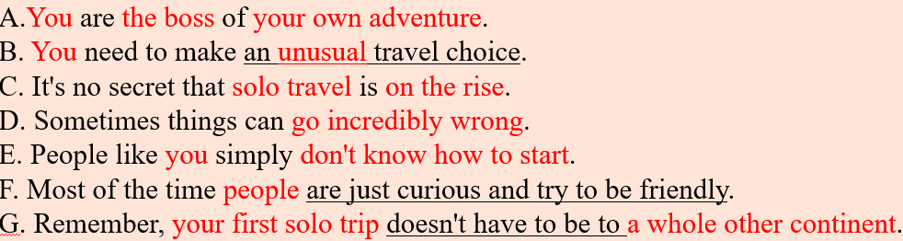
Things To Remember On Your First Solo Travel Adventure
If you've ever thought about just taking a trip yourself instead of waiting for someone to join you, you're not alone._ 36 However, do you count yourself among the many who have tried it? If you're planning your own solo trip, here are four important things to keep in mind.
37 Since you're traveling solo, how you choose to explore it is entirely up to you. This is your chance to do whatever you want whenever you want because this time, you're running the show.
Don't be afraid to talk to random people. Though there is someone who poses a threat, it's important to remember that not everyone is out to get you. 38 That's because you're a novelty, a person from another country who is visiting theirs. Therefore, instead of putting on your headphones or instantly seeing them as weirdos, use this spontaneous chat as a chance to meet the locals or get recommendations for things to do during your trip.
It's okay to have bad days. 39 It happens and it's completely okay to take some time to process whatever it is you're feeling. Take yourself to a movie or spend the day dong something relaxing like writing in your journal or reading on the beach.
It's okay to start small. 40 Start by doing a staycation in another part of town, spending a few days in a new locale a bus or train ride away. Just do whatever you're comfortable with and see how it all feels for you.
36.C：承上启下—指代一致，内容一致
37.A：中心总结—指代一致，内容一致
38.F：承上启下—指代一致，因果逻辑
39.D：承上启下—指代一致bad days，内容一致,结合下文给出的应对方式
40.G：承上启下—指代一致，内容符合主旨，结合下文例举的“小”地方
38. not everyone is out to get you并非每个人都想伤害你

Slide 17

完 形 填 空
C l o z e

Slide 18
①One day, hundreds of people were stuck in traffic on the highway in below-freezing temperatures due to a snowstorm. With the conditions making it 41 for rescue workers to help, many were trapped overnight with no access to 42_.
②But one stuck driver found a _ 43 _spot in the despair. As she was sitting in her car fearing the 44 Casey Holihan and her husband, John Noe, 45 a bread truck just ahead of them in the jam. Willing to try just about anything, they called the customer service number listed on the back of the truck and left a 46 begging for the driver to open the back and 47 _bread to the hungry passengers around them.
③It was a last-ditch effort, and the couple wasn't very 48 about getting a response. But to their 49, they soon received a phone call from the company's owner, Chuck Paterakis, with the news that he was 50 the truck's driver to open up and pass out loaves of bread from his cargo. Overjoyed by the news, Holihan and Noe 51 the truck's driver to bring much-needed things to the cars around them.
④The simple loaves of bread were surely a ray of 52 in an impossibly disturbing situation. Holihan herself calls it “one of the 53_moments” she's ever witnessed. This company could have made a(n) 54 from the bread but instead chose to help the people around them. That is just so incredible that someone chose 55 over profit, especially in a situation where people were so desperate.
文章讲述了在一场暴风雪中，数百人被困在高速公路上。Casey Holihan和丈夫John Noe在堵塞中发现一辆面包货车，他们联系车主请求分发面包给其他司机。公司老板同意了，他们的行为为绝望中的人们带来了希望，展现了人性的善良有爱。

Slide 19
①One day, hundreds of people were stuck in traffic on the highway in below-freezing temperatures due to a snowstorm. With the conditions making it 41 for rescue workers to help, many were trapped overnight with no access to 42_.
一天，由于暴风雪，数百人在高速公路上被冻在冰点以下的温度下。由于天气条件，使得救援工作者__41__去帮助，许多人被困一夜，无法获得__42__ 。
②But one stuck driver found a _ 43 _spot in the despair. As she was sitting in her car fearing the 44 Casey Holihan and her husband, John Noe, 45 a bread truck just ahead of them in the jam. Willing to try just about anything, they called the customer service number listed on the back of the truck and left a 46 begging for the driver to open the back and 47 _bread to the hungry passengers around them.
但是一位被困的司机在绝望中找到了 43 。当她坐在车里，担心着最 44_和她的丈夫John Noe，他们在交通堵塞中 45 前方有一辆面包车。他们愿意尝试任何可能的方法，于是拨打了面包车上标明的客服电话，并留下了一 46 ，恳求司机打开车厢， 47 面包给周围饥饿的乘客。
41.A.stressful B.effortless C.practical D.difficult
42.A.water B.necessities C.bread D.blankets
43.A.new B.familiar C.bright D.strange
44.A.least B.best C.most D.worst
45.A.spotted B.realized C.stared D.knew
46.A.number B.message C note D.clue
47.A.lend B.sell C.distribute D.send

Slide 20
③It was a last-ditch effort, and the couple wasn't very 48 about getting a response. But to their 49, they soon received a phone call from the company's owner, Chuck Paterakis, with the news that he was 50 the truck's driver to open up and pass out loaves of bread from his cargo. Overjoyed by the news, Holihan and Noe 51 the truck's driver to bring much-needed things to the cars around them.
这是一次孤注一掷的努力，这对夫妇并不 48 能得到回应。但令他们 49 ，他们很快就接到了公司老板Chuck Paterakis的电话，告知他们他正在 50 货车司机打开车厢，分发他货物中的面包。听到这个消息，Holihan和Noe感到非常高兴，并 51 货车司机为周围的车辆带去了急需的物品。
④The simple loaves of bread were surely a ray of 52 in an impossibly disturbing situation. Holihan herself calls it “one of the 53_moments” she's ever witnessed. This company could have made a(n) 54 from the bread but instead chose to help the people around them. That is just so incredible that someone chose 55 over profit, especially in a situation where people were so desperate.
这些面包无疑是在一个极其令人不安的情况下的一线 52 。Holihan本人称这是她所见证过的“最 53 之一”的时刻。这家公司本可以从面包中 54 ，但却选择帮助周围的人。有人在这样的危急时刻选择了 55 而非利润，这真是难以置信，特别是当人们如此绝望的时候。
keep up with - 保持同步或了解最新情况
team up with - 与...合作或组队
meet up with - 与...见面或偶遇
put up with - 忍受或容忍
48.A.upset B.optimistic C,excited D.anxious
49.A.relief B.regret C.surprise D.credit
50.A.consulting B.guiding C.begging D.instructing
51.A.kept up with B.teamed up with C.met up with D.put up with
52.A.hope B.truth C.inspiration D.faith
53.A.happiest B.bravest C.kindest D.friendliest
54.A.profit B.difference C.living D.contribution
55.A.welfare B.fame C.award D.humanity

Slide 21

语 法 填 空
本文描述了设计师王自健的获奖茶壶设计“出水龙”，该设计融合了中国传统文化元素，受到年轻消费者的喜爱，并反映了近年来中国时尚产品的流行趋势。

Slide 22
The Year of the Dragon comes with inspiration for creativity and the power to bring big ideas 56 life.
Designer Wang Zijian's Dragon Out of Water, a creative tea infuser (泡茶器), shines on the wall at the exhibition of the winning works of the 2024 Global Zodiac Design Competition at the Beijing Overseas Cultural Exchange Center. 57 (it)cute dragon design and special function are bound to appeal to young consumers. “It’s 58 unique product, and we expect a positive response from young customers,” Wang told Beijing Review.
The item belongs to China Chic,or guochao, also 59 (know) as “national wave”, 60 refers to products of all sorts including traditional Chinese cultural elements. These products 61 (embrace) by the country's younger generations in recent years. According to a report by Xinhua News Agency, Gen Z 62 (account) for 74 percent of consumers of China Chic goods in 2022, and the search volume of China Chic products has increased five times over the past decade.
As a young designer, Wang hopes 63 (capture) young consumers with his creative interpretation of dragons. “I've been 64 (thorough) studying the dragon's historical connotations(言外之意) and the 65 (psychology) characteristics of Gen Z consumers," the 34-year-old designer told Beijing Review.
56.Bring …to/into life把……带入生活
57.Its 考察所有格
58.a 考察冠词
59.known 考察非谓语
60.which 考察定语从句
61.have been embraced 考察完成时+被动
62.accounted考察谓语动词时态 account for占比；解释，说明；引起；
In this study, 30% of the errors are accounted for by human mistakes. 在这项研究中，30%的错误归因于人为失误。
62.to capture考察非谓语
64.Thoroughly考察形容词副词词性
65psychological考察词性转换

Slide 23


May the flowers of May will bloom in your June.

