Slide 1
感恩遇见，相互成就，本课件资料仅供您个人参考、教学使用，严禁自行在网络传播，违者依知识产权法追究法律责任。
更多教学资源请关注
公众号：溯恩高中英语
知识产权声明

Slide 2
高考英语阅读理解 专项突破1
· 主旨大意
· 推理判断
· 词义猜测
· 细节理解
· 语篇连贯

Slide 3
第四课
推理判断
(情感态度)

Slide 4
一、《考试说明》要求
阅读文章的主要目的是获取信息，即作者所要传达的信息。在实际的阅读活动中，有时需要根据文章提供的事实和线索，进行逻辑推理，推测作者未提到的事实或某事发生的可能性等。
1. 作出简单判
断和推理
2. 理解作者的
意图、观点
和态度
1
每篇文章都会向作者传达某个信息，但这些信息通常并不是明确表达出来的，而是隐含在文章之中。因此，这类问题要求考生在理解文章总体内容的基础上，去领会作者的言外之意。

Slide 5
二、推理判断题的类型
· What’s the writer's attitude towards the
Yellowstone wolf project?
· What's Friedman' attitude towards America's
future ?
1. 情感态度
2. 文章细节
3. 文章出处
1
· What can we infer about...in Paragraph 1?
· What can we learn from the first four paragraphs?
· Where is this text most likely from?
· In which section of a newspaper may this text
appear?

Slide 6
三、推断情感态度
1. 浙江卷对“情感态度推断”的考查：
1
2020.1 | A篇 | 推断小时候遇到的一个图书管理员Mrs. Calloway的性格特点
2018.6 | C篇 | 推断Friedman对美国未来发展的态度
2016.10 | A篇 | 推断Kate冒着生民危险救人路上的情况
2016.10 | C篇 | 推断员工对远程工作的态度
推断人(事)物品质
Which of the following words best describe...?
推断态度观点
What's the writer's attitude towards...?

Slide 7
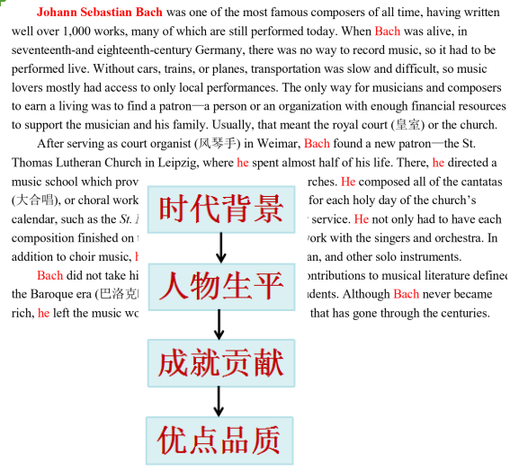
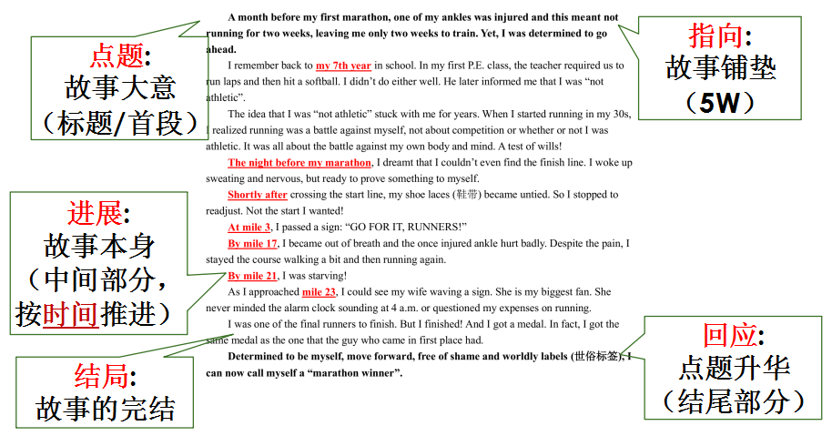
1. 推断人(事)物品质语篇的结构
抓住人物的
言行举止

Slide 8
1. 推断人(事)物品质
I never knew anyone who’d grown up in Jackson without being afraid of Mrs. Calloway, our librarian. She ran Jackson’s Carnegie Library absolutely by herself. SILENCE in big black letters was on signs hung everywhere. If she thought you were dressed improperly, she sent you straight back home to change your clothes. I was willing; I would do anything to read.
Mrs. Calloway made her own rules about books. You could not take back a book to the library on the same day you’d taken it out; it made no difference to her that you’d read every word in it and needed another to start. You could take out two books at a time and two only...
Tips：
找到所问人物
定位一言一行
关注修饰词
21. Which of the following best describes Mrs. Calloway?
A. Quiet. B. Strict
C. Humorous. D. Considerate.

Slide 9
▶Practice
In wind and rain she started on her difficult way. Soon she was at the bridge that crossed the Des Monies River. a bridge also built of wood, just like the bridge across Honey Creek. The storm has not washed this away, but there was no footpath across it. She would have to cross it by stepping from sleeper (枕木) to sleeper. With great care she began the dangerous crossing, sometimes on her hands and knees, hardly daring to look down between the sleeper into the wild flood waters below. If she should slip, she would fall between the sleepers, into the rapidly flowing steam.
At last—she never knew how long it had taken her—she felt solid ground under her feet...
22. Which of the following words best describes Kate's journey?
A. Fruitless. B. Boring. C. Well-planned. D. Risky.

Slide 10
▶Practice
Today, Dakin’s organization, WomensTrust, provides loans and scholarships to over 1,000 women in several villages in Ghana. It also brings medical supplies and care to health clinics in the area. The people of Ghana have benefited greatly from WomensTrust, and many of the volunteers have found meaningful work in the final third of their lives.
23.Which of the following best describes Dakin?
A. Inspiring and devoted. B. Mature and simple.
C. Tough and frustrated. D. Carefree and positive.

Slide 11
▶其他题目
Dana Dakin spent many years building a successful career in finance. Then she heard about the concept of living life in thirds. The first third was to be spent learning, the second spent making money, and the third spent giving back. In 2003, when Dakin reached 60, she decided it was time to start giving back. Her plan was to travel to Ghana, Africa, and find a village to “adopt.” She would provide microfinance loans (small amounts of money) to women to help revitalize the economic life of the village and its inhabitants.
21.How did Dana Dakin spend the first two-thirds of her life?
A. Receiving and giving. B. Traveling and spending.
C. Learning and earning. D. Providing and helping.

Slide 12
▶其他题目
Dakin ended up in Pokusae, where she met, and began building relationships with, the local women. She developed a program to provide microfinance loans to help the woman start their own businesses, usually selling things such as food, clothing, or household items. The businesses have helped the community, as well as individuals who run them. Dakin brought together volunteers, both retired executives (执行官) and college students who traveled with her to Pokuase to help the villagers learn how to run a small business. Together everyone involved became successful.
22. Dakin’s work has helped other people learn .
A. that retirement is a time for relaxation.
B. how to keep working hard indefinitely.
C. how to use their knowledge to help others.
D. that working in other countries is financially beneficial.

Slide 13
2. 推断态度观点题的设问
以下两题都是考查态度观点。请你思考下，设问角度或是解题角度是否相同？
· What’s the writer’s attitude towards the Yellowstone wolf project?
宏观态度
观点
· What’s Friedman’s attitude towards America's future ?
微观态度
观点

Slide 14
2. 表示态度观点的单词
doubtful
neutral
cautious
favorable
objevtive
reserved
approving
disapproving
ambigious
supportive
critical
indifferent
positive
negative
uncaring

Slide 15
1. 微观态度观点题
“Caregiving may be thought also as an activity that keeps caregivers physically and mentally active,” said Professor Arpino. Adding that previous studies that caregiving may improve cognitive functioning, mental and physical health.
Arpino noted, however, that caregiving is not the only activity that can improve health, and too many caring responsibilities can take away from other beneficial activities like working, being in social clubs, or volunteering.
You could take out two books at a time and two only...
微观态度观点
Tips：
找到所问人物
定位所说的话
关注信号词
1. What’s Arpino’s attitude toward caregiving?
A. Doubtful. B. Objective.
C. Negative. D. Favorable.

Slide 16
▶Practice
Kazakhstan announced plans to bring wild tigers back to their historical range in the Ili-Balkhash region, and singed an agreement with WWF to conduct a tiger reintroduction program. “It not only will bring wild tigers back to their ancestral home, but also protect the unique ecosystem of the Ili-Balkhash region,” said Askar Myrzakhmetov, the Minster of Agriculture of the Republic of Kazakhstan.
微观态度观点
2.What is Askar Myrzakhmetov’s attitude toward the tiger reintroduction
program?
A.Doubtful. B. Favorable. C. Concerned. D. Disapproving.

Slide 17
▶Practice
Today, though, the nurseries mean a lot to many hospital visitors and family members. Dotti James claims that “the nursery window has become a destination for parents and families from other parts of the hospital experiencing a health crisis...Standing outside the nursery, seeing the babies...can give hope to families trying to deal successfully with something difficult.” It’s pretty much a universal truth that healthy babies are an immediate mood booster.
微观态度观点
3. What’s Dotti James’s attitude toward newborn nurseries?
A. Positive. B. Concerned.
C. Disapproving. D. Disapproving.

Slide 18
2. 宏观态度观点题
One afternoon last week, I saw three tearful children from my son's school being comforted by teachers. That morning, my 11­year­old had stomach pains, retching (干呕) into a bowl. Talking to other mothers later, I heard about other children with stomachache or difficulty sleeping the night before.
What caused so much pain? Sports day. Sports day might be necessary at a highly­competitive independent school, but not at a village primary school. For the children who can fly like the wind , sports day causes no problem. For those who are overweight or just not good at sport, it is a nightmare. Even for those who enjoy running but fall halfway down the track in front of the entire school and their parents, it can prove a disaster.
I wish that sports day could be abandoned and replaced with some other less competitive event. Perhaps an afternoon of team games, with a few races for those who want them, would be less stressful for the children and a lot more fun to watch.
Tips：
纵观分析全文
看作者有没有表达自己的
想法(think/believe等词)
3. 关注信号词
宏观态度观点
4. What is the author's attitude towards sports day?
A.Critical. B. Neutral.
C. Positive. D. Ambiguous.

Slide 19
▶Practice
“Old wives’ tales” are beliefs passed down from one generation to another. For example, most of us remember our parents’ telling us to eat more of certain foods or not to do certain things. Is there any truth in these teachings? Some of them agree with present medical thinking, but others have not passed the test of time.
Did your mother ever tell you to eat your carrots because they are good for your eyes? Scientists now report that eating carrots can help prevent a serious eye disease called macular degeneration...
Even though science can tell us that some of our traditional beliefs don’t hold water, there is still a lot of truth in the old wives’ tales. After all, much of this knowledge has been accumulated from thousands of years of experience in family health care...
宏观态度观点
4. What is the author‘s attitude towards “Old wives’ tales”?
A. Subjective. B. Objective.
C. Curious. D. Dissatisfied.

Slide 20
四、小结
1. 找到所问人物
2. 定位一言一行
3. 关注修饰词
推断人(事)物品质
推理判断题
（情感态度）
1. 找到所问人物
2. 定位所说的话
3. 关注信号词
微观
推断态度观点
1. 纵观分析全文
2. 看作者有没有表达自己的
想法(think/believe等词)
3. 关注信号词
宏观

