Slide 1
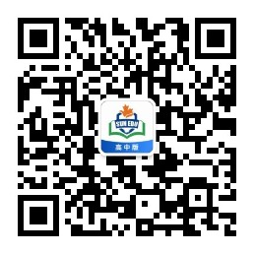
感恩遇见，相互成就，本课件资料仅供您个人参考、教学使用，严禁自行在网络传播，违者依知识产权法追究法律责任。
更多教学资源请关注
公众号：溯恩高中英语
知识产权声明

Slide 2
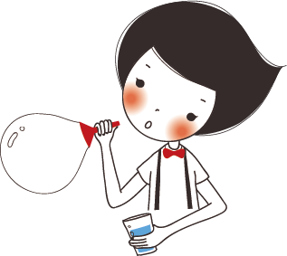
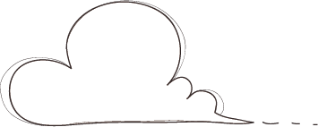






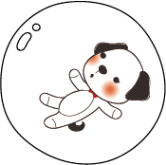

Unit2 Morals and Virtues
Write a review

Slide 3

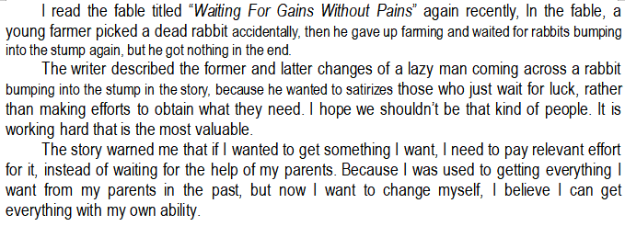
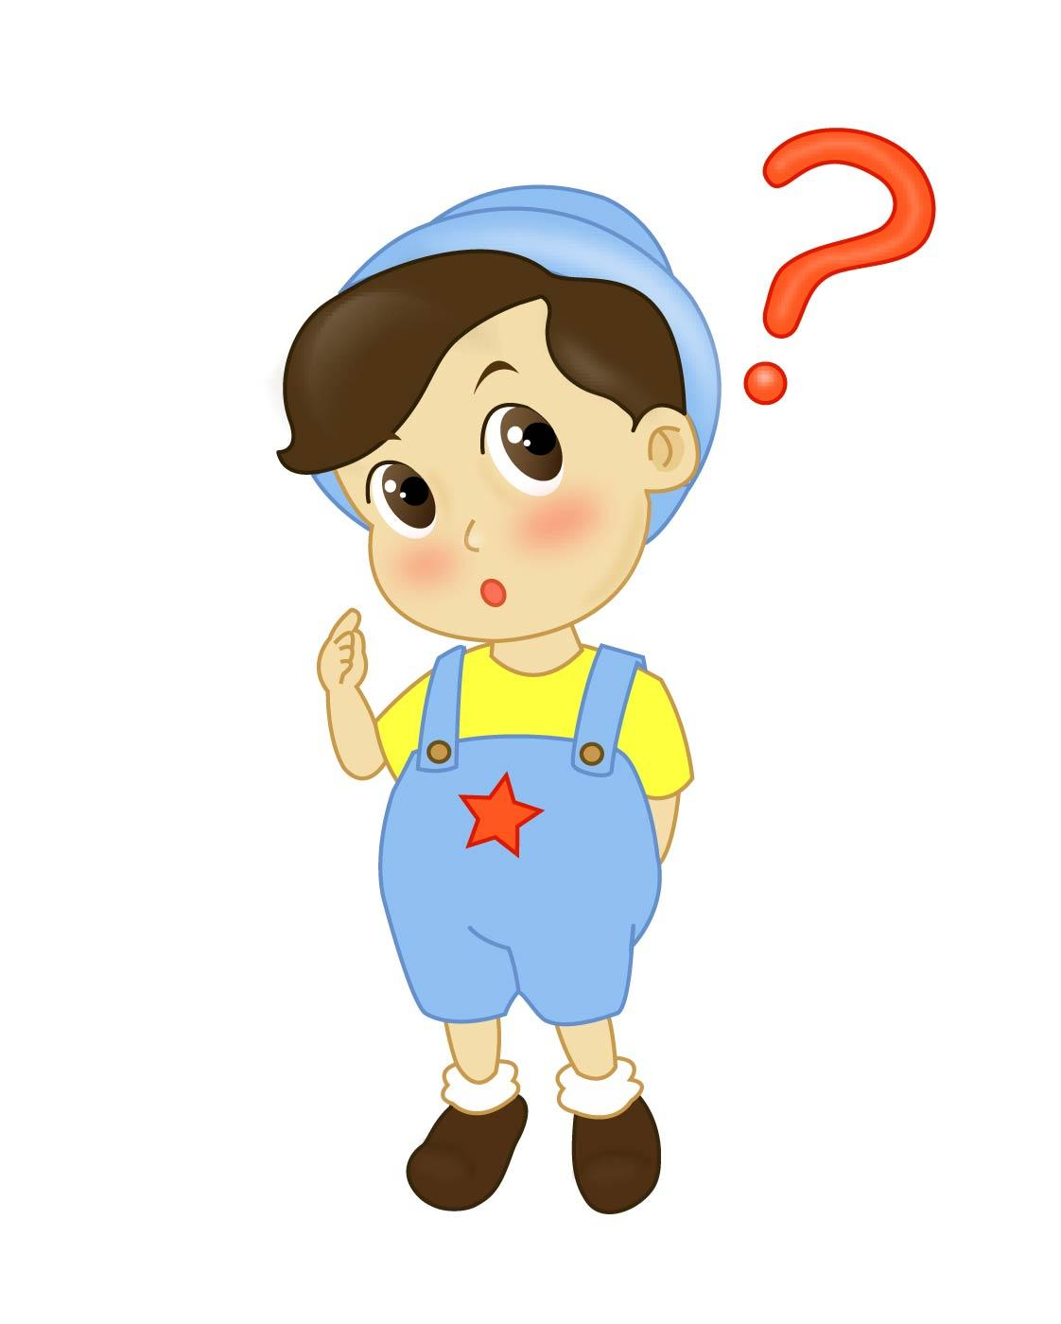

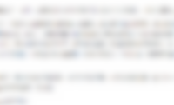
Lead-in
How to write a review?
What are we reading now? A story? A comment?
or something else?
What is a review?
A review
It's a
review
is a short passage to give your opinion on a piece of writing (book).
First you shoud give a short description of the writing, then clearly state your opinion and reasons.

Slide 4
Lead-in
Step1
How to write a review?
Basic information about the story
(title，type，main idea）
Step2
Your analysis of the story
(author's purpose，details，achievement of the purpose）
Step3
Your opinion on the story
(like or not，reasons，whether to recommend or not）

Slide 5
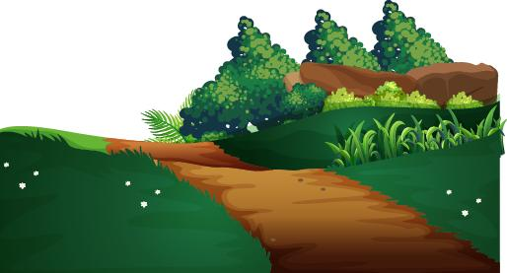
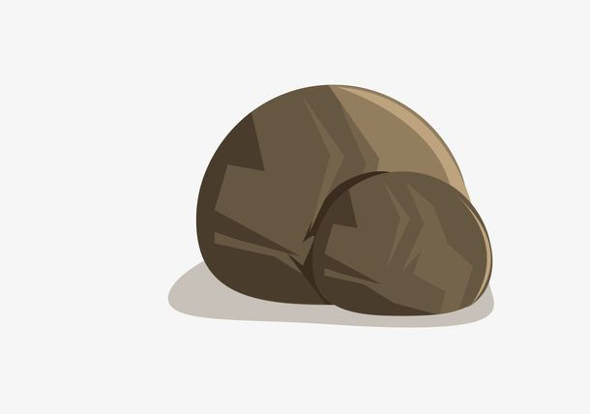
Read For Basic Information
The Stone In The Road
Sample1
I have read a story called “The Stone In The Road”. It is a fable, where the king wanted to test his villagers' response to trouble by putting a stone in the road, under which were some gold coins.
1. What's the title of the story?
Sample2
The story, “The Stone In The Road”, is a fable. In the fable, to test the villagers' response to trouble, the king put a stone with some gold coins under it, in the road.
2. What kind of story is it?
It is a fable.
3. What's the main idea of the story?(5W+H)
Sample3
“The Stone in the Road” is an old fable about a king who thinks his people are lazy, so he puts a large stone in the middle of the road and hides and waits to see if anyone will try to move it.
In the fable, the king placed a stone in the road to test villagers' response to it
Can you write the first para of your review?(use various sentences)

Slide 6
Read For Analysis
1. Why did the king carry out such an experiment?(thinking)
Sample1
The author described villagers' response clearly in the story to improve people's sense of responsibility and courage to accept challenges. I think the story was quite successful in achieving its purpose, and I have learned a lot from it.
person | Experience | Emotion | Response
milkman
woman
others
girl
To teach his villagers a lesson---take the responsibility, accept challenges
angry
picked himself up, went away
crashed into ...
2. What was the response from different people?(p21)
3. Did the king achieve his purpose? How do you know?
limped away in tears
tripped over ...
sad
Sample2
With the aim of improving people's sense of responsibility and courage to accept challenges in life, the author described different response to the stone clearly. I have the belief in its success due to the comparison between the reponse of the girl and the others, from which I have learned a lot.
nobody attempted to move the stone
Can you write the second para of your review?(use various sentence)
complained about ...
upset
tired, worried, surprised
succeeded in moving...
pushed…with all her might, wanted to...

Slide 7
Discussion
Sample
In my opinion, the “stone” in the story refers to the difficulties and challenges in our life, the “milkman” and the “woman” refer to those who don't care for others, while the “girl” refers to people who are responsible for others with a positive attitude to life. I believe I belong to the latter. I used to meet a moral dilemma where I had to make a choice whether to help the woman on the ground or not, and I chose to help, because I thought it was our responsibility to help people who are in need. And I will persist in my choice for the reason that an individual can also make a difference, making the world a better place.
Which kind of people are you ?
Which kind of people will you be?
(give examples)
What does “stone” refer to in life?
Difficulties/Challenges
Can you write the thrid para of your review?(use various sentences)
What kind of people do “milkman”, “woman” and “girl” refer to in life?
Do you think the king is wise? Why or why ont?
milkman, woman: passive, indifferent...
girl:responsible, positive, caring...

