Slide 1
感恩遇见，相互成就，本课件资料仅供您个人参考、教学使用，严禁自行在网络传播，违者依知识产权法追究法律责任。
更多教学资源请关注
公众号：溯恩高中英语
知识产权声明

Slide 2
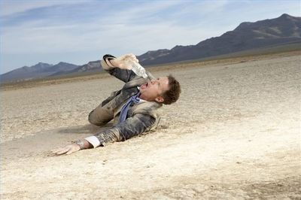
High school English descriptive language series — Lesson 4
Hunger and Exhaustion
饥饿与疲倦
Exhaustion/ Thirst / Hunger/ Cold/ Insomnia/ hopelessness
Use active verbs that move and have motion
Choose sensory descriptions that fit body parts
浙江省常山一中 吴俊峰

Slide 3
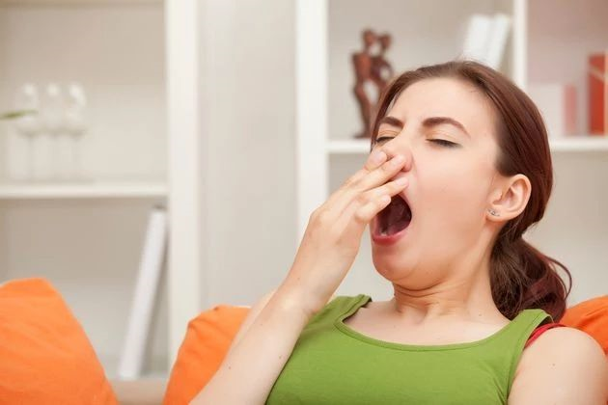
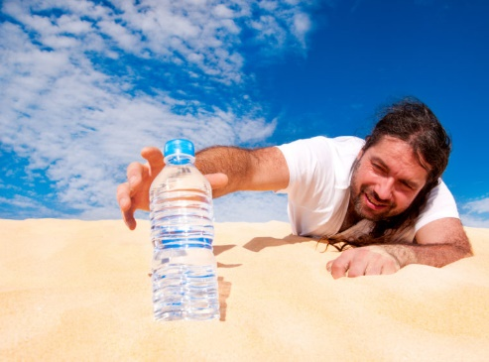
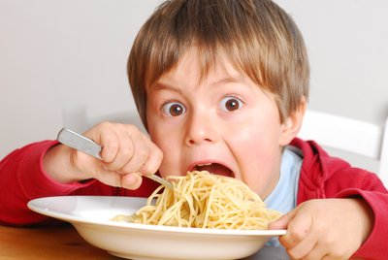
01 Introduction
02 Vocabulary 03 Skills 04 Writing 05 Self-Assessment
Picture 3
Picture 2
Picture 1
What do you need?
Before love and money, we need food and water. When we are hungry or thirsty, we do not care about anything else. Hunger and thirst are very powerful states.
Hunger and thirst give us strong feelings. It is much easier to write descriptively about things we feel strong about. Look at the three pictures above and try to describe the emotions shown in the pictures.

Slide 4
02 Vocabulary
01 Introduction 02 Vocabulary 03 Skills 04 Writing 05 Self-Assessment
2-1 Related Vocabulary
Nouns
ravenous /ˈrævənəs/adj. 贪婪的；狼吞虎咽的
rumbling /ˈrʌmblɪŋ/ adj. 隆隆声的; 咕噜声
famished /ˈfæmɪʃt/ adj. 极饥饿的
parched /pɑːtʃt/ adj. 焦的；炎热的；非常口渴的
dehydrated /ˌdiːhaɪˈdreɪtɪd/ adj. 脱水的
cracked /krækt/ adj. （声音）嘶哑的
Hunger: craving, appetite, stomach, mouth, saliva
Thirst: dehydration, throat, tongue, dryness
Others: food, meal, snacks, energy, exhaustion, panic, moisture, water
Hungry: empty, ravenous, rumbling, famished
Thirsty: parched, dry, dried, dehydrated, cracked
Others: weak, desperate, refreshing, delicious
Related
Vocabulary
craving /ˈkreɪvɪŋ/n. 渴望；热望
saliva /səˈlaɪvə/ n. 唾液；涎
dehydration/ˌdiːhaɪˈdreɪʃn/ n. 脱水
moisture /ˈmɔɪstʃə(r)/ n. 水分
Adjectives

Slide 5
.
02 Vocabulary
01 Introduction 02 Vocabulary 03 Skills 04 Writing 05 Self-Assessment
2-1 Related Vocabulary
Verbs
devour /dɪˈvaʊə(r)/v. 吞食；狼吞虎咽地吃
lick /lɪk/ v. 舔
sip /sɪp/ v. 小口喝，抿
gulp /ɡʌlp/ v. 狼吞虎咽地吃；大口地吸
growl /ɡraʊl/ v. 咆哮；发隆隆声
grip /ɡrɪp/ v. 紧握；抓住
Starve: ate, devoured, swallowed, licked, tasted
Thirst: sipped, drank, swallowed, gulped
Others: growled, shook, trembled, ordered, reached, burned, gripped
Related
Vocabulary

Slide 6
.
02 Vocabulary
01 Introduction 02 Vocabulary 03 Skills 04 Writing 05 Self-Assessment
2-1 Related Vocabulary
weak with hunger
shook with hunger
Stomach rumbled.
I could eat a horse.
hungry as a bear
dry as a bone
starving for food
Lips were parched.
gulped down
quenched my thirst
healthy appetite
voracious appetite
rumble /ˈrʌmbl/ v. (肚子因饥饿) 发咕咕声
eat a horse吃得很多（形容非常饿）
hungry as a bear 饿狼般的
dry as a bone渴极了；干透的
parched /pɑːtʃt/ adj. 焦的；非常口渴的
gulp /ɡʌlp/ v. 狼吞虎咽地吃；大口地吸
quench /kwentʃ/ vt. 熄灭；解渴
voracious /vəˈreɪʃəs/ adj. 贪吃的；狼吞虎咽的
Related
Vocabulary
Expressions

Slide 7
.
02 Vocabulary
01 Introduction 02 Vocabulary 03 Skills 04 Writing 05 Self-Assessment
2-2 Using Vocabulary
Picture One: Billy was so ravenous (adj)--he could eat a horse (expression). He gulped (v) down the noodles without even chewing (v).
Picture Two: Lawrence’s mouth was as dry as bone (expression). His throat (n) burned (v) as he dreamed of gulping (v) down some refreshing (adj) water (n).
Picture Three: A sleepy head (expression “瞌睡虫”) creeping up (v) , Miya squeezed(v) her eyes shut and tried to cover her immensely-opened (adj) yawning mouth with her palm.

Slide 8
.
03 Skills
01 Introduction 02 Vocabulary 03 Skills 04 Writing 05 Self-Assessment
3-1 Adding Vocabulary to Foundation Skill
The foundation skill of this unit is using active verbs. Go back to Lesson1 of this unit if you need to review.
Quick Reminder: we want to use active verbs that move and have motion. This helps to make our writing come alive and feel like a movie.
1. “He was hungry” uses a verb (was) that does not have motion.
2. We can describe hunger by choosing a moving verb: Hunger gripped (active verb) him and his stomach rumbled (active verb).

Slide 9
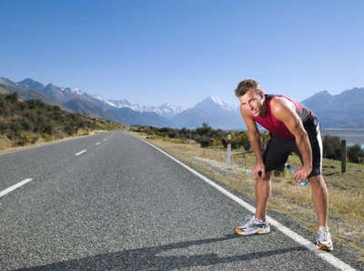
.
03 Skills
01 Introduction 02 Vocabulary 03 Skills 04 Writing 05 Self-Assessment
3-2 Active Verbs Suitable for This Lesson
My throat burned, itched, thirsted, caught
我的喉咙火辣辣的，痒，渴，哽住了
I gulped, swallowed, choked, licked
我吞咽，吞咽，窒息，舔
My stomach rumbled, growled, roared, cramped, yearned for
我的肚子在咕噜、咆哮、抽筋、渴望
I reached, grabbed, struggled, fumbled, shoved, searched
我伸手、抓、挣扎、摸索、推搡、搜寻
My head ached, pounded, wobbled, dropped
我的头隐隐作痛，砰砰作响，摇摇晃晃，耷拉下来
itch /ɪtʃ/n. 痒；渴望；v. 发痒；渴望
cramp /kræmp/ （腹部）绞痛；痛性痉挛；抽筋
yearn /jɜːn/ vi. 渴望；思念
fumble /ˈfʌmbl/v. 笨手笨脚地做；笨拙地去够
shove /ʃʌv/ vt. 挤；猛推
pound /paʊnd/ vi. 连续重击，猛击
wobble /ˈwɒbl/ v. 摇晃；摇摆

Slide 10
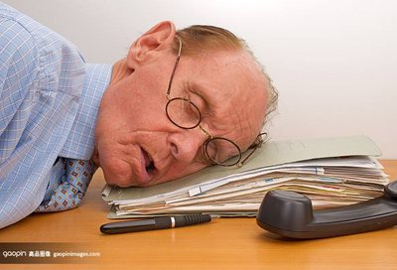
.
03 Skills
01 Introduction 02 Vocabulary 03 Skills 04 Writing 05 Self-Assessment
3-2 Active Verbs Suitable for This Lesson
My body/arm/hand shook, trembled, stumbled, wavered
我的身体/手臂/手颤抖、颤抖、跌跌撞撞、摇摆不定
My heart raced, bounced, rattled
我的心狂跳、跳跃、慌乱
Hunger/thirst gripped, strangled, tackled, washed over
饥饿/干渴攫住了，扼住了，压倒了，淹没了
Thoughts filled, flooded, swam, drowned
思想充满了，淹没在
stumble /ˈstʌmbl/ v.蹒跚；绊倒；跌跌撞撞地走
waver /ˈweɪvə(r)/ vi. 摇曳；摆动
bounce /baʊns/ v. 弹起；反弹；蹦跳；蹦蹦跳跳地走；激动得难以平静
rattle /ˈrætl/vt. 使发出咯咯声；喋喋不休；使慌乱，使惊慌
strangle /ˈstræŋɡl/ v. 把……勒死；使哽咽，使窒息
tackle /ˈtækl/ v. 擒抱摔倒；抓获

Slide 11
.
03 Skills
01 Introduction 02 Vocabulary 03 Skills 04 Writing 05 Self-Assessment
3-3 Make Full Use of Verbs
Almost every story will have some sequences in which the characters are doing things. How do you get the action right? What makes the action seem believable, interesting, and gets the blood pumping? The active verbs are the most important words,which give your scene momentum and help you portray the action scenes effectively and with style.
Take, for instance, this line from Tana French's novel In the Woods: “Footsteps thumped behind me and Sweeney streaked past, running like a rugby player and already pulling out his handcuffs. He grabbed Rosalind by the shoulder, spun her around and slammed her against the wall.（我身后传来了沉重的脚步声，斯威尼飞快地跑过，像个橄榄球运动员一样，已经掏出了手铐。他抓住罗莎琳德的肩膀，让她转过身来，用力把她往墙上摔去。）”
The words, “thumped,” “streaked,” “spun,” and “slammed,” are specific actions and they are active verbs, full of energy and focus.
thump /θʌmp/v. 捶击；猛力地移动；重步 streak /striːk/ v. 飞跑，疾驶；加上条纹
grab /ɡræb/ v. 攫取；霸占 spin- spun /spɪn/ v. 快速旋转；急转弯
slam /slæm/ v. 砰地关上；用力一放（或摔、推）

Slide 12
.
03 Skills
Exhaustion/Thirst/Hunger/Cold/ Insomnia/ hopelessness
(疲惫/ 口渴/ 饥饿/ 寒冷 /失眠/ 绝望)
01 Introduction 02 Vocabulary 03 Skills 04 Writing 05 Self-Assessment
3-3 Choose sensory descriptions that fit body parts
眼/泪/ 眉 | 慢慢地她的眼睑变得疲惫和沉重，然后慢慢得合上了。
嘴 | 1.泉水看起来是那么清新诱人，我跪下来用手捧了些水在掌心喝起来。 2.他想解释，却发现喉咙发干，火辣辣的。那天晚上，他烧得非常厉害。那男孩在床上痛苦地辗转反侧，难以入睡。 3.他又打了个呵欠，伸伸懒腰，慢慢地睁开眼睛，惊讶地环顾四周。“我这是在哪儿?”他睡意朦胧地问。
Then gradually her eyelids became so heavy and tired that they wanted to close.
1.The water looked so fresh and inviting that I knelt down, scooped some in my palms, and began to drink. (/skuːp/ v. 用勺舀)
2.He tried to explain but found his throat dry and burning with fire. That night, his fever rose very high. The boy tossed and turned painfully in bed.（翻来覆去难以入睡）
3.He yawned again and stretched, slowly opened his eyes and then stared about him in surprise. "Where am I?" he asked sleepily. （yawn sleepily 困倦地打哈欠）

Slide 13
.
03 Skills
Exhaustion/Thirst/Hunger/Cold/ Insomnia/ hopelessness
(疲惫/ 口渴/ 饥饿/ 寒冷 /失眠/ 绝望)
01 Introduction 02 Vocabulary 03 Skills 04 Writing 05 Self-Assessment
3-3 Choose sensory descriptions that fit body parts
脸/汗 | 1.汗湿的头发粘在前额和脖子上 2.满头大汗; 汗流浃背 3.他们疲惫不堪，有些绝望，瘫倒在岩石上，面无表情地面面相觑。
内脏（心/肺/胃） | 1.给某人造成负担 2.我因绝望深感难受。 3.他气喘吁吁，想加快速度，但他的力气已经耗尽了。
1.sweat-soaked hair sticking to one's forehead and neck(/səʊk/ v. 浸泡；渗透)
2.sweating profusely (/prəˈfjuːsli/ adv. 丰富地; 大量地--bleeding profusely 血流如注)
3.Exhausted and somewhat hopeless, they sank on the rock, staring at each other with blank expressions.
1.impose a heavy burden on sb (/ɪmˈpəʊz/ 迫使；把…强加于)
2.I felt sick with despair. (/dɪˈspeə(r)/ n. 绝望)
3.He was puffing and panting, trying to speed up but his strength had ran out. （puffing/pʌf/ and panting /pænt/ 呼哧呼哧喘气）

Slide 14
.
03 Skills
Exhaustion/Thirst/Hunger/Cold/ Insomnia/ hopelessness
(疲惫/ 口渴/ 饥饿/ 寒冷 /失眠/ 绝望)
01 Introduction 02 Vocabulary 03 Skills 04 Writing 05 Self-Assessment
3-3 Choose sensory descriptions that fit body parts
四肢 | 1.（尤指劳累、打击后）瘫坐在… 2.僵硬的不平稳的行走 3.他穿的单薄的运动鞋破了几个洞以致不能抵挡寒冷。 4.她的脚冰冷心，心里又装满了恐惧和绝望，在床上翻来覆去。 5.他拖着沉重的双腿回到家,筋疲力尽。 6.他感到自己的腿就像灌了铅一样,又沉重又僵硬。 7.他的腿很沉重，正在开始抽筋。
1.collapse into/onto sofa [kə'læps] / throw oneself into…
2.a herky- jerky walk
3.The thin sneakers he wore had a few holes in them and they did a poor job_{拟人} of keeping out the cold.
4.Her feet icy_{独立主格结构}, she twisted and turned（迂回曲折;辗转腾挪;辗转反侧）, unable to sleep,weighed down with fear and despair.
5.He dragged his heavy legs back home, tired out.
6.His legs felt like filling lead_{比喻}—heavy and stiff.
7.His legs were heavy under him and beginning to cramp. （/kræmp/ （腹部）绞痛；痛性痉挛；抽筋）

Slide 15
.
03 Skills
Exhaustion/Thirst/Hunger/Cold/ Insomnia/ hopelessness
(疲惫/ 口渴/ 饥饿/ 寒冷 /失眠/ 绝望)
01 Introduction 02 Vocabulary 03 Skills 04 Writing 05 Self-Assessment
3-3 Choose sensory descriptions that fit body parts
四肢 | 8.她一边颤抖一边使劲搓着双手。 9.他从头到脚都湿透了，浑身是泥。那男孩的脸因发烧而发红，尽管他经常冷得发抖。
躯干（胸/肚/臀） | 1.她陷在里面，被一种折磨着她的肉体的疲惫压得喘不过气来，这种疲惫似乎深入了她的灵魂。 2.他饿的肚子直叫，这让他意识到自从昨天以来什么也没吃。 3.他们太累了，除了伸懒腰什么都做不了。
8.She shivered, rubbing her hands together fiercely.( /ˈʃɪvə(r)/ v. 颤抖，哆嗦)
9.He was wet through from head to toe, muddy all over_{形容词作状语}. The boy’s face was red with fever, though he trembled a lot.
1.Into this she sank, pressed down by a physical exhaustion that haunted her body and seemed to reach into her soul. (/hɔːnt/ v. 常出没于…；萦绕于…；作祟)
2.His stomach made a noise, which made him realize that he hadn't eaten anything since yesterday.
3.They were all so tired that they could do nothing but yawn.

Slide 16
.
03 Skills
Exhaustion/Thirst/Hunger/Cold/ Insomnia/ hopelessness
(疲惫/ 口渴/ 饥饿/ 寒冷 /失眠/ 绝望)
01 Introduction 02 Vocabulary 03 Skills 04 Writing 05 Self-Assessment
3-3 Choose sensory descriptions that fit body parts
头/大脑 | 1.忙得不可开交/对…感到厌烦 2.因服用止痛药而昏昏沉沉 3.他醒来时感到头昏眼花，疲惫不堪。 4.我头一碰到枕头就睡着了。 5.心力交瘁，我写下了这个问题无法解决的所有原因。 6.他患失眠症。 7.疲惫早已使他感到天旋地转。他躺在地上,一阵无法抵挡的睡意袭来。
1.be tied up (with sth) / be fed up with
2.grogginess from pain medication ( n. 酒醉；东歪西倒 → groggy /ˈɡrɒɡi/adj. （因生病、劳累等）眩晕无力的；昏昏沉沉的；踉踉跄跄的)
3.He woke up feeling groggy, light headed, and exhausted_{分词作状语}.
4.I fell asleep as soon as my head hit the pillow.
5.Mentally exhausted, I wrote down all the reasons why this problem could not be solved.
6.He is suffering from insomnia.(/ɪnˈsɒmniə/ )
7.Exhaustion had made him light-headed. He lay on the floor, dragged down by an irresistible urge to sleep_{拟人}. （/ˌɪrɪˈzɪstəbl/ adj. 极度诱人的；不可抵抗的）

Slide 17
.
03 Skills
Exhaustion/Thirst/Hunger/Cold/ Insomnia/ hopelessness
(疲惫/ 口渴/ 饥饿/ 寒冷 /失眠/ 绝望)
01 Introduction 02 Vocabulary 03 Skills 04 Writing 05 Self-Assessment
3-3 Choose sensory descriptions that fit body parts
综合 | 1.以挑战耐力极限的方式行动 2.当医生们变得越来越疲劳时，错误开始潜入他们的工作中。 3.从早到晚，他工作了无数个小时，毫无倦意。 4.这是沉闷的星期一，亨利对着书本打瞌睡, 感到昏昏欲睡。 5.由于一场事故，Tony 感到绝望。
1.acting in ways that push the limits of the endurance
2.As the doctors became more tired, errors began to creep into their work_{拟人}.
3.From dawn to dusk, he works countless hours, showing no signs of tiredness.
4.It was blue Monday and Henry nodded sleepily over his books, feeling drowsy.(/ˈdraʊzi/ adj. 昏昏欲睡的)
5.As the result of an accident, ①Tony was suddenly thrown into a world of darkness and sank into hopelessness. / ②Tony felt left out and was getting desperate with loneliness. / ③Tony's beliefs in looking forward and seeing the positive in everything deserted him_{拟人}.

Slide 18
.
04 Writing
01 Introduction 02 Vocabulary 03 Skills 04 Writing 05 Self-Assessment
4-1 Show What You Have Learned
Use at least 3 action verbs as well as the hunger and thirst vocabulary you have learned to continue the piece of writing below. Add 50-75 words in the space below to continue the story. Use at least five items from the vocabulary chart. Aim to use verbs that move. Complete this task in 20 minutes.
Samantha’s heart raced as she hiked up the mountain. The scenery was stunning, and she breathed in the fresh air and admired the view. After climbing uphill for two hours, she was tired, hungry, and thirsty. She reached into her backpack for her water bottle and lunch but realized that she has left all her food and drink at home.
Samantha’s stomach rumbled, and she licked her dry lips. __________
____________________________________________________________
____________________________________________________________

Slide 19
.
04 Writing
01 Introduction 02 Vocabulary 03 Skills 04 Writing 05 Self-Assessment
4-1 Show What You Have Learned
Pre-Writing Task:
 1.Where and when did Samantha’s story take place?
 2.How did Samantha react and feel when she discovered she had no food or water?
 3.How did Samantha’s problem get resolved?
Samantha’s heart raced as she hiked up the mountain. The scenery was stunning, and she breathed in the fresh air and admired the view. After climbing uphill for two hours, she was tired, hungry, and thirsty. She reached into her backpack for her water bottle and lunch but realized that she has left all her food and drink at home.
Samantha’s stomach rumbled, and she licked her dry lips. __________
____________________________________________________________
____________________________________________________________

Slide 20
.
04 Writing
01 Introduction 02 Vocabulary 03 Skills 04 Writing 05 Self-Assessment
4-2 Sample Answers
Basic: Samantha was worried. She became very hungry and really needed something to drink. Her stomach was in pain and her body became weak.
Version 1: Samantha's head ached when she thought about her situation. Hunger washed over her, and her hands shook and trembled like a leaf. Thoughts of food flooded her mind. She stumbled across the rocks in weakness.
Version 2: Panic swam around in Samantha mind. Her head ached and her heart raced with visions of disaster. Hunger wrapped its fingers around her belly and squeezed, as she struggled to stay on her feet. She was so hungry and weak; she could eat a horse right now. Her dry throat itched and yearned for just a drop of moisture. Samantha shoved the sense of panic aside. Suddenly an idea settled into Samantha's mind. She grabbed her cell phone from her bag and ordered a large pepperoni pizza and large Coke – special delivery!

Slide 21
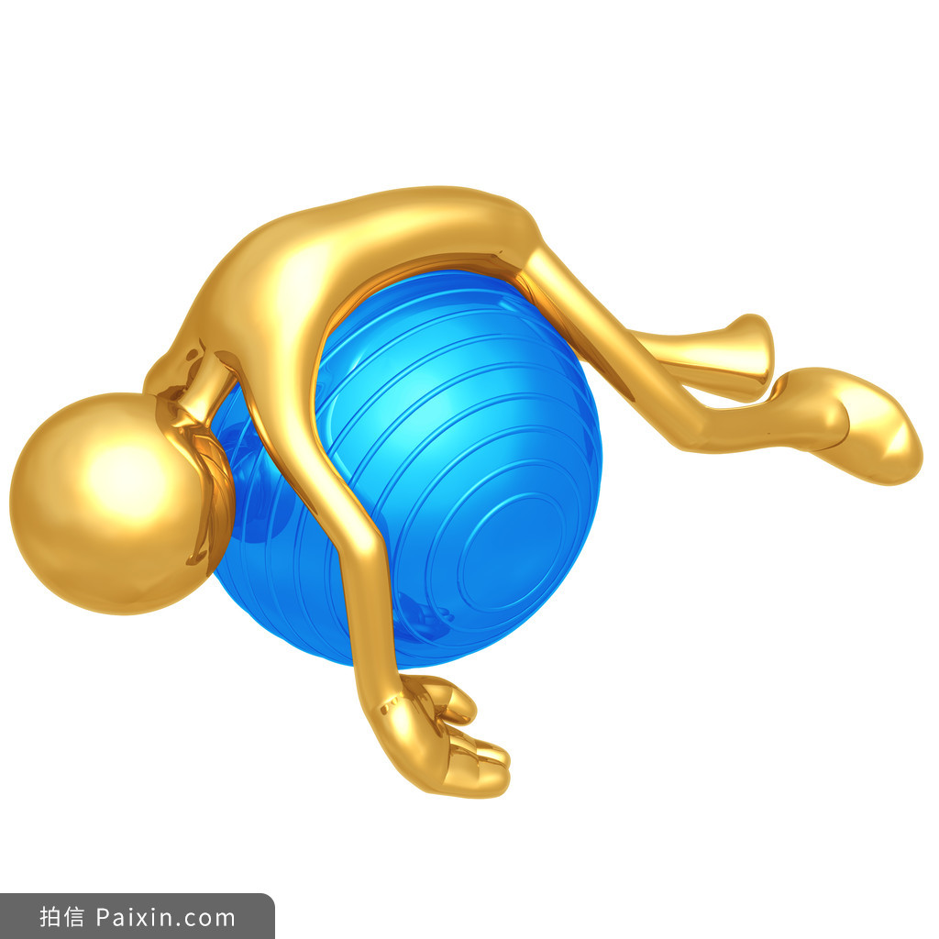
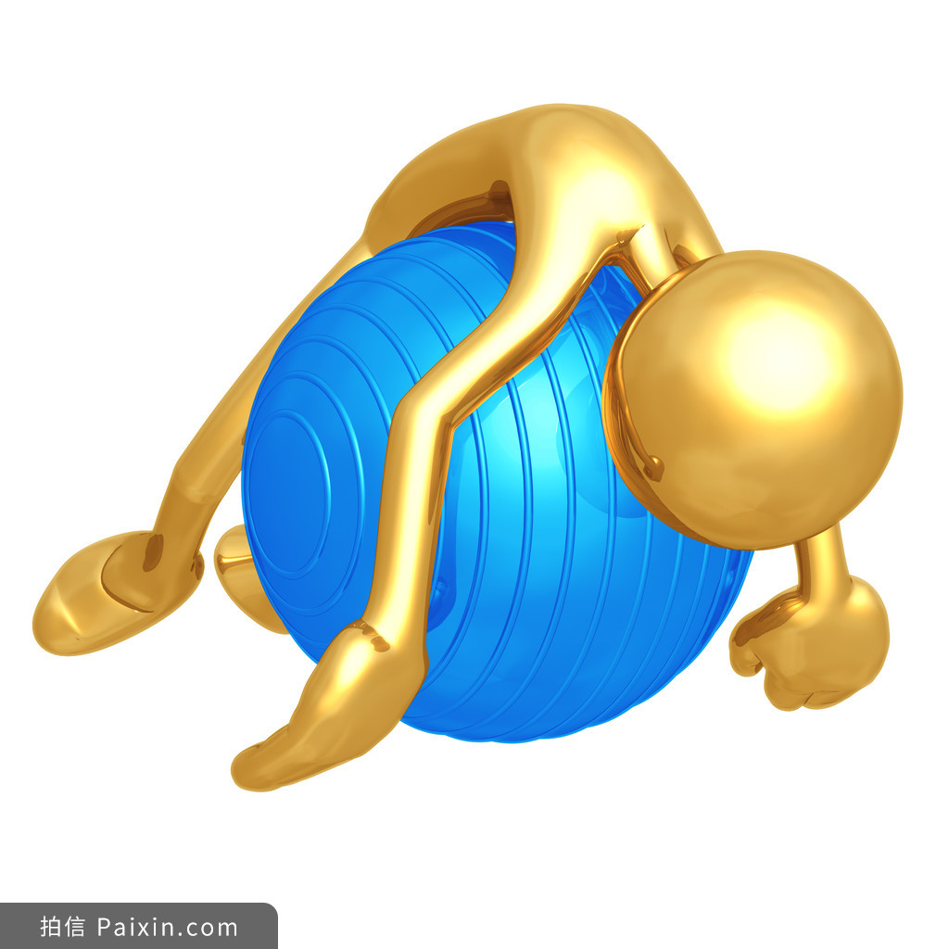
.
05 Self-assesment
01 Introduction 02 Vocabulary 03 Skills 04 Writing 05 Self-Assessment
5-1 Which new items have you learned from the above lesson?
new words
new expressions
new sentence
new writing skills

Slide 22
.
05 Self-assesment
01 Introduction 02 Vocabulary 03 Skills 04 Writing 05 Self-Assessment
5-2 阅读下面短文，根据所给情节进行续写，使之构成一个完整的故事。(2016年10月浙江高考试题)
One weekend in July, Jane and her husband, Tom, had driven three hours to camp overnight by a lake in the forest. Unfortunately, on the way an unpleasant subject came up and they started to quarrel. By the time they reached the lake, Jane was so angry that she said to Tom, “I’m going to find a better spot for us to camp” and walked away.
With no path to follow, Jane just walked on for quite a long time. After she had climbed to a high place, she turned around, hoping to see the lake. To her surprise, she saw nothing but forest and, far beyond, a snowcapped mountain top. She suddenly realized that she was lost.
“Tom!” she cried. “Help!”
No reply. If only she had not left her mobile phone in that bag with Tom. Jane kept moving, but the farther she walked, the more confused she became. As night was beginning to fall, Jane was so tired that she had to stop for the night. Lying awake in the dark, Jane wanted very much to be with Tom and her family. She wanted to hold him and tell him how much she loved him.
Jane rose at the break of day, hungry and thirsty. She could hear water trickling (滴落) somewhere at a distance. Quickly she followed the sound to a stream. To her great joy, she also saw some berry bushes. She drank and ate a few berries. Never in her life had she tasted anything better. Feeling stronger now, Jane began to walk along the stream and hope it would lead her to the lake.
As she picked her way carefully along the stream, Jane heard a helicopter. Is that for me? Unfortunately, the trees made it impossible for people to see her from above. A few minutes later, another helicopter flew overhead. Jane took off her yellow blouse, thinking that she should go to an open area and flag them if they came back again.
Paragraph 1： But no more helicopters came and it was getting dark again. __________________________________
Paragraph 2： It was daybreak when Jane woke up. _____________________________________________________

Slide 23
.
05 Self-assesment
01 Introduction 02 Vocabulary 03 Skills 04 Writing 05 Self-Assessment
Climax
missed chances to be found byhelicopters
got a plan
hopeful
ate,
drank
hungry, thirsty
getting dark,
no helicopters
hungry, exhausted
Process
stopped
missed
Suspense
(悬念)
regretful
happy?
lucky?
unforgettable?
lost
confused，tired
rescued?
quarrel
walked away
angry
Plot
Feelings
Plot
Feelings
Beginning
Ending

Slide 24
.
05 Self-assesment
01 Introduction 02 Vocabulary 03 Skills 04 Writing 05 Self-Assessment
But no more helicopters came and it was getting dark again. Disappointed, Jane had to stay alone for another night. Amid the dreadful darkness, strange sounds of wild beasts were heard. Jane was lonely and seized by extreme panic.Into this she sank, pressed down by a physical exhaustion that haunted her body and seemed to reach into her soul. Many times, Jane was on the edge of breaking down. But in the end she convinced herself that all hope was not lost. Tired and hungry, Jane fell asleep.
It was daybreak when Jane woke up. Feeling groggy, light headed, and exhausted, she swallowed some berries and then walked along the stream, hoping to find a suitable place to guide the helicopter. Fortunately, she saw a huge flat rock in an open area at a distance. She rushed to the rock, climbed onto it and waited. To her great joy, the helicopter appeared again. The nearer it got, the more she flagged the yellow blouse. Luckily, the helicopter didn’t miss Jane this time and it landed near the big rock slowly. Tom jumped off the helicopter and ran towards Jane. She broke down and burst into tears.
Her stomach made a noise, which made her realize that she hadn't eaten anything since the noon.
Jane felt left out and was getting desperate with loneliness.
Exhaustion had made her light-headed. She lay on the rock, dragged down by an irresistible urge to sleep.
Her feet icy, she twisted and turned, unable to sleep.
Her stomach rumbling
Hunger wrapped its fingers around her belly and squeezed, as she struggled to stand on her feet.

Slide 25
Sun
Edu
High school English descriptive language series — Lesson 4

