Slide 1


感恩遇见，相互成就，本课件资料仅供您个人参考、教学使用，严禁自行在网络传播，违者依知识产权法追究法律责任。
更多教学资源请关注
公众号：溯恩高中英语
知识产权声明

Slide 2
稽阳联考
英语试卷讲评
浙师大附中外语组 Lynn
2020/11/27

Slide 3
1. 出门时垃圾带出去 放在门边
3. 老人有折扣
4. 喉咙痛流鼻涕 得流感 请病假
6. 我正要说这个！ 我身无分文。
7. 关于(单词) 有空的(单词)
的确会回复所有邮件
8. 闪光灯(单词)
9. 困难的(单词) 到我家来 不熟悉这座城市
10. 最时髦的咖啡连锁店 正确的选择
履行各种职责 发展很快
报名参加职业介绍会
听力

Slide 4
阅读理解

Slide 5
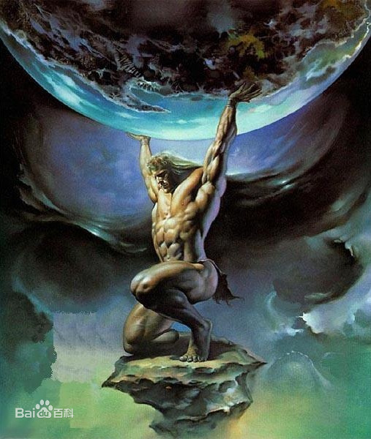
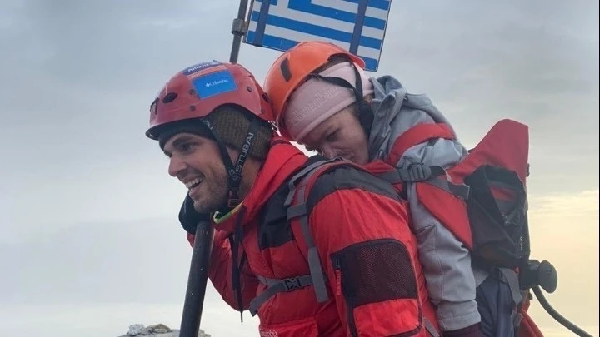
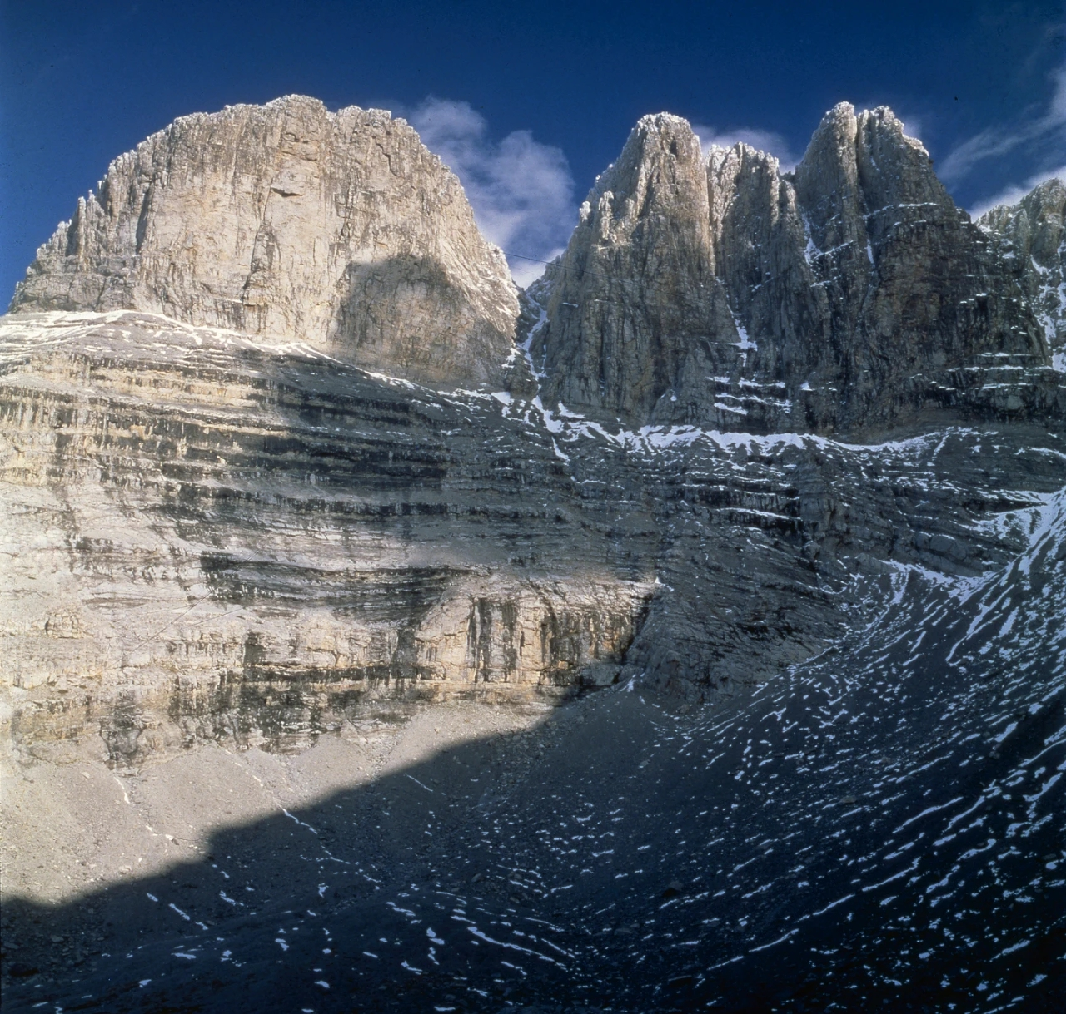
A篇
Atlas, a figure from ancient Greek myth, ____________________________________
_________.
single-handedly held the heavens high up
in the air
Courageous
inspring
C__________ Giannakos, an i________ modern-day version of Atlas, carried a d_______ companion to Mount Mytikas, thus helping to f____ her dream.
H_____ exist in real life as well.
disabled
fulfill
Heroes

Slide 6
Para.1:
Paras.2-4:
Para.5:
an inspiring modern-day version of Atlas: Giannakos
what Giannakos did
conclusion: the existence of shining examples in real life
WORD BANK
1. 单手撑起苍天 2. 英勇的 (单词)
3. 接受挑战 4. 待人如友(单词)
5. 应付此局面 6. 荣誉，勋章(单词)
7. 把某人牢牢固定在... 8. 累人的攀登
9. 共花10小时攀登 10. 得知...鼓舞人心
11. 闪光的例子 12. 半路遇上意想不到的紧急情况

Slide 7
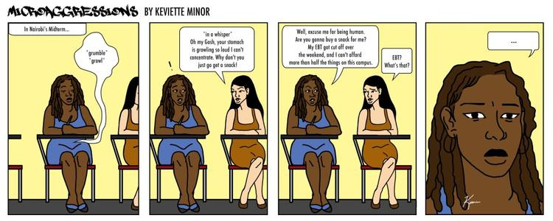
B篇
Paras.1-2: Microaggressions are being e_________ and s_____ about.
Para.3: Microaggressions are _______ physically and mentally.
Paras.4-5: Walker advised the victims _____ their opinions ______.
experienced
spoken
harmful
voice
frankly
WORD BANK
1. 太清楚...之痛
2. 感到不被理睬
3. 接触
4. 并无恶意
5. 使自己名声大振

Slide 8
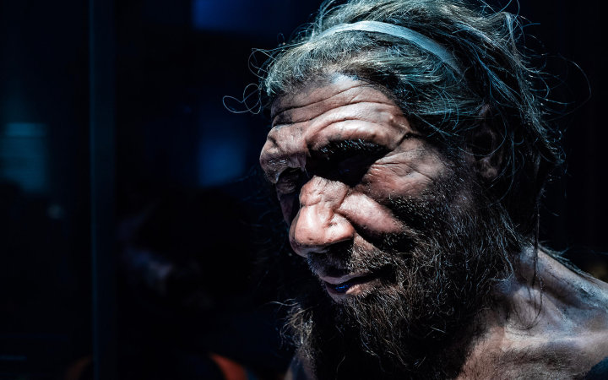
C篇
Global Warming
_______________ Drove Some
Neanderthals to Cannibalism
finding
Para.1: the _______ of the research
Para.2: the _______ ___of the research
Para.3: the _______ of the research
Para.4: some c________ from the study authors
WORD BANK
1. 虽然 (单词)
2. 之前的研究
3. 检查...的遗骸
4. 绝非...独有
significance
process
comments

Slide 9
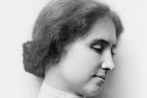
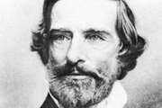
七选五
Narration
Laura Dewey Bridgman, the first deaf and blind person to learn to read and write
Dr. Samuel Howe, the person who helped Laura show the world a deaf and blind person could be as intelligent and capable as anyone

Slide 10
31. 现在的情况+情况并非一直如此+过去的情况
启示：注意前后句时态的差异；关注关键词 few ideas
32. 毁了听觉视觉+毁了嗅觉味觉+只剩触觉
启示：关注前后句
33. 写了一篇文章+这篇文章被...注意+他是...
启示：关注上一段末尾的a newspaper article+后句出现的he
34. 与上句一起描述Laura学会建立实物与单词之间的联系
35. 与上句一起描述Laura学会阅读后，最终学会书面表达

Slide 11
WORD BANK
1. 适应 2. 曾经 3. 让她触摸物品 4. 手指划过 5. 起初(单词) 6. 做某事费力
7. 之前(单词) 8. 情况并非总是如此

Slide 12

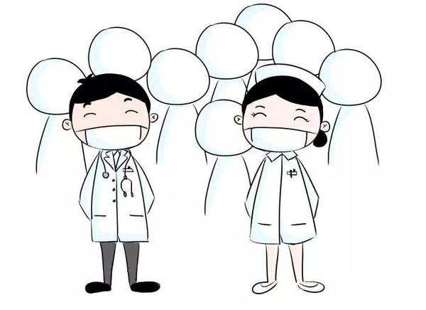
完形
upset/ sorrow-stricken
cancellation
Seeing his daughter ____________________ by the __________ of the graduation ceremony, Burdon managed to ____ one in their own yard ____________________. What he did not only _______ her dream, but also made himself _______.
host
without her knowledge
fulfilled
proud

Slide 13
WORD BANK
1. 举办毕业典礼
2. 取消(单词)
3. 弥补伤心的女儿
4. 事先不知道
5. 六个星期期间
6. 女儿不知情
7. 它符合防疫标准，所有人戴口罩间隔6英尺就坐。
8. 语塞的(单词)
9. 我别无他求。

Slide 14
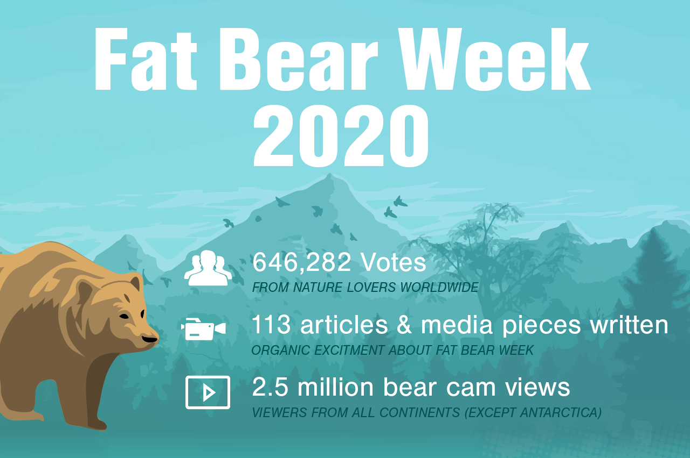
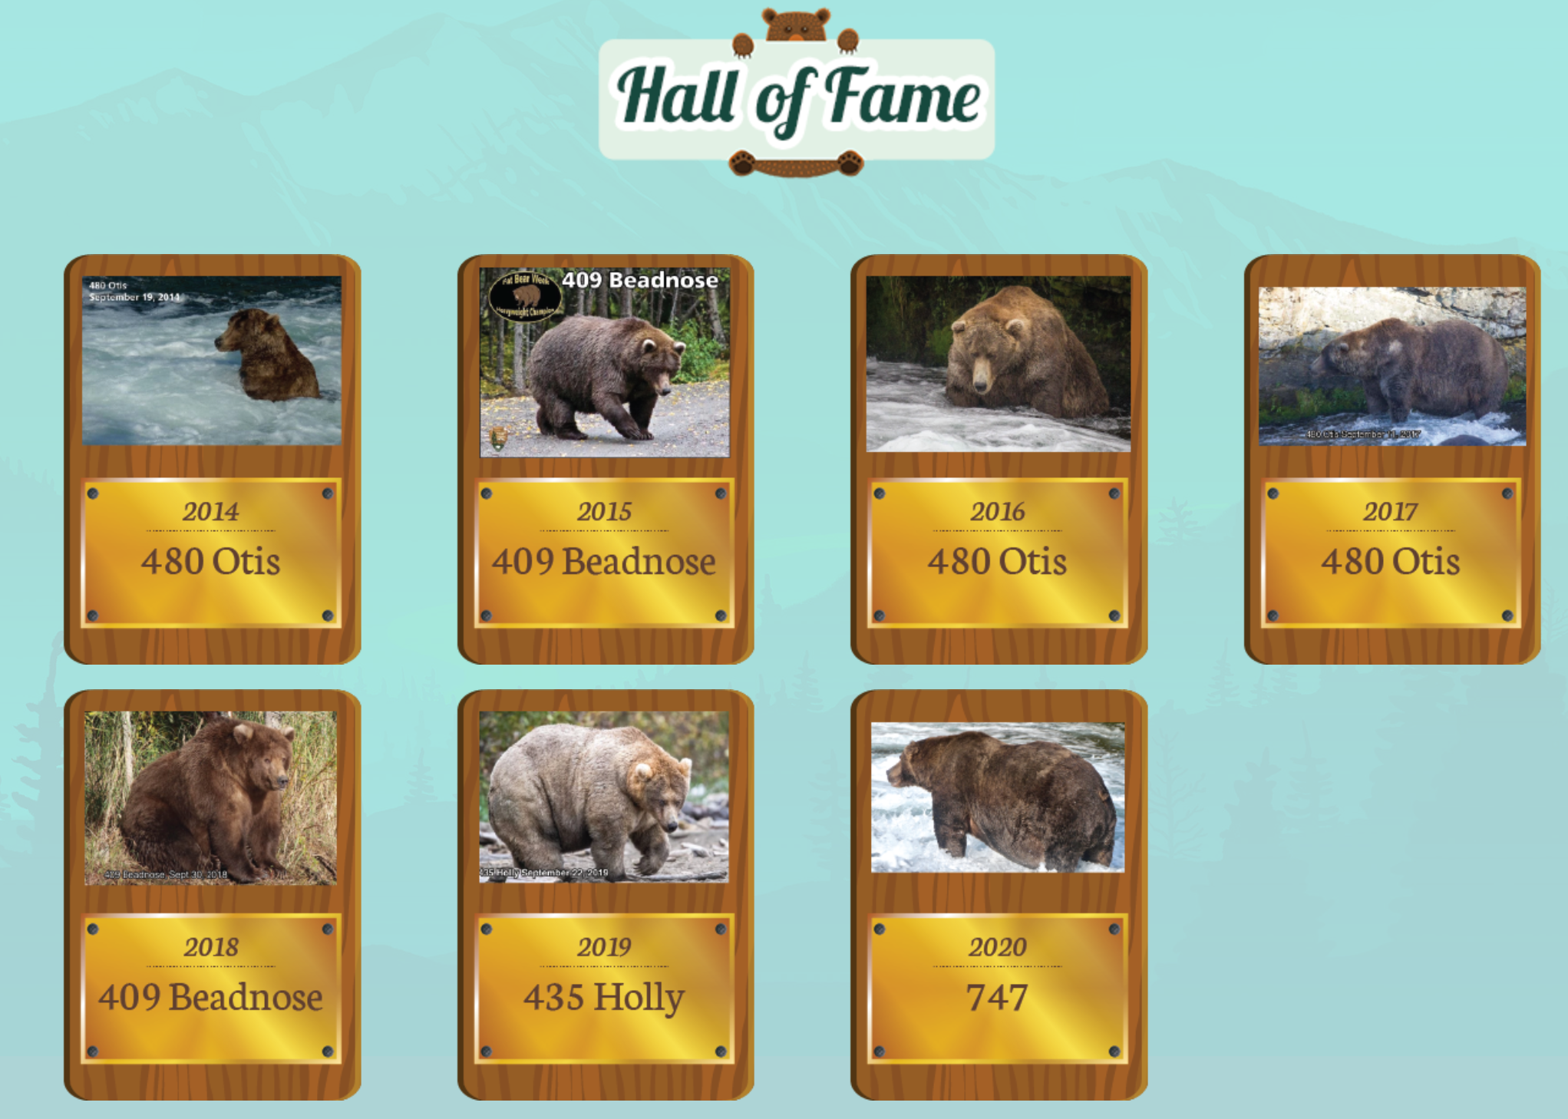
语法填空
Para.1: Introduce the topic
Fat Bear Week
Paras.2-3: Introduce Fat Bear Week
Para.4: Encourage your vote

Slide 15
56. happening V-ing
57. fattest 最高级
58. to determine 不定式
59. where 定从
60. The 冠词
61. was founded 时态语态
62. bears 名词复数
63. through 介词
64. competition 动变名
65. Or 并列连词
WORD BANK
1. 就...投票(2种表达)
2. 进入冬眠
3. 把肉肉最多的熊集合在一起
4. 赌注(单词)
5. 从9月30日到10月6日
6. 它们所特有的让体重增加的
能力让他们熬过寒冬，还能
在下一年继续参加pk。
7. 打败竞争对手赢得又一场胜利

Slide 16
THANKS

