Slide 1


感恩遇见，相互成就，本课件资料仅供您个人参考、教学使用，严禁自行在网络传播，违者依知识产权法追究法律责任。
更多教学资源请关注
公众号：溯恩高中英语
知识产权声明

Slide 2
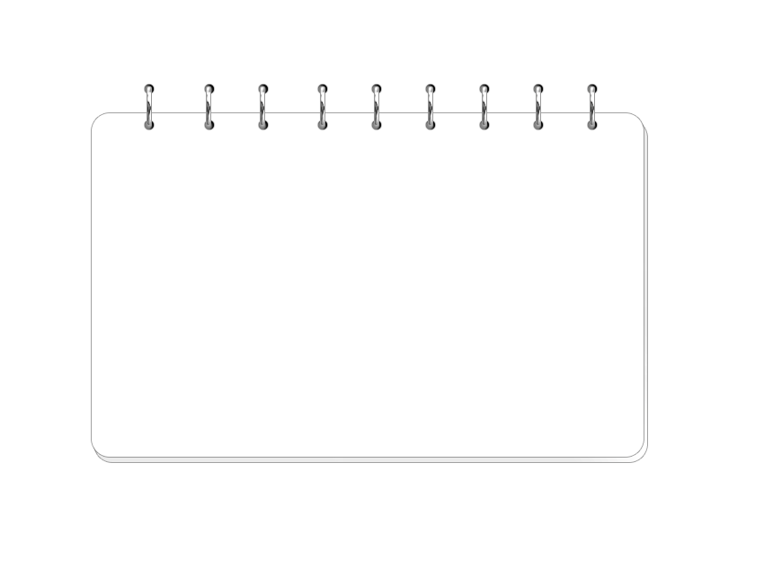

2021年高考临门一脚
高考英语结构式阅读
助您高效精准解题
洁
嘉兴四高 沈洁

Slide 3
阅读战略-----结构式阅读
词汇阅读：被词海淹没，被难词击溃
结构阅读：主题指导，以大方向指导小细节

Slide 4
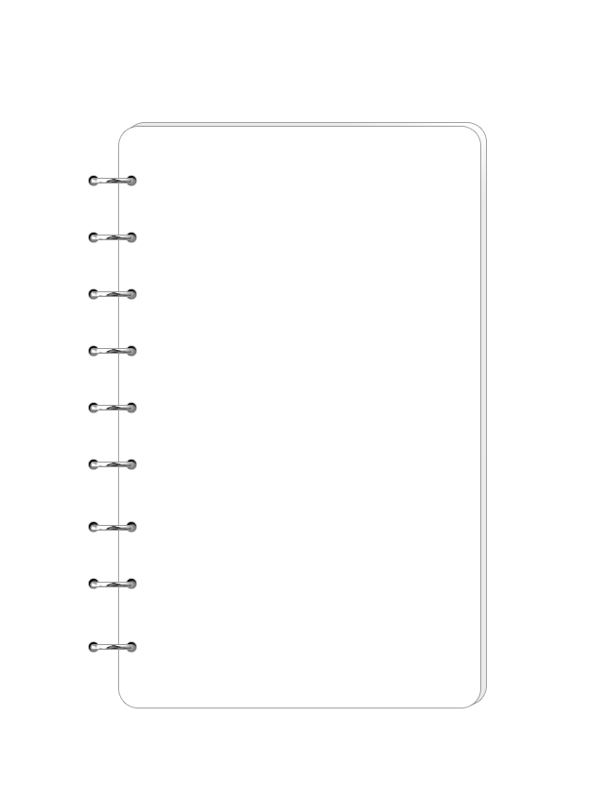






目
1.读逻辑
录
2.读结构
contents
3.读主旨
4.读态度
5.读主语

Slide 5
逻辑走向
反 正
反关系：重点在后头
顺关系：后面信息往往是对前面信息的补充说明。
1.读逻辑
转折
让步
对比
顺承
罗列
举例
因果

Slide 6
路标词
顺承：and, in the same way, that is to say, similarly, likewise
罗列：first, another, some…others, even, then, besides, in addition, additionally, furthermore, what’s moreover
举例：say, think of
因果：consequently, hence, so

Slide 7

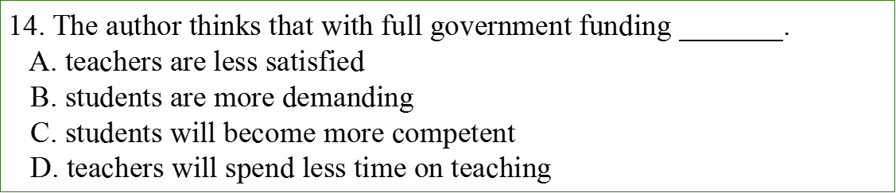

文章微观逻辑规律①：顺承（解释或者并列）
Full government funding (资助) is not very good for universities. Adam Smith worked in a Scottish university whose teachers lived off student fees. He knew and looked down upon 18th-century Oxford, where the academics lived comfortably off the income received from the government. Guaranteed salaries, Smith argued, were the enemy of hard work; and when the academics were lazy and incompetent, the students were similarly lazy.
If students have to pay for their education, they not only work harder, but also demand more from their teachers. And their teachers have to keep them satisfied. If that means taking teaching seriously, and giving less time to their own research interests, that is surely something to celebrate.

Slide 8
（2020年1月浙江）Normally, towns use rock salt to de-ice streets. The salt lowers water’s freezing point, causing ice to melt (融化). But using cheese brine could help both cheese producers and cities save money, while keeping roads safe. Cheese brine has salt in it, which, like the rock salt, helps lower water’s freezing point.
In addition to saving money, cheese brine could also be a more eco-friendly option. Many people suspect that all the rock salt used every winter is harming the environment...
The chemical washes off roads and goes into the ground. There it can pollute drinking water, harm plants, and eat away soil. By spreading cheese brine on streets before adding a layer of rock salt, Milwaukee may be able to cut its rock salt use by 30 percent.
25. What is a benefit of using cheese brine on roads?
A. Improving air quality.
B. Increasing sales of rock salt.
C. Reducing water pollution.
D. Saving the cheese industry.

Slide 9
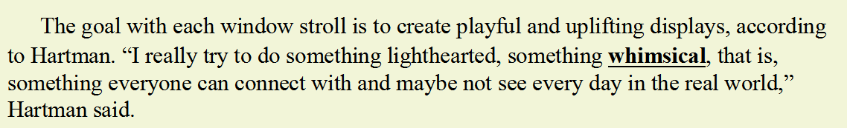


Slide 10

文章微观逻辑规律②：转折逻辑
Currently the trees in the Amazon take in around 500 million tonnes of CO2 each year: equal to the total amount of CO2 given off in the UK each year. But how will the Amazon react to future climate change? If it gets drier, will it still survive and continue to draw down CO2? Scientists hope that they will be able to learn in advance how the rainforest will manage in the future by understanding how rainforests reacted to climate change in the past.
4. How will the Amazon rainforest react to future climate change?
A. It'll get drier and continue to remove CO2.
B. It'll remain steamy, warm, damp and thick.
C. It'll get warmer and then colder and drier.
D. There is no exact answer up to present.

Slide 11
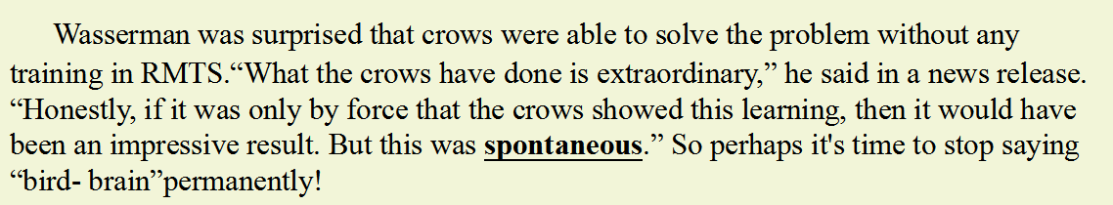

Slide 12
Ask a man in the street what education is for，and an immediate response might be“for equipping young people with the skills to get a job”.Well，yes，but is education not about a lot more than that?
Indeed，I would argue that it is because our British education holds a higher ideal (理想)—equipping young people with self-confidence and an understanding of the world around them—that it is booming internationally.
Yet I believe that what makes our education great is being threatened by the ever increasing focus on teaching to the test.The focus has arisen because only by testing children can we know what progress they have made.It’s a paradox (自相矛盾)，since the curriculum changes that are taking effect were designed to widen young people’s knowledge of the world around them.
But please do not misunderstand me.I am not suggesting that tests should be withdrawn.I am saying that schools need to have the confidence to aim much higher and wider than teaching to the test.They should put a rich learning experience for students first；the test should be used to validate(证实) learning，not an end in itself.
27.Which belongs to the purpose of education according to the author?
A.Helping young people to have a job.
B.Preparing students for all kinds of tests.
C.Making young people behave confidently.
D.Enabling young people to succeed in life.

Slide 13
（2021年高三英语教学测试）“Oversharing” has become associated with social media, but it isn’t exclusive to this platform.
27. What does the underlined word “exclusive” in paragraph 2 mean?
A. Unique
B. Similar
C. Relevant
D. Fundamental

Slide 14
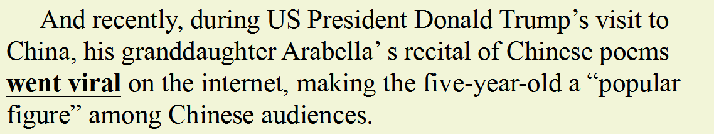
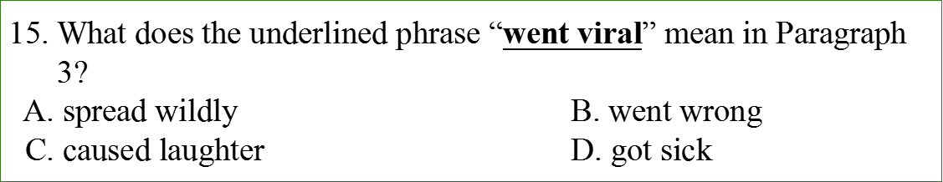
文章微观逻辑规律③：因果逻辑（显性、隐性）
现在分词作结果状语

Slide 15
（2021年1月浙江）“The vagueness of the gesture meanings suggests either that the chimps have little to communicate, or we are still missing a lot of the information contained in their gestures and actions,” she said. “Moreover , he meanings seem to not go beyond what other animals convey with non-verbal communication. So ,it seems the gulf remains.”
29. What does the underlined word “gulf” in the last paragraph mean?
A． Difference B. Conflict C. Balance D Connection

Slide 16
2.读结构
①宏观结构
Subject
Point 1
Point 2

Slide 17
宏观结构
Topic：中国经济形势一片大好。
Point 1：中国农业健康发展。
Point 2：中国工业蓬勃向前。
Point 3：中国第三产业欣欣向荣。

Slide 18
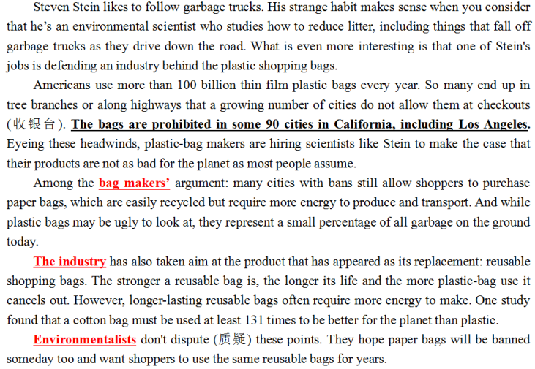
subject
Point 1:bag makers
Point 2: the industry
Point 3：environmentalists

Slide 19
2.读结构
②微观结构
Point
Illustration
Example

Slide 20
point
（嘉兴市2020-2021高二英语期末卷）I began to notice how multiplication worked magic. I saw how a little handful of seeds could produce a garden full of food, how having two rabbits could soon give you twenty, how a few caring words could heal a hurting heart. And I saw how a single act of loving-kindness could travel from person to person, heart to heart, and soul to soul until it circled the world.
22. How did the author express amazement at multiplication in paragraph 2？
By listing data B. By describing scene
C. By giving examples D. By comparing opinions.

Slide 21
3.读主旨
（2020年1月浙江） Today’s world is not an easy adjustment for young adults. A key skill set for success is persistence (毅力)，a characteristic that researchers say is heavily influenced by fathers. Researchers from Brigham Young University discovered that fathers are in a unique position to help their adolescent children learn persistence.
30. Which of the following is the best title for the text?
A. Three Characteristics of Authoritative Fathers
B. Key Skills for Young Adults to Succeed in Future
C. Children Tend to Learn Determination from Father
D. Family Relationship Influences School Performance
本文为研究类说明文，往往第一段呈现研究结论（本文中心），标题选择和主旨大意题往往都与此有关。

Slide 22
主旨的构成
主旨=主题对象+文章重心+作者感情基调
开篇
各段分论点
开篇、结尾

Slide 23
总体原则：结构式阅读，重点抓开篇
PS： 开篇的主旨段大多数是第一段，
段落较多的文章也有可能是二、三段。

Slide 24


A new study from the University of Pennsylvania School of Medicine suggests that getting out of bed when you can’t sleep might prevent your sleepless night from becoming chronic insomnia (慢性失眠).
After monitoring the sleep habits of 416 participants for one year, researchers found that night owls who restricted their time in bed were more likely to…
While this advice may seem counterintuitive at first, it makes sense once you understand what causes your sleeplessness…
So if you’re struggling to fall asleep at night, try getting out of bed and using that time…
24. What can be a suitable title for the text?
A. Sleepless? Get Out of Bed.
B. Advice on Sleeping Problems.
C. Avoiding Chronic Insomnia.
D. Taking a Nap During the Day.

Slide 25
4.读态度
(2020年7月浙江）For all of Bellevue's success, adaptive signals are not a cure-all for jammed roadways. Kevin Balke, a research engineer at the Texas A&M University Transportation Institute, says that while smart lights can be particularly beneficial for some cities, others are so jammed that only a sharp reduction in the number of cars on the road will make a meaningful difference. “It's not going to fix everything, but adaptive signals have some benefits for smaller cities,” he says.
26. What does Kevin Balke say about adaptive signals?
A. They work better on broad roads.
B. They should be used in other cities.
C. They have greatly reduced traffic on the road.
D. They are less helpful in cities seriously jammed.
正向态度 or 负向态度

Slide 26
5.读主语
看清句子的主语，如遇代词，分析指代关系
(2019荷泽模拟）Every man dreams of having a good car. With luxury cars, like Bentley, Lamborghini and Rolls-Royce, going into the world of SUVs, if you have deep pockets, you will be spoilt for choice.
◆Lamborghini Aventador SVJ
Using a new aerodynamic system allows it to set a car lap record of 6: 44 97 at Nurburgring, one of the longest and most challenging circuits in the world. Plus, carbon fiber can be seen everywhere, which makes the car strong and lightweight. There’re only 900 being built and you’ll need to cough up $517, 770 to buy one.
【小题1】What’s special about Lamborghini Aventador SVJ?
A．It offers two gas engines. B．It is an all-electric SUV.
C．It uses lightweight materials D．It has the most challenging circuit.

Slide 27


常见干扰模式
1.常识干扰（说得对，但是原文没有提到）
2.拼凑细节的干扰，容易的词有亲切感 难的词有恐惧感
3.题干定位词被替换
4.无中生有，真理 放之四海而皆准
5.反客为主 原文是客观 选项是主观
6.大小做题 范围的大小
7.极端错误 极端词汇 一些人-每一个人
8.偷换概念 主语换掉
标题文本
这里可以添加主要内容这里可以添加主要内容这里可以添加主要内容

Slide 28
B选项的定位词已被替换；C选项无中生有D选项说得对，但是原文没有提到
28.What does Hill say about Chinese women?
A. They are setting the fashion.
B. They start many fashion campaigns.
C. They admire super models.
D. They do business all over the world.
"China is impossible to overlook," says Hill. "Chinese models are the faces of beauty and fashion campaigns that sell dreams to women all over the world, which means Chinese women are not just consumers of fashion — they are central to its movement. "Of course, only are today's top Western designers being influenced by China — some of the best designers of contemporary fashion are themselves Chinese." Vera Wang, Alexander Wang, Jason Wu are taking on Galiano, Albaz, Marc Jacobs-and beating them hands down in design and sales," adds Hill.
For Hill, it is impossible not to talk about China as the leading player when discussing fashion. "The most famous designers are Chinese, so are the models, and so are the consumers," she says. "China is no longer just another market; in many senses it has become the market. If you talk about fashion today, you are talking about China —its influences, its direction, its breathtaking clothes, and how young designers and models are finally acknowledging that in many ways."

Slide 29
AC选项拼凑细节，D选项的定位词被替换
27.What can we learn about the exhibition in New York?
A. It promoted the sales of artworks.
B. It attracted a large number of visitors.
C. It showed ancient Chinese clothes.
D. It aimed to introduce Chinese models.
Earlier this year, the China Through A Looking Glass exhibition in New York exhibited 140 pieces of China-inspired fashionable clothing alongside Chinese works of art, with the aim of exploring the influence of Chinese aesthetics(美学)on Western fashion and how China has fueled the fashionable imagination for centuries. The exhibition had record attendance, showing that there is huge interest in Chinese influences.

Slide 30
（金考卷32）24.Why are some cities difficult to live in according to the text?
A. The air is heavily polluted.
B. There is no city planning.
C. Outdoor activities aren’t available.
D. Public places are limited.
Some cities are hard on their citizens. In places with poor city planning—Lagos was called out recently by the Economist Intelligence Unit—public spaces are few and far between, making outdoor activities hard. Lack of infrastructure(基础设施） jams the streets with cars and the air with pollutant, and people work long hours for little money.
A选项选项表述为严重污染，原文说的是空气中有污染物，属于大小做题；B选项原文说with poor city planning,选项为没有城市规划。Ｃ选项说没有户外活动，原文说的是使得户外活动比较困难。极端错误

Slide 31
（嘉兴市2019-2020高二英语期末卷）The best place to determine which artists and movements you want to study is a museum. Take a trip to your local museum, and take notes of your favourite pieces. You can note down the appearance of the object, describe its details like the composition（构图）and materials, and begin to discuss the work before moving on to the next object. If photography is allowed, take pictures of the paintings you love and the information placards hung beside them.
23. We can learn from the text that
A. museums are the only place to learn about art history
B. art history is a commom course at most western schools
C. taking photos may not be allowed in some museums
D. discussing art works in the museum is not acceptable
A极端错误；B无中生有；D违背原文

Slide 32
You can use your smartphone to get pretty much anything delivered directly to your door almost immediately. The hardest part is the process of trying to work out if you should tip and if so, doing the quick math before you get to the door. And, you know well that you should tip about 15-20% at restaurants, but do the same rules apply to delivery drivers?
……
However, most other delivery services say on their websites that tipping is not required. Some services, like Door Dash, do suggest no tip on their checkout window. Many, like Amazon Prime Now, allow customers to change their tip amount after their delivery has been received to reflect the quality of service. These companies help customers save money but delivery drivers are upset. They deal with bad weather, heavy traffic, extreme tiredness, and more, all for a $1 tip. Many feel that if you’d tip your pizza boy or girl, you should tip your delivery driver.
……
Just like servers in a restaurant, delivery drivers almost always rely on your tips for their income. Tipping is a long-standing cultural tradition in America. So, until drones (无人机) can deliver hot dogs straight to your door, it’s best to tip the people riding through the city at all hours to bring you hot fresh food.
24.What do we know about tipping delivery drivers?
A. It is not widely accepted.
B. It upsets many delivery services.
C. It can’t reflect the quality of service.
D. It is a deeply rooted tradition in America.
D选项是偷换概念 主语已经换掉，原文说的是tipping；选项的It指代题干中的把tipping delivery drivers

Slide 33
Thank You!

