Slide 1
感恩遇见，相互成就，本课件资料仅供您个人参考、教学使用，严禁自行在网络传播，违者依知识产权法追究法律责任。
更多教学资源请关注
公众号：溯恩高中英语
知识产权声明

Slide 2
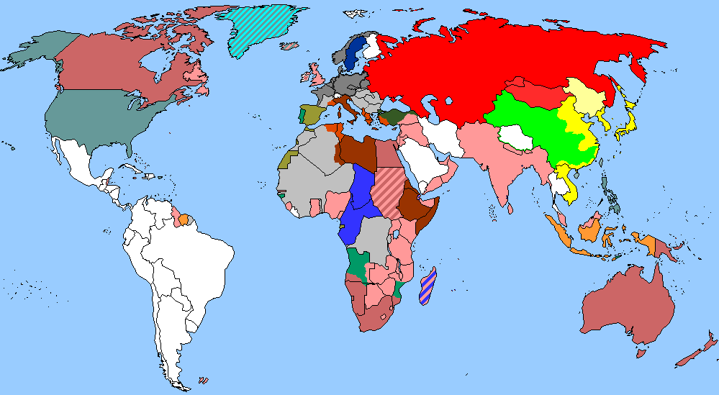
The Week
Mar 5th-11th, 2022

Slide 3
1. News Report from The Observer

Slide 4
阅读理解
（《观察家报》2022年3月6日 33页）
Three out of five women say that their caring responsibilities are preventing them from applying for jobs or promotion, while only one in five men say the same, according to new research.
The poll of 5,444 people by Ipsos Mori and the charity Business in the Community (BITC) found that nearly half the workforce are combining paid work and care. Almost three in 10 adults have left or considered leaving a job because of difficulties in balancing work and care. The latter was particularly true of women.
The majority of those with care responsibilities in the UK are parents looking after children under 18, but 36% of carers are responsible for an adult of working age or older.
Those from a black, Asian, mixed race or other ethnically diverse background were significantly more likely to say they have caring responsibilities than those from a white background. As many as 50% of carers from an ethnic minority say their caring responsibilities are holding them back, compared to 39% of white carers.
BITC Gender Equality campaign director Charlotte Woodworth said the results showed the disconnect between what workers need from employers and what they experience. “There’s a lot of competing ideas about how we should try to improve the lot of women, how we should try and create a more levelled-up society. This report tells us very clearly how significantly workplace policies and workplace cultures are undermining those efforts,” she said.
The research shows nearly one in 10 carers are “sandwich carers”, meaning they have caring responsibilities for both a child and an adult.
The charity wants the government and employers to offer new fathers more paid time off to look after their children. The research found that even among women who identify as joint carers, 52% say they do “more than my fair share”, in comparison to 10% of men. One in three men admit they do “less than my fair share”, in comparison to 4% of women.

Slide 5
1.Which of the following is true according to the passage?
A. More women than men have considered quitting their job due to their care responsibilities.
B. As many as half of carers from ethnically diverse background have to take care of an adult.
C. The report shows that the workers in the UK get what they need from their employers.
D. As joint carers, about 30% of women say they do more than they are supposed to.
A. More women than men have considered quitting their job due to their care responsibilities.
3.Which of the following can be the best title for the passage?
A. Women in the UK have to work longer hours than men
B. Half of Asian and black workers say they are treated unfairly
C. Caring roles block career advancement for three in five women
D. Employers should encourage men to take on more care responsibilities
2.What does the underlined word “lot” in Paragraph 5 mean?
A. land B. item
C. group D. situation
C. Caring roles block career advancement for three in five women
D. situation

Slide 6
词汇讲解
1. undermine: If you undermine someone’s efforts or undermine their chances of achieving something, you behave in a way that makes them less likely to succeed.
破坏，损害（某人的努力或成功的机会）
The continued fighting threatens to undermine efforts to negotiate an agreement. 持续的战斗会破坏希望通过谈判来达成协议的努力。
2. share: If you have or do your share of something, you have or do an amount that seems reasonable to you, or to other people. 应得的一份；应做的一份
I have had more than my full share of adventures.
我已经有了太多丰富多彩的历险。
翻译句子
我不想做会影响成功机会的事情。
I don't want to do something that would undermine the chances of success.
翻译句子
女性必须获得她们理应得到的高薪工作培训。
Women must receive their fair share of training for good-paying jobs.

Slide 7
句子翻译
The majority of those with care responsibilities in the UK are parents looking after children under 18, but 36% of carers are responsible for an adult of working age or older.
在英国，大多数有照顾责任的人是护理18岁以下儿童的父母，但36%的照顾人负责护理工作年龄或以上的成年人。
翻译
Those from a black, Asian, mixed race or other ethnically diverse background were significantly more likely to say they have caring responsibilities than those from a white background.
来自黑人、亚洲人、混血儿或其他种族多元化背景的人比白人背景的人更有可能说他们有照顾责任。
翻译
The research shows nearly one in 10 carers are “sandwich carers”, meaning they have caring responsibilities for both a child and an adult.
翻译
研究表明，近十分之一的照顾者是“三明治照管人”，这意味着他们对儿童和成人都有照顾责任。

Slide 8
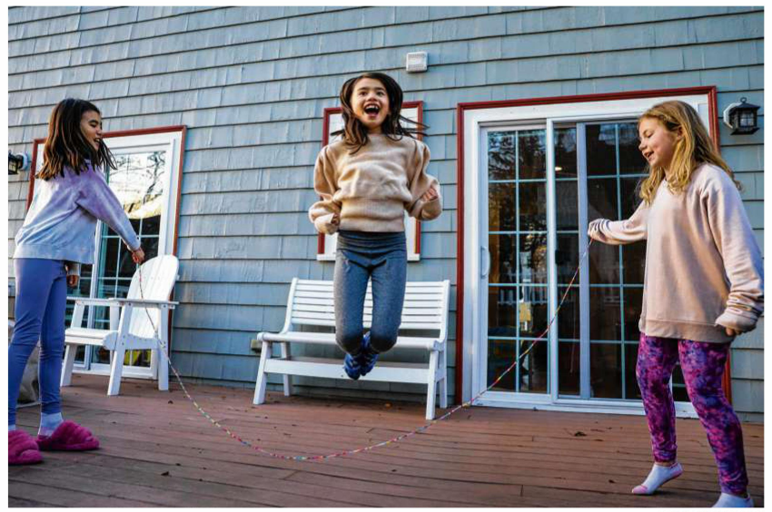
2.Study of Baby Teeth Could be An Idea Worth Chewing On
研究乳牙可能是一个值得深思的想法
Nora Fong(center), shown with her sister Lilly (left) and friend Lila,has provided one of her baby teeth for the study.

Slide 9
语篇填空
（《波士顿环球报》2022年3月9号 A1&A12版面）
who
Could children’s teeth tell us something about ____ they will become and what mental health challenges they could encounter? Dr. Erin Dunn believes they can, __________ (envision) a day _____ physicians routinely scrutinize children’s incisors (门齿) or canines (犬齿) after they fall out for signs of early life trauma. Such a screening (筛查), Dunn hopes, could one day become as routine as the blood tests doctors use ________ (check) a patient’s cholesterol(胆固醇) and glucose (葡萄糖) levels, measures that indicate whether a person faces ___ increased risk of heart disease or diabetes.
Two years ago, Dunn’s team ______ (start) recruiting New England area women who were pregnant during — or had given birth a year before — the 2013 Boston Marathon bombing to test the viability (可行性) of large-scale screening of trauma and baby teeth. Women do not need to have had a direct _________ (connect) to the bombing or the hunt for the perpetrators (作恶者) afterward. If her team can pinpoint a _______ (rely) link between stress and teeth markings, it “opens up the opportunity to use teeth as a new tool to help guide primary prevention efforts,” Dunn said. _________ (ultimate), she hopes to identify ________ (strategy) to improve resilience (复原力) among children.
envisioning
when
to check
an
started
connection
reliable
Ultimately
strategies

Slide 10
词汇讲解
1. scrutinize: to look at or examine sb/sth carefully 仔细查看；认真检查
The statement was carefully scrutinized before publication.
声明在发表前经过仔细审查。
2. trauma: a mental condition caused by severe shock, especially when the harmful effects last for a long time 精神创伤
He confronted his childhood trauma and tried to exorcize the pain.
他与童年时代的精神创伤对抗并试图祛除这种痛苦。
翻译句子
她探身向前，端详他们的面容。
She leaned forward to scrutinize their faces.
翻译句子
像火灾这样的创伤可以使孩子难过数月。
A trauma such as a fire can upset a child for months.

Slide 11
句子翻译
If her team can pinpoint a reliable link between stress and teeth markings, it “opens up the opportunity to use teeth as a new tool to help guide primary prevention efforts.”
如果她的团队能准确地找到压力和牙齿标记之间的可靠联系，这“就有机会将牙齿作为一种新工具来帮助指导一级预防工作。”
翻译
Such a screening, Dunn hopes, could one day become as routine as the blood tests doctors use to check a patient’s cholesterol and glucose levels, measures that indicate whether a person faces an increased risk of heart disease or diabetes.
邓恩希望，这种筛查有朝一日能像医生用来检查病人胆固醇和葡萄糖水平的血检那样成为常规，这些检测数据可以显示一个人患心脏病或糖尿病的风险是否增加。
翻译

Slide 12
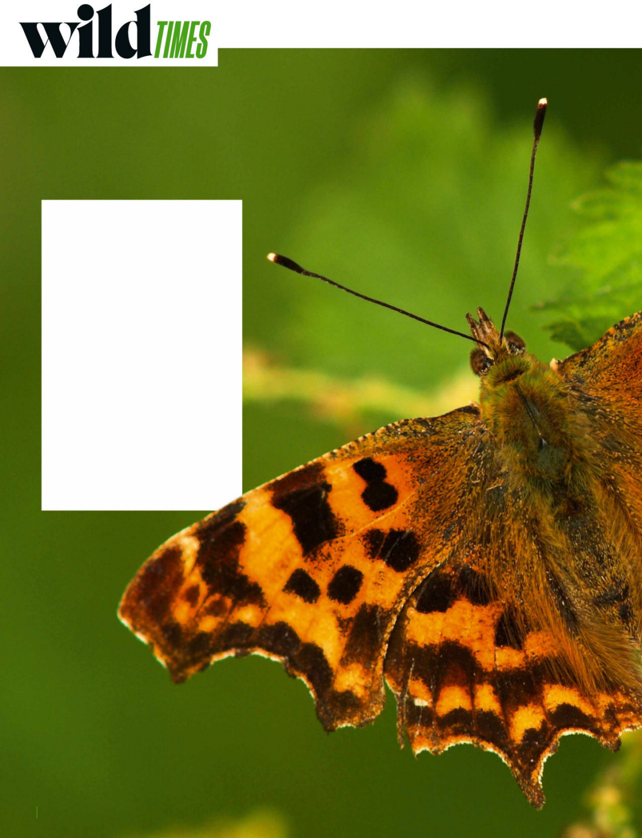
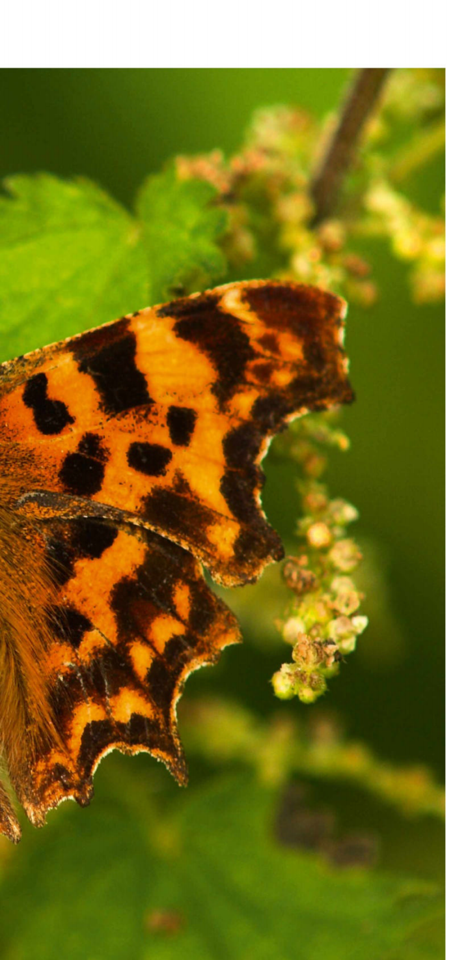
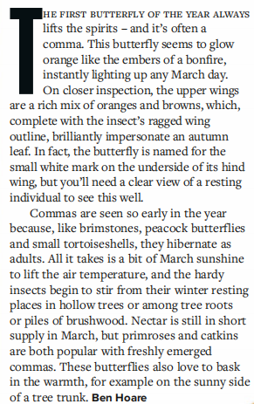
3.Brave Butterflies 给点阳光就灿烂！
Just a spot of sunshine and commas are ready to take to the skies
The comma butterfly suffered a severe decline in the 20th century but has made a comeback and is stretching its wings northwards, as far as central Scotland.

Slide 13
语篇填空
（《BBC野生生物》2022年3月刊 12页）
first
The ____ (one) butterfly of the year always lifts the spirits - and it’s often a comma (银纹多角蛱蝶). This butterfly seems to glow orange like the embers (余烬) of a bonfire, instantly _______ (light) up any March day. On closer inspection, the upper wings are a rich mix of oranges and browns, which, complete with the insect’s ragged wing outline, brilliantly impersonate an autumn leaf. In fact, the butterfly ________ (name) for the small white mark on the underside of its hind wing (后翅), but you’ll need a clear view of a resting individual to see this well.
Commas are seen so early in the year _______, like brimstones, peacock butterflies and small tortoiseshells, they hibernate (冬眠) as adults. All it takes is a bit of March sunshine _____ (lift) the air temperature, and the hardy insects begin to stir from their winter resting places in hollow _____ (tree) or among tree roots or piles of brushwood. Nectar (花蜜) is still __ short supply in March, but primroses (报春花) and catkins (柔荑花序) are both popular with ______ (fresh) emerged commas. These butterflies also love to bask in the _______ (warm), for example on the sunny side of __ tree trunk.
lighting
is named
because
to lift
trees
in
freshly
warmth
a

Slide 14
词汇讲解
1. impersonate: to pretend to be sb in order to trick people or to entertain them
冒充；假扮；模仿
He was caught trying to impersonate a security guard. 他假扮警卫被抓获。
2. emerge: to appear or come out from somewhere 出现，浮现，露出
The sun emerged from behind the clouds. 太阳从云层后面露出来。
We emerged into bright sunlight. 我们来到明媚的阳光下。
翻译句子
他被指控冒充警察。
He is charged with impersonating a police officer.
翻译句子
游泳者从湖水中浮出来。
The swimmer emerged from the lake.

Slide 15
句子翻译
On closer inspection, the upper wings are a rich mix of oranges and browns, which, complete with the insect’s ragged wing outline, brilliantly impersonate an autumn leaf.
仔细观察，上翼是丰富的橙色和棕色的混合颜色，再加上它参差不齐的翅膀轮廓，完美地模仿了一片秋天的叶子。
翻译
All it takes is a bit of March sunshine to lift the air temperature, and the hardy insects begin to stir from their winter resting places in hollow trees or among tree roots or piles of brushwood.
只要三月份的一点阳光，气温就会升高，这些耐寒的昆虫就会开始从它们冬眠的地方——中空的树、树根或灌木丛中——出发。
翻译

Slide 16
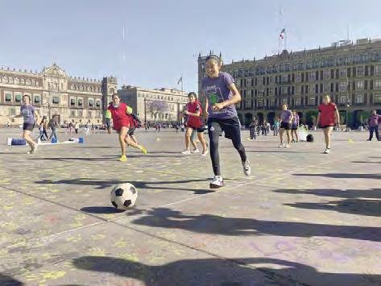
4. Kicking down sexist barriers
消除性别歧视

Slide 17
语篇填空
（《洛杉矶时报》2022年3月10日 A3版面）
bearing
The women arrived at Mexico City’s central square _________ (bear) nets, yellow cones and masking tape. They quickly improvised a soccer field. There was no referee and the field was only about 50 feet long. The five-on-five tournament, ______ attracted local news coverage and a couple of dozen curious onlookers, was a protest _________ male domination of the sport.
“There’s a different way to play the sport that’s contrary to the machista（大丈夫主义者） practices, which __________ (promote) companionship and unity,” said Pilar Tlatempa, a 26-year-old member of Barra Feminista, one of several women’s soccer groups that organized _____ event, held Wednesday afternoon.
The square, ________ (know) as the Zocalo, was still covered in feminist graffiti（女权主义的涂鸦） from the International Women’s Day protest a day _______ (early). Prevented by a long tradition of conflict about females participating in professional sports, women’s soccer __________________ (struggle) to gain a foothold in Mexico, where the men’s game is the national pastime.
As to this time, the mood was relaxed. “They play _______ (real) well, but the cause is more important,” a male __________ (instruct) said. “Women are working hard to win spaces that were prohibited.”
which
against
promotes
the
known
earlier
has been struggling
really
instructor

Slide 18
词汇讲解 1
1. improvise: to make or do sth using whatever is available, usually because you do not have what you really need 临时拼凑；临时做
There isn’t much equipment. We’re going to have to improvise.
设备不多，我们只能将就着用。
2. coverage: the reporting of news and sport in newspapers and on the radio and television 新闻报道
The incident has received wide coverage in the press.
这个事件已被新闻界广泛报道。
翻译句子
我们用木板和砖头临时搭了些架子。
We improvised some shelves out of some wood and bricks.
翻译句子
媒体的报道糟透了。
The media coverage was shocking.

Slide 19
词汇讲解 2
1. practice: a way of doing sth that is the usual or expected way in a particular organization or situation 通常的做法；惯例
They are familiar with religious practices. 他们熟悉宗教习俗。
2. prohibit: to stop sth from being done or used especially by law尤指以法令禁止
The citizens were prohibited from travelling abroad.
那时公民被禁止出国旅游。
翻译句子
在开学期时踢足球是他们的惯例。
Playing football at the beginning of the term is their practice.
翻译句子
法律禁止在报纸和杂志上刊登烟草广告。
The law that prohibits tobacco advertising in newspapers and magazines.

Slide 20
句子翻译
The five-on-five tournament, which attracted local news coverage and a couple of dozen curious onlookers, was a protest against male domination of the sport.
这场5对5的比赛吸引了当地新闻报道和几十名好奇的旁观者，它是一场对男性主宰这项运动的抗议。
翻译
Prevented by a long tradition of conflict about females participating in professional sports, women’s soccer has long struggled to gain a foothold in Mexico, where the men’s game is the national pastime.
翻译
由于受抵触女性参加职业体育的长期传统的影响，女足一直难以在墨西哥站稳脚跟。在墨西哥，男子足球是一项全国性的消遣活动。

Slide 21
5. BBC一分钟新闻听写填空 One-minute World 03/08/22

Slide 22
听写
This is BBC world news, the headlines. The town of Irpin, northwest of the capital Kyiv, came ______________ on Saturday.
The _____________ Visa and MasterCard are suspending their _______ in Russia. MasterCard said it will no longer support cards issued by Russian banks and MasterCards issued outside the country ___________ at Russian merchants.
The Israeli Prime Minister Naftali Bennett has held three hours of talks with Vladimir Putin at the Kremlin. Mr. Bennett is ___________________ to meet the Russian president.
Tens of thousands of people have been demonstrating across European cities ___________ Ukraine. There were similar scenes __________ before football matches in the English Premier League.
under heavy fire
payment giants
services
will not work
the first western leader
in support of
taking place

Slide 23
词汇讲解
1. suspend: to officially stop sth for a time; to prevent sth from being active, used, etc. for a time 暂停；中止；使暂停发挥作用（或使用等）
The union suspended strike action this week. 这周工会暂停了罢工。
2. demonstrate: to take part in a public meeting or march, usually as a protest or to show support for sth 集会示威；游行示威
They are demonstrating in favour of free higher education.
他们举行示威游行，要求实行免费高等教育。
翻译句子
在进行安全检查期间生产暂停。
Production has been suspended while safety checks are carried out.
翻译句子
在城市里，大批的人群举行示威游行，要求进行变革。
In the cities vast crowds have been demonstrating for change.

