Slide 1


感恩遇见，相互成就，本课件资料仅供您个人参考、教学使用，严禁自行在网络传播，违者依知识产权法追究法律责任。
更多教学资源请关注
公众号：溯恩英语
知识产权声明

Slide 2
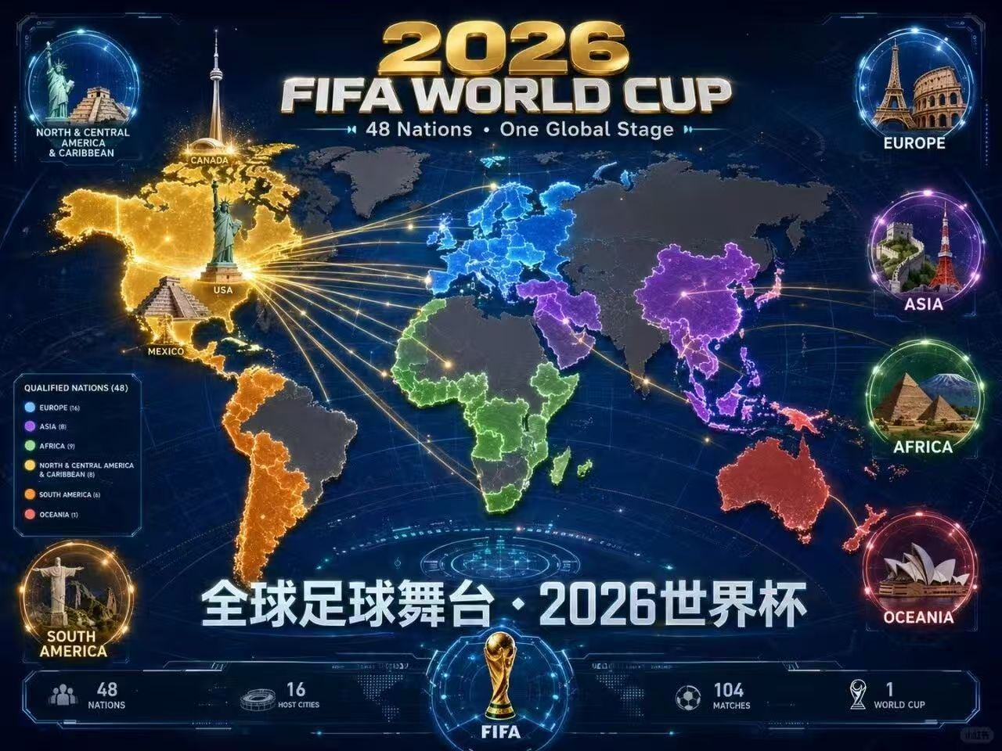
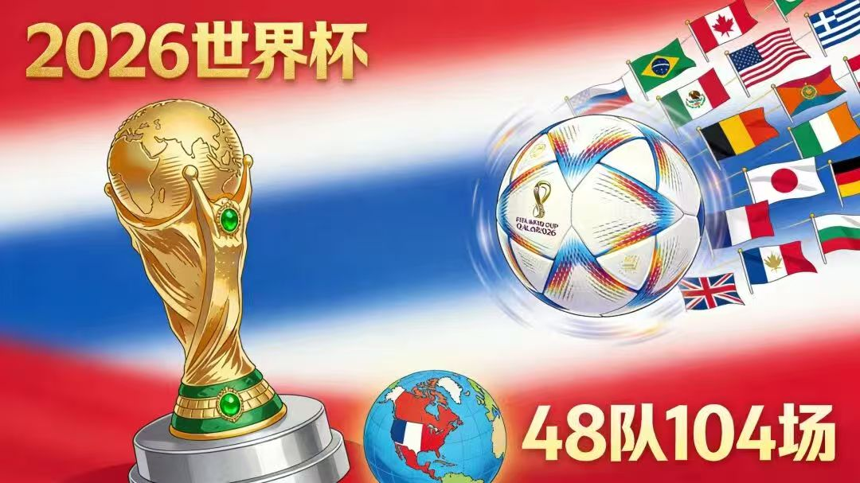
观世界杯盛景，
学地道英语表达
刘艳

Slide 3
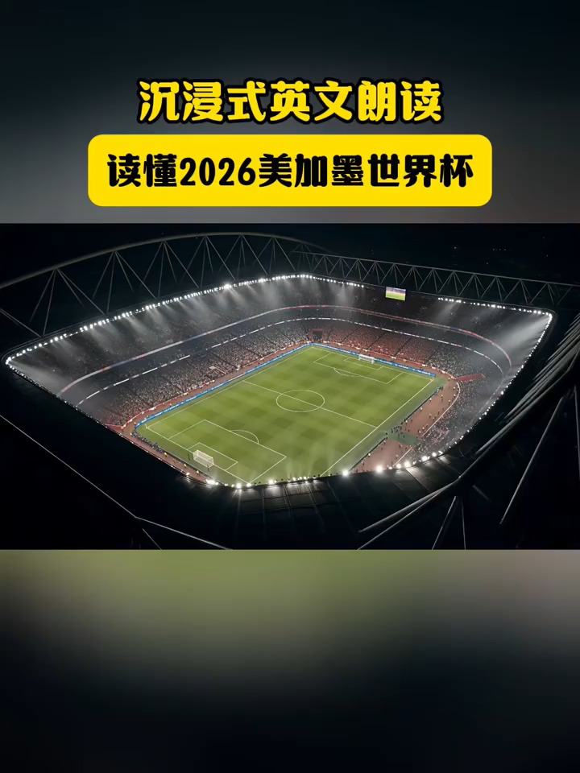
Welcome to the 2026 FIFA World Cup, a truly historic tournament. For the first time ever, the World Cup will be hosted by three countries together, the United States, Canada and Mexico. It will also be the biggest World Cup in history, with 48 teams competing on football's greatest stage. That means more matches, more stories, and more chances for the world to come together through sport. But this tournament is about more than football. It is also a celebration of diversity, ______(1. 文化) and global connection. From the energy of major American cities, to the ______(2. 热情) of Mexican football culture, to the welcoming spirit of Canada, the 2026 World Cup will bring different people and places into one global moment. For players, it is a chance to make history. For fans, it is a chance to share joy, excitement and ______(3. 难忘的) memories. The World Cup has always been more than a game. It is a ______(4. 语言) the world understands. And in 2026, that language will be spoken across North America.
culture
passion
unforgettable
language

Slide 4
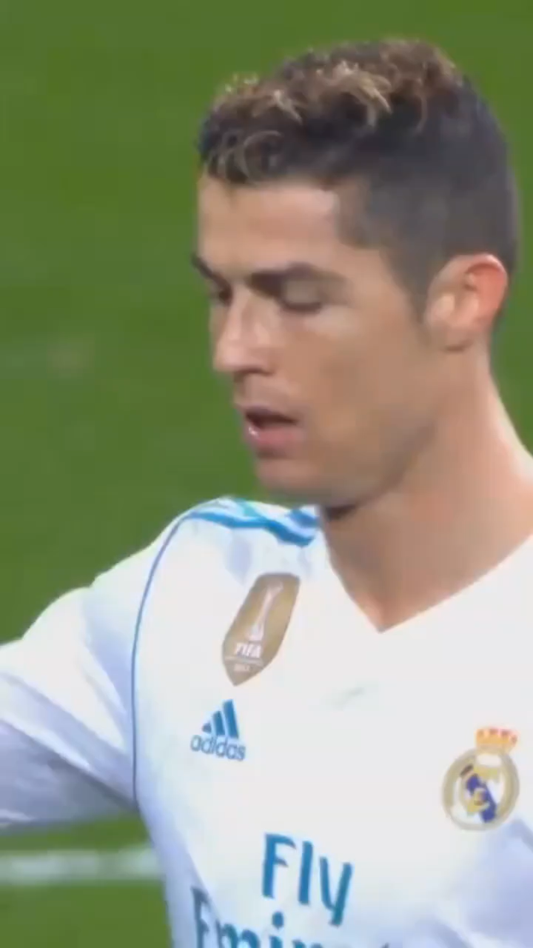
Did you know that in football, scoring two goals in a match is called a 1 , while three goals make 2 , four goals are known as a 3 , six as 4 and nine as 5 ? Only two players in football history have ever scored a triple hat trick, and you guess who they're?
brace
a hat trick
poker
a double hat trick
a triple hat trick

Slide 5
单场2 球 = a brace（梅开二度）
单场3 球 = a hat trick（帽子戏法）
单场4 球 = a poker（大四喜，英式足坛俚语）
单场6 球 = double hat trick（双帽子戏法，两个三球）
单场9 球 = triple hat trick（三帽子戏法，三组三球）
brace /breɪs/ :名词 n.
一对、一双（动物、猎物、物品）
a brace of rabbits 一对兔子
支架、托架、支撑件（建筑 / 机械）wall brace 墙撑；
（牙科）牙套；（骨科）矫正支具wear braces 戴牙套
动词 v.
支撑、加固
brace the wall 加固墙体
做好准备（迎接冲击、坏消息）
brace for the cold 做好受寒准备
绷紧身体稳住
Brace yourself! 稳住身子 / 做好心理准备！
poker /ˈpəʊkə(r)/
1. 最常用：扑克牌游戏
play poker 打扑克；Texas Hold'em poker 德州扑克
poker face 面无表情、扑克脸（固定习语）
2. 本义：拨火棍、火钳
a fire poker 炉火拨棍

Slide 6
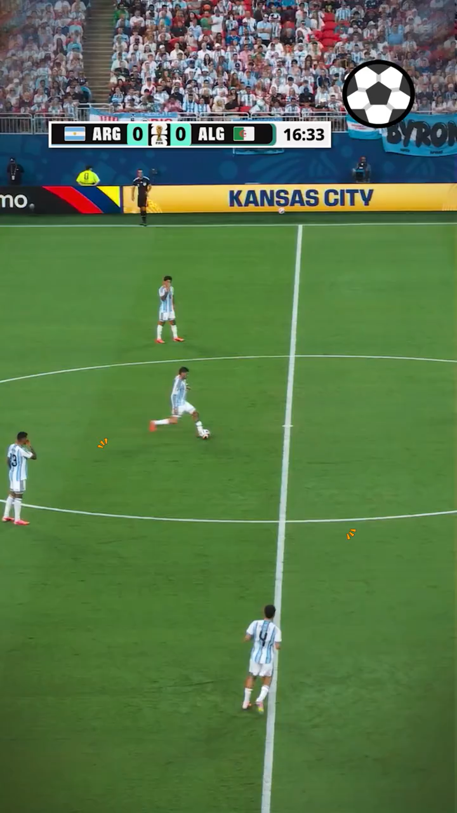
Right up the gut. What a ball that is. Messy on the turn. Options on the side. Clean up. Messy. There's your goal. There's more history. The magic man again. Now as far as Alexis Mac Allister. The decider. All the same. Three passes messy. Second goal. He might end the night as the world’s standout player. All top, top goals. Scoring messily with two. Argentina with two. Total control for the defending champions count. It goes Nico Gonzalez, Leo Messi, Leo Messi. First career World Cup hat trick ties the all-time goalscoring record, perfect start to the title defense.
皮球直窜球门中路，这脚传球非常精彩。球员转身处理球十分慌乱，边路还有出球选择。球员解围化解险情，处理球依旧混乱。进球了！又一段足坛经典时刻诞生，这位神奇球星再度发挥。再看亚历克西斯・麦卡利斯特，这是一粒制胜进球。场上局势没有改观，三脚传球衔接十分拖沓。第二个进球来了。他今晚大概率会成为全场最亮眼的球员。两粒进球都是顶级水准，他磕磕绊绊打进两球。阿根廷队取得两球领先。卫冕冠军完全掌控比赛局势。球先是传给尼科・冈萨雷斯，随后交到利奥・梅西脚下，梅西，梅西完成进攻。梅西职业生涯首次在世界杯上演帽子戏法，追平世界杯历史进球纪录，为卫冕之路迎来完美开局。

Slide 7
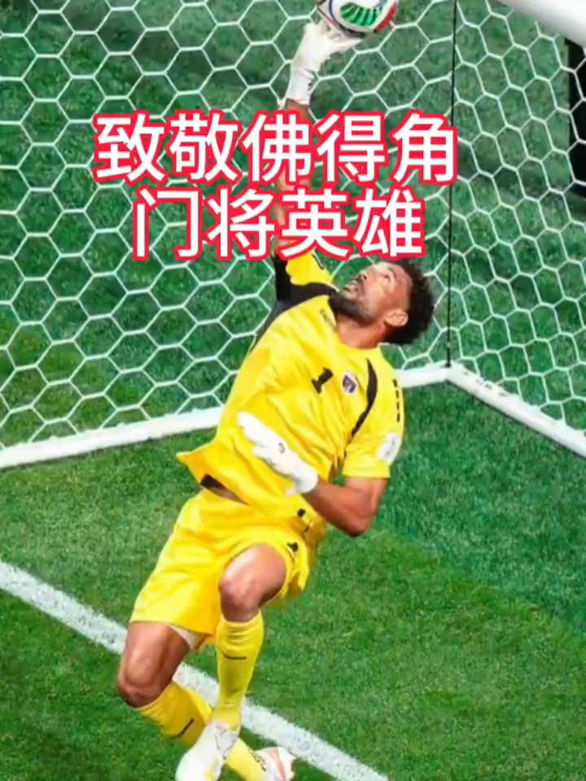
Forty-year-old goalkeeper Vozinha （/vəʊˈziːnjə/沃齐尼亚）wrote history for Cape Verde （佛得角/ˌkeɪp ˈvɜːd/）in the team’s first-ever World Cup match. 1 seven amazing saves, he helped his country hold powerful Spain to a 0-0 draw, shocking football fans around the world.
For the aging goalkeeper, this World Cup debut was the reward for decades of persistence. Vozinha did not become a professional player 2 the age of 25, much later than most athletes. Over the years, he moved across different countries and played for small clubs, never 3 (give) up his World Cup dream.
Against Spain, 4 controlled most of the game and fired 27 shots, Vozinha remained calm and brilliant throughout the match.
With
until
giving
who

Slide 8
假定你是校英文报记者李华，请你根据所给材料，为校英文报写一篇关于2026年美加墨世界杯的新闻报道。
内容包括 (参考视频材料)
1. 赛事基本情况（首次三国联合举办、参赛队伍扩容）；
2. 赛事深层意义（彰显多元文化、促进国际交流）；
3. 对球员和球迷的价值。
第一段：赛事基本概况（开篇引入）
1. 核心事件：2026年美加墨世界杯是历史性赛事；
2. 核心亮点：史上首次三国联合举办；
3. 赛事规模：48支球队参赛，成为史上规模最大的世界杯，赛事更丰富。
第二段：赛事深层价值（主体拓展）
1. 核心主旨：赛事不止于足球竞技；
2. 文化意义：彰显多元文化，融合三国地域特色与体育热情；
3. 国际意义：促进全球联结，凝聚世界各地人群。
第三段：个人与全局意义（结尾升华）
1. 对球员：创造历史、展现自我的宝贵机会；
2. 对球迷：收获欢乐与难忘的观赛记忆；
3. 全局升华：足球是通用世界语言，拉近全球距离。
1. 核心名词
tournament n. 赛事，锦标赛；diversity n. 多样性；passion n. 热情；hospitality n. 热情好客；connection n. 联系，联结；language n. 语言
2. 核心动词/短语
be set to be 注定成为；be jointly hosted by 由……联合举办；participate v. 参与；strengthen global connections 加强国际交流；make history 创造历史
3. 高分形容词
historic 历史性的；extraordinary 非凡的；cultural 文化的；unforgettable 难忘的；universal 通用的，全球的

Slide 9
假定你是校英文报记者李华，请你根据所给材料，为校英文报写一篇关于2026年美加墨世界杯的新闻报道。
内容包括 (参考视频材料)
1. 赛事基本情况（首次三国联合举办、参赛队伍扩容）；
2. 赛事深层意义（彰显多元文化、促进国际交流）；
3. 对球员和球迷的价值。
The Historic 2026 FIFA World Cup
The 2026 FIFA World Cup is set to be a historic and extraordinary tournament. For the first time in history, it will be jointly hosted by three countries: the United States, Canada and Mexico. With 48 teams participating, it will become the largest World Cup ever, offering more wonderful matches and touching stories.
Beyond exciting football games, the tournament carries deeper meaning. It celebrates cultural diversity and strengthens global connections. It combines the vitality of American cities, the passion of Mexican football and Canada’s hospitality, uniting people from all over the world.
This event is a precious chance for players to make history. For fans, it brings unforgettable memories of joy and excitement. As a universal language, football will surely bring the whole world closer together in 2026.

