Slide 1


感恩遇见，相互成就，本课件资料仅供您个人参考、教学使用，严禁自行在网络传播，违者依知识产权法追究法律责任。
更多教学资源请关注
公众号：溯恩英语
知识产权声明

Slide 2
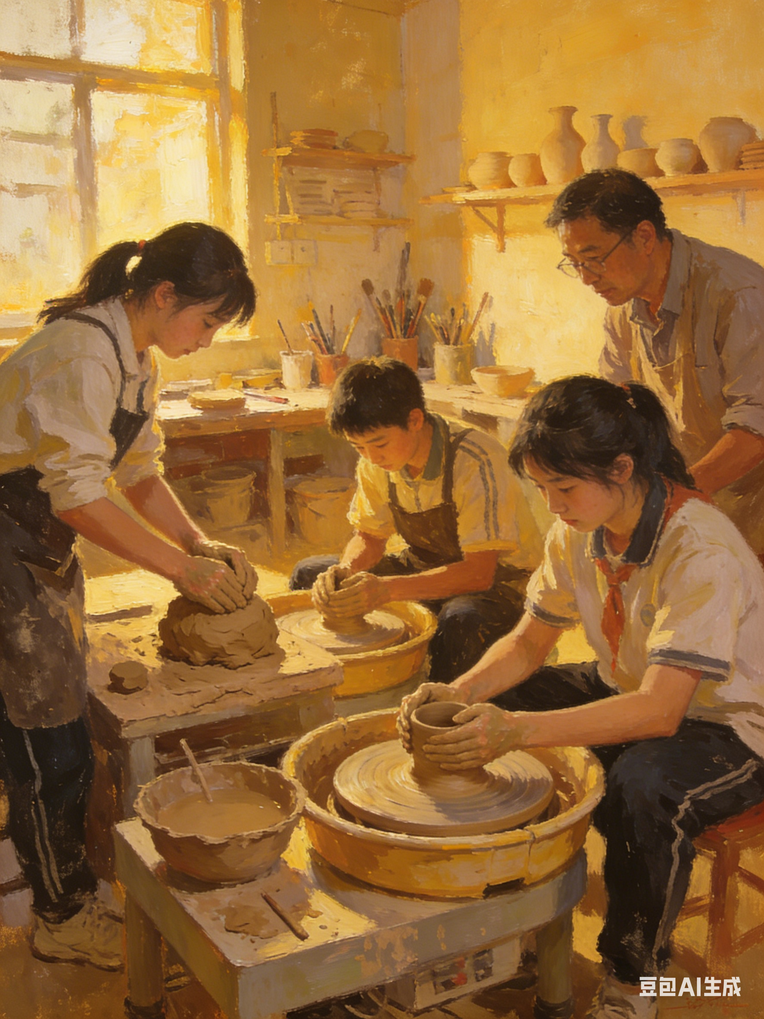
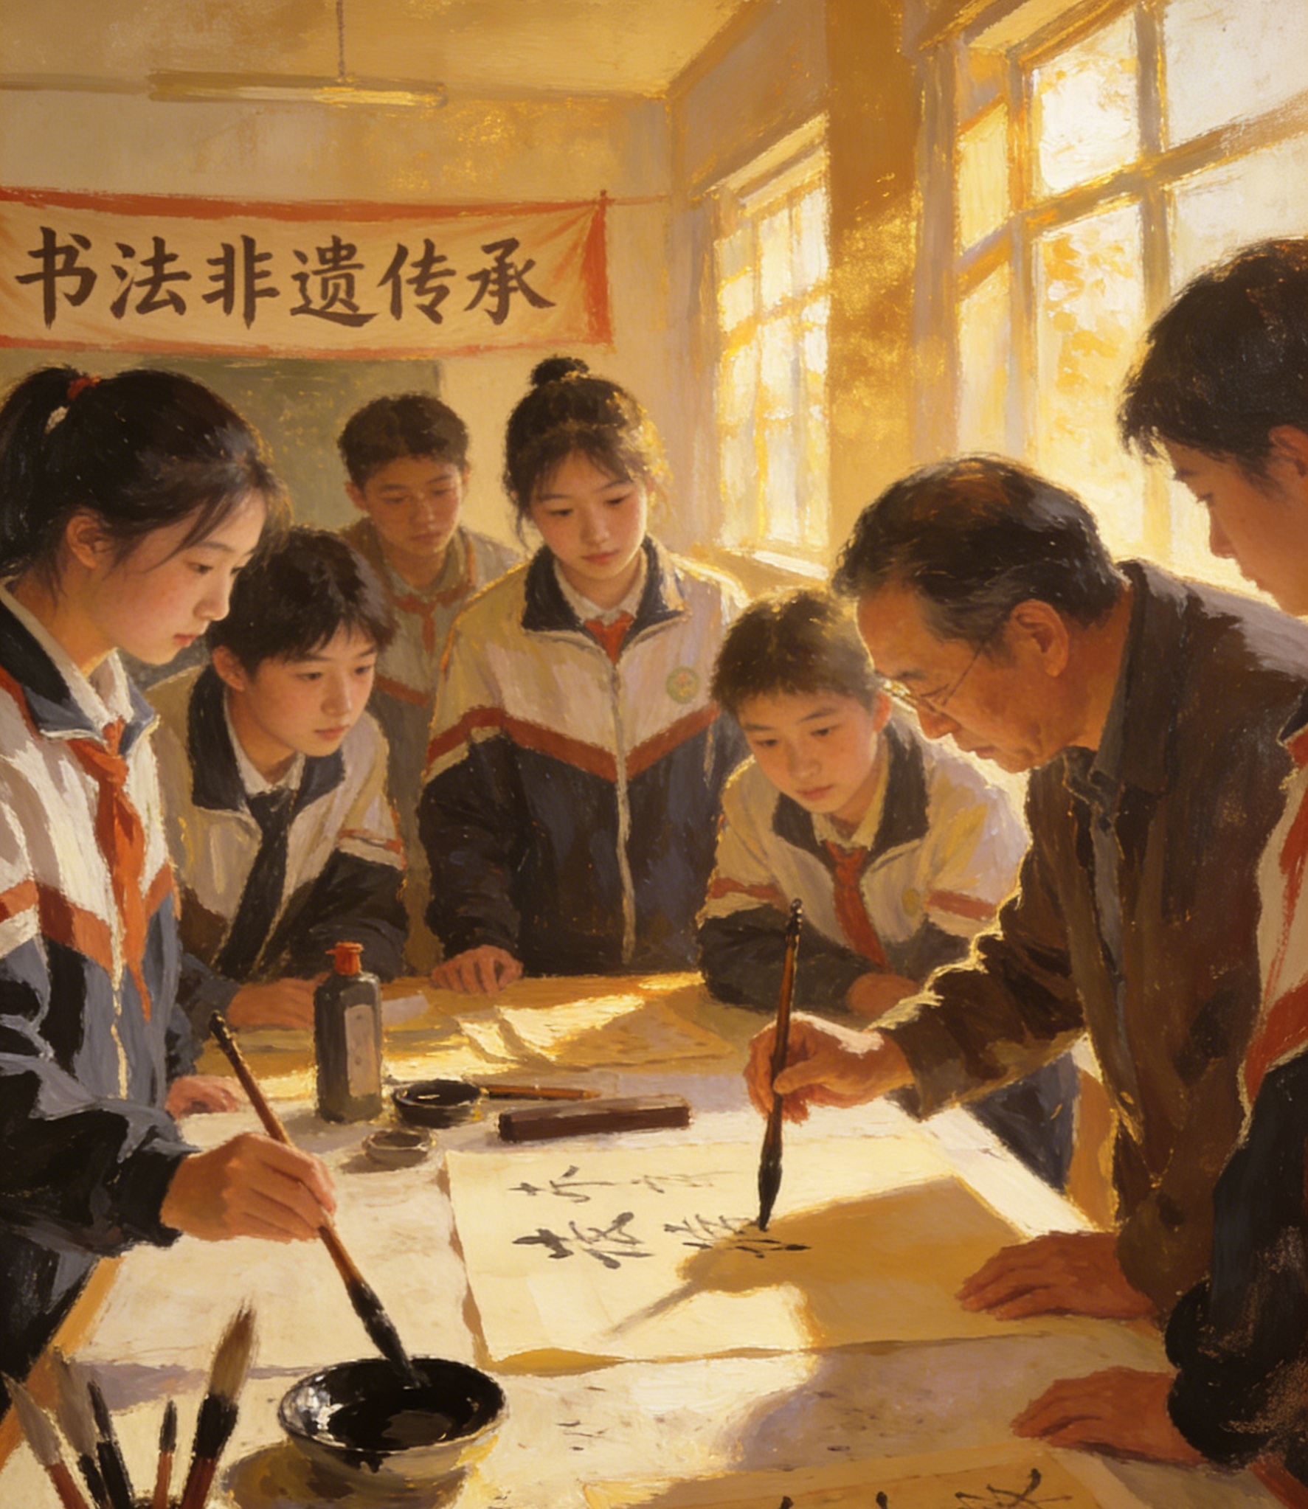
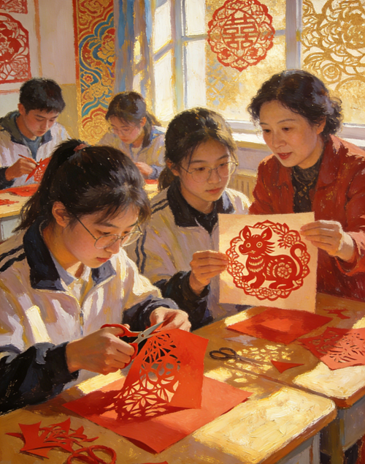
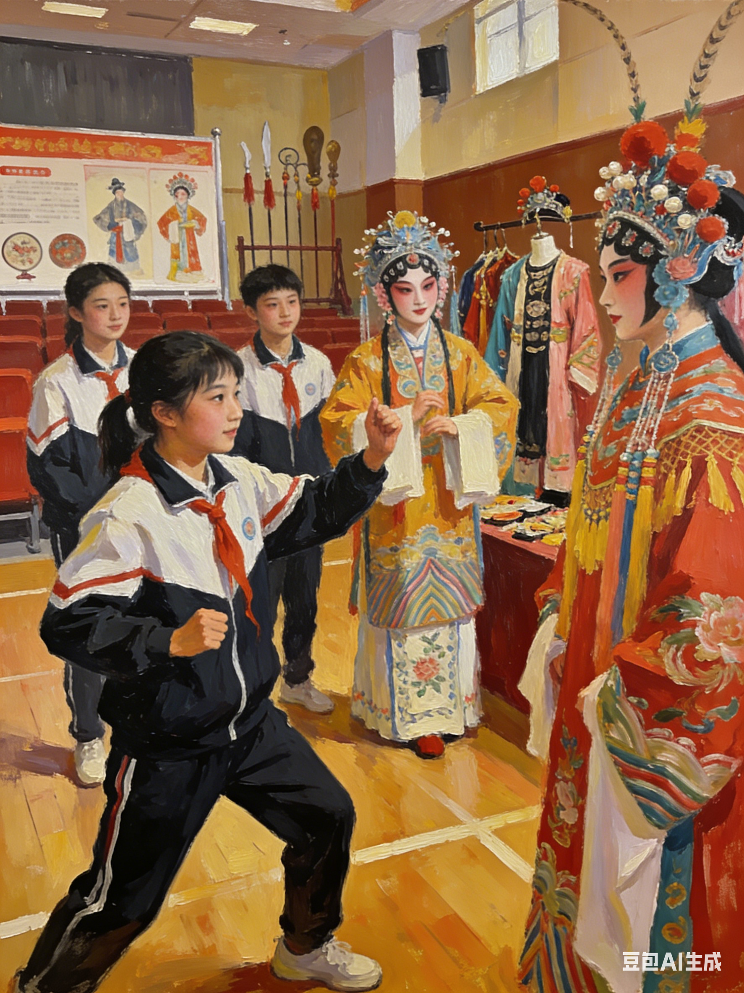
2026年2月杭州市高一上学期期末检测应用文
非遗体验类应用文写作
突破过程体验与感受评价的高分技法
刘艳

Slide 3
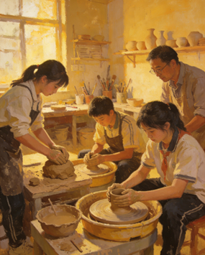
2026年2月杭州市高一上学期期末检测应用文
应用文审题表
假定你是李华，外国朋友 Peter 对中国非物质文化遗产 (Intangible Cultural Heritage) 很感兴趣，请给他写一封电子邮件，分享近期你在学校参加的一种非遗活动，如剪纸、陶艺、书法、地方戏曲等。具体内容包括:
体验过程:
你的感受。
注意:
词数应为 80 词左右。
请按如下格式在答题纸的相应位置作答。
Dear Peter,
I'm excited to tell you about a recent Intangible Cultural Heritage activity in our school.
Yours,
Li Hua
审题维度 | 具体内容
Genre (文体) | Email (电子邮件)
Tense (时态) | 1. 一般过去时 (Simple Past Tense)：描述活动过程（如 had a paper-cutting class, taught, found, practiced） 2. 一般现在时 (Simple Present Tense)：表达文化意义和个人感受（如 is a symbol of, It’s amazing）
Key Requirements (核心要点) | 1. Experience process (体验过程)：点明活动名称、时间、操作过程（遇困 - 解决 - 成果） 2. Feelings (个人感受)：结合非遗文化价值谈体会（如 proud, sense of achievement, charm of traditional art）
Content Structure (内容分层) | 1. Introduction (开头)：用给定句式引入话题，点明非遗活动主题 2. Process (主体 1)：详述活动过程，包含 “遇到困难 - 尝试解决 - 完成作品” 的逻辑 3. Feelings (主体 2)：结合作品谈个人感受，升华到非遗的文化意义 4. Conclusion (结尾)：用期待对方分享，落款署名
Tone (语气) | Friendly and Sincere (亲切真诚)，

Slide 4
瓶颈1：体验过程？
Tip：步骤拆解 + 感官互动 + 文化关联
1. 步骤拆解：按 “准备 - 尝试 - 突破 - 完成” 分层写
把单一的 “做手工” 拆成有起伏的小阶段，每个阶段加 1-2 个具体动作，对应材料里的实操优势。
准备：对应 “材料简便”，写拿到工具的细节。比如剪纸写 “we were given red paper and safety scissors”，陶艺写 “the teacher placed a lump of soft clay on my wheel”。
尝试：对应 “易于上手但有挑战”，写初次操作的小困难。比如剪纸写 “At first, my scissors kept getting stuck in the paper when I tried to cut the curved petal edges”，书法写 “I failed to hold the brush properly—my hand shook so much that the ink blotted the paper”。
突破：写解决问题的动作，比如 “Following the artist’s guidance, I slowed down my movements and focused on the lines”。
完成：对应 “产出直观”，写成品的样子，比如 “Finally, a vivid fish pattern, a symbol of abundance, appeared under my scissors”。

Slide 5
瓶颈1：体验过程
Tip：步骤拆解 + 感官互动 + 文化关联
感官互动：加入 “看、触、听” 的细节，体现沉浸式体验结合材料里的互动设计要点，加入感官描写，让过程有画面感。
视觉：剪纸 “watching the artist cut a whole scene of the Spring Festival in 5 minutes”，
皮影戏 “the shadow of the Monkey King jumped on the screen when I moved the sticks”。
触觉：陶艺 “the cool clay felt smooth and sticky in my palms as the wheel spun”，
书法 “the brush glided softly over the rice paper with a light touch”。
听觉：京剧体验写“listening to the teacher explain how each facial makeup color represents a character trait”，
剪纸 “the crisp sound of scissors cutting through paper was surprisingly satisfying”。

Slide 6
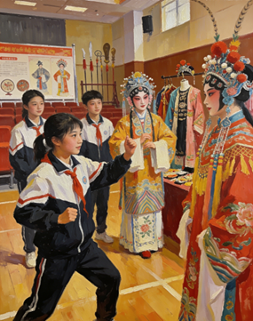
瓶颈1：体验过程
Tip：步骤拆解 + 感官互动 + 文化关联
3. 文化关联：把体验和材料里的文化价值绑定在过程中加入 1 句非遗的文化小知识，让体验不止是动手，更是懂文化。
剪纸：剪鱼图案时，加一句 “The artist told us fish symbolizes abundance in Chinese culture, so it’s a popular pattern for the Spring Festival”。
中国结：打结时，加一句 “As I tied the ‘good luck knot’, I learned it’s a symbol of harmony and an item that people often give as gifts.

Slide 7
剪纸（Paper-cutting）
分类 | 具体内容 | 英语词汇、核心短语 & 语法、修辞提升提示
四步叙事 | 准备：领取红纸、安全剪刀 尝试：剪曲线时剪刀打滑，线条不流畅 突破：放慢操作速度，跟着老师手势调整力度 完成：剪出象征富足的鱼图案 | - 核心词汇：paper-cutting, scissors, curve, pattern, abundance - 核心短语：cut out, slow down, stand for - 核心语法：一般过去时；让步状语从句；进阶非谓语动词、定语从句 - 修辞提升：高一直白叙事；高二加入感官词；高三结合文化寓意升华
三感融入 | 视觉：看老师快速剪出春节热闹场景 触觉：触摸红纸粗糙的纹理 听觉：听剪刀裁剪纸张的清脆咔嚓声 | - 词汇拓展：rough, crisp, texture, vivid - 短语搭配：touch the paper, listen to the sound, watch sb. do sth. - 修辞技巧：用感官形容词让文字更有画面感
文化点睛 | 鱼图案在中国文化中象征富足安康，是春节期间常见的吉祥纹样 | - 句型模板：... is a symbol of ... in Chinese culture - 修辞作用：用文化知识提升文章深度，避免单纯叙事

Slide 8
年级 | 汉语表达（含核心提示） | 英语表达
基础 | 上周五我们上了剪纸课，老师给我们发了红纸和剪刀，我一开始剪不好曲线，练了几次后剪出了好看的花，拿着作品特别开心（核心词汇 paper-cutting, scissors, pattern；） | Last Friday we had a paper-cutting class. Our teacher gave us red paper and scissors. I couldn't cut the curves well at first, but after practicing several times, I cut out a beautiful pattern. I felt really happy holding my work in my hands.
进阶 | 上周五的剪纸课上，我摸着粗糙的红纸，听着剪刀咔嚓的脆响跟着老师学，剪曲线时剪刀总打滑，我放慢速度反复练习，终于剪出小鱼图案，老师说鱼象征富足，我心里满是自豪（核心词汇 rough, crisp, slip, abundance；修辞触觉 + 听觉感官融入） | We attended a paper-cutting class last Friday. Touching the rough red paper and listening to the crisp sound of scissors, I tried cutting curves, but my scissors slipped often. I slowed down and kept practicing, finally making a lovely fish pattern. The artist said it stands for abundance in Chinese culture.
高级 | 上周五的剪纸工坊里，看着老师几分钟剪出热闹的春节图景，我也拿起红纸和剪刀尝试，指尖触到红纸纹路，耳边是剪刀脆响，可我总剪破鱼尾，在老师指导下稳住手腕放慢节奏，终于剪出灵动的鱼图案，这小小的剪纸藏着中国人对富足的期许，让我感受到传统艺术的温度（核心词汇 workshop, texture, vivid, expectation；修辞多感官描写 + 文化内涵升华） | Last Friday, we joined a paper-cutting workshop. Watching the artist create a lively Spring Festival scene in minutes, I tried cutting a fish with my red paper and scissors. Touching the paper’s texture and hearing the scissors’ crisp sound, I messed up the fish’s tail at first. Guided by him, I steadied my hand and slowed down, making a vivid fish pattern—a symbol of abundance that carries Chinese people’s good wishes for life.

Slide 9
陶艺（Pottery-making）
分类 | 具体内容 | 英语词汇、核心短语 & 语法、修辞提升提示
四步叙事 | 准备：老师将软黏土放置在陶艺转盘上 尝试：黏土总往两侧坍塌，无法塑形 突破：调整双手力度，控制转盘转速 完成：做出粗糙却独一无二的小杯子 | - 核心词汇：pottery, clay, wheel, collapse, unique - 核心短语：place...on..., fall apart, adjust strength, control speed - 核心语法：一般过去时；高二让步状语从句；高三定语从句、宾语从句 - 修辞提升：高一简单叙事；高二加动作细节；高三结合文化智慧升华
三感融入 | 视觉：看老师轻松将黏土捏成光滑的碗 触觉：触摸黏土柔软黏手的质感 听觉：听陶艺转盘转动的嗡嗡声 | - 词汇拓展：buzz, soft, sticky, smooth, rough - 短语搭配：watch sb. do sth., feel the texture, listen to the buzz - 修辞技巧：用拟声词和触感词增强沉浸式体验
文化点睛 | 陶艺是中国古老的手工技艺，体现了中国人化平凡为神奇的生活智慧 | - 句型模板：... is an ancient craft that shows Chinese wisdom of turning...into... - 修辞作用：用文化价值拔高文章立意

Slide 10
陶艺（Pottery-making）
年级 | 汉语表达（含核心提示） | 英语表达
基础 | 上周我们上了陶艺课，老师教我们在转盘上捏黏土，我的黏土总塌，试了好多次才做出小杯子，捧着自己的作品特别开心（核心词汇 pottery, clay, wheel, cup；语法一般过去时、简单句；句型 S+V+how to do, S+V+adj；修辞直白叙事） | We had a pottery-making class last week. A skilled teacher showed us how to shape clay on the wheel. At first, my clay kept falling apart, but I didn’t give up. After many tries, I made a small and cute cup. I felt so happy holding my own work.
进阶 | 上周的陶艺课上，转盘嗡嗡转动，我摸着软乎乎的黏土跟着老师塑形，黏土总往两边塌，我调整双手力度反复尝试，终于做出小杯子，捧着微凉的成品，成就感满满（核心词汇 buzz, sticky, adjust, achievement；with 复合结构；句型 with + 宾语 + doing；修辞听觉 + 触觉感官融入） | We had a pottery-making class last week. With the wheel buzzing, I touched the soft clay and tried to shape it. It kept collapsing, but I adjusted my hand strength and tried again and again, finally making a small cup. Holding the cool work, I felt a strong sense of achievement.
高级 | 上周的陶艺工坊里，看着老师把一团黏土变成光滑的碗，我也学着上手，柔软的黏土在指尖黏糊糊的，总往两边塌，在老师指导下我平衡手劲、放慢转盘转速，终于做出粗糙却独特的小杯子，这杯子藏着化平凡为神奇的传统智慧，让我心生敬佩（核心词汇 workshop, lump, smooth, wisdom；修辞多感官描写 + 文化内涵升华） | Last week, we participated in a pottery workshop. Watching the teacher turn a lump of clay into a smooth bowl easily, I tried to follow his steps. The soft, sticky clay kept falling apart in my hands. Guided by him, I balanced my hand strength and slowed the wheel speed, making a rough but unique cup that reflects the ancient Chinese wisdom of turning ordinary things into art.

Slide 11
书法项目（Calligraphy）
分类 | 具体内容 | 英语词汇、核心短语 & 语法、修辞提升提示
四步叙事 | 准备：领取毛笔、宣纸、墨水 尝试：握笔姿势错误，手抖导致墨水晕开 突破：老师纠正握笔姿势，静心练习笔画 完成：写出工整的 “福” 字 | - 核心词汇：calligraphy, brush, ink, blot, neat - 核心短语：hold the brush, correct the grip, calm down, write the character - 核心语法：一般过去时；高二让步状语从句；高三非谓语动词、定语从句 - 修辞提升：高一简单动作描写；高二加问题解决过程；高三结合修身内涵升华
三感融入 | 视觉：看老师写出流畅舒展的笔画 触觉：触摸毛笔柔软的笔尖 听觉：听老师讲解 “福” 字的文化寓意 | - 词汇拓展：tip, smooth, stiff, blessing, cultivation - 短语搭配：watch the strokes, touch the tip, explain the meaning - 修辞技巧：用动作细节体现书法的 “静心” 特质
文化点睛 | “福” 字在中国文化中代表福气与好运，书法是中国人修身养性的传统方式 | - 句型模板：The character "fu" stands for... in Chinese culture. Calligraphy is a way to cultivate one’s mind. - 修辞作用：结合书法的文化功能，丰富文章内涵

Slide 12
书法项目（Calligraphy）
年级 | 汉语表达（含核心提示） | 英语表达
基础 | 昨天我们上了书法课，老师给我们毛笔和宣纸，我一开始握笔姿势不对，写得很丑，练了好久终于写好 “福” 字，拿着作品特别自豪（核心词汇 calligraphy, brush, ink, character；） | We had a calligraphy class yesterday. The teacher gave us brushes and rice paper. At first, I held the brush in the wrong way and wrote badly. After practicing for a long time, I finally wrote a neat character "fu" (blessing). I felt so proud holding my work.
进阶 | 昨天的书法课上，我摸着毛笔柔软的笔尖，听老师讲解 “福” 字的寓意，我握笔姿势僵硬，手一抖墨水就晕开了，老师纠正我的姿势后，我沉下心练习，终于写出工整的 “福” 字，深深感受到书法的魅力（核心词汇 tip, blot, grip, charm；修辞触觉 + 听觉感官融入） | We had a calligraphy class yesterday. Touching the brush’s soft tip and listening to the teacher explain the meaning of "fu", I tried to write it with a stiff grip. My hand shook and the ink blotted the paper. After the teacher corrected my grip, I calmed down and practiced, finally writing a neat "fu". I deeply felt the charm of this traditional art.
高级 | 昨天的书法工坊里，看着老师挥毫写下流畅舒展的 “福” 字，我也迫不及待地尝试，我握笔姿势不对，指尖的毛笔抖个不停，墨水在宣纸上晕出污渍，老师耐心指导我握笔的力度和角度，告诉我书法讲究静心，我调整呼吸慢慢书写，终于写出工整的 “福” 字，这个字不仅是祝福，更藏着中国人修身养性的文化追求（核心词汇 workshop, stiff, cultivation, pursuit；句型 V-ing 作状语；修辞多感官描写 + 文化内涵升华） | Yesterday, we attended a calligraphy workshop. Watching the teacher write a smooth and graceful character "fu" with his brush, I couldn’t wait to try. With a wrong grip, my hand shook badly and the ink blotted the rice paper. The teacher patiently guided me on the brush-holding strength and angle, telling me that calligraphy requires a calm mind. I adjusted my breath and wrote slowly, finally creating a neat "fu"—a character that carries not only good wishes but also the Chinese cultural pursuit of self-cultivation.

Slide 13
瓶颈2：非遗活动感受评价
Tip：个人 - 技艺 - 文化’的逻辑
梯度 | 句型类型 | 核心句型 | 英文例句（结合非遗）
基础 | 1. 表达成就感 2. 赞叹技艺神奇 | 1. I felt + 形容词 (proud /happy) 2. It’s + 形容词 (amazing) + that 从句 | 1. Holding my paper-cutting work, I felt so proud. 2. It’s amazing that a piece of red paper can become a beautiful pattern.
进阶 | 1. 表达深层成就感 2. 感悟文化魅力 3. 肯定艺人智慧 | 1. I got a strong sense of achievement from... 2. This activity made me feel the unique charm of... 3. I realized the great wisdom of folk artists through... | 1. I got a strong sense of achievement from making my own pottery cup. 2. This calligraphy class made me feel the unique charm of Chinese traditional art. 3. I realized the great wisdom of folk artists through learning shadow puppetry.
高阶 | 1. 双重感受递进 2. 强调文化价值 3. 升华文化感悟 | 1. Not only did I ..., but I also ...（倒装结构） 2. It is ... that ...（强调句） 3. ..., which carries ... and makes me ...（非限制性定语从句） | 1. Not only did I finish a vivid paper-cut fish, but I also understood its meaning of abundance. 2. It is these traditional crafts that form the cultural foundation of our nation. 3. My small pottery cup, which took me many tries to make, carries the ancient wisdom of turning ordinary clay into art and makes me respect traditional culture deeply.

Slide 14

下水作文1：剪纸主题 (Paper-cutting)
Dear Peter,
I'm excited to tell you about a recent Intangible Cultural Heritage activity in our school. We attended a paper-cutting workshop last Friday. A folk artist gave us rough red paper and sharp scissors, and demonstrated how to cut a vivid fish pattern step by step.
At first, my scissors slipped constantly when I tried to cut the curved lines. I slowed down and focused on each move, and finally made a delicate work. The artist told us the fish symbolizes abundance in Chinese culture.
Holding it in my hand, I felt a strong sense of achievement. This activity let me deeply appreciate the unique charm of this traditional craft.
Looking forward to your share!
Yours,
Li Hua

Slide 15
下水作文2：陶艺主题 (Pottery-making)
Dear Peter,
I'm excited to tell you about a recent Intangible Cultural Heritage activity in our school. Our school held a pottery-making class last week. A skilled teacher taught us to knead soft clay and shape it on the spinning wheel.
At the beginning, my clay kept collapsing no matter how I tried to adjust my strength. I didn’t give up and practiced repeatedly. With the teacher’s guidance, I finally made a small but unique cup with a smooth surface.
Holding the cool cup, I was filled with pride. It’s really magical that ordinary clay can be turned into a wonderful artwork, which fully shows the wisdom of ancient craftsmen. Looking forward to your share!
Yours,
Li Hua

Slide 16
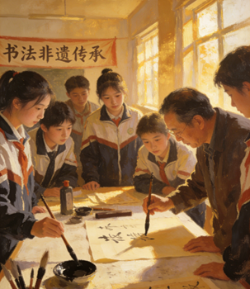
下水作文3：书法主题 Calligraphy
Dear Peter,
I'm excited to tell you about a recent Intangible Cultural Heritage activity in our school. We had a meaningful calligraphy class yesterday. The teacher first showed us the correct way to grip the brush and write the graceful character "fu", which stands for blessing.
At first, my hand shook badly and the ink blotted the rice paper. I followed the teacher’s advice to calm down and practice every stroke carefully. Finally, I wrote a neat and elegant "fu".
Looking at my work, I felt extremely proud. This activity not only taught me a new skill, but also let me feel the profound beauty of Chinese traditional culture.
Looking forward to your share!
Yours,
Li Hua

Slide 17

参考范文1
Dear Peter,
I’m excited to tell you about a recent Intangible Cultural Heritage activity in our school. We had a paper-cutting class last Friday. A folk artist taught us patiently. At first, I found it hard to control the scissors, but after practicing several times, I successfully cut out a beautiful flower pattern. When I held my work in hand, I felt so proud.
Paper-cutting is not just a skill but also a symbol of Chinese culture. It’s amazing how a piece of paper can turn into art.
Looking forward to your similar share!
Yours,
Li Hua

Slide 18

参考范文2
Dear Peter,
I’m excited to tell you about a recent Intangible Cultural Heritage activity in our school. We had a pottery-making class last week. A skilled teacher showed us how to shape clay on the wheel. At first, my clay kept falling apart, but I didn’t give up. After many tries, I made a small and cute cup. Holding my own work, I felt a strong sense of achievement.
This activity let me feel the charm of traditional art. It’s really amazing how simple clay can turn into wonderful things.
Looking forward to your similar share!
Yours,
Li Hua

