Slide 1


感恩遇见，相互成就，本课件资料仅供您个人参考、教学使用，严禁自行在网络传播，违者依知识产权法追究法律责任。
更多教学资源请关注
公众号：溯恩英语
知识产权声明

Slide 2
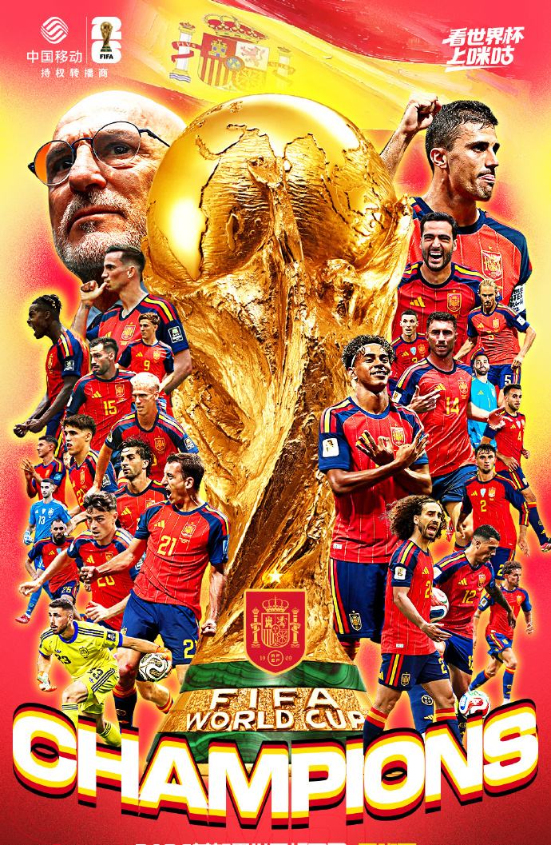
The 2026 World Cup ends with Spain standing on the top of the world.
世界杯圆满收官，西班牙登顶世界足坛之巅。

Slide 3
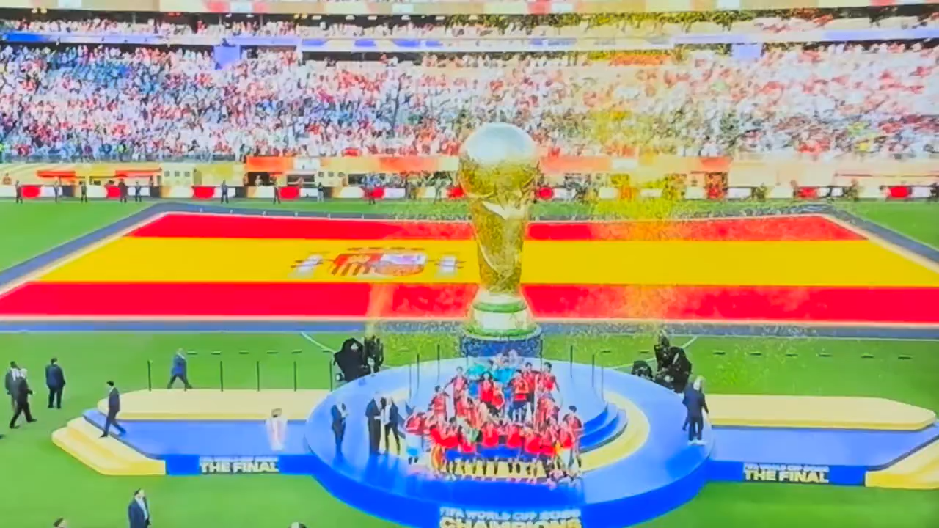

Slide 4
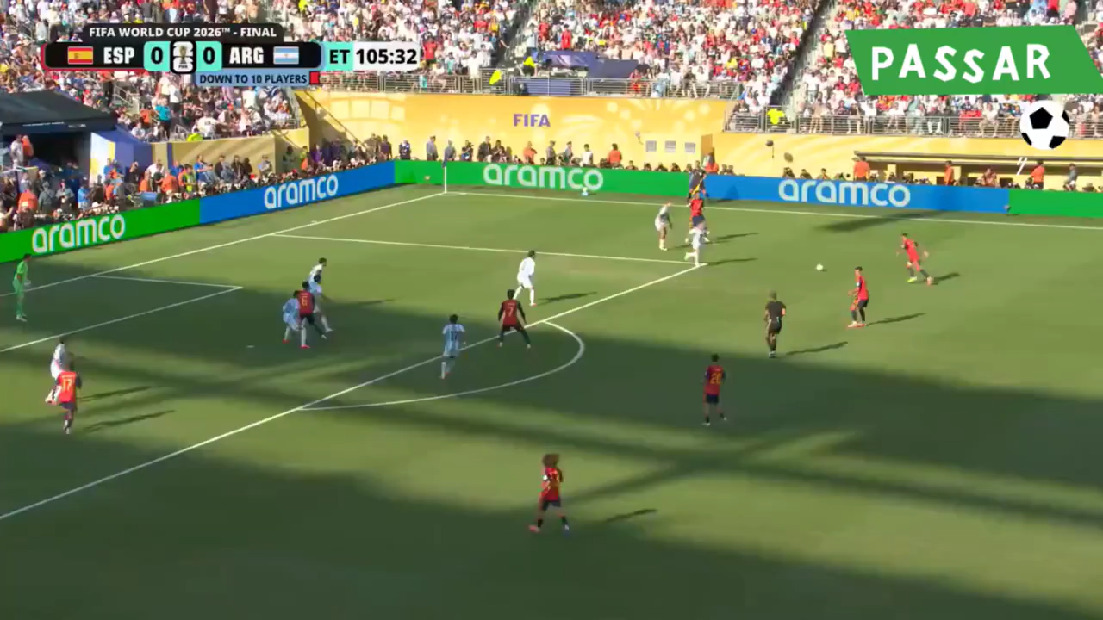

Slide 5
Spain
On July 20th, 2026, 1.______ (Spainish) won 2.______ World Cup final. They beat Argentina (阿根廷) 1-0 in extra time. The match was very close. Both teams played hard, but no one 3.______ (score) in regular time. Then in the 106th minute, Ferran Torres scored a great goal. He came off the bench and hit the ball 4.______ the net. It was the only goal of the game.
Argentina ran into big trouble late in the game. Enzo Fernández got a second yellow card and 5.______ (send) off. So Argentina had only ten players 6.______ extra time. That made it much 7.______ (difficult) for them to fight back. Spain played far better. They took 20 shots, 8.______ Argentina had only two. Spain's goalkeeper Unai Simón hardly had any work 9.______ (do). This is Spain's 10.______ (two) World Cup title. They last won in 2010. It was a wonderful night for Spanish football.
the
scored
into
was sent
in
more difficult
while
to do
second

Slide 6
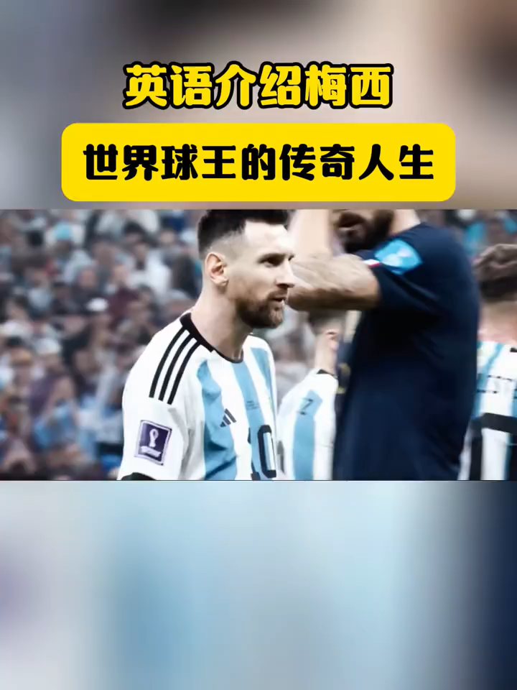
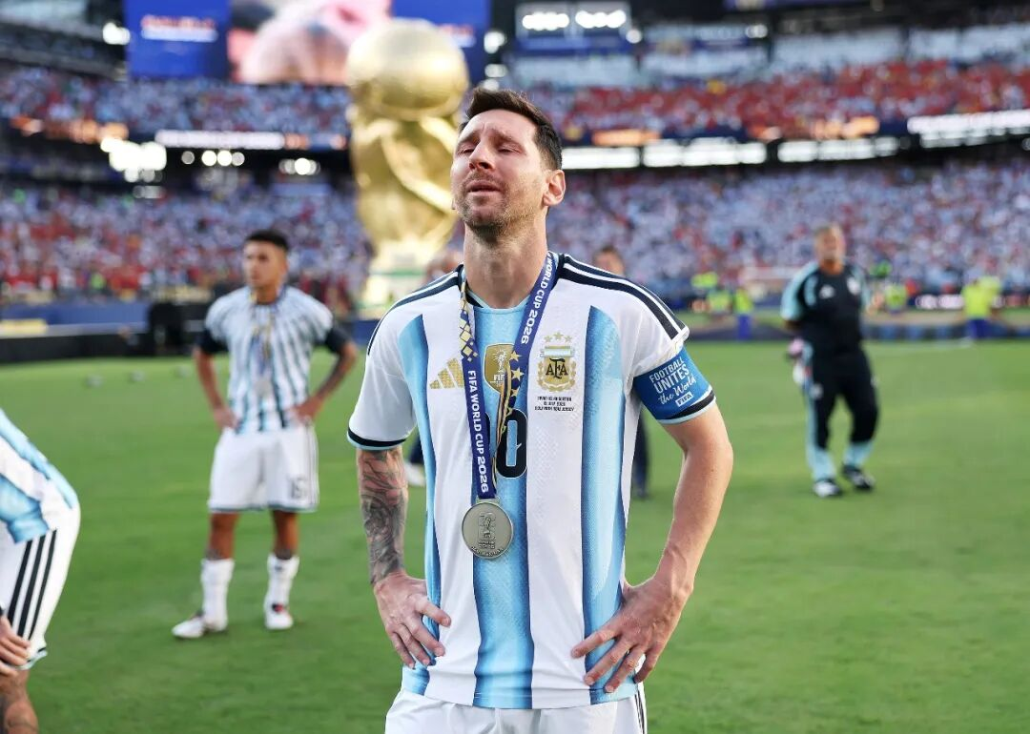
Messi Is Not a Miracle.
He’s Messi.

Slide 7
This is the story of Lionel Messi, born in Argentina in 1987. Messi was a football genius from 1.______young age, but behind the magic was a difficult journey.
As a child, he faced growth hormone deficiency and had to leave his hometown at just 13 years old 2. (pursue) his dream in Spain. At Barcelona, this quiet boy from Argentina became a global icon with his unbelievable dribbling, vision and creativity. Messi 3. (change) the way football was played. He won countless trophies, collected multiple Ballon d’Or awards and broke record after record.
But for years, one question remained — could he win the World Cup with Argentina? In 2022, Messi finally answered that question. He lifted the World Cup trophy and completed the dream 4.______ had followed him throughout his career.
But the story was not over. At the 2026 FIFA World Cup, the 39-year-old captain continued 5. (lead) Argentina on football's biggest stage, guiding his team to a second consecutive World Cup final. No longer just the player 6. creates magic with the ball, Messi became a leader 7.______(inspire) an entire generation.
From a small boy who once doubted whether he could reach the top 8.______ a legend still chasing greatness decades later, Messi's journey is more than a football story. It is a story about dreams, resilience and never 9. (give) up, because legends do not simply leave history behind, they continue 10. (write) it.
a
to pursue
changed
that /which
to lead
who
inspiring
to
giving
to write

Slide 8
英文新闻报道
假定你是校英文报记者，请根据所给信息，写一篇英文新闻报道。
要点：
比赛时间：2026 年 7 月 20 日世界杯决赛
对阵双方：西班牙（Spain 西班牙）VS 阿根廷（Argentina 阿根廷）
常规时间双方均无进球；第 106 分钟替补登场的费兰・托雷斯打入制胜一球
阿根廷球员恩佐两黄变一红被罚下，加时赛少一人作战
赛事数据：西班牙射门 20 次，阿根廷仅 2 次；西班牙门将几乎没有扑救任务
这是西班牙队队史第二座世界杯冠军奖杯，上一次夺冠为 2010 年

Slide 9
Spain Wins 2026 World Cup Championship
On July 20th, 2026, the World Cup final took place between Spain (西班牙) and Argentina (阿根廷).
The two sides fought fiercely yet neither team scored during regular time. In the 106th minute, Ferran Torres, a substitute player, scored the winning goal.
Later, Enzo Fernández of Argentina received two yellow cards and was sent off, leaving his team with ten players in extra time. Spain totally had 20 shots while Argentina only had two. Spain’s goalkeeper barely needed to make any saves.
This marks Spain’s second World Cup title, with their first championship coming back in 2010.

Slide 10
体育新闻高频核心词汇
赛事与赛程类
final /ˈfaɪnl/n. 决赛
semi-final /ˌsemiˈfaɪnl/n. 半决赛
quarter-final /ˌkwɔːtə ˈfaɪnl/n. 四分之一决赛
tournament /ˈtʊənəmənt/n. 锦标赛、杯赛
fixture /ˈfɪkstʃə(r)/n. 既定赛程、场次
regular time 常规比赛时间
extra time 加时赛
penalty shoot-out 点球大战
kick-off 开赛、开球
full time 全场比赛结束
胜负与夺冠类
claim the title 斩获冠军
secure the championship 锁定总冠军
lift the trophy 举起奖杯
seal the victory 锁定胜局
edge out … 险胜……
beat /defeat 击败（对手）
overcome /ˌəʊvəˈkʌm/v. 力克、逆转战胜
triumph /ˈtraɪʌmf/n.&v. 大胜、凯旋
suffer a narrow defeat 惜败
draw /drɔː/n. 平局

Slide 11
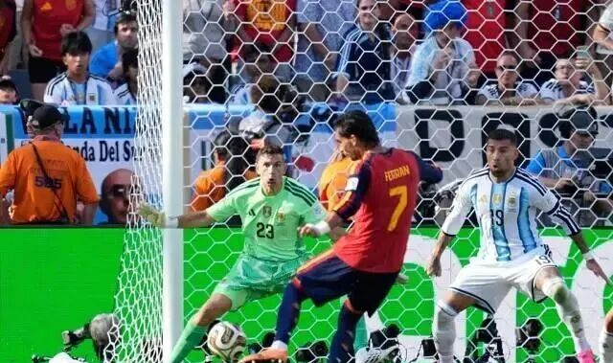
进攻、射门与得分
score a goal 破门得分
net the ball 皮球入网
winning goal 制胜球
decisive goal 决定性进球
header /ˈhedə(r)/n. 头球
strike /straɪk/n. 射门
shot /ʃɒt/n. 射门次数
assist /əˈsɪst/n. 助攻
break through 突破防线
possession /pəˈzeʃn/n. 控球权

Slide 12
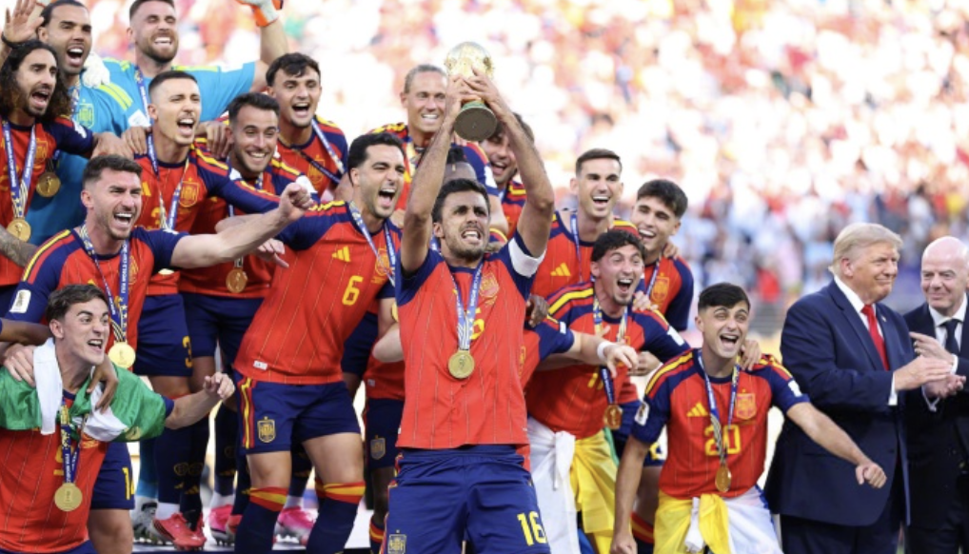
场面与局势描述
fierce competition 激烈对抗
a closely-fought game 比分胶着的比赛
dominate the game 掌控整场比赛
press the opponent 高位逼抢、施压对手
strengthen defence 加强防守
hold back the attack 阻挡进攻
run into trouble 陷入被动局面
turn the tide 扭转战局
数据与赛后评价
statistics /stəˈtɪstɪks/n. 技术统计
barely /ˈbeəli/adv. 几乎没有
remarkably /rɪˈmɑːkəbli/adv. 显著地
historic victory 具有历史意义的胜利
memorable night 难忘之夜
判罚、犯规与红黄牌
yellow card 黄牌
red card 红牌
be sent off 被罚下场
pick up two yellows 累计两张黄牌
foul /faʊl/n.&v. 犯规
penalty kick 点球
handball 手球犯规

