Slide 1

B5U2 Puzzles in Geography
Reading

Slide 2

The Union Jack
is the national flag of _____________.
the UK?
England?
Britain?
Now, we call the country
the United Kingdom
of Great Britain and Northern Ireland.
Once, we called the country
England.
Then we called it
Great Britain.
When? Why?
So puzzling!

Slide 3
People may wonder why different words are used to describe these four countries: England, Wales, Scotland and Northern Ireland. You can clarify this question if you study British history.
Puzzles
in Geography
Geography
the study of the countries, oceans, rivers, mountains, cities etc. of the world
the geography of a building, city etc. is the way all its parts are arranged
a study of British history
Puzzle
a game in which you have to think hard to solve a difficult question or problem
something that is difficult to understand or explain

Slide 4
all the things that happened in the past, especially the political, social, or economic development of a nation
a study of
British history
England Wales Scotland Northern Ireland Republic of Southern Ireland
England, Wales and Scotland
1. The countries that make up Great Britain are_______________________________________________.
2. If we speak of England we mean _____________________________________________________________.
3. The United Kingdom includes ________________________________________________________________.
4. The part of Ireland that separated from England is called _________________________________.
5. London is the capital city of ___________________________________________________________________.
England and Wales
England, Wales, Scotland and Northern Ireland
Republic of Southern Ireland
England

Slide 5
1. How was the UK formed?
2. What was the author’s attitude toward the formation of the “Great Britain”?
A. Approval B. Critical C. Neutral
peaceful
The formation of the UK is generally_____________.
First there was England. Wales was linked to it in the thirteenth century. Now when people refer to England you find Wales included as well. Next England and Wales were joined to Scotland in the seventeenth century and the name was changed to “Great Britain”. Happily this was accomplished without conflict when King James of Scotland became king of England and Wales as well. Finally the English government tried in the early twentieth century to form the United Kingdom by getting Ireland connected in the same peaceful way. However, the southern part of Ireland was unwilling and broke away to form its own government. So only Northern Ireland joined with England, Wales and Scotland to become the United Kingdom and this was shown to the world in a new flag called the Union jack.
First there was England. Wales was linked to it in the thirteenth century. Now when people refer to England you find Wales included as well. Next England and Wales were joined to Scotland in the seventeenth century and the name was changed to “Great Britain”. Happily this was accomplished without conflict when King James of Scotland became king of England and Wales as well. Finally the English government tried in the early twentieth century to form the United Kingdom by getting Ireland connected in the same peaceful way. However, the southern part of Ireland was unwilling and broke away to form its own government. So only Northern Ireland joined with England, Wales and Scotland to become the United Kingdom and this was shown to the world in a new flag called the Union jack.

Slide 6

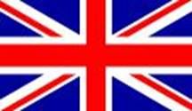


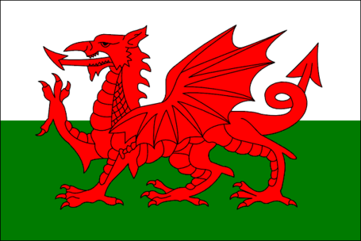
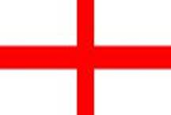
Retelling
the United Kingdom
20th century, Great Britain + Northern Ireland
Great Britain
Word Bank
join with
connect
try…to form
accomplish
change
join to
include
link
17th century, England + Wales + Scotland
England
13th century, England + Wales.
first England

Slide 7
1. What is the relationship among the four countries after the formation?
2. What is the author’s attitude towards the relationship?
A. Objective B. Negative C. Enthusiastic
3. What do you think is the benefit of relationship?
          The currency and international relations to the UK is what authority to a nation. And different institutions to each country is what identities to a nation. The relationship shows both the power and energy of the UK.
          A. education and law
          B. long established custom and practice
          C. organization and system
harmonious
The relationship among the UK is _________________.
  To their credit they do work together in some areas (eg, the currency and international relations), but they still have very different institutions. For example, Northern Ireland, England and Scotland have different educational and legal systems as well as different football teams for competitions like the world cup!
  To their credit they do work together in some areas (eg, the currency and international relations), but they still have very different institutions. For example, Northern Ireland, England and Scotland have different educational and legal systems as well as different football teams for competitions like the world cup!

Slide 8
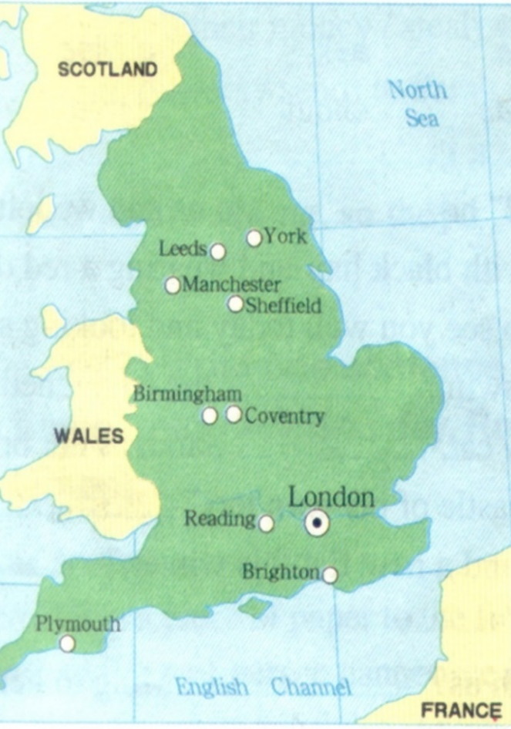
1. What is the division of England?
2. What is the characteristic of each division?
3. What is the author’s attitude towards the division of England?(Evidence)
Mixed feelings.
beneficial
The division of England is _______________ for geographical reasons.
England is the largest of the four countries, and for convenience it is divided roughly into three zones. The zone nearest France is called the South of England, the middle zone is called the Midlands and the one nearest to Scotland is known as the North. You find most of the population settled in the south, but most of the industrial cities in the Midlands and the North of England. Although, nationwide, these cities are not as large as those in China, they have world-famous football teams and some of them even have two! It is a pity that the industrial cities built in the nineteenth century do not attract visitors. For historical architecture you have to go to older but smaller towns built by the Romans. There you will find out more about British history and culture.
England is the largest of the four countries, and for convenience it is divided roughly into three zones. The zone nearest France is called the South of England, the middle zone is called the Midlands and the one nearest to Scotland is known as the North. You find most of the population settled in the south, but most of the industrial cities in the Midlands and the North of England. Although, nationwide, these cities are not as large as those in China, they have world-famous football teams and some of them even have two! It is a pity that the industrial cities built in the nineteenth century do not attract visitors. For historical architecture you have to go to older but smaller towns built by the Romans. There you will find out more about British history and culture.
England is the largest of the four countries, and for convenience it is divided roughly into three zones. The zone nearest France is called the South of England, the middle zone is called the Midlands and the one nearest to Scotland is known as the North. You find most of the population settled in the south, but most of the industrial cities in the Midlands and the North of England. Although, nationwide, these cities are not as large as those in China, they have world-famous football teams and some of them even have two! It is a pity that the industrial cities built in the nineteenth century do not attract visitors. For historical architecture you have to go to older but smaller towns built by the Romans. There you will find out more about British history and culture.
North
Midlands
South

Slide 9
1. Why is London the greatest historical treasure of all?
2. What contributed to the greatest historical treasure? (Who and how)
admirable
London, the greatest historical treasure of all is _________________.
The greatest historical treasure of all is London with its museums, art collections, theatres, parks and buildings. It is the center of national government and its administration. It has the oldest port built by the Romans in the first century AD, the oldest building begun by the Anglo-Saxons in the 1060s and the oldest castle constructed by later Norman rulers in 1066. There have been four sets of invaders of England. The first invaders, the Romans, left their towns and roads. The second, the Anglo-Saxons, left their language and their government. The third, the Vikings, influenced the vocabulary and place-names of the North of England, and the fourth, the Normans, left castles and introduced new words for food.
The greatest historical treasure of all is London with its museums, art collections, theatres, parks and buildings. It is the center of national government and its administration. It has the oldest port built by the Romans in the first century AD, the oldest building begun by the Anglo-Saxons in the 1060s and the oldest castle constructed by later Norman rulers in 1066. There have been four sets of invaders of England. The first invaders, the Romans, left their towns and roads. The second, the Anglo-Saxons, left their language and their government. The third, the Vikings, influenced the vocabulary and place-names of the North of England, and the fourth, the Normans, left castles and introduced new words for food.
The greatest historical treasure of all is London with its museums, art collections, theatres, parks and buildings. It is the center of national government and its administration. It has the oldest port built by the Romans in the first century AD, the oldest building begun by the Anglo-Saxons in the 1060s and the oldest castle constructed by later Norman rulers in 1066. There have been four sets of invaders of England. The first invaders, the Romans, left their towns and roads. The second, the Anglo-Saxons, left their language and their government. The third, the Vikings, influenced the vocabulary and place-names of the North of England, and the fourth, the Normans, left castles and introduced new words for food.
The greatest historical treasure of all is London with its museums, art collections, theatres, parks and buildings. It is the center of national government and its administration. It has the oldest port built by the Romans in the first century AD, the oldest building begun by the Anglo-Saxons in the 1060s and the oldest castle constructed by later Norman rulers in 1066. There have been four sets of invaders of England. The first invaders, the Romans, left their towns and roads. The second, the Anglo-Saxons, left their language and their government. The third, the Vikings, influenced the vocabulary and place-names of the North of England, and the fourth, the Normans, left castles and introduced new words for food.

Slide 10
Summary
1. What puzzles in geography are settled?
The formation of the UK
The relationship among the four countries
The division of England(three zones)
London(the greatest historical treasure) and the invaders
2. How are they settled in the passage?
By displaying facts in the third person view.
3. What is the author’s attitude towards the UK?

Slide 11
Group work
Suppose you are a tour guide and you are delivering a speech advertising a tour named Finding Answers to the Geographical Puzzles of the UK. You are expected to include the following points in your speech.
The following expressions may also help you:
First…be linked to;
Next…be joined to; be accomplished without… when…;
…tried…to form…by… peaceful… However,…be unwilling and… So…
To their credit…do work together…but…
…be divided into… be called… be known as… population… industry…
the greatest treasure of all… four sets of invaders… The first…The second… The third…and the fourth…
The formation of the UK
The relationship among the four countries
The division of England(three zones)
London and the invaders
You may start and end your speech like this:
In general, the UK, has a … (long/complicated, etc.) history.
…
In a word, you’ll find it worthwhile and enjoyable if you travel in the UK.

Slide 12
Assignment
1. Polish your writing for your speech and share it in the class next period.
2. Surf the Internet and find more information about the UK and the history.

