Slide 1

B2U2 An Interview
Reading

Slide 2


Welcome to the Olympics

Slide 3

Challenge your memory.

Slide 4
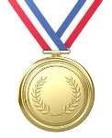
How much do you know about the Olympics?
1. Which country started the ancient Olympics?
A. Greece B. America C. South Africa
2. What was rewarded to the winners in the ancient Olympics?
A. Medals B. Money C. Olive wreath
3. When and where did the modern Olympics begin?
A. 1896; Olympia B. 1896; Athens
C. 1900; Olympia D. 1900; Athens
4. What events are held in the modern Olympics?

Slide 5
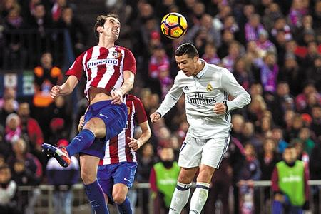
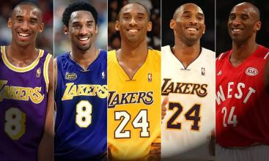
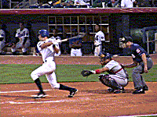
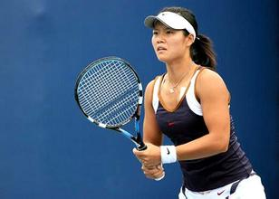
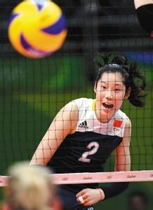
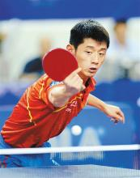
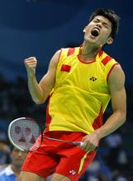
Ball Games
football (soccer)
basketball
baseball
The Pride of China
tennis
volleyball
table tennis
badminton

Slide 6
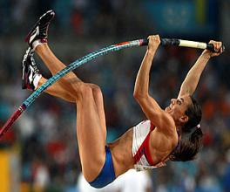
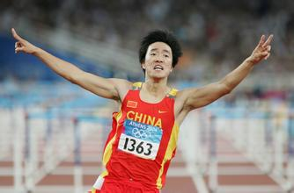
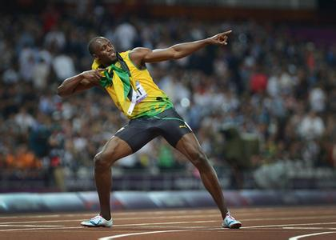
Track and Field
pole jump
hurdling
running

Slide 7
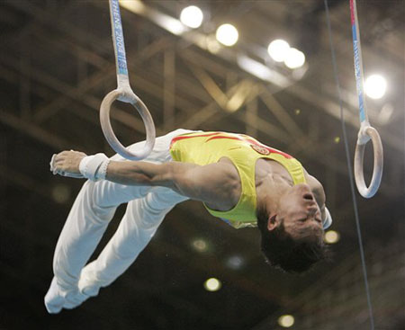
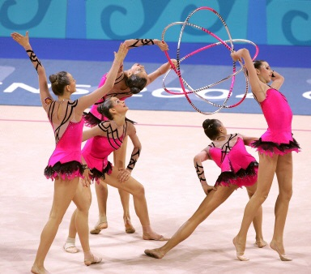
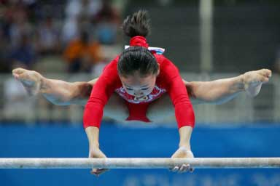
[dʒim'næstiks]
Gymnastics

Slide 8
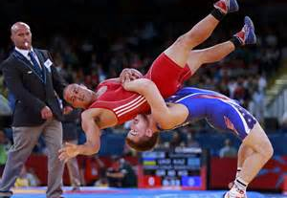
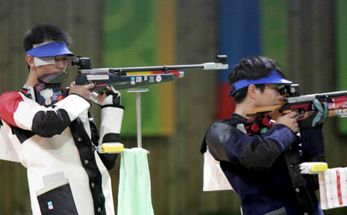
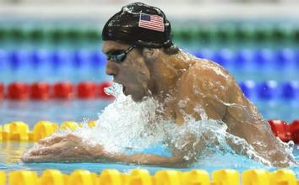
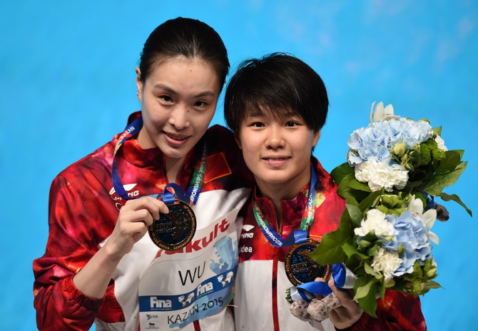
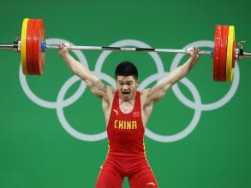
Others
wrestling
shooting
swimming
diving
weight-lifting

Slide 9
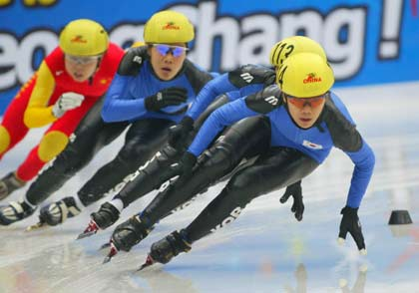
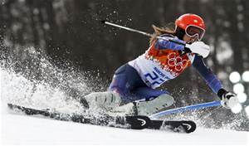
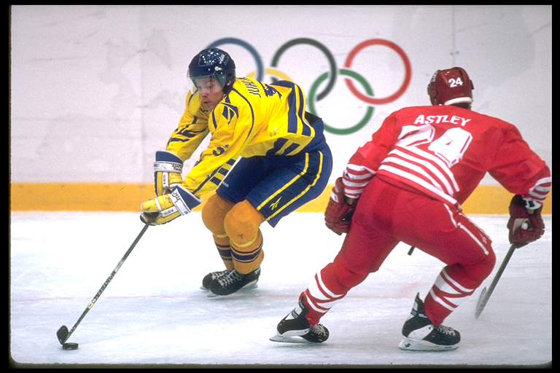
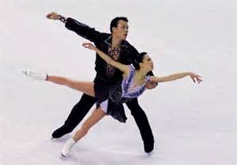
Some Sports Games in Winter
skating
skiing
ice ball
figure skating
花样滑冰
…

Slide 10
The motto of the Olympics:
Swifter, Higher and Stronger.

Slide 11
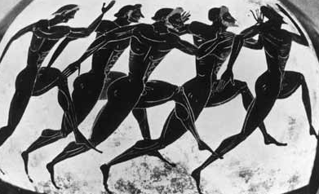
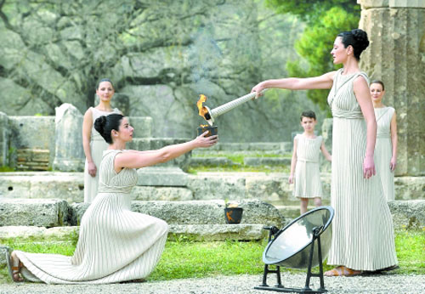
Knowledge about the Olympics
1. Ancient Olympics started in Greece.
2. Winners were rewarded olive wreath in Ancient Olympics.
3. Modern Olympics began in Athens in 1896.
4. Events in Modern Olympics include ball games, track and field, gymnastics, sports games in winter and so on.

Slide 12
The Olympic Games
The Olympic Games
  Ancient Olympics & Modern Olympics
  history (origin)
  time and place
  events
  the motto
  athletes (Olympic stars) …
Notes:
From the video, what do you know about the Olympics?

Slide 13
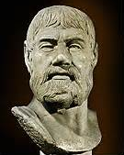

Pausanias, a Greek writer about 2,000 years ago
to learn about the modern Olympics
Li Yan, a Chinese volunteer for the 2008 Olympic Games
An Interview
Notes:
What does he want to know about the Olympics?
How does he find about the modern Olympics?

Slide 14
Step 1: Read for structure
1. What questions directly help Pausanias learn about the modern Olympics?
  How often do you hold your Games?
  Where are all the athletes housed?
  Does anyone want to host the Olympic Games?
2. What questions indirectly help Pausanias learn about the modern Olympics?
  Winter Games? How can the runners enjoy competing in winter? And what about the horses?
  Do you mean the Greek world?
  Did you say medals? Do you compete for prize money too?

Slide 15
Step 2: Read for detailed information.
prepared questions:
1. What questions directly help Pausanias learn about the modern Olympics?
  How often do you hold your Games?
  Where are all the athletes housed?
  Does anyone want to host the Olympic Games?
2. What questions indirectly help Pausanias learn about the modern Olympics?
  Winter Games? How can the runners enjoy competing in winter? And what about the horses?
  Do you mean the Greek world?
  Did you say medals? Do you compete for prize money too?
time/frequency
place/facility
host country
unprepared questions:
event
athlete
prize
Notes:
1. Is this interview successful?

Slide 16
  1. What do you think of Pausanias as an interviewer?
  He’s an experienced interviewer.
2. Any more details to show he’s experienced?
  My name is…, I’ve come to find out…May I ask you…?
  How interesting! Thank you so much for…
  Please wait a minute! All those events, all those countries and even women taking part?
to introduce himself & state purpose
to express thanks
to make sure the information is correct

Slide 17
A successful interview often includes:
  self-introduction
  the purpose of the interview
  prepared & unprepared questions (to the topic)
  thanks

Slide 18
Step 3: Make an interview.
If you were Li Yan, interview Pausanias to learn about the ancient Olympics.
time (how often)
event (what)
athlete (who)
host country
prize
every four years
running; horse riding
no slaves nor women
Greece
olive wreath
on a regular basis | reach the agreed standard
be admitted as competitors | for the honor of winning
compete against…for… | a great responsibility and honor

Slide 19
Step 4: Identify facts and inquire relations.
Similarities & Differences
one set of Games
no women nor slaves
only Greece
two main sets of Games
athletes who have reached the standard
competitors from all over the world
776 BC
394 AD
1896
Ancient Olympics
be held every four years
have running races
no prize money for winners
Modern Olympics
In a word, the Olympics are _____________________________.
making progress/ developing/improving
Notes:
What are the similarities and differences between Ancient Olympics and Modern Olympics?

Slide 20
Step 5: Write a paragraph.
If you were Pausanias, after interviewing Li Yan, write an article about the similarities and differences of the ancient and modern Olympics.
The ancient Olympics started in 776 BC while the modern Olympics appeared in the year of 1986.
Although the ancient and modern Olympics share some similarities, they are different in some ways.
fact
√
opinion
____________+ _____________ = ______________
an opinion
several facts (to the opinion)
a paragraph
Notes:
The topic sentence must present both a subject and an attitude toward that subject.
The topic sentence determines everything that follows.
All sentences that follow your original statement must go back to your controlling idea.

Slide 21
Step 6: Enjoying and evaluating.
Pay attention to the check points:
Is the writing well-organized?
Are the new words and expressions properly used?
Is it creative and attractive?

Slide 22
An article about the similarities and differences of the ancient and modern Olympics
Both the ancient and modern Olympics are held every four years on a regular basis. Running races are included as well. Athletes compete for the motto of the Olympics: “Swifter, Higher and Stronger.” Of course, winners will be awarded no prize money. Although the ancient and modern Olympics share some similarities, they are different in some ways. Firstly, there’s one set of Games in the former while there’re two sets of Games, mainly the Winter and the Summer Olympics in the latter. Secondly, neither slaves nor women could take part before. However, athletes who have reached the agreed standard for their event will be admitted as competitors now. Finally, different from the ancient Olympics, nowadays, every country considers it a great responsibility and honor to host the Olympics.

Slide 23
Both the ancient and modern Olympics are held every four years on a regular basis. Running races are included as well. Athletes compete for the motto of the Olympics: “Swifter, Higher and Stronger.” Of course, winners will be awarded no prize money. Although the ancient and modern Olympics share some similarities, they are different in some ways. Firstly, there’s one set of Games in the former while there’re two sets of Games, mainly the Winter and the Summer Olympics in the latter. Secondly, neither slaves nor women could take part before. However, athletes who have reached the agreed standard for their event will be admitted as competitors now. Finally, different from the ancient Olympics, nowadays, every country considers it a great responsibility and honor to host the Olympics.
Both the ancient and modern Olympics are held every four years on a regular basis. Running races are included as well. Athletes compete for the motto of the Olympics: “Swifter, Higher and Stronger.” Of course, winners will be awarded no prize money. Although the ancient and modern Olympics share some similarities, they are different in some ways. Firstly, there’s one set of Games in the former while there’re two sets of Games, mainly the Winter and the Summer Olympics in the latter. Secondly, neither slaves nor women could take part before. However, athletes who have reached the agreed standard for their event will be admitted as competitors now. Finally, different from the ancient Olympics, nowadays, every country considers it a great responsibility and honor to host the Olympics.
In a word,
the Olympics are making progress.

Slide 24

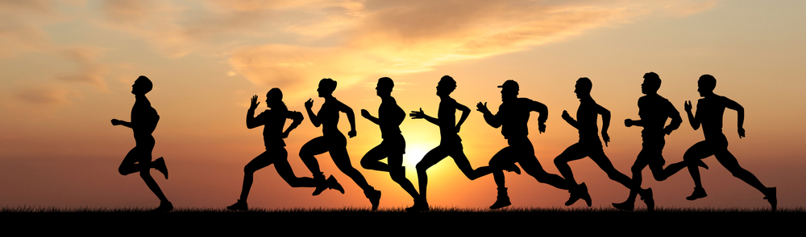
The Olympic Games help promote a better and more peaceful world.
The sports help ___________________________________
________________________
The sports help build up a stronger body and improve happiness.

Slide 25
Step 7: Homework.
Role play the interview (pair work);
Finish writing the paragraph and share a possible version with the rest of the class;
Appreciate the improved version of writing and memorize the ways to express comparison(类比) and contrast(对比). (individual work)

