Slide 1


扫码关注
回复：hello sun
获取课件制作、录课等实用工具包
知识产权声明
感恩遇见，相互成就，本课件资料仅供您个人参考、教学使用，严禁自行在网络传播，违者依知识产权法追究法律责任。
更多教学资源请关注
订阅号：溯恩英语

Slide 2

Carol

Slide 3


Slide 4
Mindmap
culture shock
definition
stages
tips

Slide 5
Part 1
232 million
3.2 percent
400 citizens
WHY
to arouse the readers' interest in the topic of CULTURE SHOCK

Slide 6
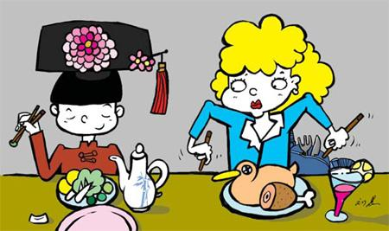
Part 1
definition
what is CULTURE SHOCK?
Culture shock is when someone feels he or she doesn't belong in a new country.

Slide 7


stages
Part 2
stage | signs | reasons
stage 1
stage2
opportunities & possibilities
feel excitement
everyday things are different;
people think of home better;
people don't trust or talk to others.
upset-lonely-no sense of belonging

Slide 8


Part 3
tips
Develop friendships with local people/build your network of friends
(1) Do not think things will be like they are at home.
(2) Talk to people.
(3) Do not let one person's actions affect your idea of the whole society.
(4) Understand that everyday things, such as how close people stand to one another, how people wait in line, and how long people pause in conversations, are different.
Make preparatins such as reading books on cultural communication
Continue language study/increase language ability
Spare time for relaxation
......

Slide 9
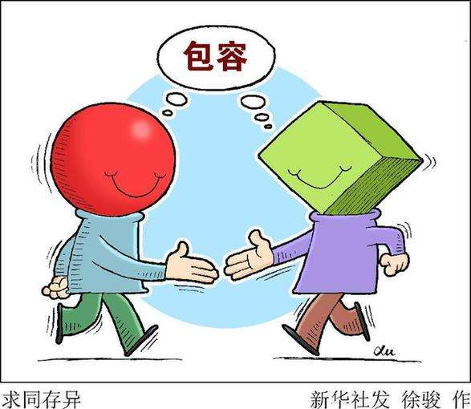
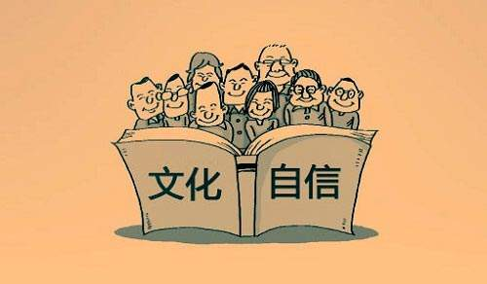
Part 3
Try to identify with(理解；与...产生共鸣) others. This doesn't mean you have to change who you are to fit in.
Seek common ground while reserving differences.
求同存异

Slide 10

Dear XXX,
I’m really feeling fed up with my life here and longing for home. Getting anything done over here is a nightmare --- the locals are so lazy and unhelpful. And on top of all that I feel sleepy all the time, seem to have lost all my zest(兴奋、激动的心情). What's wrong with me? What can I do?
Love,
Joyce

Slide 11
Dear Joyce,
Very glad to hear from you. From what you described in your letter, I’m guessing you are experiencing ___________, during which people may feel_____ at first, later _______________________.
Here I’d like to offer some tips for you. .....(choose 2 out of all tips to describe)...
I'm sure things will get better. Please feel free to contact me at any time.
Yours,
_______

Slide 12

Homework
Complete and polish the letter on your own.

Slide 13
扫码关注
回复：hello sun
获取课件制作、录课等实用工具包
知识产权声明
感恩遇见，相互成就，本课件资料仅供您个人参考、教学使用，严禁自行在网络传播，违者依知识产权法追究法律责任。
更多教学资源请关注
订阅号：溯恩英语

