Slide 1


扫码关注
回复：hello sun
获取课件制作、录课等实用工具包
知识产权声明
感恩遇见，相互成就，本课件资料仅供您个人参考、教学使用，严禁自行在网络传播，违者依知识产权法追究法律责任。
更多教学资源请关注
订阅号：溯恩英语

Slide 2
SUMMARY WRITING
浙江省龙游中学 顾芳园
Email：11804726@qq.com

Slide 3
Our problem:
How could we write a better summary?

Slide 4

Could we write a better summary in a rush?

Slide 5
What’s the topic of the passage?
Paragraph1:
These days our society develops rapidly and forces people to rush. It appears that people have got used to being in a hurry. However, it’s better for people to take their time and live their life at a slower pace than to hurry to get things done.

Slide 6
What do you think will be talked about in the following paragraphs?
Try to draw the mind map of your prediction.

Slide 7
the writing style
Narration(记叙文)
Exposition（说明文）
Argumentation（议论文）

Slide 8
viewpoint
However, it’s better for people to take their time and live their life at a slower pace than to hurry to get things done.
reasons
The main reason that convinces us to oppose doing work in a hurry is the possibility of doing wrongs in a rush.
Slowing down the pace of life helps people enjoy their life better.
conclusion
Therefore, take your time and live your life at a slower pace.
Finally, slower life pace provides better healthy conditions for us.
What to write

Slide 9
How to rewrite (a sample of the viewpoint)
Change sentence patterns
However, it’s better for people to take their time and live their life at a slower pace than to hurry to get things done.
People had better take their time than finish things in a hurry.
To live a life in no rush is better than to do everything hurriedly.
Omit needless words
Use synonyms
Use infinitive

Slide 10
Para 4th Reason3
Finally, slower life pace provides better healthy conditions for us. As is known to all, taking actions in a hurry bothers people and raises their stress. People think if they are not in a hurry, they will become a loser and that annoys them. Being in a hurry can hurt people both physically and mentally. According to some studies, people who have a slower pace suffer fewer diseases, tend to be happier and live much longer than those whose life is tense, even if the former finish jobs more slowly than the latter.
bothers
raises their
stress.
Negative impacts
loser
annoys
fewer diseases
Positive impacts
be happier
live much longer

Slide 11
Try to rewrite it with supporting details.
Finally, slower life pace provides better healthy conditions for us.
physically; mentally;
Additionally, slowing down helps people live a healthy life physically and mentally.
As is known to all & According to studies→ facts
In addition, based on some facts, it has been proved that slowing down helps people live a healthy life physically and mentally.
positive; negative
cover essential supporting details

Slide 12
Tips :
To cover all main points
Cover all topic points
To be concise
Omit needless words
Omit repeating words/phrases
To use own words
Change sentence patterns
Use synonyms
Use infinitive
Cover essential supporting details
Write your summary and show us.

Slide 13
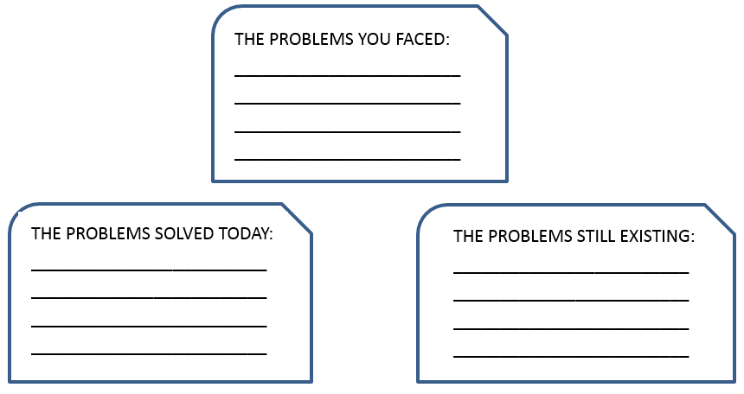
What problems have been solved?

Slide 14
Assignment
Write a rethinking on how to write a better summary.
May you enjoy a slow life
in the near future~

Slide 15
扫码关注
回复：hello sun
获取课件制作、录课等实用工具包
知识产权声明
感恩遇见，相互成就，本课件资料仅供您个人参考、教学使用，严禁自行在网络传播，违者依知识产权法追究法律责任。
更多教学资源请关注
订阅号：溯恩英语

