Slide 1


扫码关注
回复：hello sun
获取课件制作、录课等实用工具包
知识产权声明
感恩遇见，相互成就，本课件资料仅供您个人参考、教学使用，严禁自行在网络传播，违者依知识产权法追究法律责任。
更多教学资源请关注
订阅号：溯恩英语

Slide 2

Summary Writing
邱赛仙
浙江省衢州第三中学

Slide 3
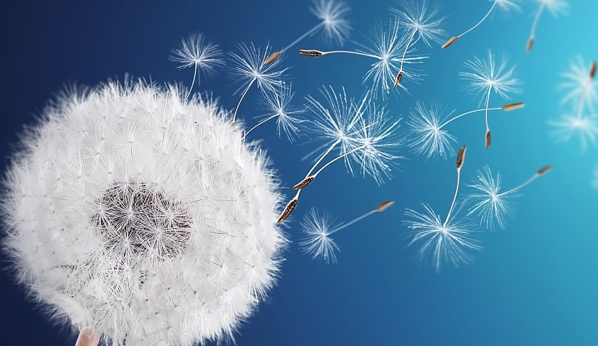
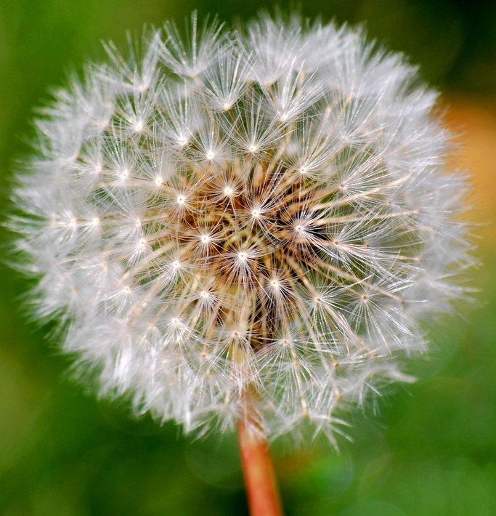
What is this ?
Dandelions
What does it make you think of?

Slide 4
What is the main idea of paragraph 1?
For years, humans have made war with the dandelion. Most people consider dandelions(蒲公英) annoying weeds, and try to get rid of them. They usually pull them up by the roots, or use chemicals to kill the plants. But our war with the dandelion may soon be over.
Dandelions have long been seen as annoying weeds. However, the idea will be ended.
Do you think the author is to introduce the good or bad points of dandelions?

Slide 5
Work in pairs : try to predict what the author is to talk about dandelions and how to organize the idea.
  Weeds are useful to----
dandelions’ benefits
and reasons
2.----
3.----
Be used for animals’ food
How to remove dandelions easily
Remove it with a new way
Be used in making medicine

Slide 6
So what kind of words or phrases will you pay special attention to when reading?
Read to check how the author express his ideas.
Although considered weeds, it’s no secret that dandelions have their uses. Young dandelions leaves make a delicious salad. Dandelion plants have a long, thin root called a taproot, which grows deep into the soil. The taproot creates tunnels in the soil, which allow water and air to mix in and keep soil healthy. Dandelion flowers also attract ladybugs, which can help kill small insect pests. However, most people still think of the dandelion as a simple weed. It‘s the sap ( 汁液 ), though, that just might change their minds.
what does “minds” refer to? What do you think will be
talked about in the next paragraph?

Slide 7
Finish reading the next two passages and try to figure out how the author organize his idea and draw the mind map of the passage.
dandelions
annoying weeds
转折关系
useful
sap
disadvantages of rubber trees
对比关系
advantages of natural rubber
allergic
并列关系
long time to grow

Slide 8
If you’ve ever picked a dandelion, you’ve probably noticed the milky sap that comes out from the stem．Dandelion sap is a natural source or rubber(橡胶). Around 30,000 different products are made from rubber today. Most of these products are made from rubber that comes from the rubber trees. But there are problems with these products. Some people have a serious allergy (过敏症)to this kind of rubber And for some reason, many of the rubber trees on our planet are now dying off. These trees take years to grow, so they are not easy to replace.
对比：Dandelion sap , a natural source of rubber, has advantages over rubber from rubber trees, the problem of which is that many people are allergic to it and replacing rubber trees takes a number of years.
对比：Dandelion sap is a natural source of rubber, which is better than rubber from rubber trees, the problem of which is that many people are allergic to it and replacing rubber trees takes a number of years.
对比：compared to rubber from rubber trees, Dandelion sap is a natural source of rubber. Besides, many people are allergic to rubber from rubber trees , which also take a number of years to grow.
How did the author help you understand the uses of dandelions?
By comparison
How to summarize this paragraph?

Slide 9
Try to summarize the main idea of the last paragraph
Compare the following two , which is better ? Why?
Scientists are starting to look at dandelion sap as a possible good source of rubber for the future. Dandelions are easy to plant and they grow quickly. People who are allergic to rubber products made from rubber trees are not likely to be allergic to dandelion rubber. Still, scientists have some questions they need to answer before we can make dandelions our main source of rubber. Some scientists believe that in less than five years we will have those answers and will finally end the war with this so-called weed. when we make peace with the dandelion, at long last, we‘ll be planting it, instead of pulling it!
Unlike traditional rubber, dandelion sap is easy to get and can’t cause allergy. Although still a long way to go, scientists are optimistic about its future.
However, dandelion sap is easy to get and can’t cause allergy. Although scientists are optimistic about its future , there is still a long way to go.

Slide 10
Try to write a summary of the passage and try to check your writing with the following criteria:
Does it focus on the main topic?
Does it cover all the key points?
Does it read logically and coherently?
Does it contain the original sentences ?
Is it brief enough?

Slide 11
Possible answer:
Dandelions have long been seen as annoying weeds. (1)However, they are actually of some use.(2) Dandelion sap , a natural source of rubber, has advantages over rubber from rubber tree, the problem of which is that many people are allergic to it and replacing rubber trees takes a number of years. (3)Compared to traditional rubber, dandelion sap is easy to get and can’t cause allergy. Although still a long way to go, scientists are optimistic about its future.(4)

Slide 12
扫码关注
回复：hello sun
获取课件制作、录课等实用工具包
知识产权声明
感恩遇见，相互成就，本课件资料仅供您个人参考、教学使用，严禁自行在网络传播，违者依知识产权法追究法律责任。
更多教学资源请关注
订阅号：溯恩英语

