Slide 1

扫码关注
回复：hello sun
获取课件制作、录课等实用工具包
知识产权声明
感恩遇见，相互成就，本课件资料仅供您个人参考、教学使用，严禁自行在网络传播，违者依知识产权法追究法律责任。
更多教学资源请关注
公众号：溯恩高中英语

Slide 2

·
How to Abstract Keywords
in Summary Writing
  浙江省常山县第一中学 洪笑英
  May 30, 2019

Slide 3

parts of speech of keywords
noun
notional word
(实词)
verb
adjective
keywords
logical connector
(逻辑连接词)

Slide 4
layers of keywords
keywords about the theme
主旨关键词
layer 1
一级关键词
keywords from the title
标题关键词
layer 2
二级关键词
keywords about the main key points
主要点关键词
layer 3
三级关键词
keywords about the minor key points
次要点关键词

Slide 5
strategies of
abstracting
keywords keywords
①
abstract keywords from textual patterns
基于篇章模式提取关键词
strategies
②
abstract keywords from cohesion and coherence
基于衔接与连贯提取关键词
③
abstract keywords from thematic progression
基于主位推进提取关键词

Slide 6
Strategy 1
Abstract keywords from textual pattern
基于篇章模式提取关键词

Slide 7
Textual Patterns
in Summary Writing
概要写作篇章模式
概括-具体模式
问题-解决模式
主张-反应模式
提问-回答模式
概要陈述：概括/整体
具体陈述：举例/细节论证
情景: 呈现现象
问题：提出问题
反应：解决问题的方法
评价/结果：
情景：呈现现象
回答：对问题的答案
反应：作者提出支持或反驳，
给出相应的理由。
提问：用提问方式表达问题；
回答：对问题的答案

Slide 8
Positions of keywords
Keywords
about the theme
Keywords about
main key points
概括-具体模式
概括-具体模式
概括-具体模式
概括陈述部分
具体陈述与原因部分
问题-解决模式
问题解决部分
现象、问题与原因部分
问题-解决模式
主张-反应模式
作者观点部分
现象、问题与原因部分
主张-反应模式
提问-回答模式
问题回答部分
问题与原因部分
提问-回答模式

Slide 9
Positions of keywords
Logical
relationship
Keywords about the minor points
目的关系
目的部分
背景关系
背景部分
条件关系
条件部分
转折关系
转折前部分
解释关系
解释部分
让步关系
让步部分

Slide 10
问题-解决模式
CHEMICAL OR ORGANIC FARMING? (M4U2 Using Language)
Over the past half century, using chemical fertilizers has become very common in farming. …Recently, however, scientists have been finding that long-term use of these fertilizers can cause damage to the land and, even more dangerous, to people’s health.
What are some of the problems caused by chemical fertilizers? First, they damage the land…. Chemicals also stay in the ground and underground water for a long time. … In addition, fruit, vegetables and other food grown with chemical fertilizers usually grow too fast to be full of much nutrition. …
With these discoveries, some farmers and many customers are beginning to turn to organic farming. Organic farming is simply farming without using any chemicals. They focus on keeping their soil rich and free of disease. ……
Organic farmers also use many other methods to keep the soil fertile. …
“标题”关键词：
chemical farming,
organic farming
现象
“主题”关键词：
organic farming,
“要点”关键词：
问题
“现象”
关键词：
chemical fertilizers,
damage
the land,
and people's
health
“问题”
关键词：
problems
“解决
方法”
关键词：
ways
解决方法

Slide 11
What are some of the problems caused by chemical fertilizers? First, they damage the land by killing the helpful bacteria and pests as well as the harmful ones. Chemicals also stay in the ground and underground water for a long time. This affects crops and, therefore, animals and humans, since chemicals get inside the crops and cannot just be washed off. These chemicals in the food supply build up in people’s bodies over time. Many of these chemicals can lead to cancer or other illnesses. In addition, fruit, vegetables and other food grown with chemical fertilizers usually grow too fast to be full of much nutrition. They may look beautiful, but inside there is usually more water than
vitamins and minerals.
problems
“解释类次要点”
关键词
“次要点”
关键词：
damage the
land
“次要点”
关键词：
lead to illnesses
“次要点”
关键词：
grow too fast to be full of nutrition
Para2

Slide 12
With these discoveries, some farmers and many customers are beginning to turn to organic farming. Organic farming is simply farming without using any chemicals. They focus on keeping their soil rich and free of disease. A healthy soil reduces disease and helps crops grow strong and healthy. Organic farmers, therefore, often prefer using natural waste from animals as fertilizer. They feel that this makes the soil in their fields richer in minerals and so more fertile. This also keeps the air, soil, water and crops free from chemicals.
“原因类次要点”
关键词
“次要点”
关键词：
make soil richer , more fertile;
“次要点”
关键词：
keep air, soil,water crops free from chemicals
Para3

Slide 13
Summary
Though commonly used, chemical fertilizers cause damage to the land and people’s health.(要点1) The root of the problems lies in the chemicals which break the ecological balance, stay in soil and water and cause a lack of food nutrition.(要点2) On the contrary, organic farming which simply uses natural fertilizers to make the field more fertile and away from chemicals is becoming more popular with some farmers and customers.(要点3) Besides using natural waste as organic fertilizer, many other methods like shifting crops periodically, making full use of the soil and growing grass between the crops are adopted to make the land healthy and productive.(要点4)
Notes:
www.515ppt.com

Slide 14
Strategy 2
Abstract keywords from cohesion andcoherence
基于衔接连贯提取关键词

Slide 15
扫码关注
回复：hello sun
获取课件制作、录课等实用工具包
知识产权声明
感恩遇见，相互成就，本课件资料仅供您个人参考、教学使用，严禁自行在网络传播，违者依知识产权法追究法律责任。
更多教学资源请关注
公众号：溯恩高中英语

Slide 16
语法衔接（grammatical cohesion）
词汇衔接（lexical cohesion）
逻辑衔接（logical cohesion）
衔接手段

Slide 17

1.语法衔接：
1
1
人称照应 (he,it,they,/their,our, /hers, yours……)
I went to see the writer. He lived in a remote village and his house was just a hut.
照应
指示照应 (the,/this,that,these,those,/here, there……)
When food comes out of any oven, it should stand a while. During this delay the centre carries on cooking.
比较照应 (different, same, 比较级……)
John took four hours to reach London. Bill, on the other hand, was driving more slowly.

Slide 18
1.语法衔接：
名词性替代 (one,the other……):
I wish I’d bought a few jars of honey. Did you notice the ones they were selling by the roadside?
2
替代
动词性替代 (do,does,did……):
Wendy looks very happy as she always used to do.
小句性替代 (so,not……):
We are told that he will come tonight, and if so, our meeting will be held tomorrow.

Slide 19
1.语法衔接：
名词性省略:
Compared with the blue cloth, I prefer the red <cloth>.
3
省略
动词性省略:
He was frightened and <was> starting to cry.
小句性省略:
—Can you hear me ?
—Yes. <I can hear you.>

Slide 20
2.词汇衔接：语篇中使用一些相互之间存在意义联系的词语，从而建立一个贯穿语篇的语义链条，保证语篇的连贯性。
1
词汇复现
  同词或同源词的重复
  Many teenagers don't know about tattoo inks well and think tattoo inks are safe to use. Tattoo inks are made to be injected into the skin.
  同/近义词复现
  Everything faded into mist. The past was erased, the erasure was forgotten, the lie became truth.
  上/下义词复现
  As the sun was rapidly sinking, everything changed colors. The white clouds had turned red, the hills were violet, the woods purple, the valleys black.

Slide 21
2.词汇衔接：语篇中使用一些相互之间存在意义联系的词语，从而建立一个贯穿语篇的语义链条，保证语篇的连贯性。
2
词汇同现
  话题词汇的同现
  He led me to the crowded shop and to a bench with a large professional karaoke box on it. He placed his large hand lovingly on his treasure and said, "I have 800 karaoke songs in here. You can take your pick and I'll record them for you. That should get you started."
  反义词关系
  Focusing on the positive has been shown to have benefits to one's health and well-being, jusst as focusing on the negative has been proven to have a harmful effect.

Slide 22
3.逻辑衔接：
  根据信息的层级，往往段落间及段落内（尤以段落间）的表并列、递进、转折、总结、因果、条件之类的联系词，可视为关键词。

Slide 23
Keywords from coherenc and cohesion
基于衔接与连贯理论的关键词
单击这里输入大标题
1.
frequently used notion words
（高频使用的实词）
Keywords
2.
superordinate (上义词)
3.
logical words (逻辑连接词)

Slide 24
例：【2018年11月浙江高考概要原文】
It's a really good idea to visit colleges before you apply because their websites can all start to look and sound the same. Nothing will give you the sense of what it will actually be like to live on a college campus like visiting and seeing for yourself the dorms, classrooms and athletic equipment and,of course,the students.It seems a little crazy once senior year hits to find the time to visit college campuses,and it can also be pricey if the schools you are applying to happen to be more than a car ride away.But keep in mind that you are making a decision about the next four years of your life, and do all the research you can to make sure you are making the right one.
There's no excuse not to visit the schools in your local area. In fact, a lot of college applications even ask if you have visited campus, and obviously, if you live across the country that won't be as much of a possibility, but if you live nearby, go check it out!
If campus visits aren't going to happen before you apply, at the very least you should find some time between applying and getting your acceptance letters to visit the schools you'd like to attend. It can save you a lot of heartache if you rule out now the things that you don't like about certain campuses, things that you wouldn't know unless you actually visit.
Now, if time and money are making it impossible, then check out the online college fairs at CollegeWeekLive. It's a chance to chat online with admissions officers, students, and college counselors(倾问)，and it won't cost you a penny! You can register for its online college fair at collegeweeklive.com. While visiting an online college fair can't take the place of an actual campus visit, it can be a very useful tool that along with all your other research will help you make an informed decision about which colleges or universities you'd like to attend.

Slide 25
从词汇衔接和语法衔接角度提取的高频关键词：
关键词 | 词汇衔接 |  |  | 语法衔接 |  | 出现频次 | 段落位置
visit | v. | visit | 重复 |  |  | 8 | P1, P2, P3, P4
 | n. | visits | 重复 |  |  | 2
 |  |  |  | it | 人称指代 | 2
college | n. | college | 重复 |  |  | 11 | P1, P2,P3，P4
 |  | school | 近义词 |  |  | 3
 |  | campus | 近义词 |  |  | 6
 |  | university | 近义词 |  |  | 1
 |  | dorms, classrooms and athletic equipment | 上、下义词 |  |  | 3
 |  | students | 话题词汇同现 |  |  | 1
 |  |  |  | it | 人称指代 | 1
apply | v. | apply | 重复 |  |  | 4 | P1, P2, P3
 | n. | application | 重复 |  |  | 1

Slide 26
从词汇衔接和语法衔接角度提取的高频关键词：
关键词 | 词汇衔接 |  |  | 语法衔接 |  | 出现频次 | 段落位置
make a decision | n. | make a decision | 重复 |  |  | 2 | P1，P4
 |  |  |  | make the right one | 人称 照应 | 1
time | n. | time | 重复 |  |  | 3 | P1，P3，P4
pricy | adj. | pricy | 重复 |  |  | 1 | P1，P4
 | n. | money | 话题词汇同现 |  |  | 1
 | n. | penny | 话题词汇同现 |  |  | 1

Slide 27
从逻辑衔接角度提取段落联系语：
逻辑衔接 |  | 段落位置
条件关系 | … if you live nearby,go check it out! | P2
 | If campus visits aren't going to happen before you apply, at the very least you should find some time …to visit the schools. | P3
 | …if time and money are making it impossible, then check out the online college fairs … | P4

Slide 28
【Summary】To ensure a brilliant college life, it's really worthwhile to pay a visit to your desired colleges before application. If you live nearby, be sure to check it out before you apply. Even after submitting applications, a visit can help figure out its real conditions in advance and avoid much trouble. For students lacking money and time, logging on the online college fair at College WeekLive. com is a good alternative to help them better understand schools.
【评析】该概要范文把visit colleges、apply、make a decision、time 、pricy 以及if多个关键词构成语义关联的衔接链，通过词汇衔接（重复、同义词/近义词、上下义词等）、语法衔接和逻辑衔接手段串领全文信息，达成语篇的语义连贯。

Slide 29
Strategy 3
Abstract keywords form thematic progression
基于主位推进的关键词提取

Slide 30
Thematic Progression
主位推进模式
语篇中，各个句子间不仅从语法和语义上相互联系，还表现在从主位到述位的发展进程。主位的作用不仅是照应前面的句子，保持句子的连贯，而且还要充当后面句子的出发点，推动语篇的发展。句子和句子主述位间的这种照应、衔接和过渡关系构成“主位推进程序”(thematic progression )。
从功能句法的角度大多数句子可以被切分为两个基本成分：
1.主位：陈述的基础，通常位于句首，引起话题，一般表示已知信息。
2.述位：陈述的核心，叙述话题内容，是对话题的阐述和说明，一般表示新信息。

Slide 31
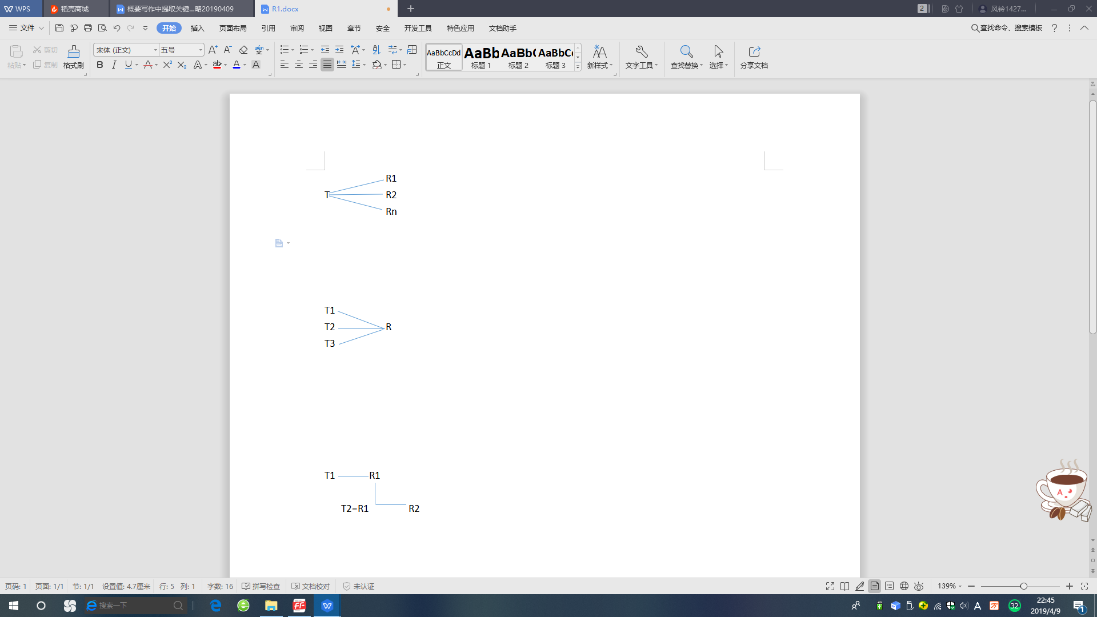
B : 述位同一型
(亦称集中型: 述位相同,主位不同)
e.g. In Kenya 's Tsavo Game Park ,five thousand elephants were slaughtered .In Zambia the game department killed 1,500 elephants in the Luangwa Valley .In Lusaka and Ndola ,elephants were also thinned out and their meat sold in the butcher 's shops .
Patterns of thematic progression 主位推进模式主要类型
A : 主位同一型
(亦称平行型: 主位相同,述位不同)
e.g. Jazz is in part music for dancing ,but it is more than that ; it is the popular music of the people. It has a steady unbroken rhythm. It coexists with popular songs of the moment .

Slide 32
D: 交叉型
(前一句的主位是后一句的述位)
e.g. Gaga walked behind his friends quietly .But his friends didn 't want him .Gaga followed them to the river and cried loud ly .
C: 延续型
(前一句的述位或述位的一部分充当后一句的主位,这个主位又引进一个新的述位,该述位又充当下一句的主位,如此延续下去)
e. g. We elect local ,state and federal officials to make laws .These laws keep order in society .The order of society provides us with a safe livin g environ ment .

Slide 33
Keywords from Thematic Progression
基于主位推进模式的关键词
单击这里输入大标题
frequently-stated thematical information
（被反复陈述的主位信息）
Keywords
1.
2.
recurrent rheme information
(反复出现的述位信息)

Slide 34
关键词
color, be used, influence
反复被陈述的主位信息
反复出现的述位信息
The power of color has been used for centuries and we should be making the most of it in our lives. Color affects us to a greater degree than most of us realize. It is used increasingly by psychologists and therapists for influencing mood and state of mind, and for various types of treatments when we are ill. Some people even believe that the blind can benefit from the‘vibrations’ that color gives off.

Slide 35
扫码关注
回复：hello sun
获取课件制作、录课等实用工具包
知识产权声明
感恩遇见，相互成就，本课件资料仅供您个人参考、教学使用，严禁自行在网络传播，违者依知识产权法追究法律责任。
更多教学资源请关注
公众号：溯恩高中英语

Slide 36
Thank you！

