Slide 1


扫码关注
回复：hello sun
获取课件制作、录课等实用工具包
知识产权声明
感恩遇见，相互成就，本课件资料仅供您个人参考、教学使用，严禁自行在网络传播，违者依知识产权法追究法律责任。
更多教学资源请关注
订阅号：溯恩英语

Slide 2
Why Do We Laugh?
Young
2019-4-3

Slide 3
The first reason for laughing
reason
People laugh to be social.
They want to make a connection with other people.
explanation
examples
For example, people laugh at simple statements that people use to begin a conversation.
In addition, babies laugh because they too want to connect.
As an example… we laugh loud only when other people are around .
a further
example

Slide 4
The second reason for laughing
It can connect or divide social groups.
reason
Laughter can make people feel part of a group or not part of the group.
explanation
Someone laughs to say something back, and it communicates something.
People use laughing at someone to let someone know they don’t belong.
example

Slide 5


The third reason for laughing
Laughter is a response that we don't have to think about.
reason
explanation
example
contagious（会蔓延的）
Laughter is ,
and...
spontaneous（自发的、无意识的）
What are the benefits of laughter?
Is this paragraph well-organized? Why?

Slide 6
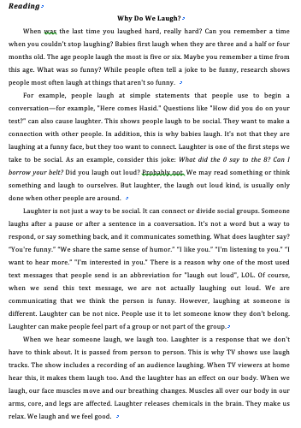
Why Do We Laugh? (reasons)
People laugh to
be social.
reason
explanation
example
social
for purposes
People laugh to
connect or divide social groups.
a contagious/
spontaneous
People laugh because
it is spontaneous.
response

Slide 7


Slide 8
扫码关注
回复：hello sun
获取课件制作、录课等实用工具包
知识产权声明
感恩遇见，相互成就，本课件资料仅供您个人参考、教学使用，严禁自行在网络传播，违者依知识产权法追究法律责任。
更多教学资源请关注
订阅号：溯恩英语

