Slide 1


扫码关注
回复：hello sun
获取课件制作、录课等实用工具包
知识产权声明
感恩遇见，相互成就，本课件资料仅供您个人参考、教学使用，严禁自行在网络传播，违者依知识产权法追究法律责任。
更多教学资源请关注
订阅号：溯恩英语

Slide 2
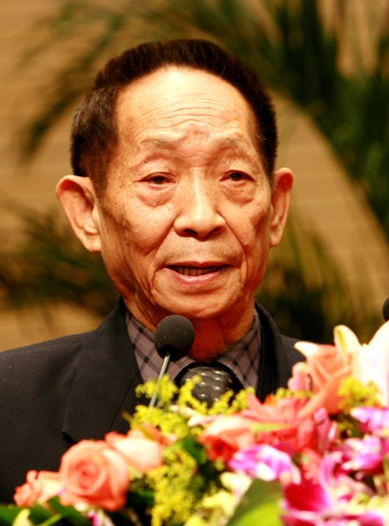
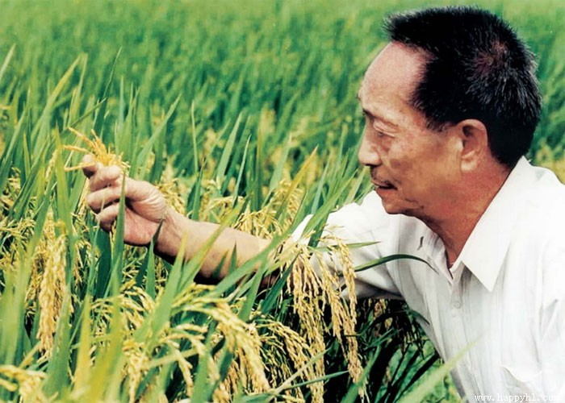
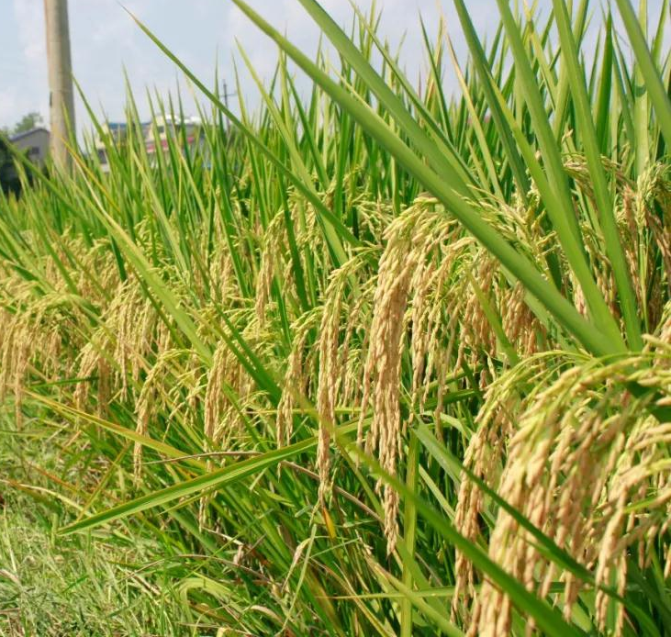
A Pioneer for all people
presented by
桐乡市高级中学 俞莺婕

Slide 3
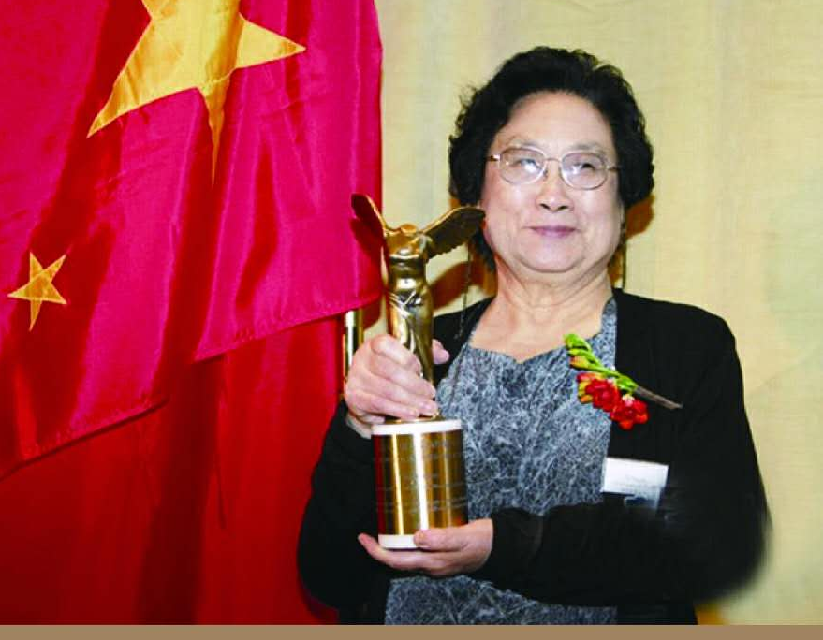
Lead in
1. What does “pioneer” mean to you?
famous?
creative?
productive?
2. Who is she?
3. Do you think she is a pioneer in science?
4. Do you think she is a pioneer for all people?

Slide 4
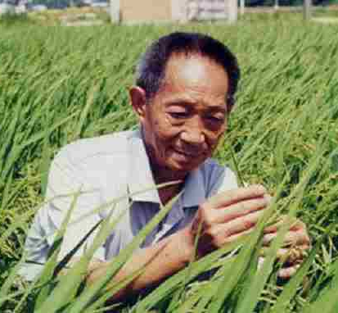
Reading
Paragraph 1 Introduction
Focus on who, what and why:
1. Who is the pioneer?
2. What did he do as a pioneer?
a famous scientist
a devoted farmer
work the land to do his research
struggle for farmers
He considers himself as a .
farmer
Why is he considered a pioneer for all people?

Slide 5
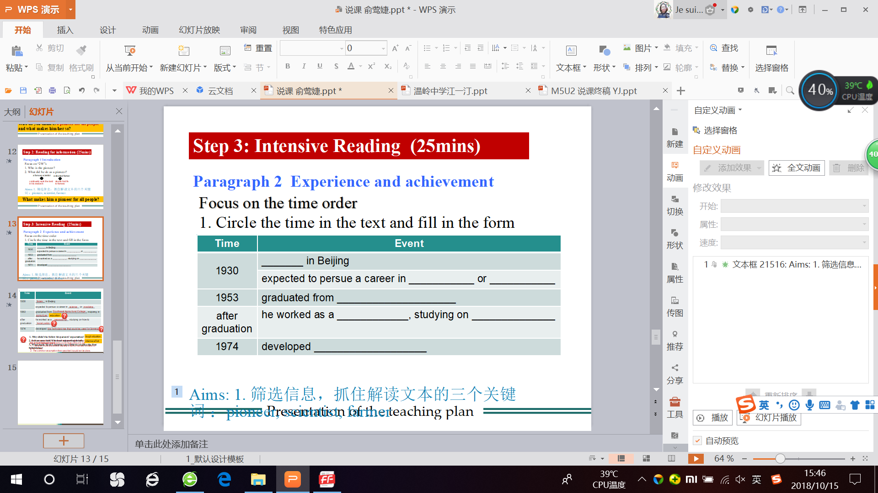
Reading
Paragraph 2 Experience and contribution
Tip1: Present sb's experience and achievement in the order of time.
Focus on the TIME ORDER
1. Circle the time in the text and fill in the form.

Slide 6

Time | Event
1930 | _______ in Beijing
1953 | graduated from __________________________
after graduation | He set his life goal as to find ways to _____________ without ________ _the area of the fields.
born
Southwest Agricultural College
education
grow more rice
expanding
1. Why did he devoted all his life to finding ways to grow more rice?
original intention
As a young man, he saw the great need for incresing the rice output.
At that time, hunger was a disturbing problem in many parts of the countryside.
2. Is it an easy task? Find out supporting details.
years of hardwork
No. In 1950, Chinese farmers could produce about 56,000,000 tons of rice.In a recent harvest, nearly 200,000,000 tons of rice was produced.
3. What made Yuan Longping successful in creating the first hybrid rice?

Slide 7
Reading
Paragraph 2 Experience and contribution
Tip2: Present sb's contribution with data.
Focus on the DATA
1. Circle the number in the text and tell what they mean.
2. What will you do after you becoming famous and rich?
22%,7%
nearly 200 million
many (other countries)
consumption
production
circulation
to rid the world of hunger
to produce harvests twice as large as before
to bring Yuan Longping fame and fortune

Slide 8
扫码关注
回复：hello sun
获取课件制作、录课等实用工具包
知识产权声明
感恩遇见，相互成就，本课件资料仅供您个人参考、教学使用，严禁自行在网络传播，违者依知识产权法追究法律责任。
更多教学资源请关注
订阅号：溯恩英语

Slide 9
Reading
Paragraph 3 Qualities
Focus on the CONTRAST
Tip3: Present sb's quality by contrast.
1. What was Yuan Longping's attitude towards being famous?
He didn't care about being famous. He feels it gives him less freedom to do his research.
2. What did Yuan Longping attitude towards his money?
He believes that a person with too much money has more rather than fewer troubles.
He gives millions of yuan to equip others for their research in agriculture.
3.Why was so?
Paragraph 1 He considers himself a farmer.
indifferent to fame & wealth
Paragraph 2 What he did is for the farmer.
earnest
He considers himself a farmer.
Yuan “stays true to his original intentions”(不忘初心)

Slide 10
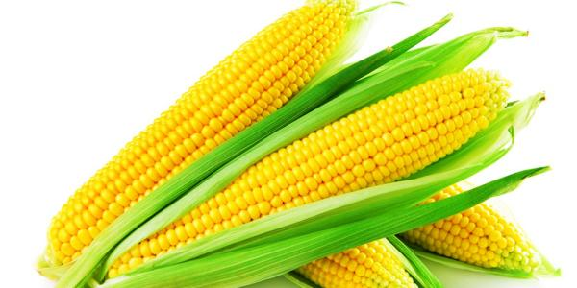
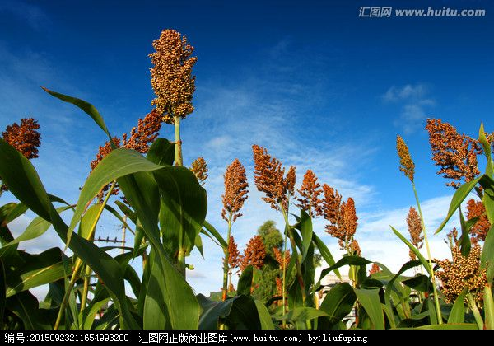
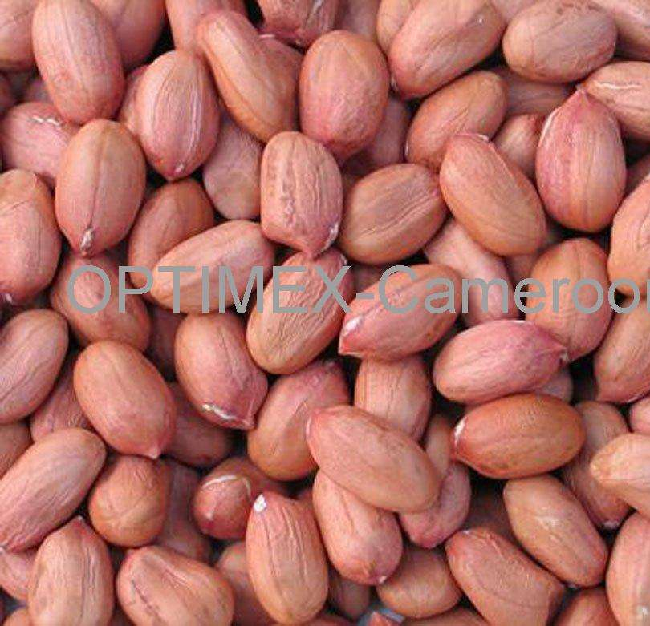
Reading
Paragraph 4 Qualities
Tip4: Present sb's quality via key words.
Focus on the KEY WORD.
What do you think is the key word in this paragraph?
dreams
1. producing a kind of rice plants
that could feed more people:
the rice plants as tall as sorghum
each ear of rice was as big as an ear of corn
each grain of rice was as huge as a peanut
creative /
innovative
One dream is not always enough
progressive
2. to export his rice so that it can be grown around the globe

Slide 11

Reflecting
What makes Yuan Longping a pioneer for all people?
Focus on the CONTENT
a pioneer
for all people
a scientist
education,hardwork, contributions
Para 2
Para 1
a farmer
qualities
Para 3-4
Stay true to his
original intention
(不忘初心)
indifferent to fame & wealth
earnest
creative /
innovative
progressive

Slide 12
Step 4: Reflecting (6mins)
What makes Yuan Longping a pioneer for all people?
Focus on the WRTING TECHNIQUES:
Tip1: Present sb's experience and achievement in the order of time.
Tip2: Present sb's contribution with data.
Tip3: Present sb's quality by contrast.
Tip4: Present sb's quality via key words.

Slide 13
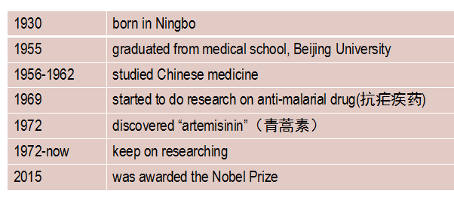
Step 5: Inspiring (6mins)
Back to the quetion in Lead-in, discuss it with your classmates:
Discussion:
1. Who is she?
2. What is she famous for?
3. Do you think she is a pioneer in science?
4. Do you think she is a pioneer for all people?
Tu's experiences

Slide 14
Tu Youyou's experience
1930 | born in Ningbo
1955 | graduated from medical school, Beijing University
1956-1962 | studied Chinese medicine
1969 | started to do research on anti-malarial drug(抗疟疾药)
1972 | discovered “artemisinin”（青蒿素）
1972-now | keep on researching
2015 | was awarded the Nobel Prize

Slide 15
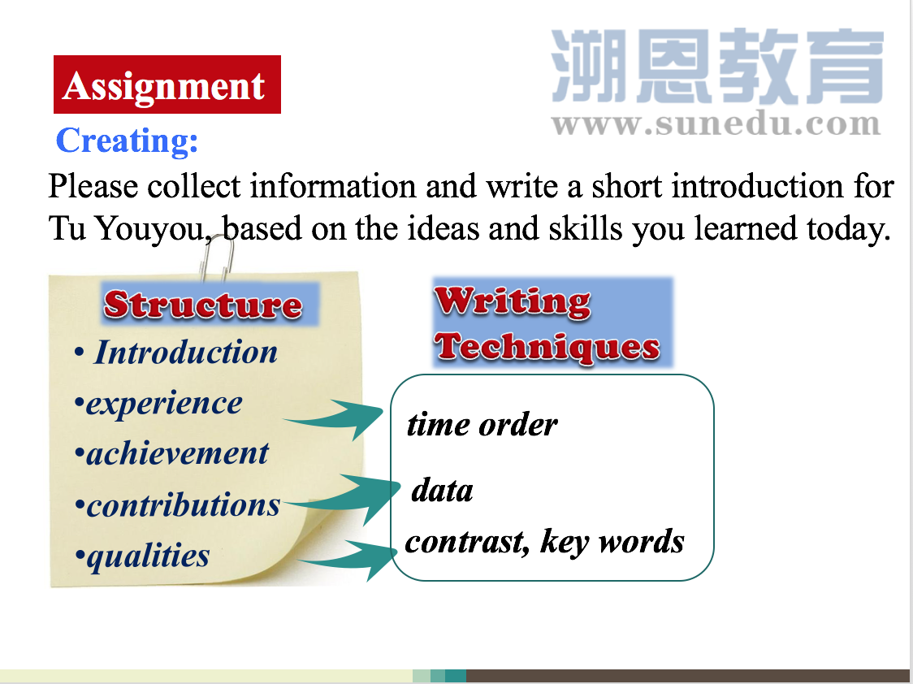

Slide 16
扫码关注
回复：hello sun
获取课件制作、录课等实用工具包
知识产权声明
感恩遇见，相互成就，本课件资料仅供您个人参考、教学使用，严禁自行在网络传播，违者依知识产权法追究法律责任。
更多教学资源请关注
订阅号：溯恩英语

