Slide 1

感恩遇见，相互成就，本课件资料仅供您个人参考、教学使用，严禁自行在网络传播，违者依知识产权法追究法律责任。
更多教学资源请关注
公众号：溯恩高中英语
知识产权声明

Slide 2
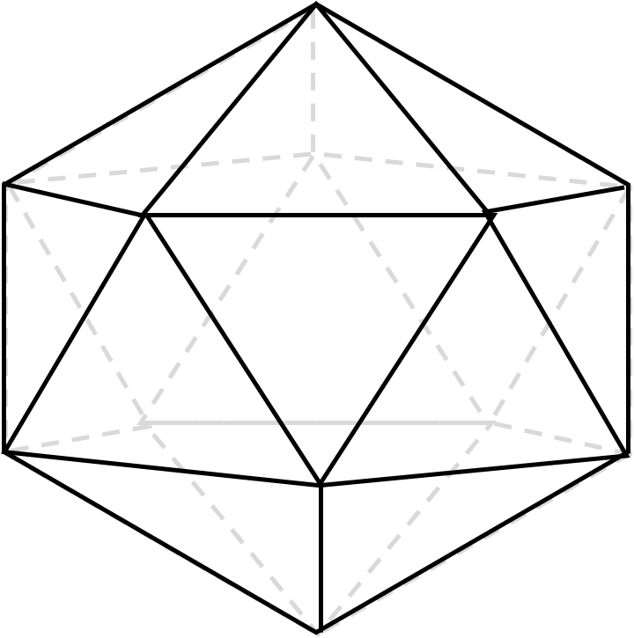
WELCOME
修辞手法在高考英语书面表达中的妙用
浙江金华第一中学
何建军
从G12高分作文说开去

Slide 3
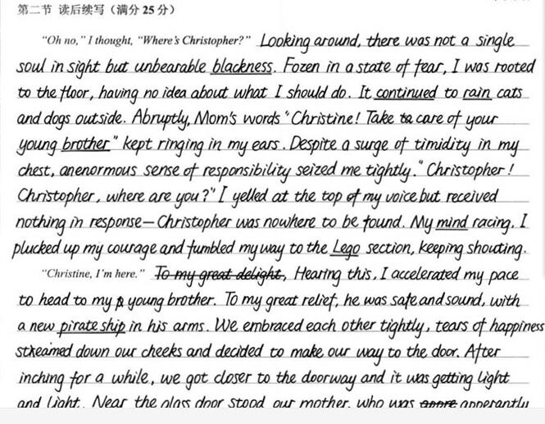
佳作赏析

Slide 4
引言
修辞手法是通过修饰、调整语句，运用特定的表达形式以提高语言表达作用的方式和方法。修辞不仅仅在中文里很常见，在英文里也是多种多样。据粗略统计，莎士比亚剧作中就有60多种。
英文修辞法在文章中运用恰当，能化平淡为新奇，化呆板为鲜活，化枯燥为生动，化冗杂为洗练，化晦涩为明快，化一般为艺术，唤起美感，娱人耳目，增强语言的表现力，说服力和感染力！
现实生活不乏这样的例子。
修 辞

Slide 5
If people keep telling you to quit smoking, don‘t listen… They are probably trying to trick you into living longer.
如果有人苦口婆心劝你戒烟，不要理…他们大概是想骗你活得长些
When you rescued your trousers ，did you find the note was whiter than white？
就是反讽的形式，从洁白无瑕的原意来形容洗白了的钞票。
The bad news was a dagger into her heart（隐喻）
The bad news knocked at her door at midnight（拟人）
1）When reports came into London Zoo that a wild puma had been spotted forty-five miles south of London, they were not taken seriously. 2）When the article arrived, the editor read the first sentence and then refused to publish it. The article began.

Slide 6
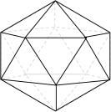
修辞
CONTENTS
比喻
拟人
Man’s life is often compared to a candle.
The wind stood up and gave a shout.
夸张
押韵
You are the whole world to me, and the moon and the stars.
Our hopes, our hearts, our hands are with those on every continent who are building democracy and freedom.

Slide 7
比 喻
比喻能化抽象为形象

Slide 8
1、Simile 明喻
明喻是一种最简单、最常见的修辞方法，将具有共性的不同事物作对比，
表明本体和喻体的关系，两者都在对比中出现，其基本格式是“A像B”，
标志词常用like, as, seem, as if, as though, similar to, such as 等。例子：
1）The whispers in the morning of lovers sleeping tight are rolling like thunder now. From ”The Power of Love”
2）I wandered lonely as a stay dog.我像一只流浪狗一样孤独地四处漂泊。
3）Einstein likes to put a cloak on, as if he had just walked out of a fairy tale.
爱因斯坦喜欢披着斗篷，就好像刚刚从童话故事中走出来。
4）This elephant is like a snake, as anybody can see.
这头大象和任何人见到的一样像一条蛇。
5）He looked as if he had just stepped out of my book of fairy tales and had passed me like a spirit. 他看上去好像刚从我的童话故事书中走出来，像幽灵一样从我身旁走过去。
6）It has long leaves that sway in the wind like slim fingers reaching to touch something.
它那长长的叶子在风中摆动，好像伸出纤细的手指去触摸什么东西似的。
明 喻

Slide 9
暗喻
2、metaphor 隐喻，暗喻
隐喻是简缩了的明喻，是将某一事物的名称用于另一事物，通过比较形成。这种比喻不通过比喻词进行，而是直接将用事物当作乙事物来描写，甲乙两事物之间的联系和相似之处是暗含的。举个例子
1）Man's life is often compared to a candle.人生常被比为蜡烛。
2）Hope is a good breakfast, but it is a bad supper.希望是顿美好的早餐，但却是一顿糟糕的晚餐。
3) Life was like a box of chocolates, you never know what you're going to get.
生命就像一盒巧克力，结果往往出人意料。<310>

Slide 10
实战
（2012）根据英语作文要求，我们可以写出这样的句子：
To some extent, we are the captains of our own routines, and what we want has a profound influence on the directions.
“一定意义上来说，我们都是自己人生航海中的船长，我们的所欲对我们的方向有着巨大的影响。”
该句中将“我们”比喻为“船长”，生动形象地表示出个人对自己人生的决定意义。
（2012）根据英语作文要求，我们可以写出这样的句子：
With directions in your hand and wheels under your feet, nobody but you can change the path on your lane.”
“你的方向掌握在你手中，你的车轮滚动在你的脚下，只有你能改变你的道路。”
该句中将人生方向与前进隐喻为手中的方向盘和车轮的前进，使抽象的事物具体化。

Slide 11
实战
(2016年10月)根据英语作文要求，我们可以写出这样的句子：
The twinkling stars seemed the helicopter driven by Tom to pick her up away from this terrible forest.
“天空中闪烁的明星好像是Tom驾驶的来接她离开这片可怖森林的直升机。”
该句中将明星比喻为直升机，表达了She此刻的无助与后悔。
(2016年10月)根据英语作文要求，我们可以写出这样的句子：
Jane was so hungry that there was thunder in her stomach and she could hardly move.“Jane是如此饥饿以致于她的肚子中雷声阵阵，并且无力移动一分。”
该句中将饥饿时的肚子叫比喻为雷声，生动地表现出Jane此时的饥饿。

Slide 12
实战
(2016年10月)根据英语作文要求，我们可以写出这样的句子：
The voice of the birds is like water bubbling in the silver jar, and flowers are as yellow as the hair of the mermaid(美人鱼) who sits upon the amber throne.
(2017年6月) 根据英语作文要求，我们可以写出这样的句子：
These words like a penetrate of sunshine warmed his heart.
“这些话就像一缕阳光温暖了他的心。”
该句将话语比喻为一缕阳光，生动地写出了这些话的温暖。

Slide 13
实战
(2017年6月) 根据英语作文要求，我们可以写出这样的句子：
Paul accelerated the car immediately, with Mac’s heart still popping wildly like a deer.
“Paul立即加快车速，而Mac的心依旧像小鹿一样跳个不停。”
该句中将Mac的心跳比喻为小鹿跳动，生动地写出了Mac此时的紧张、心有余悸。
(2017年6月) 根据英语作文要求，我们可以写出这样的句子：
The car dashed away like the wind.
“车如旋风迅速地开走了。”
该句中将车开走比喻为风，生动地写出了车速之快。

Slide 14
实战
(2017年6月) 根据英语作文要求，我们可以写出这样的句子：
The wolf was chasing the car like playing a game.
“这匹狼就像玩游戏一样追逐着汽车。”
该句中将狼的追逐比喻为玩游戏，生动写出了狼的邪恶凶猛。
(2017年6月)根据英语作文要求，我们可以写出这样的句子：
Feeling a warm current coursing through their body, Paul and Becky had their eyes blurred.
“Paul和Becky感受到了一股热流从身体中淌过，”
该句中将感动比喻为热流，生动地写出了这份感受的温暖。

Slide 15
实战
(2017年6月)根据英语作文要求，我们可以写出这样的句子：
Mac felt what happened just now was like a bad dream.
“Mac感觉刚才所发生的一切都是一场噩梦。”
该句中将刚才的事件比喻为一场噩梦，生动写出了这件事情对Mac带来的可怕印象。

Slide 16
实战
(2017年6月) 根据英语作文要求，我们可以写出这样的句子：
A cluster of sunshine cast over the road as if extending its encouragement
and blessing to them.
“一缕阳光落到路上，好像在表达对他们的鼓励与祝福。”
该句中将阳光比喻为鼓励和祝福，生动地写出了该场景的温暖。

Slide 17
拟 人

Slide 18
拟人
新概念英语第二册第九课讲的是，一座大钟在新年到来之际停了不走，拒绝欢迎新年的到来，The big clock refused to welcome the New Year，用的是拟人化的手法，这句话相当于说the big clock was in bad humor 大钟心情不好，但是镇上的人们情绪并没有受到影响，They were still very cheerful，they sang and laughed他们又是唱歌又是笑。在The big clock refused to welcome the New Year中，赋予了钟这个无生命的事物具有了有生命事物的比如人类欢迎的功能，我们称为拟人。拟人（personification）这种修辞方法是把人类的特点、特性加于外界事物之上，使之人格化，以物拟人，以达到彼此交融，合二为一。

Slide 19
拟人
例子:
1.She may have tens of thousand of babies in one summer.(From“ Watching Ants”)
一个夏天她可能生育成千上万个孩子。 这里用“she”和“babies”把蜜蜂比作人类妇女的生育。
2.My only worry was that January would find me hunting for a job again. 我唯一担心的是，到了一月份我又得去找工作。 英语里常把“年”“月”“日”人格化，赋以生命，使人们读起来亲切生动。

Slide 20
拟人
3.The wind stood up and gave a shout.大风凛冽,发出怒吼。
4.The night gently lays her hand at our fevered heads.夜晚温柔地安抚着我们狂热的头脑。
5.I was very happy and could hear the birds singing in the woods. 我很开心，似乎听到了林中唱歌的鸟儿。

Slide 21
拟人
（2012）根据英语作文要求，我们可以写出这样的句子：
Several examples bolster my opinion.
“有几个例子”
（2012）根据英语作文要求，我们可以写出这样的句子：
His deed can fairly shed light on “Your future depends mostly on you.”
“他的行为完全可以印证这句话“你的未来大部分取决于你。”
该句中将他的行为拟人化，更为生动。

Slide 22
拟人
（2012）根据英语作文要求，我们可以写出这样的句子：With his lover leaving him without a word, he was nearly beaten down by all the obstacles.“他的爱人一言不发地离开了，而他几乎被这些挫折所打败。”将挫折人格化，更为生动。
（2014）根据英语作文要求，我们可以写出这样的句子：Literary books weave an attractive portrait of complex relationships and extraordinary stories. “文学书籍描述了一个具有吸引力的人物关系和不同寻常的故事情节。”该句中运用weave这个单词将books人格化，这比用have、cover、include等词生动得多。

Slide 23
拟人
（2014）根据英语作文要求，我们可以写出这样的句子：Science is perhaps the most powerful force to push human civilization forward.
“科学可能是推动人类文明前进的最强大的的力量。”
（2014）Literary books have the power to touch our hearts, make us think and help us to discover the value of what we call “life”.
（2014）Literary books, not only does it create a magical world full of imagination, but also it helps us get to know the deeper meaning of human being.

Slide 24
拟人
(2016年10月) With the yellow blouse dancing in the breeze, she flashed back to her satisfactory life with Tom.
(2016年10月) A sense of despair hit her, and the endless loneliness was swallowing her.
(2016年10月) Loneliness crowded in her mind.
(2016年10月)Exhaustion came dominating Jane as she hopelessly fell down into the soft grass.
(2016年10月)A strong feeling of wanting to survive immediately caught her heart.

Slide 25
拟人
(2017年6月) Guilt oppressing them ,they apologized.
(2017年6月) Even the cars are afraid of the wolves here.
(2017年6月) Just in time ,Paul’s car arrived, blaring angrily .
(2017年6月) Watching the wolf swallowed by the road, Mac sank down to the back seat.
(2017年6月) Haunted by a deep sorrow and intolerable sadness, he left the two cyclists.
(2017年6月) Never before in his life had he been so overwhelmingly overcome by sadness.

Slide 26
夸张
夸张是对事物着意夸大，以言过其实的说法来表达强调的目的。夸张的修辞手法可以加强语势，增加表达效果。

Slide 27
夸张
1.My blood froze. 我的血液都凝固了。
2. I beg a thousand pardons.我千百次地祈求宽恕。
3. Love you. You are the whole world to me, and the moon and the stars.我爱你。你对我而言如同全世界，如同夜空中的星月一般圣洁。
4. I was scared to death.我吓死了。
5. When she heard the bad news, a river of tears poured out.
当她听到这个噩耗，眼泪像绝了堤的洪水，滚落下来。

Slide 28
夸张
夸张—— 夸张能强化语义，突出形象，渲染感情。如何表达她十分地紧张，几乎所有人都会翻译成She was extremely anxious.意思一目了然，表现却显得单薄。如果改成She had her heart in her mouth.是不是味道完全不一样了？同样再看一句
She went home, crying terribly.
She went home in a flood of tears./ She went home, tears streaming down.

Slide 29
夸张
与运用了夸张手法的后者相比，前者明显黯然失色许多。2016年10月浙江省高考英语书面表达的读后续写就可以这样表达：
She sat by the stream, resting her aching feet. If I hadn't quarreled with Tom, I wouldn’t have to be here. Jane thought regretfully, with tears welling up in her eyes.
Desperate and hopeless, Jane knelt down, tears streaming down her face.

Slide 30
押韵
在生活和阅读中一天天一点点的积累，会让我们在某一天不自觉地写出这样优美的句子来，使文章带上一层靓丽的颜色。

Slide 31
押韵
1) Our hopes, our hearts, our hands are with those on every continent who are building democracy and freedom. 我们的希望，我们的内心，我们的双手与各大洲为民主和自由而奋斗的人民紧紧相连。这是美国第42任总统克林顿就职演说中的一句话，他利用头韵hope，heart，hand三个单词清辅音三次重复/h/，使得演说音韵悠扬，节奏明朗。这种音韵美，更能充分地表达出自己的思想感情，给人以更深刻的印象，可谓诵之金声玉振，闻之行云流水。

Slide 32
押韵
2) As snug as a bug in a rug. 就像臭虫钻在地毯里一样舒服。这句话没有贬义，仅仅表示非常舒服而已。它是美国政治家 Benjamin Franklin创造的,他巧妙的运用了三个同韵词，读起来琅琅上口。外国大人安顿小孩上床睡觉就常使用。 Let’s pull up the covers. There you are, Tom, as snug as a bug in a rug. 被子盖上，就是这样，汤姆，恩，很舒服的。Benjamin Franklin创造的还有：
Time is money. Early to bed and early to rise makes one healthy, wealthy and wise.睡的好，起的早，富足，聪明，身体好。此句中的healthy和wealthy音韵的感觉就特别好。

Slide 33
押韵
3）Marriage is a three-ring circus: engagement ring, wedding ring, and suffering.这是刊登在读者文摘上的一句话，通过ring这个词的韵律，使得句子非常美。
4)"Performance is based upon preparation; therefore, prepare well and you will perform well." 这个韵律优美的句子来自于读者文摘中Damon Nailer老师。

Slide 34
押韵
5）如表达土生土长的，新概念英语3 lesson41有这样的句子，City born and city bred, I have always regarded the country as something you look at through a train window, or something you occasionally visit during the weekend.我生在城市，长在城市，总认为乡村是透过火车车窗看到的那个样子，或偶尔周末去游玩一下的景象。
6）如表达到处here and there，There were a few books here and there, but apart from that the room was quite bare.房间里到处放着几本书，但除此之外几乎没有什么东西。

Slide 35
押韵
7）如表达bread and butter 谋生的职业;谋生之道。Gardening is my bread and butter at the moment.眼下园艺工作是我的谋生之道。
8）描写成功的艰辛：How and why he had come to Princeton, New Jersey is a story of struggle, success, and sadness.
9）描写一堂课：interesting and informative
10）描写牛奶：frothing and fragrant

Slide 36
押韵
11）说到美貌和智慧，大多数人都想把两者做到最好。
When it comes to beauty and brains, most people want to get the best of both.
12）当你逐渐走进英语，领略到她的深处之美，或许便能写出更是吸引人的文字，如：
The composition(作文）and completion of this dissertation（专题论文）would not have been possible without the contribution, motivation and supervision of a number of individuals to whom I would like to extend my sincerest gratitude.（既有com的头韵，又有tion的尾韵）

Slide 37
押韵
11）说到美貌和智慧，大多数人都想把两者做到最好。
When it comes to beauty and brains, most people want to get the best of both.
12）当你逐渐走进英语，领略到她的深处之美，或许便能写出更是吸引人的文字，如：
The composition(作文）and completion of this dissertation（专题论文）would not have been possible without the contribution, motivation and supervision of a number of individuals to whom I would like to extend my sincerest gratitude.（既有com的头韵，又有tion的尾韵）

Slide 38
押韵实例
例1 thick 和 thin 为前韵词，可用于表达困难、苦难，对于2016年10月的读后续写我们可以这样运用：…it was at the moved instant that she knew this man deserve her to rely on through thick and thin...“就在那动人的一瞬间她明白了，这个男人值得她依赖，值得与她风雨兼程。”

Slide 39
押韵实例
例2 safe 和 sound 为前韵词，可用于形容人未受伤害、安然无恙，2017年6月读后续写我们可以这样写：Finding his friends safe and sound，Mac finally came to a relief.“发现他的朋友安然无恙后，Mac终于松了一口气。”
2016年10月的读后续写同样可以写：Tom rushed at her, held her arms and looked at her from head to toe to make sure she was safe and sound.“Tom冲向她，抱住她，把她从头到脚检查了一遍确保她安然无恙。”

Slide 40
押韵实例
例3 Confused 和 depressed 为结尾音节韵词，用以形容人的迷惑与沮丧，我们可以将它作为状语用于2017年6月读后续写中：Confused and depressed, Jane held her yellow blouse with her trembling hands.“非常沮丧和迷惑，Jane用颤抖的手抓着她的黄衬衫。”

Slide 41
押韵实例
例4 Inside 和 outside 为后韵词，表示里里外外、内部和外部的，2017年6月读后续写表达Jane处于险境中，我们可以这样描写：Twelve people inside and outside of the rescue party came to help when Jane was in difficulty.“当Jane处于困境中，内内外外有12个人参与了拯救工作。”

Slide 42
押韵实例
例5 tightly 和lovingly 为后韵词，表示充满爱意、紧紧地（相拥），在2016年10月的读后续写中，Tom找到Jane之后，我们可以这样叙述：Tom hugged Jane tightly and kissed her lovingly, apologizing constantly for his huge mistake.“Tom与Jane紧紧相拥，充满爱意地亲吻着她，不断地为他的巨大过错而道歉。”

Slide 43
押韵实例
例6 Excited 和 thrilled 为后韵词，表达人的激动，在2016年10月的读后续写中，Jane终于找到飞机的心里感受，我们可以这样表达：Excited and thrilled, she spotted the helicopter landed beside her on the open area .“她激动地发现一架直升机在她边上的一块开阔地带落了地。”

Slide 44
要想写出活泼的句子，优美的文章，离不开修辞手法的运用。很多学生写文章时，仅仅满足把事情说清楚，平铺直叙，只注重语言通顺不通顺，合理不合理，对语言的运用不作深究，说穿了就是“冷落”修辞手法，忽略了修辞与写作的“攀枝结节”。
本人认为，让人读起来舒畅、愉悦的文字，便是好文章，所以，无需拘泥于拗口的高级句型和词汇，如水般流畅便是最美。语言的使用者不分高低贵贱，因此地道的纯粹的英语，是通顺的、流畅的、简洁的，如此而已。因此巧妙地使用押韵，比喻和拟人的修辞手法可以让读者有有美的视觉感，五脏六腑都有轻松愉悦之享受。这种特殊的魅力，让笔下生花。
Conclusion

Slide 45

修辞？
Think
Beijing was not built in a day.

Slide 46
HOMEWORK
欣赏2018年六月高考好文章并模仿
Suddenly a little rabbit jumped out in front of my horse. Never had I seen such a lovely creature in my life so I followed its track without thinking twice. But the cute rabbit, which aroused my interest, was quickly out of sight. In the process of seeking for it , I was totally immersed in the charm of nature. The luxuriant forests, the tiny flowers that perfumed the air, the groups of

Slide 47
HOMEWORK
sheep in the far distance and the singing river all made me feel my soul purified. Both dad and I had forgotten the time and it seemed difficult for us to go back.
We had no idea where we were and it was getting dark. The lovely plants around us turned into a horrible appearance. The dead silence between dad and me made me more nervous

Slide 48
HOMEWORK
and scared. Finally we decided to wait. At that moment, it was completely dark except the faint light given out of a few stars in the sky. All of a sudden, I saw torchlight moving and heard the voice of Uncle Paul. Instinctively I shouted back crazily. The fear and despair that had been building up inside of me just

Slide 49
HOMEWORK
came to an end. Ultimately, we were back, safe and sound. Sitting in the guestroom, I found it really blissful to be accompanied by your beloved ones!

Slide 50
BYE
THANK YOU
Performance management and assessment
浙江金华第一中学
何建军

Slide 51
感恩遇见，相互成就，本课件资料仅供您个人参考、教学使用，严禁自行在网络传播，违者依知识产权法追究法律责任。
更多教学资源请关注
公众号：溯恩高中英语
知识产权声明

