Slide 1


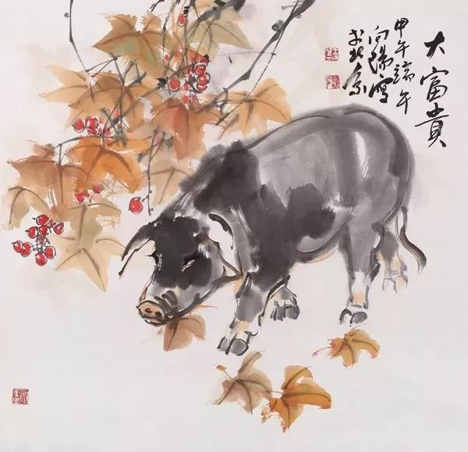

诸事顺遂
新猪拱户院生财
金
榜
题
名
光
耀
第
the First Lesson of the
New Semester
浙江省常山一中 吴俊峰

Slide 2





CONTENTS
1
About the PIG
2
About the CULTURES
3
About the WISHES

Slide 3





1
About the pig

Slide 4
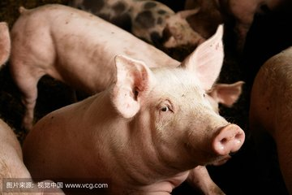
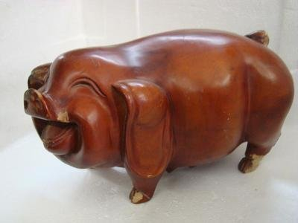
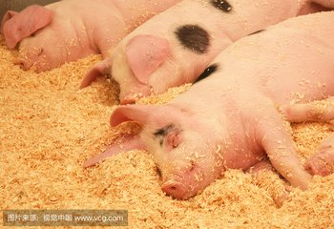

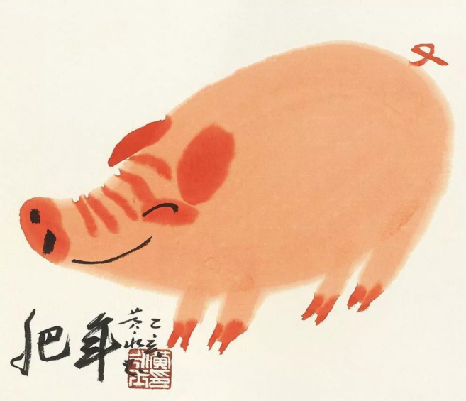
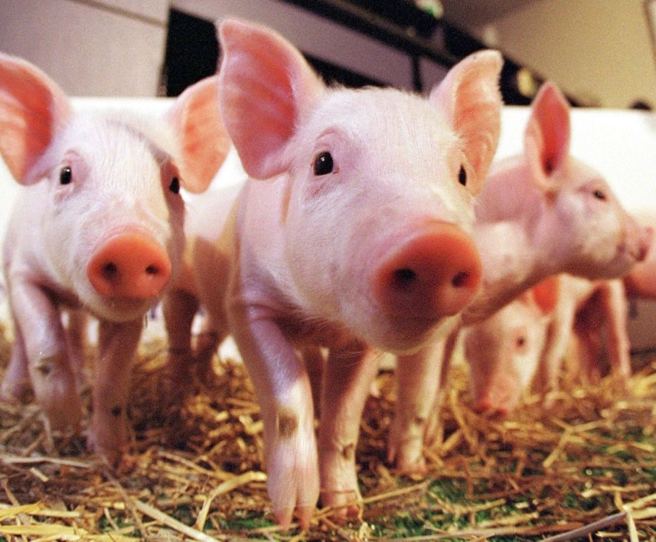
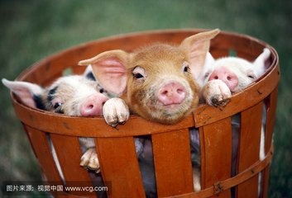
free talk: what kind of animal is the pig ，in your eyes？
dirty
cute
lazy
ugly
fat
greedy
lovely

Slide 5
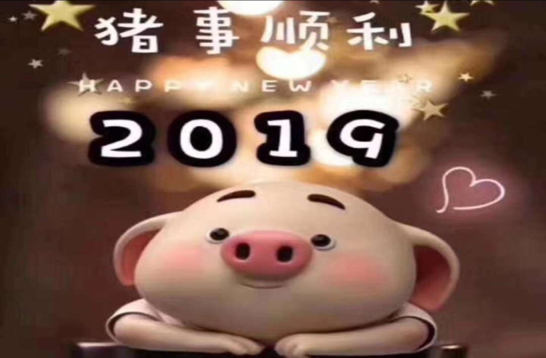
Do you know the auspicious words about the pig ?
as happy as a pig in mud
直译是：像猪滚在泥里一样开心 (mud:泥)
引申意思：开心到不行，乐翻天！
Happy Chinese New Year, be as happy as pig in mud every day!

Slide 6


A famed person and a fattened pig are alike in danger.
人怕出名猪怕壮

Slide 7
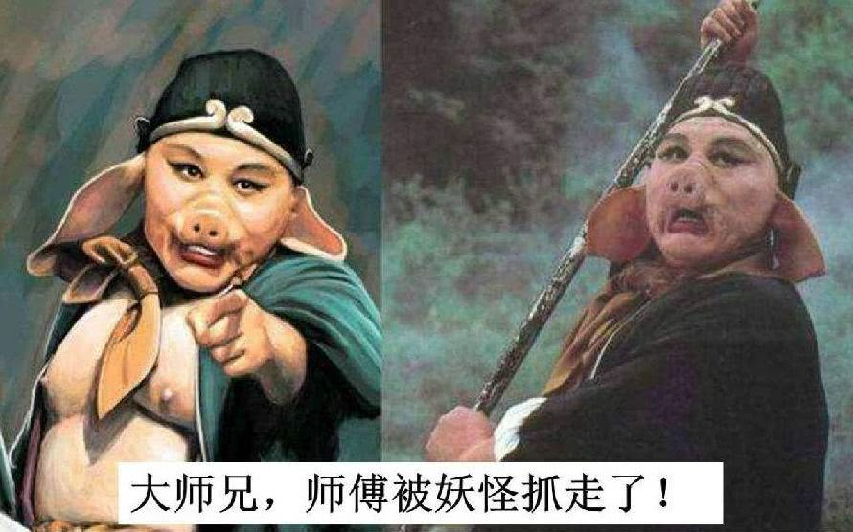
"猪队友"
With friends like that, who needs enemies?

Slide 8
Choose a number and guess the meanings of the following idioms about pigs 题
8
7
2
Guessing
6
3
5
4

Slide 9


Idioms about the pig
1. a pig of a sth :
They’re improving, and they’re a pig of a team to beat.
困难的事；讨厌的事

Slide 10
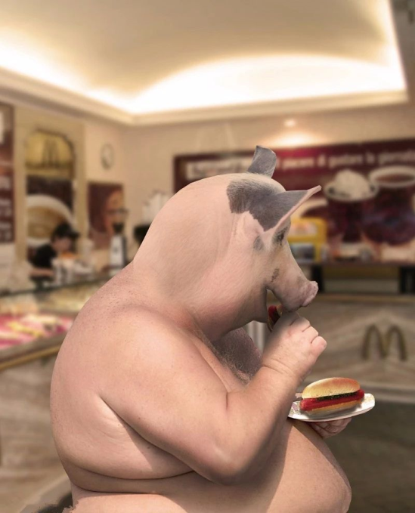
Idioms about the pig
2.make a pig of oneself :
I made a real pig of myself at Spring Festival ，so I’m on a diet again.
吃得过多

Slide 11
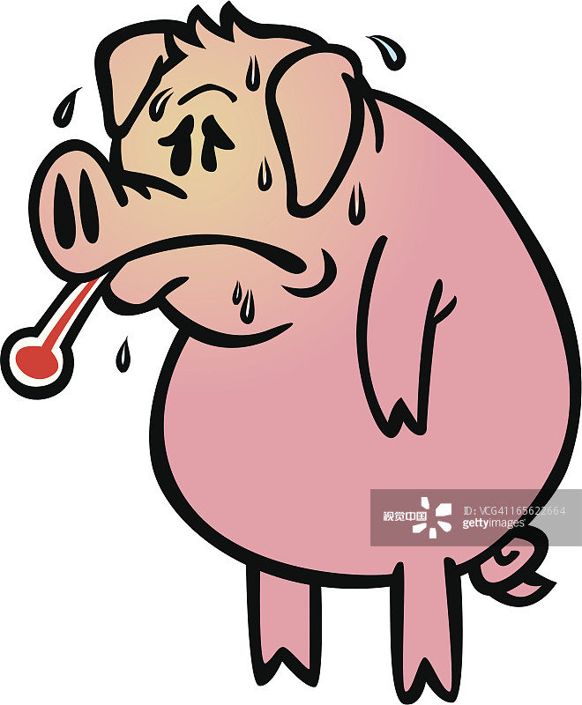
Idioms about the pig
3.make a pig’s ear of :
Mark’s made a pig’s ear of the decorating — there’s paint all over the carpet.
把某事弄糟

Slide 12

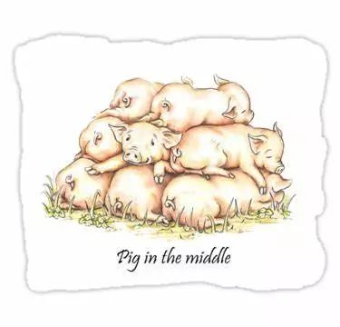
Idioms about the pig
4. be piggy in the middle:
Mum and Dad are quarreling bitterly and I’m piggy in the middle between them.
(被夹在中间) 左右为难的人

Slide 13
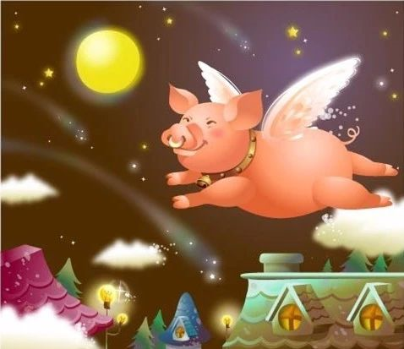
Idioms about the pig
5. pigs might fly / when pigs fly:
— With a bit of luck, we’ll be finished by the end of the month.
— Yes, and pigs might fly.
(表示不相信某事会发生) 太阳从西边出来：

Slide 14
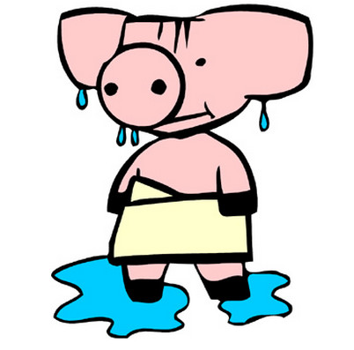
Idioms about the pig
6. sweat like a pig :
I was so nervous that I was sweating like a pig.
汗流浃背；大汗淋漓

Slide 15

Idioms about the pig
7. eat like a pig :
She is one of those lucky people who can eat like a pig and still stay thin.
吃得很多；吃得像猪一样难看

Slide 16
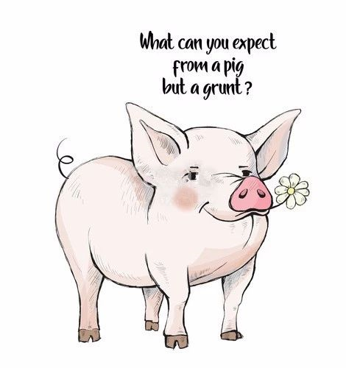
Idioms about the pig
8. What can you expect from a pig but a grunt?
grunt /grʌnt/ n. 咕哝；呼噜声
[谚语] 狗嘴里吐不出象牙。

Slide 17
2
About the cultures

Slide 18

文化的猪年：十二生肖
zodiac /'zəʊdɪæk/n. 属相，星座
The Chinese Zodiac has animal signs.
In 2019, it's .
12
the Year of the Pig

Slide 19
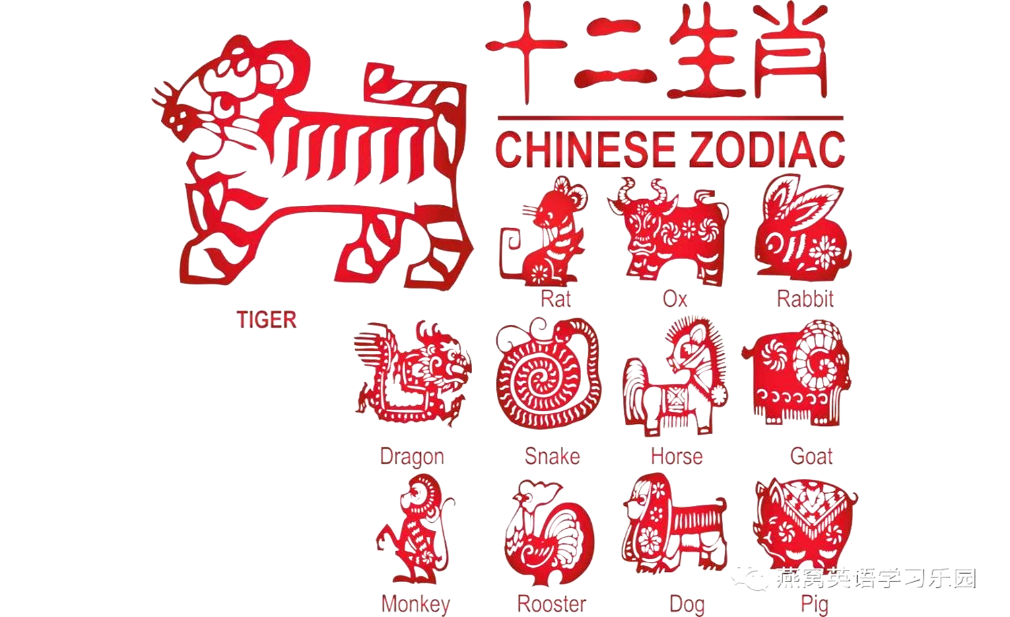
文化的猪年：十二生肖
zodiac /'zəʊdɪæk/n. 属相，星座
What are twelve Chinese Zodiac signs?
It’s not appropriate to say:
鼠—mouse，
牛—cow，
羊—sheep，
鸡—chicken

Slide 20
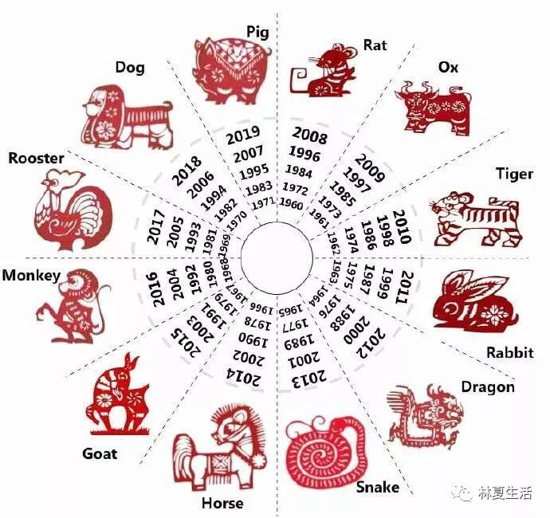
文化的猪年：十二生肖
zodiac /'zəʊdɪæk/n. 属相，星座
-What is your Chinese zodiac sign? 你属什么的？
-My Chinese zodiac sign is ... 我属…

Slide 21
文化的猪年：邀老外过春节——应用文写作
（2017年11月浙江省英语高考应用文写作）假定你是李华，得知外教Mr. Hall 寒假不回国，想邀请他到你家过春节。请给他写一封信，内容包括： 1. 时间；2. 一同过节的家人； 3. 活动。
注意：1. 词数80左右 2. 可以适当增加细节，以使行文连贯
开放性要点？
春节活动安排
What activities will be attractive to foreigners?
traditional，ethnic，Chinese characteristic

Slide 22
文化的猪年：邀老外过春节——应用文写作
风俗
饮食
玩乐
red paper cutting，set off fireworks, give lucky money to children, watch Spring Festival Gala，paste the couplets
make dumplings，family reunion dinner , the family banquet/ feast, Hot Pot(火锅) , Beijing Roast Duck , taste local flavor snacks
enjoy Yue Opera, appreciate folk arts and crafts, go to temple fair
Finish the composition as an after-class assignment.

Slide 23
3
About the wishes

Slide 24

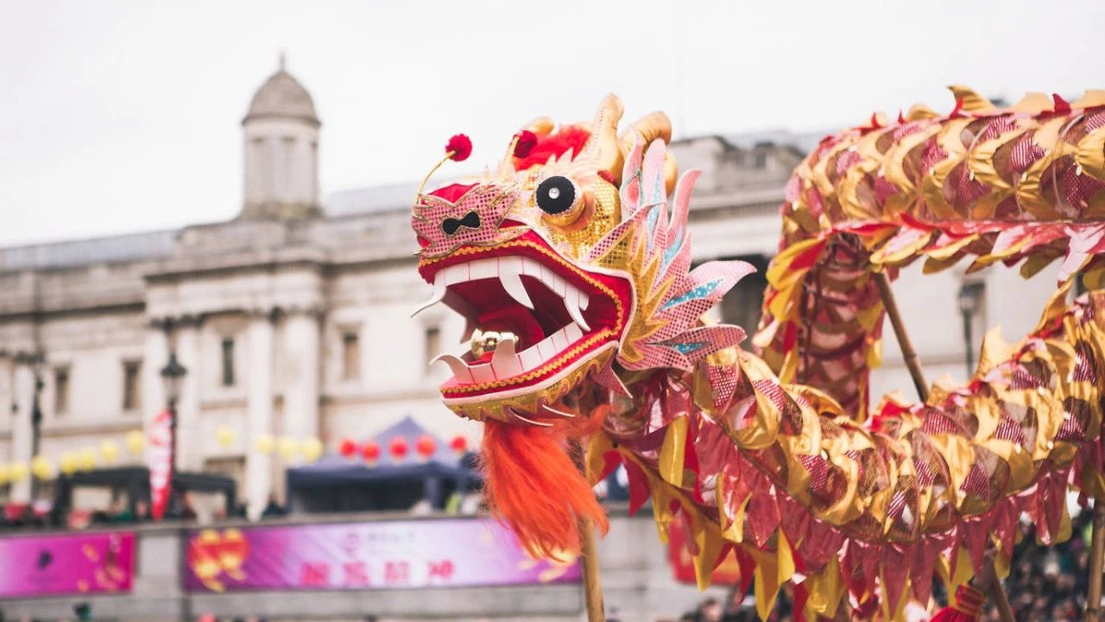
吉祥的猪年：英国首相的新春祝福
The fireworks . The red envelopes . And, around the world, hundreds of millions of people to celebrate the Chinese New Year.

Slide 25
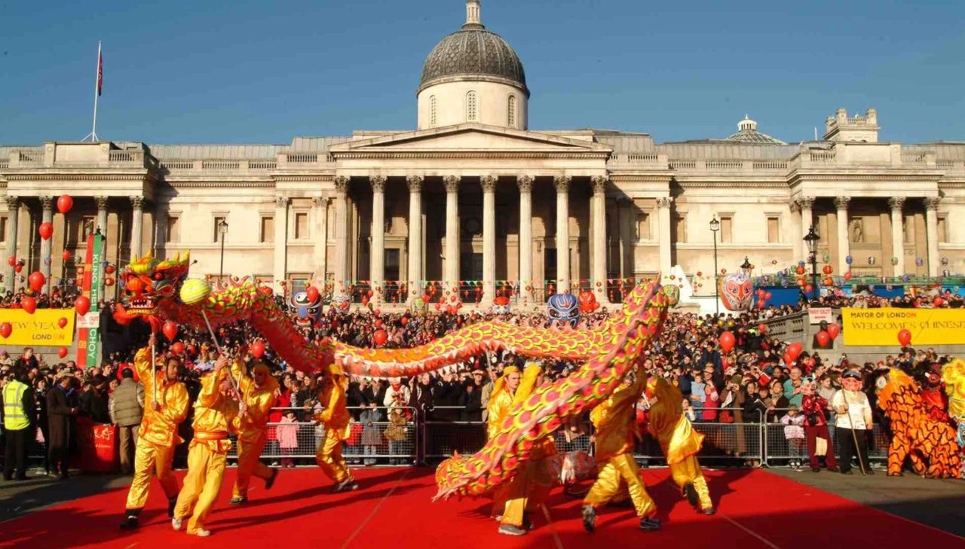
吉祥的猪年：英国首相的新春祝福
Across the UK, lanterns in Manchester, Liverpool, Nottingham and many of our other great cities — in London,
one of the biggest Chinese New Year celebrations outside Asia.

Slide 26
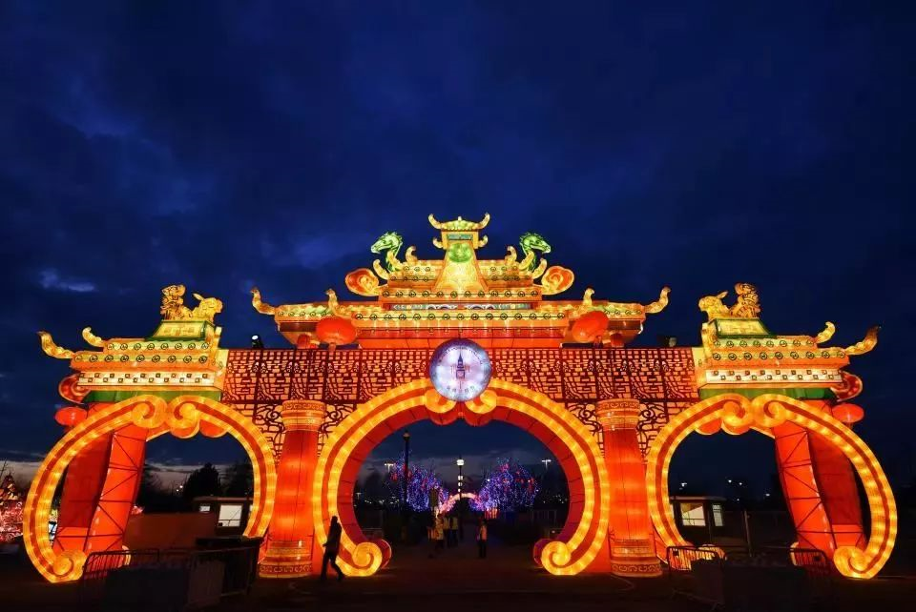
吉祥的猪年：英国首相的新春祝福
showcase n. 陈列橱 vt. 使展现
vibrancy /'vaɪbrənsi/n.
振动；活力
The festivities are one of the
of Britain’s cultural calendar,
the , vibrancy and of our society.

Slide 27
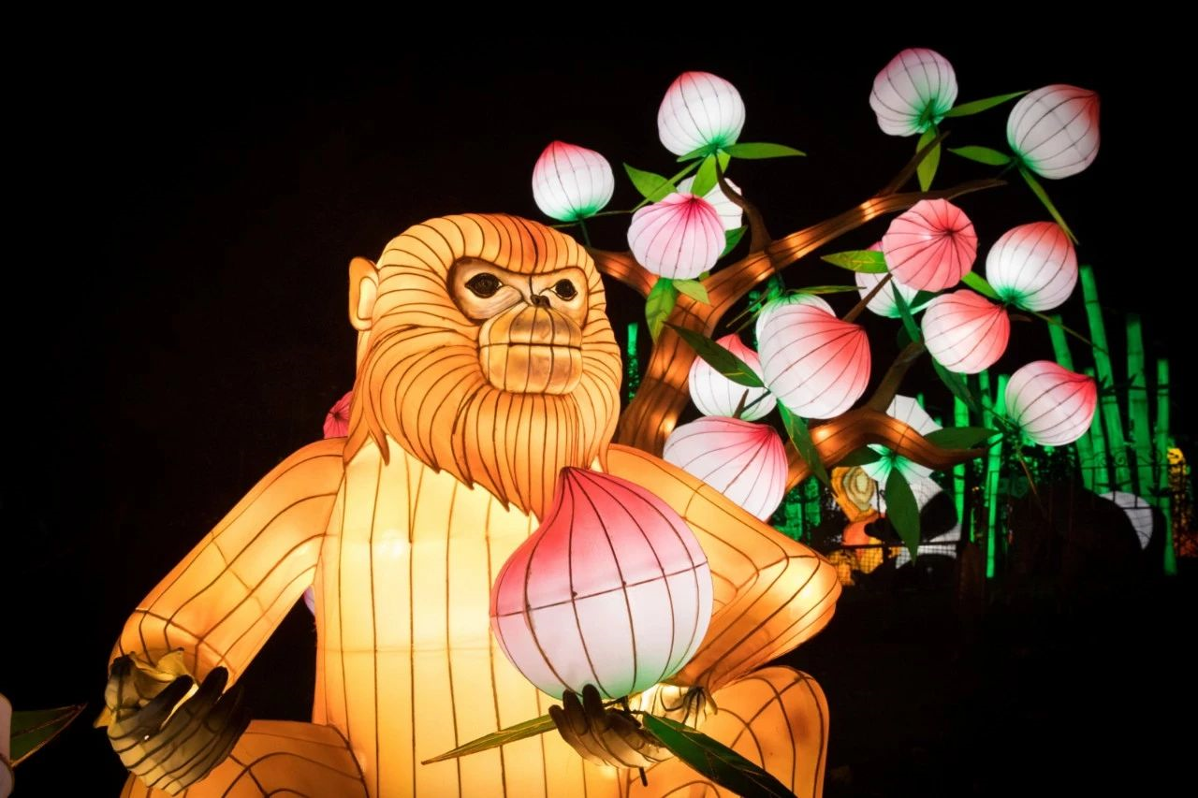
吉祥的猪年：英国首相的新春祝福
And they’re a of the incredible role
— from students , to families well over a century.

Slide 28
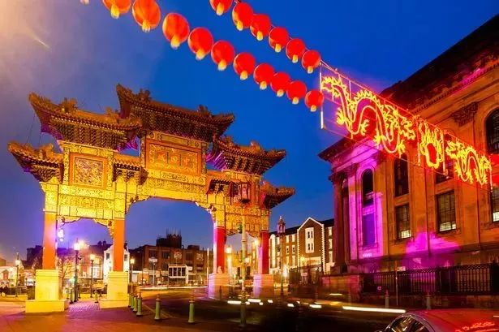
吉祥的猪年：英国首相的新春祝福
legacy /'legəsɪ/n. 遗赠，遗产
It’s a legacy and a contribution that I celebrated here at Downing Street last week, together
figures from across our Chinese community – people the UK would not be .

Slide 29

吉祥的猪年：英国首相的新春祝福
auspicious /ɔː'spɪʃəs/
adj. 吉利的；幸运的
So you are celebrating, let me wish you a very happy new year, and a
and auspicious year of the Pig.

Slide 30
吉祥的猪年：英国首相的新春祝福
The fireworks . The red envelopes . And, around the world, hundreds of millions of people to celebrate the Chinese New Year.
are being prepared
are being filled
are coming together

Slide 31
吉祥的猪年：英国首相的新春祝福
Across the UK, lanterns in Manchester, Liverpool, Nottingham and many of our other great cities — in London,
one of the biggest Chinese New Year celebrations outside Asia.
are being hung
including here
home to

Slide 32
吉祥的猪年：英国首相的新春祝福
showcase n. 陈列橱 vt. 使展现
vibrancy /'vaɪbrənsi/n.
振动；活力
The festivities are one of the
of Britain’s cultural calendar,
the , vibrancy and of our society.
undoubtedly
highlights
showcasing
strength
diversity
multicultural

Slide 33
吉祥的猪年：英国首相的新春祝福
And they’re a of the incredible role
— from students , to families well over a century.
reminder
that our Chinese community plays in British life
who have just arrived here to study
whose roots in this country go back

Slide 34
吉祥的猪年：英国首相的新春祝福
legacy /'legəsɪ/n. 遗赠，遗产
It’s a legacy and a contribution that I celebrated here at Downing Street last week, together
figures from across our Chinese community – people the UK would not be .
bringing
leading
without whom
the successful, dynamic country it is today

Slide 35
吉祥的猪年：英国首相的新春祝福
auspicious /ɔː'spɪʃəs/
adj. 吉利的；幸运的
So you are celebrating, let me wish you a very happy new year, and a
and auspicious year of the Pig.
wherever and however
prosperous

Slide 36







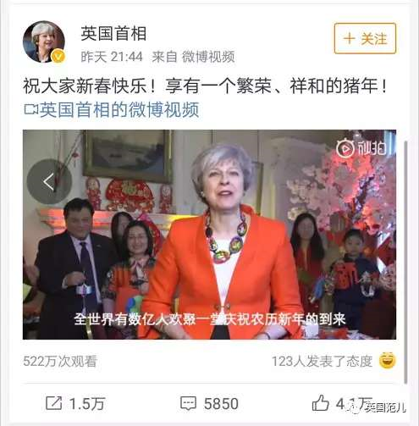
吉祥的猪年：英国首相的新春祝福
What message can you get from Theresa May’s speech?
That the Premier gave her thanks to the contributions that Chinese people made to some extent reflects that Chinese traditional culture brings about strong vitality, prosperity and diversity all around.
Salute to our great, powerful, prosperous homeland. I just feel so proud and honored to be one of the Chinese people. I wish our mother land a stronger, flourishing, invigorating future.

Slide 37

追梦的猪年：Pig Year is a Big Year
一个流动的中国，充满了繁荣发展的活力。我们都在努力奔跑，我们都是追梦人。
——习近平主席2019年新年贺词
China, as a country of people , is pursuing . We are all .
We are all .
on the move
energetically
prosperity
新年愿景
running very hard
dream chasers

Slide 38

追梦的猪年：Pig Year is a Big Year
这个时候，快递小哥、环卫工人、出租车司机以及千千万万的劳动者，还在辛勤工作，我们要感谢这些美好生活的创造者、守护者。大家辛苦了。
——习近平主席2019年新年贺词
Even as we speak, there are deliverymen, street cleaners, taxi drivers, and others . We should thank these workers
. Their hard work .
新年愿景
countless
who are hard at work
who contribute to the
creation of our beautiful society
is much appreciated

Slide 39


追梦的猪年：Pig Year is a Big Year
From now on,
Be a cheerful person.
Time has taken the old away,
Pig New Year is on our way.
新年愿景

Slide 40

追梦的猪年：Pig Year is a Big Yea
From this term on,
Be a person.
Time has taken away,
is on our way.
Be a joyful person.
Time has taken worries away. Big happiness is on our way.
Be a diligent person.
Time has taken laziness away. Big dream is on our way.
Be a fruitful person.
Time has taken failures away. Big success is on our way.
新年愿景

Slide 41
追梦的猪年：Pig Year is a Big Yea
May the new year bring in your life
祝愿诸位新的一年：
joys that never fade,
欢乐常在，
hopes that never die,
希冀长存，
and strength that never weakens.
活力不减，
Wishing you a very happy Chinese New Year.
新春快乐！

Slide 42
邀老外过春节——应用文写作参考范文
Dear Mr. Hall,
Hearing your schedule to stay in China in the coming winter vacation, I’m writing to extend my sincere invitation to you to spend the Spring Festival with my family.
Our family gathering, to be held on the night of February 18th, means cosy reunion for us, including my grandparents, uncles and aunts with their kids. We’ll have a big feast together, chatting casually. As for activities, setting off fireworks and going to the temple fair never fail to bring laughter. And I suppose the splendid Spring Festival Gala will also be your cup of tea.
Never deprive yourself of such simple pleasures! Looking forward to your early reply.
Yours genuinely,
Li Hua

Slide 43


感恩遇见，相互成就，本课件资料仅供您个人参考、教学使用，严禁自行在网络传播，违者依知识产权法追究法律责任。
更多教学资源请关注
公众号：溯恩高中英语
知识产权声明

