Slide 1
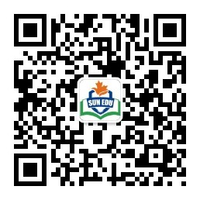
扫码关注
回复：hello sun
获取课件制作、录课等实用工具包
知识产权声明
感恩遇见，相互成就，本课件资料仅供您个人参考、教学使用，严禁自行在网络传播，违者依知识产权法追究法律责任。
更多教学资源请关注
订阅号：溯恩英语

Slide 2



完形填空
苏殷旦
2019.07.05

Slide 3



1
文本改编
目
录
2
篇章特点
CONTENTS
3
考点特征

Slide 4

PART
文本改编
01
Click here to add your title

Slide 5

改编思路
删减文本
将868个字的给定文本删减到250字左右词汇不超纲
抓文本主线
通过加深对父亲的描写，刻画出父亲对“我”深深的爱
语篇的衔接与连贯
通过各种衔接与连贯手段，让完形填空每一空都有迹可循。

Slide 6
My father never kept anything for emotional purpose ---except once. I was the only one in my family who cared about baseball and I always dreamed of watching my heroes at Yankee Stadium. One winter, I wrote down a schedule of the summer dates and dreamed every night. To my surprise, one evening I saw my father examining it before going out to work.
The following Sunday, he told me, “Let’s put away some money into a jar each week, and maybe we can go to Yankee Stadium this summer.” I immediately washed out a jar and attached a label: YANKEE STADIUM FUND, 1960.
Each of us contributed to the jar weekly. However, we still hadn’t gone to a game because my father had had to work every Saturday. So one day, I informed him of the remaining time, and then he comforted me, “Don’t worry and we’ll have a free Saturday.”
On the morning of the last game, I sat waiting hopelessly with no sign of my father who had been to work suddenly appeared and yelled, “I got two tickets!”
I could hardly breathe when we finally sat together, father and son, watching my New York Yankees. I sat cheering, but for my father, all I could see is a face lined with tiredness from working all week.
In 1963, my father died suddenly while working. In his bedroom, I noticed a faded ticket in his yellowed book, which read, October 1, 1960, General Admission. My father, who saved nothing for emotional reasons, had decided to keep this, a memory of our afternoon together.

Slide 7
My father never kept anything for emotional purpose ---except once. I was the only one in my family who cared about baseball and I always dreamed of watching my heroes at Yankee Stadium. One winter, I wrote down a schedule of the summer dates and dreamed every night. To my surprise, one evening I saw my father examining it before going out to work.
The following Sunday, he told me, “Let’s put away some money into a jar each week, and maybe we can go to Yankee Stadium this summer.” I immediately washed out a jar and attached a label: YANKEE STADIUM FUND, 1960.
Each of us contributed to the jar weekly. However, we still hadn’t gone to a game because my father had had to work every Saturday. So one day, I informed him of the remaining time, and then he comforted me, “Don’t worry and we’ll have a free Saturday.”
On the morning of the last game, I sat waiting hopelessly with no sign of my father who had been to work suddenly appeared and yelled, “I got two tickets!”
I could hardly breathe when we finally sat together, father and son, watching my New York Yankees. I sat cheering, but for my father, all I could see is a face lined with tiredness from working all week.
In 1963, my father died suddenly while working. In his bedroom, I noticed a faded ticket in his yellowed book, which read, October 1, 1960, General Admission. My father, who saved nothing for emotional reasons, had decided to keep this, a memory of our afternoon together.
My father never kept anything for emotional purpose ---except once.
动作描写
examining before going out to work.
Let’s put away some money into a jar each week, maybe we can go to Yankee Stadium this summer
语言描写
comforted
Don’t worry and we’ll have a free Saturday
首尾呼应
appeared and yelled
I got two tickets
a face lined with tiredness from working all week.
外貌描写
My father, who saved nothing for emotional reasons, had decided to keep this, a memory of our afternoon together.
memory

Slide 8
PART
篇章特点
02
Click here to add your title

Slide 9
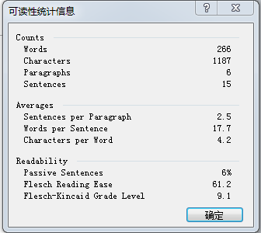
My father never kept anything for emotional purpose ---except once. I was the only one in my family who cared about baseball and I always dreamed of watching my heroes at Yankee Stadium. One winter, I wrote down a schedule of the summer dates and dreamed every night. To my surprise, one evening I saw my father examining it before going out to work.
The following Sunday, he told me, “Let’s put away some money into a jar each week, and maybe we can go to Yankee Stadium this summer.” I immediately washed out a jar and attached a label: YANKEE STADIUM FUND, 1960.
Each of us contributed to the jar weekly. However, we still hadn’t gone to a game because my father had had to work every Saturday. So one day, I informed him of the remaining time, and then he comforted me, “Don’t worry and we’ll have a free Saturday.”
On the morning of the last game, I sat waiting hopelessly with no sign of my father who had been to work suddenly appeared and yelled, “I got two tickets!”
I could hardly breathe when we finally sat together, father and son, watching my New York Yankees. I sat cheering, but for my father, all I could see is a face lined with tiredness from working all week.
In 1963, my father died suddenly while working. In his bedroom, I noticed a faded ticket in his yellowed book, which read, October 1, 1960, General Admission. My father, who saved nothing for emotional reasons, had decided to keep this, a memory of our afternoon together.
文章难度易读度Flesh值
Flesh值 | 难易程度
50-60 | 较难
61-70 | 中等
71-80 | 较为容易
81-90 | 偏易

Slide 10
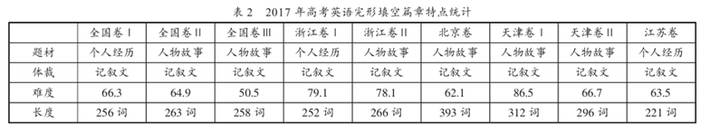
(王新飞、杨志强；2018)
篇章特点
题材 | 个人经历
体裁 | 记叙文
难度 | 61.2
长度 | 266词

Slide 11
PART
考点特征
03
Click here to add your title

Slide 12
扫码关注
回复：hello sun
获取课件制作、录课等实用工具包
知识产权声明
感恩遇见，相互成就，本课件资料仅供您个人参考、教学使用，严禁自行在网络传播，违者依知识产权法追究法律责任。
更多教学资源请关注
订阅号：溯恩英语

Slide 13

考点特征
考点层次
考点分布
删词间距
语篇层次
句子层次
词组层次
单词层次
动词（短语）
名词（短语）
形容词、副词、
连词、介词（短语）
删词间距为5-10词为最佳

Slide 14
1.
考点层次
Click here to add your title

Slide 15
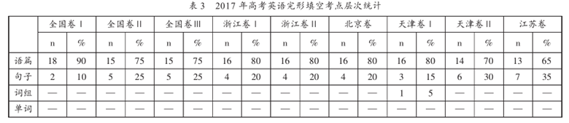
(王新飞、杨志强；2018)
完形填空试题中的层次越低，考点的效度就会越低，反之则越高。
考点层次
语篇 | 16（80%）
句子 | 4 （20%）
词组 | ——
单词 | ——

Slide 16
2.
考点分布
Click here to add your title

Slide 17
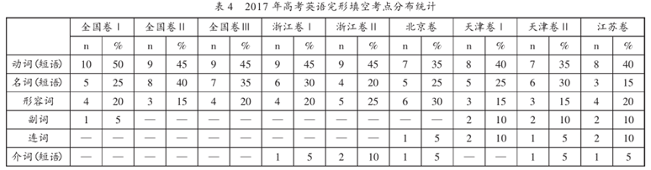
(王新飞、杨志强；2018)
实词为主、虚词为辅

Slide 18
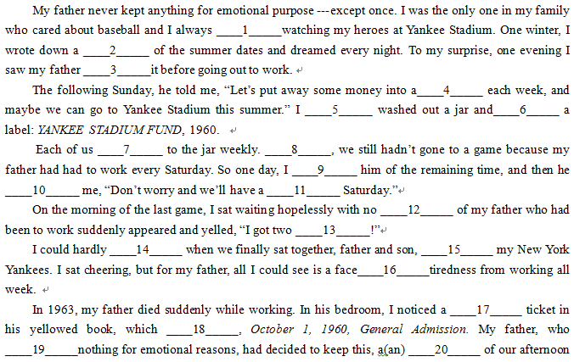

Slide 19
考点分布
动词 10（50%） |  | 名词 5（25%） | 形容词 2（10%） | 副词 1（5%） | 词组 2（10%）
谓语动词(7) | 非谓语动词(2) | schedule, jar, sign, tickets, memory | free, faded | However | dreamed of, lined with
attached, contributed, informed, comforted, breathe, read, saved | exploring (现在分词作宾语)， greeting （现在分词作伴随状语）,

Slide 20
3.
删词间距
Click here to add your title

Slide 21
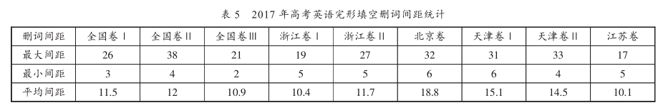
(王新飞、杨志强；2018)
删词间距
最大间距 | 19
最小间距 | 3
平均间距 | 10.7

Slide 22
PART
例题分析
04
Click here to add your title

Slide 23

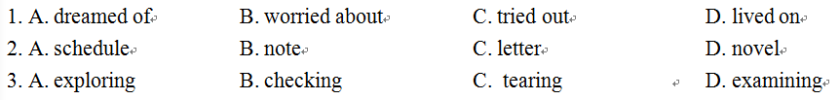
答案解析
1.考察词义复现，后面一句中出现了dreamed,所以第一空应该是dreamed of，所以选A。
2. examining表示to look at sth. closely or carefully, 用在这里可以凸显出父亲对孩子的这个梦想很上心，从而突出父亲对孩子的爱，所以选D。

Slide 24
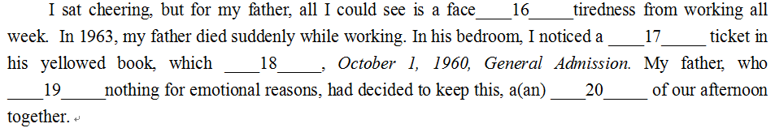
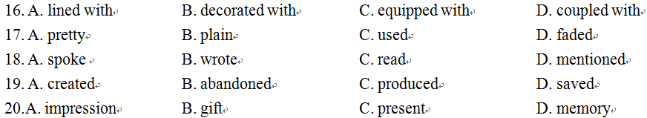
16. 根据上下文这里应该填A，lined with这个词不单单可以表现出父亲因为工作满脸的疲倦，还非常形象刻画出岁月在父亲脸上留下的皱纹。
17.这里是对形容词的考察，从语义上看，used (用过的) 和faded ( 褪色的) 都可以，但是faded这个词用在这里非常好得反衬出这个那场比赛那段旧时光已经越走越远，但是我们父与子的感情却日益加深，再一次凸显父子之间的情深，而used就不能体现出这一感情色彩，所以选D。
19. 这一题考察的是词汇手段里面的反义词，save与后面的keep形成对比，所以选D。

Slide 25
扫码关注
回复：hello sun
获取课件制作、录课等实用工具包
知识产权声明
感恩遇见，相互成就，本课件资料仅供您个人参考、教学使用，严禁自行在网络传播，违者依知识产权法追究法律责任。
更多教学资源请关注
订阅号：溯恩英语

Slide 26
Thank you
2019.07.05

