Slide 1


感恩遇见，相互成就，本课件资料仅供您个人参考、教学使用，严禁自行在网络传播，违者依知识产权法追究法律责任。
更多教学资源请关注
公众号：溯恩高中英语
知识产权声明

Slide 2

M5U5
First Aid
New Words and Expressions

Slide 3

重点单词
aid
1. ________ n. & vt. 帮助；援助；资助
2. ________ adj. 暂时的；临时的
3. ________ vi. & vt. (____, ____) 流血
4. ________ vi. & vt. （使）噎住；（使）窒息
5. ________ n. 毒药；毒害 vt. 毒害；使中毒
6. ________ adj. 复杂的
7. ________ n. 变化；多样（化）；多变（性）
8. ________ adj. 轻微的；温和的；温柔的
9. ________ vi. & vt. (______, _______)（使）膨胀；隆起
10.________ vt. & vi. 榨；挤；压榨
11.________ adj. 至关重要的；生死攸关的
12.________ vt. & vi. 倒；灌；注；涌
temporary
bleed
bled
bled
choke
poison
complex
variety
mild
swell
swelled
swollen
squeeze
vital
pour

Slide 4
重点单词
tight
13. ________ adj. 牢的；紧的；紧密的
14. ________ adj. （动作）稳定有力的；坚定的
15. ________ vt. & vi. 刺；戳；刺伤
16. ________ vt. & vi. 治疗；对待；款待 n. 款待；招待
17. ________ vt. 涂；应用 vi. 申请；使用；有效
18. ________ n. 压力；挤压；压迫（感）
19. ________ adj. 潮湿的
20. ________ n. 症状；征兆
21. ________ adj. 难以忍受的；不能容忍的
22.________ n. 屏障；障碍（物）
23. ________ n. 损伤；伤害
24.________ n. 器官
firm
stab
treat
apply
pressure
damp
symptom
unbearable
barrier
injury
organ

Slide 5
派生单词
1. __________ adj. 暂时的；临时的 ___________ adv. 临时地
2. __________ n. 损伤；伤害 ___________ adj. 受伤的；有
3. __________ n. 毒药；毒害 vt. 毒害 __________ adj. 有毒的
4. __________ adj. 复杂的 __________ n. 复杂性
5. __________ n. 变化；多样（化） __________ adj. 各种各样的
6. __________ adj. 潮湿的 __________ n. 潮湿
7. __________ n. 勇敢；勇气 __________ adj. 勇敢的
8. __________ n. 压力；挤压 __________ v. 按；压榨；敦
9. __________ adj. 牢的；紧的；紧密的 __________ n. 密封性；紧密
10.__________ vt. 涂；应用 vi. 申请；使用 __________ n. 运用；申请；施用
temporary
temporarily
injury
injured
poison
poisonous
complex
complexity
variety
various
damp
dampness
bravery
brave
pressure
press
tight
tightness
apply
application

Slide 6
重点短语
1.________________ （对伤患者的）急救
2.________________ 生病
3.________________ 触电；电休克
4.________________ 榨出；挤出
5.________________ 反复；多次
6.________________ 在适当的位置；适当
7.________________ 若干；许多
8.________________ 找到
9.________________ 区别对待；有影响；起（重要）作用
first aid
fall ill
electric shock
squeeze out
over and over again
in place
a number of
put one’s hands on
make a difference

Slide 7
词义释义
____________ an area of land around a large river with streams running down into it
____________ a change in your body or mind that shows that you are not healthy
____________ a vehicle with special equipment, used for taking sick or injured people to a hospital
____________ a tool for cutting paper or cloth, that has two sharp blades with handles, joined together in the middle
____________ a strip of cloth used for tying around a part of the body that has been hurt in order to protect or support it
____________ a narrow line of light, heat or other energy
____________ a public or religious occasion that includes a series of formal or traditional actions
basin
symptom
ambulance
scissors
bandage
ray
ceremony

Slide 8
话题词汇
nosebleed, sprain, chock, blister, bruise, char, infection, symptom, stab
Words about injuries
Words about human bodies
ankle, skin, organ, tissue, throat, wrist
Words about treatment
first aid, bandage, squeeze out, ointment, ambulance, apply
Words about articles for daily use
cupboard, pan, stove, scissors, kettle, sleeve, blouse

Slide 9
美句赏析
barrier
Age is no ______. It's a limitation you put on your mind. ---Jackie Joyner-Kersee
For every ________ problem there is an answer that is clear, simple, and wrong.
---H. L. Mencken
I have seen what a laugh can do. It can transform almost ___________ tears into something bearable, even hopeful. ---Bob Hope
When people are putting _______ on me I just completely ignore it. ---Zayn Malik
complex
unbearable
pressure

Slide 10
遣词造句
Group 1: first aid; injury; vital
Group 2: poison; variety; organ
Group 3: swollen; unbearable; bandage
The first aid, which offers immediate treatment, is vital to serious injuries.
There are a variety of poisons, which can do great harm to human organs.
When you find the swollen skin unbearbale, stop using the bandage and go to hospital as soon as possible.

Slide 11
核心词汇
1. swell
v. swelled, swollen
连线与右侧相应的意思匹配
Her ankle was already starting to swell.
The crowd swelled to around 10,000.
His heart swelled with pride as he watched his daughter collect her prize.
The wind swelled (out) the sails.
（使）鼓气，（使）隆起
肿胀【尤指身体部位】
洋洋得意
【数量】增加，增多

Slide 12
Quiz
翻译
1. 他的银行存款在过去三周增加了$222,000.
His bank balance has swelled by $222,000 in the last three weeks.
2. 你的脚晚上会肿吗？
Do your feet swell at night?
3. 一说到她的儿子，这个母亲充满了骄傲。
The mother was swelling with pride when she spoke of her son.

Slide 13
核心词汇
2. pour
v.
倾倒；倒出；倒（饮料）
Pour the oil into a frying pan and heat.
He got up and poured himself another drink.
I've poured you a cup of tea.
涌流；倾斜；喷发
Tears poured down his cheeks.
Thick black smoke was pouring out of the roof.
（雨）倾盆而下；下大雨
The rain continued to pour down.
It's pouring outside.

Slide 14
Quiz
用pour的不同用法造句
他坐在窗边，给自己倒了一杯茶。外面的雨下得很大。回忆起前几天发生的事，他泪如雨下。
Sitting by the window, he poured himself a cup of tea. Outside, it was pouring. Tears poured down his cheeks when he recalled what had happened in the other day.

Slide 15
核心词汇
3. treat
v.
behave towards sb/sth 对待某人/某事
My parents still treat me like a child.
He was treated as a hero on his release from prison.
illness/injury 治疗，医治
It's difficult to treat patients because of a shortage of medicine.
Nowadays, malaria (疟疾) can be treated with drugs.
pay for sth enjoyable 花钱享受
She treated him to lunch.
I'm going to treat myself to a new pair of shoes.

Slide 16
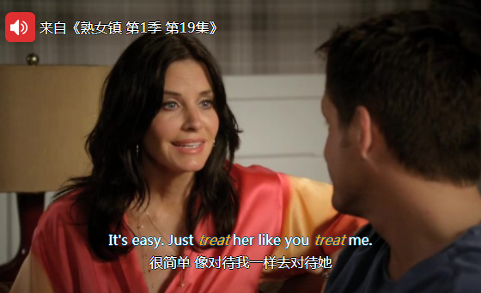
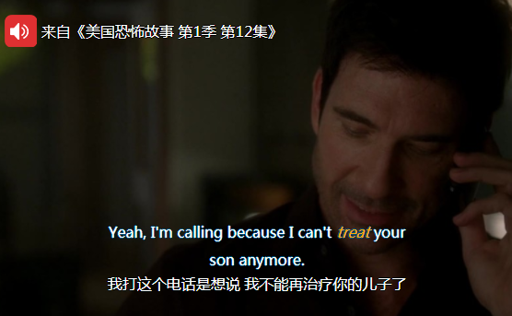
Quiz
翻译台词

Slide 17
核心词汇
4. apply
v.
利用找出apply可能的用法
I am continuing to apply for the job.
They may apply to join the organization.
He has applied himself to this task with considerable energy.
What I am saying only applies to some of you.
The new technology was applied to farming.
Apply the cream to your face and neck.
apply for sth, apply to do sth 申请
apply oneself to sth
勤奋工作
apply to 适用
apply sth to (sth) 应用
apply sth to (sth) 涂，抹
派生词
application 申请，应用

Slide 18
Quiz
翻译名言
你不能对天气发怒，因为天气无关于你。生活中的大多方面也同样适用。
You can't get mad at weather because weather's not about you. Apply that lesson to most other aspects of life. (by Douglas Coupland)
只要好好利用，总会有足够的时间。
One always has time enough, if one will apply it well. (by Johann Wolfgang von Goethe)
我们告诉申请者，如果你不打算在这一辈子，就不必申请。
We tell applicants, 'If you don't intend to be here for life, you needn't apply.'
(by S. Truett Cathy)

Slide 19
核心词汇
5. squeeze
v.
He squeezed her hand and smiled at her.
挤压；捏
He took out his wet clothes and squeezed the water out.
挤出；榨出；拧出
We managed to squeeze six people in the car.
（使）挤入；塞入

Slide 20
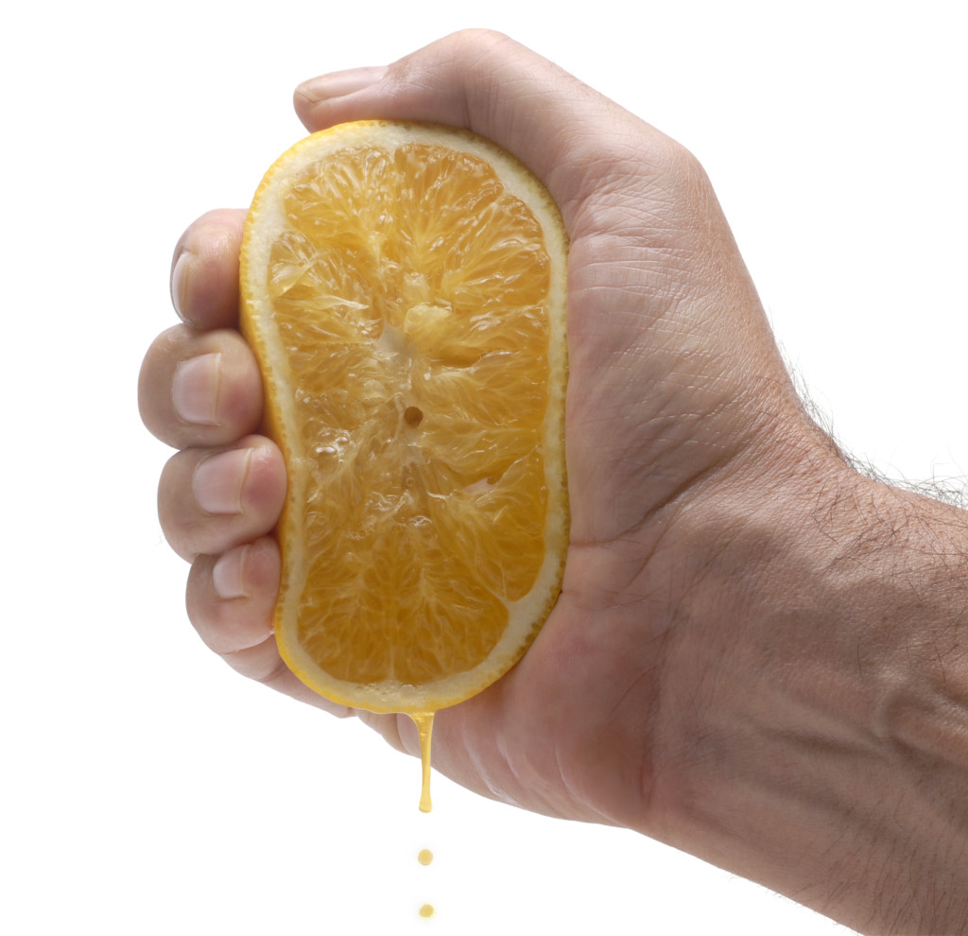
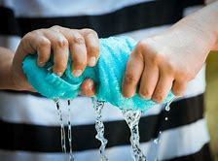
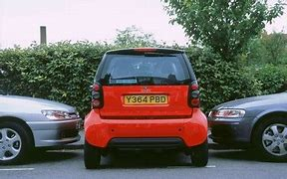
Quiz
根据图片写英文表达
squeeze orange juice
squeeze the water out
squeeze into a parking space

Slide 21
即学即用
When you ______, you can go to hospital for treatment. However, if it is a serious illness or _____, _______ should be performed immediately to save life before an __________ comes. Here are some suggestions when a person suffers an ____________. The first thing to remember is not to move a person with an electrical injury unless he or she is in immediate danger. If the injured person has such __________ as severe burns and difficulty breathing, seek emergency care as soon as possible. When waiting for medical help, you can take some actions. For example, Turn off the source of electricity, if possible. You can also ______ a bandage to the burned areas. ________ the injured person in a proper way before medical help comes can always _________________.
fall ill
injury
first aid
ambulance
electric shock
symptoms
apply
Treating
make a difference

