Slide 1


感恩遇见，相互成就，本课件资料仅供您个人参考、教学使用，严禁自行在网络传播，违者依知识产权法追究法律责任。
更多教学资源请关注
公众号：溯恩高中英语
知识产权声明

Slide 2

B3U5
Canada - “The True North”
New Words and Expressions

Slide 3

重点单词
1. ________ vi. & n. 聊天;闲聊
2. ________ vt. & vi. 包围;围绕
3. ________ vi. & vt. 测量;衡量;判定 n.计量单位;措施
4. ________ prep. 在……之内
5. ________ n. 边界;国界;边沿 vt. & vi. 与……接壤;接近
6. ________ vt. & vi. 混合;调配
7. ________ n. 测验;问答比赛
8. ________ vt. 证实;证明;批准
9. ________ n. 距离;远方
10.________ adv. 在附近 adj. 附近的;邻近的
11.________ n. 传统;风俗
12.________ vt. 使印象深刻;使铭记
chat
surround
measure
within
border
mix
quiz
confirm
distance
nearby
tradition
impress

Slide 4
重点单词
13. ____________ adj. 欣喜的;高兴的;愉快的
14. ____________ adj. 恐惧的;受惊吓的
15. ____________ adj. 宽阔的;广泛的
16. ____________ n. 黎明;拂晓;破晓
17. ____________ adv. 接近;大约
18. ____________ adj. 市区的 adv. 在市区;往市区
19. ____________ adj. 有薄雾的;模糊的
20. ____________ adj. 富有的
21. ____________ n. 霜;霜冻
22. ____________ n. 话题
23. ____________ adj. 城市的;市镇的
24. ____________ n. 景色;风景
pleased
terrified
broad
dawn
approximately
downtown
misty
wealthy
frost
topic
urban
scenery

Slide 5
派生单词
1. _________ vt. & vi. 包围;围绕 _________ adj. 周围的；附近的
2. _________ n. 系统;体系;制度 _________ adj. 成体系的；系统
3. _________ n. 宗教;宗教信仰 _________ adj.宗教信仰的
4. _________ n. 学说;理论 _________ adj.理论上的
5. _________ n. 球体;地球仪;地球 _________ adj. 全球性的;全世界的
6. _________ adj. 猛烈的;激烈的;强暴的 _________ n. 暴力；暴行
7. _________ adj. 基本的;基础的 _________ adv. 从根本上
8. _________ adj. 有害的 _________ n. & v. 伤害；损害
9. _________ vi. & vt. 乘;增加 _________ n. 相乘；增加
10.________ vi. 存在;生存 _________ n.存在；生活方式
11.________ n. 难题 vt. & vi. (使)迷惑 _________ adj.困惑的；迷惑不解的
surround
surrounding
system
systematic
religion
religious
theory
theoretical
globe
global
violent
violence
fundamental
fundamentally
harmful
harm
multiply
multiplication
exist
existence
puzzle
puzzled

Slide 6
重点短语
prime minister
1.________________ 首相;丞相
2.________________ 与其;不愿
3.________________ 定居;平静下来;专心于
4.________________ 设法做
5.________________ 看见;瞥见
6.________________ 对……有天赋
7._______________ 在远处
rather than
settle down
manage to do
catch sight of
have a gift for
in the distance

Slide 7
词义释义
____________ in, towards or typical of the centre of a city, especially its main business area
____________ a person who is the official head of a country or region that is governed by another country
____________ one of the large land masses of the earth such as Europe, Asia or Africa
____________ a competition or game in which people try to answer questions to test their knowledge
____________ towards the east
____________ a cloud of very small drops of water in the air just above the ground, which makes it difficult to see
____________ used to show that something is almost, but not completely, accurate or correct
downtown
governor
continent
quiz
eastward
mist
approximately

Slide 8
话题词汇
  Vancouver, Toronto, Calgary, Ottawa, the Rocky Mountains, Thunder Bay, Lake Superior, Niagara, St Lawrence River
Places in Canada
Animals in Canada
  beaver, grizzly, penguin, eagle
  polar, eastward, westward, upward, surround, within, border, urban, downtown, nearby, harbour, continent, booth, workplace
Direction and location

Slide 9
美句赏析
scenery
One person's car is another person's _______. ---Jonathan Ive
Early to bed and early to rise makes a man healthy, _______ and wise.
---Benjamin Franklin
Laughter is the closest _________ between two people. ---Victor Borge
Faith is the bird that feels the light when the _____ is still dark.
---Rabindranath Tagore
I want to do things that _______ me, unless they're going to kill me.---Orlando Bloom
wealthy
distance
dawn
terrify

Slide 10
遣词造句
Group 1: multicultural; chat; Canadian
Group 2: scenery; manage to do; settle down
Group 3: eastward; catch sight of; eagle
Group 4: have a gift for; impress; topic
Canada is a multicultural country, where you can see Canadians of different colors chat with each other.
He managed to make ends meet, after he settled down in the distant place with a beautiful scenery.
Going eastward, you will catch sight of eagles, which cannot be seen easily.
He has a gift for telling stories of various topics, which impresses people a lot.

Slide 11
核心词汇
1. surround
n. & v.
写出例句中surround相关表达的含义
The lake is surrounded with/by trees.
They’ve surrounded the building with police.
Science and secrecy surround the murder.
I like to surround myself with beautiful things.
被...环绕
用...包围...
（某情况或事件）密切相关
与某事在一起/为伍

Slide 12
Quiz
名言翻译
和积极的人在一起，你也会变得积极。
Surround yourself with positive people and you'll be a positive person. (by Kellie Pickler)
我被优秀的人包围，而我也和优秀的人在一起。
I'm surrounded by good people, and I surround myself with good people. (by Lil Peep)

Slide 13
核心词汇
2. measure
v. & n.
将例句中measure的含义与右边中文意思匹配
She was being measured for her wedding dress.
Education shouldn't be measured purely by examination results.
The room measures 6*6 meters.
Measures are being taken to reduce crime in the city.
Sending flowers is a measure of how much you care.
n. 尺度，标准，程度
v. （某物的）体积
[长度，数额等]为
v. 估量，衡量
n. 措施
v. 测量

Slide 14
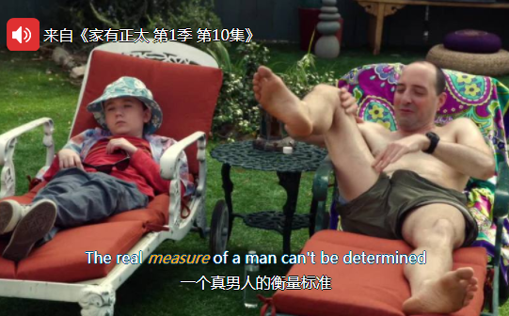
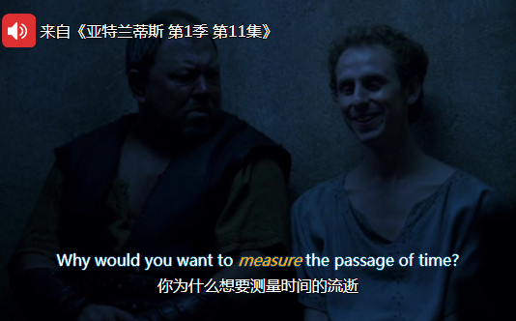
Quiz
台词翻译

Slide 15
核心词汇
v.
3. impress
根据例句写出impress的用法和相应意思
He impressed her with his sincerity.
We were very impressed by the standard of work.
Father impressed on me the value of hard work.
I had always impressed upon the children that if they worked hard they would succeed in life.
Her words impressed themselves on my memory.
impress sb with/by sth
使留下深刻印象
impress sb on/upon sth
使意识到(重要性/严重性)
impress sth/itself on sth
使铭记；给留下深刻印象
派生词 impression n. 印象；效果；印记

Slide 16

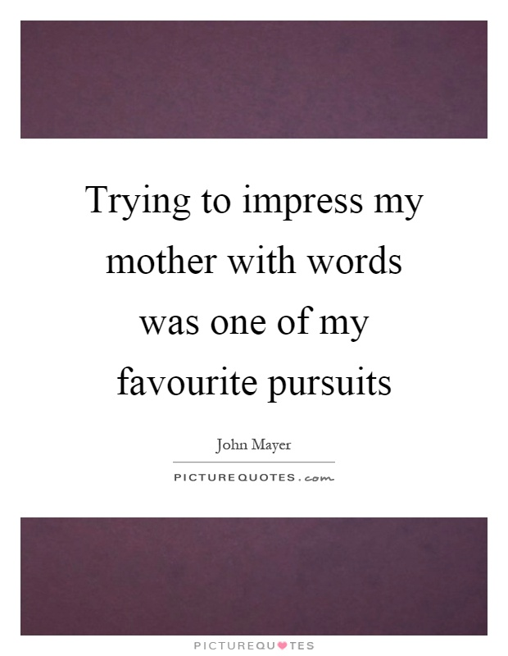
Quiz
名言翻译
我努力让我妈记住我说的话。
给别人留下深刻印象要比给别人快乐更容易。

Slide 17
核心词汇
4. mix
n. & v.
写出例句中mix相关表达的意思
Mix the soured cream with ketchup.
His books mix historical facts with fantasy.
Charlie doesn't mix well with the other children.
The town offers a fascinating mix of old and new.
（和）混合，搅和
（使）结合
交往，相处，交际
... 的混合；混杂

Slide 18
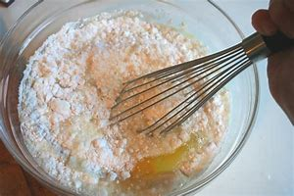

Quiz
根据图片写句子
mix the egg with the flour
a mix of colors

Slide 19
核心词汇
5. confirm
v.
写出例句中confirm的相关意思
New evidence has confirmed the first witness' story.
Could you confirm the dates we discussed?
This just confirms my worst fears.
证实
肯定，确认
证实（自己的想法或情感）
派生词
confirmation n. 证实，批准

Slide 20
Quiz
改写句子
Rumors of job losses later turned out to be true.
Rumors of job losses were later confirmed.
It has made me believe that not being an actor is a right decision.
It has confirmed me in my decision not to become an actor.

Slide 21
即学即用
Canada is the second largest country in the world in land area, after Russia. ___________ by the Atlantic Ocean, the Pacific Ocean, and the Arctic Ocean, it has the longest ______ with water of any country in the world. Its border with its ______ country the US is also the longest, with four fifths of the population living in ______ areas near the southern border.
Many places in Canada have long been home to many Aboriginal people. Later, Europeans ____________ here, contributing to the country's various _________. Now in Canada, many cultures are _____ and coexist with each other, which ________ a lot of visitors.
Surrounded
border
nearby
urban
settled down
traditions
mixed
impresses

Slide 22

溯恩教育感谢一路有你

