Slide 1


感恩遇见，相互成就，本课件资料仅供您个人参考、教学使用，严禁自行在网络传播，违者依知识产权法追究法律责任。
更多教学资源请关注
公众号：溯恩高中英语
知识产权声明

Slide 2

M4U5
Theme Park
New Words and Expressions

Slide 3

重点单词
1. ________ n. 秋千；摇摆 v. (______, ______) 摇摆；摆动
2. ________ vt. 保存；保留 n. 保护区
3. ________ vt. & vi. 前进；促进；提前
4. ________ n. 题目；主题（曲）
5. ________ adj. 中心的；中央的
6. ________ adj. 不同的；各种各样的
7. ________ n. 幻想；怪念头
8. ________ n. 消遣；娱乐（活动）
9. ________ n. 有吸引力的事物；吸引
10.________ n. 旅游业
11. ________ adj. 独一无二的；仅有的
12.________ n. 引擎；发动机
swing
swung
swung
preserve
advance
theme
central
various
fantasy
amusement
attraction
tourism
unique
engine

Slide 4
重点单词
13. ________ n. 长度；长
14. ________ n. 行动；事迹
15. ________ n. 剑
16. ________ n. 移民；殖民者
17. ________ adj. 运动的
18. ________ n. 少数；少数民族
19. ________ n. 丛林
20. ________ n. 生物；动物
21. ________ adj.高级的；先进的
22.________ n. 允许进入；入场费；承认
23. ________ n. 纪念品
24.________ n. 运动鞋
length
deed
sword
settler
athletic
minority
jungle
creature
advanced
admission
souvenir
sneaker

Slide 5
派生单词
various
variety
1._______ adj. 不同的；各种各样的 _______ n. 品种；变化；多样化
2.________ n. 幻想；怪念头 _________ adj. 极好的；了不起的
3. ________ n. 有吸引力的事物；吸引 _________ adj. 迷人的；楚楚动人的
4._______ adj. 独一无二的；仅有的 _________ n. 独特性；唯一
5._______ vt. 保存；保留 n. 保护区 ___________ n. 保存；保护
6. ______ n. 移民；殖民者 _________ n. 解决；结算；处理
7.________ adj. 运动的 ______ n. 运动员
8._________ n. 少数；少数民族 ______ adj. 较次的；未成年的
9.________ vt. & vi. 前进；促进；提前 _________ adj.高级的；先进的
10. _________ n. 允许进入；承认 ______ v. 承认（过错、罪行）
fantasy
fantastic
attraction
attractive
unique
uniqueness
preserve
preservation
settler
settlement
athletic
athlete
minority
minor
advance
advanced
admission
admit

Slide 6
重点短语
be famous for
1.________________ 以……而闻名
2.________________ 难怪；不足为奇
3.________________ 根据……模仿；仿造
4.________________ 提前
5.________________ 接近
6.________________ 活跃起来
no wonder
be modeled after
in advance
get close to
come to life

Slide 7
词义释义
____________ a person whose job is making and repairing wooden objects and structures
____________ a plane, bus or train that travels regularly between two places
____________ a thing that you buy and/or keep to remind yourself of a place, an occasion or a holiday/vacation
____________ a small magazine or book containing pictures and information about something or advertising something
____________ an area of tropical forest where trees and plants grow very thickly
____________ a shoe that you wear for sports or as informal clothing
____________ a wide road, where traffic can travel fast for long distances.
____________ a weapon with a long metal blade and a handle
carpenter
shuttle
souvenir
brochure
jungle
sneaker
freeway
sword

Slide 8
话题词汇
Parks
Camelot Park, Central Park, Dollywood, Futuroscope
Different themes
cartoon, pirate, fairy tale, fantasy, jungle, roller coaster
Characters in theme parks
pirate, carpenter, craftsman, bald, knight, Merlin the Wizard, settler, athletic, translator, minority, diver
brochure, sneaker, souvenir, freeway, shuttle, admission, outing, tourism, attraction, amusement
Tour

Slide 9
美句赏析
fantasy
I love _______; I love imagination - that's the inner child in me.
---Hannah John-Kamen
The more you like yourself, the less you are like anyone else, which makes you ______. ---Walt Disney
A thousand words will not leave so deep an impression as one ____. ---Henrik Ibsen
Never be afraid to stand with the _______ when the _______ is right, for the _______ which is right will one day be the majority. ---William Jennings Bryan
When you live in the shadow of a big tree, you have to run twice as fast to get into the _______. ---Leonard Lauder
unique
deed
minority
minority
minority
sunlight

Slide 10
遣词造句
Group 1: cartoon; be famous for; fantasy; various
Group 2: be modelled after; no wonder; theme
Group 3: get close to; creature; come to life
Group 4: in advance; wherever; attraction
Group 5: unique; minority; central; advanced
He has created various cartoons, which are famous for his fantasy.
The theme park is modelled after Disneyland. No wonder it attracts tourists from all over the world.
When you get close to the creature, it will come to life and roar at you.
Wherever you go, you'd better search information about the tourist attractions in advance.
That you are unique does not mean you are the minority and that you are more advanced than others.

Slide 11
核心词汇
1. swing
v. & n.
写出例句中swing的词性和意思。
She suffers from mood swings.
She swung her bag at him.
His mood could swing from joy to despair.
Kids are playing on the swing.
Let your arms swing as you walk.
He took a swing at my head and missed.
n. 【意见或情绪的】明显变化
v. （挥动某物）朝...打去
v. （使）【感情、意见等】剧变
n. 秋千
v. （使）前后摆动
n. 【手臂等】挥动

Slide 12
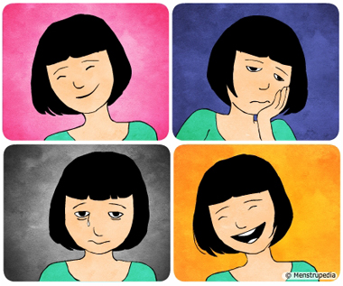
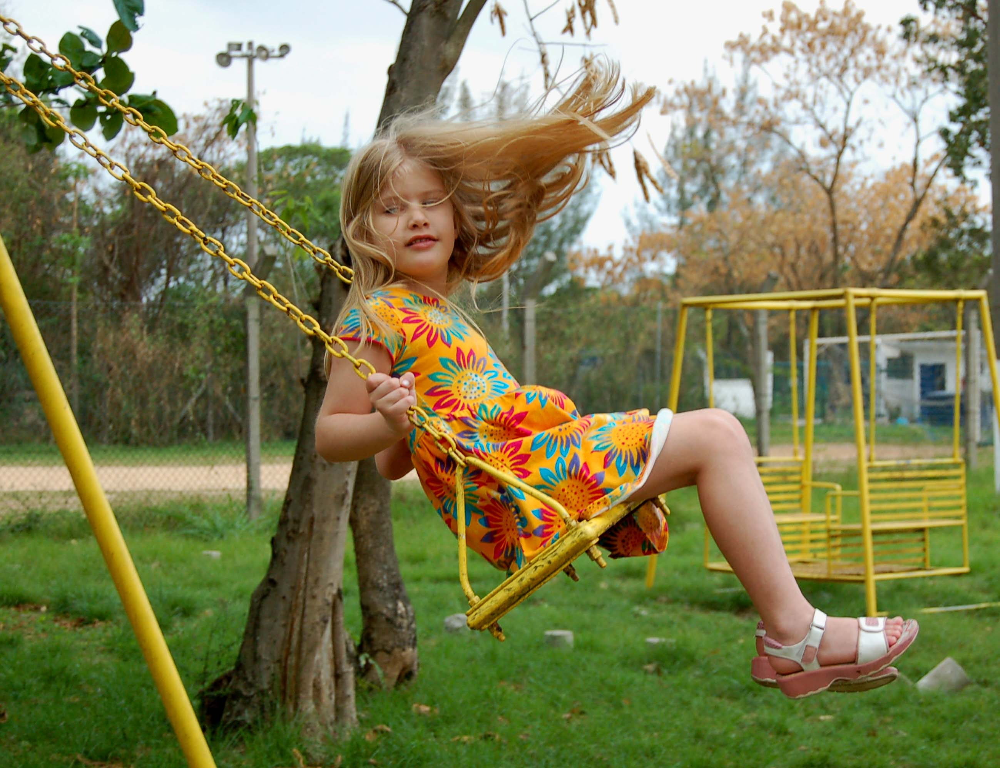
Quiz
根据图片写句子
The girl suffers from mood swings, as her mood often swings from happiness to sadness and then back to joy.
The girl swung higher and higher while sitting on a swing.

Slide 13
核心词汇
2. preserve
v. & n.
写出例句中preserve作为动词和名词时的意思。
verb
We will do everything to preserve peace.
维护
The society is set up to preserve endangered species from extinction.
保护；使继续存活
I like to make puree (果酱), using only enough sugar to preserve the plums.
保藏；保鲜
noun
Foodball is no longer the preserve of men.
专门领域
A game preserve is a place to protect wildlife animals.
保护区
She decided to make peach preserves for Christmas gifts.
果酱

Slide 14
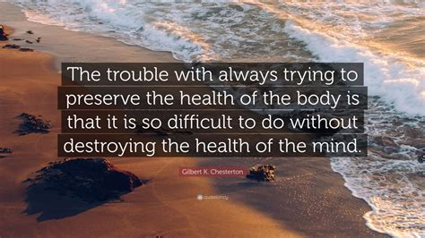
Quiz
名言翻译
努力保持身体健康的问题在于很难不破坏思想的健康。

Slide 15
核心词汇
3. advance
n. & v.
写出例句中advance相关表达的含义
The army advanced across the plain.
The group's researchhas done much to advance our knowledge of the HIV virus.
The article advances a new theory to explain changes in the climate.
We live in an age of rapid technological advance.
It's cheaper if you book the tickets in advance.
前进穿过
增进了解
提出理论
科技发展
事先

Slide 16
Quiz
改写句子
China has made great progress in space exploration in recent years.
China has made great advances in space exploration recently.
Recent years have witnessed China's great advances in space exploration.
China's space exploration has advanced a lot in recent years.
Can you prepare your report before the meeting.
Can you prepare your report in advance of the meeting?

Slide 17
核心词汇
4. various
adj.
找出例句中与various相近的表达
It is hard to see any one plan meeting the need of such a diverse group of countries.
People learn English for a variety of reasons.
Finland and China have cooperated well in a range of ways.
No matter how much he loved all kinds of animals, he loved dogs the best.
diverse
a variety of
a range of
all kinds of

Slide 18
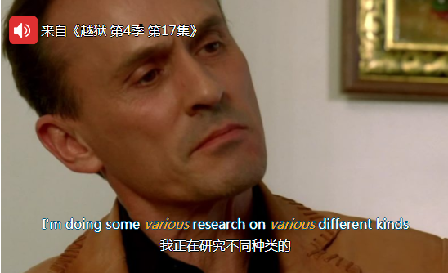
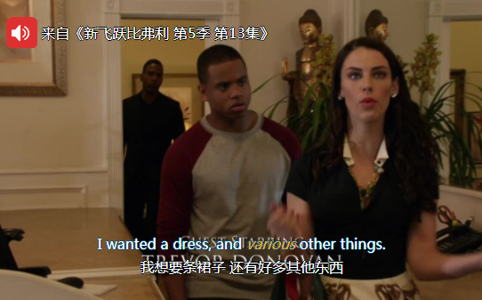
Quiz
台词翻译

Slide 19
核心词汇
5. fantasy
n.
尝试翻译以下句子。
He lived in a fantasy world of his own, even as a small boy.
甚至还是个孩子的时候，他就生活在一个幻想世界里。
Memories can sometims be pure fantasy.
记忆有时纯粹是幻想。
It is a surrealist fantasy set in South American village.
这是一部以南美某村庄为背景的超现实主义幻想作品。

Slide 20
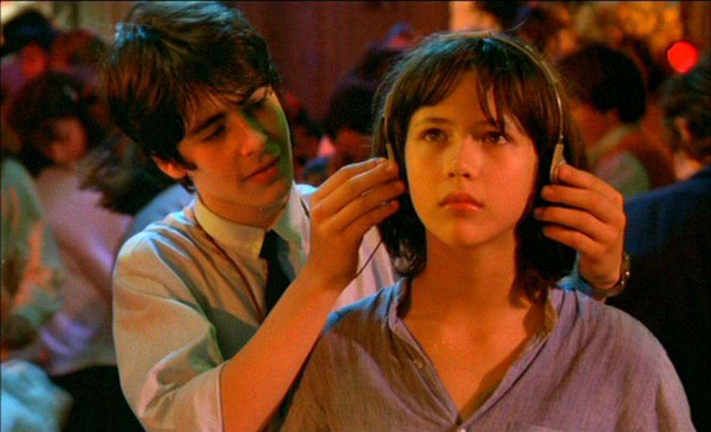
Quiz
歌词填空
Dreams are my reality
A different kind of reality
I dream of loving in the night
And loving seems alright
Although it's only _______
from Reality
fantasy

Slide 21
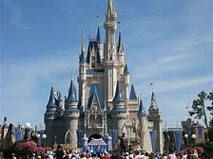
即学即用
Disneyland is indeed a ________ land, where you can find a lot of _______ characters in the fairy tale. Named after Walter Disney, who ___________ his motion picture production companies, the ______ park attracts millions of tourists around the world each year. __________ many people book the tickets __________ of visiting the park.
The first Disneyland park was opened in Anaheim, California on July 17, 1955, when Walt’s brother bought the first Disneyland __________ ticket. Now, there are six Disneyland parks around the world, bringing __________ to a lot of people. Pirates of the Caribbean is said to be the most popular ___________ at Disneyland, and in the entire world.
fantasy
cartoon
is famous for
theme
No wonder
in advance
admission
amusement
attraction

