Slide 1


感恩遇见，相互成就，本课件资料仅供您个人参考、教学使用，严禁自行在网络传播，违者依知识产权法追究法律责任。
更多教学资源请关注
公众号：溯恩高中英语
知识产权声明

Slide 2

B3U2
Healthy Eating
New Words and Expressions

Slide 3

重点单词
diet
1. ________ n. 日常饮食 vi. 节食
2. ________ vt. 平衡;权衡 n. 天平;平衡
3. ________ vt. & vi. 油煎;油炸
4. ________ v. aux. 应当;应该
5. ________ adj. 生的;未加工的
6. ________ n. 强项;长处;力量
7. ________ vt. 咨询;请教;商量
8. ________ vt. 限制;限定 n. 界限;限度
9. ________ n. 利益;好处 vt. & vi. 有益于;有助于;受益
10.________ vt. & vi. (使)联合; (使)结合
11.________ vt. & n. 烧烤;烤肉
12.________ adj. 烤制的 vt. & vi. 烤;烘;烘烤
balance
fry
ought
raw
strength
consult
limit
benefit
combine
barbecue
roast

Slide 4
重点单词
slim
13. ________ vi. 变细;减肥 adj. 苗条的;纤细的
14. ________ n. 好奇心
15. ________ n. 顾客;消费者
16. ________ n. 折扣
17. ________ n. 缺点;虚弱;弱点
18. ________ vi. & vt. 消化 n. 摘要;概要
19. ________ vi. 怒目而视;闪耀 n. 怒视;眩目的光
20. ________ vi. & vt. 窥探;秘密监视 n. 间谍;侦探
21. ________ vi. 叹息;叹气 n. 叹息;叹息声
22.________ n. 大蒜
23. ________ n. 纤维;纤维制品
24.________ n. 女主人;女主持人
curiosity
customer
discount
weakness
digest
glare
spy
sigh
garlic
fibre
hostess

Slide 5
派生单词
1. _________ n. 好奇心 ________ adj. 好奇的；求知欲强的
2. _________ n. 缺点;虚弱;弱点 ________ adj. 虚弱的；无力的
3. _________ n. 强项;长处;力量 ________ adj. 强壮的；强健的
4. _________ vt. 咨询;请教;商量 ________ n. 咨询；磋商
5. _________ vt. & n.限制;限定 ________ adj. 有限的
6. _________ n. 利益 vt. & vi. 有益于 ________ adj. 有利的
7. _________ vt. & vi. (使)联合 ________ n. 结合；联合
8. _________ n. 合作;协作 ________ v. 合作;协作
9. _________ n. 过度肥胖 ________ adj. 臃肿的；虚胖的
10._________ adj. 有毒的 ________ n. & v. 毒药；毒物
curiosity
curious
weakness
weak
strength
strong
consult
consultation
limit
limited
benefit
beneficial
combine
combination
cooperation
cooperate
obesity
obese
poisonous
poison

Slide 6
重点短语
a balanced diet
1. ________________ 平衡膳食
2. ________________ 应当;应该
3. ________________ 体重减轻;减肥
4. ________________ 被放过;(做坏事)不受惩罚
5. ________________ 说谎
6. ________________ 赢回;重新获得
7. _______________ 谋生
8. _______________ 欠债
9. _______________ 削减;删节
10._______________ 不久以后
11._______________ 增加体重
ought to
lose weight
get away with
tell a lie
win … back
earn one’s living
in debt
cut down
before long
put on weight

Slide 7
词义释义
____________ to stop something from increasing beyond a particular amount or level
____________ a person or an organization that buys something from a shop/store or business
____________ to collect secret information about another country, organization or person
____________ an outdoor meal or party when food is cooked in this way
____________ a sum of money that somebody owes
____________ (of a person) thin, in a way that is attractive
____________ an amount of money that is taken off the usual cost of something
limit
customer
spy
barbecue
debt
slim
discount

Slide 8
话题词汇
spaghetti, nut, bean, pea, cucumber, eggplant, pepper,
mushroom, pear, lemon, barbecue, mutton, kebab, bacon, cola, vinegar, fibre, carrot, garlic, bacon, muscle
food
cooking skills
roast, stir, fry, stir-fry
disease
scurvy, rickets, obesity

Slide 9
美句赏析
Satisfaction of one's ________ is one of the greatest sources of happiness in life.
---Linus Pauling
Reading is a _______ ticket to everywhere. ---Mary Schmich
Weakness of attitude becomes ________ of character. ---Albert Einstein
Our mobile phones have become the greatest ___ on the planet. ---John McAfee
The drama of life begins with a wail (哀号) and ends with a _____. ---Minna Antrim
curiosity
discount
weakness
spy
sigh

Slide 10
遣词造句
Group 1: balanced diet; protective; bean
Group 2: ought to; fry; roast
Group 3: lose weight; lie; slim
Group 4: discount; win ... back; customers
Group 5: glare; spy; get away with
If you keep a balanced diet, that means you not only eat energy-giving and body-building food, but also protective food like beans.
You ought to eat less fried or roast food, as they are unhealthy.
It is a lie that as long as you exercise you will lose weight and become slim.
Offering a 20% discount, you can win customers back.
He glared at me as if I spied on him and got away with it.

Slide 11
核心词汇
1. diet
n. & v.
根据例句写出diet的相关意思
Lyn always seems to be on a diet.
Not all diets are good for you.
n. 节食；规定饮食
She doesn't eat a very healthy diet.
It is important to have a balanced diet.
n. 日常饮食；日常食物
She's always dieting but she never seems to lose any weight.
v. 节食；按规定进食

Slide 12
Quiz
一句多译
你在节食吗？你瘦了很多。
Have you been dieting? You've been a lot thinner.
Have you been on a diet? You've lost a lot of weight.

Slide 13
核心词汇
2. consult
v.
根据例句找中consult相关用法。
If the pain continues, consult your doctor.
I need to consult with my lawyer.
Consult your doctor about how much exercise you should get.
I need to consult with my colleagues on the suggestions.
consult (with) sb
consult (with) sb (on/about) sth
派生词
consultation n. 咨询

Slide 14

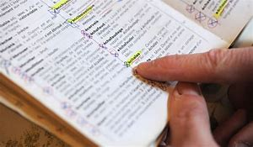
Quiz
根据图片写相关短语
consult the doctor about illness
consult the dictionary about new words

Slide 15
核心词汇
3. benefit
v. & n.
n.
have the benefit of 得益于
be of benefit to 使...受益
根据例句找出benefit的用法
I've had the benefit of a good education.
The regulations will be of benefit to everyone concerned.
They are working together to benefit the whole society.
Both sides have benefited from the talks.
They would benefit by reducing their labor costs.
v.
benefit sth 使受益
benefit by/from sth 得利于
派生词
beneficial adj. 有益的

Slide 16
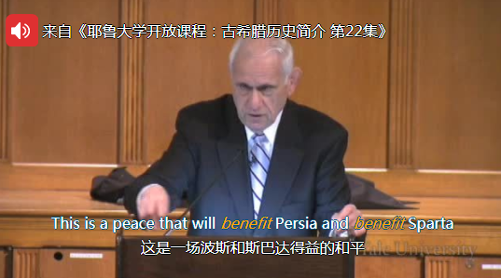
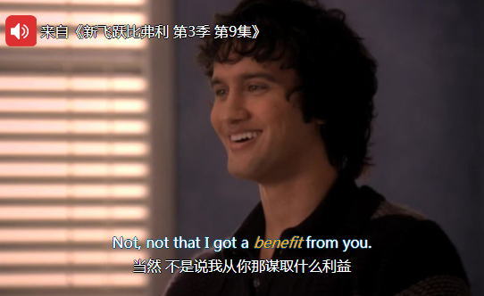
Quiz
台词翻译

Slide 17
核心词汇
4. limit
v. & n.
翻译例句中limit相关词组
There is a limit to the amount of pain we can bear.
The EU has set strict limits on levels of pollution.
Violent crime is not limited to big cities.
...是有限度的
作出严格限制
不局限于

Slide 18
Quiz
名言翻译
明日生活中种种可能的唯一限制是你今日使用的各种“但是”。
The only limits to the possibilities in your life tomorrow are the buts you use today. (by Les Brown)
依靠别人取得成功只会束缚、限制你。
Relying on someone else to be successful only ties you down and limits you. (by Fabrizio Moreira)

Slide 19
核心词汇
5. combine
v.
将例句中combine的相关意思与右边中文意思连线
Combine eggs with a little flour.
The hotel combines comfort with convenience.
She has successfully combined a career and bringing up a family.
They combined against a common enemy.
合并，协力
组合，混合
兼有，兼备
同时做（几件事）

Slide 20
Quiz
翻译
几种流感病毒(virus)混合在一起形成新型病毒。医生联手科技（单位）共同研制新药对抗该病毒。
Several types of flu viruses combined to form a new virus. In order to fight against it, doctors and techonology combined to invent new medicine.

Slide 21
即学即用
A lot of girls dream about having a ____ body. Here are some tips on how to __________ while keeping healthy. The first suggestion is to __________ junk food. Though delicious, they often contain a lot of fat, which will contribute to your increasing weight. It is also advised to keep a _____________. That means you ________ eat protein, fat and vegetables, which contain all the fiber, vitamins and minerals you need to be healthy. In addition, you can also _______ from doing exercise. Keeping doing so regularly, you will lose some weight ___________. If you follow these tips, you will probably ____ both beauty and confidence ____.
slim
lose weight
cut down
balanced diet
ought to
benefit
before long
win
back

Slide 22

溯恩教育感谢一路有你

