Slide 1


感恩遇见，相互成就，本课件资料仅供您个人参考、教学使用，严禁自行在网络传播，违者依知识产权法追究法律责任。
更多教学资源请关注
公众号：溯恩高中英语
知识产权声明

Slide 2

M4U3
A taste of English humour
New Words and Expressions

Slide 3

重点单词
1. ________ adj. 满足的；满意的 n. 满足 vt. 使满足
2. ________ vt. & vi. 使欢乐；款待
3. ________ vt. & vi. (_________, ________) 战胜；克服
4. ________ vt. 使信服
5. ________ v. 导演；指示 adj. 直的；直率的
6. ________ v.（使）滑动；（使）滑行 n. 滑动；幻灯片
7. ________ n. 耳语；低语 vt. & vi. 低语；小声说
8. ________ vi. 作出反应；回应
9. ________ n. 幽默；滑稽
10.________ vt. 使惊诧
11. ________ adj. 幸运的；吉利的
12.________ adj. 平常的；普通的
content
entertain
overcome
overcame
overcome
convince
direct
slide
whisper
react
humour
astonish
fortunate
ordinary

Slide 4
重点单词
13. ________ adj. 厌烦的
14. ________ prep. 遍及；贯穿 adv. 到处；始终；全部
15. ________ adj. 无家的；无家可归的
16. ________ adj. 用旧的；用坏的；破烂的
17. ________ n. 失败（者）
18. ________ vt. & vi. 嚼碎；咀嚼（食物）
19. ________ adj. 突出的；杰出的；显著的
20. ________ n. 姿态；手势 vi. 做手势
21. ________ adj. 特殊的；特别的 n. 细节；细目
22.________ n. 时刻；场合
23. ________ vt. 使发笑；使愉快
24.________ n. 解释；讲解；说明
bored
throughout
homeless
worn
failure
chew
outstanding
gesture
particular
occasion
amuse
explanation

Slide 5
派生单词
humour
humorous
1.________ n. 幽默；滑稽 _________ adj. 好笑的；诙谐的
2.__________ n. 表演者；演出者 __________ n. 表现；业绩；表演
3. ________ vt. 使惊诧 _________ adj. 令人感到惊讶的
4.________ adj. 平常的；普通的 _________ adv.普通地；平常地
5._______ adj. 厌烦的 ________ adj. 令人厌倦的
6. ________ vt. & vi. 使欢乐；款待 ___________ adj. 愉快的；有趣的
7.________ n. 失败（者） ____ v. 失败；不及格
8._________ vt. 使信服 __________ adj. 令人信服的
9.______ vt. & vi. 导演；指示；指挥 ________ n. 导演
10. __________ n. 解释；讲解；说明 _________ v. 解释；说明
performer
performance
astonish
astonishing
ordinary
ordinarily
bored
boring
entertain
entertaining
failure
fail
convince
convincing
direct
director
explanation
explain

Slide 6
重点短语
up to now
1.________________ 直到现在
2.________________ 对……满足
3.________________ 穷的；缺少的
4.________________ 挑出；辨别出
5.________________ 切断；断绝
6.________________ 担任主角；主演
7.________________ 磨破的；穿旧的
feel/be content with
badly off
pick out
cut off
star in
worn-out

Slide 7
词义释义
gesture
____________ a movement that you make with your hands, your head or your face to show a particular meaning
____________ a type of soft thick white food made by boiling oats in milk or water, eaten hot, especially for breakfast
____________ a person who performs for an audience in a show, concert, etc.
____________ to bite food into small pieces in your mouth with your teeth to make it easier to swallow
____________ the money that is available to a person or an organization and a plan of how it will be spent over a period of time
____________ a play or film/movie that is intended to be funny, usually with a happy ending
____________ a line of hair that a man allows to grow on his upper lip
____________ person, especially a police officer, whose job is to examine crimes and catch criminals
porridge
performer
chew
budget
comedy
moustache
detective

Slide 8
话题词汇
Words that describe people
humour, depressed, content, astonish, fortunate, badly off, ordinary, bored, charming, homeless, moustache, underdog, outstanding, confidence, amusing, drunk
punchline, mime, comedy, performer, subtle, entertain, direct, star in, costume, actress, verbal, nonverbal
Words about the play

Slide 9
美句赏析
humour
The only way to survive is to have a sense of _________. ---Bob Newhart
Do not speak of your happiness to one less _________ than yourself. ---Plutarch
A hero is no braver than an _________ man, but he is brave five minutes longer.
---Ralph Waldo Emerson
Success is not final, ________ is not fatal: it is the courage to continue that counts.
---Winston Churchill
___________ people have one thing in common: An absolute sense of mission.
---Zig Ziglar
fortunate
ordinary
failure
Outstanding

Slide 10
遣词造句
Group 1: up to now; be content with; performer
Group 2: astonishing; fortunate; badly off
Group 3: bored; ordinary; cut off
Group 4: pick out; outstanding; star in
Group 5: explanation; detective; gesture
Up to now they have been content with the performers in the comedy.
It is astonishing that such a fortunate man, born into a well-educated and wealthy family, would be badly off in his late years.
Bored with the social activities, the boy decided to cut off relationships with others and return to the ordinary life.
In this photo, can you pick out the outstanding actress who starred in the moive?
The detective gestured that he need more explanation before a convincing result could be made.

Slide 11
核心词汇
1. content
adj., n, & vt.
写出例句中content的词性和意思。
She hadn't read the letter and so was unaware of its contents.
She stayed in the library, where she could read to her heart's content.
He had to be content with third place.
Mr Smith has been asking for more responsibility, but has had to content himself with a minor post.
n. 内容
n. 满意，满足
adj. 满意的；满足的
v. 使满足；使满意

Slide 12
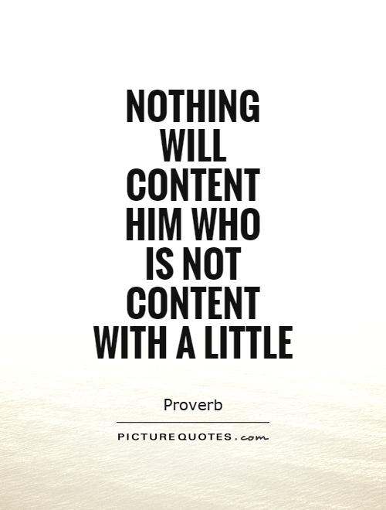

Quiz
句子翻译
一个不满足一点的人，什么都满足不了他。
好的内容不是讲故事，是把你的故事讲好。

Slide 13
核心词汇
2. entertain
v.
根据例句写出entertain可能的意思。
A museum should aim to entertain as well as educate.
She entertained the children with stories, songs and drama.
Barbecues are a favorite way of entertaining friends.
She could never entertain the idea of living in the country.
使快乐；使有兴趣
招待；款待
怀有...想法
派生词
entertaining adj. 令人愉快的
entertainment n. 娱乐；消遣

Slide 14
Quiz
改写句子
Barbecues are a favorite way of treating friends.
Barbecues are a favorite way of entertaining friends.
He interested us for hours with his stories and jokes.
He entertained us for hours with his stories and jokes.
How foolish I am to have doubts.
How foolish I am to entertain doubts.

Slide 15
核心词汇
3. direct
v. & adj.
将例句中direct相应的意思与右侧意思匹配
Could you direct me to the station?
Educational level has a direct effect on income.
Which is the most direct route to London?
You will have to get used to his direct manner.
Most of his anger was directed against himself.
A new manager has been appointed to direct the project.
adj. 直接的
v. 给(某人)指路
adj. 直率的
v. 管理；指导
adj. 笔直的
v. 把...对准

Slide 16

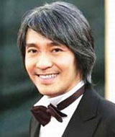
Quiz
根据图片写句子
Stephen Chow has directed a lot of popular films.
You can take a direct flight from Canada.

Slide 17
核心词汇
4. overcome
v.
利用例句写出overcome的意思
She overcame injury to win the Olympic gold medal.
In the final game Sweden easily overcame France.
Her parents were overcome with grief at the funeral.
克服；解决
战胜
【某种情绪】控制...，受到...的极大影响

Slide 18
Quiz
编写故事
Use different meanings of “overcome” to make up a story.
Anna used to be a shy girl. Whenever she stood on the stage, she was overcome with anxiety and fear and started to shake. With time going by, she beomes much more confident and has overcome shyness.

Slide 19
核心词汇
5. slide
n. & v.
写出例句中slide相关表达的意思
We slid down the grassy slope.
Daniel slid out of the room when no one was looking.
Students' test score started to slide in the mid- 1990s.
The economy is on the slide.
a slide show
往下滑
偷偷溜出
下降
降低
幻灯片

Slide 20
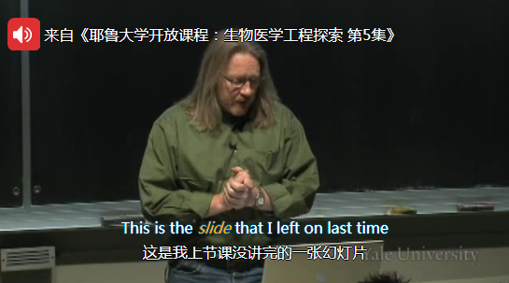
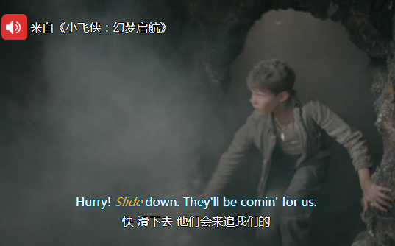
Quiz
台词翻译

Slide 21

即学即用
Mr. Bean is a non-verbal British sitcom ________ by John Howard Davies, John Birkin, and Paul Weiland, with Rowan Atkinson __________ the comedy. The title character Mr. Bean rarely speaks but ________ the audience a lot. "A child in a grown man's body", he often seems unaware of basic aspects of the way the world works and ________ differently from others. It is unknown whether Mr. Bean is well off or _________. However, one thing is for sure that he has ___________ both the young and the old. __________, the sitcom has received a number of international awards, including the Rose d'Or.
directed
starring in
amuses
reacted
badly off
entertained
Up to now

