Slide 1


感恩遇见，相互成就，本课件资料仅供您个人参考、教学使用，严禁自行在网络传播，违者依知识产权法追究法律责任。
更多教学资源请关注
公众号：溯恩高中英语
知识产权声明

Slide 2

B3U4
Astronomy: the science of the stars
New Words and Expressions

Slide 3

重点单词
system
1. ________ n. 系统;体系;制度
2. ________ n. 学说;理论
3. ________ adj. 猛烈的;激烈的;强暴的
4. ________ prep. 不同;不像
5. ________ adj. 有害的
6. ________ vi. 存在;生存
7. ________ n. 谜;难题 vt. & vi. (使)迷惑;(使)为难
8. ________ n. & vt. 拉(力);拖;牵引力
9. ________ n. 天文学
10.________ n. 宗教;宗教信仰
11. ________ n. 球体;地球仪;地球
12.________ n. 碳
theory
violent
unlike
harmful
exist
puzzle
pull
astronomy
religion
globe
carbon

Slide 4
重点单词
13. ___________ n.大气层;气氛
14. ___________ adj. 基本的;基础的
15. ___________ n. 链子;连锁;锁链
16. ___________ vi. & vt. 乘;增加
17. ___________ n. 氧
18. ___________ adv. 因此;于是
19. ___________ n. 万有引力;重力
20. ___________ adj. 温和的;文雅的
21. ___________ n. 气候
22. ___________ vi. & vt. 碰撞;坠落
23. ___________ vi. & vt. (使)浮动;(使)漂浮 n. 漂浮物
24. ___________ n. 质量;团;块;大量; <复>群众
atmosphere
fundamental
chain
multiply
oxygen
thus
gravity
gentle
climate
crash
float
mass

Slide 5
派生单词
1. ________ n. 天文学 __________ n. 天文学家
2. ________ n. 系统;体系;制度 _________ adj. 成体系的；系统
3. ________ n. 宗教;宗教信仰 _________ adj.宗教信仰的
4. ________ n. 学说;理论 _________ adj.理论上的
5. ________ n. 球体;地球仪;地球 _________ adj. 全球性的;全世界的
6. ________ adj. 猛烈的;激烈的;强暴的 _________ n. 暴力；暴行
7. ________ adj. 基本的;基础的 _________ adv. 从根本上
8. ________ adj. 有害的 _________ n. & v. 伤害；损害
9. ________ vi. & vt. 乘;增加 __________ n. 相乘；增加
10._______ vi. 存在;生存 __________ n.存在；生活方式
11._______ n. 难题 vt. & vi. (使)迷惑 __________ adj.困惑的；迷惑不解的
astronomy
astronomer
system
systematic
religion
religious
theory
theoretical
globe
global
violent
violence
fundamental
fundamentally
harmful
harm
multiply
multiplication
exist
existence
puzzle
puzzled

Slide 6
重点短语
1.________________ 太阳系
2.________________ 宇宙大爆炸;创世大爆炸
3.________________ 及时;终于
4.________________ 下蛋
5.________________ 产生;分娩
6.________________ 轮到某人;接着
7._______________ 二氧化碳
8._______________ 阻止;制止
9._______________ 感到高兴;感到振奋
10._______________ 既然
11._______________ 熟悉;掌握;理解
12._______________ 突发;爆发
13._______________ 密切注意;当心;提防
solar system
Big Bang
in time
lay eggs
give birth to
in one’s turn
carbon dioxide
prevent ... from
cheer up
now that
get the hang of
break out
watch out for

Slide 7
词义释义
____________ a gas that is present in air and water and is necessary for people, animals and plants to live.
____________ the mixture of gases that surrounds the earth
____________ an object shaped like a ball with a map of the world on its surface, usually on a stand so that it can be turned
____________ the belief in the existence of a god or gods
____________ the scientific study of the life and structure of plants and animals
____________ the scientific study of the sun, moon, stars, planets, etc.
____________ an electronic device that is sent into space and moves around the earth or another planet.
oxygen
atmosphere
globe
religion
biology
astronomy
satellite

Slide 8
话题词汇
Chemical substance
化学物质
  atom, carbon, nitrogen, vapour, acid, oxygen, dioxide, carbon dioxide
Scientists
  astronomer, biologist, geologist, physicist
Science
  astronomy, religion, biology
Animals
  shellfish, amphibian, reptile, dinosaur, mammal

Slide 9
美句赏析
Souls are not designed to _____ around in thin air. ---Alex Chiu
When you _____ and burn, you have to pick yourself up and go on and hope to make up for it. ---Burt Reynolds
______ is what we expect; weather is what we get. ---Mark Twain
A _______ word, a kind look, a good-natured smile can work wonders and accomplish miracles. ---William Hazlitt
Imagination makes us shape better stories, sure, but it also allows us to ________ possibilities. ---Amitava Kumar
float
crash
Climate
gentle
multiply

Slide 10
遣词造句
Group 1: astronomy; solar system; theory
Group 2: unlike; atmosphere; oxygen
Group 3: fundamental; acid; harmful
Group 4: puzzle; give birth to; multiply
Group 5: gentle; cheer up; get the hang of
Astronomy is the theory about the solar system and the whole universe.
Unlike Earth, no oxygen can be found in the atmosphere of this planet.
Acid is fundamental to life, but can be harmful if taken too much.
It is a puzzle why rabbits in this area multiplied so rapidly as they didn't seem give birth to any new babies.
So gentle and warm-hearted the physicist is that he cheers us up and helps us get the hang of the topic.

Slide 11
核心词汇
1. puzzle
n. & v.
写出例句中puzzle的词性和含义
My sister puzzles me and causes my anxiety.
What puzzles me is why he left the country without telling anyone.
v. 使...迷惑不解
The rise in accidents remains a puzzle.
He thought he had solved the puzzle.
n. 谜一样的人或事物，难题

Slide 12
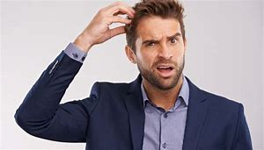
Quiz
翻译
令布朗先生不解的是，约翰是如何解开这个难题的。
What puzzles Mr. Brown is how John solved the puzzle.

Slide 13
核心词汇
2. pull
v. & n.
将例句中pull的含义与右边中文意思匹配。
I helped pull him out of the water.
He pulled the slip of paper from his shirt pocket.
I gave the door a sharp pull and it opened.
Huges pulled himself slowly to his feet.
He pulled to a stop behind a pickup truck.
v. 掏出
v. （使劲）移动
v. 拉
v. 停车
n. 拉；拽；扯

Slide 14
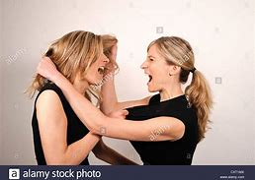
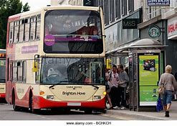
Quiz
根据图片写相关句子
They fought and pulled each other's hair.
The bus pulled to a stop at the stop station.

Slide 15
核心词汇
3. exsit
v.
写出例句中exist相关意思
He thought that if he couldn't see something, it didn't exist.
Research opportunities exsit in a wide range of areas.
Does life exsit on other planets?
存在；实际上有
We existed on a diet of rice.
They can't exist on the money he's earning.
（尤其在困境或贫困中）生活，生存
派生词 existence n. 存在, 生存

Slide 16
Quiz
名言翻译
我想要生活，而不仅仅是生存。
I intend to live life, not just exist. (by George Takei)
恐惧不存在于任何地方，只存在于头脑中。
Fear doesn't exist anywhere except in the mind. (by Dale Carnegie)
解决问题的第一步是认识到它的存在。
The first step in solving a problem is to recognize that it does exist. (by Zig Ziglar)

Slide 17
核心词汇
4. violent
adj.
根据例句写出violent的可能意思
暴力的
The crowd suddenly turned violent.
I took a violent dislike to him.
Her dress was a violent pink.
猛烈的；剧烈的
鲜艳夺目的
派生词
violence n. 暴力，暴行，狂热

Slide 18
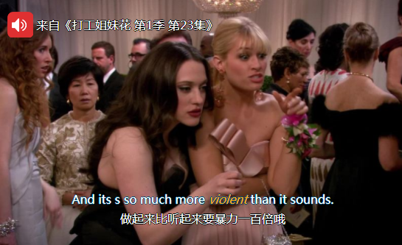
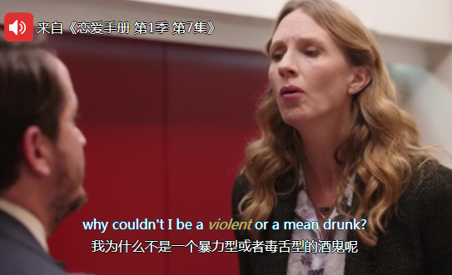
Quiz
台词翻译

Slide 19
核心词汇
5. theory
n.
根据例句推断有关theory的搭配
These birds helped Darwin develop his theory of natural selection.
Researchers gave workers a questinnaire to test that theory.
No evidence emerged to prove either theory.
Modern research strongly supports this theory.
In theory, everyone will have to pay the new tax.
develop a theory 提出理论
test a theory 测试理论
prove a theory 证明理论
support a theory 支持理论
in theory 理论上

Slide 20
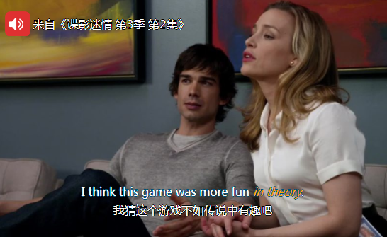
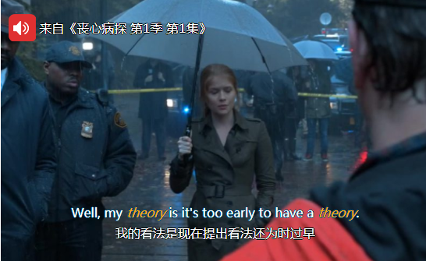
Quiz
名言翻译

Slide 21
即学即用
There are many ________ on the origin of life on Earth. One theory has something to do with ________. According to this theory, all the different forms of life that occur today on planet earth, have been created by God. The second theory holds that lightening ____________ life, as it can make amino acids (氨基酸) and sugars from an __________ with water. Life may also develop from molecules (分子) such as RNA, which still _____ and performs roles in the living things. Another theory is that life did not begin on Earth at all, but was brought here from elsewhere in space. So you are probably from the stone from the universe that _________ on the Earth . Despite all of these theories, how life began on Earth still remains a _______.
theories
religion
gave birth to
atmosphere
exists
crashed
puzzle

Slide 22

溯恩教育感谢一路有你

