Slide 1


感恩遇见，相互成就，本课件资料仅供您个人参考、教学使用，严禁自行在网络传播，违者依知识产权法追究法律责任。
更多教学资源请关注
公众号：溯恩高中英语
知识产权声明

Slide 2

M4U2
Working the land
New Words and Expressions

Slide 3

重点单词
1. ________ vt. & vi. 斗争；拼搏；努力
2. ________ vt. & vi. 使变大；伸展
3. ________ vt. 摆脱；除去
4. ________ adv. 因为；所以；因而
5. ________ vt. & vi. 输出；出口
6. ________ vt. 遗憾；惋惜 n. 遗憾；懊悔
7. ________ n. 焦点；中心点 vt. 集中；聚集
8. ________ vt. 减少；减缩
9. ________ n. 评论；议论 vi. & vt. 表达意见；作出评论
10.________ adj. 晒黑的
11. ________ n. 十年；十年期
12.________ adj. 特级的；超级的
struggle
expand
rid
therefore
export
regret
focus
reduce
comment
sunburnt
decade
super

Slide 4
重点单词
13. ________ n. 产量；输出
14. ________ n. 庄稼；农作物；产量
15. ________ n. 饥饿；欲望 vt. & vi. （使）饥饿
16. ________ adj. 引起烦恼的；令人不安的
17. ________ vt. & vi. 循环；流传
18. ________ n. 战役；战斗；较量 vt. & vi. 搏斗；奋斗
19. ________ n. 自由；自主
20. ________ vt. & vi. 配备；装备
21. ________ n. 工作；职业；占领
22.________ n. 营养；滋养；食物
23. ________ vt. 画底线标出；强调
24.________ n. 总结；摘要；概要
output
crop
hunger
disturbing
circulate
battle
freedom
equip
occupation
nutrition
underline
summary

Slide 5
派生单词
1.________ n. 饥饿 v. （使）饥饿 _________ adj. 饥饿的
2.___________ adj. 引起烦恼的 ________ v. 打扰；干扰
3. ________ vt. & vi. 使变大；伸展 _________ n. 扩张；膨胀
4.________ vt. & vi. 循环；流传 _________ n. 循环；流通
5.________ vt. & vi. 配备；装备 __________ n. 设备；装备
6. _________ n. 工作；职业；占领 _________ v. 占据；占领
7.________ vt. 使迷惑；使为难 __________ n. 困惑；混淆
8._______ vt. 遗憾；惋惜 n. 遗憾；懊悔 __________ adj. 后悔的；失望的
9.________ n. 发现；发觉 ________ v. 发现
10. _______ vt. 减少；减缩 _________ n. 降低；减少
11. ________ n. 总结；摘要；概要 ___________ v . 总结；概述
hunger
hungry
disturbing
disturb
expand
expansion
circulate
circulation
equip
equipment
occupation
occupy
confuse
confusion
regret
regretful
discovery
discover
reduce
reduction
summary
summarize

Slide 6
重点短语
thanks to
1.________________ 幸亏；由于；因为
2.________________ 摆脱；除去
3.________________ 对……感到满意4.________________ 宁愿；宁可
5.________________ 逐渐增强；建立；开发
6.________________ 导致；造成（后果）
7.________________ 使……免受（影响；害等）
8. ________________ 集中（注意力、精力等）于
rid… of
be satisfied with
would rather
build up
lead to
keep … free from/of
focus on

Slide 7
词义释义
____________ a plant that is grown in large quantities, especially as food
____________ the simplest and smallest forms of life.
____________ an insect or animal that destroys plants, food, etc.
____________ the process by which living things receive the food necessary for them to grow and be healthy
____________ a collection of information shown in numbers
____________ the legal right of belonging to a particular nation
____________ a job or profession
____________ the top layer of the earth in which plants, trees, etc. grow
crop
bacteria
pest
nutrition
statistic
nationality
occupation
soil

Slide 8
话题词汇
Words related to agricultural products
  crops, hybrid, output, sorghum, grain, peanut, production, soybean, chemical, organic, bacteria, pest
Methods of agriculture
  equip, fertilizer, nutrition, mineral, soil, industrial
Agricultural achievements
  super, hunger, expand, circulate, thanks to, rid...of, be satisfied with, freedom, export, build up, lead to, reduce, keep … free from/of

Slide 9
美句赏析
hunger
hunger
The _______ for love is much more difficult to remove than the _______ for bread.
---Mother Teresa
Sometimes by losing a _____ you find a new way to win the war. ---Donald Trump
Just living is not enough... one must have sunshine, _________, and a little flower.
---Hans Christian Andersen
Never _______ a single defeat with a final defeat. ---F. Scott Fitzgerald
The greatest ________ of all time is that a person can change his future by merely changing his attitude. ---Oprah Winfrey
battle
freedom
confuse
discovery

Slide 10
遣词造句
Group 1: sunburnt; lead to; decade; output
Group 2: disturbing; rid ... of; pest; nutrition
Group 3: thanks to; keep ... free from; hunger
Group 4: would rather; focus on; comment
Group 5: build up; confuse; be satisfied with
Decades of work in agriculture leads to his sunburnt skin as well as high output in crops.
It is disturbing that the pest is hard to rid of, for which a lot of plants fail to get enough nutrition.
Thanks to Yuan Longping, the new crop keeps many people free from hunger.
I would rather focus on my own work than comment on others' lives.
Once you build up confidence, you will be satisfied with your own life and not be confused by others' words.

Slide 11
核心词汇
1. struggle
v.
写出例句中struggle的相关表达和意思
She is struggling to bring up family alone.
The airline is struggling with high costs.
Millions of people are struggling for survival.
He struggled against cancer for two years.
struggle to do sth
艰难做某事
struggle with sth 努力应付
struggle for sth 为...奋斗
struggle against sth 与...抗争
派生词
struggle n. 挣扎；奋斗

Slide 12
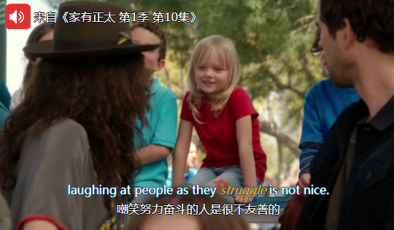
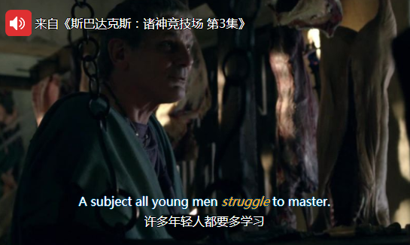
Quiz
台词翻译

Slide 13
核心词汇
2. expand
v.
将例句中expand相关意思与右边中文意思匹配。
Water expands as it freezes.
The hotel wnats to expand its business by adding a swimming pool.
I repeated the question and waited for her to expand.
A child's vocabulary expands through reading.
细谈；详述
拓展【业务】
（使）扩大；增加

Slide 14

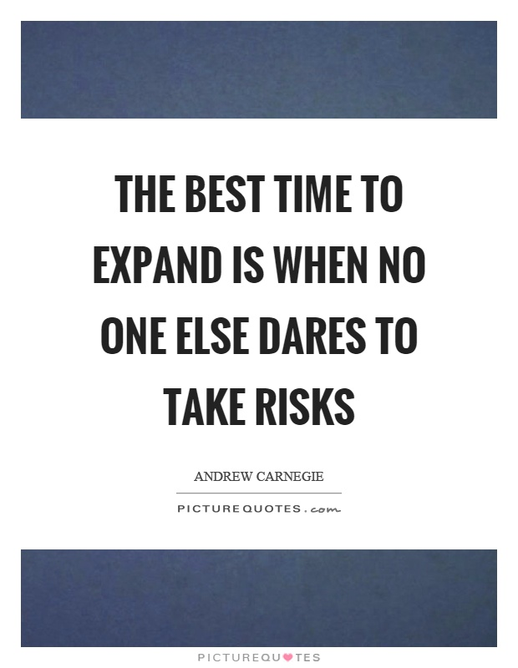
Quiz
名言翻译
没有人敢冒险之时便是拓展的最佳时机。
只有努力到极限，你才能拓展你的能力。

Slide 15
核心词汇
3. regret
n. & v.
根据例句写出regret的相关表达
1. I regret leaving school so young.
regret doing sth 后悔做某事
2. I regret that I will be unable to attend.
regret that ... 后悔... ...
3. I lost touch with her, much to my regret.
to one's regret 让某人遗憾的是
4. I decided with some regret that it was some to move on.
with regret 遗憾地

Slide 16

Quiz
一句多译
很抱歉，我不能参加你的生日派对。
I really regret that I will be unable to attend your birthday party.
Much to my regret that I am unable to attend your birthday party.

Slide 17
核心词汇
4. reduce
v.
利用例句找出reduce用法
Giving up smoking reduces the risk of heart disease.
Costs have been reduced by 20% over the past year.
The number of employees was reduced from 40 to 25.
reduce sth
reduce sth by sth
reduce from sth to sth
派生词
reduction n. 减少，下降，缩小

Slide 18
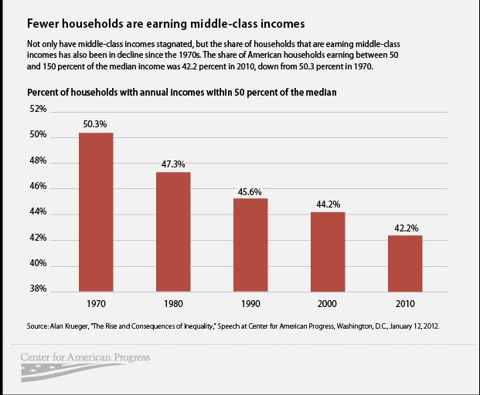
Quiz
看图造句
The number of households who are earning middle-class incomes have been reduced from 50.3% to 42.2% over the past four decades.

Slide 19
核心词汇
5. comment
n. & v.
根据例句写出comment相关搭配
She made helpful comments on my work.
Have you any comment to make about the cause of the disaster?
I don't feel I can comment on their decision.
One student commented that she preferred literature to social science.
make comments on/about sth
comment on sth
comment that ...

Slide 20
Quiz
名言翻译
我相信言论自由，但我也相信我们应该有权评论言论自由。
I believe in freedom of speech, but I believe we should also have the right to comment on freedom of speech. (by Stockwell Day)
“无可奉告”是个很好的表达。我经常使用这个表达。
'No comment' is a splendid expression. I am using it again and again. (by Winston Churchill)

Slide 21
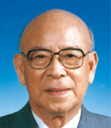
即学即用
Zhuang Qiaosheng is the most famous wheat (小麦) scientist in China. Despite a very difficult situation and poor condition, Zhuang _________ his work in wheat research and has made great achievements, _________much higher grain increase. One of his great discoveries is to _____ the wheat _________ some diseases, which therefore increases the output. Zhuang is also a pioneer in promoting wheat production in Tibet. _________ him, more and more wheat is able to grow there. Zhuang is never _____________ his work and devotes more than six decades to the wheat study. People ________ that he is a hardworking and modest scientist.
focused on
leading to
keep
free from
Thanks to
satisfied with
comment

