Slide 1

扫码关注
回复：hello sun
获取课件制作、录课等实用工具包
知识产权声明
感恩遇见，相互成就，本课件资料仅供您个人参考、教学使用，严禁自行在网络传播，违者依知识产权法追究法律责任。
更多教学资源请关注
公众号：溯恩高中英语

Slide 2

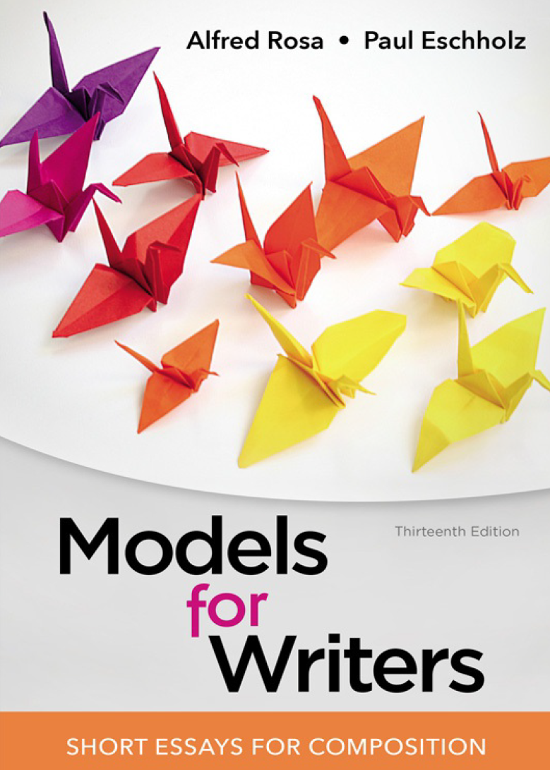
From reading to writing
How to read critically
杭州师范大学附属中学
姜建军

Slide 3
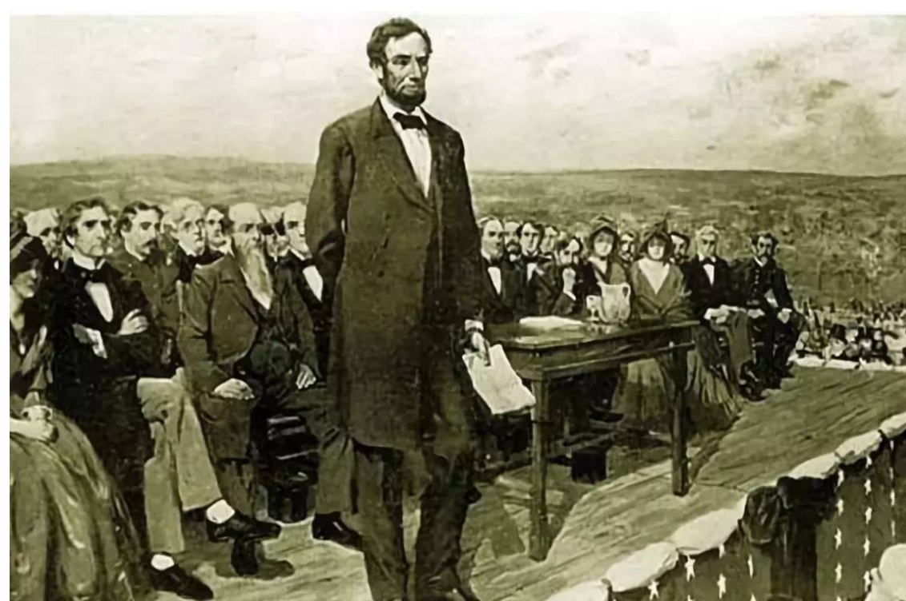
The Gettysburg Address
--by Abraham Lincoln

Slide 4

Step 1 Prepare yourself to read the selection
A title
A portrait of the writer
The biographical note about the author (life, work reputation and authority)
The publication information (when and where)
The rhetorical highlights (model features of the selection)
The beginning of a selection
A headnote
A writing prompt
reflecting on what you know

Slide 5

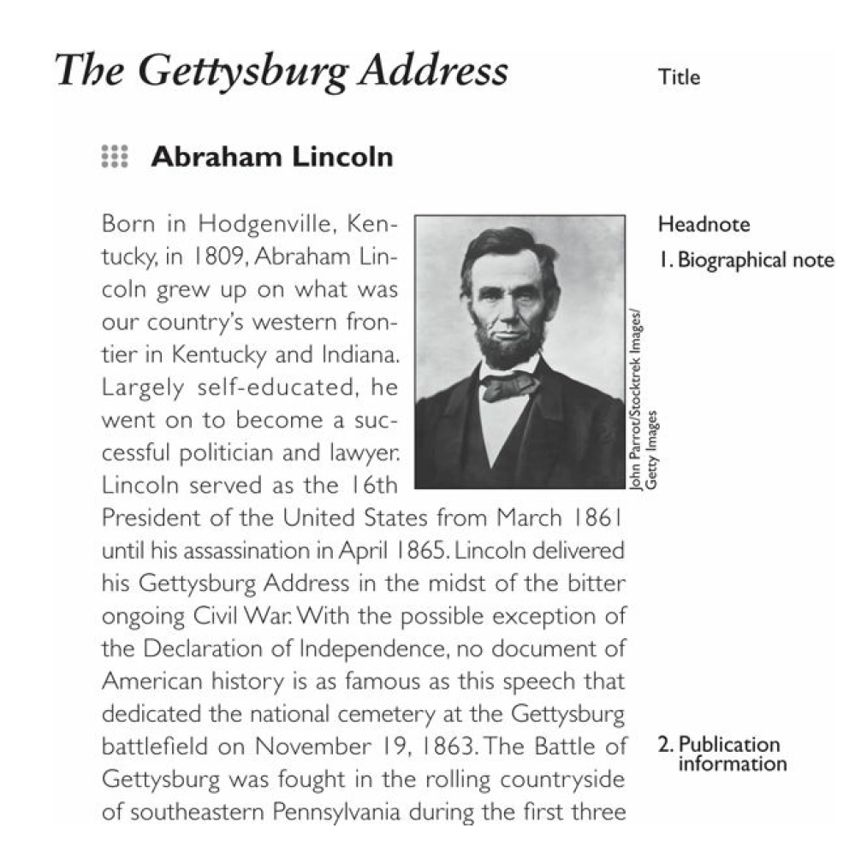
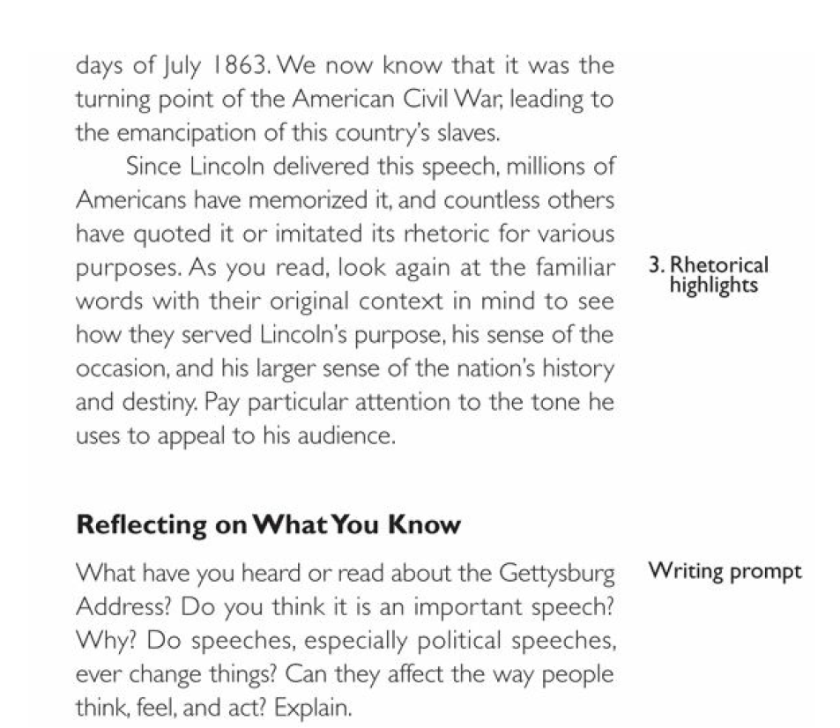
Step 1 Prepare yourself to read the selection

Slide 6
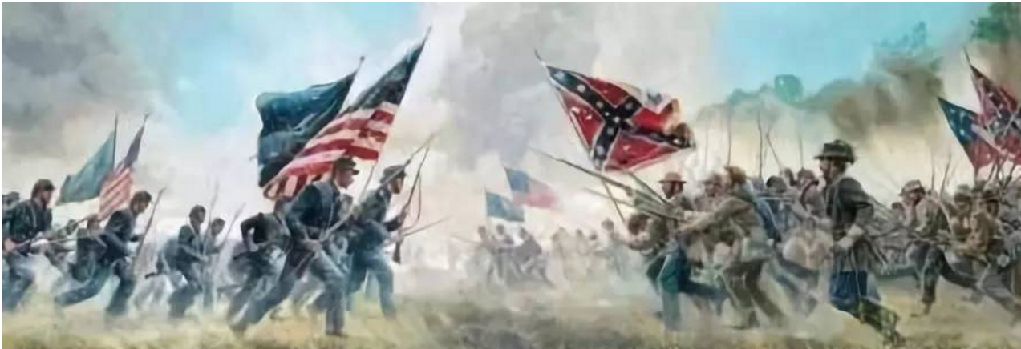
The address’ title The Gettysburg Address | Lincoln will talk about the battle at Gettysburg and the conflict between the North and the South.
The biographical note | Lincoln (1809-1865) lived between the two important events in the history of the country.
The publication information | Lincoln delivered his speech on November 19, 1863 (four and a half months after the battle at Gettysburg.)
The rhetorical highlights | How Lincoln used diction and tone to enhance both his purpose and senxe of the occasions.
The writing prompt | The reader reflects on something about the Gettysburg Address to compare it with the reaction to Lincoln’s speech.

Slide 7
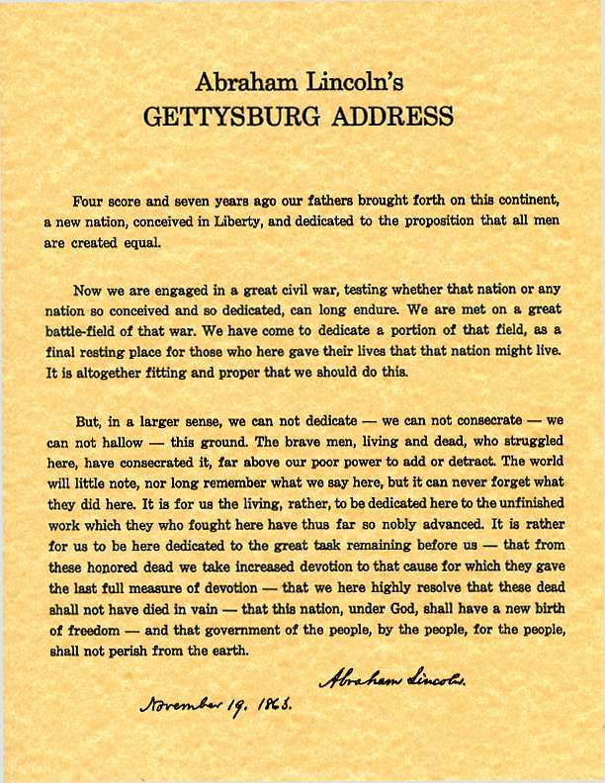
Step 2 Read the selection
To get acquainted with the essay
To form the first impression of it
To modify the sense of the writer’s message and purpose
Circle the news words
Put question marks alongside

Slide 8
Step 3 Reread the selection
Where it going
What the essay is about
How it goes there
can pay special attention to the author’s purpose and means of achieving the purpose
can determine whether the writer reveals a bias and adequately support the opinions
can look for features of organization and style for future reference

Slide 9
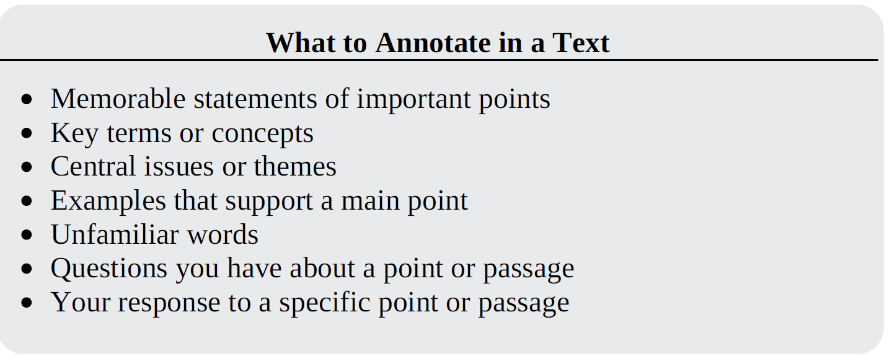
Step 4 Annotate the text with marginal notes

Slide 10
扫码关注
回复：hello sun
获取课件制作、录课等实用工具包
知识产权声明
感恩遇见，相互成就，本课件资料仅供您个人参考、教学使用，严禁自行在网络传播，违者依知识产权法追究法律责任。
更多教学资源请关注
公众号：溯恩高中英语

Slide 11
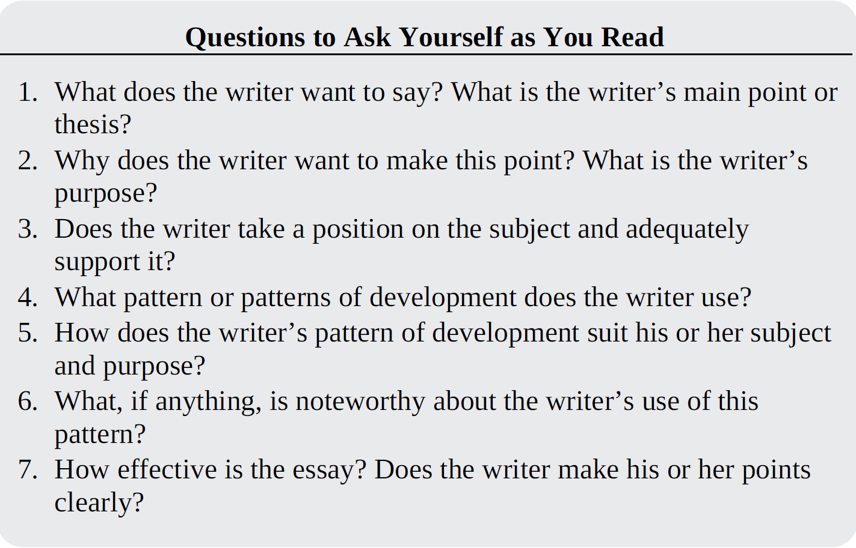
Step 5 analyze and evaluate the text with questions

Slide 12
The Gettysburg Address
--by Abraham Lincoln
Four score and seven years ago our fathers brought forth on this continent, a new nation, conceived in liberty, and dedicated to the proposition that all men are created equal.
Opening
Echoes “Declaration of Independence

Slide 13
The Gettysburg Address
--by Abraham Lincoln
Now we are engaged in a great civil war, testing whether that nation, or any nation so conceived and so dedicated, can long endure. We are met on a great battle-field of that war. We have come to dedicate a portion of that field, as a final resting place for those who here gave their lives that that nation might live it is altogether fitting and proper that we should do this.
Announces purposes of solemn occasion
Interesting repetition of “conceived’ and “dedicated”

Slide 14
The Gettysburg Address
--by Abraham Lincoln
But, in a larger sense, we can not dedicate– we can not consecrate– we can not hallow– this ground. The brave men, living and dead, who struggled here , have consecrated it, far above our poor power to add or detract. The world will little note, nor long remember what we say here , but it can never forget what they did here.
“But” shifts focus to soldiers who fought at Gettysburg
“consecrate” feels spiritual
Ironic

Slide 15
The Gettysburg Address
--by Abraham Lincoln
It is for us the living, rather, to be dedicated here to the unfinished work which they who fought here have thus far so nobly advanced. It is rather for us to be here dedicated to the great task remaining before us—that from these honoured dead we take increased devotion to that cause for which they gave the last full measure of devotion—that we here highly resolve that these dead shall not have died in vain– that this nation, under God, shall have a new birth of freedom– and that government of the people, by the people, for the people, shall not perish from the earth.
Reminds “the living” of work to be done
Parallel construction emphasizes Lincoln’s resolve

Slide 16
Appreciation of the language
Point of view | The first person is mainly used to pull closely the relationship with the listeners, enhancing credibility and instigation.
Repetition of the key words | …dedicated to the proposition… so conceived and so dedicated… We have come to dedicate a portion of that field… we can not dedicate–…
Repetition of the structures | It is for us the living, rather, to be... It is rather for us to be… of the people, by the people, for the people

Slide 17
Appreciation of the language
Parallelism | 1) …we can not dedicate– we can not consecrate– we can not hallow– this ground. 2) ---that ….we take increased devotion to that cause… . —that we here highly resolve... –- that this nation shall have a new birth of freedom… -– that government …shall not perish from the earth.

Slide 18
葛底斯堡演说
-- 亚伯拉罕• 林肯
在八十七年前，我们的国父们在这块土地上创建一个新的国家，乃基于对自由的坚信，并致力于所有人皆生而平等的信念。
当下吾等被卷入一场伟大的内战，以考验是否此国度，或任何肇基于和奉献于斯者，可永垂不朽。吾等现相逢于此战中一处浩大战场。而吾等将奉献此战场之部分，作为这群交付彼者生命让那国度勉能生存的人们最后安息之处。此乃全然妥切且适当而为吾人应行之举。

Slide 19
但，于更大意义上，吾等无法效力、无法奉上、无法成就此土之圣。这群勇者，无论生死，曾于斯奋战到底，早已使其神圣，而远超过吾人卑微之力所能增减。这世间不曾丝毫留意，也不长久记得吾等于斯所言，但永不忘怀彼人于此所为。吾等生者，理应当然，献身于此辈鞠躬尽瘁之未完大业。吾等在此责无旁贷献身于眼前之伟大使命：光荣的亡者之处吾人肩起其终极之奉献—吾等在此答应亡者之死当非徒然—此国度，于神佑之下，当享有自由之新生– 民有、民治、民享之政府当免于凋零。

Slide 20
扫码关注
回复：hello sun
获取课件制作、录课等实用工具包
知识产权声明
感恩遇见，相互成就，本课件资料仅供您个人参考、教学使用，严禁自行在网络传播，违者依知识产权法追究法律责任。
更多教学资源请关注
公众号：溯恩高中英语

Slide 21
