Slide 1



高中英语经典原著研读
铁门紧锁，隔绝的是平等的生命。
人性从纯净到残暴 ，战争下的隐喻童话。
以童真视角，展现战争…
“Childhood is measured out by sounds and smells and sights, before the dark hour of reason grows.”
在黑暗的理性到来之前，用以丈量童年的是听觉、嗅觉以及视觉。
The Boy in the Striped Pyjamas
穿条纹睡衣的男孩
——浙江省常山一中 吴俊峰

Slide 2

感恩遇见，相互成就，本课件资料仅供您个人参考、教学使用，严禁自行在网络传播，违者依知识产权法追究法律责任。
更多教学资源请关注
公众号：溯恩高中英语
知识产权声明

Slide 3
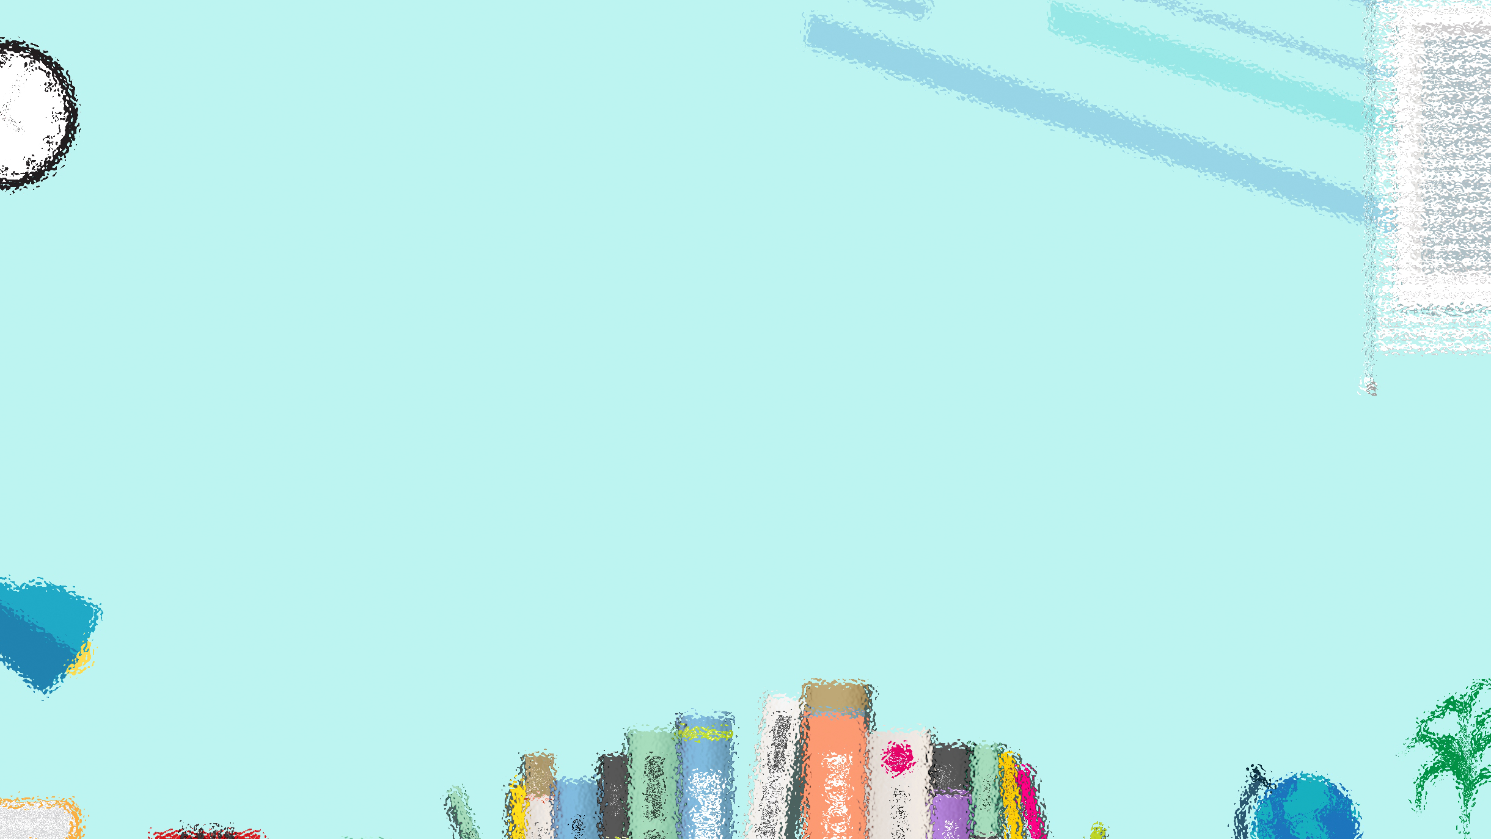
目 录 CONTENTS
Information about the book
Read to analyze plot and character
Read to appreciate
the language
Post-
reading
01
02
03
04
05
06
07
Pre-
reading
Read to explore literary devices
Read to learn new word and write the passage

Slide 4
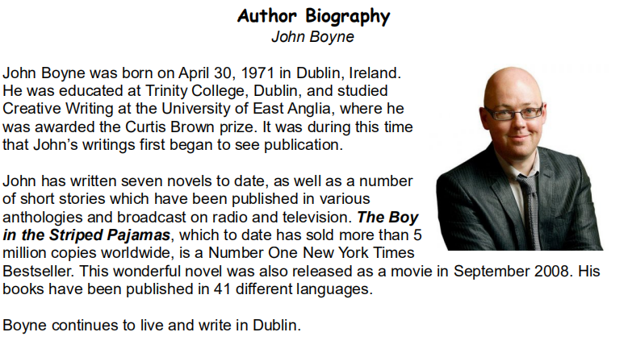
Information
about the book
作者介绍

Slide 5
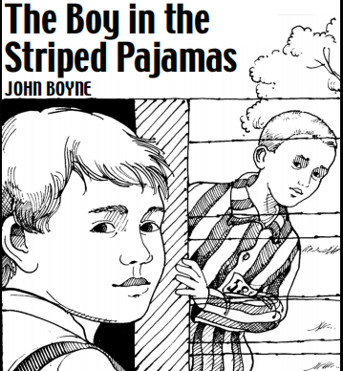
Information
about the book
内容简介
The Boy in the Striped Pajamas focuses on Bruno, a boy living in Berlin during . When his father is promoted to Commandant, he and his family move to the country, near a place Bruno calls
From his new home, Bruno sees a camp, which he explores. While walking along the wire fence, Bruno meets a boy named , who shares a with him. The two become fast friends. Over later, Bruno's family decides they are going to move back to Berlin. Bruno visits Shmuel to tell him the news, but learns that Shmuel's father . To help find him, Bruno sneaks into the camp and changes into clothes. As the boys search the , they are discovered by Nazi soldiers and sent to the .
nine-year-old
World War II
"Out-With."
Jewish
Shmuel
birthday
a year
is missing
prison
camp
您的标题
gas chambers
Management

Slide 6
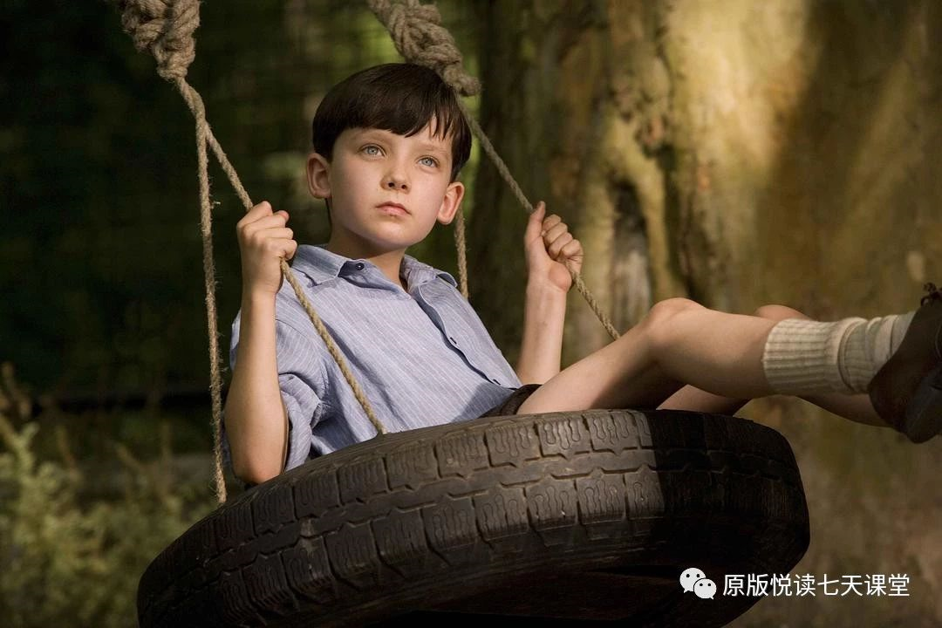
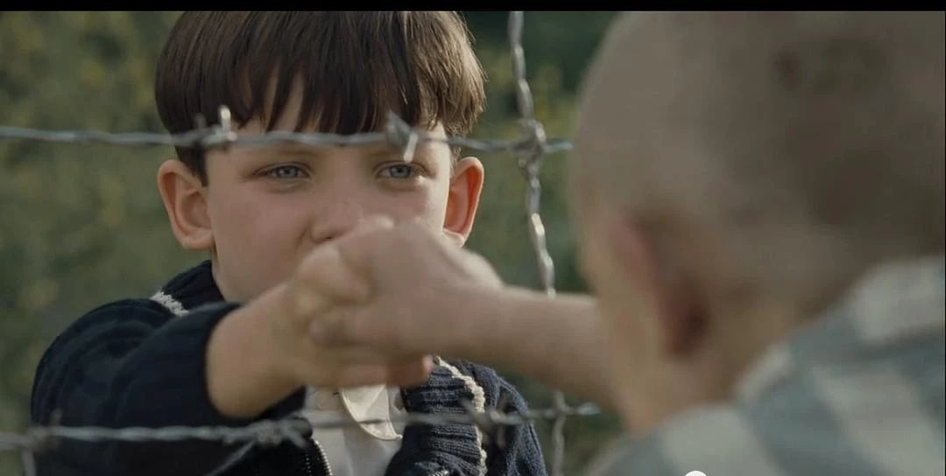
Information
about the book
从儿童的视角还原二战历史真相
本书的故事，是关于一个德国纳粹高级军官的儿子与一名身处集中营的犹太小孩之间的友谊，时间背景是二战时期。作者的意图很明显，试图通过一个孩子的视角，来审视那个特殊而癫狂的年代。那些杀戮和令人难以直视的鲜血，在孩子的眼中被折射的是如此光陆怪离和有趣，但越是如此越是让人痛苦得难以遏制。
这是一本沉重的书，从翻开书的第一页开始就有一丝不安的气氛笼罩在我们四周，让我们如坐针毡。固然孩子需要纯真，但某些沉重的故事也能通过简单的语言讲述给我们的孩子。记住历史的痛，可能得从很小就要开始，纯真永远不能是遗忘的借口，记住历史的痛，是为了不让悲剧再次发生。令人庆幸的是，约翰·伯恩发现了这一点，所以他讲述了这个故事，他一定也希望我们将这个故事讲述给我们的孩子。

Slide 7
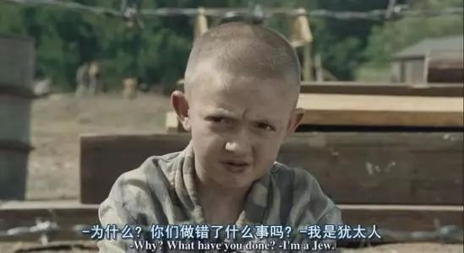
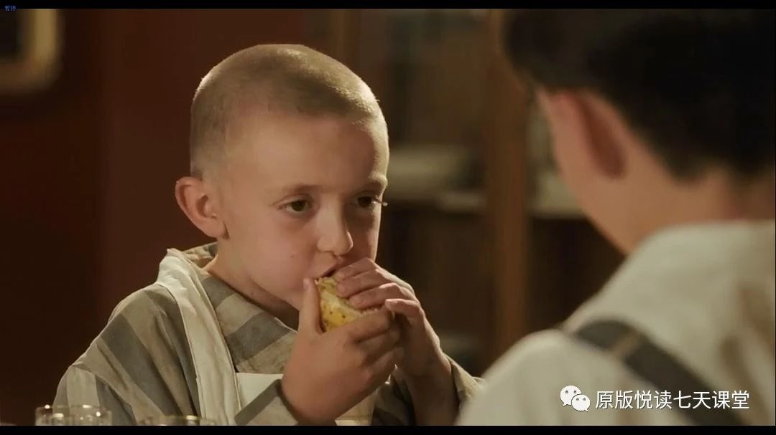
Information
about the book
清新的叙述风格和淡化的写作手法
作者采用了巧妙的淡化手法，比如，全书中没有出现过一次“奥斯维辛”这个词。西方的孩子大多知道波兰的“奥斯维辛”意味着大屠杀，若是整本书不断地出现这个词，会让孩子们立刻想到“屠杀”“残酷”的字眼。作者巧妙地运用孩子发音的不准确性将其称作为“out-with”。儿童文学作家就是这样，他们牵着孩子的手，让孩子们看这个世界的真善美、假丑恶，一点一点地认识真实的世界，不残酷，但也不肤浅。
该作品的叙述风格清新自然，以9岁男孩的眼睛来看待生活、成年人、战争，以及犯罪等沉重的真相，用天真讲述残忍，往往比沉重的笔调更能够抓住人心。
这本书前半部分将两个孩子描写得越是美好、纯真、善良，看到结局愈发令人感到命运的残酷。这样的衬托，似乎格外让人不忍心。
书中虽然充满了孩童的天真与善良的本能，但最后依旧使我们遍体鳞伤。悲剧像是集体造成的，每一个人却似乎都是悲剧的受害者。可是，到底谁才是造成悲剧的那个人？合上书本，去思考一下这样的问题，而不仅仅沉湎于悲伤，也许这才是阅读本书的意义吧。

Slide 8
Information
about the book
推荐理由
2.这是一个孩子的故事，9岁的小男孩布鲁诺在奥斯维辛所经历的“探险”，一个纳粹男孩与犹太男孩间纯真的友谊。但这本书却并不仅仅属于孩子，像《哈里波特》《小王子》一样，也是一部给成年人阅读的童话，它属于所有能够理解那段历史的人。
4.作者简单，天真，不事雕琢的纯朴文字开拓了一个孩子高度具体的内心世界，甚至会让你忘了这是一个关于集中营的故事，你所感受到的是人性的纯真无邪，当然，还有那一丝历史的沉重。
6.本书除了诺贝尔文学奖，几乎囊括欧美所有文学奖。蝉联爱尔兰图书榜66周，入围“英国十大书”。荣获爱尔兰图书奖、巴克夏图书奖、谢菲尔德图书奖、兰开夏图书奖等。
1.用纯真的双眼，看尽残酷的世界。一道隔离生死的“篱笆”，演绎出一个发人深省的“童话”。
5.英文原版阅读难度适合高中生。因为是儿童视角的缘故，所用语言较简单，读起来顺畅友好。五万词左右，大约相当于三本英文版《小王子》的长度。
3.爱尔兰新锐作家、卡耐基勋章获得者约翰·伯恩风靡之作。图书出版后几乎囊括了欧美所有文学类及儿童图书类大奖。《哈利波特》系列制片人大卫·海曼将小说改编成电影，于2008年上映。

Slide 9
Pre-reading
Learning Objectives for the novel
• Examine the significance of the title of the novel and each chapter.
探讨小说标题和每一章的意义。
• Identify the form of narration used in the novel and analyze why Boyne might have chosen it. 确定小说中使用的叙事形式，并分析为什么作者伯恩会选择它。
• Explore themes involving boundless friendship, childhood innocence, denial, and ethics. 探索涉及无界限友谊、童年天真、否定、道德规范的主题。
• Discuss the author's use of puns and wordplay and its effect on the novel.
讨论作者对双关语和文字游戏的使用及其对小说的影响。
• Interpret symbols in the novel, including Shmuel's "pajamas" and the fence.
解读小说中的符号，包括Shmuel的“睡衣”和栅栏。
• Track the following motifs: guilty observer, exploration, and power/control.
探究以下主题: 内疚的观察者，探索，权力或控制。
• Trace the character development of the novel's protagonist, Bruno.
追溯小说主人公布鲁诺(Bruno)的性格发展。

Slide 10
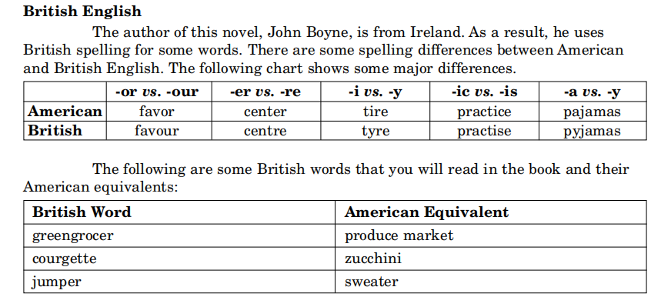
Learning differences
between AE and BE in the novel
Pre-reading

Slide 11
Pre-reading
Literary Elements in the novel
• Conflict
• Fable
• Flashback
• Foreshadowing
• Imagery
• Irony
• Metaphor
• Parallelism
• Repetition
• Simile
• Symbolism
• Theme
• 冲突
• 寓言
• 倒叙
• 铺垫
• 形象化
• 讽刺
• 暗喻
• 排比
• 重复
• 明喻
• 象征意义
• 主题

Slide 12

Pre-reading
What are the major themes of the novel?
Innocence
The story shows the naïvety of Bruno and Shmuel as they explore their friendship amid a horrific time in history.
Major Themes
Friendship
The novel demonstrates how friendship is so powerful that it can cross all boundaries.
Ethics
The adult characters of the novel do nothing to fight the unjust treatment of those imprisoned at Auschwitz; this lack of ethics is, for some, due to loyalty to the party, and others, due to fear or self-preservation.

Slide 13
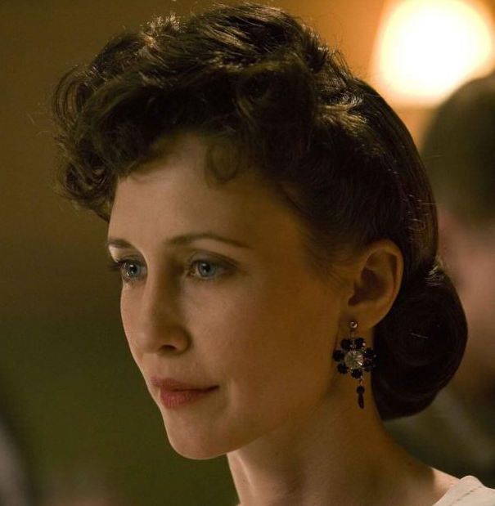
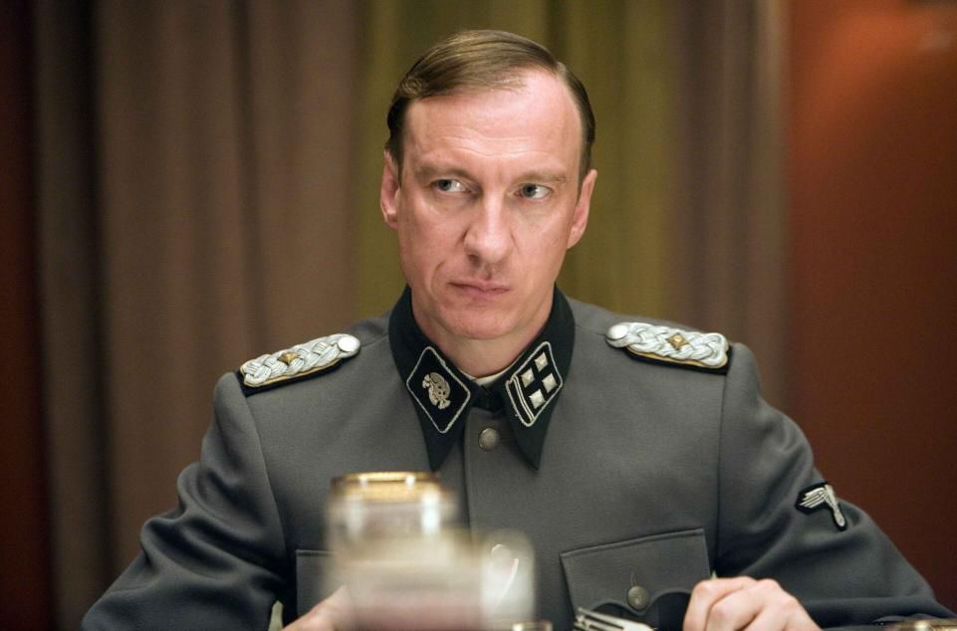
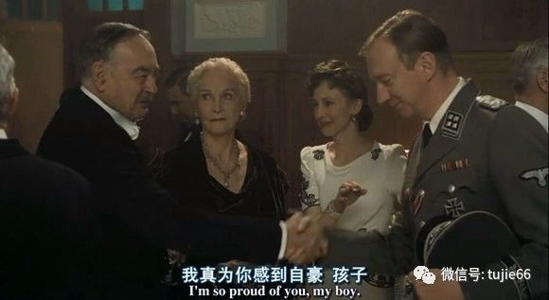

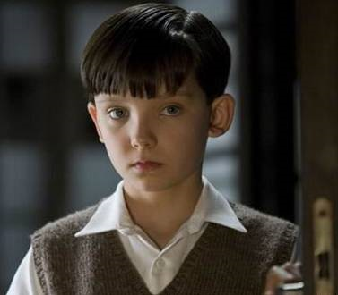
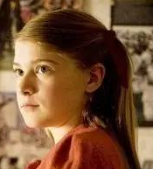
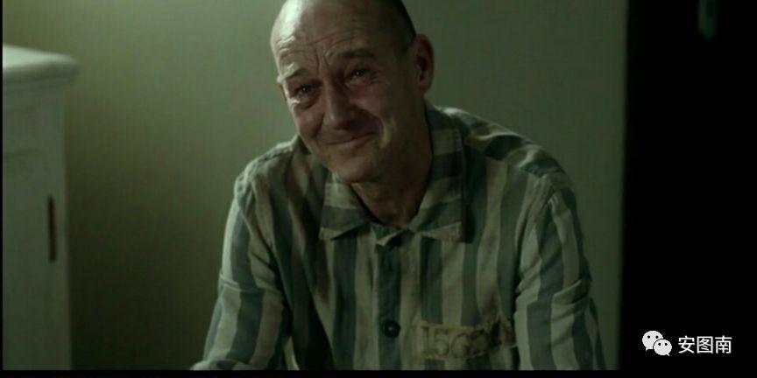
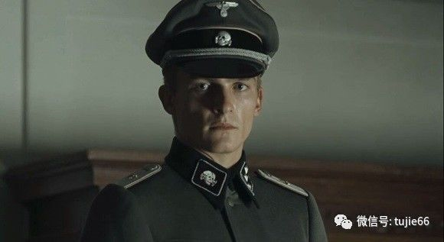
Pre-reading
Character Map
Bruno's mother
Bruno's father
a Nazi commandant
What is the inner fence?
Why is there a fence?
Who breaks the fence?
How to break the fence?
Bruno's grandparents
Shmuel
the other main character
the fence
Gretel
Bruno's sister
Bruno
the main character
Lieutenant Kotler
a Nazi officer
Pavel
a waiter but once a doctor

Slide 14

Pre-reading
The outline of the novel
Chapter 1 Bruno Makes a Discovery
Chapter 2 The New House
Chapter 3 The Hopeless Case
Chapter 4 What They Saw Through the Window
Chapter 5 Out Of Bounds At All Times And No Exceptions
Chapter 6 The Overpaid Maid
Chapter 7 How Mother Took Credit for Something That She Hadn't Done
Chapter 8 Why Grandmother Stormed Out
Chapter 9 Bruno Remembers That He Used to Enjoy Exploration
Chapter 10 The Dot That Became a Speck That Became a Blob That Became a Figure That Became a Boy
Chapter 11 The Fury
Chapter 12 Shmuel Thinks of an Answer to Bruno's Question
Chapter 13 The Bottle of Wine
Chapter 14 Bruno Tells a Perfectly Reasonable lie
Chapter 15 Something He Shouldn't Have Done
Chapter 16 The Haircut
Chapter 17 Mother Gets Her Own Way
Chapter 18 Thinking Up the Final Adventure
Chapter 19 What Happened the Next Day
Chapter 20 The Last Chapter
beginning
development
clamix
ending

Slide 15
Chapter 1-2
Analyzing plot and character
Why doesn’t Bruno understand the nature of his father’s job?
2. How does Bruno's mother feel about leaving the house in Berlin?
3. Why is Bruno reluctant to leave Berlin?
4. How does Bruno react to his new house?
5. How do Bruno and Maria react to the young soldier in the hall?
Nobody ever explains his father’s job to Bruno: they just say it is important and that the “Fury” has big things in mind for him.
Bruno's mother seems upset and sad about leaving the house in Berlin.
Bruno is reluctant to leave Berlin because he loves his large, comfortable house, which is close to his grandparents and accessible to his three good friends.
Bruno thinks the new is desolate and small, set in a place where there are no other houses, and thus, no friends nearby.
Bruno takes an instant dislike to eems awed by his presence, as she stands very straight and holds her hands in front of her with- out looking into his face.

Slide 16
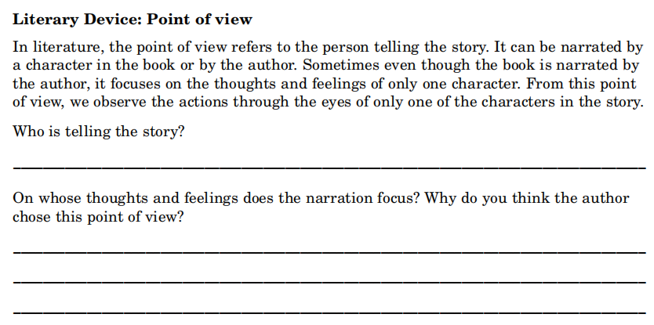
Chapter 1-2
Exploring literary devices
文学手法: 叙事视角

Slide 17
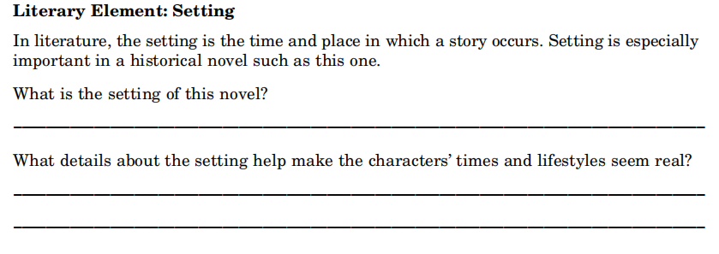
Chapter 1-2
Exploring literary devices
文学作品的要素：写作背景
Concentration Camps(集中营): prisons set up by German Nazis where Jews and other people considered “undesirable” were starved, tortured, killed, or left to die of disease.
Discrimination and Prejudice(歧视和偏见): biased attitude toward individuals based solely on their race, religion, nationality, gender, or other characteristic.
Gas Chambers(毒气室): buildings constructed to allow poisonous gas to be used for the extermination of Jews and others during the Holocaust.

Slide 18
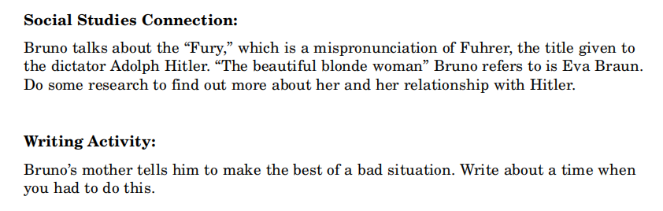
Chapter 1-2
Exploring literary devices
Genocide(种族灭绝): the intentional killing of people who belong to a particular race, religion, culture, or other group.
Holocaust/Shoah(大屠杀): refers to the mass killing by German Nazis of six million Jews in Europe during World War II.
Propaganda(政治宣传): information purposely distorted to sway people’s thinking in a particular direction.

Slide 19
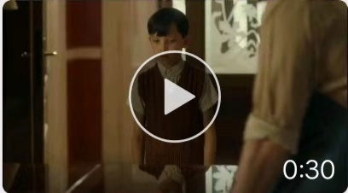
Chapter 1-2
Appreciating the language
he was surprised to find Maria, the family's maid - who always kept her head bowed and never looked up from the carpet - standing in his bedroom, pulling all his belongings out of the wardrobe and packing them in four large wooden crates, even the things he'd hidden at the back that belonged to him and were nobody else's business.
他惊讶地发现玛丽娅——那个总是低着头，从不敢把目光从地毯上移开的女佣(人物神态描写)——竟然正在他的房间里把所有的东西从衣柜拿出来，放进(动作描写)四个大藤条箱里，甚至连他藏在衣柜后面，不为人知的东西也被翻了出来，收进藤条箱里。 （find sb doing 发现某人正在做某事）
She was a tall woman with long red hair that she bundled into a sort of net behind her head, and she was twisting her hands together nervously as if there was something she didn't want to have to say or something she didn't want to have to believe.
bundle /'bʌnd(ə)l/ n. 束；捆 vt. 捆
她身材高挑，一头红色的长发用发网束在脑后(外貌描写)。母亲紧张地拧着手，似乎有些话令她难以启齿，又或者有些什么事情令她感觉难以置信（心理描写）。
语言描写
Play mp4-1
神态描写
动作描写
环境描写
外貌描写

Slide 20
Chapter 1-2
Appreciating the language
She sighed and threw her hands in the air in frustration before marching back to the staircase, followed by Bruno, who wasn't going to let the matter drop without an explanation.
let the matter drop 不再提这件事；罢休
母亲叹了一口气，无奈地摊开双手(动作描写)，又走回楼梯口。布鲁诺跟在后面，他不弄清楚这件事情是不会善罢甘休的（心理描写）。
Bruno thought about this and frowned. He wasn't particularly bothered if Gretel was being sent away because she was a Hopeless Case and caused nothing but trouble for him.
Hopeless Case 绝症；死棋
布鲁诺想了一会儿，皱起了眉头。如果格蕾特尔被送走，那么他是不会介意的，因为她是个“无可救药”的孩子。（心理描写，刻画布鲁诺的幼稚和童真）
Bruno's eyes opened wide and his mouth made the shape of an O. He felt his arms stretching out at his sides like they did whenever something surprised him.
布鲁诺睁大了眼睛，嘴巴张成了一个“O”。他感觉到他的手臂从身体两侧张开了。每当他感到惊讶的时候就会这么做。（神态描写——惊讶）
语言描写
神态描写
动作描写
环境描写
外貌描写

Slide 21
Chapter 1-2
Appreciating the language
“Oh, you'll make other friends,”said Mother, waving her hand in the air dismissively, as if the making of a boy's three best friends for life was an easy thing.
dismissively adv. 轻蔑地；不屑一顾地
“哦，你还会交上新朋友的，”母亲说道，手在空中随便挥舞了一下，就好像一个小男孩交三个好朋友是一件很容易的事情。 （语言和神态描写）
He made his way up the stairs slowly, holding onto the banister with one hand, and wondered
whether the new house in the new place where the new job was would have as fine a banister to slide
down as this one did. ... And Bruno liked nothing better than to get on board the banister at the top
floor and slide his way through the house, making whooshing sounds as he went. ... Down to the
ground floor, where you fell off the end of the banister and had to land flat on your two feet or it
was five points against you and you had to start all over again.
他慢慢地走上楼梯(动作描写)，一手扶着楼梯扶手，心里想着父亲新工作的那个新地方的新家里是否也有这样好的扶手呢（心理描写）。...对于布鲁诺来说没有什么事情能够比顺着扶手从头至尾“咻咻”地滑下来（onomatopoeia /,ɒnə(ʊ)mætə'piːə/ 拟声）更有意思了。 ...滑到底层的时候，你从扶手上飞出去，要么两脚稳稳地站住，要么就会被扣掉五分。在这里，一轮滑梯游戏结束，需要重新再来过（细节描写，表现布鲁诺的快乐的童年）。
语言描写
神态描写
动作描写
环境描写
外貌描写

Slide 22
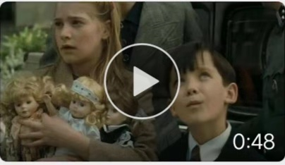
Chapter 1-2
Appreciating the language
“Say goodbye to them?” he asked, staring at her in surprise. “Say goodbye to them?”he repeated, spluttering out the words as if his mouth was full of biscuits that he'd munched into tiny pieces but not actually swallowed yet. “Say goodbye to Karl and Daniel and Martin?” he continued, his voice coming dangerously close to shouting, which was not allowed indoors. “But they're my three best friends for life!” （ /'splʌtə/ v. 气急败坏地说，急促地说；发出呛咳声）；（/mʌn(t)ʃ/ v. 用力咀嚼）
“跟他们说再见？”他惊讶地盯着母亲问道。“跟他们说再见？”他重复了一遍，嘴里蹦出这几个字，就好像塞了满口饼干，刚刚嚼碎，却还没来得及咽下去。“跟卡尔、丹尼尔和马丁说再见？”他继续问道，声音接近喊叫，这在家里可是不允许的。“但他们是我一生中最好的朋友！” （语言和神态描写）
The new house, however, stood all on its own in an empty, desolate place and there were no other houses anywhere to be seen, which meant there would be no other families around and no other boys to play with, neither friends nor trouble.
desolate/'des(ə)lət/ adj. 荒凉的；无人烟的
这个新家则是孤零零地坐落在一片光秃秃的荒地上（环境描写），周围也看不到其他房子。这就意味着，这附近没有其他家庭，也就没有任何孩子跟他玩，甚至连他要躲的麻烦小孩都没有（排比）。
Play mp4-2
语言描写
神态描写
动作描写
环境描写
外貌描写

Slide 23
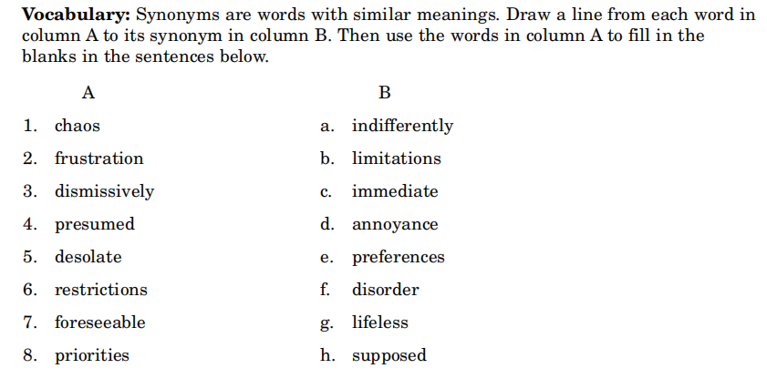
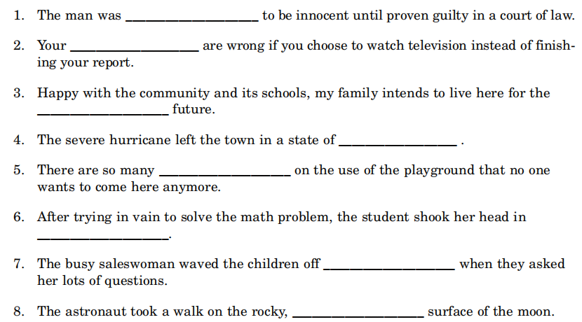
Chapter 1-2
Learning new words（单词释义及语境应用）
presumed
priorities
foreseeable
chaos
restrictions
frustration
dismissively
desolate

Slide 24

Chapter 1-2
Writing the passage
仿写活动

Slide 25
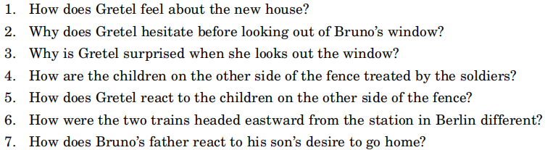
Chapter 3-5
Analyzing plot and character
1. Gretel doesn't like the new house, but she defers to her father and plans to make the best of it.
2. Gretel hesitates because there is something in Bruno's manner as he looks out the window that
upsets her.
3. Gretel is surprised because she cannot seem to make sense of the huge fence and what lay beyond it:
a grassless area with low huts and large square buildings; smoke stacks in the distance; groups of
boys and men.
4. The soldiers shout at the children, causing some of them to cry.
5. Gretel thinks the children on the other side of the fence are dirty and wants to avoid them.
6. Bruno's train was comfortable with few people, while the train on the other track was crowded and
uncomfortable.
7. Bruno's father tells his son that “Out-With” is their new home now and insists that he becomes
accustomed to the idea.

Slide 26
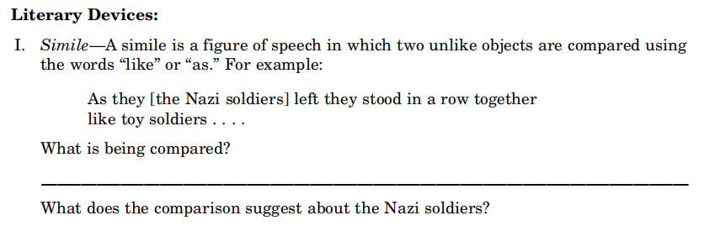
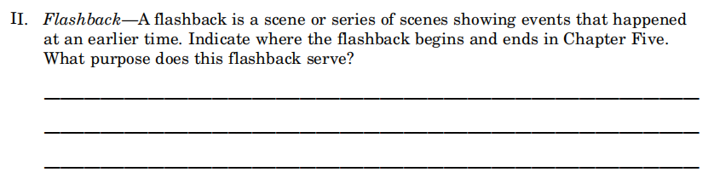
Chapter 3-5
Exploring literary devices
文学手法: 明喻，倒叙

Slide 27
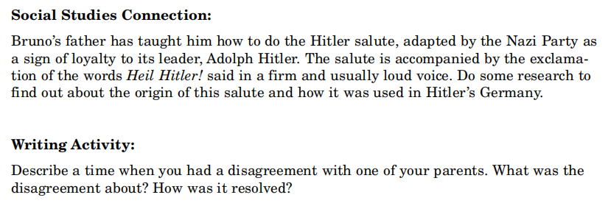
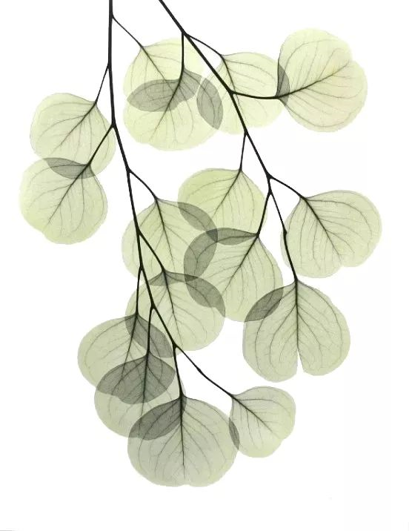
Chapter 3-5
Exploring literary devices

Slide 28
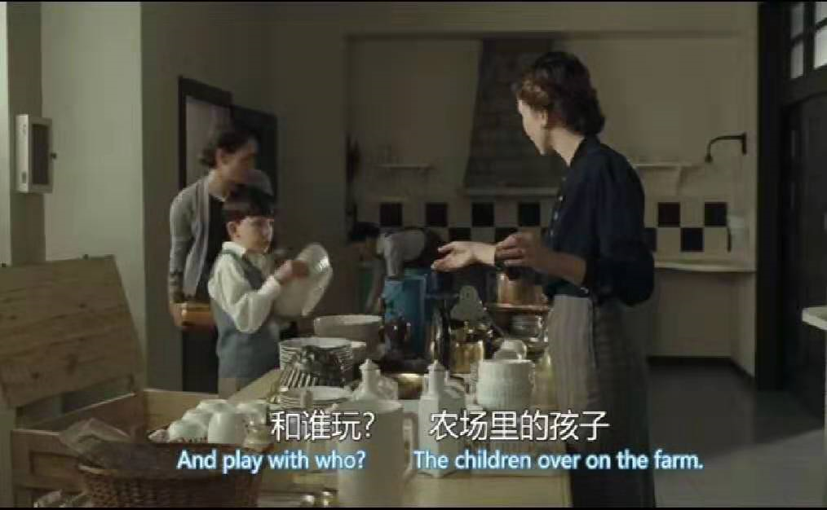
Chapter 3-5
Appreciating the language
Gretel was three years older than Bruno and she had made it clear to him from as far back as he could remember that when it came to the ways of the world, particularly any events within that world that concerned the two of them, she was in charge. Bruno didn't like to admit that he was a little scared of her, ...She had some nasty habits, as was to be expected from sisters. She spent far too long in the bedroom in the mornings for one thing, and didn't seem to mind if Bruno was left outside, hopping from foot to foot, desperate to go.
（nasty /'nɑːstɪ/adj. 极差的；恶心的； 令人不愉快的）
格蕾特尔比布鲁诺大三岁，并且从布鲁诺记事开始，她就一直对布鲁诺强调，当涉及到这个世界，尤其是关乎到他们两人的这个世界中的事情时，都由她说了算(性格描写)。布鲁诺并不愿承认他有点害怕格蕾特尔。...她有着姐姐们的一些通病(性格描写)。例如，早上她会在卫生间待上很长时间，根本就不管门外焦急等待的布鲁诺。布鲁诺在门外跳来跳去，绝望得都快憋不住了（动作描写）。
“What are you doing in here?”she shouted, spinning round. “Don't you know you don't enter a lady's room without knocking?” (/spɪn/ v. 旋转)
“你来这儿干什么？”她打着转转喊道，“难道你不知道，不敲门就闯入一位淑女的房间是很不礼貌的吗？” （语言和神态描写）
语言描写
神态描写
Play mp4-4
动作描写
环境描写
外貌描写

Slide 29
Chapter 3-5
Appreciating the language
“So we're here at Out-With because someone said out with the people before us?”
“所以，我们住在‘一起出去’，就因为有人让以前住在这里的人‘一起出去’了？” 。
此处用到了英语中常见的修辞格之一双关语pun，作者巧妙地运用孩子发音的不准确性将“奥斯维辛”称作为“out-with”形成谐音双关，又形成“奥斯维辛集中营”与“out-with出去一起自由”的语义双关。读者大多知道波兰的“奥斯维辛”意味着大屠杀，若是整本书不断地出现这个词，会让人立刻想到“屠杀”“残酷”的字眼。然而全书中没有出现过一次这个词，作家牵着孩子的手，让孩子们看这个世界的真善美、假丑恶，一点一点地认识真实的世界，不残酷，但也不肤浅。
双关语大致可以分为两类：
1.词义双关：利用英语词汇的一词多义特点，使之在特定语境下产生特殊的语言双关。
例句解析：A: What's the longest sentence in the world? B: Life sentence.
其中的"sentence"一词就巧妙地利用了单词的同音同形异义，既可以指“句子”，又可以指“刑期”。所以，这个对话可以翻译为: A: 世界上最长的句子是什么? B: 无期徒刑。
2. 谐音双关：利用单词发音相同或者相近的特点而构成的语义相关。这样的英文词汇有:weak和week, deer 和dear, knew和new, in和inn, meet和meat等等。
例句解析：Seven days without water makes one weak（week）.可以解释为:七天不喝水，使人软弱无力，然而七天又刚好是一个星期。利用了weak和week同音造成歧义，读来别有一番趣味。
A bicycle can't stand on its own because it is two-tyred（too tired）.可以解释为是：自行车站不起来，是因为它只有两个轮胎(two-tyred)。而two-tyred和too tired同音，所以也可以说它太累了。
语言描写
神态描写
动作描写
环境描写
外貌描写

Slide 30
Chapter 3-5
Appreciating the language
Trying not to appear too obvious, he strolled casually towards it. He placed his hands in the pockets of his short trousers and attempted to whistle a song he knew while not looking at his sister at all. stroll /strəʊl/ v. /n. 散步，闲逛；（体育比赛）轻而易举地获胜
为了不表现得太明显，他假装随意地踱步，向窗户走去。他把手插在裤兜里，嘴里吹着口哨，眼睛根本不看他的姐姐。 (动作神态描写)
'Bruno!' snapped Gretel, marching towards him so quickly that he jumped back from the window and backed up against a wall. snap /snæp/ vi. 咬；厉声说；咯嗒一声关上
“布鲁诺！”格蕾特尔愤怒了，她朝布鲁诺冲过去，吓得他跳转过来，靠墙站着。 (语言动作描写)
There was a garden directly beneath Bruno's window. Quite a large one too, and full of flowers which grew in neat orderly sections in soil that looked as if it was tended very carefully by someone who knew that growing flowers in a place like this was something good that they could do, like putting a tiny candle of light in the corner of a huge castle on a misty moor on a dark winter's night.
布鲁诺的窗下是一个花园，一个很大的花园。花园打理得井井有条，鲜花绽放，一看就是有人精心照料。他们知道，在这种地方种花再必要不过了，就像是在薄雾中的荒野上，一座阴暗城堡的一角，点燃了一支小小的蜡烛。 （环境描写，比喻手法。在纳粹集中营需要鲜花，就像蜡烛点燃世界，点亮希望。）
语言描写
神态描写
动作描写
环境描写
外貌描写

Slide 31
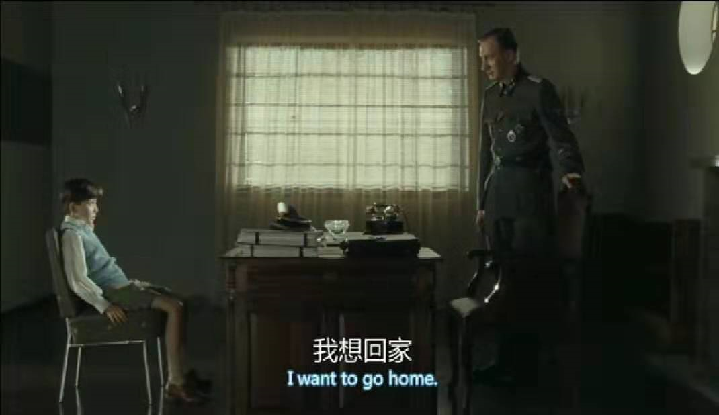
Chapter 3-5
Appreciating the language
'Look over there,' said Bruno, and Gretel followed the direction of the finger he was pointing and saw, emerging from a hut in the distance, a group of children huddled together and being shouted
at by a group of soldiers. huddle /'hʌd(ə)l/ v.v. 挤在一起；蜷缩；靠拢（听取指示）；聚集（私下讨论）
“看那儿！”布鲁诺突然高声喊道，格蕾特尔顺着他所指的方向看了过去。在远处的一个小房子里，出现了一群挤在一起的小孩子，一群士兵对着他们大声叫喊。 (集中营场景描写)
Father was at the centre of them and looked very smart in his freshly pressed uniform. His thick dark hair had obviously been recently lacquered and combed, and as Bruno watched from above he felt both scared and in awe of him. lacquer /'lækə/ v. 给……涂漆；给（头发）喷定型发胶
父亲站在他们正中间，军装笔挺，显得英武帅气。他浓密的头发刚刚染过，并且经过精心的梳理，虽然布鲁诺只是远远地看着他，但是仍然能够感觉到自己对父亲又敬又畏。 (外貌描写)
语言描写
神态描写
Play mp4-5
动作描写
环境描写
外貌描写

Slide 32
Chapter 3-5
Appreciating the language
The words were out before he could really think about whether they were sensible or not; once he heard them floating in the air they didn't seem like entirely the kind of things he should be saying to Father, but there they were, already said, and not a thing he could do to take them back. Bruno swallowed nervously and, after a few moments' silence, glanced back at Father, who was staring at him stony-faced. Bruno licked his lips and looked away. He felt it would be a bad idea to hold Father's eye.
说这些话的时候，布鲁诺几乎未加思索；他听到这些话飘荡在空气中，不像他应该对父亲说的话，但是那些话已经说出口了，他已经说了，就像泼出去的水一样收不回来了。布鲁诺紧张地咽了咽口水，沉默了一会儿，抬头看着父亲，父亲正铁青着脸看着他。布鲁诺舔了舔嘴唇，看了看别处，他想最好还是不要看父亲的眼睛。 (神态和心理描写)
“A home is not a building or a street or a city or something so artificial as bricks and mortar. A home is where one's family is, isn't that right?”
artificial /ɑːtɪ'fɪʃ(ə)l/ adj. 人造的；仿造的；虚伪的
“家，不是一个房子，不是一条街，不是一个城市，不是像砖头石灰那样肤浅的东西。有家人的地方才是家，你说是吗？” (语言描写，此句出自布鲁诺父亲之口，因此极具戏剧性反讽效果。)
语言描写
神态描写
动作描写
环境描写
外貌描写

Slide 33
Chapter 3-5
Writing the passage
仿写活动

Slide 34
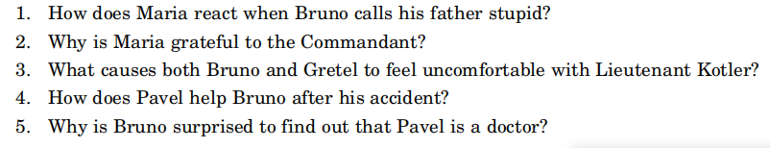
Chapter 6-7
Analyzing plot and character
1. After Bruno calls his father stupid, Maria is horrified, insisting that his father is a
good man.
2. Maria feels grateful because the Commandant gave her a job and paid for her
mother's hospital care and funeral expenses.
3. Both Bruno and Gretel feel uncomfortable when Kotler treats Pavel in a
disrespectful way.
4. Pavel carries Bruno back to the house and kindly and gently administers to his
wounds.
5. Bruno is surprised that a doctor would be waiting on tables.

Slide 35
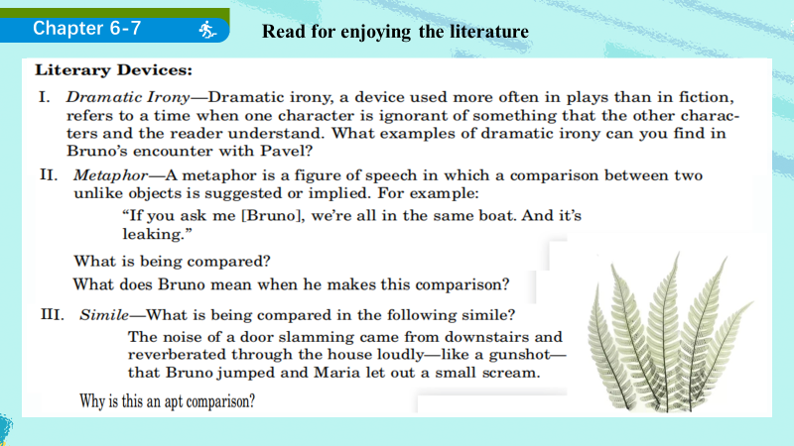
Exploring literary devices
文学手法: 戏剧性反讽，暗喻，明喻

Slide 36
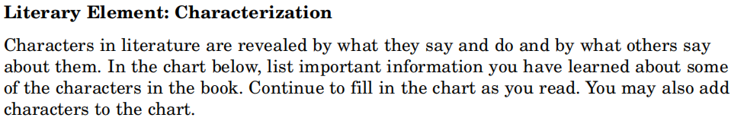
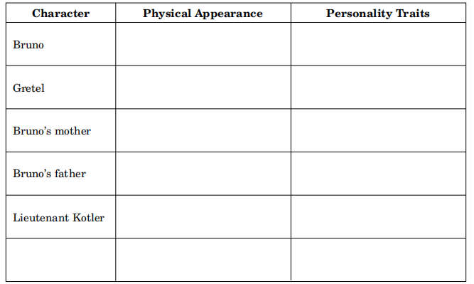
Chapter 6-7
Exploring literary devices
文学作品的要素：人物塑造

Slide 37
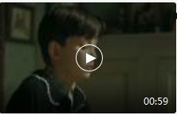
Chapter 6-7
Appreciating the language
Sometimes, when it was a warm afternoon, I liked to sit out there in the sunshine and eat my lunch underneath the ivy tree by the pond. The flowers were very beautiful there. The scents. The way the bees hovered around them and never bothered you if you just left them alone.
hover /'hɒvə/ vi. 盘旋，翱翔；徘徊
有时候，下午很暖和，我就喜欢坐在外面晒太阳，在池塘边的常春藤下吃午饭。那里的花很漂亮，还有花香。蜜蜂绕着花儿忙碌，只要你不惊扰它们，它们也不会惊扰你。（①调动各种感官，强化环境描写，通过对柏林花园的怀念凸显对新环境的不适的内心矛盾。②对蜜蜂的拟人描写）
写好景物和环境技巧和方法：一、从视觉、听觉、味觉调动各种感官体验和感悟，二、巧用联想、想象和多种修辞手法，三、安排好描写顺序，虚实相生，动静结合。
her hands clenched into fists, as if she was terribly angry about something. Her mouth opened but froze there for a moment, as if she was scared of all the things she might say if she allowed herself to begin. 她的手攥成了拳头，似乎非常气愤。她张开嘴，但又像僵住了一样，好像如果她真要说出来，会被自己所说的话吓坏似的。 （神态描写——惊恐）
Suddenly, and for no reason that he could think of, Bruno felt an overwhelming urge to cry.
overwhelming /,ovɚ'wɛlmɪŋ/ adj. 压倒性的；势不可挡的
突然，布鲁诺没有了任何理由，很想嚎啕大哭一场。（神态描写）
语言描写
神态描写
动作描写
环境描写
Play mp4-6
外貌描写

Slide 38
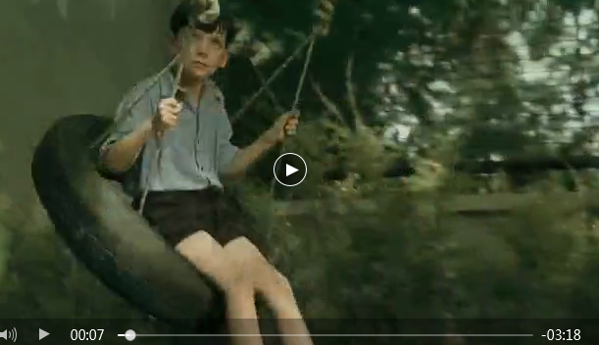
Chapter 6-7
Appreciating the language
Every time the tyre swung backwards it rose in the air and narrowly avoided hitting the trunk of the tree itself, but it still came close enough for Bruno to use his feet to kick himself even faster and higher on the next swing. This worked very well until his grip on the tyre slipped a little just as he kicked the tree, and before he knew it his body was turning inside and he fell downwards, one foot still inside the rim while he landed face down on the ground beneath him with a thud.
thud /θʌd/n. 砰的一声；重击
每次秋千向后荡的时候就升入了空中，差一点点就会撞到树干上，但是布鲁诺还是不停地用脚蹬着地，使秋千荡得更快更高。布鲁诺玩得很开心，直到有一次当他踢树的时候，握绳子的手松了一下，等他反应过来的时候，身体已经从轮胎里掉了下去，一只脚还挂在轮胎边缘，脸朝下，砰的一声摔在地上。（动作描写，语言细腻，生动传神）
Everything went black for a moment and then came back into focus. ... there was a wide gash which seemed to have been waiting for him to look at it because once all the attention was focused on it, it started to bleed rather badly.
gash /gæʃ/ n. 很深的裂缝；砍得很深的伤口 vt. 划开；砍入很深；（使）负深伤
布鲁诺眼前一黑，但马上又清醒了过来。...有一个很大的伤口，这个伤口好像就等着被发现呢，因为布鲁诺一看见它，它就开始流血。 （拟人的修辞格，符合儿童心理特征。）
Play mp4-7
语言描写
神态描写
动作描写
环境描写
外貌描写

Slide 39
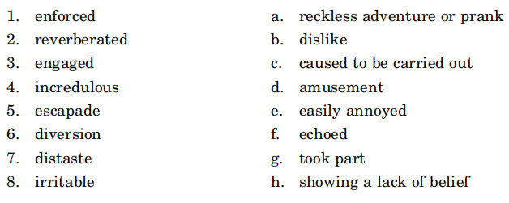
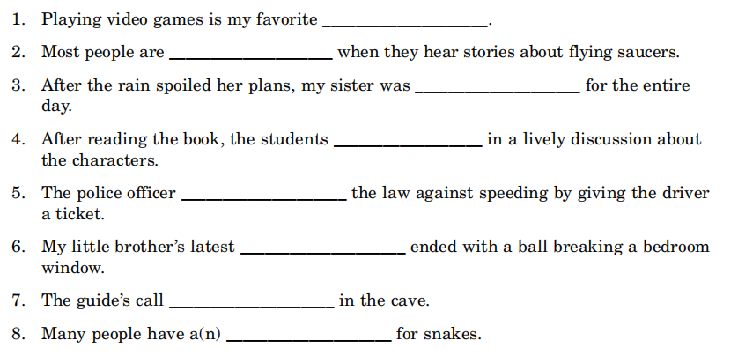
Learning new words（单词释义及语境应用）
Chapter 6-7
diversion
incredulous
irritable
engaged
enforced
escapade
reverberated
distaste

Slide 40

Chapter 6-7
Writing the passage
仿写活动

Slide 41
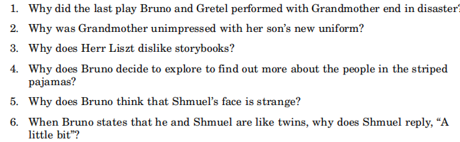

Chapter 8-10
Analyzing plot and character
1. After the play that turned out to be the last one, Grandmother had a fight with Bruno's father
and stormed out of the house.
2. Grandmother thought that her son should care less about the uniform and more about what it
represented.
3. Herr Liszt believes that the only books that are important are those about things that matter in his
contemporary world and not about fiction.
4. Bruno decides to explore because he wonders what the difference is between the people in the striped
pajamas and the people wearing the uniforms.
5. Bruno thinks that Shmuel's face is strange because it appears to be very thin and grey, and his eyes
seem very sad.
6. While Bruno can only see how he and Shmuel are alike, Shmuel can see the big difference.

Slide 42

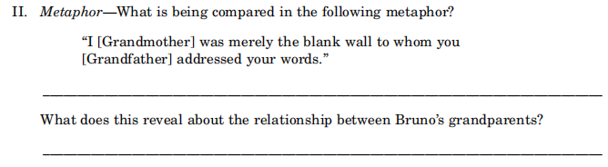

Chapter 8-10
Exploring literary devices
文学手法:倒叙，暗喻，戏剧性反讽

Slide 43
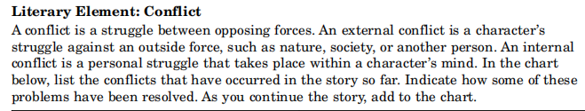
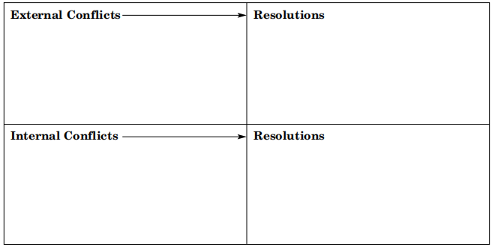
Chapter 8-10
Exploring literary devices
文学作品的要素：矛盾冲突

Slide 44
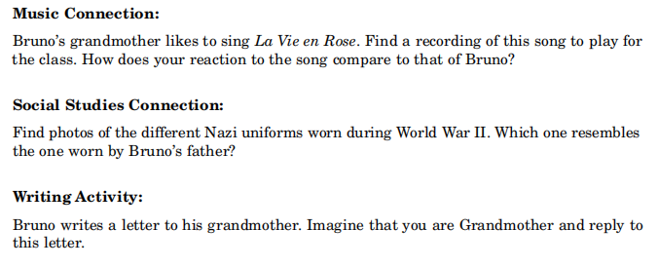
Chapter 8-10
Exploring literary devices

Slide 45
Chapter 8-10
Appreciating the language
“Sing! Sing!” everyone at the party would cry, and after a suitable pause - sometimes as long as ten or twelve seconds - she would finally give in and turn to the young man at the piano and say in a quick and humorous voice, “La Vie en Rose, E-flat minor. And try to keep up with the changes.”
“来一首！来一首！”聚会上的每个人都会喊起来，然后稍停顿一下——有时会有十或十二秒——她就投降了，转向坐在钢琴边的年轻人，快速而幽默地强调说： “《玫瑰人生》，E小调。我会尽量跟上你的。” (动作和神态描写，would表过去常常。)
对家庭教师的人物刻画（一个清高但对现实无奈的知识分子）：
a man called Herr Liszt rattled up the driveway on his boneshaker.
一个叫里茨先生的男人咣咣咣地开着他的破车来了
Herr Liszt was a mystery to Bruno.
对于布鲁诺来说，里兹先生是个谜一样的人物。
Herr Liszt made a hissing sound through his teeth and shook his head angrily.
里兹先生从牙缝里发出了嘘嘘声，生气地摇摇头
he said in a sinister voice. “To get your head out of your storybooks and teach you more about where you come from. About the great wrongs that have been done to you.”
他用一种阴险的口吻说，“把你的脑袋从故事书里抽出来，多教教你是从哪里来的，改正那些对你犯下的大错误。”
语言描写
神态描写
动作描写
环境描写
外貌描写

Slide 46
Chapter 8-10
Appreciatingthe language
However, Mother and Father's voices were muffled and hard to make out, Grandfather's was not to be heard at all, while Grandmother's was surprisingly slurred. Finally, after a few minutes, the door slammed open and Gretel and Bruno darted back up the stairs while Grandmother retrieved her coat from the rack in the hallway.
“Ashamed!” she called out before she left. “That a son of mine should be—”
“A patriot,” cried Father, who perhaps had never learned the rule about not interrupting your mother.
“A patriot indeed!” she cried out. “The people you have to dinner in this house. Why, it makes me sick. And to see you in that uniform makes me want to tear the eyes from my head!” she added before
storming out of the house and slamming the door behind her.
然而，父母的话很难听清楚，爷爷的声音根本就听不到，只有奶奶的话能断断续续模模糊糊听到一些。最后，过了几分钟，门砰地一声地打开了，格蕾特尔和布鲁诺赶紧溜上楼梯，奶奶在走廊的衣帽架上取下外套。
“羞耻！”她走之前大声说，“我的儿子是个——”
“爱国者！”父亲大声回应，他可能不知道谁也不能打断母亲说话的规矩。
“好一个爱国者！”她大喊，“在这个房子里吃饭的爱国者们，为什么让我感到恶心。看着你穿着这身军装，我都想把自己的双眼挖出来！”她说着冲出了房间，重重地把门摔上了。
(语言和动作描写，不同人物对战争的观点差异来增强角色之间的冲突 ，引发思考。)
语言描写
神态描写
动作描写
环境描写
外貌描写

Slide 47
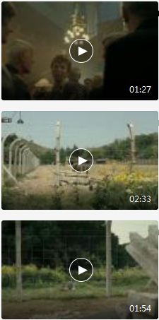
Chapter 8-10
Appreciating the language
But while he was thinking this his feet were taking him, step by step, closer and closer to the dot in the distance, which in the meantime had become a speck, and then began to show every sign of turning into a blob. And shortly after that the blob became a figure. And then, as Bruno got even closer, he saw that the thing was neither a dot nor a speck nor a blob nor a figure, but a person.
In fact it was a boy.
他想着想着，脚步却带着他一步一步地接近那远处的小点，而这个小点也逐渐变成了一个小斑，然后又慢慢变成了一小块。很快的，这个小块变成了影子。但是最后，当布鲁诺继续靠近的时候，他发现那不是一个小点，不是小块，也不是影子，而是一个人。
实际上，那是个小男孩。
(描写的空间顺序，由远及近 the dot→ a speck →a blob → a figure →a person→a boy。场景描写真实性很重要，通过场景展开的合理联想，还可以使文章虚实有度，富有张力。)
语言描写
神态描写
Play mp4-8
Play mp4-9
Play mp4-10
动作描写
环境描写
外貌描写

Slide 48
感恩遇见，相互成就，本课件资料仅供您个人参考、教学使用，严禁自行在网络传播，违者依知识产权法追究法律责任。
更多教学资源请关注
公众号：溯恩高中英语
知识产权声明

Slide 49
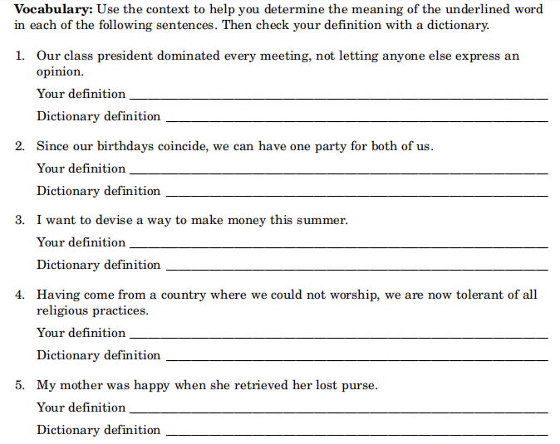
Chapter 8-10
Learning new words（单词释义及语境应用）
controlled or ruled
happen at the same time
think up or plan
accepting of the beliefs and ways of others
got back again

Slide 50
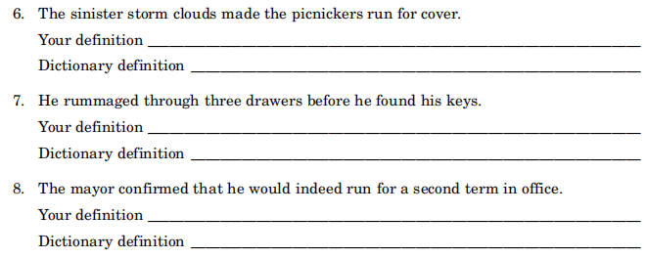
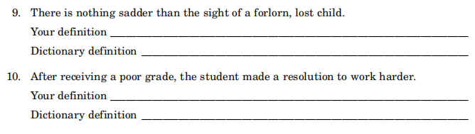
Chapter 8-10
Learning new words
threatening
searched thoroughly
proved to be true
miserable and hopeless
something decided upon

Slide 51
Chapter 8-10
Writing the passage
仿写活动

Slide 52
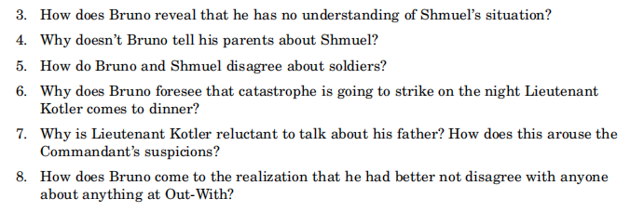
Chapter 11-13
Analyzing plot and character
1. Bruno considered the Fury as being a rude guest after he expressed displeasure that Gretel was
learning French, and abruptly left a conversation with the children to sit down in Father's seat at the
head of the table.
2. The blonde woman continued to talk kindly to the children after the Fury walked out, praising Gretel
for learning French and showing concern for Bruno's tight shoes.
3. It is clear that Bruno does not understand Shmuel's plight when he compares Shmuel's move to Out-
Wth with his; does not believe that so many people could live in one room in the ghetto; or that there
were no doors on Shmuel's train. Furthermore, he can't understand why the hundreds of boys in the
camp don't play.
4. Bruno does not tell his parents about Shmuel because he believes that they might not approve of him,
and he doesn't want to give up his friendship with the boy.

Slide 53
Chapter 11-13
Analyzing plot and character
5. Bruno believes that there are good soldiers like his father, while Shmuel has only experienced the
cruelty of soldiers.
6. Bruno foresees that catastrophe is going to strike because Pavel looks smaller and paler than usual,
and his service is impeded because he is unsteady on his feet and slow to respond.
7. Lieutenant Kotler is reluctant to talk about his father because the man left Germany for Switzerland.
The Commandant suspects that Kotler's father left because he disagreed with Hitler's policies.
8. Bruno decides to be acquiescent at Out-With after he watches Lieutenant Kotler brutally punish
Pavel for spilling wine, and nobody, not even Bruno's father, stops him.

Slide 54
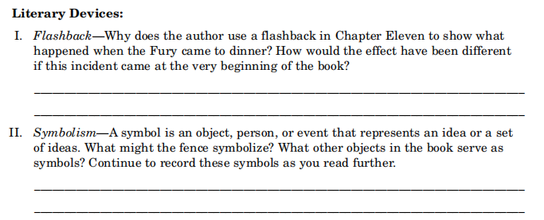
Chapter 11-13
Exploring literary devices
文学手法: 倒叙，象征意义

Slide 55
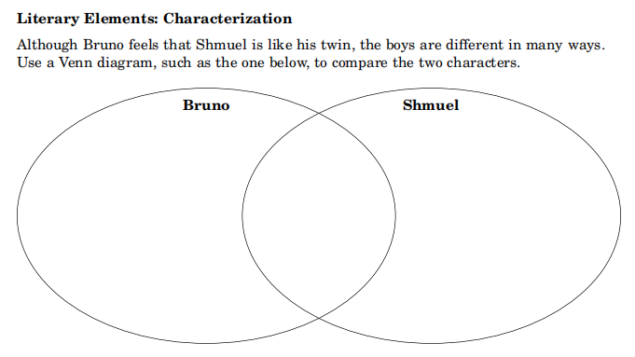
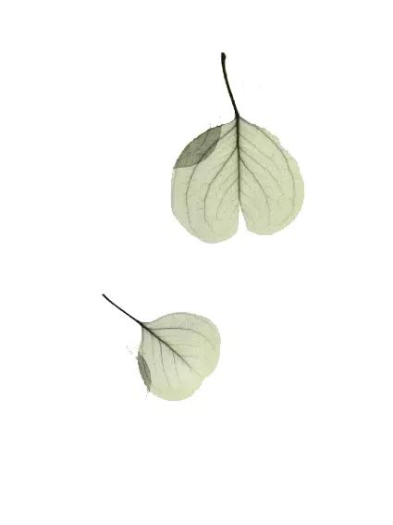
Chapter 11-13
Exploring literary devices
文学作品的要素：人物塑造

Slide 56
Chapter 11-13
Appreciating the language
“You can change your plans if you want to,' said Mother, 'but I've made arrangements to go to the theatre with—”
“The Fury has something he wants to discuss with me,”said Father, who was allowed to interrupt Mother even if no one else was. “I just got a phone call this afternoon. The only time he can make it is Thursday evening and he's invited himself to dinner.”
Mother's eyes opened wide and her mouth made the shape of an O. Bruno stared at her and wondered whether this was what he looked like when he was surprised about something.
“你可以取消你的，”母亲说，“不过那天晚上我打算去剧院，已经答应了——”
“元首说有事情和我商量，”父亲说，别人都不可以打断母亲说话，除了他。“我今天下午接到了一个电话。他只有星期四晚上有时间，他说那天晚上要来我们家共进晚餐。”
母亲睁大双眼，嘴张成了“O”形。布鲁诺盯着她，想自己吃惊的时候是不是就是这副模样。
重复叙事的写作手法:
本段中的两个划线句 “allowed to interrupt Mother”, “ eyes opened wide and her mouth made the shape of an O”以及“out-with”在整本书中重复或反复出现。重复有主题的重复、叙事的重复以及话语的重复。选择一些个性化的语言细节来展现人物的性格特征；采用重复式的细节单元把人物性格特征作一种变形的夸张，形成“重复式斜升”描述，每一次都在不同的层次、角度重复使用，把事件的意义进行多方面、多层次的展现。
语言描写
神态描写
动作描写
环境描写
外貌描写

Slide 57

Chapter 11-13
Appreciating the language
对Shmuel希姆尔的人物刻画（一个被关押的犹太小孩，瘦骨嶙峋，经常受到毒打，对未来充满着忧郁与不安。可即便这样他也依然保留了善良的天性。）
Shmuel shook his head and continued with his story. He didn't often think about these things any more because remembering his old life above the watch shop made him very sad.
希姆尔摇摇头，继续说他的故事。他已经很少再想这些事情了，因为每当回忆起那些在钟表店的日子，他就会很悲伤。
“Chocolate,” said Shmuel very slowly, his tongue moving out from behind his teeth. “I've only ever had chocolate once.”
“巧克力，”希姆尔慢慢地说，他的舌头都从牙齿后面舔了出来。“我只吃过一次巧克力。”
Shmuel shrugged his shoulders and pulled himself to his feet. “I think I'd better get back,” he said.
希姆尔耸耸肩膀，把头埋在腿里。“我想我得回去了。”他说。
“Who's Maria?” asked Shmuel, not looking up as he gobbled down the food hungrily.
“谁是玛丽娅？”希姆尔问，他狼吞虎咽地，顾不得抬头。
“There aren't any good soldiers,” repeated Shmuel.
“没有好士兵。”希姆尔重复说。
Play mp4-11
Play mp4-12
Play mp4-13
语言描写
神态描写
动作描写
环境描写
外貌描写

Slide 58
Chapter 11-13
Appreciating the language
Later that night, when Bruno went to bed, he thought about all that had happened over dinner. He remembered how kind Pavel had been to him on the afternoon he had made the swing, and how he had stopped his knee from bleeding and been very gentle in the way he administered the green ointment. And while Bruno realized that Father was generally a very kind and thoughtful man, it hardly seemed fair or right that no one had stopped Lieutenant Kotler getting so angry at Pavel, and if that was the kind of thing that went on at Out-With then he'd better not disagree with anyone any more about anything; in fact he would do well to keep his mouth shut and cause no chaos at all. Some people might not like it.
那天晚上，布鲁诺上床睡觉的时候，想了想刚才餐桌上发生的一切。他还记得他做秋千的那个下午，帕维尔是多么慈祥，他是怎样帮他的膝盖止血，那么温柔地帮他涂绿色的药水。他意识到，父亲虽然总是那样一个和蔼周到的人，但还是没有阻止柳特伦特·科特勒那样对帕维尔发脾气，如果这就是在“一起出去”理所应当发生的事情，那么他就不能再认同任何人或任何事；事实上，他只能安静地闭上嘴巴，不添麻烦就行。某人可能不喜欢这样。
叙述视角对小说文本构建和主体思想起关键作用, 叙事视角创造了兴趣、冲突、悬念、乃至情节本身。本段通过布鲁诺心理活动的描写，以儿童视角看成人世界“Pavel” 和“Father ”到底谁好谁坏，他十分困惑，最后只能 “ he'd better not disagree with anyone any more about anything”和 “keep his mouth shut and cause no chaos” ，让读者透过纸背，直达灵魂深处，形成强烈冲击。
语言描写
神态描写
动作描写
环境描写
外貌描写

Slide 59

Chapter 11-13
Read for learning new words（单词释义及语境应用）
extravagant /ɪk'strævəgənt/ adj. 奢侈的；浪费的；过度的；放纵的
enunciating /ɪ'nʌnsɪeɪt/ vt. 发音；阐明；宣布
disdain /dɪs‘deɪn/ n. 蔑视 vt. 鄙弃
contradict /kɒntrə'dɪkt/vt. 反驳；否定；与…矛盾

Slide 60


Chapter 11-13
Learning new words（单词释义及语境应用）
catastrophe /kə'tæstrəfɪ/n. 大灾难
vital /'vaɪt(ə)l/ adj. 至关重要的；生死攸关的
deliberately /dɪ'lɪbərətli/adv. 故意地
administered /əd‘mɪnɪstə/vt. 管理；执行；给予 (administer first aid 施行急救)

Slide 61

Chapter 11-13
Writing the passage
仿写活动

Slide 62

Chapter 14-15
Analyzing plot and character
1. After making a slip of the tongue, Bruno pretends that his friend is an imaginary
one, fearing that Gretel will somehow ruin the friendship.
2. When Bruno repeats out loud the tragic disappearance of Shmuel's grandfather,
he realizes how sad his friend must have been feeling: he regrets neglecting to offer
his friend solace.
3. It is clear that Lieutenant Kotler is getting close to Bruno's mother because he is
always in the living room making jokes with her, whenever the Command ant is
away, he hangs around the house; he is at the house when Bruno goes to bed and
before he wakes up in the morning; she calls him “Kurt” and "precious.”

Slide 63
Chapter 14-15
Analyzing plot and character
4. Shmuel is brought to Bruno's house by Lieutenant Kotler to polish the glasses.
5. Bruno gives Shmuel chicken to eat and then denies that he did so when Lieutenant
Kotler questions him, leading Kotler to believe that the boy stole the food.
6. Bruno fears Kotler and does not have the courage to stand up for his friend by
telling the truth.

Slide 64

Chapter 14-15
Exploring literary devices
文学作品的要素：情感

Slide 65

Chapter 14-15
Exploring literary devices

Slide 66

Chapter 14-15
Appreciating the language
She made a raspberry sound through her lips and some of her spit landed on Bruno's face
'Boring,' she said in a sing-song voice. /'rɑːzb(ə)rɪ/ n. 舌头放在唇间发出的声音；（表示轻蔑，嘲笑等的）咂舌声
她朝他吐了吐舌头，发出很难听的声音，还在布鲁诺的脸上溅了几颗唾沫星子。“无聊。”她说。（语言和神态描写）
The words were out of his mouth quicker than he could stop them and he felt a pain in his
stomach and grew furious with himself for saying that.
这话说得太快了，他都没来得及阻止它们从嘴里溜出来，他的胃抽搐了一下，恼恨自己怎么管不住自己的嘴巴。（动作和心理描写）
His stomach churned inside him and he thought for a moment that he was going to be sick. He had never felt so ashamed in his life; he had never imagined that he could behave so cruelly.
churn/tʃɜːn/ v. 搅拌；搅动
他觉得胃里一阵翻腾，他觉得自己要病倒了。他这一生中从未这样羞愧过；他也从没有想像过自己可以作出这样的举动。（心理描写，排比修辞）
语言描写
神态描写
Play mp4-15
动作描写
环境描写
外貌描写

Slide 67
Chapter 14-15
Appreciating the language
Bruno considered the dilemma he was in. On the one hand his sister and he had one crucial thing
in common: they weren't grownups. And although he had never bothered to ask her, there was every chance that she was just as lonely as he was at Out-With. After all, back in Berlin she had had Hilda and Isobel and Louise to play with; they may have been annoying girls but at least they were her friends. Here she had no one at all except her collection of lifeless dolls. Who knew how mad Gretel was after all? Perhaps she thought the dolls were talking to her.
But at the same time there was the undeniable fact that Shmuel was his friend and not hers and he didn't want to share him. There was only one thing for it and that was to lie.
布鲁诺思考他所处的这个进退两难的局面。一边是他的姐姐，他们有一个很重要的共同点就是：他们不是大人。虽然他从来没有问过她，但是她跟他一模一样，在“一起出去”都极为孤独。毕竟，在柏林的时候，她还能和希尔达、伊莎贝尔和路易斯玩；虽然都是喜欢争吵的丫头，但毕竟都是她的朋友。这里，除了她那些没有生命的娃娃们，她没有一个伙伴。谁知道格蕾特尔是不是快要无聊得发疯了？可能她认为娃娃们在跟她说话。
但是另一边，一个不争的事实是，希姆尔是他的朋友，而不是她的，他也不想跟她分享。那么现在布鲁诺只能说谎了。
（此段心理描写非常符合儿童心理特征，心理描写是通过剖析人物的心理活动，挖掘人物的思想感情，以刻画人物形象内在性格特征的一种描写方法。人物心理的间接描写有以下几种方法：神态揭示法、行动反映法、语言透露法、环境衬托法）
语言描写
神态描写
动作描写
环境描写
外貌描写

Slide 68

Chapter 14-15
Learning new words（单词释义及语境趣用）
d i l e mma
g r i m a c e
u n d e n i a b l e
s o p h i s t i c a t i o n
s a r c a s m
dilemma /dɪ'lemə/n. 困境；进退两难
grimace /'grɪməs/ vi. 扮鬼脸 n. 鬼脸
undeniable /ʌndɪ'naɪəbəl/ adj. 不可否认的
sophistication /sə,fɪstɪ'keɪʃn/n. 复杂；老于世故
sarcasm /'sɑːkæzəm/ n. 讽刺；挖苦；嘲笑
crucial /'kruːʃəl/ adj. 重要的；决定性的
medicinal /mɪ'dɪsɪnəl/ adj. 药的；药用的；治疗的
seething /'siːðɪŋ/ adj. 火热的，沸腾的
c r u c i a l
m e d i c i n a l
s e e t h i n g
i g n o r a n t

Slide 69
Chapter 14-15
Writing the passage
仿写活动

Slide 70

Chapter 16-18
Analyzing plot and character
1. Bruno is happier about his life at Out-With because his parents seem more cheerful,
Lieutenant Kotler was transferred, and Shmuel is his friend.
2. Gretel's explanation about the fence makes little sense to someone like Bruno, who has
no prejudice against Jews.
3. Bruno looks more like Shmuel after his father shaves his head because it is infested
with lice.
4. When Bruno mentions the children on the other side of the fence, the Commandant
realizes that the horrors of the camp are too close to his family.

Slide 71

Chapter 16-18
Analyzing plot and character
5. Shmuel is particularly unhappy because his father disappeared after going on a work
duty.
6. Bruno plans to get into the camp unnoticed because he has a shaven head and will
wear a pair of the striped pyjamas that Shmuel will bring for him.
7. Bruno sees his visit to the camp as an adventure and a way to see what is on the other
side of the fence; Shmuel sees it as a chance to get help in locating his father.

Slide 72

Chapter 16-18
Exploring literary devices
文学作品的要素：写作目的

Slide 73

Chapter 16-18
Appreciating the language
Father was particularly sad because he had fought with Grandmother and they hadn't made it up
before she died.
There were a lot of wreaths delivered to the church and Father was proud of the fact that one of them had been sent by the Fury, but when Mother heard she said that Grandmother would turn in her grave if she knew it was there.
父亲特别难过因为他跟祖母吵了架，而直到她去世两人都没能和解。
很多人送了花圈到教堂，让父亲非常自豪的是，其中有一个是元首送的，但是，当母亲听说以后，说如果祖母知道了，她会从坟墓里跳出来。（夸张的修辞格）
“Bruno,” she said in a childish voice, as if this was the most obvious thing in the world, “The fence isn't there to stop usfrom going over there. It's to stop them from coming over here.”
“布鲁诺，”她用小孩子的腔调说，好像这是世界上最显而易见的事情，“那铁丝网不是阻止我们过去，而是阻止他们过来。”(语言描写和神态描写)
语言描写
神态描写
动作描写
环境描写
外貌描写
Play mp4-16
Play mp4-17
Play mp4-18

Slide 74
Chapter 16-18
Appreciating the language
And so the decision was made. Word was sent ahead that the house should be cleaned, the windows washed, the banister varnished, the linen pressed, the beds made, and Father announced that Mother, Gretel and Bruno would be returning to Berlin within the week.
于是就这么定了。消息已经先传到了柏林，房子得预先清扫，窗户得洗洗，楼梯扶手要重新油漆，布艺要熨烫，床需要铺好（语法上省略，修辞上排比，表现出命令的执行力），父亲说，母亲、格蕾特尔和布鲁诺将在一周内回柏林。
he waited for ten minutes and was about to turn back for home, extremely worried that he would
have to leave Out-With without seeing his friend again, when a dot in the distance became a speck and that became a blob and that became a figure and that in turn became the boy in the striped pyjamas.
他等了大约十分钟，还是没有来，于是就打算回家了，他非常担心，如果他离开了“一起出去”，就再也见不到他的朋友了，接着，他看见远处的一个小点，变成了一个小斑，然后变成一小块，接着变成一个影子，最后变成了穿条纹衣服的小男孩。(与第十章第一次见到希姆尔的描写重复，但布鲁诺此时的心情是离别的沉重。尽管是重复描写，但对比明显，文学性强)
“They do,” said Shmuel, leaning forward, his eyes narrowing and his lips curling up a little in anger. “But that's all right because I hate them too. I hate them,” he repeated forcefully.
“他们恨。”希姆尔说，身体往前倾，他的眼睛眯了起来，嘴唇略微撅起，带着愤怒。“不过没关系，因为我也恨他们。我恨他们，”他强硬地重复着。(神态描写)
语言描写
神态描写
动作描写
环境描写
外貌描写

Slide 75



Chapter 16-18
Learning new words（单词反义释义及语境应用）
misshapen
misshapen /mɪs'ʃeɪp(ə)n/adj. 畸形的；丑恶的，怪异的
commitment
commitment /kə'mɪtm(ə)nt/ n. 承诺，保证；承担义务
rejection
rejection /rɪ'dʒekʃ(ə)n/ n. 抛弃；拒绝
departure
departure /dɪ'pɑːtʃə/n. 离开；出发
explicit
explicit /ɪk'splɪsɪt; ek-/adj. 明确的；清楚的；直率的；详述的
inconsolable
inconsolable /ɪnkən'səʊləb(ə)l/adj. 无法安慰的；伤心欲绝的
remotely
remotely /rɪ'məʊtlɪ/adv. 遥远地；（程度）极微地

Slide 76
Chapter 16-18
Writing the passage
仿写活动

Slide 77

Chapter 19-20
Analyzing plot and character
1. Because it is raining hard on Friday, Bruno does not know if he can pursue his plan to
get into the camp.
2. The boys would like to embrace. Bruno wants Shmuel to know how much he likes
him, and Shmuel wants to thank Bruno for all his help.
3. Bruno imagined children playing and happy families sitting in rocking chairs and going
to shops and cafes; however, he sees crowds of sad, skinny, hopeless people being
bullied by soldiers.
4. Bruno doesn't leave because he wants to keep his promise to Shmuel to look for his
father.

Slide 78
Chapter 19-20
Analyzing plot and character
5. Bruno is prevented from going home because he and Shmuel get caught in a march.
6. Forgetting the names of his former friends, Bruno comes to realize that Shmuel is his
best friend. To show affection for the boy, Bruno takes hold of his hand.
7. In denial, Bruno's mother expects to see him in Berlin; Gretel misses him very much
and spends a lot of time alone in her room crying; his father spends all his time thinking
about Bruno.
8. When the Commandant notices the gap at the base of the fence, he realizes that Bruno
must have crawled under and been killed along with the inmates.

Slide 79

Chapter 19-20
Exploring literary devices
文学手法:伏笔铺垫，讽刺

Slide 80

Chapter 19-20
Exploring literary devices
文学作品的要素：主题

Slide 81
Chapter 19-20
Appreciating the language
However, the clock was ticking and there was nothing he could do about it. And after all, it was
only the morning and a lot could happen between then and the late afternoon, which was when the
two boys always met. The rain would surely have stopped by then.
然而，时钟嘀嗒嘀嗒地响着，他无所事事。毕竟，这只是早上，从现在到下午见面的时间还早，这期间还可能发生很多事情。雨到那时候一定会停的。（运用环境描写烘托人物心情——忐忑不安）
His boots squelched in the mud and he started to enjoy the walk more than he ever had before.
With every step he seemed to face the danger of toppling over and falling down, but he never did and
managed to keep his balance, even at a particularly bad part where, when he lifted his left leg, his boot stayed implanted in the mud while his foot slipped right out of it.
squelch /skweltʃ/ vt. 消除；镇压；压碎；使…咯吱咯吱的响 vi. 嘎吱作响
他的靴子踏着泥巴，他比以往更加享受这种感觉。每一步，他都走得东倒西歪的，几乎要摔倒，但是他努力控制着平衡，即使在最难走的地方，当他抬腿的时候，靴子陷入了泥巴里脚踩空了，也没有摔倒。（动作描写，将动作放慢，细化，让连续性变强，让视觉效果更细腻。）
语言描写
At first it felt horrible putting his bare feet into so much mud; they sank down to his ankles and every time he lifted a foot it felt worse. But then he started to rather enjoy it.
刚开始的时候，他觉得光脚踩在那么多泥巴里很恐怖，泥巴都盖过了脚踝，每当他提起脚的时候，感觉就更加糟糕。但是，他很快就喜欢上了这种感觉。（心理描写，由害怕到享受——刺激！）
神态描写
动作描写
环境描写
外貌描写

Slide 82
Chapter 19-20
Appreciating the language
In fact everywhere he looked, all he could see was two different types of people: either happy, laughing, shouting soldiers in their uniforms or unhappy, crying people in their striped pyjamas, most of whom seemed to be staring into space as if they were actually asleep.
而事实上，不论布鲁诺看到哪里，他就能发现所有的人都分成了两类：穿军装的、高兴的、说笑的、喊叫的士兵，和穿条纹衣服的、不高兴的、哭泣的人，他们很多人两眼发直，好像睁着眼睡着了一样。（运用对比的修辞手法，突出被表现事物的本质特征，加强文章的艺术效果和感染力。）
Bruno frowned. He looked up at the sky, and as he did so there was another loud sound, this time
the sound of thunder overhead, and just as quickly the sky seemed to grow even darker, almost black, and rain poured down even more heavily than it had in the morning. Bruno closed his eyes for a moment and felt it wash over him. When he opened them again he wasn't so much marching as being swept along by the group of people, and all he could feel was the mud that was caked all over his body and his pyjamas clinging to his skin with all the rain and he longed to be back in his house, watching all this from a distance and not wrapped up in the centre of it.
布鲁诺皱皱眉头。他抬头看看，这时又是一声巨响，这次是头顶的雷声，天立刻更暗了，几乎黑了，大雨倾盆而下，比早上的更猛烈。布鲁诺闭上眼睛，感觉到雨把他给浇透了。当他再次睁开眼睛的时候，与其说是他的双脚在行进，还不如说是被人群推挤着向前走。他能感觉到的，是全身包裹的泥土，和已经湿透了紧贴在皮肤上的条纹衣服。他真希望能够回到他的家里，从窗户里旁观这一切，而不是被包围在人群里亲身经历这一切。（环境描写与情节发展是相互依存的，可深化主题）
语言描写
神态描写
动作描写
环境描写
外貌描写

Slide 83

Chapter 19-20
Appreciating the language
He looked down and did something quite out of character for him: he took hold of Shmuel's tiny
hand in his and squeezed it tightly. “You're my best friend, Shmuel,” he said. “My best friend for life.”
他低下头，做了一件不符合他性格的事情：他把希姆尔的小手握在自己的手里，紧紧地抓住。“你是我最好的朋友，希姆尔。”他说。“我一生中最好的朋友。”（动作和语言描写）
He looked into the distance then and followed it through logically, step by step by step, and when
he did he found that his legs seemed to stop working right - as if they couldn't hold his body up any longer - and he ended up sitting on the ground in almost exactly the same position as Bruno had every afternoon for a year, although he didn't cross his legs beneath him.
他看了看远处，然后顺势往前走，一步一步一步……他感觉到他的腿快不听使唤了——好像它们不能再支撑他的身体——然后他坐倒在了地上，几乎就是那一年间布鲁诺每个下午坐的地方，虽然他没有盘着腿坐。（动作+心理描写，虚实相生，人物形象丰满，读后令人回味。）
语言描写
神态描写
动作描写
环境描写
外貌描写
Play mp4-19
Play mp4-20

Slide 84
感恩遇见，相互成就，本课件资料仅供您个人参考、教学使用，严禁自行在网络传播，违者依知识产权法追究法律责任。
更多教学资源请关注
公众号：溯恩高中英语
知识产权声明

Slide 85


Chapter 19-20
Appreciating new words
（单词类比及联系归纳）
implanted
implanted 植入的
unaccustomed
unaccustomed /ʌnə'kʌstəmd/ adj. 不习惯的；奇怪的
random
random /'rændəm/adj. [数] 随机的；任意的；胡乱的n. 随意
appalled
appalled /ə'pɔld/adj. 惊骇的；丧胆的
mercilessly
mercilessly /'mɝsɪlɪsli/ adv. 残忍地；毫无慈悲地
logically
logically /'lɑdʒɪkli/ adv. 逻辑上；合乎逻辑

Slide 86
Chapter 19-20
Writing the passage
仿写活动

Slide 87



Post-reading
Post-reading questions and activities

Slide 88
Post-reading
Post-reading questions and activities
The title of Chapter 20 is “ The Last Chapter”, please continue to write an alternative ending to the story.
Choose a scene from the book and illustrate（给…加插图） it. Or redesign the front and back cover of this novel, including the important information as well as a short summary on the back.
Select scenes from the novel, dramatise and act them out, writing an original dialogue between two characters from a book, e.g. Mother and Father, Bruno and Shmuel, Father and Lieutenant Kotler, etc.

Slide 89

作者的后记
Post-reading
本书处处充满对比：儿童的天真与纳粹的残忍，铁丝网内的犹太人与铁丝网外的纳粹军官家庭，高官富家少爷Bruno与穷苦犹太少年Shmuel。作者并没有选择正面描写集中营内的惨况、纳粹的残忍、犹太人的遭遇，而是跟随两个小男孩的视角，侧面地反映时代，通过儿童的天真来反衬出纳粹的恶性和时代的癫狂。就像作者在后记中说的：
“Throughout the writing and rewriting of the novel, I believed that the only respectful way for me to deal with this subject was through the eyes of a child, and particularly through the eyes of a rather naïve child who couldn't possibly understand the terrible things that were taking place around him.” (对我来说，写作这个话题，唯一尊重历史的方式是通过孩子的视角，尤其是通过一个不了解周遭世界正在发生的可怕事情的孩子的视角。)

Slide 90

Post-reading
作者的后记
“ After all, only the victims and survivors can truly comprehend the awfulness of that time and place; the rest of us live on the other side of the fence, staring through from our own comfortable place, trying in our own clumsy ways to make sense of it all.”(毕竟，只有受害者和幸存者才能真正地体会当时的恐怖；而我们只不过是住在铁丝网的另一侧，在和平的时代里回望历史，试图以我们笨拙的方式去理解其中的含义罢了。)
“It‘s the responsibility of the writer to uncover as much emotional truth within that desperate landscape as he possibly can. Their lost voices must continue to be heard; their untold stories must continue to be recounted. For they represent the ones who didn’t live to tell their stories themselves.”(这是作者的责任，尽可能多地揭示在绝望的情况下的情感真相。必须继续听到他们失去的声音;他们不为人知的故事必须继续加以叙述。因为他们代表的是那些没有活着讲述自己故事的人。)

Slide 91

Post-reading
读者的评价
This is a fantastic book with the moral to not be at the wrong place at the wrong time or their will be trouble. This book also reveals the horrors of the Polish concentration camp, Auschwitz. It is very frightening yet also exiting, and I found this book as one of the most ideal type of classical literature.
The character are also very real like and despite such a tragic ending (both boys were gassed) I found it very interesting. When I came home from school, I silently read it, but although I thought I had accidentally read it aloud but it later turned out that it was only because I was so into this book. ——亚马逊网站读者
“尽管只是对暴力、盲目的憎恨以及悲惨的条件稍作暗示，伯恩已经引入了关于迫害与恐怖的尖锐故事。作者将坚实的人物塑造与纯朴真挚的叙述结合，让这本书充满力量，让人铭记。对那些知道希特勒“最终解决方案”的人而言，这本书又为大屠杀文学增添了独特的一笔。” ——《美国校园图书馆杂志》

Slide 92
Post-reading
读者的评价
“充满力量，让人激动……对于某些人而言，《穿条纹衣服的男孩》作为这一主题（二战中德国纳粹迫害犹太人）的启蒙读本会让他们铭记，正如《安妮日记》之于他们的父母。” ——《美国》
“从我拿起这本书的那刻起，它就深深吸引了我……所有关心爱尔兰当代文学的人，不论长幼，都应该读读这本书，因为它是本罕见的杰作——简单，看似随意以致几近完美。我深陷其中，泪水流过面颊……” ——《爱尔兰独立报》
“不时地，读者们会遭遇一部震撼而感人的作品，让他们在掩卷之后仍会长久思考。《穿条纹衣服的男孩》正是这样的一部小说……文学中又一有力而动人的篇章。” ——《约克郡晚邮报》
“成功的小说会引发想象力，让我们经历一段与我们不同的生命，而《穿条纹衣服的男孩》就有这种魔力，透过它，让我们对大屠杀有了全新的观感……这本小说的结局让读者掩卷后久久不能释怀，能激发想法与不同意见，是一本值得阅读、值得讨论、值得珍藏心中的小说！” ——英国ACHUKA童书书评网 雅各·霍普

Slide 93

丈量童年的触角，是那么宝贵。孩子是无辜的，无论他是德国人还是犹太人，战胜者还是战败者，都不应该在战争中受到伤害。《穿条纹睡衣的男孩》，让人扼腕叹息：战争残酷，孩子童真，珍爱和平，温情永存。请保护好孩子丈量童年的触角！
Thank you!
天堂没有条纹睡衣，
男孩你们一路走好！

