Slide 1

感恩遇见，相互成就，本课件资料仅供您个人参考、教学使用，严禁自行在网络传播，违者依知识产权法追究法律责任。
更多教学资源请关注
公众号：溯恩高中英语
知识产权声明

Slide 2

Sharing
for minds thinking alike
杭州师范大学附属中学
毕小亮

Slide 3
The Introduction
Name
Models for Writers
Author
Alfred Rosa · Paul Eschholz
Edition
Thirteenth
Readers
Students and instructors highly interested in essays writing
brief; practical;
accessible; engaging;
informative; abundant study materials;
high-interest models of rhetorical elements, principles and patterns;
Characteristics

Slide 4
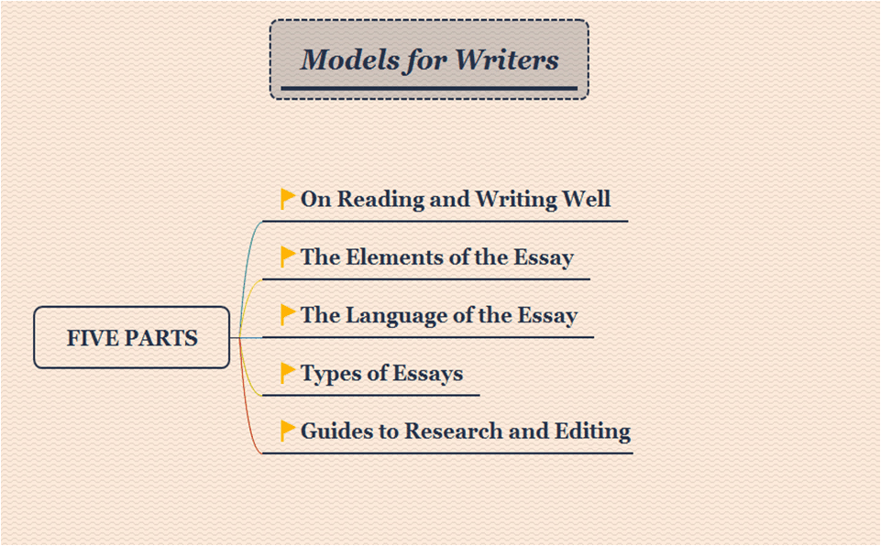

Slide 5
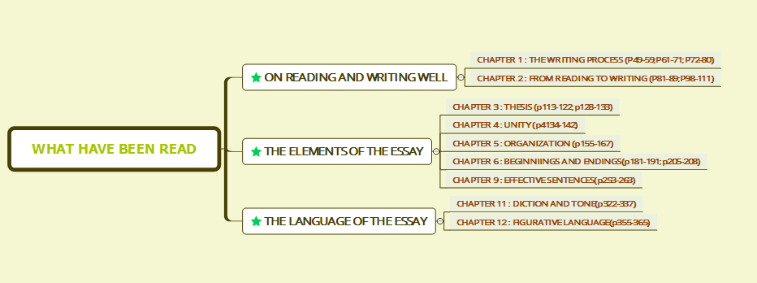
What have been read

Slide 6
感恩遇见，相互成就，本课件资料仅供您个人参考、教学使用，严禁自行在网络传播，违者依知识产权法追究法律责任。
更多教学资源请关注
公众号：溯恩高中英语
知识产权声明

Slide 7
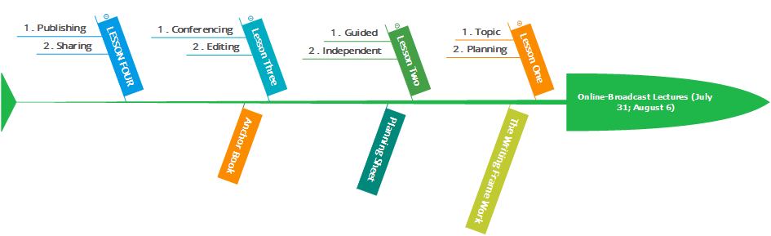
Two online-broadcast lectures
Each week, students conference with a partner.
Read their writings out loud to their partners.
The focus of this conference is not only to give compliments and suggestions, but also to practice their thinking.
Give compliments, receive feedback and practice thinking, like:
A star, A wish and A thing
I really like…
Why don’t you try…

Slide 8
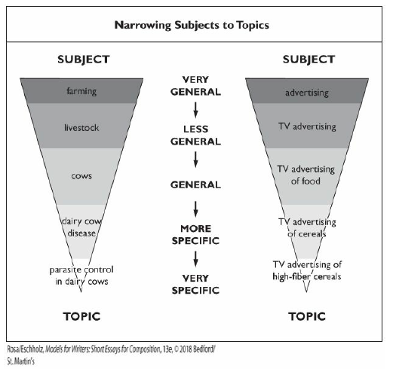
×
√
A successive topic:
Broad one
vs
Narrow one

Slide 9
Prewriting
5
Understand
your
assignment
Develop
your
thesis
1
Choose a
subject
area
and
focus on
a topic
Get
ideas
and
collect
information
(Brainstorm;
Cluster;
Research)
Understand
what
a thesis is
2
3
4
Step 1: Ask Questions
Step 2: List Several Possible Thesis Statements
Step 3: Choose Your Direction
Step 4: Write Your Thesis Statement
Step 5: Revise Your Thesis Statement If Necessary

Slide 10
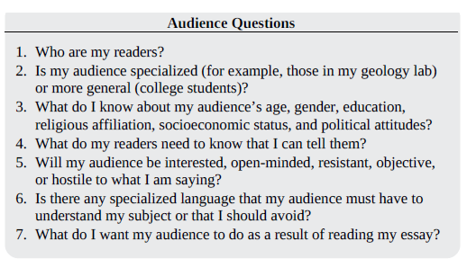
How to know your audience better?

Slide 11

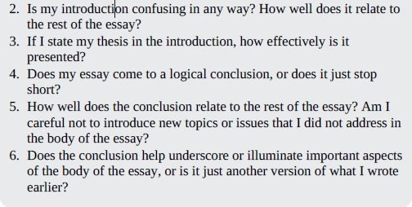
Beginning and Endings

Slide 12
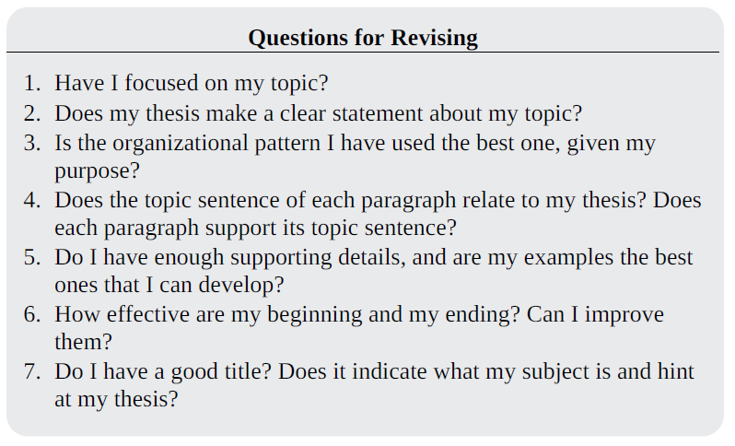
Revise

Slide 13
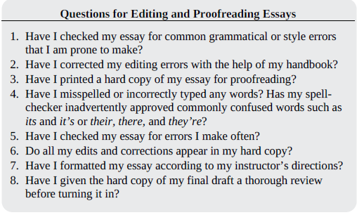
Edit and proofread

Slide 14
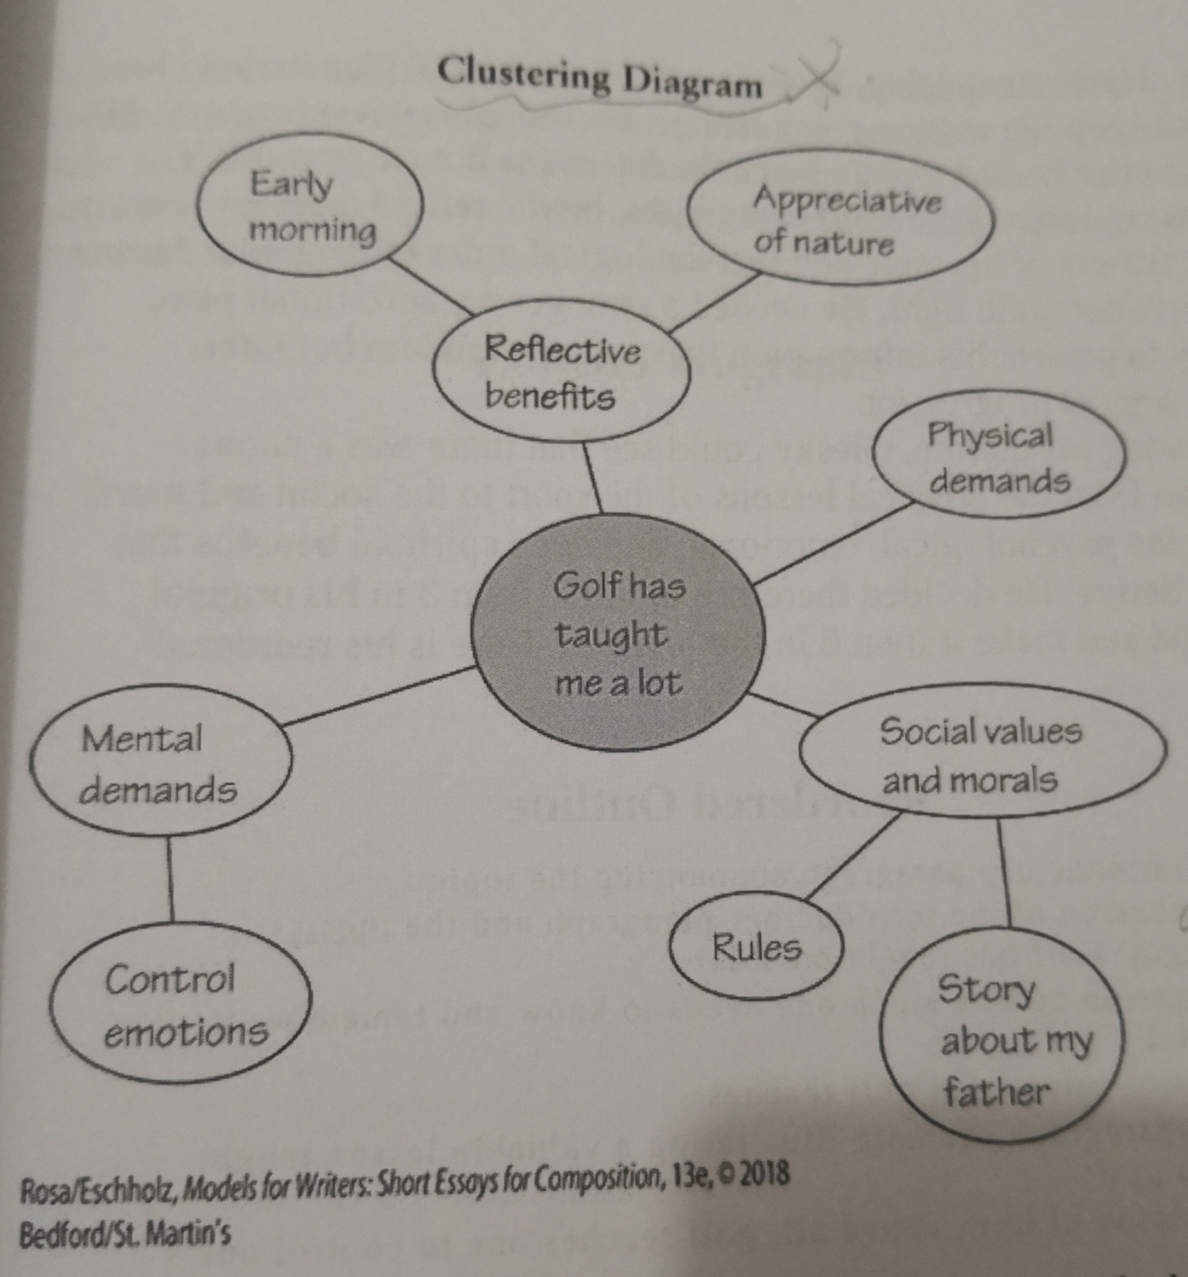
A
Cluster
Example

Slide 15
感恩遇见，相互成就，本课件资料仅供您个人参考、教学使用，严禁自行在网络传播，违者依知识产权法追究法律责任。
更多教学资源请关注
公众号：溯恩高中英语
知识产权声明

Slide 16
Read Critically
1.Prepare to read the selection.
(title;headnote:biographical note,publication information,
rhetorical highlights;writing prompt)
2.Read the selection.(get acquainted with the essay and to form your first impression of it.)
3.Reread the selection.(test your first impression;pay special attention to the author's purpose and means of achieving that purpose;look for features of organization and style.)
4. Annotate the text with marginal notes.
(annotate things that work best.)
5.Analyse and evaluate the text with questions.
(learn from an example of annotating Abraham Lincoln's The Gettysburg Address.)

Slide 17
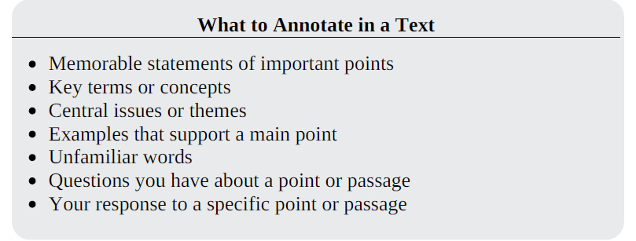
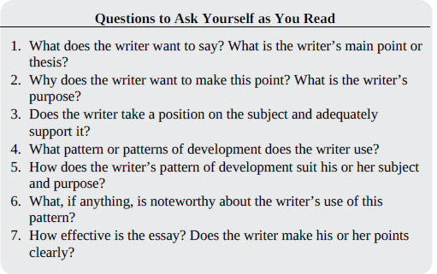

Slide 18
What’s the thesis statement?
the most important point you make about your topic;
debatable, or open to an opposing argument;
more general than the ideas and facts used to support it;
appropriately focused for the length of your paper.

Slide 19
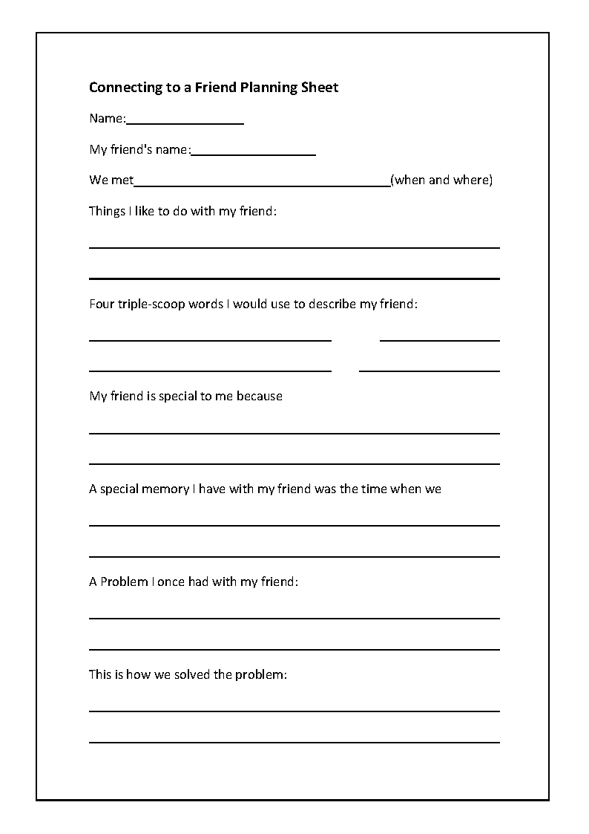
Planning Sheet
Model-1

Slide 20
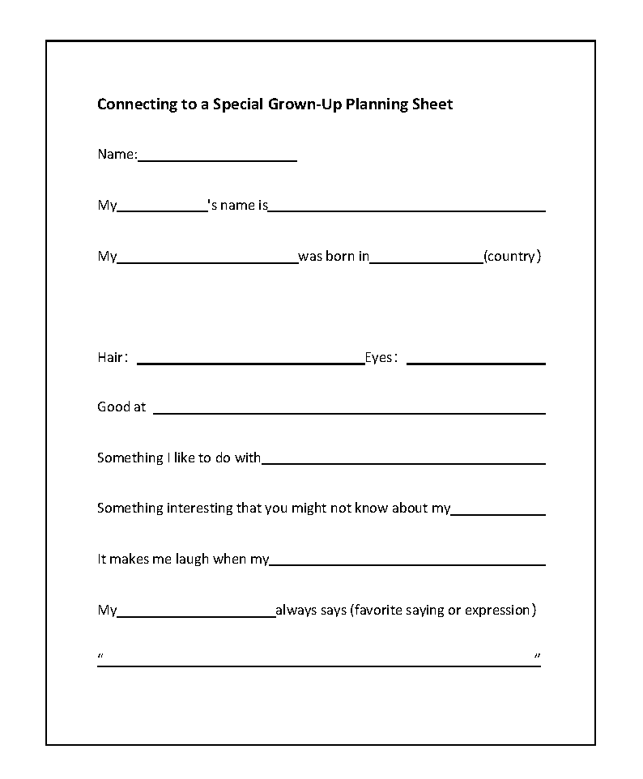
Planning Sheet
Model-2

Slide 21
Tips for Unity
In order to have an effective unity, whether an essay is long or longer, it must avoid digressions and remain close to the author’s main idea and make sure each paragraph in your essay is related to the thesis.

Slide 22
Vivid descriptive languages from A View from the Bridge
1.He was a lumpy little guy with baggy shorts, a faded T-shirt and heavy sweat socks falling down over old sneakers.
2.Partially covering his shaggy blond hair was one of those blue baseball caps with gold braid on the bill and a sailfish patch sewn onto the peak.
3.With my hands on my hips and the sweat dripping from my nose I asked…
4.His belly is almost white and his back is a gunmetal gray. When he jumped he came out of the water about six feet, and his scales caught the sun and flashed it all over the place.
5.I watched as the tarpon began to slowly swim away, tired but still alive.

Slide 23
Effective Ways of Beginnings
Anecdote (a brief narrative drawn from current news events, history, or your personal experience)
Analogy and Comparison (getting readers to think about a topic they might otherwise reject as uninteresting or un familiar.)
Dialogue/Quotation (briefly illustrating a particular attitude or point you want to discuss)
Facts and Statistics (supporting your argument by presenting brief and startling facts or statistics)
Irony or Humor (for entertainment or for unexpected approach to your topic)

Slide 24
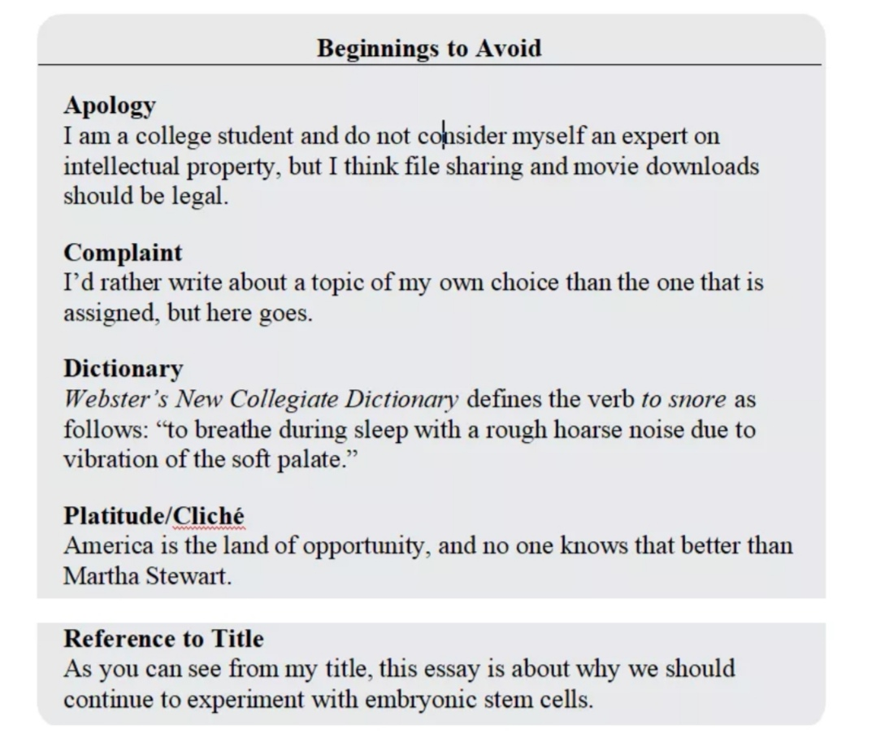
Inappropriate Ways of Beginnings
陈词滥调

Slide 25
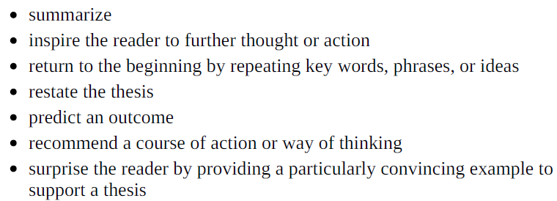
Say farewell to “In summary, Finally, In conclusion…”
but check for a strong and an effective conclusion as follows:

Slide 26
Tips for various effective sentences
Subordination从句(deemphasizing some ideas but highlighting something important. Trying to place the important ideas in main clauses and other ideas go into dependent clauses.)
Periodic and Loose Sentence圆周句和松散句(The main idea is placed at the end, which is called a periodic sentence; Its main idea put at the beginning, which is called a loose sentence)
Dramatically Short Sentences短句(helping drive a point home)
Active and Passive Voice主动和被动语态( Using passive voice when necessary. Remember that active verbs are more vigorous and vivid.)
Coordination并列(simplifying on several facts or ideas )
Parallelism平行结构(Using it when it is coordinated and grammatically the same)

Slide 27
How to be a Master of Diction
Diction: choosing and using precise and appropriate words.
Connnotation and Denotation: denotative meaning is usually facial and literal, while connotative meaning is usually associative or emotional.
Abstract and Concrete Words: abstract words name things nobody can touch with your own feeling exiting in your mind, while concrete words name things we can touch.
General and Specific Words: move back and forth from one to another.
Use more fresh language rather than Cliches(陈词滥调).
Sparingly and carefully use Jargon(术语、行话), easy and interesting languages are preferable.
Tell the situation whether it is formal or informal.

Slide 28
Different kinds of tone
a. Nostalgic(怀旧的);
b. Angry(愤怒的);
c. Sarcastic(讽刺的);
d. Objective or Academic(客观的；学术的);
e. Business or Professional(职业性的);
f. Dramatic(戏剧性的);
g. Ironic(嘲讽的)

Slide 29
Examples of Figurative Language
Essay One: The Flight of the Eagle by N. Scott Momaday
Main idea: the intricate movement of two golden eagle
Vivid descriptive language:
cavort(欢跃), spin(旋转), spiral(盘旋), swoop(俯冲), hover(翱翔), lean(斜靠), swing(转向), feint(佯攻), scream(尖叫)
Essay Two: The Barrio by Robert Ramirez
Features: 20 paragraphs with plain language but profound hidden meaning.
Figures of speech: simile; metaphor; extended metaphor;
personification

Slide 30



Reading for:
Possibility
Progress
Persistence
Pleasure

