Slide 1

感恩遇见，相互成就，本课件资料仅供您个人参考、教学使用，严禁自行在网络传播，违者依知识产权法追究法律责任。
更多教学资源请关注
公众号：溯恩高中英语
知识产权声明

Slide 2
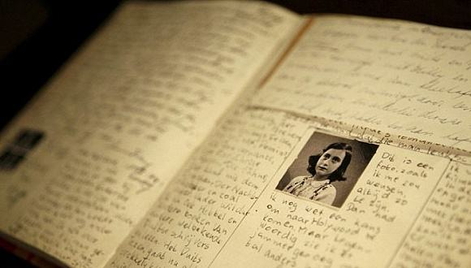
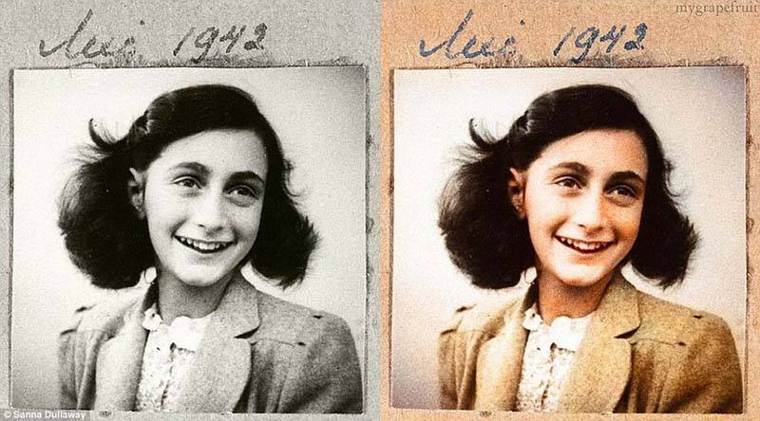
M1U1 Reading Anne’s Best Friend
桐乡市高级中学 俞莺婕

Slide 3
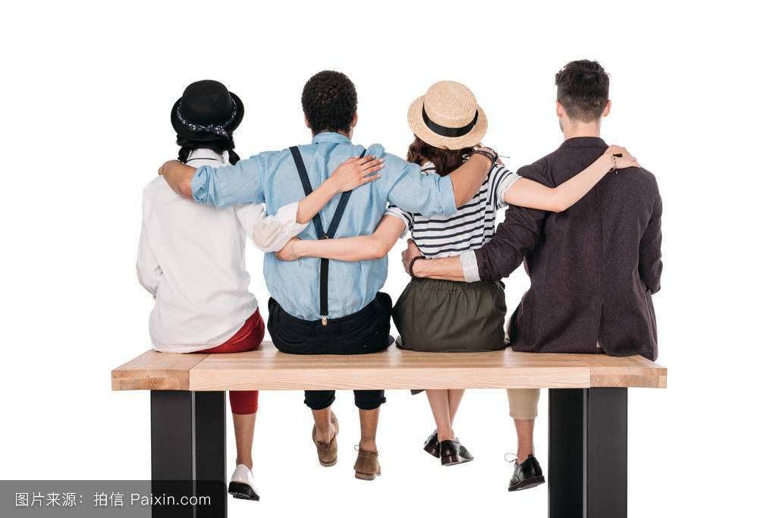
Warming-up
Free-talk
Who/What is your friend?
How do you become friends?
Why do we need friends?

Slide 4
Why do we need friends?
We need friends to ...
^{study with}
^{play with}
^{share with}
^{talk with}

Slide 5
Pre-reading
Prediction
What do you want to know after reading the title?
Who is Anne?
What is her friend?
How did they become friends?
Why is it her best friend?

Slide 6
Reading
Read Paragraph 1 and find out:
What is Anne's friend?
How did they become friends?

Slide 7
Reading
What is Anne's friend?
Do you want a friend whom you could tell everything to, like your deepest feelings and thoughts? Or are you afraid that your friend would laugh at you, or would not understand what you are going through? Anne Frank wanted the first kind, so she made her diary her best friend.
Do you want a friend whom you could tell everything to, like your deepest feelings and thoughts? Or are you afraid that your friend would laugh at you, or would not understand what you are going through? Anne Frank wanted the first kind, so she made her diary her best friend.

Slide 8

Reading
How did they become friends?
FRIDAY, JUNE 12, 1942
I hope I will be able to confide(吐露) everything to you, as I have never been able to confide in anyone, and I hope you will be a great source of comfort and support.(安慰和支持)
...
Do you want a friend whom you could tell everything to, like your deepest feelings and thoughts? Or are you afraid that your friend would laugh at you, or would not understand what you are going through? Anne Frank wanted the first kind, so she made her diary her best friend.
Do you want a friend whom you could tell everything to, like your deepest feelings and thoughts? Or are you afraid that your friend would laugh at you, or would not understand what you are going through? Anne Frank wanted the first kind, so she made her diary her best friend.

Slide 9
感恩遇见，相互成就，本课件资料仅供您个人参考、教学使用，严禁自行在网络传播，违者依知识产权法追究法律责任。
更多教学资源请关注
公众号：溯恩高中英语
知识产权声明

Slide 10
Reading
Background Information
Read Paragraph 2 and find out:
Who is Anne?
Why is it(Kitty) her best friend?

Slide 11
Reading
Background Information
Who is Anne?
Anne lived in Amsterdam in the Netherlands during world war Ⅱ. Her family was Jewish so they had to hide or they would be caught by the German Nazis. She and her family hid away for nearly twenty-five months before they were discovered. During that time, the only true friend was her diary. She said, “I don't want to set down a series of facts in a diary as most people do, but I want this diary itself to be my friend and I shall call my friend kitty.” Now read how she felt after being in the hiding place since July 1942.
Anne lived in Amsterdam in the Netherlands during world war Ⅱ. Her family was Jewish so they had to hide or they would be caught by the German Nazis. She and her family hid away for nearly twenty-five months before they were discovered. During that time, the only true friend was her diary. She said, “I don't want to set down a series of facts in a diary as most people do, but I want this diary itself to be my friend and I shall call my friend kitty.” Now read how she felt after being in the hiding place since July 1942.

Slide 12
Historically…

Slide 13
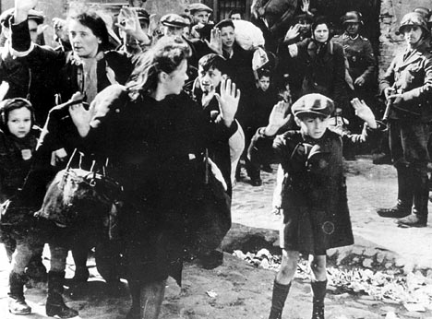
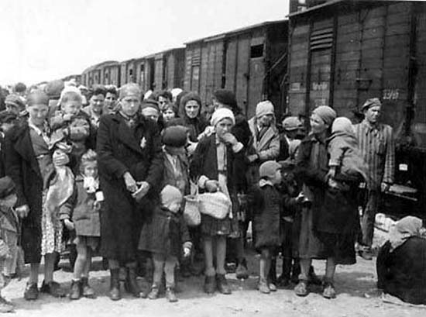
During World War II
Jews were rounded up (围捕) by Nazi soldiers and forced to leave home.
They were gathered and sent to Nazi concentration camps.
(集中营)
Notes:
大卫星（即六芒星，又名大卫之盾、所罗门封印、犹太星），是犹太教和犹太文化的标志。以色列建国后将大卫星放在以色列国旗上，因此大卫星也成为了以色列的象征。大卫王之星与以色列历史上3000年前的大卫王朝有着莫大关系，大卫作王时期，国力强盛。大卫名字之读音，由于希伯来文没有声母，所以“大卫”(David) 应该省去中间的响音'a’ 和 'd'，读成dvd ( 音： da-vic )，头尾都是D。到了距今2000年时，流行使用希腊文，希腊文的D字用大草写的时候就是一个三角形，所以dvd ，D头D尾，书写时就变成了两个三角形，将两个三角形以反方向覆盖，就变成了一个六角星，这就是大卫之星的起源。以色列人把大卫之星放在国旗上，就是表示他们对复兴大卫王朝的盼望

Slide 14
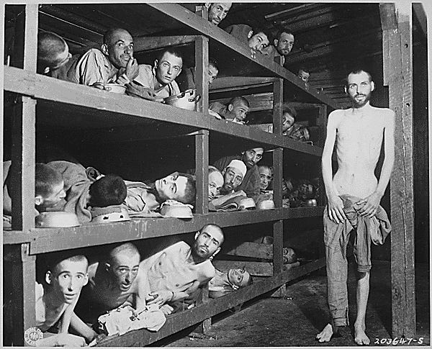
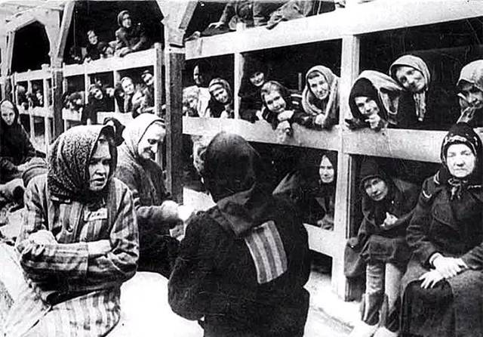
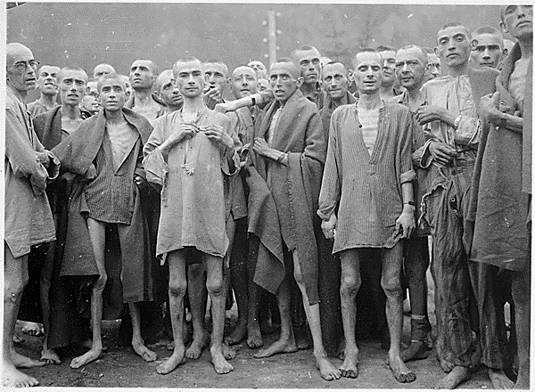
In concentration camps
Men and women were seperated in different camps and each camp was crowded with helpless Jews.
Jews with working ability were forced to work for long hours for Nazis in concentration camps.

Slide 15
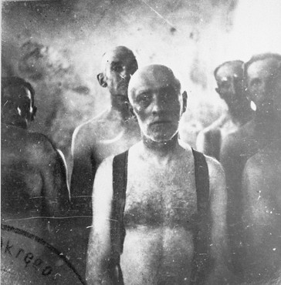
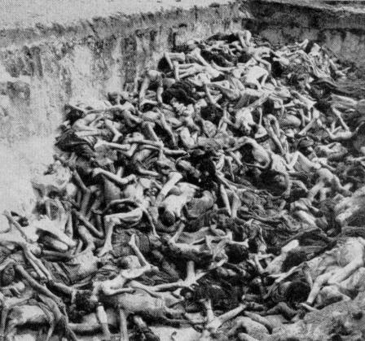
Historically, this massive killing is called the Holocaust. [hɔləkɔ:st]（大屠杀）
At last
The Jews in concentration camps were driven to the gas chambers.
(毒气室)
The remains (尸体) of Jews were put in mass graves.
(万人坑)

Slide 16
Reading
Background Information
Why is it(Kitty) her best friend?
Anne lived in Amsterdam in the Netherlands during world war Ⅱ. Her family was Jewish so they had to hide or they would be caught by the German Nazis. She and her family hid away for nearly twenty-five months before they were discovered. During that time, the only true friend was her diary. She said, “I don't want to set down a series of facts in a diary as most people do, but I want this diary itself to be my friend and I shall call my friend kitty.” Now read how she felt after being in the hiding place since July 1942.
Anne lived in Amsterdam in the Netherlands during world war Ⅱ. Her family was Jewish so they had to hide or they would be caught by the German Nazis. She and her family hid away for nearly twenty-five months before they were discovered. During that time, the only true friend was her diary. She said, “I don't want to set down a series of facts in a diary as most people do, but I want this diary itself to be my friend and I shall call my friend kitty.” Now read how she felt after being in the hiding place since July 1942.

Slide 17
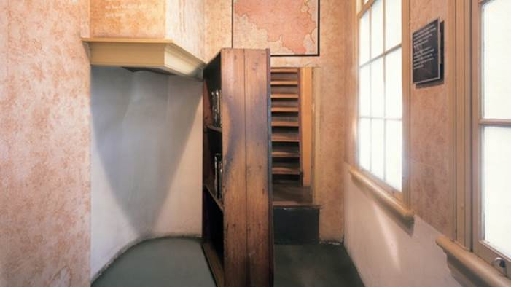
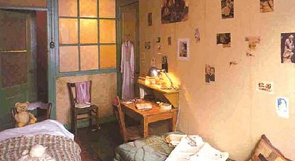
In July 1942, the Franks went into hiding in some secret rooms behind a bookcase in the building where Anne's father worked.
On 13 July 1942, the Franks were joined by the van Pels, and then in November by Fritz Pfeffer, a dentist and friend of the family, which means Anne had to share food and room with new friends. Soon tensions developed and Anne found herself didn't get along well with anyone except her father.

Slide 18

Reading
Anne's Diary
Find the sentence showing the main idea of the text.
I wonder if it’s because I haven’t been able to be outdoors for so long that I’ve grown so crazy about everything to do with nature.
How would Anne explain her craziness about nature?
A. By giving examples B. By listing numbers C. By contrasting
D. By analyzing the cause and effect
To predict:
What will be talked about in the following passage?

Slide 19
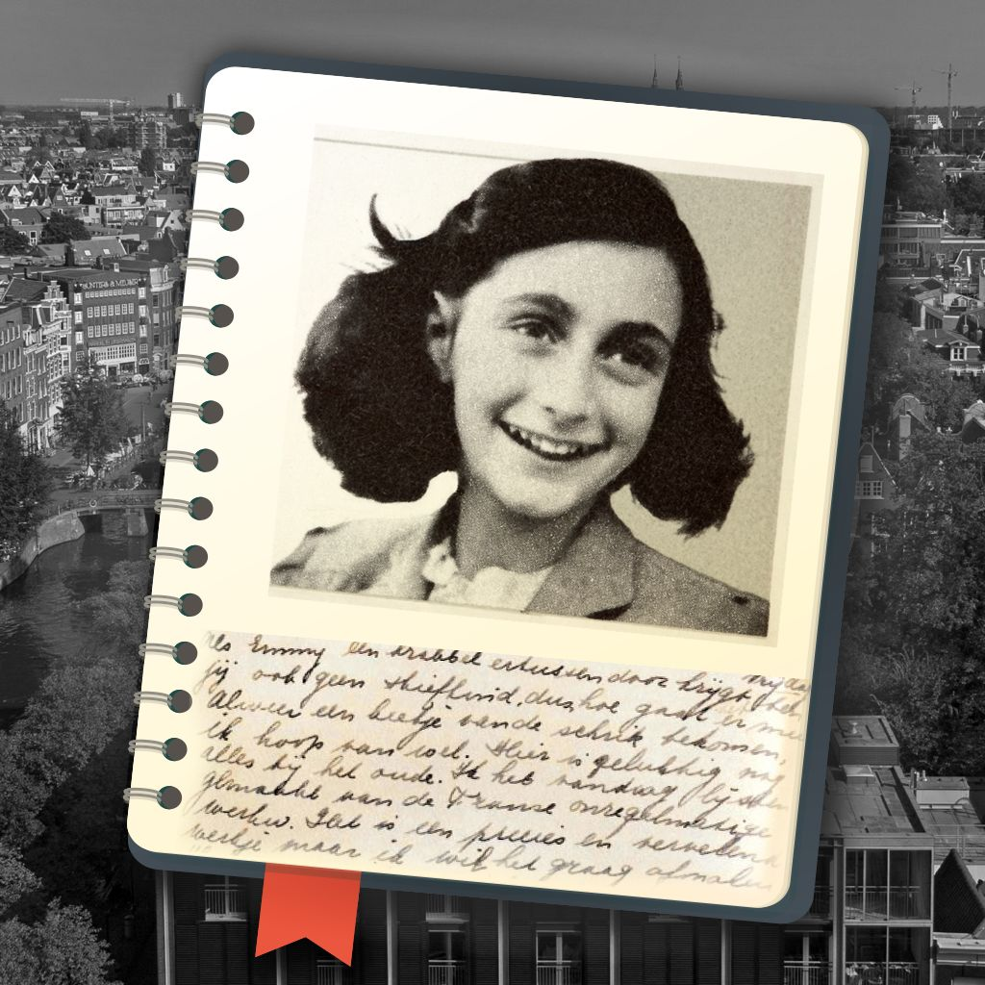
Reading
Anne's Diary
How many examples are there in the passage?

Slide 20
Reading
Anne's Diary
Example 1
I stayed awake on purpose until half past eleven in order to have a good look at the moon by myself.
What is the result?
But as the moon gave far too much light, I didn’t dare open a window.
By saying this, Anne wanted to tell Kitty that_________________.
She wanted to admire the moon badly, but it was a pity that she could only admire the moon through the window.
She was crazy about nature.

Slide 21
Reading
Anne's Diary
Example 2
I happened to be upstairs at dusk when the window was open. I didn’t go downstairs until the window had to be shut.
What is Anne’s feeling?
The dark, rainy evening, the wind, the thundering clouds held me entirely in their power.
By saying this, Anne wanted to tell Kitty that__________________
She was amazed at the dark stormy evening.
She was crazy about nature.

Slide 22

Checking
Anne's Diary
How did Anne explain her craziness about nature?
A. By giving examples B. By listing numbers C. By contrasting
D. By analyzing the cause and effect
Examples are usually used to support the main idea/author's opinion.

Slide 23
before
There was a time when a deep blue sky, the song of the birds, moonlight and flowers could never have kept me spellbound.
now
contrast 对比
The dark, rainy evening, the wind, the thundering clouds held me entirely in their power.
What did the contrast suggest?
I wonder if it’s because I haven’t been able to be outdoors for so long that I’ve grown so crazy about everything to do with nature.
Contrast is usually used to support the main idea /author's opinion.

Slide 24
Thinking
Why did Anne became so crazy about everything to do with nature?
I wonder if it’s because I haven’t been able to be outdoors for so long…
It was the first time in a year and a half that I’d seen the night face to face…
direct reason
indirect reason?

Slide 25
Reading
Anne's Diary
Does the last paragraph also talk about her craziness about nature?
I am only able to look at nature through dirty curtains hanging before dusty windows. It’s no pleasure looking through these any longer because nature is one thing that really must be experienced.
She was looking forward to seeing nature and experiencing it.
She was not only crazy about everything to do with nature.
What she really wanted badly was _____________________.
freedom & peace
indirect reason

Slide 26
Thinking
mind map
Can you draw a mind map of the letter?
beginning
Main idea
support
body
Example1&2
ending
conclusion

Slide 27
感恩遇见，相互成就，本课件资料仅供您个人参考、教学使用，严禁自行在网络传播，违者依知识产权法追究法律责任。
更多教学资源请关注
公众号：溯恩高中英语
知识产权声明

Slide 28
Sharing
Walking with a friend in the dark is better than walking alone in the light. --Helen Keller
Do you agree with Helen Keller?
Can you give an example to support Helen's words?
eg: In the dark, lonely and depressive hiding days, Kitty was the only one Anne could confided to. By recording her thoughts, desires and expectations, Kitty helped divided Anne's grief and doubled her joy.

