Slide 1

感恩遇见，相互成就，本课件资料仅供您个人参考、教学使用，严禁自行在网络传播，违者依知识产权法追究法律责任。
更多教学资源请关注
公众号：溯恩高中英语
知识产权声明

Slide 2
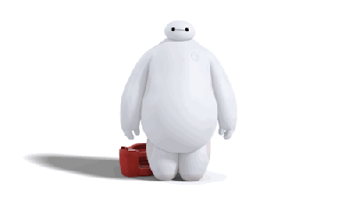
Book7
Unit2
Robot
Robot
Robot
方一曾

Slide 3
What is a robot?
car
robot

Slide 4
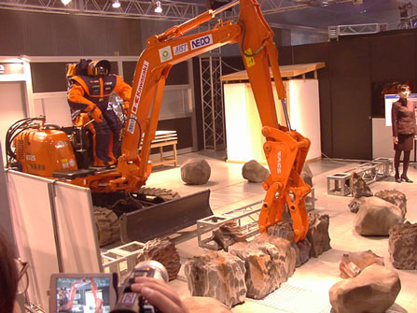
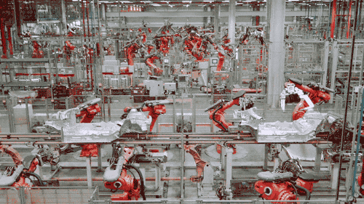
car
robot
Industrial robots

Slide 5
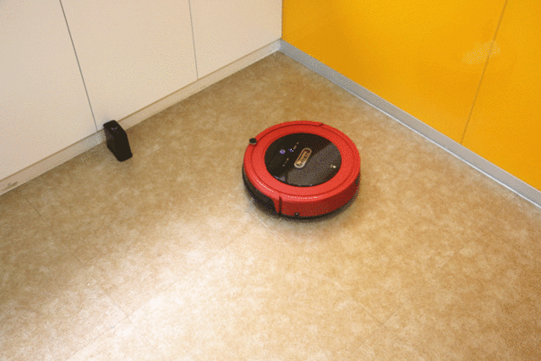
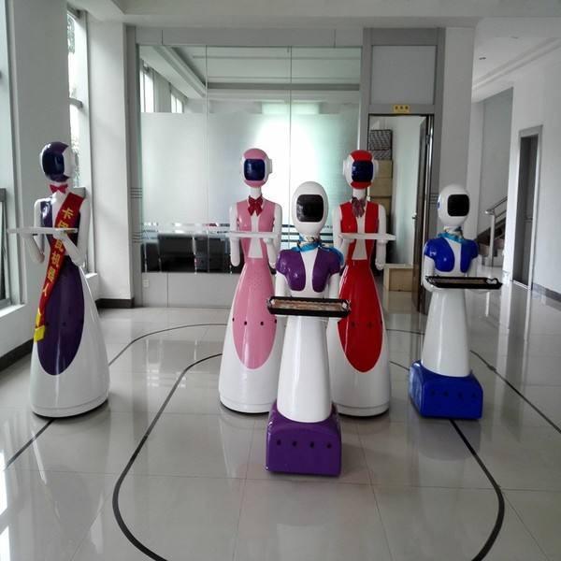
car
robot
household robots

Slide 6
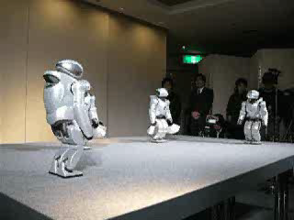
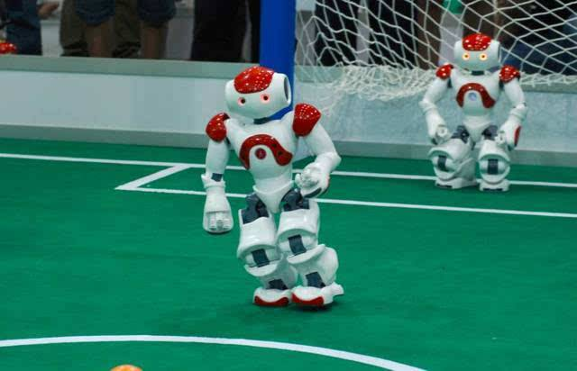
car
robot
entertainment robots

Slide 7
A robot is
A machine _________(design) to do jobs
that
designed
____________(perform) usually by humans.
are performed
Robots are programmed and controlled by a computer.
car
robot

Slide 8

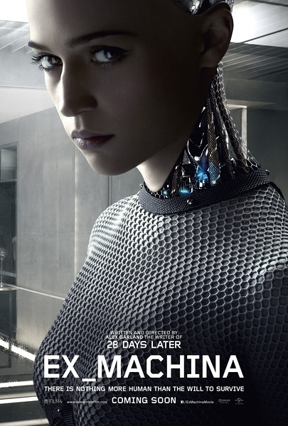

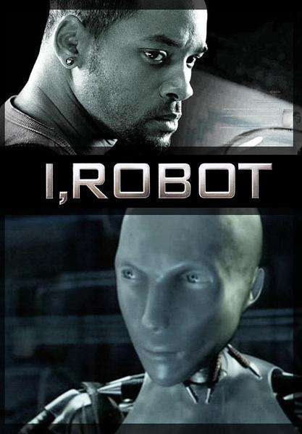


Which kind of robots do you need?
If you have chance to own a robot,
Which robot character do you like?

Slide 9

Share the story about the robot character of any fiction , films, TV, etc
Do you think it is possible for a robot to think, have feelings, have its own desires or feel like a human being?

Slide 10
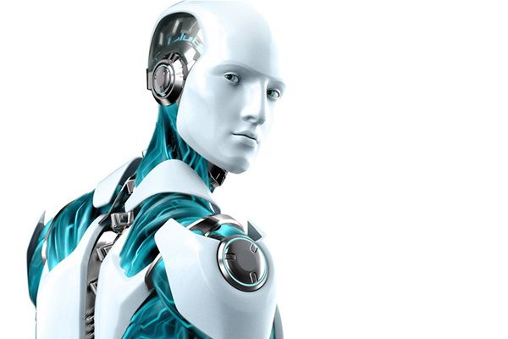
enjoy
story
a
Satisfaction Guaranteed

Slide 11
Reading
Satisfaction Guaranteed
A science fiction story
written in 3rd person

Slide 12






worked for a company that made robots
test out
a household robot
Larry
Tony
Claire
Satisfaction
Skim p1-4 and clarify the relationship between characters
The beginning:
Tony was tested out by Claire in 3 weeks’ absence of Larry.
A housewife
Who is satisfied?
A woman Claire envied
Guaranteed
Gladys

Slide 13



Scan the passage and clear up the plot development
dislike
More like a human than a machine
At first sight
Felt alarmed
tall, handsome , a deep voice
Felt embarrassed
Wanted to help Claire dressing
Looked so human
Disturbed&frightened
Felt ridiculous
trust
Comfort her
Be told many things
Promise to help
The softness & warmth of the skin
Felt absurd/amazed
Just a machine
Felt his warmth
flipped
Carry her in time
At last
(be touched)
Plan a well-prepared party
A machine? A human? A dear?

Slide 14
感恩遇见，相互成就，本课件资料仅供您个人参考、教学使用，严禁自行在网络传播，违者依知识产权法追究法律责任。
更多教学资源请关注
公众号：溯恩高中英语
知识产权声明

Slide 15
Finish the reading and answer the questions
Why did Tony open the curtains?
He wanted Claire’s guests to see him and Claire together so
that she would be envied by women guests .
Robots are programmed and controlled by a computer.
What did Tony mean to Claire at last? What about Tony?
A perfect lover
tall
handsome
capable
clever
sweet
considerate…
A human
with shortcomings
overweight
self-abased
sensible
clumsy
peacockish
…..
An emotionless machine

Slide 16
Further-reading
What would Larry feel knowing the result?
Satisfaction
It is a science fiction story.
Who is satisfied?
Guaranteed
Was that a good ending for Claire? Hadn’t Claire been hurt? Was it a bonus ?
The end:
Claire cried all night.
Tony had to be rebuilt.
The company was pleased.
Larry?
Try to learn the set of 3 “laws” for robot.

Slide 17
Emotion distinguishes human from machine.
Beyond reading
What is the relationship between humans & robots going to be?
Will robots replace humans to live alive?
What make humans different from robots?
Discuss & Share your idea
human1
A producer
A product
robots
A lover
A lover
A helper
human2
A user

Slide 18
Writing
Try to set another ending for the story. The beginning sentence is given : Larry arrived home, seeing Claire’s crying face. __________________________________
__________________________________________________________________________________________

Slide 19
Read for writing
List the sentence expressing different feelings.
When she first saw the robot, she felt alarmed.
It was disturbing and frightening that he looked so human.
She looked at his fingers with wonder as they turned each page and suddenly reached for his hand. she was amazed by his fingernails and the softness and warmth of his skin.
By the amused and surprised look on her face , Claire knew that Gladys thought she was having an affair.
Make use of sentences & expressions to describe Larry’s feeling

Slide 20
Read for writing
List the sentence using –ing form as adverbial or attributive.
On the second morning, Tony, wearing an apron, brought her breakfast and then asked her whether her needed help dressing.
Claire thanked Ton, telling him that he was a “dear”.
Tony folded his arms around her, bending his face close to hers.
He had opened the curtains that night so that the other women would see him and Claire, knowing that there was no risk to Claire’s marriage.
Try to use –ing form to describe an action, a result , a state etc.

Slide 21
A possible version
Larry arrived home, seeing Claire’s crying face. ________________________________________________________________________________________________
________________________________________________________________________________________________________________________________________________
His feet made no sound on the ground, but Claire turned slowly to face him, closing her hands beneath the table. By the embarrassed and sad look on her face, Larry knew that she was worried and fearful. Quietly, settling into the leather seat beside Claire, he held her in his arms softly, whispering “Everything will be fine!”
human

Slide 22
homework
Polish your passage , share the passage with others and discuss what makes up a good story esp. a science fiction story.

Slide 23
Robot movies are not new and have provoked profound thoughts for ages. In 2004 sci-fi film I, Robot, humanoid robots pose a fatal threat to humanity, and the 2009 animated film 9 opens with the near extinction of human beings at the hands of robots. Big Hero chooses to tell a simple but heartwarming story about the bond between humans and a robot.

Slide 24
How did Tony help Claire?
Helped her deal with interpersonal relationship
Gave her a new cut
Change her the makeup
Improve the house’ decoration
Mentally
Physically
Gladys’ misunderstanding
Claire
Have an affair
Tony
Wept with anger
Plan a well-prepared party
Do you think Claire was satisfied with Tony’s performance?
Why Claire called Tony not Larry for help?

Slide 25
感恩遇见，相互成就，本课件资料仅供您个人参考、教学使用，严禁自行在网络传播，违者依知识产权法追究法律责任。
更多教学资源请关注
公众号：溯恩高中英语
知识产权声明

Slide 26
Bye
Bye

