Slide 1
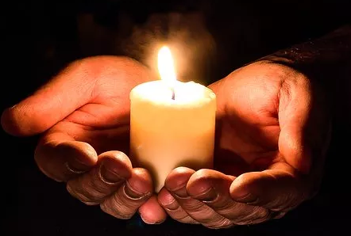
M1U4 Earthquakes
杭州师范大学附属中学
苏殷旦

Slide 2
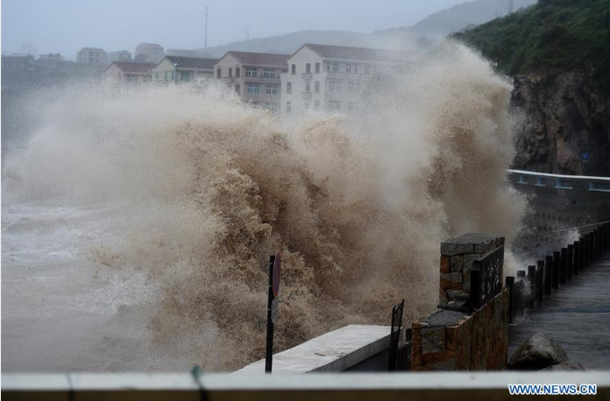
Lead-in
On August 10th, there was a serious disaster in Linhai Taizhou,
Eastern Zhejiang Province.
What was it ?
Typhoon Lekima

Slide 3
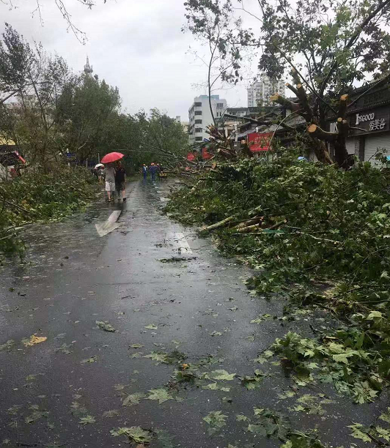
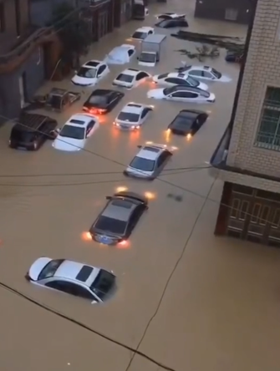
fell down
The traffic was stopped.
Water, food and ________ were hard to get
Trees __________
electricity

Slide 4
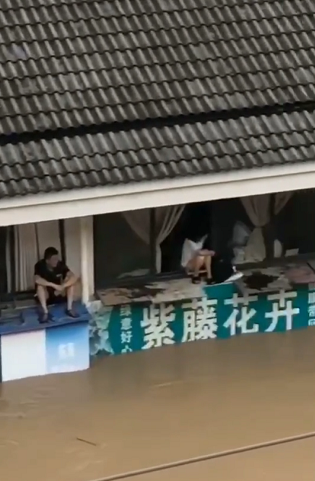
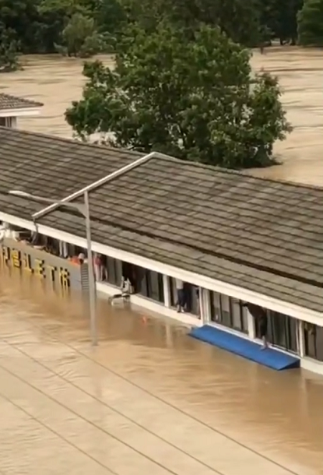
trapped
People were _________there and couldn’t get out in a short time.

Slide 5
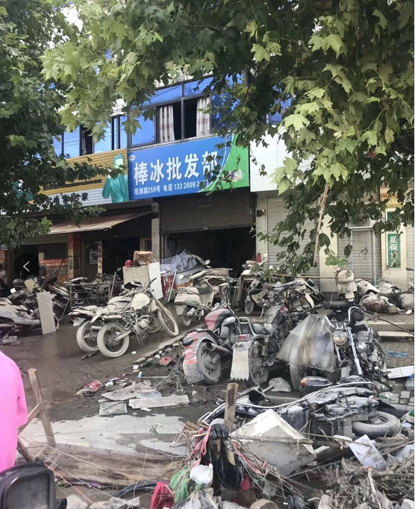
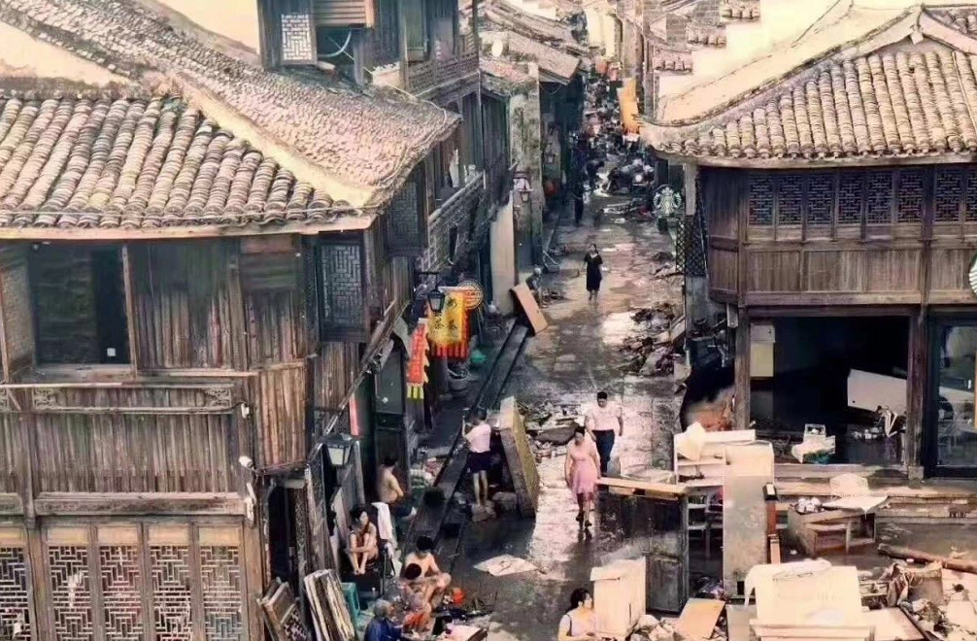
The city was ________.
in ruins

Slide 6
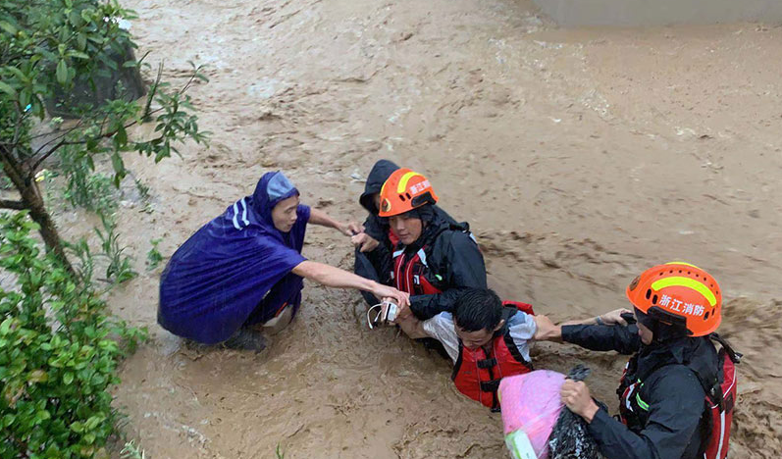
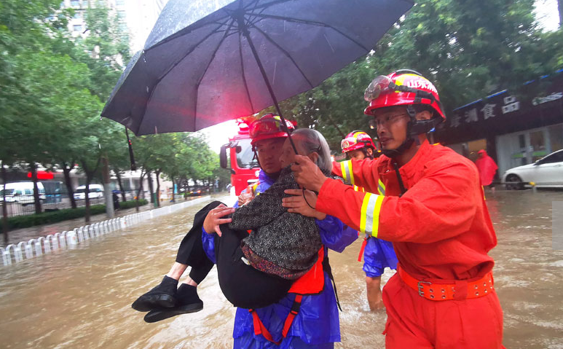
________ helped the trapped people.
Rescuers

Slide 7
A night the earth didn't sleep
Read and Answer
M1U4 Reading
1. What is the writing style of this passage?
An exposition (说明文)
B. An argumentation(议论文)
C. A narration(记叙文)

Slide 8
Read and Answer
2. What is structure of the passage?
3. What is the order of the passage?

Slide 9
1. Strange things were happening in the countryside of northeast Hebei. For three days the water in the village wells rose and fell, rose and fell. Farmers noticed that the well walls had deep cracks in them. A smelly gas came out of the cracks. In the farmyards, the chickens and even the pigs were too nervous to eat. Mice ran out of the fields looking for places to hide. Fish jumped out of their bowls and ponds. At about 3:00 am on July 28,1976,some people saw bright lights in the sky. The sound of planes could be heard outside the city of Tangshan even when no planes were in the sky. In the city, the water pipes in some buildings cracked and burst. But the one million people of the city, who thought little of these events, were asleep as usual that night.
2. At 3:42 am everything began to shake. It seemed as if the world was at an end! Eleven kilometers directly below the city the greatest earthquake of the 20th century had begun. It was felt in Beijing, which is more than two hundred kilometers away. One-third of the nation felt it. A huge crack that was eight kilometers long and thirty meters wide cut across houses, roads and canals. Steam burst from holes in the ground. Hard hills of rock became rivers of dir. In fifteen terrible seconds a large city lay in ruins. The suffering of the people was extreme. Two-thirds of them died or were left without parents. The number of people who were killed or injured reached more than 400,000.
3. But how could the survivors believe it was natural? Everywhere they looked nearly everything was destroyed. All of the city's hospitals,75%of its factories and buildings and 90% of its homes were gone. Bricks covered the ground like red autumn leaves. No wind, however, could blow them away. Two dams fell and most of the bridges also fell or were not safe for travelling. The railway tracks were now useless pieces of steel. Tens of thousands of cows would never give milk again. Half a million pigs and millions of chickens were dead. Sand now filled the wells instead of water .People were shocked. Then, later that afternoon, another big quake which was almost as strong as the first one shook Tangshan. Some of the rescue workers and doctors were trapped under the ruins. More buildings fell down. Water,food,and electricity were hard to get. People began to wonder how long the disaster would last.
4. All hope was not lost. Soon after the quakes, the army sent 150,000 soldiers to Tangshan to help the rescue workers. Hundreds of thousands of people were helped. The army organized teams to dig out those who were trapped and to bury the dead. To the north of the city, most of the 10,000 miners were rescued from the coal mines there. Workers built shelters for survivors whose homes had been destroyed. Fresh water was taken to the city by train, truck and plane. Slowly, the city began to breathe again.
Before the earthquake
Part 1(para 1）:_________________
time
Part 2(para 2-3）:_________________
During the earthquake
Part 3(para 4）_________________
After the earthquake

Slide 10
Read for Beginning—Para 1
?
Strange things were happening in the countryside of northeast Hebei. For three days the water in the village wells rose and fell, rose and fell. Farmers noticed that the well walls had deep cracks in them. A smelly gas came out of the cracks. In the farmyards, the chickens and even the pigs were too nervous to eat. Mice ran out of the fields looking for places to hide. Fish jumped out of their bowls and ponds. At about 3:00 am on July 28,1976, some people saw bright lights in the sky. The sound of planes could be heard outside the city of Tangshan even when no planes were in the sky. In the city, the water pipes in some buildings cracked and burst. But the one million people of the city, who thought little of these events, were asleep as usual that night.
Strange things were happening in the countryside of northeast Hebei.
Topic sentence?

Slide 11
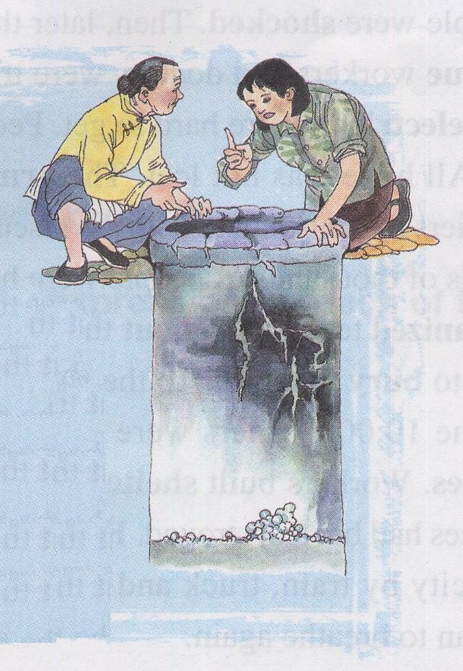
Read for Beginning—Para 1
Strange things were happening in the countryside of northeast Hebei. ①For three days the _____ in the village wells________________________. ②Farmers noticed that the well walls had deep cracks in them.③ A smelly gas came out of the cracks. ④ In the farmyards, the chickens and even the pigs were too nervous to eat. ⑤Mice ran out of the fields looking for places to hide.⑥Fish jumped out of their bowls and ponds. ⑦At about 3:00 am on July 28,1976, some people saw bright lights in the sky. ⑧The sound of planes could be heard outside the city of Tangshan even when no planes were in the sky. ⑨In the city, the water pipes in some buildings cracked and burst. But the one million people of the city, who thought little of these events, were asleep as usual that night.
water
rose and fell, rose and fell

Slide 12
Read for Beginning—Para 1
Strange things were happening in the countryside of northeast Hebei. ①For three days the water in the village wells rose and fell, rose and fell. ②Farmers noticed that the well walls had____________in them.③ A smelly gas came out of the cracks. ④ In the farmyards, the chickens and even the pigs were too nervous to eat. ⑤Mice ran out of the fields looking for places to hide.⑥Fish jumped out of their bowls and ponds. ⑦At about 3:00 am on July 28,1976, some people saw bright lights in the sky. ⑧The sound of planes could be heard outside the city of Tangshan even when no planes were in the sky. ⑨In the city, the water pipes in some buildings cracked and burst. But the one million people of the city, who thought little of these events, were asleep as usual that night.
deep cracks

Slide 13
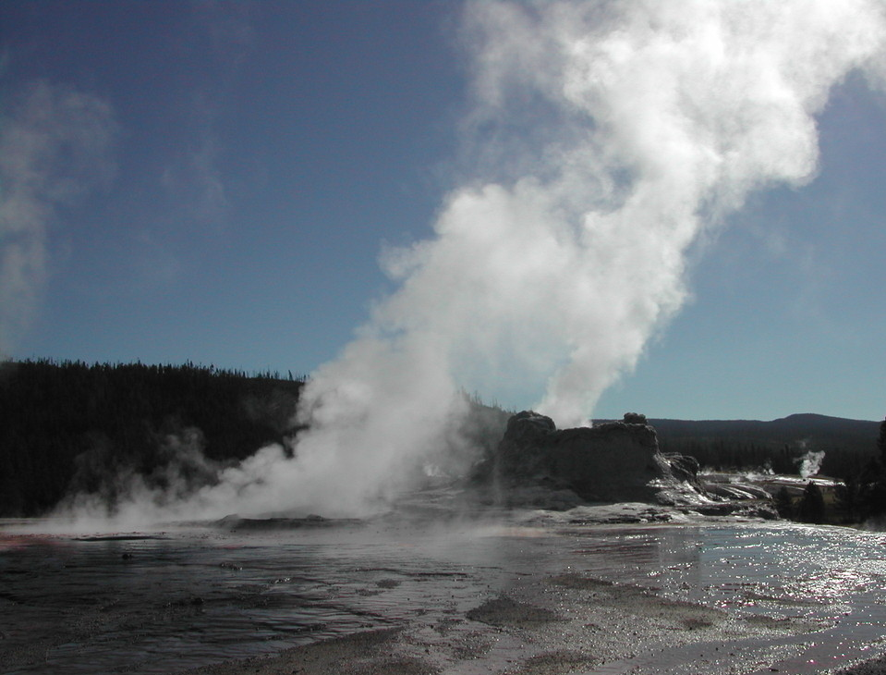
Read for Beginning—Para 1
Strange things were happening in the countryside of northeast Hebei. ①For three days the water in the village wells rose and fell, rose and fell. ②Farmers noticed that the well walls had deep cracks in them. ③ A smelly gas _____________________④ In the farmyards, the chickens and even the pigs were too nervous to eat. ⑤Mice ran out of the fields looking for places to hide.⑥Fish jumped out of their bowls and ponds. ⑦At about 3:00 am on July 28,1976, some people saw bright lights in the sky. ⑧The sound of planes could be heard outside the city of Tangshan even when no planes were in the sky. ⑨In the city, the water pipes in some buildings cracked and burst. But the one million people of the city, who thought little of these events, were asleep as usual that night.
came out of the cracks

Slide 14
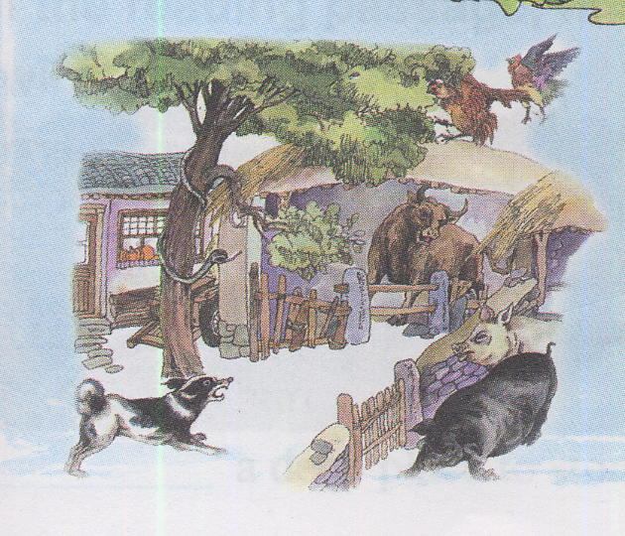
Read for Beginning—Para 1
Strange things were happening in the countryside of northeast Hebei. ①For three days the water in the village wells rose and fell, rose and fell. ②Farmers noticed that the well walls had deep cracks in them.③ A smelly gas came out of the cracks. ④ In the farmyards, ___________ and even ________ were too nervous to eat. ⑤Mice ran out of the fields looking for places to hide.⑥Fish jumped out of their bowls and ponds. ⑦At about 3:00 am on July 28,1976, some people saw bright lights in the sky. ⑧The sound of planes could be heard outside the city of Tangshan even when no planes were in the sky. ⑨In the city, the water pipes in some buildings cracked and burst. But the one million people of the city, who thought little of these events, were asleep as usual that night.
the chickens
the pigs

Slide 15
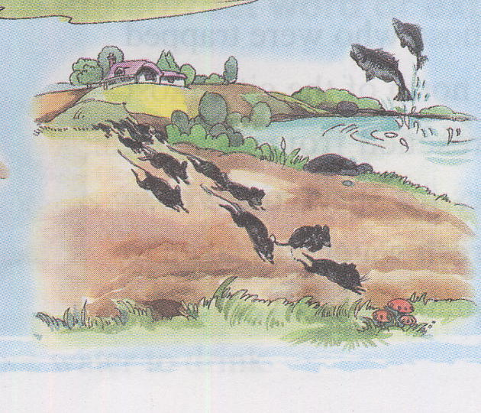
Read for Beginning—Para 1
Strange things were happening in the countryside of northeast Hebei. ①For three days the water in the village wells rose and fell, rose and fell. ②Farmers noticed that the well walls had deep cracks in them.③ A smelly gas came out of the cracks. ④ In the farmyards, the chickens and even the pigs were too nervous to eat. ⑤Mice __________________ looking for places to hide.⑥Fish jumped out of their bowls and ponds. ⑦At about 3:00 am on July 28,1976, some people saw bright lights in the sky. ⑧The sound of planes could be heard outside the city of Tangshan even when no planes were in the sky. ⑨In the city, the water pipes in some buildings cracked and burst. But the one million people of the city, who thought little of these events, were asleep as usual that night.
ran out of the fields

Slide 16
Read for Beginning—Para 1
Strange things were happening in the countryside of northeast Hebei. ①For three days the water in the village wells rose and fell, rose and fell. ②Farmers noticed that the well walls had deep cracks in them.③ A smelly gas came out of the cracks. ④ In the farmyards, the chickens and even the pigs were too nervous to eat. ⑤Mice ran out of the fields looking for places to hide.⑥Fish ______________their bowls and ponds. ⑦At about 3:00 am on July 28,1976, some people saw bright lights in the sky. ⑧The sound of planes could be heard outside the city of Tangshan even when no planes were in the sky. ⑨In the city, the water pipes in some buildings cracked and burst. But the one million people of the city, who thought little of these events, were asleep as usual that night.
jumped out of

Slide 17
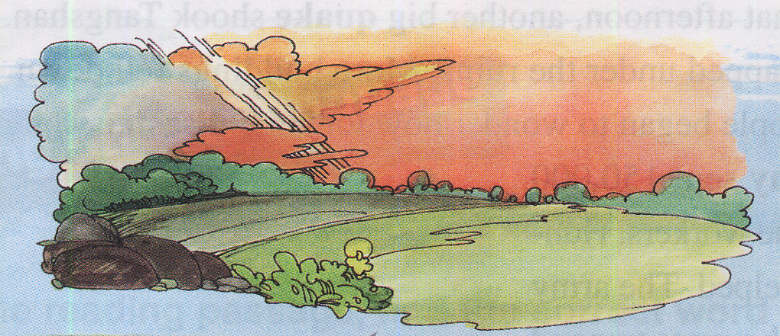
Read for Beginning—Para 1
Strange things were happening in the countryside of northeast Hebei. ①For three days the water in the village wells rose and fell, rose and fell. ②Farmers noticed that the well walls had deep cracks in them.③ A smelly gas came out of the cracks. ④ In the farmyards, the chickens and even the pigs were too nervous to eat. ⑤Mice ran out of the fields looking for places to hide.⑥Fish jumped out of their bowls and ponds. ⑦At about 3:00 am on July 28,1976, some people saw ___________ in the sky. ⑧The sound of planes could be heard outside the city of Tangshan even when no planes were in the sky. ⑨In the city, the water pipes in some buildings cracked and burst. But the one million people of the city, who thought little of these events, were asleep as usual that night.
bright lights

Slide 18
Read for Beginning—Para 1
Strange things were happening in the countryside of northeast Hebei. ①For three days the water in the village wells rose and fell, rose and fell. ②Farmers noticed that the well walls had deep cracks in them.③ A smelly gas came out of the cracks. ④ In the farmyards, the chickens and even the pigs were too nervous to eat. ⑤Mice ran out of the fields looking for places to hide.⑥Fish jumped out of their bowls and ponds. ⑦At about 3:00 am on July 28,1976, some people saw bright lights in the sky. ⑧The sound of planes could be heard outside the city of Tangshan even when no planes were in the sky. ⑨In the city, the water pipes in some buildings cracked and burst. But the one million people of the city, who thought little of these events, were asleep as usual that night.

Slide 19
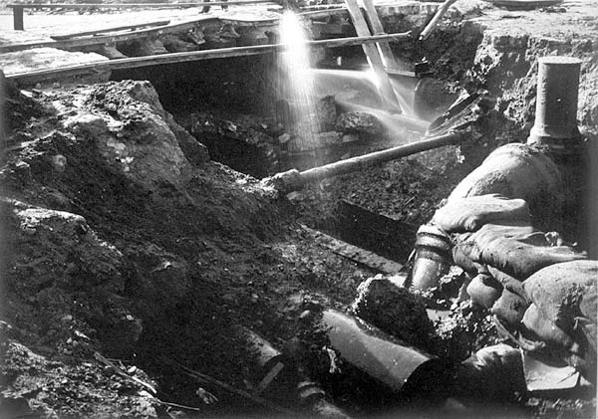
Read for Beginning—Para 1
Strange things were happening in the countryside of northeast Hebei. ①For three days the water in the village wells rose and fell, rose and fell. ②Farmers noticed that the well walls had deep cracks in them.③ A smelly gas came out of the cracks. ④ In the farmyards, the chickens and even the pigs were too nervous to eat. ⑤Mice ran out of the fields looking for places to hide.⑥Fish jumped out of their bowls and ponds. ⑦At about 3:00 am on July 28,1976, some people saw bright lights in the sky. ⑧The sound of planes could be heard outside the city of Tangshan even when no planes were in the sky. ⑨In the city, the water pipes in some buildings _______ and _______. But the one million people of the city, who thought little of these events, were asleep as usual that night.
pipe
cracked burst

Slide 20
Read for Beginning—Para 1
Strange things were happening in the countryside of northeast Hebei. ①For three days the water in the village wells rose and fell, rose and fell. ②Farmers noticed that the well walls had deep cracks in them.③ A smelly gas came out of the cracks. ④ In the farmyards, the chickens and even the pigs were too nervous to eat. ⑤Mice ran out of the fields looking for places to hide.⑥Fish jumped out of their bowls and ponds. ⑦At about 3:00 am on July 28,1976, some people saw bright lights in the sky. ⑧The sound of planes could be heard outside the city of Tangshan even when no planes were in the sky. ⑨In the city, the water pipes in some buildings cracked and burst. But the one million people of the city, who thought little of these events, were asleep as usual that night.
Strange things were happening in the countryside of northeast Hebei.
Strange Signs

Slide 21
Read for Beginning—Para 1
Strange things were happening in the countryside of northeast Hebei. ①For three days the water in the village wells rose and fell, rose and fell. ②Farmers noticed that the well walls had deep cracks in them.③ A smelly gas came out of the cracks. ④ In the farmyards, the chickens and even the pigs were too nervous to eat. ⑤Mice ran out of the fields looking for places to hide.⑥Fish jumped out of their bowls and ponds. ⑦At about 3:00 am on July 28,1976, some people saw bright lights in the sky. ⑧The sound of planes could be heard outside the city of Tangshan even when no planes were in the sky. ⑨In the city, the water pipes in some buildings cracked and burst. But the one million people of the city, who thought little of these events, were asleep as usual that night.
But the one million people of the city, who thought little of these events, were asleep as usual that night.
Tansitional Sentence
Function?

Slide 22
Read for Beginning—Para 1
Topic Sentence
Strange things were happening in the countryside of northeast Hebei. ①For three days the water in the village wells rose and fell, rose and fell. ②Farmers noticed that the well walls had deep cracks in them.③ A smelly gas came out of the cracks. ④ In the farmyards, the chickens and even the pigs were too nervous to eat. ⑤Mice ran out of the fields looking for places to hide.⑥Fish jumped out of their bowls and ponds. ⑦At about 3:00 am on July 28,1976, some people saw bright lights in the sky. ⑧The sound of planes could be heard outside the city of Tangshan even when no planes were in the sky. ⑨In the city, the water pipes in some buildings cracked and burst. But the one million people of the city, who thought little of these events, were asleep as usual that night.
Strange things were happening in the countryside of northeast Hebei.
Supporting Sentences
Transitional Sentences

Slide 23
Read for Beginning—Para 1
Strange
Strange things were happening in the countryside of northeast Hebei. ①For three days the water in the village wells rose and fell, rose and fell. ②Farmers noticed that the well walls had deep cracks in them.③ A smelly gas came out of the cracks. ④ In the farmyards, the chickens and even the pigs were too nervous to eat. ⑤Mice ran out of the fields looking for places to hide.⑥Fish jumped out of their bowls and ponds. ⑦At about 3:00 am on July 28,1976, some people saw bright lights in the sky. ⑧The sound of planes could be heard outside the city of Tangshan even when no planes were in the sky. ⑨In the city, the water pipes in some buildings cracked and burst. But the one million people of the city, who thought little of these events, were asleep as usual that night.
Strange things were happening in the countryside of northeast Hebei.
a common way of expressing unusual things
contrast
People’s ignorance of these unusual things
thought little of
as usual
The sharp contrast between the commonly unusual signs and people’s usual behaviors futher implies the huge cost and negative impacts the earthquake brings to the city
Function?

Slide 24
Read for Developing —Para 2-3
2. At 3:42 am everything began to shake. It seemed as if the world was at an end! Eleven kilometers directly below the city the greatest earthquake of the 20th century had begun. It was felt in Beijing, which is more than two hundred kilometers away. One-third of the nation felt it. A huge crack that was eight kilometers long and thirty meters wide cut across houses, roads and canals. Steam burst from holes in the ground. Hard hills of rock became rivers of dir. In fifteen terrible seconds a large city lay in ruins. The suffering of the people was extreme. Two-thirds of them died or were left without parents. The number of people who were killed or injured reached more than 400,000.
3. But how could the survivors believe it was natural? Everywhere they looked nearly everything was destroyed. All of the city's hospitals,75%of its factories and buildings and 90% of its homes were gone. Bricks covered the ground like red autumn leaves. No wind, however, could blow them away. Two dams fell and most of the bridaes also fell or were not safe for travelling. The railway tracks were now useless pieces of steel. Tens of thousands of cows would never give milk again. Half a million pigs and millions of chickens were dead. Sand now filled the wells instead of water .People were shocked. Then, later that afternoon, another big quake which was almost as strong as the first one shook Tangshan. Some of the rescue workers and doctors were trapped under the ruins. More buildings fell down. Water, food,and electricity were hard to get. People began to wonder how long the disaster would last.
How does the author express the severity of the earthquake?

Slide 25
Read for Developing —Para 2-3
2. At 3:42 am everything began to shake. It seemed as if the world was at an end! Eleven kilometers directly below the city the greatest earthquake of the 20th century had begun. It was felt in Beijing, which is more than two hundred kilometers away. One-third of the nation felt it. A huge crack that was eight kilometers long and thirty meters wide cut across houses, roads and canals. Steam burst from holes in the ground. Hard hills of rock became rivers of dir. In fifteen terrible seconds a large city lay in ruins. The suffering of the people was extreme. Two-thirds of them died or were left without parents. The number of people who were killed or injured reached more than 400,000.
everything began to shake
which is more than two hundred
kilometers away. One-third of the nation
A huge crack
eight
kilometers long and thirty meters wide
In fifteen terrible seconds a large city lay in ruins
The suffering of the people
was extreme. Two-thirds
reached more than 400,000.
The extent of the earthquake
An unbelievable amount of loss
The severity of the earthquake

Slide 26
Read for Developing —Para 2-3
3. But how could the survivors believe it was natural? Everywhere they looked nearly everything was destroyed. All of the city's hospitals,75% of its factories and buildings and 90% of its homes were gone. Bricks covered the ground like red autumn leaves. No wind, however, could blow them away. Two dams fell and most of the bridaes also fell or were not safe for travelling. The railway tracks were now useless pieces of steel. Tens of thousands of cows would never give milk again. Half a million pigs and millions of chickens were dead. Sand now filled the wells instead of water .People were shocked. Then, later that afternoon, another big quake which was almost as strong as the first one shook Tangshan. Some of the rescue workers and doctors were trapped under the ruins. More buildings fell down. Water, food,and electricity were hard to get. People began to wonder how long the disaster would last.
But how could the survivors believe it was natural?
was destroyed
Did people have time to shock?
were gone
fell
fell
(v.) to keep sb in a dangerous place or bad situation
that they want to get out of but cannot
never give milk again
were dead
Then, later that afternoon, another big quake
trapped
Some of the rescue workers and doctors were trapped
More buildings fell down
were hard to get
wonder how long the disaster would last.
desperate and hopeless

Slide 27
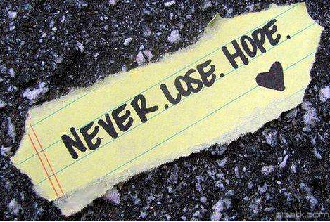
Read for Resolution—Para 4
All hope was not lost.
4. All hope was not lost. Soon after the quakes, the army sent 150,000 soldiers to Tangshan to help the rescue workers. Hundreds of thousands of people were helped. The army organized teams to dig out those who were trapped and to bury the dead. To the north of the city, most of the 10,000 miners were rescued from the coal mines there. Workers built shelters for survivors whose homes had been destroyed. Fresh water was taken to the city by train, truck and plane. Slowly, the city began to breathe again.
sent
help
organized
dig out
bury
were rescued
built shelters
was taken to
Why?
A series of actions bring hope to the earthquake-stricken areas

Slide 28
Read for Numbers —Para 1-4
Sentence examples
Function
At about 3:00 am on July 28,1976
● _____________________________, some people saw bright lights in the sky.
●At _________ everything began to shake.
exact time
Indicate the ____________of the earthquake
3:42 am
1/3
● ________nation felt it.
● In ___________ a large city lay in ruins.
● ______________of them died or were left without parents.
● _________________ of people were killed or injured.
● ______ of its factories and buildings and _____of its homes were gone.
15 seconds
Numbers
Convincing
2/3
the severity
Indicate the ___________of the earthquake
More than 400,000
75%
90%
150,000
●________soldiers were sent to Tangshan to help the rescue
workers.
● ______________________ of people were helped.
● _________________miners were rescued
hope
Indicate the ___________after the earthquake
Hundreds of thousands
most of the 10,000

Slide 29
Further Thinking
1. Can you think of a title for the passage? Give your reasons
A Night the Earth Didn’t Sleep
Figure of Speech ?
Personification
Unusual time for sleep due to the disastrous earthquake
Usually time for sleep

Slide 30
Read for Appreciation
Sentence | Figures of Speech | Function
For three days the water in the village wells rose and fell, rose and fell.
Repetition
to make a deeper impression on the reader
It seemed that the world was at an end!
to emphasize the seriousness of the disaster and people’s desperation
Exaggeration
Bricks covered the ground like red autumn leaves.
Simile
to create a vivid image of the ruins
Slowly, very slowly, the city began to breathe again.
Personification
to create a vivid image

Slide 31
Homework
Try to imitate Para 1 and write your own experience of a natural disaster in a short paragraph with the words given, at least five.
burst, pipes, at an end, in ruins, suffering, injured, disaster, electricity, dig out, shelter...
________________________________________________________
________________________________________________________
________________________________________________________

