Slide 1

感恩遇见，相互成就，本课件资料仅供您个人参考、教学使用，严禁自行在网络传播，违者依知识产权法追究法律责任。
更多教学资源请关注
公众号：溯恩高中英语
知识产权声明

Slide 2
Strive to be your better self !
Spring into action
Take responsibilities
Rise to the challenges
Inspire imagination
Venture into new boundaries
Enjoy the thrill of exploration
——2019年秋季开学第一课
浙江省常山一中 吴俊峰

Slide 3
What was your summer holiday plan?
How was it carried out?
Nature
entertainment activities
volunteer activities
Society
Self
sport exercise
Your Summer holiday
reading
travelling

Slide 4
Content
People and Nature
人与自然
01
Garbage classification
垃圾分类
People and Self
人与自我
02
Chinese animated film Ne Zha 中国动画片《哪吒》
People and Society
人与社会
03
Archaeological Ruins of Liangzhu Ancient City
良渚古城遗址

Slide 5
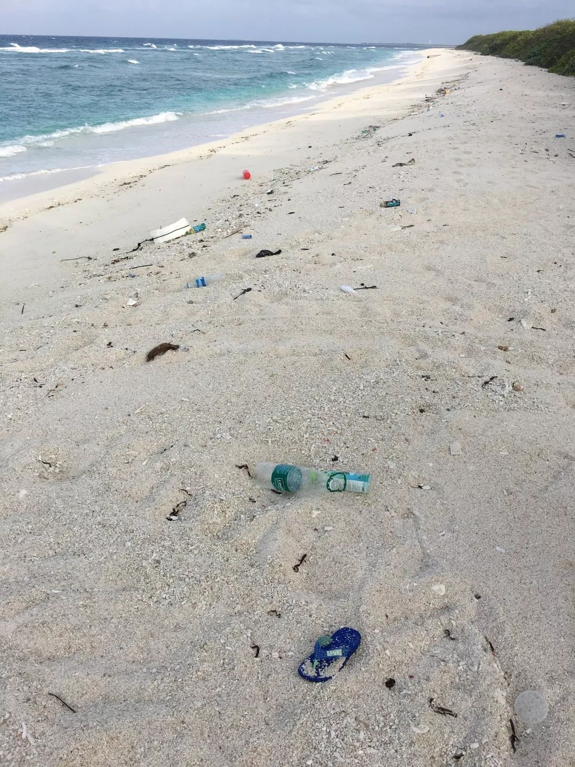
Why should we execute garbage classification ?
/'eksɪkjuːt/ vt. 实行；执行
01
Nature
A lot of garbages are found on the beach.

Slide 6
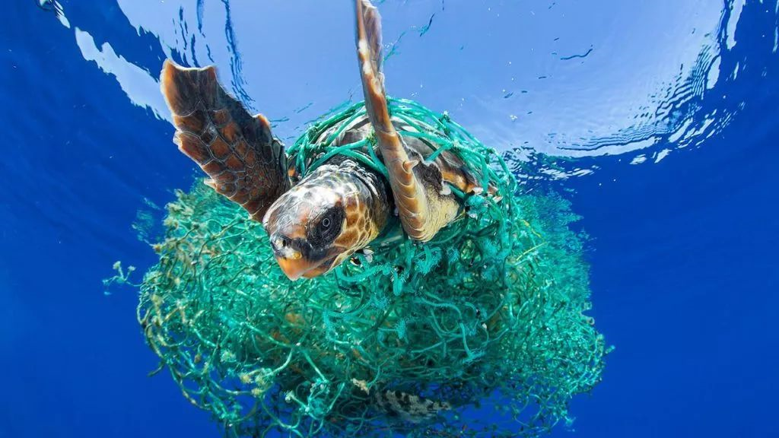
Why should we execute garbage classification ?
01
Nature
A sea turtle is entangled in ghost fishing gear.
entangle /ɪn'tæŋg(ə)l/
vt. 使纠缠；卷入；使混乱
be entangled in 陷入（困境）
ghost /gəʊst/ n. 鬼，幽灵
gear /gɪə/n. 齿轮；装置，工具
ghost fishing gear 幽灵般的渔具

Slide 7
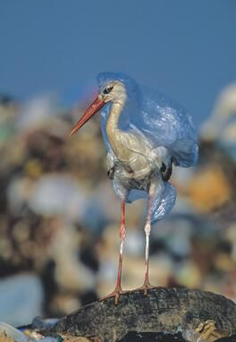
Why should we execute garbage classification ?
01
Nature
A stork suffocates in a plastic bag at a garbage dump in Spain.
stork /stɔːk/ n. [鸟] 鹳
suffocate /'sʌfəkeɪt/
v. 受阻，受扼制；窒息
dump /dʌmp/
v. 倾倒；丢下；随便堆放
n. 垃圾场；废渣堆

Slide 8
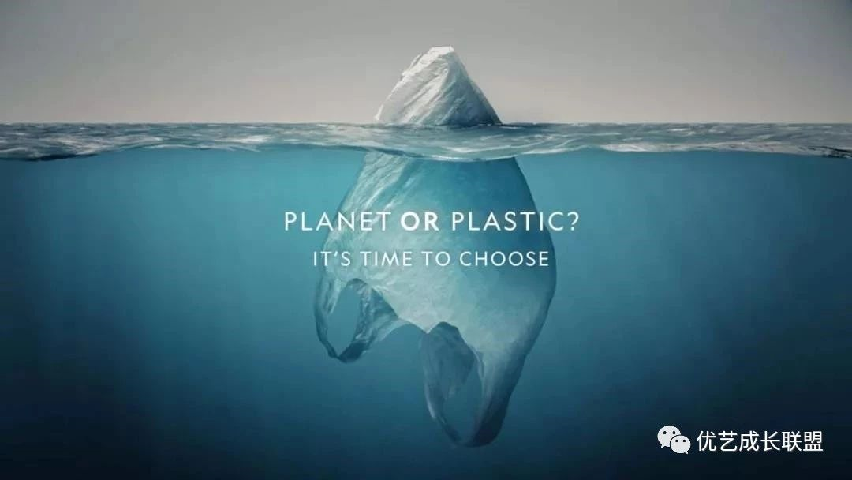
Why should we execute garbage classification ?
01
Nature
The presence of garbage in seas and oceans threatens wildlife because many marine animals get trapped in the trash and ingest large amounts of plastic, which can be fatal.
海洋里的垃圾正严重威胁海洋自然生态，因为海洋动物们被困在垃圾里，摄取大量的塑料，足以致命。
——莫夕亚市环境主任Consuelo Rosauro
marine/mə'riːn/adj. 海的；海产的；海生的
trash /træʃ/n. 垃圾；废物 vt. 丢弃；修剪树枝
ingest /ɪn'dʒest/ vt. 摄取；咽下；吸收
fatal /'feɪt(ə)l/ adj. 致命的；毁灭性的；命中注定的

Slide 9
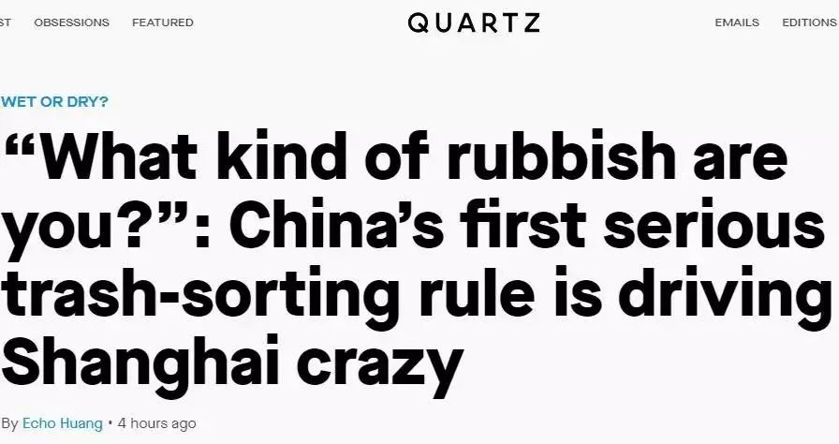
What kind of rubbish are you?
01
Nature
People find it counterintuitive that corn should go into "residual waste" instead of kitchen waste because it doesn't decompose, that fish bones belong to "kitchen waste," while ribs belong to "residual waste." Some said they were asked "What kind of rubbish are you" by the cleaning staff standing by the bins.
人们发现一些垃圾的分类有些和日常认知不大一样。比如玉米芯是“残余垃圾（干垃圾）”而不是“厨余垃圾”，因为它不易降解。鱼骨属于“厨余垃圾”而棒骨却属于“干垃圾”。有些人表示，他们扔垃圾时被垃圾箱一旁的监督员叫住问道：“你是什么垃圾？”
counterintuitive /,kaʊntərɪn'tjuːɪtɪv/adj. 违反直觉的 decompose/diːkəm'pəʊz/ v. 分解；腐烂

Slide 10
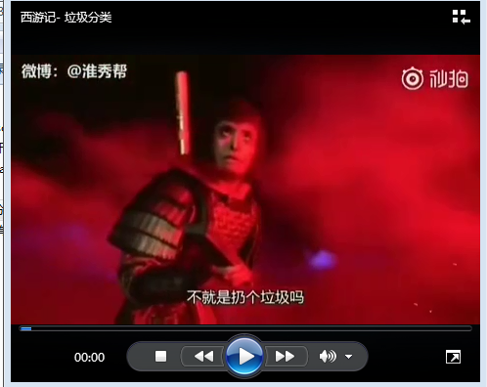
A Chinese Odyssey —— Garbage Sorting
01
Nature
A Chinese Odyssey —— Garbage Sorting
《大话西游》 之 “垃圾分类”
Play Video-1

Slide 11
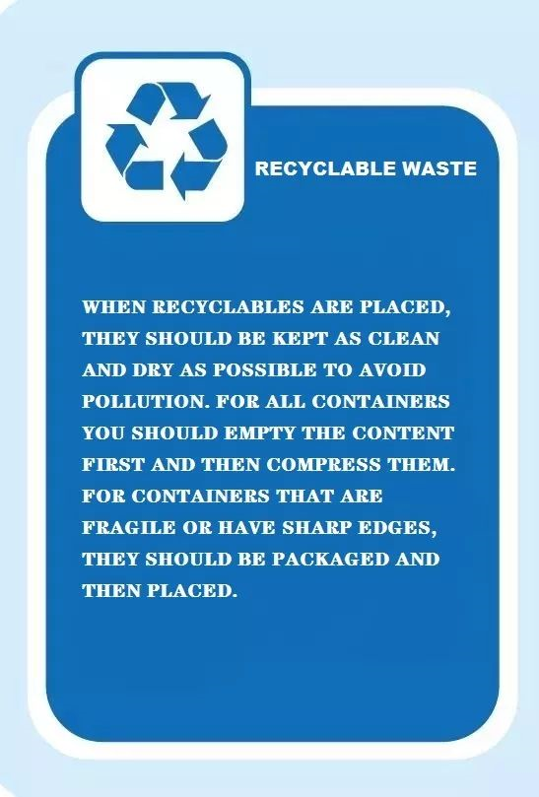







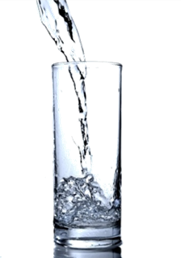
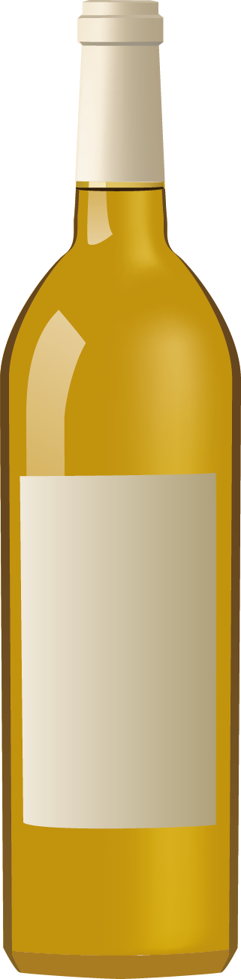


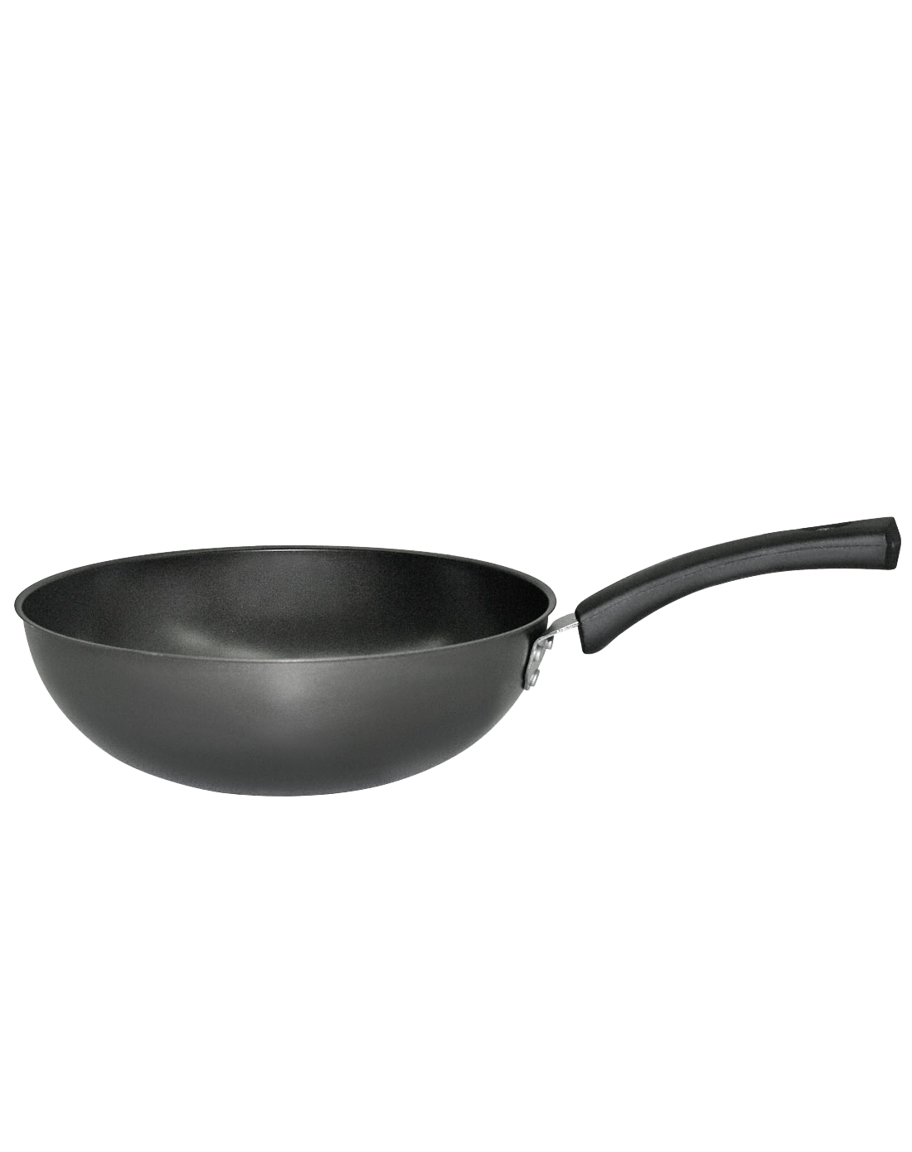






How to sort garbage? —— Recyclable Waste
01
Nature
Waste paper:
newspapers, cartons, books, paper bags
Waste plastics :
toys、 emulsion cans、 hangers
The most important thing to remember for recyclable waste is that only clean plastic and glass are recyclable! Make sure to rinse your containers and break down any packaging before putting them in the recycling.
对于可回收垃圾而言，最重要的是记住只有干净的塑料和玻璃才能回收利用！在将它们放入回收之前，请务必冲洗容器并脱离所有包装。
Waste glass products :
wine bottles, glasses、 glass magnifying glasses
Waste metal :
cans、 pots、 screwdrivers、 knife
Waste fabric :
leather shoes, clothes, plush toys， bags

Slide 12
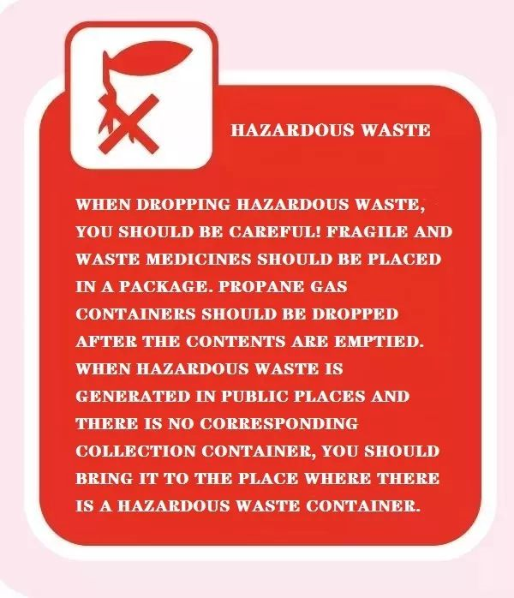
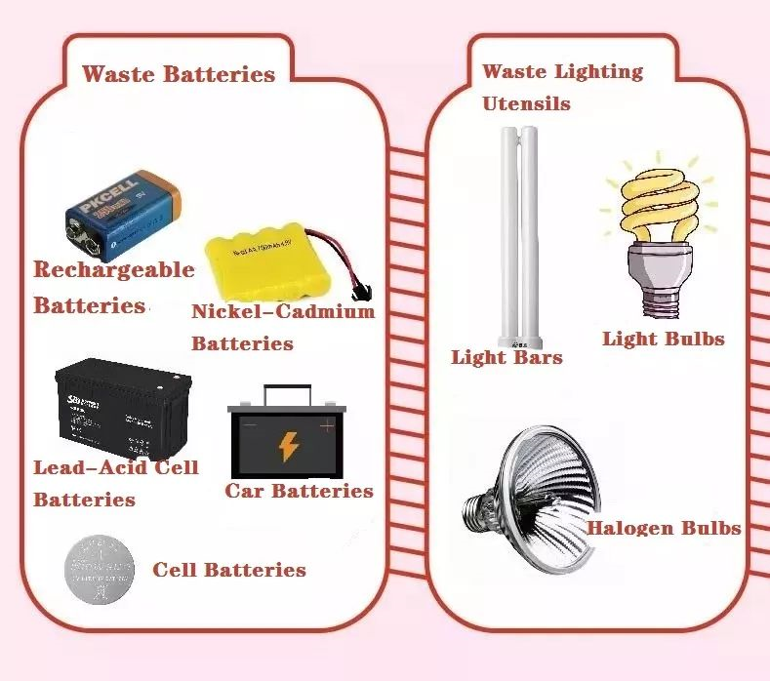
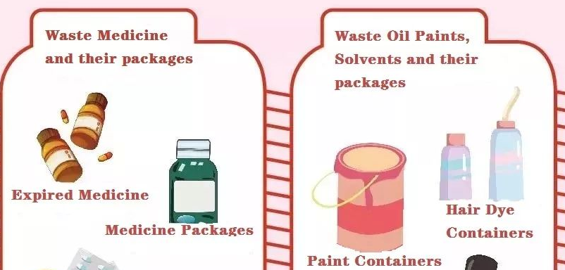
How to sort garbage? —— Harmful Waste
01
Nature
Hazardous waste
Mainly include: wastes that contain heavy metals that are harmful to human health or that cause actual or potential harm to the environment include batteries, fluorescent tubes, light bulbs, mercury thermometers, paint buckets, some home appliances, expired medicines, expired cosmetics, etc.
主要包括：含有重金属、对人体健康有害或对环境造成实际或潜在危害的废物，包括电池、荧光灯管、灯泡、水银温度计、油漆桶、一些家用电器、过期药品、过期化妆品等。

Slide 13
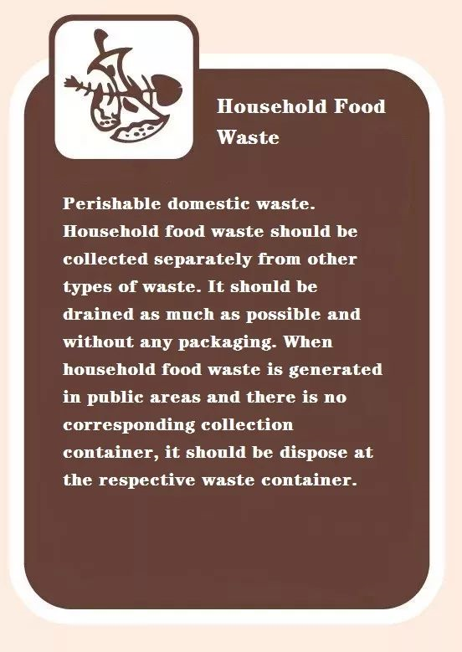
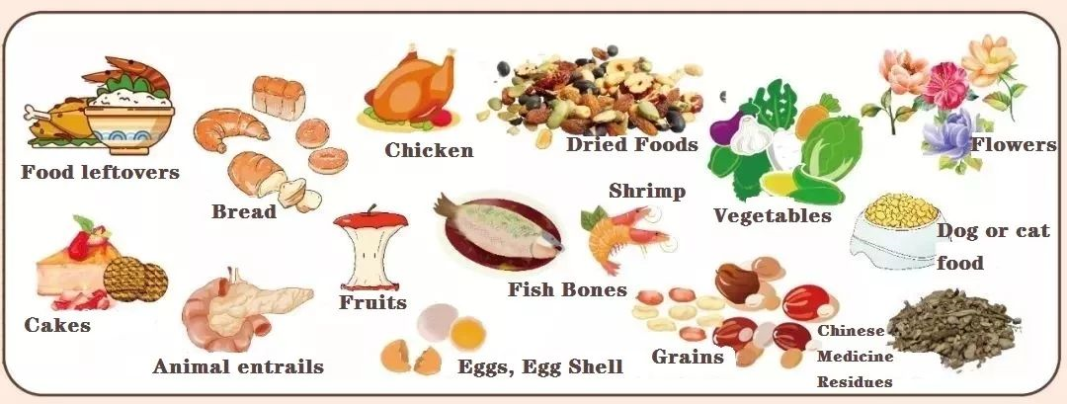
How to sort garbage?
—— Household Food Waste (湿垃圾)
01
Nature
waste ingredients; seasonings;leftovers; expired food; powder food; melon peel; flowers and plants
食材废料, 调料, 剩饭剩菜, 过期食品, 粉末类食品,瓜皮 , 花卉
厨余垃圾

Slide 14
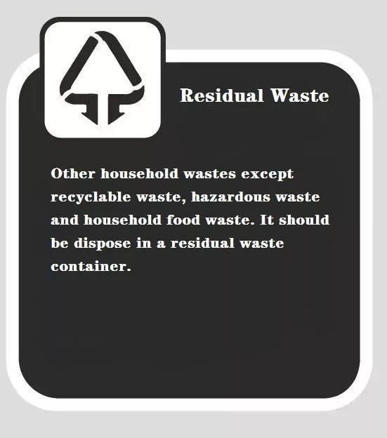
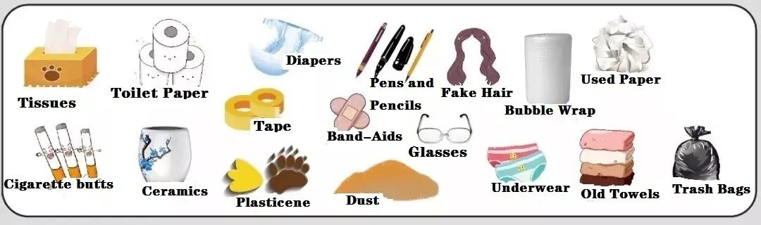
How to sort garbage?
—— Residual Waste (干垃圾)
01
Nature
Napkins, toilet paper, baby diapers, dog urine pad, cat sand, plastic, woven bag, bones, hard shells, hair, slag, rubber source old towels, disposable tableware, ceramic products, bamboo products and so on.
餐巾纸、卫生间用纸、尿不湿、狗尿垫、猫砂、污损塑料、编织袋、骨头、硬贝壳、毛发、炉渣、橡皮泥、旧毛巾、一次性餐具、陶瓷制品、竹制品等。
/rɪ'zɪdjʊəl/
残余垃圾

Slide 15
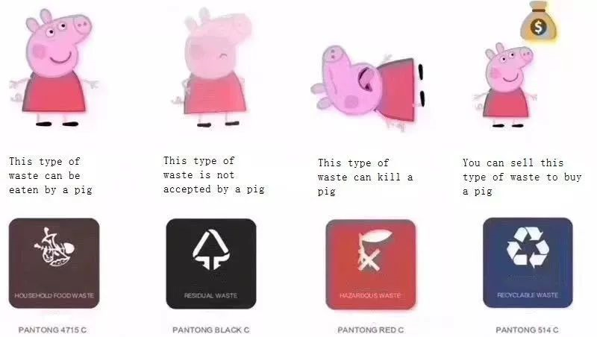
How to sort garbage?
01
Nature
Household Food Waste
Residual Waste
Hazardous waste
Recyclable Waste

Slide 16
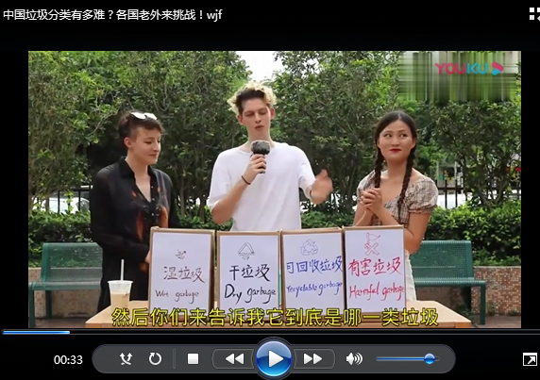
How do foreigners sort garbage?
01
Nature
Play Video-2

Slide 17

How to sort garbage?
Enjoy the thrill of exploration
01
Nature
Playing
Let's Play A Game
1
2
3
Pick out one number and finish the task in it.
Each task contains six kinds of garbage. please put them in place. You'll get one point for every garbage you put in the right place.

Slide 18

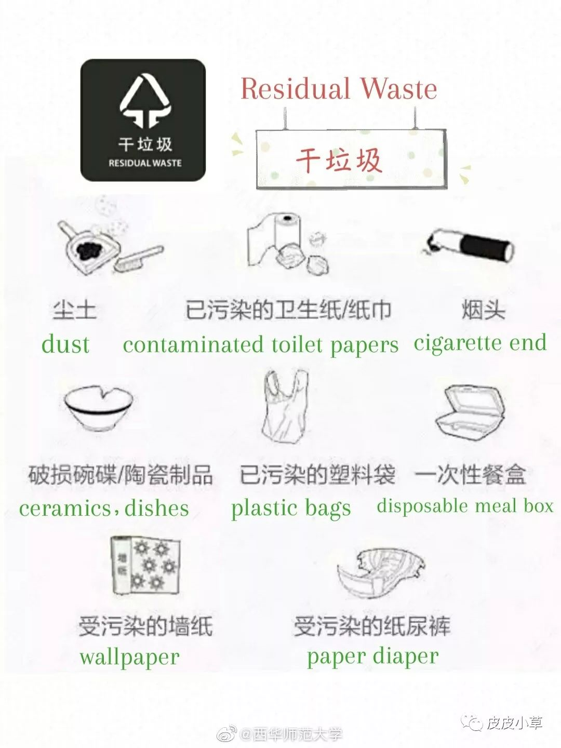

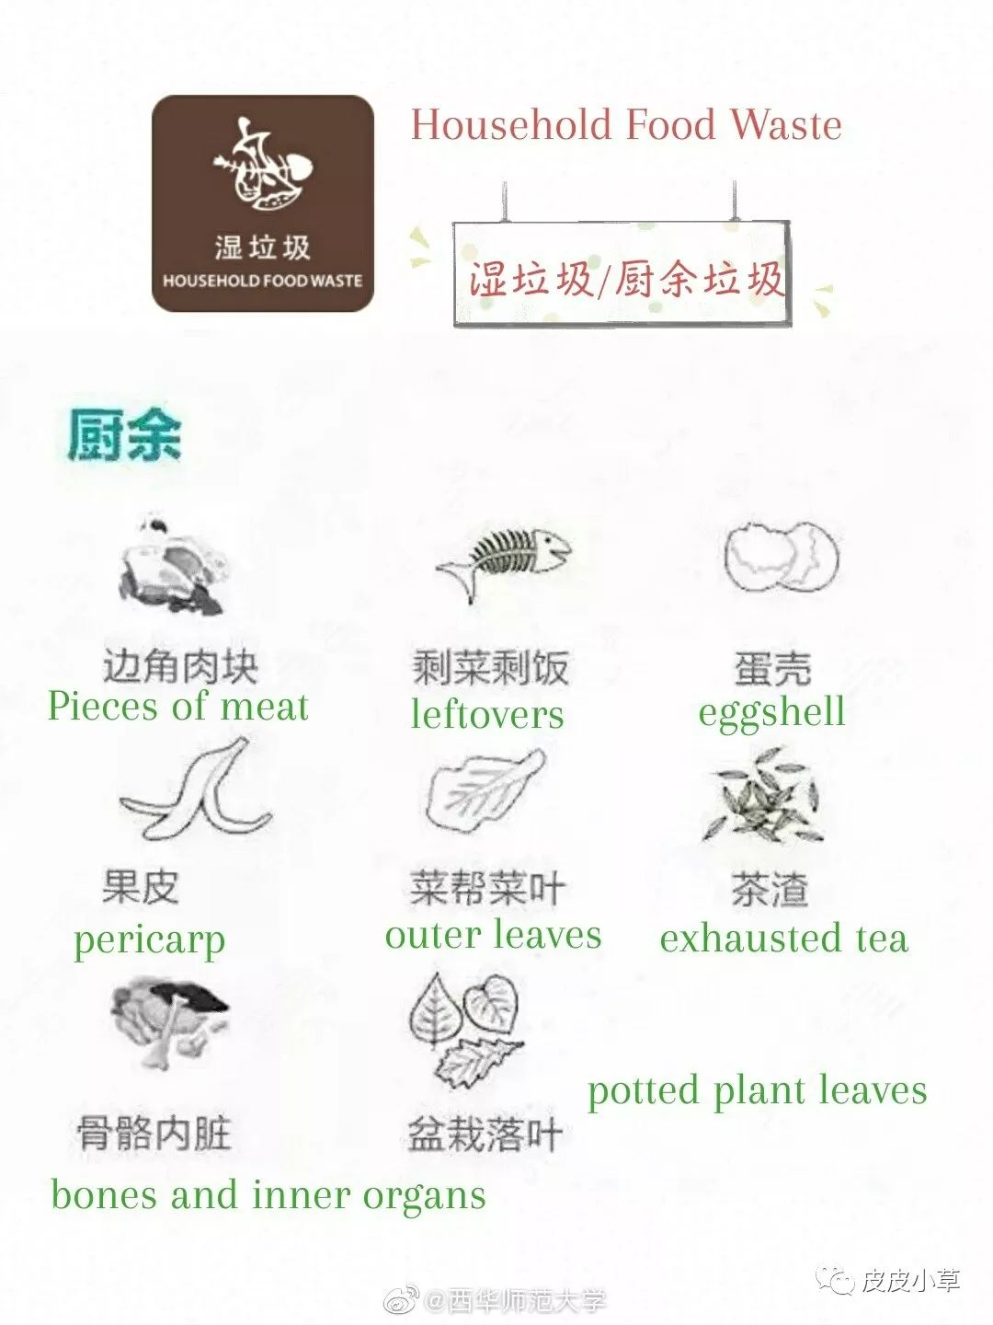
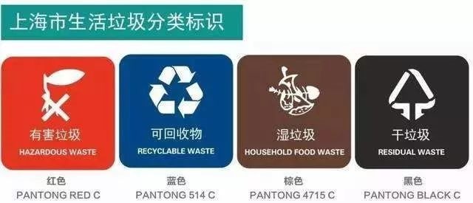

Shanghai Garbage Sorting Competition - 1
01
Nature
pill 药丸/片剂
disposable meal box
一次性餐盒
potted plant leaves
盆栽落叶
cigarette end 烟头
leftovers 剩饭菜
can 罐

Slide 19
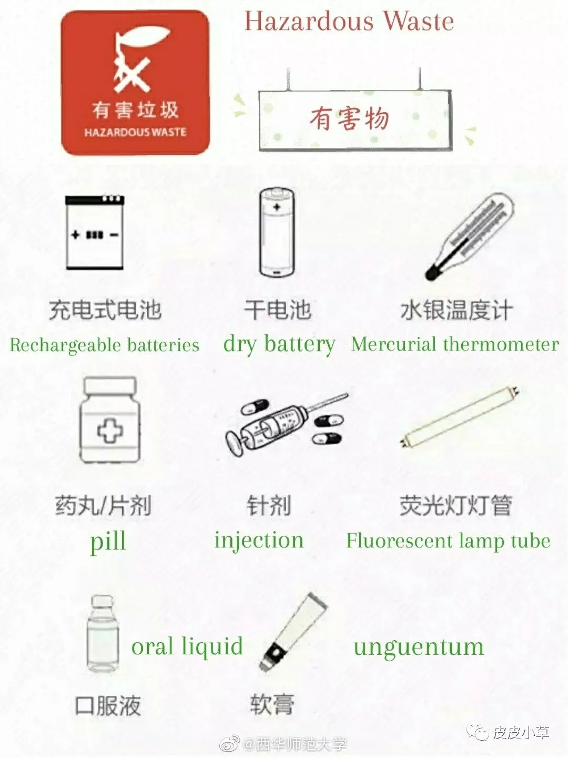
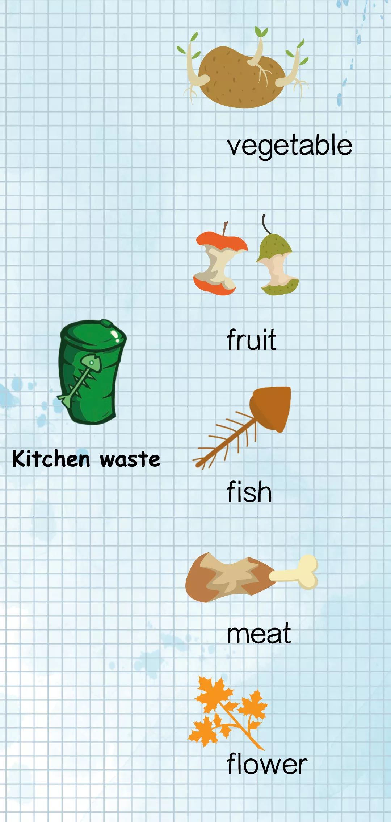

Shanghai Garbage Sorting Competition - 2
01
Nature
wine bottle 酒瓶
ceramics, dishes
破损碗碟/陶瓷
injection 针剂
fruit 水果
pot 锅
waste oil drum废油桶

Slide 20
感恩遇见，相互成就，本课件资料仅供您个人参考、教学使用，严禁自行在网络传播，违者依知识产权法追究法律责任。
更多教学资源请关注
公众号：溯恩高中英语
知识产权声明

Slide 21

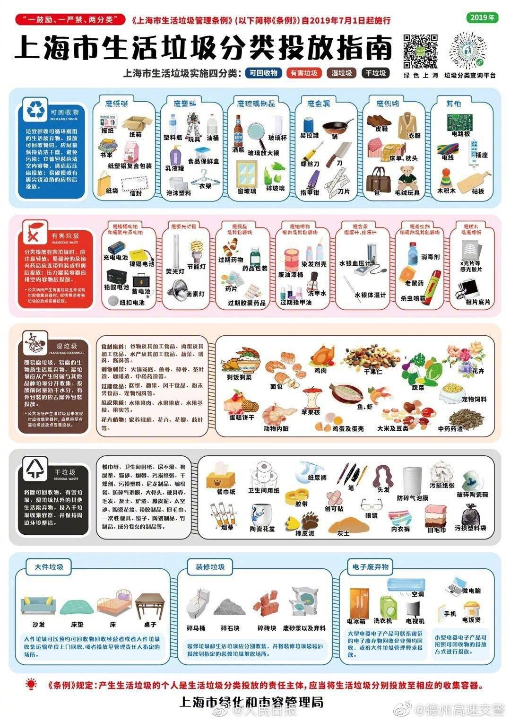

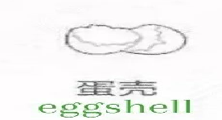
Shanghai Garbage Sorting Competition - 3
01
Nature
halogen lamp卤素灯
napkin 餐巾纸
carton纸板箱
battery电池
leather shoes皮鞋
eggshell蛋壳

Slide 22
What should we do ?
Spring into action
01
Nature
When collecting garbage, it should be collected airtight and classified to prevent secondary environmental pollution.
airtight /'eətaɪt/ adj. 密闭的，密封的
Before putting, paper should be stacked neatly as far as possible to avoid kneading; bottles and cans should be used up as much as possible, cleaned up and put into the container; kitchen waste should be bagged and airtight.
stack /stæk/v. （使）放成整齐的一叠 knead /niːd/ vt. 揉合，揉捏
The garbage shall be placed in designated places and containers according to the tips of garbage classification marks. Glass should be handled carefully to avoid damage.
designated/'dɛzɪg,netɪd/ adj. 指定的；特指的
After placing the garbage, please cover the top of the garbage bin to avoid contamination of the surrounding environment and breeding of mosquitoes and flies.
contamination /kən,tæmɪ'neɪʃən/ n. 污染; 污染物
01
02
03
04

Slide 23
Discussion about “Garbage classification”
Take responsibilities
01
Nature
Individuals can do nothing to improve the environment; only governments and large companies can make a difference.
To what extent do you agree or disagree?
01
Some think that environmental problems are too big for individuals to solve, while others think the problems cannot be solved unless individuals take some action.
Discuss both views and give your opinion.
02
Explain some of the ways in which humans are damaging the environment. What can governments do to address these problems?
What can individual people do?
03

Slide 24
About the natural environment
01
Nature
Waste / Rubbish/Litter
The amount of waste we produce has increased. This problem is a result of our consumer culture. Products are not made to last. If something breaks, we throw it away and buy a new one. Advertisers encourage us to buy the newest fashions.
Packaging is an important part of selling. Most foods are sold in non-biodegradable plastic packaging.
The amount of household waste is growing. This waste ends up in landfill sites. landfill /'læn(d)fɪl/ n. 垃圾填埋地；垃圾堆
People do not think about the consequences of dropping rubbish. They assume that somebody is paid to clean the streets.
Plastic packaging does not break down easily.

Slide 25
About the natural environment
01
Nature
Impact of Humans on the Environment
The increasing world population is putting pressure on natural resources.
Fossil fuels like oil and gas are running out.
fossil /'fɒs(ə)l; -sɪl/ n. 化石 adj. 化石的 fossil fuels[能源] 化石燃料
We are destroying wildlife habitats.
We have cut down enormous areas of rainforest.
This has led to the extinction of many species of animals and plants.

Slide 26
About the natural environment
01
Nature
Solutions to Environment Problems
Governments could introduce laws to limit emissions from factories. They should invest in renewable energy from solar, wind or water power. They could impose “green taxes” on drivers and airline companies.
Government campaigns should promote recycling and reusing useful materials.
Governments should be stricter about waste produced by companies.They should put legal limits on packaging.
Individuals should also try to be greener. We should take public transport rather than drive. We should choose products with less packaging.
Recycling saves energy and raw materials.We should recycle as much as possible.
Consumers should avoid buying over-packaged products.
Households can use several rubbish bins to separate waste.

Slide 27
About the natural environment
01
Nature
Environment-damaging products
对环境有害的产品
Vicious circle 恶性循环
Pollutant-free commodities 无污染的产品
Eco-friendly materials 环保材料
Ecological balance 生态平衡
Over-consumption 过度消费
Over-exploitation 过度开采
Shortage of natural resources 自然资源的短缺
Renewable energy \ sources可再生能源\资源
Government intervention 政府干预
International cooperation. 全球合作
Joint efforts 联合努力
Sustainable development 可持续发展
Environment deterioration 环境恶化
Environmental consciousness 环保意识
Household garbage 生活垃圾
Urban garbage 城市垃圾
Emissions 排放物
Deforestation 滥伐森林
Serious environmental issues严重环境事件
Soil erosion 水土流失
Disposable items 一次性用品
Non-biodegradable garbage
不可以降解的垃圾
Poisonous and harmful substance
有毒和有害物质

Slide 28
Content
People and Nature
人与自然
01
Garbage classification
垃圾分类
People and Self
人与自我
02
Chinese animated film Ne Zha 中国动画片《哪吒》
People and Society
人与社会
03
Archaeological Ruins of Liangzhu Ancient City
良渚古城遗址

Slide 29

What can we learn from the film Ne Zha ?
Venture new boundaries
Break stereotypes
/'sterɪə(ʊ)taɪp/ 固有印象
02
Self
In the new animated film Ne Zha, the title protagonist has a big change to his look. The audience may think he is ugly at first, but after watching the movie, they will love him because of his soul and spirit,
在新版动画片中，哪吒却长成了这样观众可能一开始觉得他很丑，但是看完电影后，他们会因为他的灵魂和精神而爱他，。
protagonist/prə'tæg(ə)nɪst/ 主人公，也可以是main character. Leading role
There are also several changes in the storyline and other characters from the original Ne Zha story.
除了哪吒形象的变化，情节和人物的设定，更是从头到尾的颠覆。

Slide 30
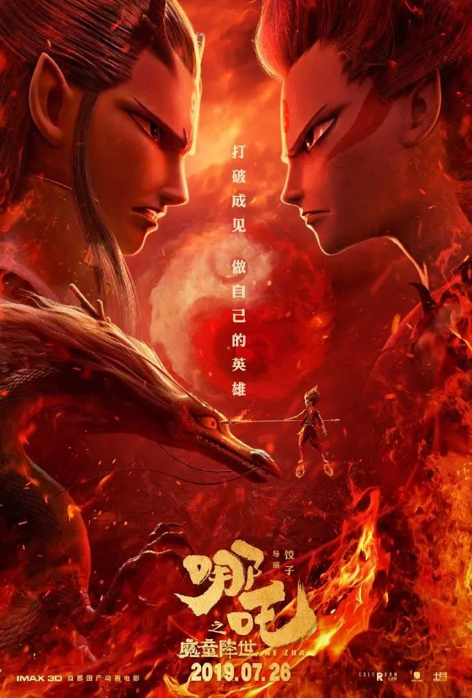
What can we learn from the film Ne Zha ?
Rise to the challenges
02
Self
Fighting
In the film Ne Zha is fighting prejudice: He is hated,
feared and shunned as the reincarnation of a devil. But Ne Zha believes his fate is not predetermined and that he can choose to be a demon or a god.
在这部电影里，哪吒反抗的是偏见：魔丸转世的他被陈塘关的百姓疏远、恐惧和憎恶。但哪吒相信“我命由我不由天”，是魔是神，只有他自己才能决定。
Prejudice is hard to overcome. 成见是座大山
My destiny isn't written in the stars, but held in my
hands. 我的命运不是天注定，而是掌握在我自己的手中。
prejudice /'predʒʊdɪs/ n. 偏见；侵害
shun /ʃʌn/ vt. 避开，避免；回避
reincarnation /,riːɪnkɑː'neɪʃ(ə)n/ n. 再生；化身
devil /'dev(ə)l/ n. 魔鬼；家伙；恶棍
pre-determine vt. 预先确定；预先决定
written in the stars 成语， 表示“命中注定”

Slide 31
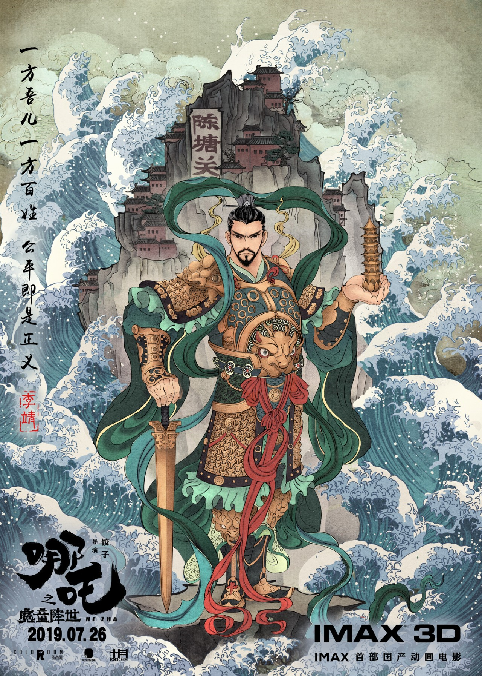
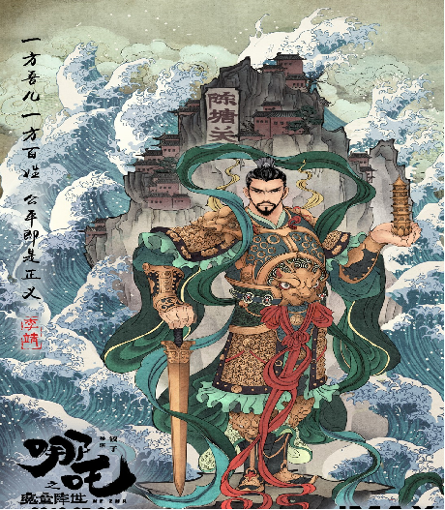
What can we learn from the film Ne Zha ?
Take responsibilities
02
Self
Sacrifice
Ne Zha's father, Li Jing, is the chief who governs the fictional port city Chen Tang Guan. He is no longer cowardly and selfish as depicted in the past works; instead, he becomes a noble father willing to sacrifice his own life to rescue Ne Zha.
而以往文学作品中懦弱而自私的陈塘关总兵李靖，这次却是为了救哪吒，甘愿牺牲自己性命的好父亲。
fictional /'fɪkʃənl/ adj. 虚构的；小说的
cowardly /'kaʊədlɪ/ adj. 怯懦的，懦弱的；胆小的 adv. 胆怯地
depict /dɪ'pɪkt/ vt. 描述；描画
sacrifice /'sækrɪfaɪs/ n. 牺牲；祭品；供奉 v. 牺牲；献祭

Slide 32
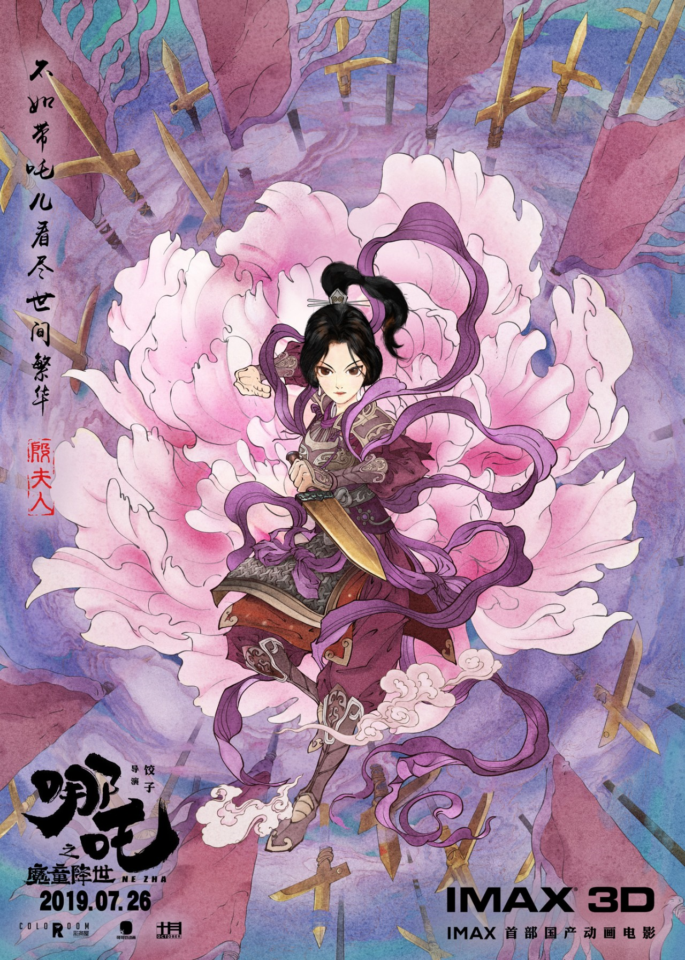
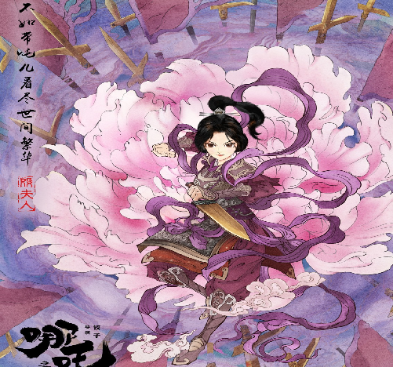
What can we learn from the film Ne Zha ?
Take responsibilities
02
Self
Sacrifice
Ne Zha's mother, Mrs Yin, is portrayed as an
optimistic and powerful woman. She does not forget to accompany her children while she was busy with her official duties. Whenever Na Zha is in trouble, she stands up and guards him timely.
母亲殷夫人则被塑造为一个乐观开朗的“女强人”，在忙公务之余也不忘陪伴孩子，每次哪吒遭诘难时，她都第一时间站出来护着他。
portray /pɔː'treɪ/vt. 描绘；扮演

Slide 33
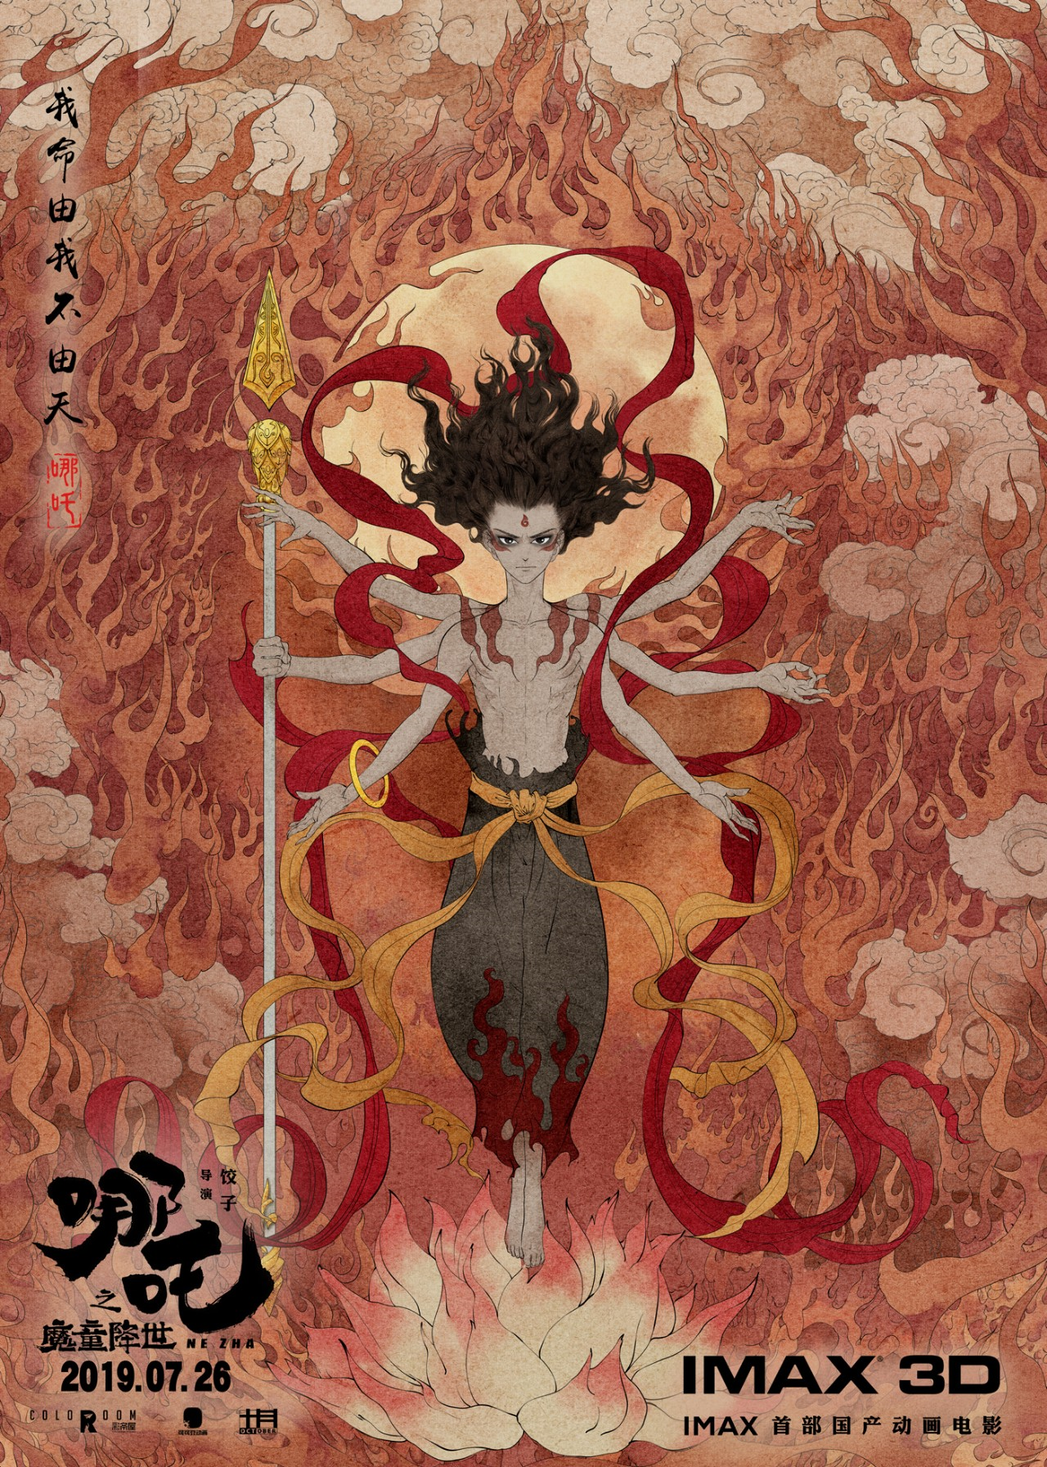
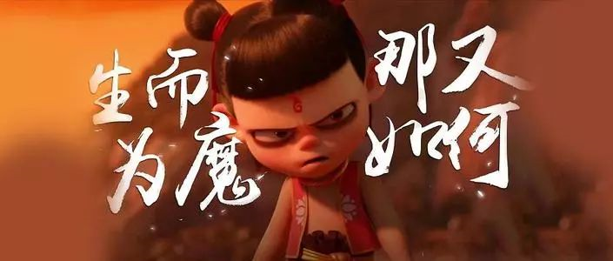
The memorable lines from the film Ne Zha ?
02
Self
Born as a demon, so what ?
生而为魔，那又如何。
demon /'diːmən/ n. 恶魔；魔鬼；邪恶的事物
My fate is not fixed and depends on myself. I have the final say of being a demon or immortal.
我命由我不由天，是魔是仙，我是谁只有我自己说了算。
immortal /ɪ'mɔːt(ə)l/ adj. 不朽的；神仙的；长生的 n. 神仙；不朽人物

Slide 34
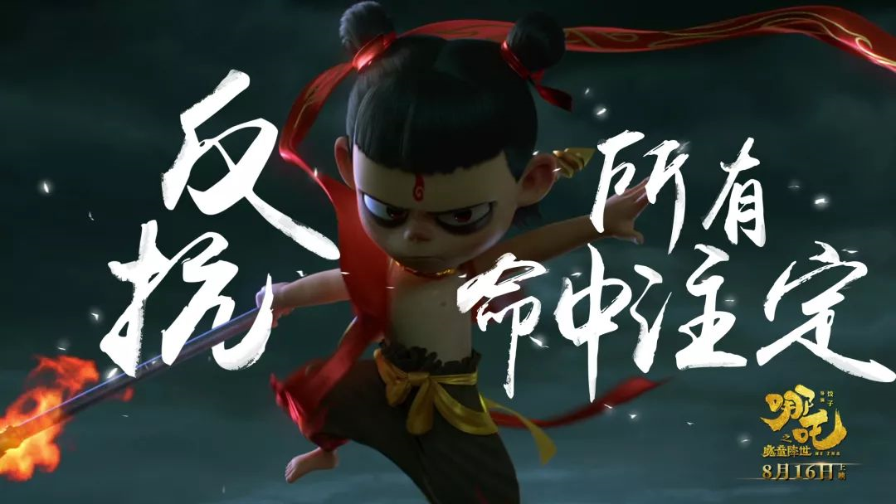
The memorable lines from the film Ne Zha ?
02
Self
If you suffer an unfair fate, don’t lose heart, and fight with it till the last minute.
若命运不公，就和它斗到底。
I will let people look at me with new eyes. Wait and see!
我会让所有人刮目相看，走着瞧！
If you ask me whether people can change their own destiny, I will show you I don't know. As far as I am concerned, do not believe in destiny, which is the fate of Nezha.
如果你问我，人能否改变自己的命运，我也不晓得，但是不认命，就是哪吒的命。
Chances to change your destiny in your life are few and far between.
一生中能改变命运的机会，可不多呀！few and far between不常碰到或发现的;稀少的
The viewpoints of others are nonsense. It's the truth my father taught me that who you are denpends on what you say.
别人的看法都是狗屁，你是谁只有你自己说了才算，这是爹教我的道理。

Slide 35
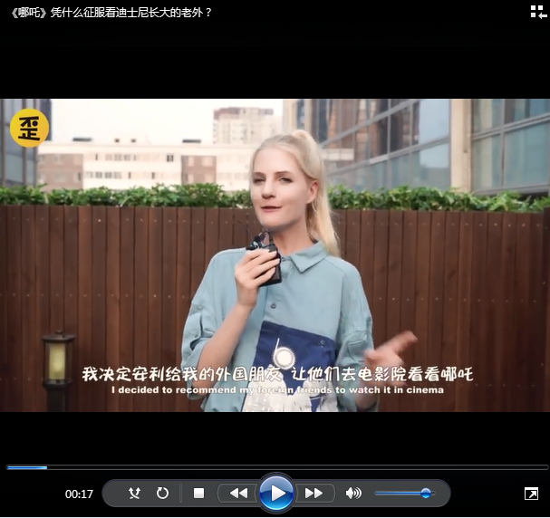
What do foreigners think of the film Ne Zha?
02
Self
Play Video-3

Slide 36
Content
People and Nature
人与自然
01
Garbage classification
垃圾分类
People and Self
人与自我
02
Chinese animated film Ne Zha 中国动画片《哪吒》
People and Society
人与社会
03
Archaeological Ruins of Liangzhu Ancient City
良渚古城遗址

Slide 37
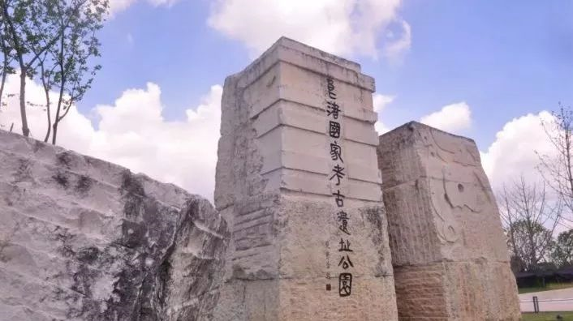
Archaeological Ruins of Liangzhu Ancient City
03
Society
The Archaeological Ruins of Liangzhu City in Hangzhou, Zhejiang province, which date back to 5,300 years, were inscribed onto the UNESCO World Heritage list on July 6, 2019. 2019年7月6日，联合国教科文组织会议上，位于浙江杭州的“良渚古城遗址”成功列入《世界遗产名录》。良渚古城遗址的历史可追溯到5300年前。inscribe /ɪn'skraɪb/ vt. 题写；铭记
"It is considered to be a supreme achievement of prehistoric rice-cultivating civilization of China and East Asia over 5,000 years ago and an outstanding example of early urban civilization," said a report by the International Council on Monuments and Sites (ICOMOS). supreme /suː'priːm/ adj. 最高的；至高的；最重要的
国际古迹遗址理事会在评估报告中称：“良渚古城遗址是东亚和中国5000多年前史前稻作文明的最高成就，是人类文明史上早期城市文明的一个杰出范例。”

Slide 38
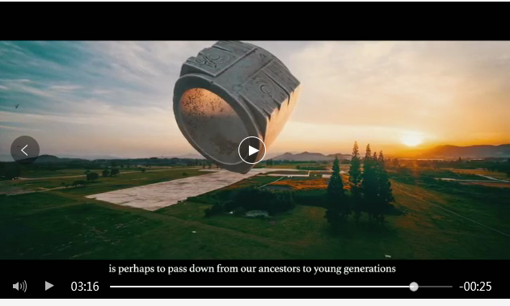
Archaeological Ruins of Liangzhu Ancient City
Inspire imagination
03
Society
Its early time of formation, a great achievement and rich diversities show the outstanding contribution (made by the Yangtze River Basin to “Diversity in Unity” feature of the origin of Chinese civilization).
其形成之早，成就之大，多样性之丰富，体现了长江流域对中华文明起源“多元一体”特征的突出贡献。
Play Video-4

Slide 39
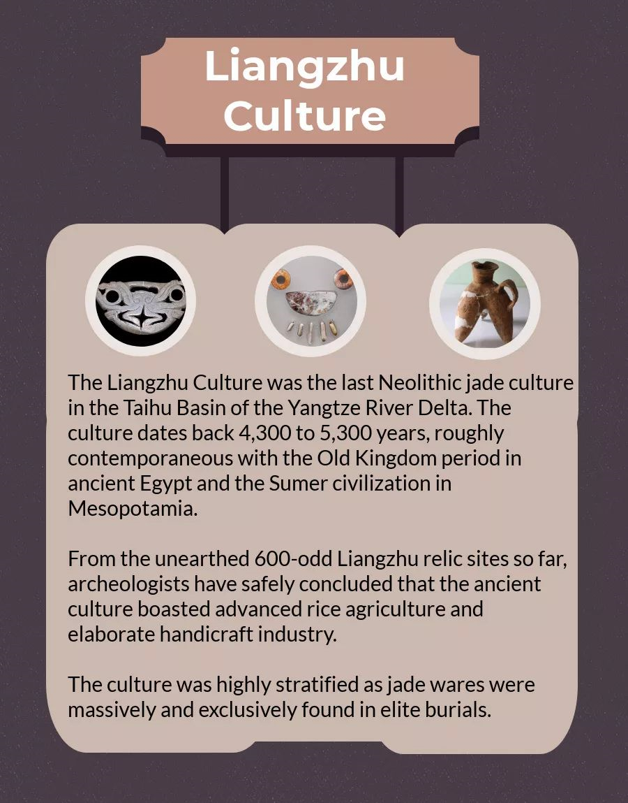
Liangzhu culture
03
Society
良渚文化是长江三角洲太湖流域最后的新石器时代玉文化。这种文化可以追溯到4300年到5300年前，大致与古埃及的古王国时期和中美洲的苏美尔文明同期。
从迄今出土的600余处良渚遗址中，考古学家们得出了一个可靠的结论: 良渚文化以其先进的水稻农业和精细的手工业而自豪。
这种文化是高度分层的，因为玉器是贵族墓葬中大量和唯一发现的。
contemporaneous
/kən,tempə'reɪnɪəs/adj. 同时期的
archeologist /,ɑːkɪ'ɒlədʒɪst/ n. 考古学家
boast /bəʊst/ vt. 夸口说；以有…而自豪
elaborate/ɪ'læb(ə)rət/ adj. 精心制作的
stratify /'strætɪfaɪ/ v. 分层；阶层化
jade ware n. 玉器
exclusively /ɪk'skluːsɪvlɪ/ adv. 唯一地
elite /eɪˈliːt/ n. 精英；精华

Slide 40
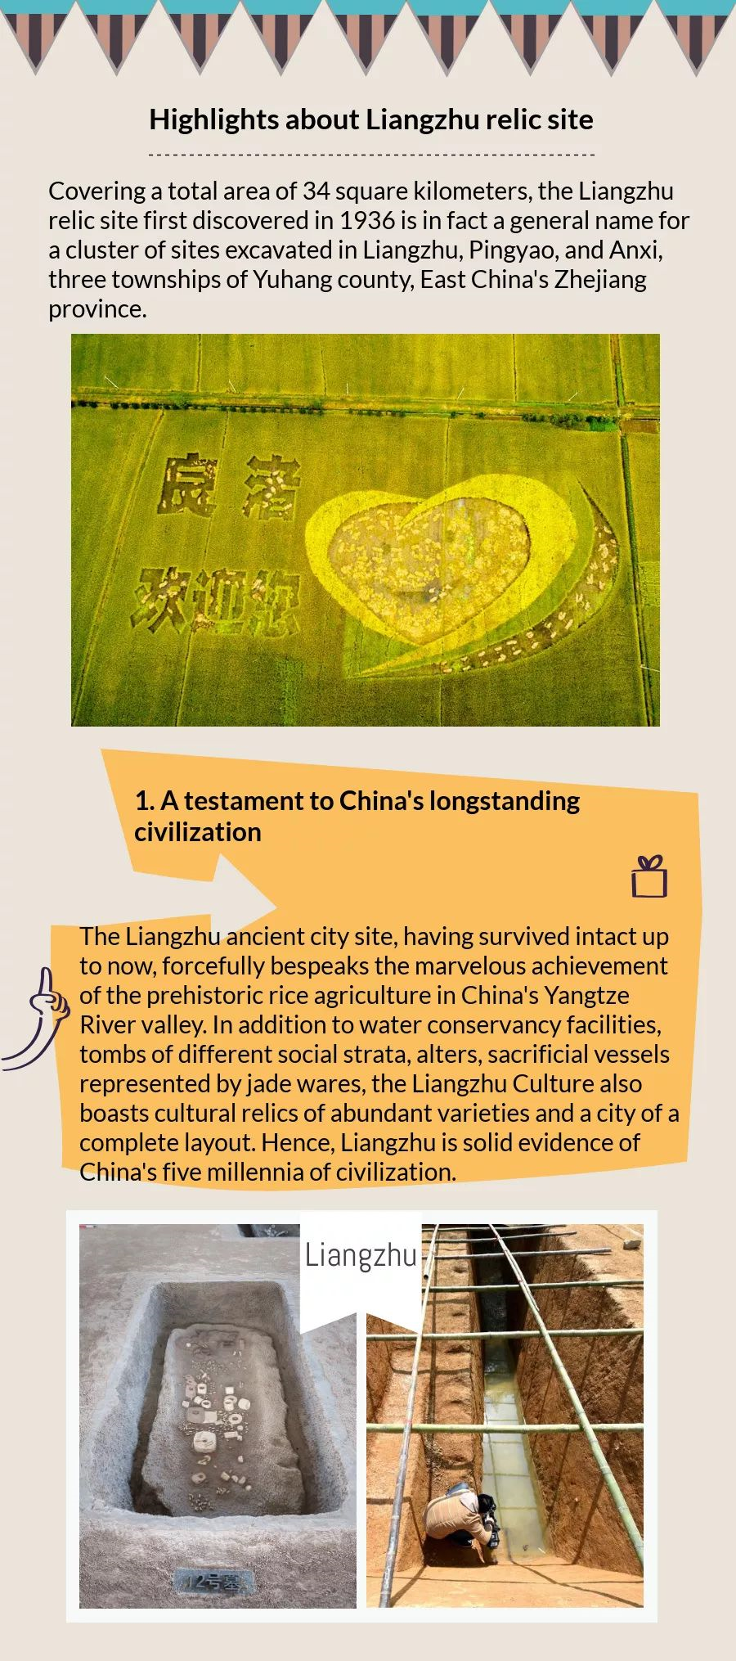
Highlights about Liangzhu relic site
03
Society
1. 这是中国悠久文明的见证
良渚古城遗址至今保存完好，有力地说明了中国长江流域史前水稻农业的辉煌成就。良渚文化除了水利设施、不同社会阶层的墓葬、圣坛、以玉器为代表的祭祀器物外，还拥有种类丰富的文物和布局完整的城市。因此，良渚是中国五千年文明的坚实证据。
testament /'testəm(ə)nt/ n. [法] 遗嘱；确实的证明
intact /ɪn'tækt/ adj. 完整的；原封不动的
bespeak /bɪ'spiːk/ vt. 表示；预约；证明
marvelous /ˈmɑːvələs/ adj. adj. 了不起的；非凡的
conservancy /kən'sɜːv(ə)nsɪ/ n. 管理；保护；保存
facility /fə'sɪləti/ n. 设施；设备
strata /'strɑːtə/ n. 层；[地质] 地层；阶层
vessel /'ves(ə)l/ n. 血管；容器，器皿
layout n. 布局；设计；安排；陈列
millennia /mɪˈleniə/ n. 千年期；一千年

Slide 41
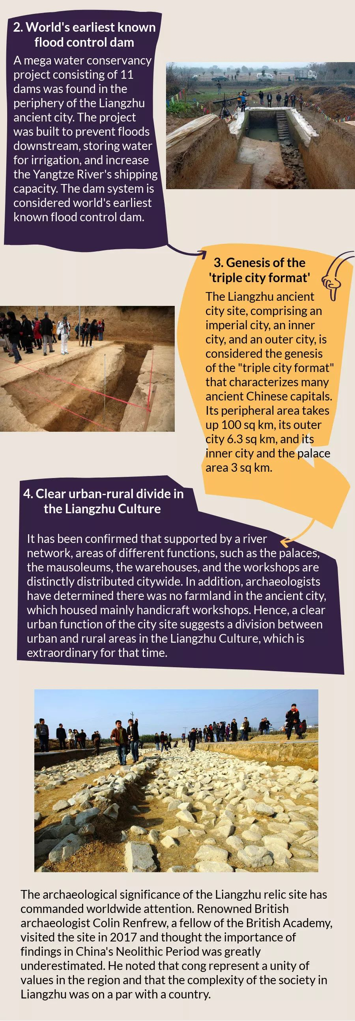
Highlights about Liangzhu relic site
03
Society
2. 世界上已知最早的防洪大坝
在良渚古城外围发现了由11座大坝组成的大型水利工程。该项目是为了防止下游洪水，储存灌溉用水，增加长江航运能力。大坝系统被认为是世界上已知最早的防洪大坝。
mega /'megə/ adj. adj. 巨大的；优秀的
periphery /pə'rɪf(ə)rɪ/n. 外围；圆周
irrigation /ˌɪrɪˈɡeʃn/n. 灌溉

Slide 42
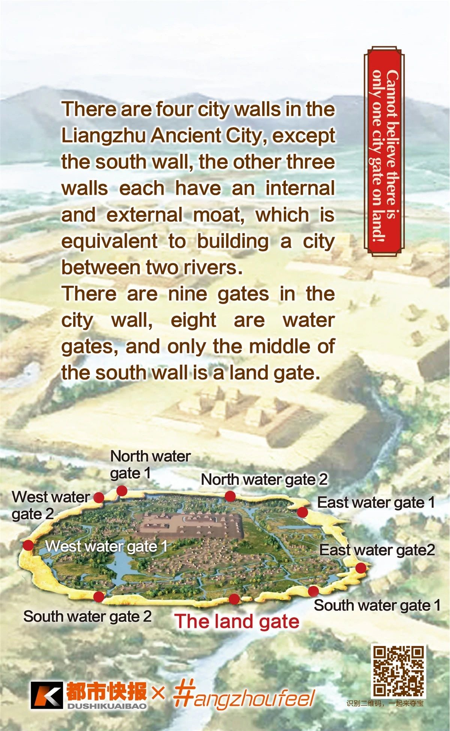
Highlights about Liangzhu relic site
03
Society
3.“三重城市模式”的起源
良渚古城遗址由一座皇城、一座内城和一座外城组成，被认为是中国古代都城“三城格局”的起源。周边面积100平方公里，外围城市6.3平方公里，内城和宫殿3平方公里。
triple /'trɪp(ə)l/ adj. 三倍的；三方的
format /'fɔːmæt/ n. 格式；版式
comprise /kəm'praɪz/ vt. 包含；由…组成
imperial /ɪm'pɪərɪəl/ adj. 帝国的；皇帝的
genesis /'dʒenɪsɪs/ n. 发生；起源
peripheral /pə'rɪf(ə)r(ə)l/ adj. 外围的；次要的

Slide 43
Highlights about Liangzhu relic site
03
Society
4. 明显的良渚文化中的城乡差异
已经证实，在河网的支撑下，不同功能的区域，如宫殿、陵墓、仓库和车间，明显分布在全市。此外，考古学家已经确定，这座古城没有农田，主要是手工作坊。因此，城市场地清晰的城市功能暗示了良渚文化中城乡的划分，这在当时是不寻常的。
mausoleum
/,mɔsə'liəm/n. 陵墓；阴森森的大厦
distinctly /dɪ'stɪŋ(k)tlɪ/ adv. 明显地
distribute /dɪ'strɪbjuːt/ vt. 分配；散布
handicraft
/'hændɪkrɑːft/ n. 手工艺；手工艺品

Slide 44
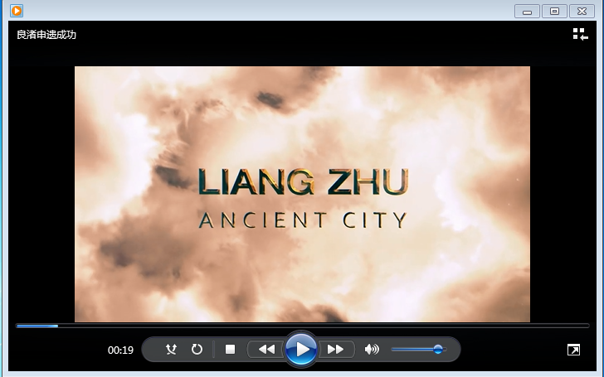
Further information
Enjoy the thrill of exploration
03
Society
Play Video-5

Slide 45
感恩遇见，相互成就，本课件资料仅供您个人参考、教学使用，严禁自行在网络传播，违者依知识产权法追究法律责任。
更多教学资源请关注
公众号：溯恩高中英语
知识产权声明

Slide 46
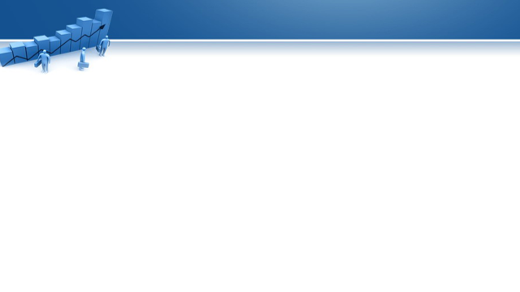


Thank you!
Spring into action
Take responsibilities
Rise to the challenges
Inspire imagination
Venture into new boundaries
Enjoy the thrill of exploration
Strive to be your better self !

