Slide 1

感恩遇见，相互成就，本课件资料仅供您个人参考、教学使用，严禁自行在网络传播，违者依知识产权法追究法律责任。
更多教学资源请关注
公众号：溯恩高中英语
知识产权声明

Slide 2

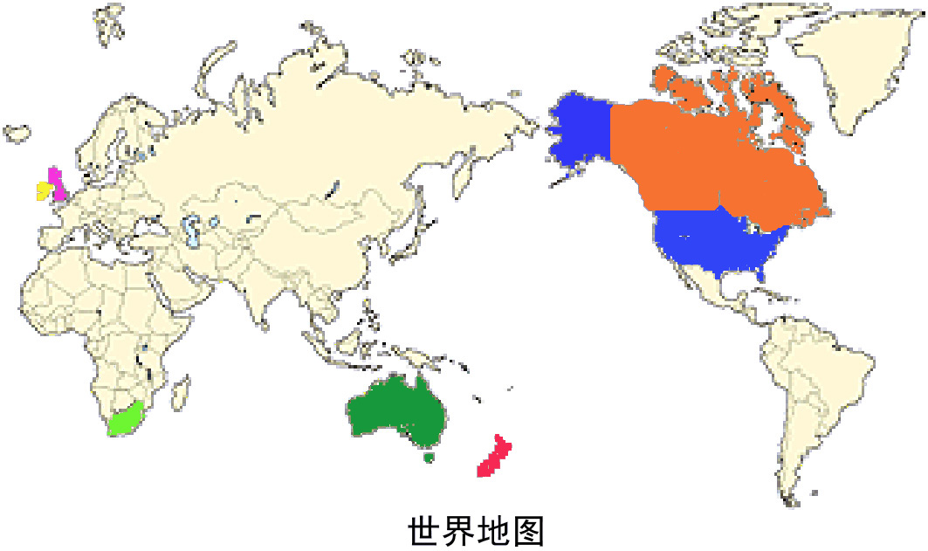
Can you list the countries that use English as an official language?
English Around the World
Do you know why English is spoken by so many people in so many different countries?
the United Kingdom
Canada
the USA
Ireland
Australia
South Africa
New Zealand
Key words: trade, tourism, internet website, official language of the UN, entertainment

Slide 3

The Road to Modern English
杭师大附中 沈如意

Slide 4
Title Prediction
The Road to Modern English
What does “the road” mean?
2. Predict what the passage is mainly about?

Slide 5
Read for style
What’s the writing style of the article?
An argumentation
An exposition
C. A narration
exposit or introduce sth

Slide 6
Read for Details— Para. 1
At the end of the 16th century, about five to seven million people spoke English. Nearly all of them lived in England. Later in the next century, people from England made voyages to conquer other parts of the world and because of that, English began to be spoken in many other countries. Today, more people speak English as their first, second or a foreign language than ever before.
At the end of the 16thcentury
Later in the next century
Today
more people speak English as their first, second or a
foreign
language than ever before.
1. What’s the topic sentence ?
2. How is this paragraph organized ?
time

Slide 7
Read for Details— Para. 1
How has English become popular?
people
today
the next century
the end of the 16th century
?
More people speak in more countries
Many other countries
(5-7million)England
conquer

Slide 8

Read for Details— Para. 2
Topic sentence ?
Native English speakers can understand each other even if they don't speak the same kind of English.
Native English speakers can understand each other even if they don't speak the same kind of English. Look at this example:
British Betty: Would you like to see my flat?
American Amy: Yes. I'd like to come up to your apartment.
example:
British Betty: Would you like to see my flat?
American Amy: Yes. I'd like to come up to your apartment.
flat
apartment
So why has English changed over time?

Slide 9
Read for Details— Para. 3-4
Topic sentence?
So why has English changed over time? Actually all languages change and develop when cultures meet and communicate with each other. At first the English spoken in England between about AD 450 and 1150 was very different from the English spoken today. It was based more on German than the English we speak at present. Then gradually between about AD 800 and 1150, English became less like German because those who ruled England spoke first Danish and later French. These new settlers enriched the English language and especially its vocabulary. So by the 1600's Shakespeare was able to make use of a wider vocabulary than ever before. In 1620 some British settlers moved to America. Later in the 18th century some British people were taken to Australia too. English began to be spoken in both countries.
Actually all languages
change and develop when cultures meet and communicate with each other.
How has English changed over time ? Underline the times
Finally by the 19th century the language was settled.
Finally by the 19th century the language was settled. At that time two big changes in English spelling happened: First Samuel Johnson wrote his dictionary and later Noah Webster wrote The American Dictionary of the English Language. The latter gave a separate identity to American English spelling.

Slide 10
Read for Details— Para. 3-4
be enriched by Shakespeare &
taken to American by British settlers
be based more on German (Anglo-Saxon 盎格鲁-撒克逊 settlers)
settled &
American English owns its identity
AD 450-1150
AD 800-1150
In 1620
later in the 18th century
by the 19th century
more like French and Danish (ruler)
be taken to Australia

Slide 11
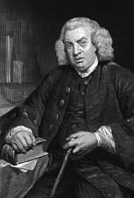
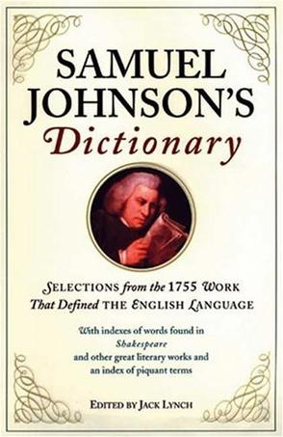
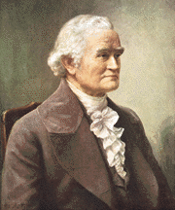

Read for Details— Para. 4
Finally by the 19th century the language was settled. At that time two big changes in English spelling happened: First Samuel Johnson wrote his dictionary and later Noah Webster wrote The American Dictionary of the English Language. The latter gave a separate identity to American English spelling.
Samuel Johnson
Noah Webster
a profound effect on Modern English, pre-eminent British dictionary
gave a separate identity to American English spelling

Slide 12
感恩遇见，相互成就，本课件资料仅供您个人参考、教学使用，严禁自行在网络传播，违者依知识产权法追究法律责任。
更多教学资源请关注
公众号：溯恩高中英语
知识产权声明

Slide 13
Read for Details— Para. 5
Topic sentence
English now is also spoken as a foreign or second language in South Asia. For example, India has a very large number of fluent English speakers because Britain ruled India from 1765 to 1947. During that time English became the language for government and education. English is also spoken in Singapore and Malaysia and countries in Africa such as South Africa. Today the number of people learning English in China is increasing rapidly. In fact, China may have the largest number of English learners. Will Chinese English develop its own identity? Only time will tell.
English now is also spoken as a foreign or second language in South Asia.
examples: India & China？
India is a typical country who speaks English as a second language because of its long being ruled by Britain.
China, another typical nation who speaks English as a foreign language, has a largest number of English learners.
What’s the author’s attitudes towards the spread of English?
A. neutral B. positive
C. negative D. doubtful

Slide 14
Para. 3-4-5: road to Modern English
be based more on German (Anglo-Saxon 盎格鲁-撒克逊 settlers)
be enriched by Shakespeare &
taken to American by British settlers
settled &
American English owns its identity
AD 450-1150
AD 800-1150
In 1620
later in the 18th century
by the 19th century
now
spoken as a foreign language or second language
more like French and Danish (ruler)
be taken to Australia

Slide 15
Conclusion
Language can change with time.
Language can change
when cultures
communicate with
each other.
time
place

Slide 16
1. At the end of the 16th century,…English began to be spoken in many other countries. Today, more people speak English as their first, second or a foreign language than ever before.
2. Native English speakers can understand each other even if they don't speak the same kind of English. Look at this example…
3. So why has English changed over time? Actually all languages change and develop when cultures meet and communicate with each other…became less like German because those who ruled England spoke first Danish and later French. These new settlers enriched the English language and especially its vocabulary. So by the 1600's Shakespeare was able to make use of a wider vocabulary than ever before. In 1620 some British settlers moved to America. Later in the 18th century some British people were taken to Australia too. English began to be spoken in both countries.
4. Finally by the 19th century the language was settled. At that time two big changes in English spelling happened: First Samuel Johnson wrote his dictionary and later Noah Webster wrote The American Dictionary of the English Language. The latter gave a separate identity to American English spelling.
5. English now is also spoken as a foreign or second language in South Asia. For example, India has …Today the number of people learning English in China is increasing rapidly. In fact, China may have the largest number of English learners. Will Chinese English develop its own identity? Only time will tell.
Tip1: Topic sentence usually lies in the first, the last sentence or sometimes after a question with some signal words such as today, actually, now, finally, etc.
Tip 2: (how to develop a paragraph) topic sentence+ examples

Slide 17
Read for Structure
Q1:Can we leave out para 1?
1. At the end of the 16th century,…English began to be spoken in many other countries. Today, more people speak English as their first, second or a foreign language than ever before.
2. Native English speakers can understand each other even if they don't speak the same kind of English. Look at this example…
3. So why has English changed over time? Actually all languages change and develop when cultures meet and communicate with each other…became less like German because those who ruled England spoke first Danish and later French. These new settlers enriched the English language and especially its vocabulary. So by the 1600's Shakespeare was able to make use of a wider vocabulary than ever before. In 1620 some British settlers moved to America. Later in the 18th century some British people were taken to Australia too. English began to be spoken in both countries.
4. Finally by the 19th century the language was settled. At that time two big changes in English spelling happened: First Samuel Johnson wrote his dictionary and later Noah Webster wrote The American Dictionary of the English Language. The latter gave a separate identity to American English spelling.
5. English now is also spoken as a foreign or second language in South Asia. For example, India has …Today the number of people learning English in China is increasing rapidly. In fact, China may have the largest number of English learners. Will Chinese English develop its own identity? Only time will tell.
No, it introduces the topic and serves as a transitional sentence.
Today, more people speak English as their first, second or a foreign language than ever before.
Q2: Look at the two topic sentences and guess what does “also” imply ?
Signal word “also” refers another aspect which implies the structure of the passage.
English now is also spoken as a foreign or second language in South Asia.

Slide 18
Spoken as first, second or a foreign language
Read for Structure
Para 1
Para 5
Para 2,3,4
conquest & cultural communication
English development as first language
English development as second or foreign language

Slide 19
Title Reading
The Road to Modern English
What does “the road” mean?
The Development/History of English

Slide 20
Further Thinking
What’s your attitude towards the spread of English?
Why do you think people all over the world want to learn English?

Slide 21
Retell the road
Retell the Road to Modern English
be enriched by Shakespeare &
taken to American by British settlers
settled &
American English owns its identity
be based more on German (Anglo-Saxon 盎格鲁-撒克逊 settlers)
AD 450-1150
AD 800-1150
In 1620
later in the 18th century
by the 19th century
now
more like French and Danish (ruler)
spoken as a foreign language or second language
be taken to Australia

Slide 22
Assignment
Write down a summary of the development of English around 80 words
be enriched by Shakespeare &
taken to American by British settlers
settled &
American English owns its identity
be based more on German (Anglo-Saxon 盎格鲁-撒克逊 settlers)
AD 450-1150
AD 800-1150
In 1620
later in the 18th century
by the 19th century
now
more like French and Danish (ruler)
spoken as a foreign language or second language
be taken to Australia

Slide 23
感恩遇见，相互成就，本课件资料仅供您个人参考、教学使用，严禁自行在网络传播，违者依知识产权法追究法律责任。
更多教学资源请关注
公众号：溯恩高中英语
知识产权声明

Slide 24
example
English changes when culture meets and develops. Between AD 450 and 1150, English was first based more on German and then more like French and later Danish due to the rulers. In 1620, Shakespeare enriched its vocabulary and at the same time English was taken to America and was also taken to Australia later in the 18th century. By the 19th century, English was settled and American English has its own identity thanks to Noah Webster. Now it is also spoken as a foreign language or second language in Asian and African countries.

