Slide 1

感恩遇见，相互成就，本课件资料仅供您个人参考、教学使用，严禁自行在网络传播，违者依知识产权法追究法律责任。
更多教学资源请关注
公众号：溯恩高中英语
知识产权声明

Slide 2

M1U4 Earthquakes
Using Language
杭州师范大学附属中学
苏殷旦

Slide 3
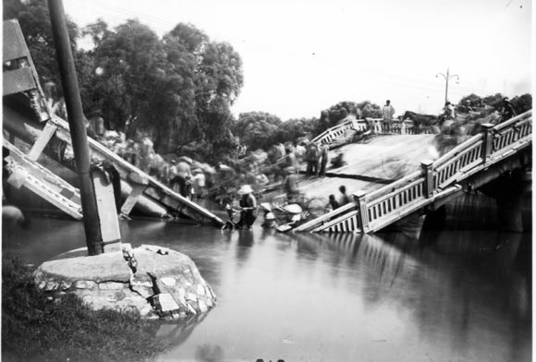
Lead-in
Life is not always full of happiness. Natural disasters can strike at any time. They may cause damage, sadness even death to human beings.
Tangshan
1976

Slide 4
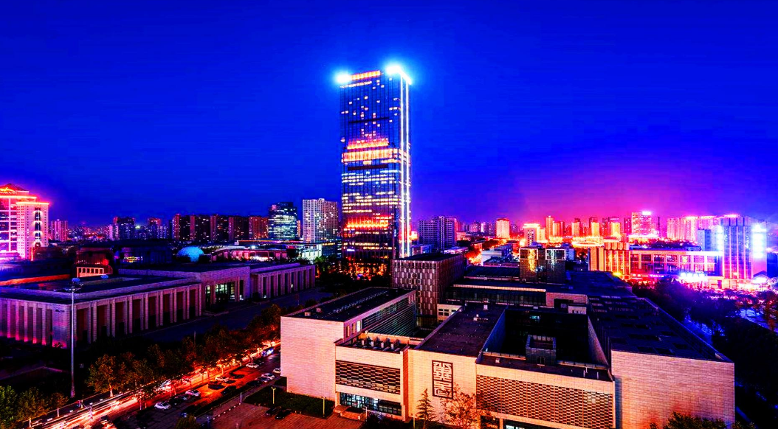
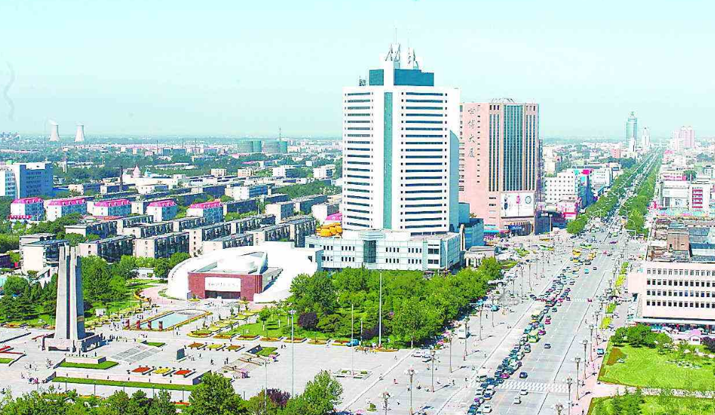
Lead-in
Tang shan’s New Look
But
thanks to those who worked hard to rebuild the city

Slide 5
Lead-in
The United Nations praised / honored the people of Tangshan for rebuilding their city so quickly
The high school speaking competition about new Tangshan

Slide 6
A letter of Invitation
congratulate sb on sth
compete with / against / for
Congratulations! We are pleased to tell you that
Congratulations! We are pleased to tell you that you have won the high school speaking competition about new Tangshan. Your speech was heard by a group of five judges, all of whom agreed that it was the best one this year. Your parents and your school should be very proud of you!
Next month the city will open a new park to honour those who died in the terrible disaster. The park will also honour those who helped the survivors. Our office would like to have you speak to the park visitors on July 28 at 11:00 am. As you know, this is the day the quake happened______years ago.
We invite you to bring your family and friends on that special day.
competition
Background
be very proud of you
show respect / honor to / towards
honour
Express invitation and contents of Activity
would like to have you speak
Restate invitation
would like to have sb. do sth.

Slide 7
Features of an invitation letter
Topic Paragraph
State your purpose or background of writing directly
Invitation
Letter
Introduce the contents of the invitation clearly including specific activitiy, time, location, arrangement and related requirements and wishes
Body Paragraph
Concluding Paragraph
Restate your invitation sincerely and look forward to an early reply

Slide 8
Useful Expressions
1
Topic Paragraph

Slide 9
Useful Expressions
1.
Topic Paragraph
We would like to invite you to ...
It is my greatest pleasure/ honor that I'm writing to invite you to... , which will be held...
It gives me the greatest pleasure to invite you to...
We should be very grateful if you could...

Slide 10
感恩遇见，相互成就，本课件资料仅供您个人参考、教学使用，严禁自行在网络传播，违者依知识产权法追究法律责任。
更多教学资源请关注
公众号：溯恩高中英语
知识产权声明

Slide 11
Useful Expressions
2.
Body Paragraph
It will be held in… from …to … on …
There will be activities such as ..., which I am sure you will thoroughly enjoy.

Slide 12
Useful Expressions
3.
Concluding Paragraph
I'm looking forward to seeing you there.
I would feel honored if you could come.

Slide 13
Practise

Slide 14
Practise
Suppose you are Li Hua, the president of your school union, and you are going to hold a fund-rasising activity on the current disaster--Typhoon Lekima so as to raise money for the typhoon-stricken people to help rebuild their houses. And you are going to write an invitation letter to one of the heros in this disaster to give a speech on this disaster as a guest . (about 100 words)
Purpose
Three Steps
Activity
Wishes

Slide 15
A sample
Dear ______,
Our school is planning to hold a fund-raising activity next week. It is my greatest honor to ask you to come as a guest and make a brief speech on the latest typhoon Lekima.
The activity will start at 9:00 and end at 11:00 next Monday morning on the playground of our school. Because of your heroic deeds, we would very much like you to join us in sharing your bravery with us. Your story will definitely help us gain a deeper understanding of this disaster and see how much the typhoon-stricken people are in need.
I would feel honored if you could come and please let me know as soon as possible so that I can make arrangements in advance. I'm looking forward to seeing you and enjoy the talk.
With best wishes.
Yours sincerely
Li Hua

Slide 16
感恩遇见，相互成就，本课件资料仅供您个人参考、教学使用，严禁自行在网络传播，违者依知识产权法追究法律责任。
更多教学资源请关注
公众号：溯恩高中英语
知识产权声明

Slide 17
Homework-Further Exploration
Suppose you are the hero invited by the school, and prepare a short speech, in which you should include:
1. Decribe what you witnessed during the typhoon
2. Describe the things you did during the rescue?
3. Thank those who worked hard to rescue survivors
and rebuild the city

