Slide 1

扫码关注
回复：hello sun
获取课件制作、录课等实用工具包
知识产权声明
感恩遇见，相互成就，本课件资料仅供您个人参考、教学使用，严禁自行在网络传播，违者依知识产权法追究法律责任。
更多教学资源请关注
订阅号：溯恩英语

Slide 2
M4U5 Reading
Theme Parks——Fun And More Than Fun
邱 赛 仙
浙江省衢州第三中学

Slide 3
Predicting
What do you expect to read with the title
Theme Parks——Fun And More Than Fun?

Slide 4
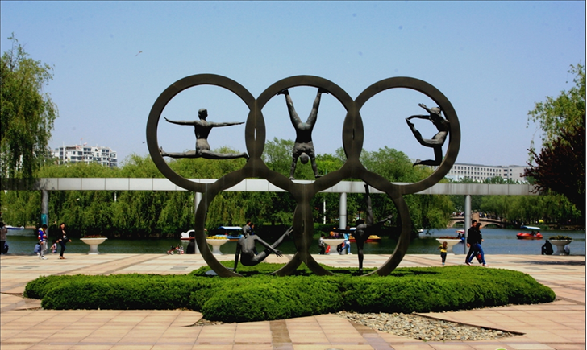
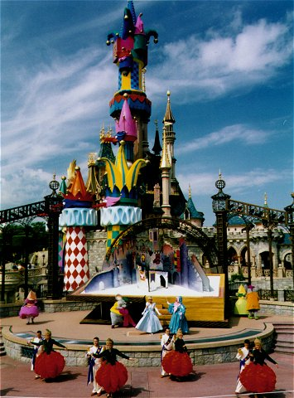

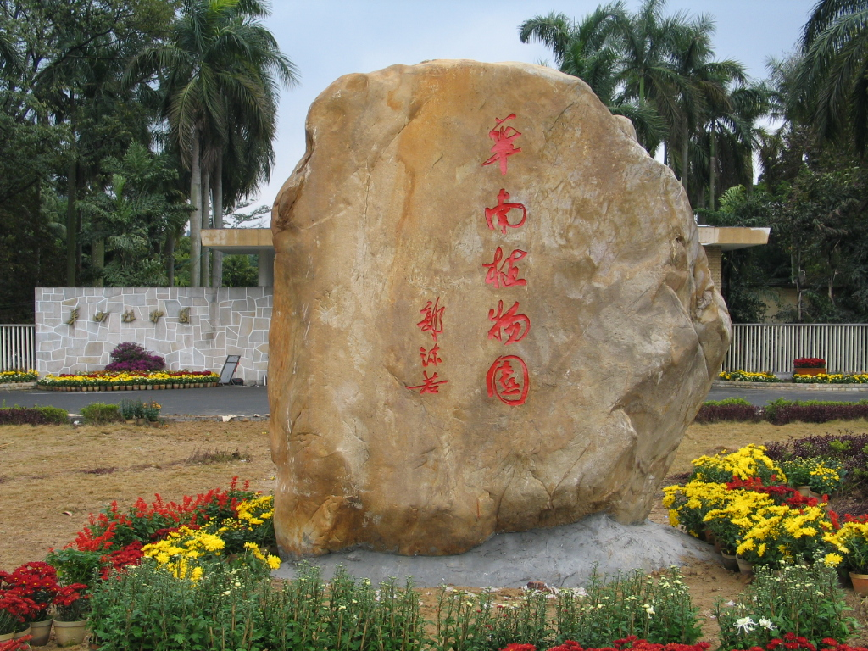
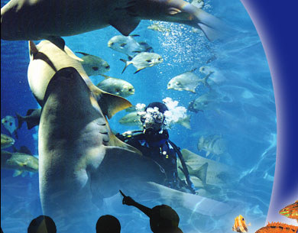

Slide 5
history or culture theme parks
sports theme parks
Theme
Parks
marine or
ocean parks
Disneyland
Future parks
science
theme parks

Slide 6
Recalling
What fun can we have in a theme park?
Bumper car
roller coaster
Merry-go-round
Ferris wheel
slide
Amusement park
Pirate ship
bungee jumping
Horror films
Free-fall rides

Slide 7
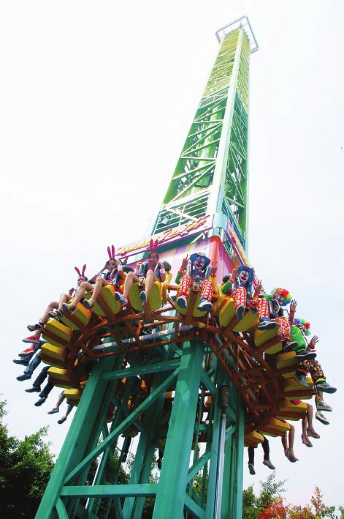
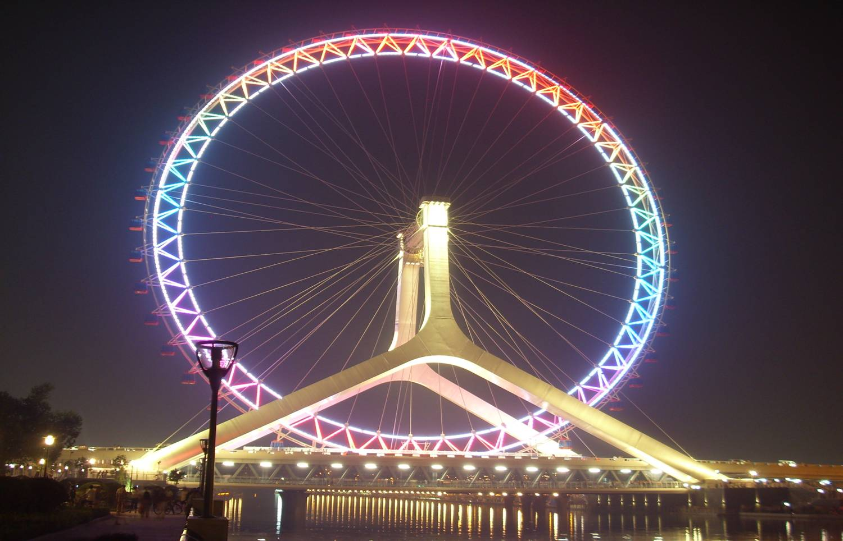
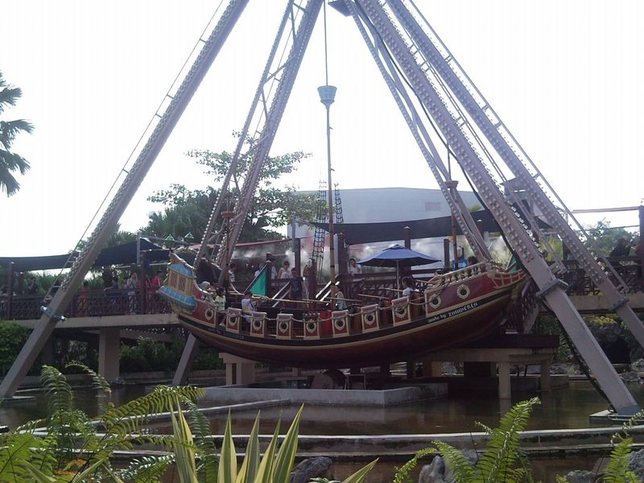
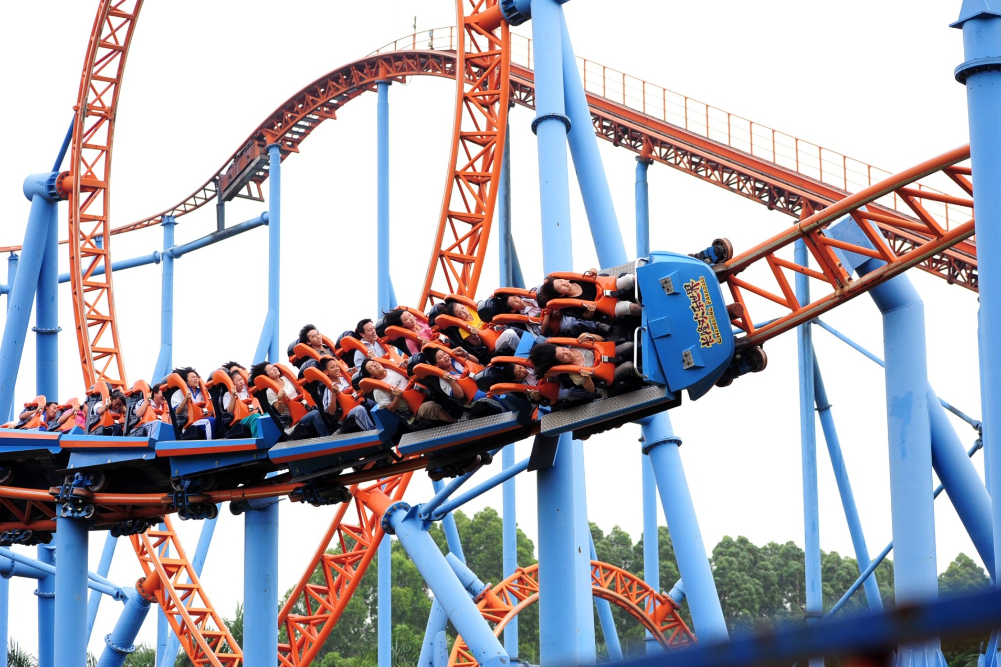
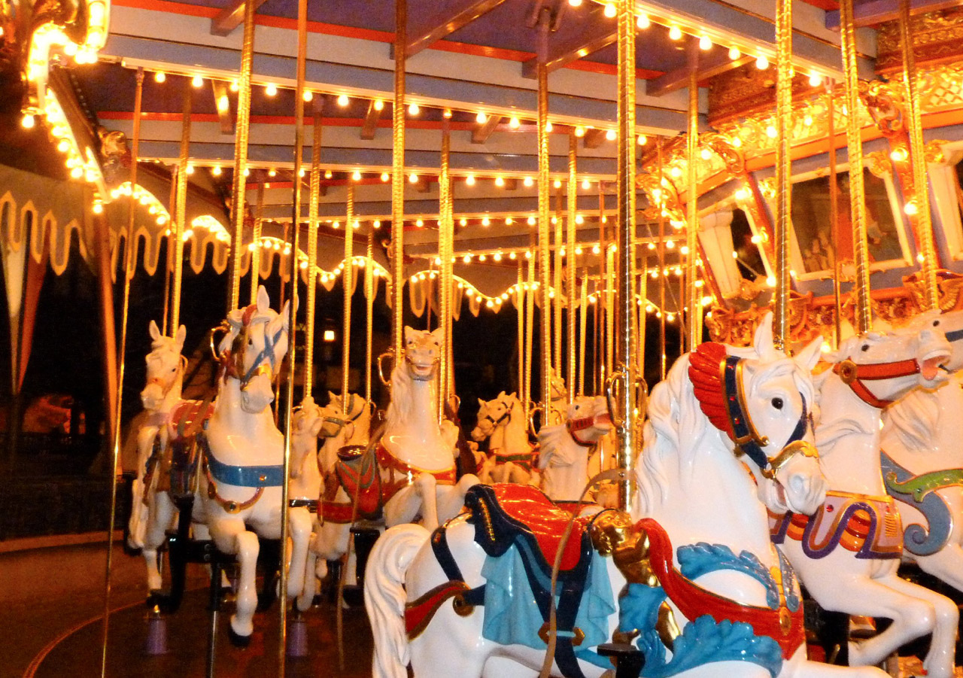
Roller-coaster rides
Free-fall rides
Ferris wheel
Pirate ship
merry-go-round

Slide 8
Game: relay in sentence making !
How would you introduce the topic?
Student1: There are many theme parks in the world.
various
Student2: There are many interesting activities in different theme parks.
with
fun
Student3 :

Slide 9
扫码关注
回复：hello sun
获取课件制作、录课等实用工具包
知识产权声明
感恩遇见，相互成就，本课件资料仅供您个人参考、教学使用，严禁自行在网络传播，违者依知识产权法追究法律责任。
更多教学资源请关注
订阅号：溯恩英语

Slide 10
Fast reading
Find out the main idea of the following paragraphs.
Para. 1
There are various kinds of theme parks, with a different park for almost everything.
Disneyland— the fantasy amusement park
Para. 2
Para. 3
Dollywood—the traditional culture park
Para. 4
England’s Camelot Park— the
history theme park

Slide 11
Reading and appreciating
paragraph1
Rhetorical question
Which theme park would you like to visit? There are various kinds of theme parks, with a different park for almost everything: food, culture, science, cartoons, movies or history. Some parks are famous for having the biggest or longest roller coasters, others for showing the famous sights and sounds of a culture. Whichever and whatever you like, there is a theme park for you!
various words
examples for details
What is the intended reader of the passage?
How did the author try to arouse the readers’ interest?

Slide 12
Reading and thinking
Paragraphs 2-4
Read from paragraph2 to paragraph4, and decide which theme park would you like to visit and give your reasons.

Slide 13
How did the author make the theme park appealing to you?
The theme park you are probably most familiar with is Disneyland. It can be found in several parts of the world. It will bring you into a magical world and make your dreams come true, whether travelling through space, visiting a pirate ship or meeting your favorite fairy tale or Disney cartoon character. As you wander around the fantasy amusement park, you may see Snow White or Mickey Mouse in a parade or on the street. Of course Disneyland also has many exciting rides, from giant swinging ships to terrifying free-fall drops. With all these attractions, no wonder tourism is increasing wherever there is a Disneyland. If you want to have fun and more than fun, come to Disneyland!
magical
thrilling
various activities to entertain yourself

Slide 14
Dollywood, in the beautiful Smoky Mountains in the southeastern USA, is one of the most unique theme parks in the world. Dollywood shows and celebrates America’s traditional southeastern culture. Although Dollywood has rides, the park’s main attraction is its culture. Famous country music groups perform there all year in indoor and outdoor theatres. People come from all over America to see carpenters and other
craftsmen make wood, glass and iron objects in the old-fashioned way. Visit the candy shop to try the same kind of candy that American southerners made 150 years ago, or take a ride on the only steam-engine train still working in the southeast USA. You can even see beautiful bald eagles in the world’s largest bald eagle preserve. And for those who like
rides, Dollywood has one of the best old wooden roller coasters, Thunderhead. It is world-famous for having the most length in the smallest space. Come to Dollywood to have fun learning all about America’s historical southeastern culture!
and celebrates America’s traditional southeastern culture.
activities to learn about America’s historical southeastern culture

Slide 15
If you want to experience the ancient days and great deeds of
English knights and ladies, princes and queens, then England’s
Camelot Park is the place for you. Every area of the park is
modelled after life in the days of King Arthur and the Knights
of the Round Table. In one place, you can watch magic shows
with Merlin the Wizard. If you want to see fighting with swords
or on horseback, then the jousting area is a good place to visit.
If you do well there, King Arthur may choose you to fight in
the big jousting tournament. Do you like animals? Then visit
the farm area, and learn how people in ancient England ran
their farms and took care of their animals. To enter a world of
fantasy about ancient England, come to Camelot Park!
Use hypothesis to attract readers to explore the park

Slide 16
Critical thinking
How do you understand the title “Theme Park –—
Fun and more than fun”?
fun and more than fun
Disneyland is mainly for entertainment
Dollywood’s main attraction is its culture
Camelot Park is to help learn about history
Theme parks are fun to visit, but they can also be educational.
What is the purposes for building theme parks?

Slide 17
Purposes for building theme parks
 | Purpose | Explanation
1
2
3
many rides to go on and
shows to see
to entertain
Visitors can learn about history, cultures and science.
to educate
to make profits
charge for admission, rides and shows; sell souvenirs and advertise them on TV

Slide 18
扫码关注
回复：hello sun
获取课件制作、录课等实用工具包
知识产权声明
感恩遇见，相互成就，本课件资料仅供您个人参考、教学使用，严禁自行在网络传播，违者依知识产权法追究法律责任。
更多教学资源请关注
订阅号：溯恩英语

Slide 19
Micro-writing
Work in pairs to design the best theme park in your mind.
name
theme
attractions
purposes
----

Slide 20
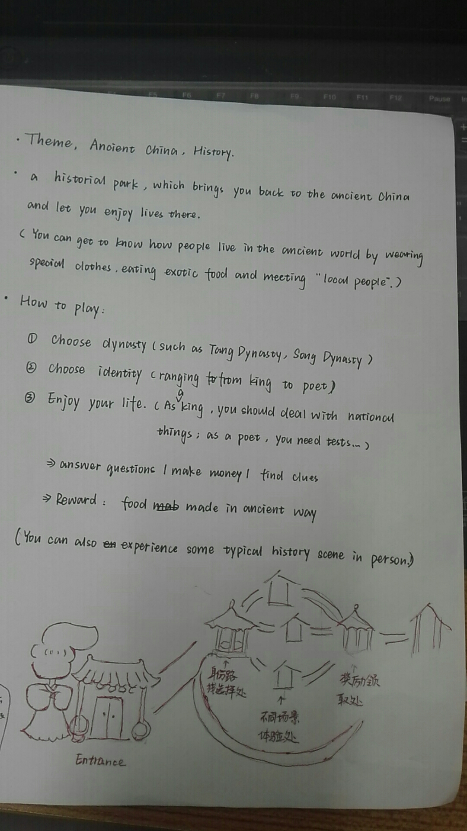
学生习作
Ancient China Theme Park
* What to learn
A historical park, which brings you back to ancient China and let you experience life there.
(you can get to know how people lived in the ancient by wearing special clothes, eating exotic food and meeting “local people”)
*How to enjoy yourself
① choose dynasty (such as Tang Dynasty, song Dynasty)
②Choose identity(ranging from the king to the poet)
③ Enjoy yourselves
→ as a king, you are to deal with national events.
→ answer questions—make money—find clues
→ reward: food made in ancient way.

