Slide 1
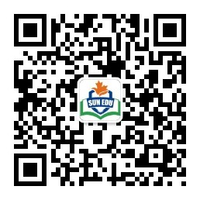
扫码关注
回复：hello sun
获取课件制作、录课等实用工具包
知识产权声明
感恩遇见，相互成就，本课件资料仅供您个人参考、教学使用，严禁自行在网络传播，违者依知识产权法追究法律责任。
更多教学资源请关注
订阅号：溯恩英语

Slide 2

M4U5 Using Language
Futuroscope-Exciting And Learning
邱 赛 仙
浙江省衢州第三中学

Slide 3
step 1: Talking
What is the theme park you are dreaming to visit ?
a journey to space
a voyage to the ocean
The fantastic
theme park
a trip to the jungle
----
a visit to ancient castle

Slide 4
step2: Viewing and thinking
Futuroscope can satisfy all your demands
What do you expect to read from the passage with the help of the map of Futuroscope?
what to see?
what to do?
How to visit it?
what to learn
----

Slide 5
Step3: Reading and checking
journey to the solar system
Space
thrilled
pulled into a Black Hole
excited
amazed
surviving an air crash
Earth
How to feel?
what to do?
unbelievable
joining in car racing
delighted
skiing on the most difficult mountain
astonished
----
meeting face to face with a dinosaur
dive to the undersea
Under sea
P1

Slide 6
in time order
How did the author describe so rich an experience?
Last week I took a journey deep into space, to the end of the solar system, and was pulled into a black hole. Then I took a trip to Brazil and experienced surviving an airplane crash in the jungle. After that, I joined some divers and went to the bottom of the ocean to see strange blind creatures that have never seen sunlight. For a break, I took part in some car racing and then skied down some of the most difficult mountains in the world. I ended my travels by meeting face to face with a dinosaur, the terrible T-Rex, and survived the experience!
Last week
space
Then
jungle
After that
ocean
For a break,
car racing
ended
thrilling activities in space，land and the ocean
dinosaur

Slide 7
How can the park make it ?
advanced technology
future
scope
3-D cinemas
giant movie screens
exciting
learning
brand new experiences
get close to
learning centres
P2

Slide 8
扫码关注
回复：hello sun
获取课件制作、录课等实用工具包
知识产权声明
感恩遇见，相互成就，本课件资料仅供您个人参考、教学使用，严禁自行在网络传播，违者依知识产权法追究法律责任。
更多教学资源请关注
订阅号：溯恩英语

Slide 9
buy tickets at the park entrance
tickets
book tickets online
How to visit the park ?
individuals
visitors
class or large groups
shuttle service
transportation
by car
plan your trip well
preparations
wear sneakers or other walking shoes
P3

Slide 10
Step4: Reading and thinking
Q1: What is the major reason that has made Futuroscope such a success?
admission fee and advanced technology
Q2: What is the theme of futuroscope?
science and technology
Q3: What appeals to you most about Futuroscope?
Q4:What is futuroscope in your opinion?

Slide 11
Step5: Writing
Suppose you are a staff member of Futuroscope, make a brochure to advertise the theme park.

Slide 12
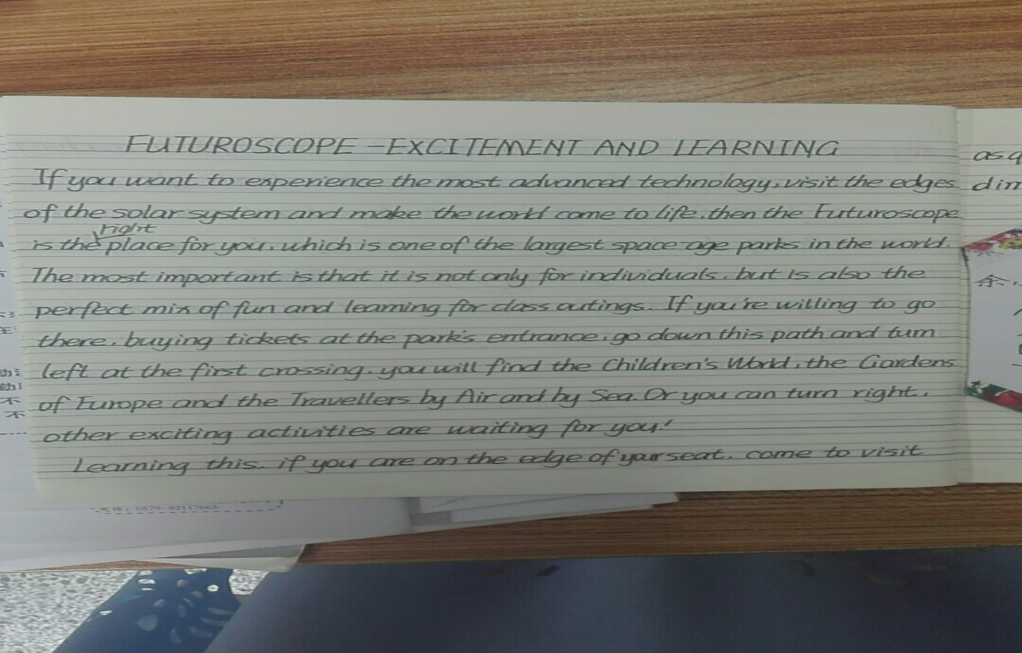

Slide 13
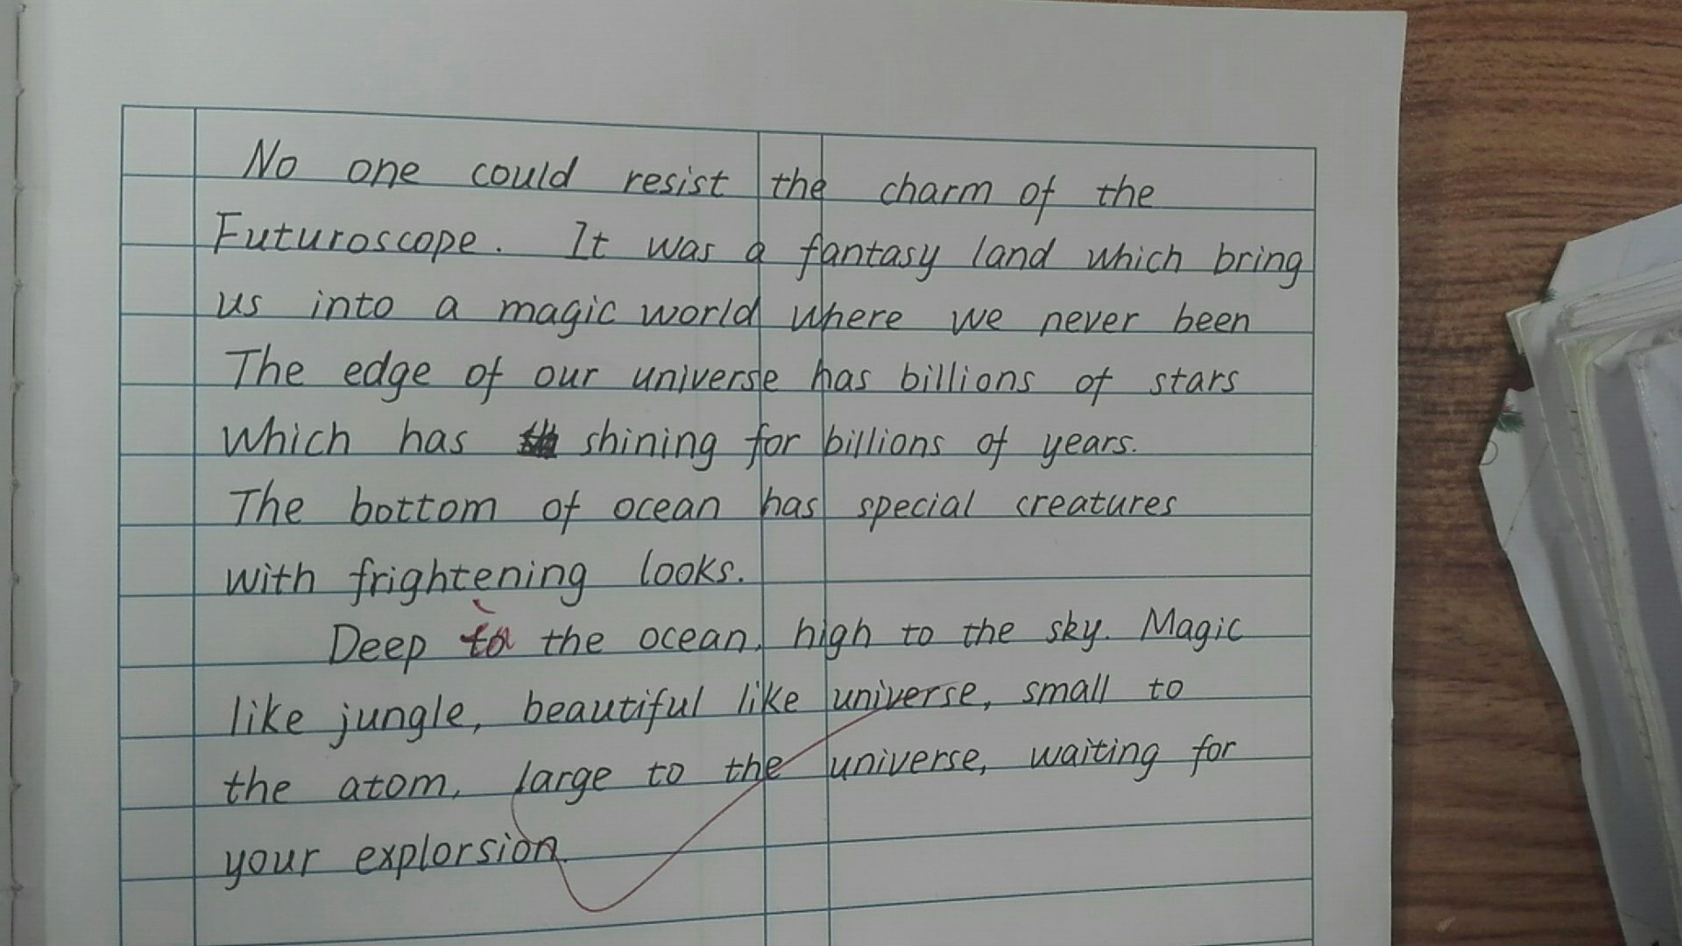

Slide 14
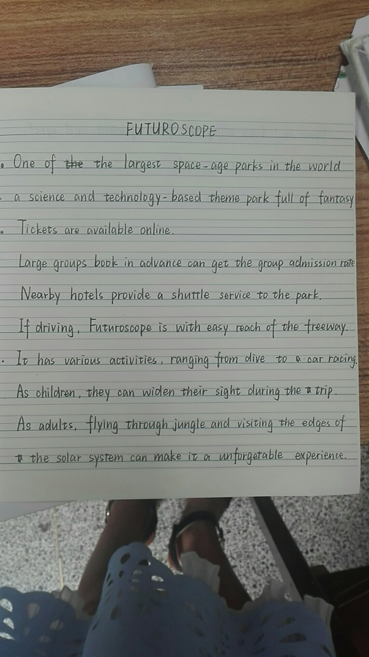

Slide 15
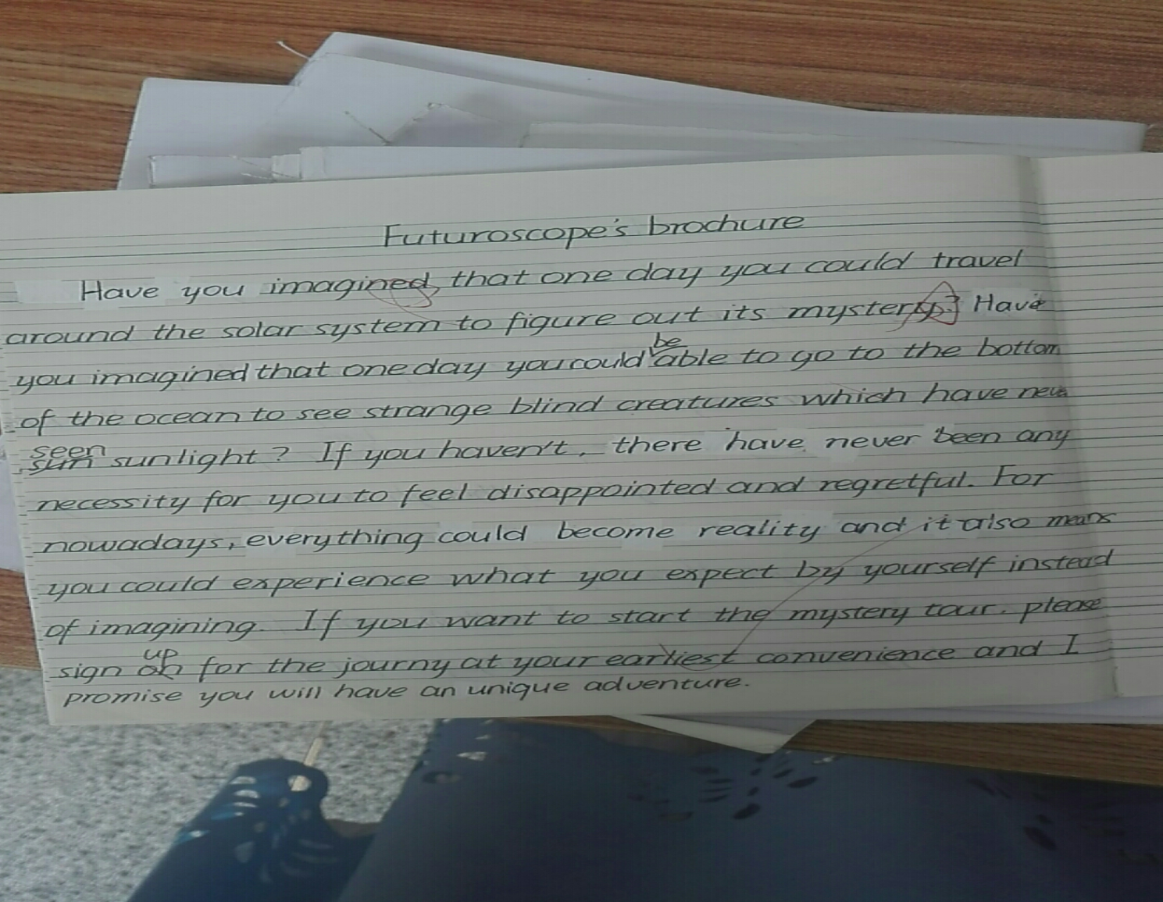

Slide 16
扫码关注
回复：hello sun
获取课件制作、录课等实用工具包
知识产权声明
感恩遇见，相互成就，本课件资料仅供您个人参考、教学使用，严禁自行在网络传播，违者依知识产权法追究法律责任。
更多教学资源请关注
订阅号：溯恩英语

Slide 17
