Slide 1

感恩遇见，相互成就，本课件资料仅供您个人参考、教学使用，严禁自行在网络传播，违者依知识产权法追究法律责任。
更多教学资源请关注
公众号：溯恩高中英语
知识产权声明

Slide 2
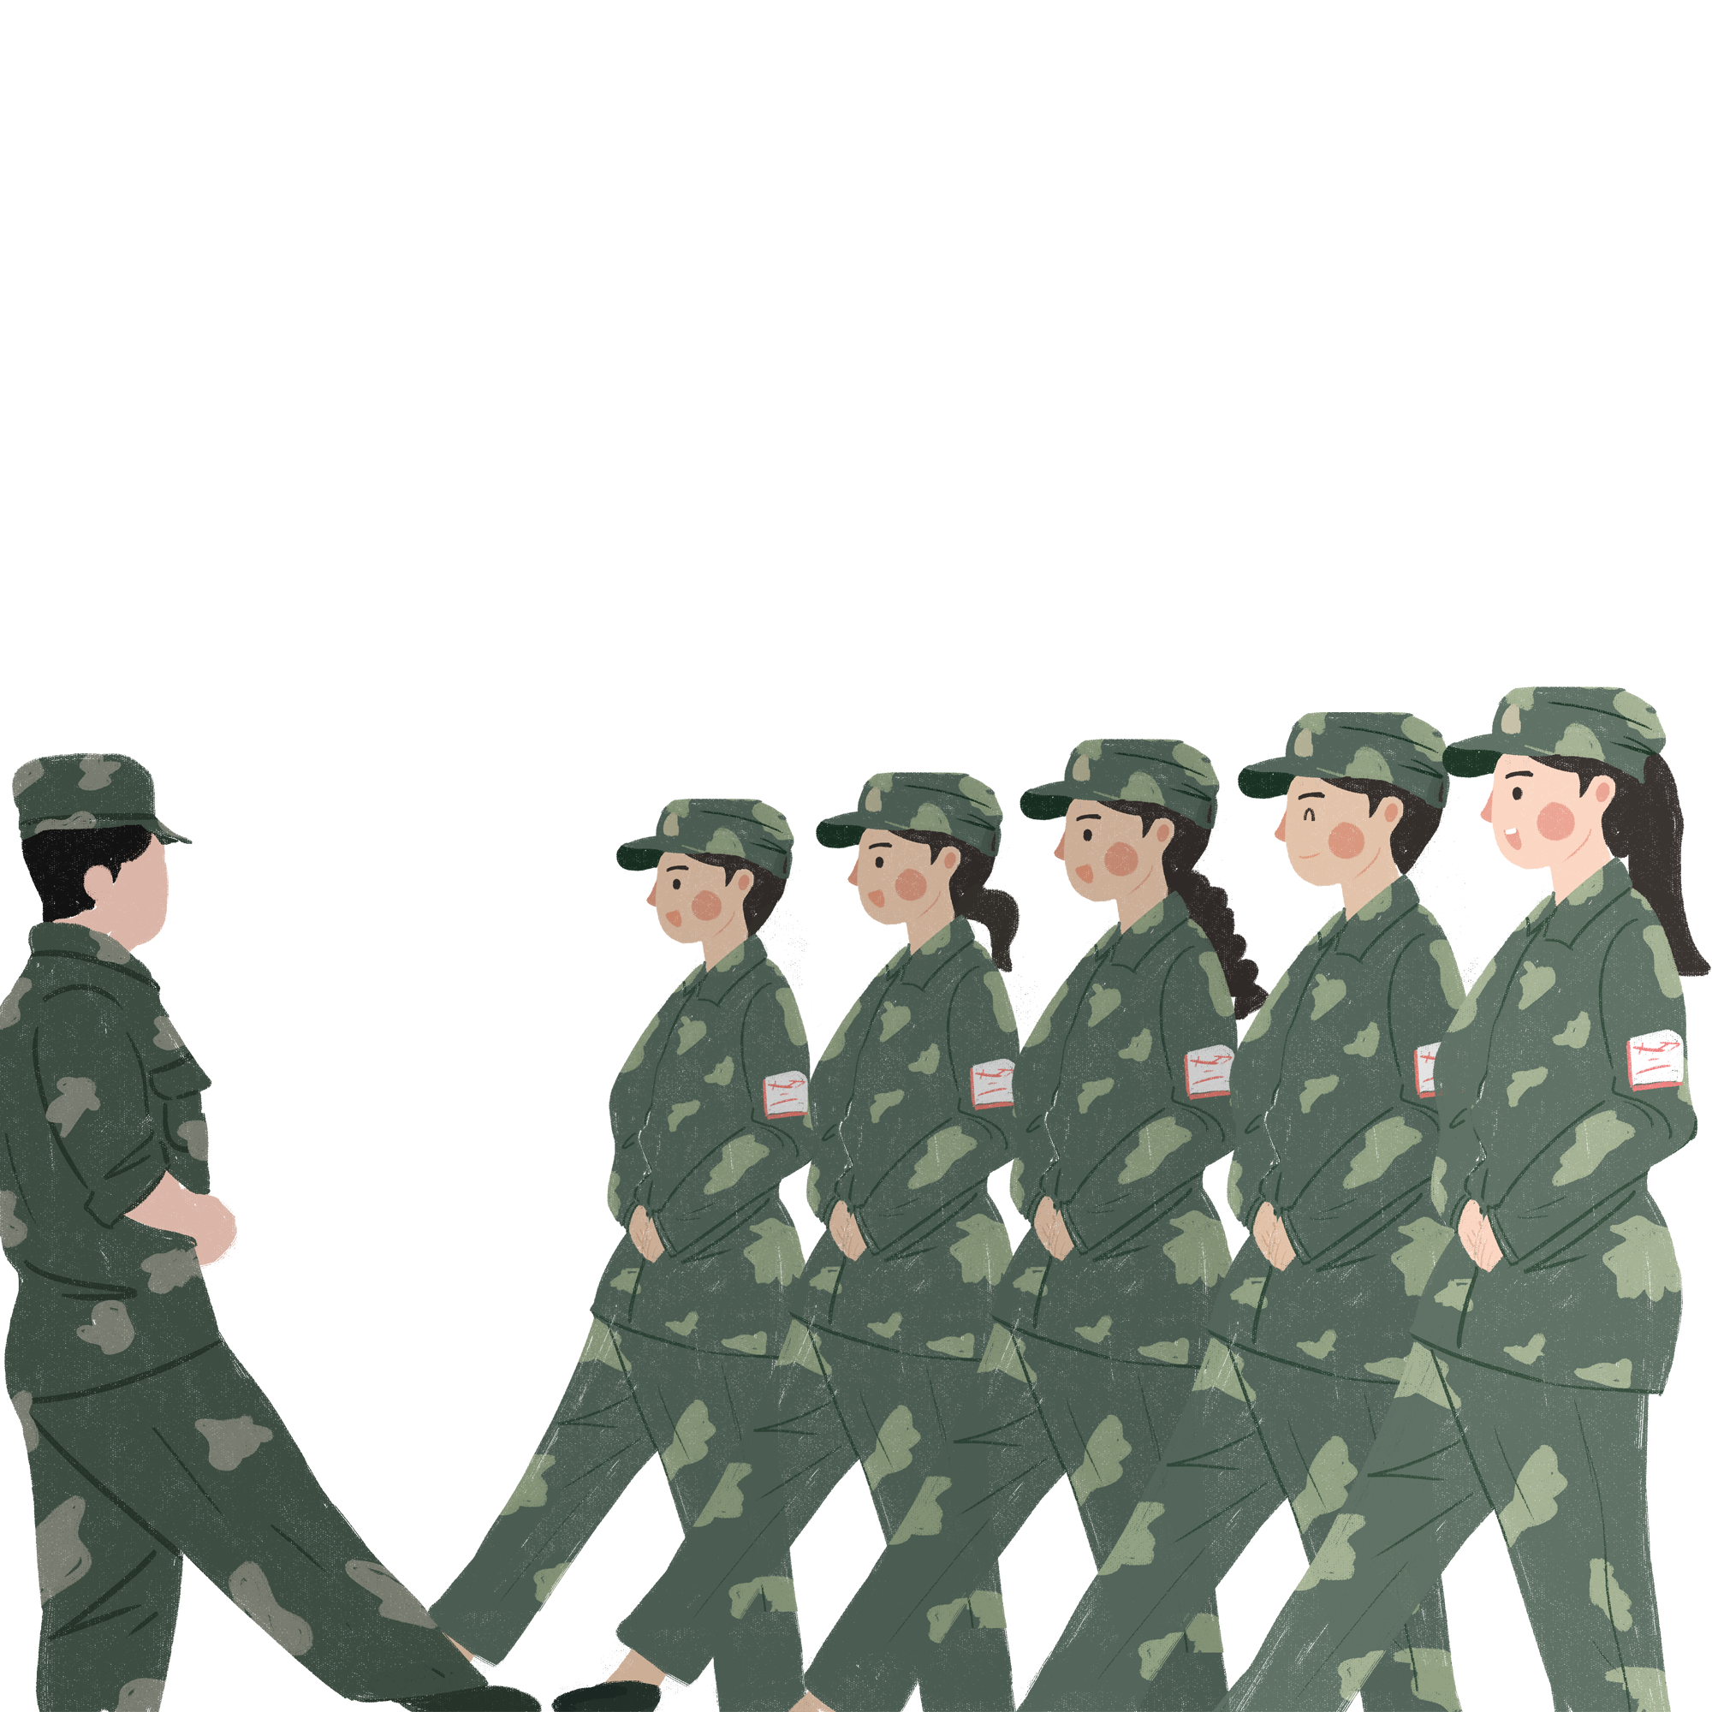
Discovering Useful Structures
人教版新教材
Model 1 Unit1 Teenage Life
Apple

Slide 3

What left you a deep impression during your first week in high school?

Slide 4
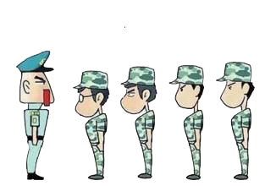
Experience of military training
1. How was your military training in the first week?
2. How many students joined in the training in your class?
3. What was the weather like during those days?
4. How many hours have you been trained each day?
5. What do you think of your drillmaster?

Slide 5
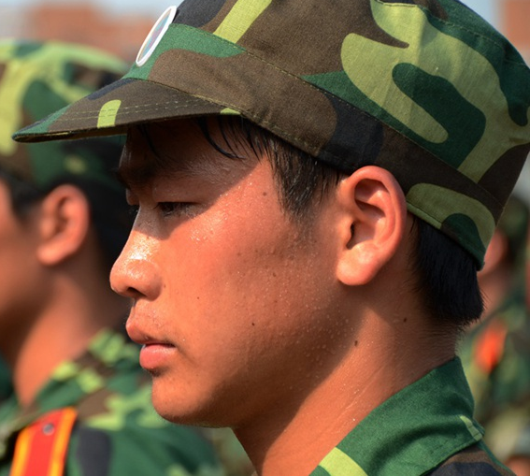
An impressive experience of military training
Complete the following passage with suitable words. (Two of them are extra.)
following; more;new; quite; nonstop; sudden;enough; heavy; per; dazzling; tired; tough
Sep.6th Thursday Sunny
With the _______ school semester around the corner, 640 students in our school attended the seven-day-long military training. It was really a _______ trial(考验) to freshmen. We were trained ________ for six hours ______day in marching and walking in the hot, _________ sunshine. Presently(不久), a ________ shower worsened the situation. Beaten by the steady drops of the rain, we were almost _______ to death. However, our strict drillmaster(教官) pushed us to move on, saying “All your sweat and efforts will pay off in the end! Hold on!” Hearing the words, we hardened our will, and became ______ diligent in the _______ days. Strangely _______, we didn't feel painful any more. And finally to our joy we receive an award in the military parade.
new
tough
nonstop
per
dazzling
sudden
tired
more
following
enough

Slide 6

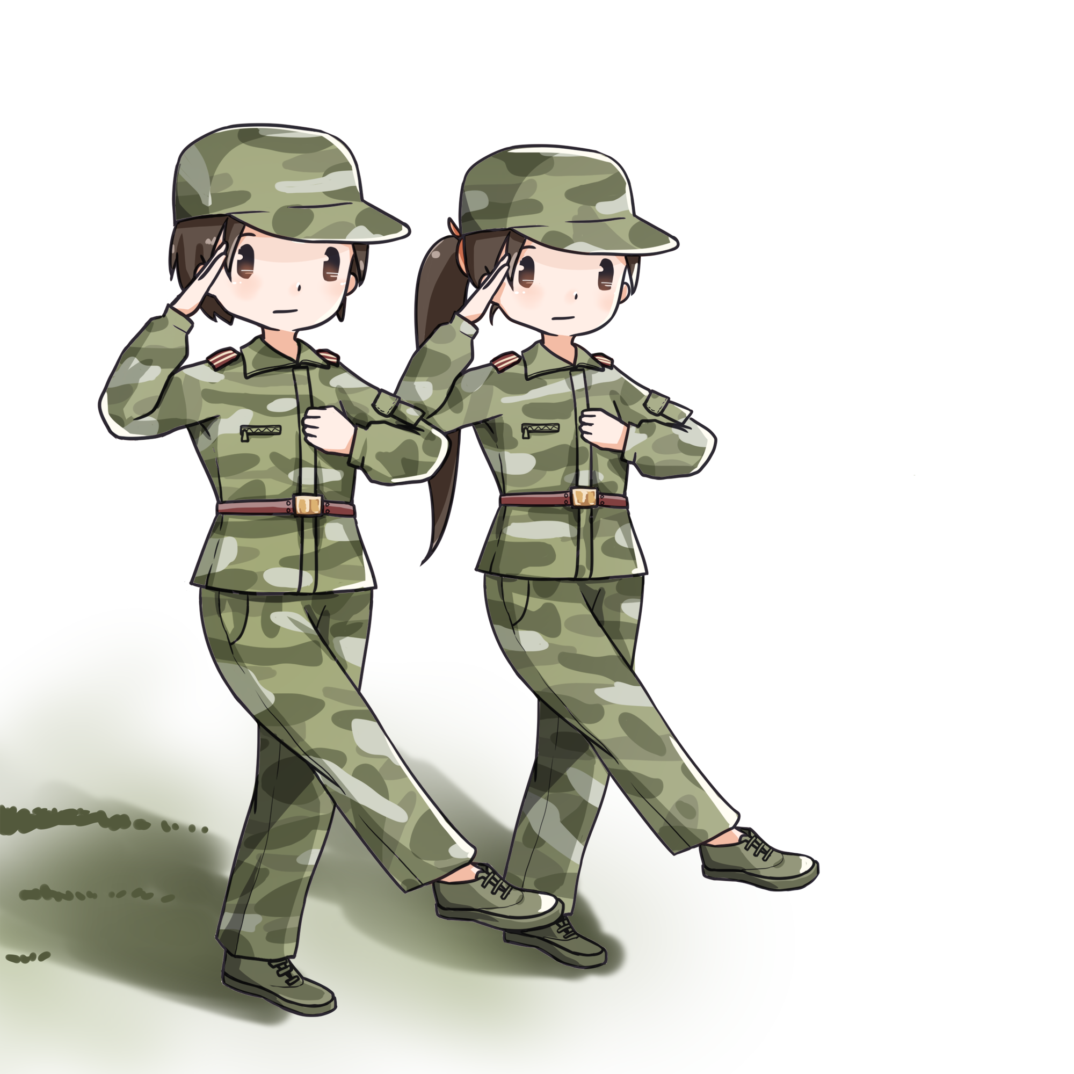
限定词
中心词 headword（n.）
NP
限定词
形容词
中心词headword （n.）
Sep.6th Thursday Sunny
With the new school semester around the corner, 640 students in our school attended the seven-day-long military training. It was really a tough trial(考验) to freshmen. We were trained nonstop for six hours per day in marching and walking in the hot, dazzling sunshine. Presently(不久), a sudden shower worsened the situation. Beaten by the steady drops of the rain, we were almost tired to death. However, our strict drillmaster(教官) pushed us to move on, saying “All your sweat and efforts will pay off in the end! Hold on!” Hearing the words, we hardened our will, and became more diligent in the following days. Strangely enough, we didn't feel painful any more. And finally to our joy we receive an award in the military parade.
the new school semester
640 students
用于限定名词所指的范围，如特指或泛指、定量或不定量等。如these，three，a，the，my和that等。
被修饰的名词
the seven-day-long military training
a tough trial
six
hours
per day
the hot, dazzling sunshine
a sudden shower
the steady drops
our strict drillmaster
All your
sweat and efforts
the following
days
the military parade.

Slide 7
前置修饰词
中心词headword（adj.）
AdjP
中心词headword（adj.）
后置修饰词
Sep.6th Thursday Sunny
With the new school semester around the corner, 640 students in our school attended the seven-day-long military training. It was really a tough trial(考验) to freshmen. We were trained nonstop for six hours per day in marching and walking in the hot, dazzling sunshine. Presently(不久), a sudden shower worsened the situation. Beaten by the steady drops of the rain, we were almost tired to death. However, our strict drillmaster(教官) pushed us to move on, saying “All your sweat and efforts will pay off in the end! Hold on!” Hearing the words, we hardened our will, and became more diligent in the following days. Strangely enough, we didn't feel painful any more. And finally to our joy we receive an award in the military parade.

Slide 8
前置修饰词
中心词headword（adv.）
AdvP
中心词headword（adv.）
后置修饰词
Sep.6th Thursday Sunny
With the new school semester around the corner, 640 students in our school attended the seven-day-long military training. It was really a tough trial(考验) to freshmen. We were trained nonstop for six hours per day in marching and walking in the hot, dazzling sunshine. Presently(不久), a sudden shower worsened the situation. Beaten by the steady drops of the rain, we were almost tired to death. However, our strict drillmaster(教官) pushed us to move on, saying “All your sweat and efforts will pay off in the end! Hold on!” Hearing the words, we hardened our will, and became more diligent in the following days. Strangely enough, we didn't feel painful any more. And finally to our joy we receive an award in the military parade.

Slide 9




Why are AdjP/AdvP /NP important to use?
What have you learnt during the military training?
They make your writing /speaking more
SPECIFIC
VIVID
VISUAL
CONVINCING
A: I learnt that the train is meaningful.
B: The seven-day training was an unforgettable memory
that was really meaningful to each newly-admitted
student. So tough as it might be, we have become more
endurant through it.

Slide 10

Practice
Describe the following pictures with NP/AdjP/AdvP
After a seven-day training, I got severely sunburnt.
Beneath the extremely hot sun, beads of sweat continued to roll down my sunburnt face.
After a tough day, totally exhausted, I surprisingly found my exposed skin from red to completely black.

Slide 11
感恩遇见，相互成就，本课件资料仅供您个人参考、教学使用，严禁自行在网络传播，违者依知识产权法追究法律责任。
更多教学资源请关注
公众号：溯恩高中英语
知识产权声明

Slide 12
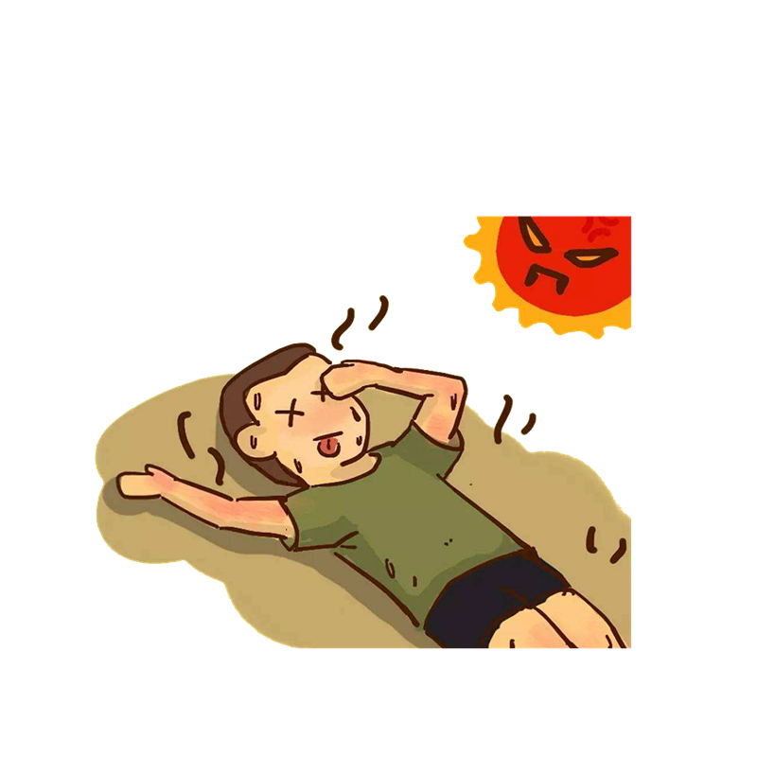
After two-hour tedious physical training, one of my classmates, Lihua, fainted in the blazing heat.

Slide 13
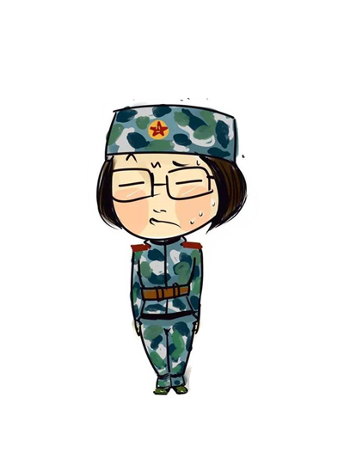
The most terrible part of the military training is to stand still for almost two hours each day. The longer I stood, the more stiff I felt my body become.

Slide 14
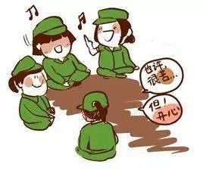
The military training made us united as a team. We shared our sweat and tears, happiness and sorrows through daily ups and downs.

Slide 15


Group work
A. Use NPs/AdjPs/AdvPs to shapen the following surroundings
The school contains flowers and plants that can ease tiredness .
.
What was so amazing to see is that the fresh, lush school contains a variety of bright, colorful flowers and strong, green plants along the playground that can ease our tiredness.

Slide 16

Is military training necessary for freshmen?
Extremely tough as it was, it offered an opportunity for students to heighten their awareness of self-discipline, harden their bodies as well as learn some skills to cooperate with others.

Slide 17
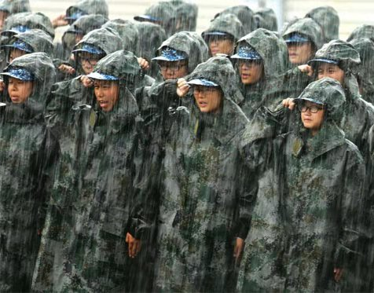
A new understanding of military training:
The military training is a way to:
T______ our bodies;
R______ our faith;
A______ our indolence(懒惰)；
I ______ our military spirit;
N_____ the distance between classmates
oughen
estore
bandon
nherit
arrow

Slide 18
Homework
下文是Amy 所写的军训通讯稿, 缺少生动、具体的描写。现在Amy求助你帮她改写文章，请你用合适的名词短语、形容词短语、副词短语丰富稿件内容，使描述对象/事件更加具体、生动、突出。

Slide 19

B. Use NPs/AdjPs/AdvPs to concretize the following event
We began our military training with fear. Actually, I
prayed that it would rain so we could miss it and stay indoors. But I was wrong. The training continued even it rained cats and and dogs. What's worse, exhausted as we were, there was much for us to improve.
Suddenly, a girl fainted. I took her to the room. When she came to life, she cried and complained. I tried to calm her down and explained reasons to her. To my joy, she returned to continue the training with me.

Slide 20
As planned, we began our one-week military training with increasing fear day after day. To be honest, every single day I prayed in my heart that it would rain heavily so we could miss it and stay indoors. But I was totally wrong. The training continued even it rained cats and dogs. What's worse, extremely exhausted as we were, there was still much for us to improve.
What impressed me most was a girl beside me who fainted in the dazzling sun. I took her to the medical room immediately. When slowly she came to life, she burst out crying and complained a lot about the harsh training. I tried to calm her down and explained the positive reasons to her. To my great joy, with my encouragement, she returned to continue the training with me.
Recalling the past seven days, I learnt that the military training made us united as a real family. We shared our sweat and tears, happiness and sorrows through daily ups and downs. The strict discipline and hard training were real challenges, but it was these sufferings that strengthened our minds, and tightened our friendships.

Slide 21
感恩遇见，相互成就，本课件资料仅供您个人参考、教学使用，严禁自行在网络传播，违者依知识产权法追究法律责任。
更多教学资源请关注
公众号：溯恩高中英语
知识产权声明

Slide 22
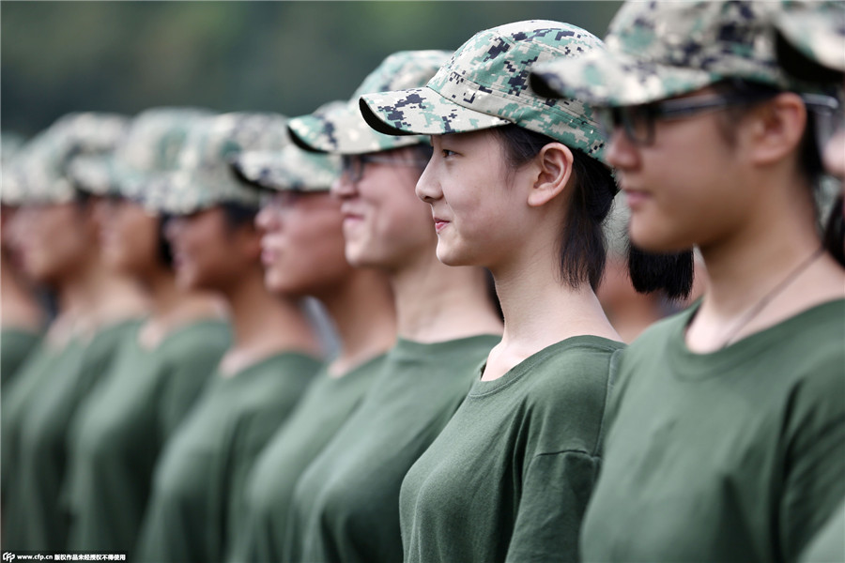
The end

