Slide 1

感恩遇见，相互成就，本课件资料仅供您个人参考、教学使用，严禁自行在网络传播，违者依知识产权法追究法律责任。
更多教学资源请关注
公众号：溯恩高中英语
知识产权声明

Slide 2
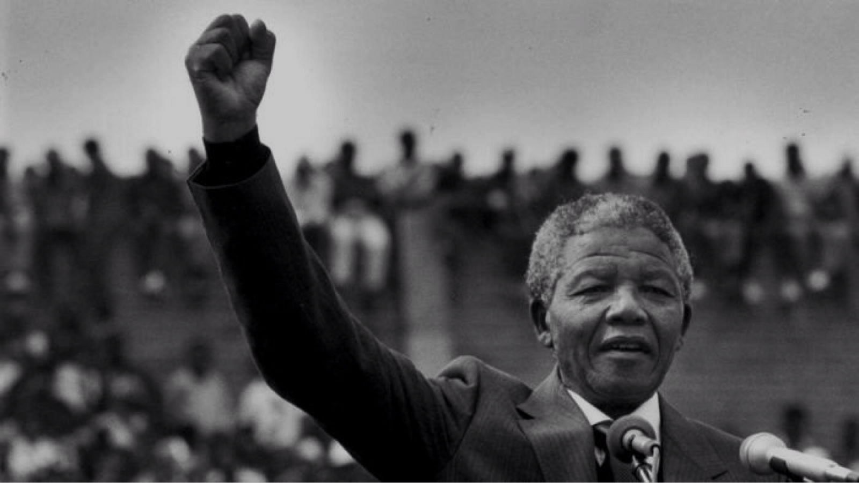

M1U5
Nelson Mandela
— a modern hero
Using language

Slide 3
revision
Elias’story
born
1940 | Elias was _____ in South Africa.
1946 | Elias began school.
1948 | Elias left school and got a job because his family couldn’t ____________________________.
1952 | Elias went to Nelson Mandela for advice because he worried about ________________.
1963 | Elias _______ some government buildings.
pay the school fees and bus fare
becoming out of work
blew up

Slide 4

Elias’ life experiences
+
born
Happiness
Time
1940 1946 1948 1952 1963
_

Slide 5
Elias’ life experiences
+
met
Mandela
began school
blew up
buildings
born
?
Happiness
Time
1940 1946 1948 1952 1963
left school
_

Slide 6
Reading
2
____ Mandela taught Elias during lunch breaks and the
evening.
____ Elias found a job in an office.
____ Elias became a guide showing tourists over Robben
Island with Mandela’s help.
____ Elias was fired because he had used violence against
government.
____ Elias was not allowed to take a degree in prison.
____ Elias had the hardest time of his life on Robben Island.
selfless
4
6
the ANC came to power
5
more equal rights
3
1

Slide 7

In the prison
1. He was beaten.
the hardest time
2. The guards were cruel.
3. His friends died in prison.

Slide 8
Elias’ life experiences
became a guide
+
received
education
got a job
blew up
buildings
Happiness
Time
1963 1967 1994
couldn’t get a degree
out of work
in prison
alone
remembered pains
_

Slide 9
感恩遇见，相互成就，本课件资料仅供您个人参考、教学使用，严禁自行在网络传播，违者依知识产权法追究法律责任。
更多教学资源请关注
公众号：溯恩高中英语
知识产权声明

Slide 10


Role Play
Elias
Student A
Explain the reasons of your terror and fear
Elias’s wife
Student B
Express your sympathy
Encourage him to cheer up

Slide 11
Reference
Elias
Elias’s wife
I worried about whether…
The time when … I felt…
It was a prison where…
You couldn’t imagine…
We have reached a stage where…
I just want you not to lose heart.
I’ m always willing to support you because….
Only then can we…
I hope you can...

Slide 12
The Encouragement Letter
Beginning
Para.1 to show your concern and clearly state your writing purpose
I’m extremely sorry to hear that….
I regret to hear that…
I cannot tell you how sad I was when I was told…
Hearing that…, I’m very concerned about …

Slide 13
The Encouragement Letter
Body
Para.2 to further encourage the recipient
Only when …can you go through the difficulty.
I’m fully confident that…
overcome the difficulty
fight against…
believe in oneself

Slide 14
The Encouragement Letter
Closing
Para.3 to offer some help and express your wishes
If you want me to do anything, do not hesitate to let me know.
I would be delighted if I can do anything for you.
I’ll always be here to support you.
I hope that by the time this letter reaches you, you’ll be feeling much better.
Hope you can be out of depression as soon as possible.

Slide 15
感恩遇见，相互成就，本课件资料仅供您个人参考、教学使用，严禁自行在网络传播，违者依知识产权法追究法律责任。
更多教学资源请关注
公众号：溯恩高中英语
知识产权声明

Slide 16
Assignment
Suppose you’re Nelson Mandela, write a letter to encourage Elias and offer him some help!
Dear Elias,
_________________________________________________________________________________________________________________________________
______________________________________________________________________________________
Yours,
Nelson
In 1994

