Slide 1
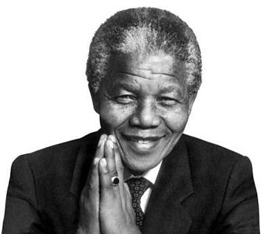
M1U5
Nelson Mandela
— a modern hero
Reading

Slide 2

感恩遇见，相互成就，本课件资料仅供您个人参考、教学使用，严禁自行在网络传播，违者依知识产权法追究法律责任。
更多教学资源请关注
公众号：溯恩高中英语
知识产权声明

Slide 3
Guessing Game
Who is my hero/heroine?
He/she discovered a new drug and selflessly tested it on himself/herself.
He/she saved millions of lives, mainly in Africa.
He/she was the first Chinese to win The Nobel Prize in Medicine.

Slide 4
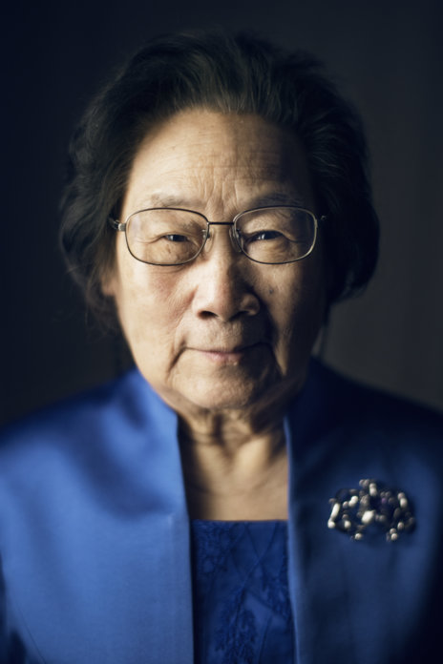
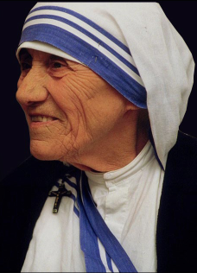
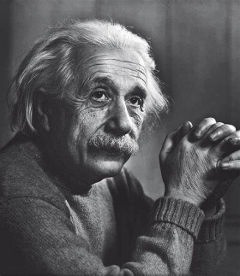
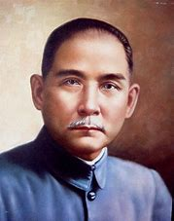
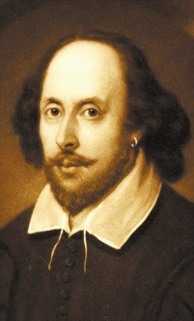
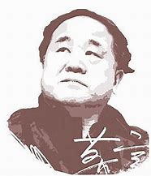
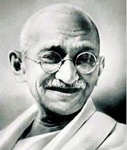
Guessing Game
My heroine
Tu Youyou
Your hero/heroine
?
…

Slide 5
Qualities
selfless
devoted
brave
hard-working
hero/ heroine
determined
helpful
kind
…

Slide 6
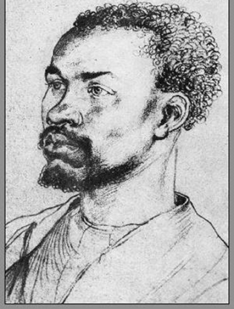
Fast reading
Elias’s story
Who is Elias?
When was he born? When did this story end?
Who is the story teller?
What’s the relationship between him and Mandela?

Slide 7
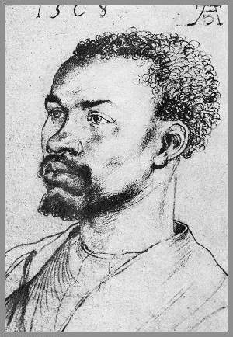
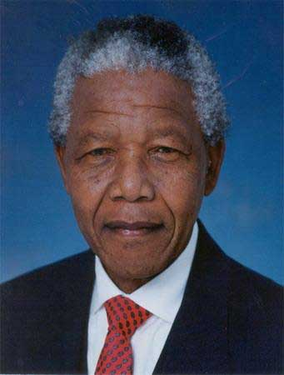
Fast reading
1940-1963
What’s the relationship between them?
A. Relatives
B. Enemies
C. Guide and supporter
Elias:
a poor black worker
Nelson Mandela: a black lawyer

Slide 8
Guide
Supporter
________ did Elias need Mandela’s guidance?
________ did Mandela guide him?
________ did Elias support Mandela?
________ did he support Mandela?
Why
How
How
Why

Slide 9
Para.1&2
Why?
little education
no passbook to work
(for black people only)
Guide
Notes:
Why did he receive little education?
What if he didn’t get one?

Slide 10
Para.3-5
How?
He told Elias how to get the correct papers to stay in Johannesburg.
Guide

Slide 11
感恩遇见，相互成就，本课件资料仅供您个人参考、教学使用，严禁自行在网络传播，违者依知识产权法追究法律责任。
更多教学资源请关注
公众号：溯恩高中英语
知识产权声明

Slide 12
Para.3-5
How ?
He joined ANC Youth League as soon as he could.
He helped Mandela blow up some government buildings.
Why?
Support

Slide 13
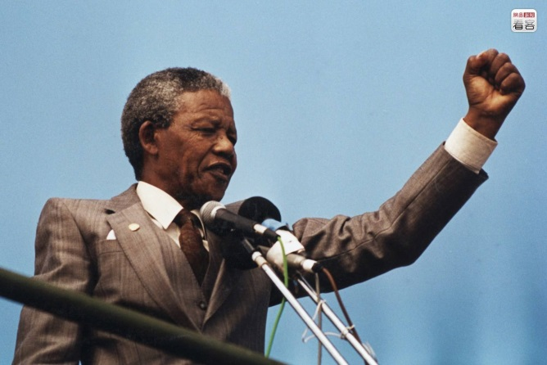
Para.3-5
“The last thirty years have seen the greatest number of laws stopping our rights and progress, until today we have reached a stage where we have almost no right at all.”
Black people
__________________ was not allowed to
___________________________________, ____________________________________,
____________________________________, because _________________________________________________ in the last thirty years.
vote or choose their leaders
get the jobs they wanted
and decide where to live
laws stopped their rights and progress

Slide 14
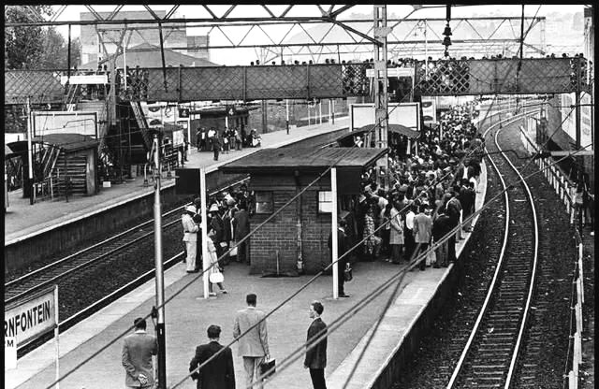
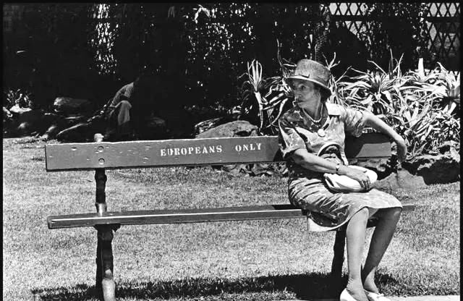
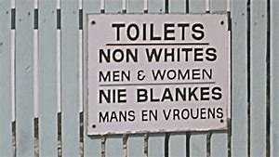
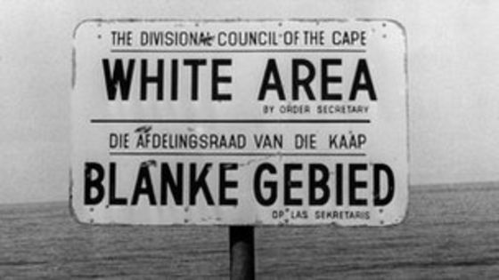
No equal rights

Slide 15

Apartheid（种族隔离）
the former political system in South Africa in which only white people had full political rights and other people, especially black people, were forced to live away from white people, go to separate schools, etc.

Slide 16
Para.3-5
“… we were out into a position in which we had either to accept we were less important , or fight the government. We chose to attack the laws. We first broke the law in a way which was peaceful; when this was not allowed… only then did we decide to answer violence with violence.”

Slide 17
Para.3-5
Laws didn’t give black people right.
e.g. blow up some government buildings
Notes:
Why did he have little education?
What if he didn’t get one?

Slide 18
Para.3-5
Laws didn’t give black people right.
accept they were less important
fight the government
attack the law in a peaceful way
e.g. blow up some government buildings
answer violence with violence
make black and white people equal
Notes:
Why did he have little education?
What if he didn’t get one?

Slide 19

Guide
Support

Slide 20
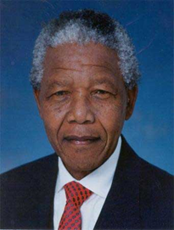
QUALITIES
He offered guidance to poor black people on their legal problems. He was generous with his time, for which I was grateful.
generous
He told me how to get correct papers so I could stay in Johannesburg. I became more hopeful about my future. I never forgot how kind Mandela was.
kind

Slide 21
QUALITIES
…I do not like violence …but in 1963 I helped him blow up some government buildings. …if I was caught I could be put in prison.
loyal
I was happy to help because I know it would help us achieve our dream of making black and white equal.
helpful

Slide 22
Tips
How to describe a person’s good qualities
Use some positive words to describe.
Connect it with what the person did and what people remember about him or her.

Slide 23
Talking
Who is your hero in the passage? Why?
selfless
determined
devoted
brave
hard-working
helpful
loyal
generous
…
I think _____ is my hero because ___________.
He/she is such a _______ person that ___________.
Notes:
Why did he have little education?
What if he didn’t get one?

Slide 24
Assignment
Write a short passage to describe the good qualities of your hero and explain why you choose him（her） as your hero（heroine）. Try to use at least 5 words or expressions from below and underline them.
helpful; generous; selfless; hopeful; devote;
worry about; as a matter of fact; in trouble; be willing to; turn to

Slide 25
Sample 1
In my opinion, Tu Youyou is my heroine because she is such a selfless and helpful person who devotes her whole life to developing a new drug. She used to be worried about its effect and she was so responsible that she even tested it on herself to check. As a matter of fact, her discovery makes millions of African people in trouble hopeful again. That’s why I respect her so much.

Slide 26
感恩遇见，相互成就，本课件资料仅供您个人参考、教学使用，严禁自行在网络传播，违者依知识产权法追究法律责任。
更多教学资源请关注
公众号：溯恩高中英语
知识产权声明

Slide 27
Sample 2
As for me, Gandhi is my hero because he is such a brave and selfless person who is generous in giving help to poor Indian people. During that time, Indian people reached a stage where they had almost no right at all. Gandhi bravely chose to stand out against the British rule in a non-violent way. What’s more, he was even willing to achieve the independence at the cost of his personal comfort. Later, his experiences successfully inspired the Indian youth to devote their life to an independent nation. I was moved by his story, so every time I lose heart and worry about my study, Gandhi’s bravery can always cheer me up and make me hopeful again.

